Slide 1
Section 12.4
Planetary Motion and Kepler’s Laws

Slide 2
TOPICS
Motion in polar coordinates
Kepler’s Laws of Planetary Motion

Slide 3
Motion in Polar Coordinates
Since we will be discussing the movement of planets over time, we assume the polar variables r and θ are both functions of t. Using vector notation, then, we describe a generic curve C in the xy-plane by the vector function
where we define and, because we will soon find it useful, we define a unit vector perpendicular to u(t).

Slide 4
Motion in Polar Coordinates
Given the position r(t) of an object, its velocity v(t) is then

Slide 5
Motion in Polar Coordinates
And its acceleration a(t) is

Slide 6
Motion in Polar Coordinates
Omitting the argument t, we summarize the above as follows:

Slide 7
Example 1
In terms of the vectors
describe the velocity and acceleration vectors of a particle whose position function is

Slide 8
Example 1 (cont.)
Solution
Using polar notation, the function
where and
So

Slide 9
Example 1 (cont.)
And
Figure 1 is a graph of the particle’s path over the time interval −3 ≤ t ≤ 3 with its velocity and acceleration vectors v and a shown in red and blue, respectively, at

Slide 10
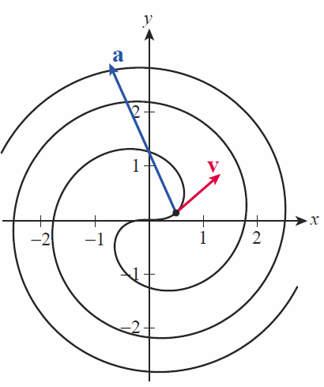
Example 1 (cont.)

Slide 11
Example 1 (cont.)

Slide 12
Theorem: Kepler’s Laws of Planetary Motion
Kepler’s Laws of Planetary Motion
1. Each planet revolves around the sun in an elliptical orbit, with the sun at one focus of the ellipse.
2. A line segment between the sun and a given planet sweeps out equal areas of the ellipse over equal periods of time.
3. The ratio of the square of the period of one revolution of a planet and the cube of the length of the semimajor axis of its orbit is a constant independent of the planet.

Slide 13
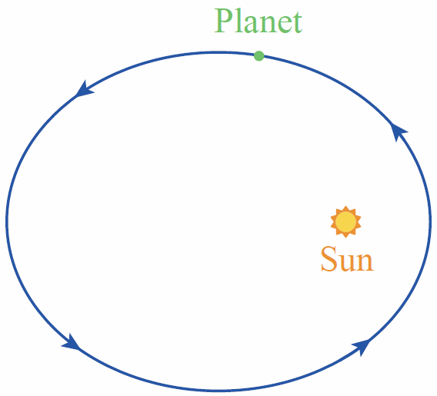
Theorem: Kepler’s Laws of Planetary Motion (cont.)
Kepler’s Laws of Planetary Motion (cont.)
Figure 2

