Slide 1
Section 13.1
Functions of Several Variables

Slide 2
TOPICS
Real-valued functions of two variables
Graphs and contour maps
Functions of three or more variables

Slide 3
Real-Valued Functions of Two Variables
We begin with functions that map ℝ² into ℝ as these functions can (at least in principle) be easily described geometrically and will serve to introduce all of the relevant ideas. The new material in this chapter is primarily a shift in how we think about and work with multivariable functions. For example, we will view the surface area formula A = 2π rh + 2π r² as defining a function A in the variables r and h and the quadric surface 9x² + 4y² − z = 0 as defining a function z in the variables x and y.

Slide 4
Definition: Real-Valued Functions of Two Variables
Real-Valued Functions of Two Variables
A real-valued function f of two (real) variables is a function that returns a real number denoted f(x, y) for each ordered pair (x, y) in a domain D ⊆ ℝ². The range of f is the set of real numbers If the domain of f is not explicitly stated, it is assumed to be all ordered pairs (x, y) for which f(x, y) is a well-defined real number. In the equation form z = f(x, y), x and y are referred to as the independent variables and z as the dependent variable.

Slide 5
Example 1
Determine the domain and range of each of the given functions, and evaluate each at the point (1, 2).

Slide 6
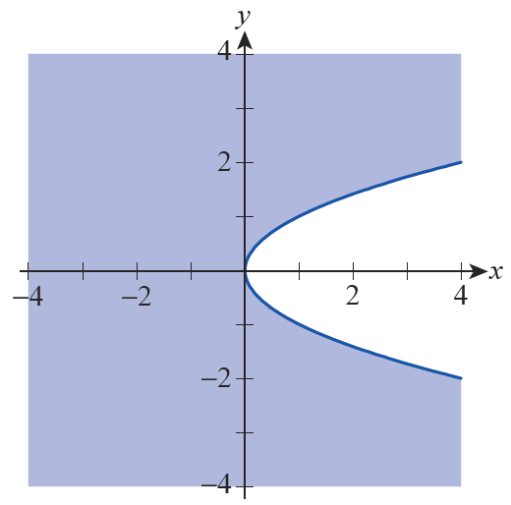
Example 1 (cont.)
Solution
a. In order for f(x, y) to be a real number, we need y² − x ≥ 0. This inequality then defines the domain of f, which is depicted as the shaded region in Figure 1.
Figure 1

Slide 7
Example 1a (cont.)
All nonnegative real numbers are possible outputs of f, so the range of f is the interval [0, ∞). And since (1, 2) ∈ D, f can be evaluated at the ordered pair and

Slide 8
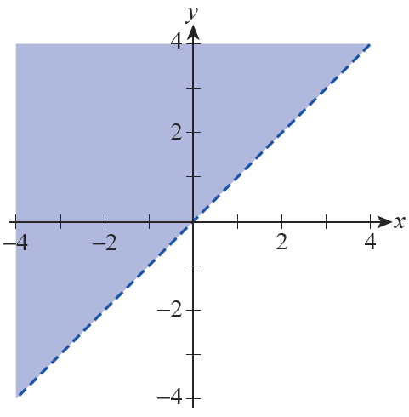
Example 1 (cont.)
b. For g(x, y) to be a real number, we require y − x > 0, so the domain of g consists of the part of the xy-plane above the line y = x, as shown in Figure 2—we use a dashed line to indicate that the line y = x is not included in the domain.
Figure 2

Slide 9
Example 1b (cont.)
Every real number can be written in the form ln(y − x) for some x and some y in the domain, so the range of g is ℝ. Finally,

Slide 10
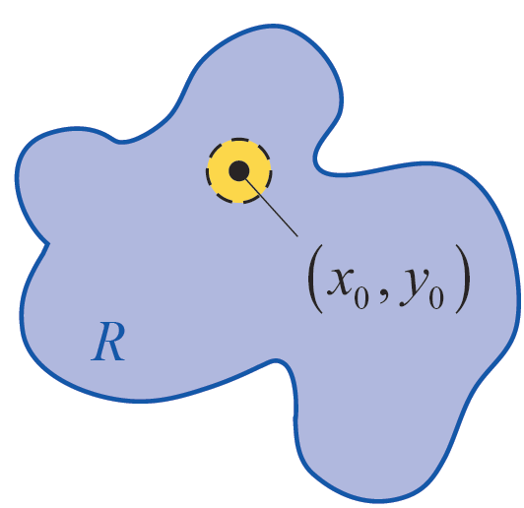
Definition: Interior Points, Boundary Points, and Open and Closed Regions
Interior Points, Boundary Points, and Open and Closed Regions
Let R be a region of the Cartesian plane ℝ². A point is said to be an interior point of R if, for some ε > 0, all points within a distance of ε from are also elements of R—that is, where
Interior Point

Slide 11
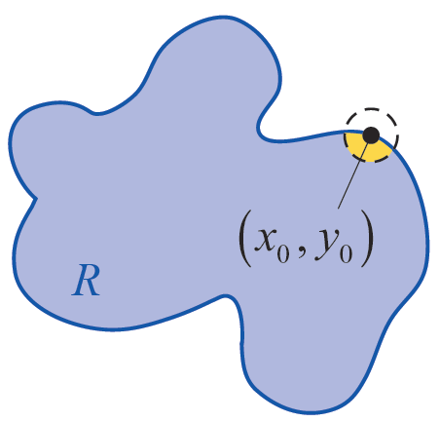
Definition: Interior Points, Boundary Points, and Open and Closed Regions
Interior Points, Boundary Points, and Open and Closed Regions (cont.)
(a set of the form is called an open disk of radius ε ). A point is said to be a boundary point of R if, for every ε > 0, contains both points that lie in R and points that lie outside R—note that can be a boundary point of R without being an element of R itself.
Boundary Point
Figure 3

Slide 12
Definition: Interior Points, Boundary Points, and Open and Closed Regions
Interior Points, Boundary Points, and Open and Closed Regions (cont.)
A region R is open if every point in R is an interior point, while R is closed if it contains all of its boundary points. Figure 3b illustrates a typical interior point and boundary point of a region.
Interior Point
Figure 3b
Boundary Point

Slide 13
Definition: Bounded and Unbounded Regions
Similarly, we extend the idea of a bounded interval to a bounded region with the following definition.
Bounded and Unbounded Regions
Let R be a region of the Cartesian plane ℝ². R is said to be bounded if, for some d > 0, that is, every point of R is within d units of the origin. A region for which no such d exists is unbounded.

Slide 14
Example 2
The domain found in part a. of Example 1 is closed, as it contains all of its boundary points—namely, the points of the curve y² − x = 0.
On the other hand, the domain of Example 1 part b. is open.

Slide 15
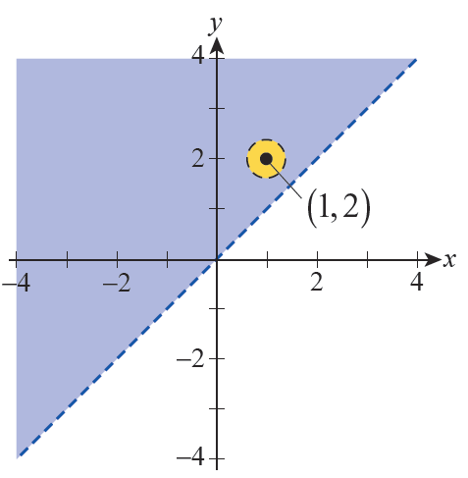
Example 2 (cont.)
Any point in the domain lies some positive distance d away from the line y = x, so
as depicted in Figure 4 for the point (1, 2). The boundary of the domain is the line y = x, which in this case is not a part of the domain.
Figure 4

Slide 16
Example 2 (cont.)
Both of the domains of Example 1 are unbounded, as they contain points arbitrarily far away from the origin. In contrast, any set provides a simple example of a bounded region, as by definition it consists only of points within some fixed distance of the origin.

Slide 17
Graphs and Contour Maps
Given a function f(x, y) that maps its domain D into ℝ, we frequently desire a way to visualize its features. The two most common methods of doing so are the subject of the next definition.

Slide 18
Definition: Graphs and Contour Maps of Functions of Two Variables
Graphs and Contour Maps of Functions of Two Variables
The set of ordered triples in ℝ³ is called the graph of the function f : D → ℝ—equivalently, the graph of f is the set of all points (x, y, z) solving the equation z = f(x, y). The set of points in D for which f(x, y) = c, for some fixed constant c, is called a contour (or level curve) of f, and a collection of such contours is called a contour map.

Slide 19
Graphs and Contour Maps
Graphing a two-variable function f(x, y) in ℝ³ is the natural analog of graphing a single-variable function f(x) in ℝ². Surfaces in ℝ³ can serve as examples of graphs of two-variable functions, though we may have to restrict our attention to a portion of the surface in order to represent it as a function.

Slide 20
Example 3
Write the half of the sphere x² + y² + z² = 9 above the xy-plane as a function of x and y.
Solution
Solving the equation x² + y² + z² = 9 for z, we must choose whether to use the negative or positive root. The positive root corresponds to the hemisphere above the xy-plane, so we define

Slide 21
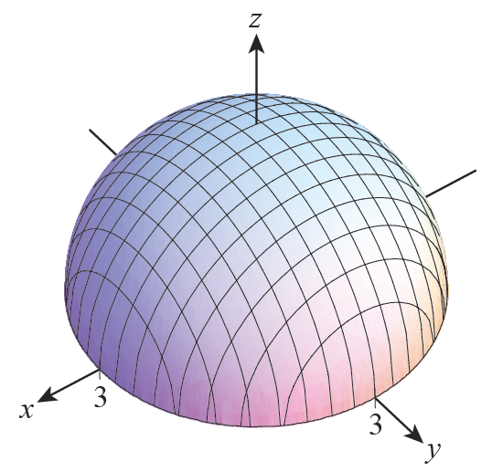
Example 3 (cont.)
The graph of f is shown in Figure 5; note that the domain of f is the region in the xy-plane.
Figure 5

Slide 22
Example 4
The quadric equation 9x² + 4y² − z = 0 defines a surface called an elliptic paraboloid, and its graph appears in Figure 6. The equation also defines z as a function of x and y, namely

Slide 23
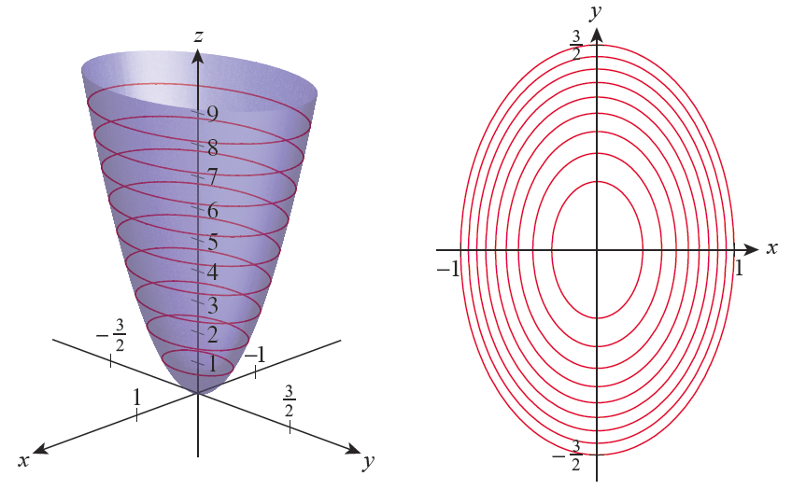
Example 4 (cont.)
Figure 6
Figure 7

Slide 24
Example 4 (cont.)
For this particular function, a contour map, such as shown in Figure 7, is also very instructive. The nine specific contours in Figure 7 correspond to the nine traces in Figure 6, which are all depictions of intersections of the surface with planes parallel to the xy-plane. Specifically, the nine contours and traces correspond to the equations

Slide 25
Example 4 (cont.)
The classification of this quadric surface as an elliptic paraboloid reflects the fact that each contour in the xy-plane is an ellipse, namely 9x² + 4y² = c for some constant c.
For example, with c = 1,
9x² + 4y² = 1 or .

Slide 26
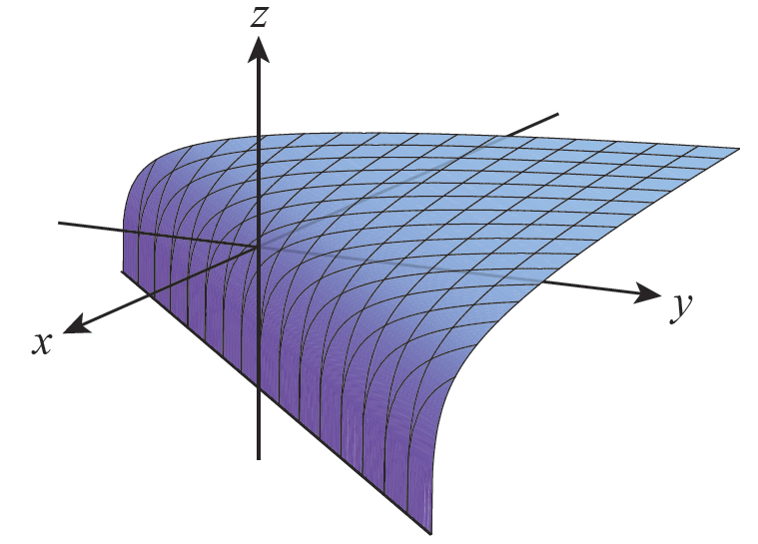
Example 5
The surface defined by the function is shown in Figure 8. As we determined in Example 1, the domain of g is the region
Figure 8

Slide 27
Example 5 (cont.)
Although the illustration of the surface may not convey the fact that the range of g is the entire set of real numbers, note that as we consider points (x, y) in the domain closer and closer to the boundary line y = x, and as we consider points (x, y) for which y − x gets larger and larger. We will later return to the matter of limits of multivariable functions.

Slide 28
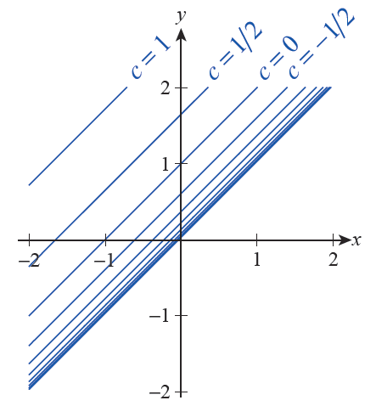
Example 5 (cont.)
Since g(x, y) is constant along lines of slope 1, every contour map of the function will look something like Figure 9, which shows level curves for values of c from −5 to 1 in increments of Note how the contour lines “bunch up” as c → −∞.
Figure 9

Slide 29
Example 6
Just as a curve in ℝ² may represent a function x = f(y), a surface in ℝ³ may represent a function of two variables other than x and y.
Express the planar surface x + 2y + 3z = 2 as a function of two variables other than the pair x and y.
Solution
Expressing the surface as a function of y and z is very easily done.

Slide 30
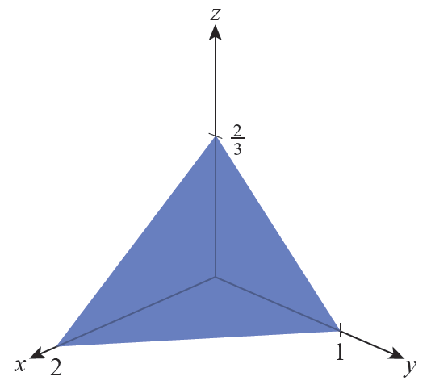
Example 6 (cont.)
Expressing the surface as a function of x and z is almost as easy.
The graph of both functions is the plane shown in Figure 10 (only the portion in the first octant is shown). In graphing f the value of the function is used as the x-component and in graphing g the value of the function corresponds to the y-component.
Figure 10

Slide 31
Technology Note
Computer algebra systems, such as Mathematica, are very useful in constructing both graphs and contour maps; most of them have built‑in commands to generate such images. For instance, the command to plot the function from Example 5 in Mathematica is Plot3D and its basic use is shown in Figure 11.

Slide 32
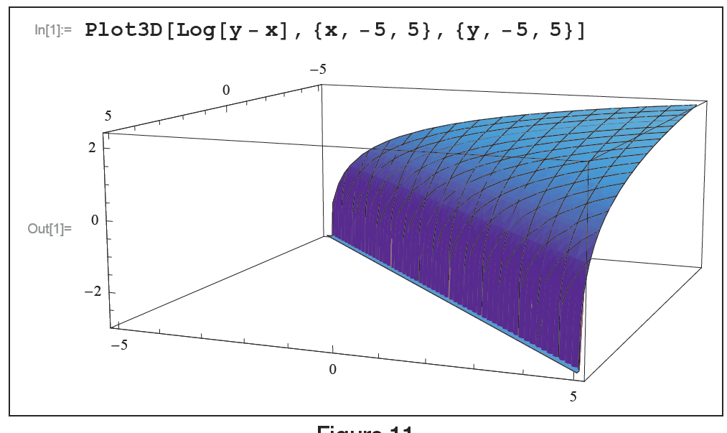
Technology Note (cont.)
Figure 11

Slide 33
Technology Note (cont.)
Contour maps can be constructed with the ContourPlot command, as shown in Figure 12, where we plot the nine specific contours of the elliptic paraboloid from Example 4. Both commands have many options allowing the user to refine the image as desired, which is what has been done to create Figures 8 and 7, respectively.

Slide 34
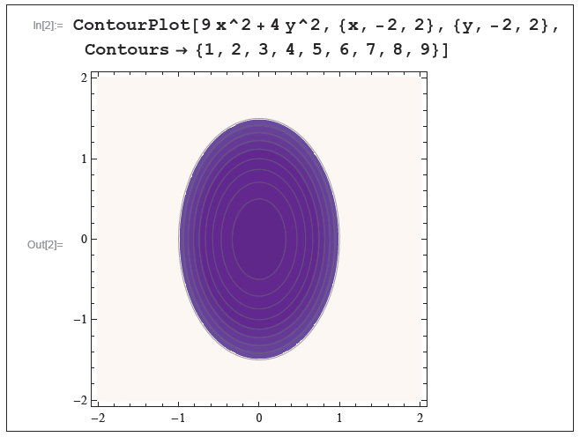
Technology Note (cont.)
Figure 12

Slide 35
Graphs and Contour Maps
Contour maps also appear in nonmathematical settings, for example in topographical maps (Figure 13) and maps of lines of constant temperature (isotherms) (Figure 14) or constant pressure (isobars) in weather reports.

Slide 36
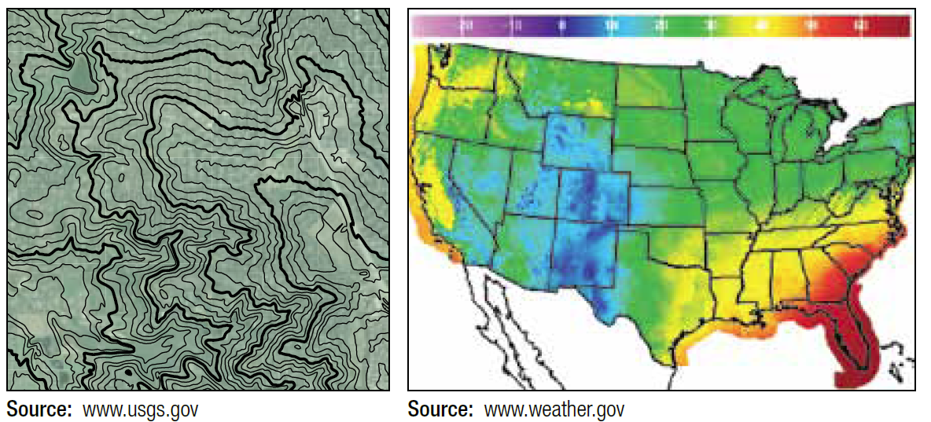
Graphs and Contour Maps
Figure 13
Figure 14

Slide 37
Functions of Three or More Variables
As the number of variables in the definition of a function increases, our ability to represent the function with pictures deteriorates. For a function f(x, y, z) of three variables, the analog of a level curve (or contour) is a level surface—that is, the collection of points in ℝ³ for which f(x, y, z) = c for some constant c.

Slide 38
Functions of Three or More Variables
In principle, we can readily show any level surface of f(x, y, z) but a complete depiction would consist of all level surfaces at once, and such an image would almost certainly be impossible to interpret. Even worse, an illustration of the graph of a function f(x, y, z), which consists of all 4-tuples of the form (x, y, z, f(x, y, z)), would require an ability to draw in ℝ⁴.

Slide 39
Definition: Real-Valued Functions of n Variables
Real-Valued Functions of n Variables
A real-valued function f of n (real) variables is a function that returns a real number denoted for each ordered n-tuple in a domain D ⊆ ℝ^{n}. The range of f is the set of real numbers

Slide 40
Definition: Real-Valued Functions of n Variables
Real-Valued Functions of n Variables (cont.)
Important: In order to simplify notation, it is common to denote an ordered n-tuple as simply x; context tells us whether x refers to a single real variable, that is, x ∈ ℝ, or whether and refers to an element of ℝ^{n}. Note the correlation with the notation used for position vectors: the point corresponds to the terminal point of the position vector

Slide 41
Definition: Real-Valued Functions of n Variables
Real-Valued Functions of n Variables (cont.)
In practice, we typically use notation like f(x, y) and f(x, y, z) for functions whose domains are subsets of ℝ² or ℝ³, and the notation f(x), where when discussing a generic function f: ℝ^{n} → ℝ with n an unspecified positive integer.

Slide 42
Definition: Interior Points, Boundary Points, Open and Closed Regions, and Boundedness in ℝ^{n}
Interior Points, Boundary Points, Open and Closed Regions, and Boundedness in ℝ^{n}
Let R be a region (i.e., a subset) of ℝ^{n}. A point is said to be an interior point of R if, for some ε > 0, all points within a distance of ε from p are also elements of R—that is, where
and |p − q| denotes the Euclidean distance between p and q:
ℝ^{n}

Slide 43
Definition: Interior Points, Boundary Points, Open and Closed Regions, and Boundedness in ℝ^{n}
Interior Points, Boundary Points, Open and Closed Regions, and Boundedness in ℝ^{n} (cont.)
(a set of the form is called an n-dimensional open ball of radius ε ). A point p is said to be a boundary point of R if, for every ε > 0, contains both points that lie in R and points that lie outside R. The region R is said to be open if every point in R is an interior point, and R is said to be closed if it contains all of its boundary points.

Slide 44
Definition: Interior Points, Boundary Points, Open and Closed Regions, and Boundedness in ℝ^{n}
Interior Points, Boundary Points, Open and Closed Regions, and Boundedness in ℝ^{n} (cont.)
Finally, R is said to be bounded if, for some d > 0, that is, every point of R is within d units of the origin of ℝ^{n}. If no such d exists, R is unbounded.

Slide 45
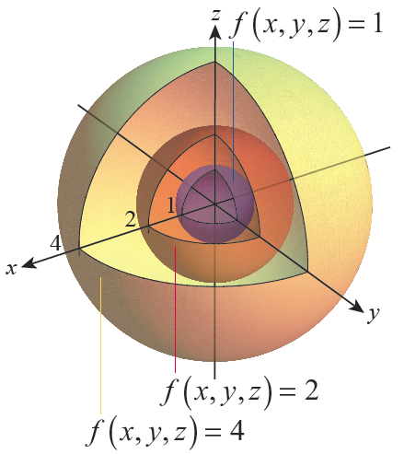
Example 7
The function returns the distance between each ordered triple (x, y, z) and the origin. Thus, its level surfaces consist of all the nested spheres centered at the origin. Figure 15 shows, in a cut-out diagram, level surfaces of the function corresponding to the three level values 1, 2, and 4.
Figure 15

