Slide 1
Section 13.3
Partial Derivatives

Slide 2
TOPICS
Evaluation and interpretation of partial derivatives
Higher‑order and mixed partial derivatives
Differentiability and continuity

Slide 3
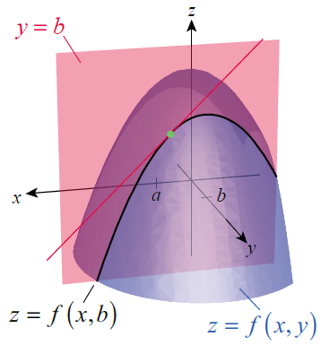
Evaluation and Interpretation of Partial Derivatives
Suppose (a, b) is a point in the domain of a real-valued function z = f(x, y). The intersection of the plane y = b and the graph of z = f(x, y) is the graph of the one-variable function z = f(x, b) in the plane y = b, as shown in Figure 1. If the function f(x, b) is differentiable in the variable x at the point x = a, then the limit of the following difference quotient exists and we define it as one of two partial derivatives.
Figure 1

Slide 4
Definition: Partial Derivative with Respect to x
Partial Derivative with Respect to x
If the limit below exists, the partial derivative of f(x, y) with respect to x at (a, b) is

Slide 5
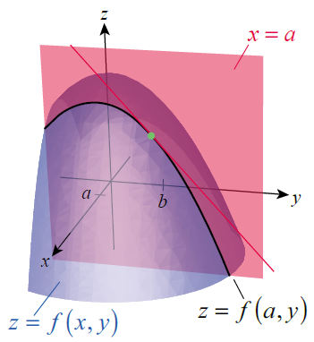
Evaluation and Interpretation of Partial Derivatives
Similarly, if we hold x fixed with the value x = a, the graph of z = f(a, y) in the plane x = a is the graph of a function of a single variable y (see Figure 2). If it is differentiable in y at the point y = b, the value of its derivative is the other partial derivative.
Figure 2

Slide 6
Definition: Partial Derivative with Respect to y
Partial Derivative with Respect to y
If the limit below exists, the partial derivative of f(x, y) with respect to y at (a, b) is

Slide 7
Evaluation and Interpretation of Partial Derivatives
Given the function z = f(x, y), any of the following may be used to indicate the two partial derivatives.

Slide 8
Evaluation and Interpretation of Partial Derivatives
To indicate the evaluation of one or the other partial derivative at a particular point (a, b), any of the following may be used.

Slide 9
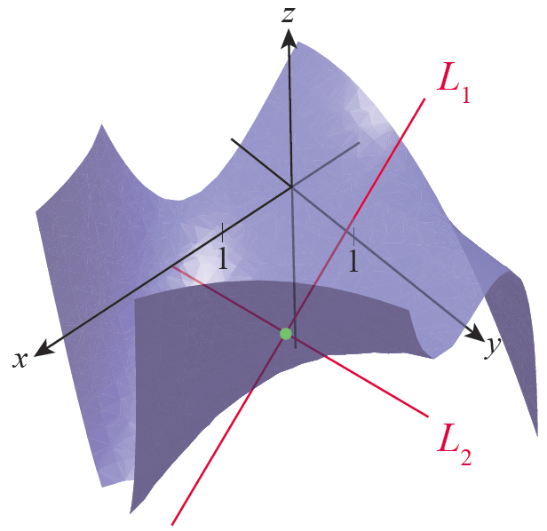
Example 1
Given the function determine and Then find equations for L₁ and L₂, the lines tangent to the surface z = f(x,y) at the point (1,1) and parallel to, respectively, the xz-plane and the yz-plane (see Figure 3).
Figure 3

Slide 10
Example 1 (cont.)
Solution
We treat y as a constant in order to find the partial derivative f_{x} .
Similarly, we treat x as a constant to find f_{y} .
Evaluating these two partial derivatives at the point (1,1) gives us

Slide 11
Example 1 (cont.)
To determine the two tangent lines with these respective slopes, we also need to know
so the corresponding point on the surface z = f(x, y), is (1,1,−3). This means L₁ contains the point (1,1,−3) and has slope, in the plane y = 1, equal to f_{x}(1,1) = −4. One way of expressing this fact is that is a direction vector for L₁; that is, the line changes −4 units in the z‑direction for every change of 1 unit in the x‑direction.

Slide 12
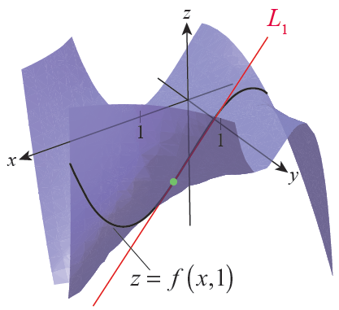
Example 1 (cont.)
So a vector equation for the tangent line is
Figure 4 illustrates the curve z = f(x, 1) in black and the line L₁ in red. Note that the shape of the curve is consistent with a cubic function, and f(x,1) is indeed a cubic function in x.
Figure 4

Slide 13
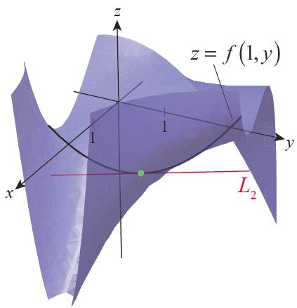
Example 1 (cont.)
Similar reasoning leads to the following vector equation for the tangent line L₂.
The curve z = f(1, y) and the line L₂ are shown in Figure 5; note that the shape of the curve is consistent with a quadratic function, which is exactly the case for f(1, y).
Figure 5

Slide 14
Example 2
Assuming x, y, and z are independent variables, find the three partial derivatives of the function
Solution
To find f_{x} , we treat y and z as constant and differentiate f with respect to x.

Slide 15
Example 2 (cont.)
Holding x and z constant, we find
and holding x and y constant gives us

Slide 16
Example 3
Given the equation z² − 4x² − 5y² = 0, determine z_{x} and z_{y} wherever they exist.
Solution
This equation is the equation of an elliptic cone, and in a global sense the equation doesn’t define a function of x and y. But the equation does define z as a function of x and y in a neighborhood of every point on the surface. To find the partial derivatives z_{x} and z_{y} , we treat z as, respectively, a differentiable function in x and then y and implicitly differentiate with respect to each of the two variables.

Slide 17
Example 3 (cont.)
With respect to x:
With respect to y:
At any point (x, y, z) on the surface z² − 4x² − 5y² = 0 where z is locally a differentiable function in x and y individually, the rate of change of z in the x‑direction is 4x/z and the rate of change in the y‑direction is 5y/z.

Slide 18
Example 3 (cont.)
As an example, the point (2, −2, 6) lies on the surface and the partial derivatives at that point are
and
The formulas found are not defined where z = 0, which in this example corresponds to the one point on the surface where z is not locally a differentiable function of x or of y.

Slide 19
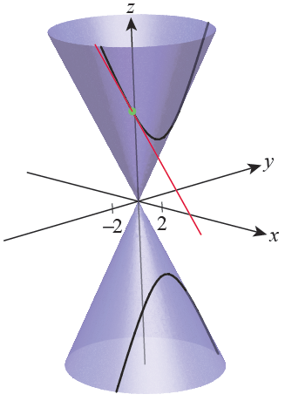
Example 3 (cont.)
Figure 6 is an illustration of the surface and, in black, the curve that results from fixing x = 2; the point (2, −2, 6) is shown in green and the line tangent to the point in the plane x = 2 is shown in red—this tangent line has slope If we had chosen instead to work with the point (2, −2, −6) on the surface, the slope of the tangent line in the plane x = 2 would be
Figure 6

Slide 20
Technology Note
Technology Note
The syntax of the commands used by a computer algebra system to evaluate partial derivatives often reflects the underlying mathematics. For instance, the command in Mathematica is D, the same as for ordinary differentiation, and we obtain the desired partial derivatives by specifying which variable to differentiate with respect to. The three partial derivatives of the function of Example 2 can be found using Mathematica, as shown in Figure 7.

Slide 21
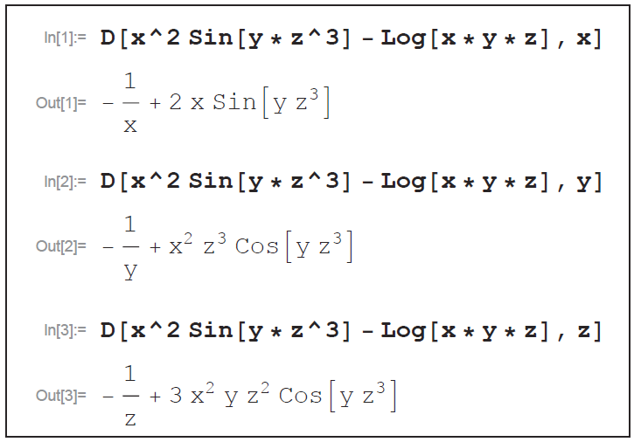
Technology Note
Technology Note (cont.)
Figure 7

Slide 22
Example 4
In general, the density ρ of an object is related to its mass m and volume v by ρ = m/v. If we let Δm denote the possible error in measurement of mass, then the corresponding propagated error in density Δρ is
Similarly, a possible error Δv in the measurement of volume leads to propagated error in density of

Slide 23
Example 4 (cont.)
If both m and v are subject to measurement error, the formula for the propagated error in density must reflect that fact. One common approach in such cases is to assume that the combined effect is approximately the square root of the sum of the squares of the individual errors.

Slide 24
Example 4 (cont.)
In order to express the relationship in terms of relative error, this is often expressed as

Slide 25
Higher‑Order and Mixed Partial Derivatives
If the partial derivatives of a function f(x, y) exist, they are also functions of x and y, so it is natural to investigate their own partial derivatives in turn. We use any of the following to denote the four possible second-order partial derivatives of z = f(x, y).

Slide 26
Higher‑Order and Mixed Partial Derivatives
The partial derivatives f_{xy} and f_{yx} are called mixed partial derivatives, since they are differentiated with respect to more than one variable. Note how the order of the differentiation relates to the notation so that, for instance,

Slide 27
Example 5
Determine the second-order partial derivatives of
Solution
We first find
and
and then proceed to determine the second-order partial derivatives.

Slide 28
Example 5 (cont.)

Slide 29
Higher‑Order and Mixed Partial Derivatives
It is no coincidence that f_{xy} = f_{yx} in Example 5—as it turns out, this will always be the case if f(x, y) satisfies the fairly lenient conditions of the following theorem, discovered by the French mathematician Alexis Clairaut (1713–1765).

Slide 30
Theorem: Clairaut’s Theorem
Clairaut’s Theorem
If f(x, y) and the partial derivatives f_{x} , f_{y} , f_{xy}, and f_{yx} are all defined on an open region containing the point (a,b) and if f_{xy} and f_{yx} are continuous at (a,b) then

Slide 31
Example 6
Given find z_{yx} .
Solution
If we think about the partial derivatives of f, without actually determining what they are, we can fairly quickly decide that
(1) both z_{x} and z_{y} exist everywhere and
(2) z_{x} is significantly easier to compute than z_{y} .

Slide 32
Example 6 (cont.)
In fact, there really is no concern about the existence or continuity of any partial derivative of any order (with respect to either variable): polynomials are never a cause for concern, and all derivatives of the second term will contain fractions whose denominators are powers of y² + 3, which can never be 0.
So since the two mixed second-order partial derivatives will be equal, we will compute z_{xy} instead of z_{yx} .

Slide 33
Example 7
Given the function compute f_{zxyz} and f_{yxzz} .
Solution
Just for the purpose of illustration, the two mixed partial derivatives can also be written as shown below.
and

Slide 34
Example 7 (cont.)
We find the derivatives as follows.

Slide 35
Example 7 (cont.)

Slide 36
Higher‑Order and Mixed Partial Derivatives
Since so many mathematical models involve functions of more than one variable, it’s not surprising that equations relating the partial derivatives of functions are common; such equations are called partial differential equations. Entire texts are devoted to the subject of solving partial differential equations, so we will merely introduce them here.

Slide 37
Higher‑Order and Mixed Partial Derivatives
Examples include wave equations such as u_{tt} = c²u_{xx} (discussed below), Laplace’s equation f_{xx} + f_{yy} + f_{zz} = 0 (used in solving problems in electromagnetism, gravitation, and fluid dynamics), and the Black‑Scholes equation (used in modeling prices of stock options, and for which Robert Merton and Myron Scholes were awarded the Nobel Prize in Economics in 1997).

Slide 38
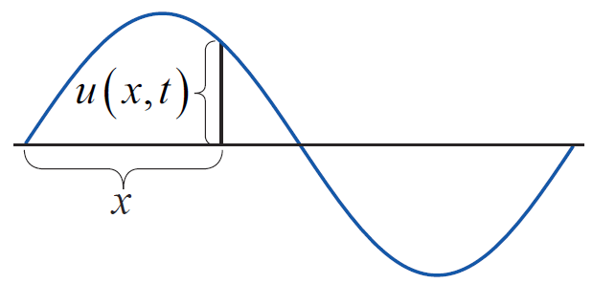
Example 8
The wave equation u_{tt} = c²u_{xx} models the motion of a waveform as it travels along a string—the function u(x, t) is the displacement of a point x units from one end of the string at time t, and the constant c is determined by physical characteristics such as the density of the string and its tension (see Figure 8 for a snapshot at one particular moment t).
Figure 8

Slide 39
Example 8 (cont.)
Show that the function u(x, t) = sin(x – ct) is a solution of u_{tt} = c²u_{xx} .
Solution
Given
and
and
and
so it is indeed the case that u_{tt} = c²u_{xx} .

Slide 40
Differentiability and Continuity
Before leaving this section, it is important to make one more observation: The existence of the partial derivatives of a function does not necessarily mean the function is differentiable. In fact, and in seeming contrast to the one-variable case, the existence of the partial derivatives at a point is not even sufficient to guarantee continuity at that point!

Slide 41
Example 9
Define f : ℝ² → ℝ by
That is, f(x,y) = 1 if (x, y) lies on either the x-axis or the y-axis, and f(x, y) = 0 for all other points. Then f_{x}(0, 0) = 0 (f has the constant value 1 along the x-axis and hence the rate of change of f in the x‑direction is 0), and similarly f_{y}(0, 0) = 0. So although both partial derivatives of f exist at the origin, f is not continuous at the origin.

Slide 42
Definition: Differentiability of Multivariable Functions
Differentiability of Multivariable Functions
A function f : ℝ² → ℝ is differentiable at (a, b) if f_{x}(a, b) and f_{y}(a, b) exist and the increment satisfies an equation of the form
where each of ε₁ and ε₂ approach 0 as both Δx and Δy approach 0.

Slide 43
Definition: Differentiability of Multivariable Functions
Differentiability of Multivariable Functions (cont.)
Differentiability of a function f : ℝ³ → ℝ at a point (a, b, c) requires that f_{x}(a, b, c), f_{y}(a, b, c), and f_{z}(a, b, c) exist and that the increment Δf satisfies
where each of ε₁, ε₂, and ε₃ approach 0 as Analogous statements apply for the differentiability of functions of more than three variables.

Slide 44
Theorem: The Increment Theorem of Differentiability
The Increment Theorem of Differentiability
If the partial derivatives of f(x, y) exist throughout an open region R containing the point (a, b) and if f_{x} and f_{y} are both continuous at (a, b) then f is differentiable at (a, b) That is, the increment Δf at (a, b) can be written as
where each of ε₁ and ε₂, approach 0 as

Slide 45
Theorem: The Increment Theorem of Differentiability
The Increment Theorem of Differentiability (cont.)
Hence, if the partial derivatives are continuous throughout R, f is differentiable on all of R.
Analogous statements apply to functions of three or more variables.

Slide 46
Theorem: Differentiability Implies Continuity
Note that our increment-based definition of differentiability allows us to easily extend the important fact below from the one-variable to the multivariable case.
Differentiability Implies Continuity
If f is differentiable at a point, then f is continuous at that point.

Slide 47
Theorem: Differentiability Implies Continuity
Proof
For convenience, we will prove the theorem in the two-variable case.
If f is differentiable at (a, b) then by definition the increment Δf can be written in such a way that

Slide 48
Theorem: Differentiability Implies Continuity
Proof (cont.)
That is, as Δx → 0 and Δy → 0.

