Slide 1
Section 13.5
Directional Derivatives and Gradient Vectors

Slide 2
Topics
Directional derivatives
Gradient vectors

Slide 3
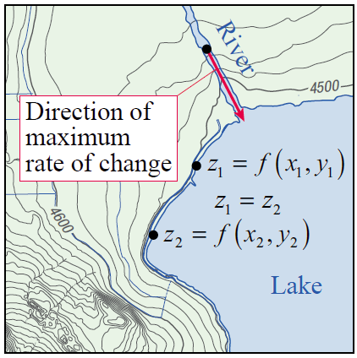
Directional Derivatives
The definition and techniques we will develop apply to functions of any number of variables, but we’ll begin with functions of two variables since our ability to visualize them as surfaces is helpful. To make
the discussion even more concrete,
suppose z = f (x, y) describes the
elevation at a point with longitude
x and latitude y—as we know, one
way of depicting f(x, y) is as a
topographical map, as shown
in Figure 1.
Figure 1

Slide 4
Directional Derivatives
The shoreline of the lake in the figure constitutes one particular level curve, or contour, of the surface, and the rate of change of z at any point of the shoreline in the direction of the shoreline must be 0, since z neither rises nor falls along the level curve. On the other hand, flowing water seeks out the course of most rapid descent, so the rate of change of z at any point of the river in the direction of flow must be a negative number with the largest possible magnitude, which is always normal to the level curves.

Slide 5
Directional Derivatives
Implicitly, the rate of change of z in both cases is measured with respect to horizontal distance.
More formally, suppose that f(x, y) is a differentiable function and that C is a curve parametrized by the differentiable functions x = g(t) and y = h(t). Then by the Chain Rule, the rate of change of f with respect to t at a given point of C is

Slide 6
Directional Derivatives
Suppose is a unit vector. To determine the derivative of f at the point (a, b) in the direction of u, which we will denote as we let C be the line parametrized by x = a + tu₁ and y = b + tu₂, and define

Slide 7
Directional Derivatives
Since is the distance between the points
(a + tu₁, b + tu₂) and (a, b), D_{u} f(a, b) is the rate of change of f(x, y) at the point (a, b) with respect to distance, or arc length, along the line C. We can also express this directly as a limit of difference quotients, as shown next.

Slide 8
Definition: Directional Derivative
Directional Derivative
If the limit exists, the directional derivative of f(x, y) at the point (a, b) in the direction of the unit vector
is

Slide 9
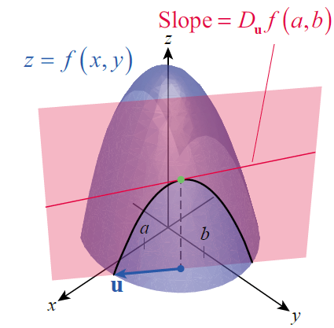
Directional Derivatives
Geometrically, D_{u} f(a, b) is the slope of the line passing through (a, b, f (a, b)) and tangent to the curve formed by intersecting the surface
f(x, y) with the vertical plane
containing the point (a, b, 0)
and the vector u = u₁ i + u₂ j,
as shown in Figure 2.
Figure 2

Slide 10
Example 1
Find the derivative of f(x, y) = 3xy at the point (2, 1) in the direction of
Solution
It is important to first convert the direction vector to a unit vector, so that the line C along which we are differentiating is parametrized with respect to arc length.
Accordingly, let

Slide 11
Example 1 (cont.)

Slide 12
Gradient Vectors
The calculation performed in Example 1 came from the difference quotient interpretation of directional derivative, which is useful for conceptual understanding but which fails to use the power of the Chain Rule. To see how the Chain Rule helps, consider again a unit direction vector and the line C parametrized by Then the derivative of f(x, y) at the point (a, b) in the direction of u is as follows.

Slide 13
Gradient Vectors
Using dot product notation, we can write this as follows:

Slide 14
Definition: Gradient Vector
Gradient Vector
The gradient vector of the function f(x, y) is the vector
The symbol ∇ (an upside-down Greek capital delta) is called the “gradient” or “del” operator, and the vector ∇f is read as “gradient of f ,” “grad f ,” or “del f .”

Slide 15
Definition: Gradient Vector
Gradient Vector (cont.)
The gradient operator extends naturally to functions of more than two variables. Given a function

Slide 16
Gradient Vectors
In everyday language, “gradient” usually refers to a slope or rate of change, and ∇f can be remembered as simply listing, in vector form, the partial derivatives (rates of change) of f in each of the coordinate directions.

Slide 17
Theorem: Computation of D_{u} f(c)
Computation of D_{u} f(c)
Assuming the derivative of f(x, y) at the point (a, b) in the direction of the unit vector exists,
More generally, if is differentiable at the point and if is a unit vector, then

Slide 18
Example 2
Find the derivative of at the point
(1, −1) in the direction of
Solution
We first determine ∇f at an arbitrary point (x, y).
So Next, we convert the direction vector into a unit vector pointing in the same direction.

Slide 19
Example 2 (cont.)
Finally,
Since D_{u} f (1, −1) is negative, we know that the surface
z = f(x, y), must have a downward trend in the direction of 2i + 3j at the point (1, −1).

Slide 20
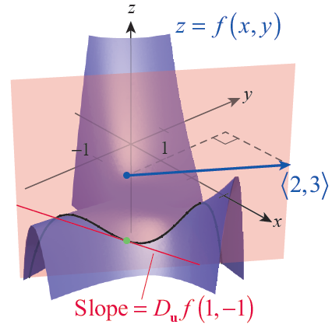
Example 2 (cont.)
Figure 3 illustrates the intersection of the surface
z = f(x, y) with the vertical plane containing the point (1, −1, 0) and the vector 2i + 3j, along
with the line tangent to the curve
defined by the intersection. As
expected, the surface does
indeed show a decreasing
value for f(x, y) at the point
(1, −1) if we head in the
direction of 2i + 3j.
Figure 3

Slide 21
Gradient Vectors
Recall that we have an alternative formula for the dot product of two vectors
where θ is the angle between the vectors u and v (positioned with the same initial point). Applying this to directional derivatives,
where θ is the angle between ∇f (c) and u. Given our knowledge of cosine, this immediately tells us the following three important facts.

Slide 22
Properties of the Directional Derivative
Properties of the Directional Derivative
Assume f is differentiable at c and that
1. The greatest rate of increase of f at c occurs when
θ = 0, since cos 0 = 1; that is, when u points in the direction of ∇f(c). Further, if u points in the direction of ∇f(c),

Slide 23
Properties of the Directional Derivative
Properties of the Directional Derivative (cont.)
2. The greatest rate of decrease of f at c occurs when
θ = π, since cosπ = −1; that is, when u points in the direction of −∇f(c). Further, if u points in the opposite direction of ∇f(c),

Slide 24
Properties of the Directional Derivative
Properties of the Directional Derivative (cont.)
3. The rate of change of f at c is 0 if since
that is, when u points in any direction orthogonal to ∇f(c). This follows from the fact that if u is orthogonal to ∇f(c),

Slide 25
Example 3
Given the function f(x, y) = sin(x + y²), find the direction and value of a. greatest rate of increase, b. greatest rate of decrease, and c. no change from the point (2, 1).
Solution
We first determine ∇f.
So
and

Slide 26
Example 3 (cont.)
This tells us the following.
a. The direction of most rapid increase in f from the point (2, 1) is approximately and the rate of change of f in that direction is approximately 2.21.
b. The direction of most rapid decrease in f from the point (2, 1) is approximately and the rate of change of f in that direction is approximately
−2.21.

Slide 27
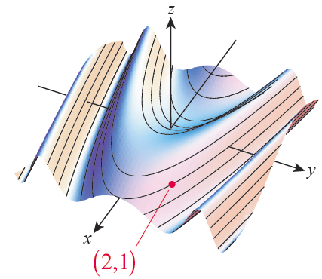
Example 3 (cont.)
c. The two directions of no change in f from the point (2, 1) are normal to ∇f(2, 1), so they are approximately and Note that this is consistent with
the contours of the surface
shown in Figure 4.
Figure 4

Slide 28
Gradient Vectors
The fact that ∇f is always normal to any particular contour can also be shown as follows. Suppose
is a smooth level curve of the differentiable function f (x, y), say f(r(t)) = k. Then

Slide 29
Gradient Vectors
Recall that r′(t) points in a direction tangential to the curve r(t), so ∇f is normal to the level curve r at every point. We can use this observation to quickly find tangent lines to implicitly defined curves.

Slide 30
Example 4
Find an equation for the line tangent to the graph of
at the point (4, 0).
Solution
The given curve is a contour of the function

Slide 31
Example 4 (cont.)
The fact that the gradient is always normal to the contour through any particular point means that is normal to the line tangent to the curve
at the point (4, 0). We can express this fact in equation form by noting that if (x, y) denotes an arbitrary point on the tangent line, then
and must be perpendicular. That is,

Slide 32
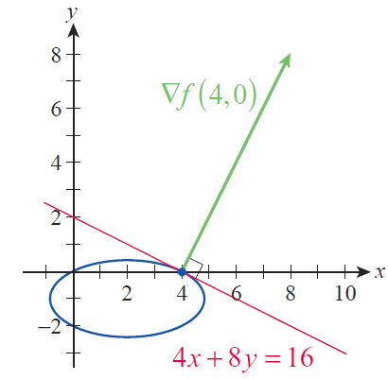
Example 4 (cont.)
Figure 5 shows the relationship between the contour f(x, y) = 8 (in blue), its gradient vector ∇f(4, 0) (in green), and the line tangent to the
contour at (4, 0) (in red).
Figure 5

Slide 33
Properties of the Gradient
Properties of the Gradient
Assume f and g are both differentiable functions and that k is a fixed real number. Then the following laws hold.
Sum/Difference Law
Constant Multiple Law
Product Law
Quotient Law

Slide 34
Example 5
Determine the gradient of the function
Solution

Slide 35
Example 5 (cont.)

Slide 36
Example 6
Suppose the temperature, in Celsius, at a point (x, y, z) in a small region of space over a heat source is modeled by the function
where x and y (in meters) are orthogonal horizontal displacements and z (also in meters) is the vertical displacement from the heat source. Find the direction from the point (1, 3, 2) of the greatest rate of decrease of temperature.

Slide 37
Example 6 (cont.)
What is the rate of change in that direction?
Solution
We begin with the gradient.

Slide 38
Example 6 (cont.)
The direction of the greatest decrease in rate of change of T from the point (1, 3, 2) is then
and the rate of decrease in that direction is approximately

