Slide 1
Section 13.8
Lagrange Multipliers

Slide 2
TOPICS
The method of Lagrange multipliers
Lagrange multipliers with two constraints

Slide 3
The Method of Lagrange Multipliers
The fact that the gradient of a multivariable function is orthogonal to its level curves lies at the heart of the method. To gain an intuitive understanding of why the method works, consider the task of maximizing or minimizing a function f(x, y) under the constraint that g (x, y) = k; in other words, considering only those points (x, y) on the curve g(x, y) = k, find the extreme values of f(x, y). In general, we would not expect the contour lines of f and g to exhibit any common behavior, so f may very well take on different values as we trace out the contour g(x, y) = k.

Slide 4
The Method of Lagrange Multipliers
But suppose (x₀, y₀) is a point at which the tangents to the contour lines of f and g coincide. Then, in the direction of the contour, f is neither increasing nor decreasing at the point (x₀, y₀), meaning (x₀, y₀) is a critical point for f and a candidate for an extremum. Since and are both orthogonal to the common tangent line at the point (x₀, y₀),
for some constant λ. The real number λ is called a Lagrange multiplier in this context. Before formalizing the above argument, we will demonstrate its application with an example.

Slide 5
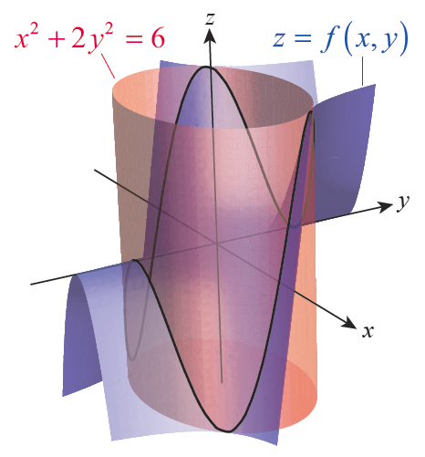
Example 1
Find the absolute extreme values of the function
f(x, y) = x²y on the curve x² + 2y² = 6.
Solution
The graph of z = f(x, y), is shown
as the blue surface in Figure 1,
and the graph of x² + 2y² = 6 in
red (recall that since z doesn’t
appear in the constraint, the
graph of x² + 2y² = 6 in ℝ³ is an
elliptic cylinder parallel to the
z­-axis).
Figure 1

Slide 6
Example 1 (cont.)
If we define g(x, y) = x² + 2y²,
then we seek the extreme values
of f(x, y) subject to the constraint
g(x, y) = 6; that is, we are looking
for the high and low points on the
intersection of the two surfaces,
shown as the black curve in
Figure 1.
Figure 1

Slide 7
Example 1 (cont.)
Using Lagrange’s method, we introduce the variable λ and solve the equation ∇f = λ∇g for x and y. But this equation actually has three variables, and we will need to also consider the constraint g(x, y) = 6 in order to determine x and y. Since and
we are led to the following system of equations.

Slide 8
Example 1 (cont.)
The first equation implies x = 0 or λ = y. Since f takes on both positive and negative values along the curve
g(x, y) = 6 and f(0, y) = 0, the solution x = 0 can be discarded. Substituting λ = y into the second equation results in the relation x² = 4y², and substituting this into the third equation gives us y² = 1, or y = ±1. Using the relation x² = 4y² again, we obtain x = ±2. We could also note that λ = ±1, but we don’t actually need explicit values for λ—its purpose was simply to stretch, shrink, and/or reverse ∇g so that the equation ∇f = λ∇g could be satisfied.

Slide 9
Example 1 (cont.)
The four points (±2, ±1), are the candidates for the extreme values of f on g(x, y) = 6 and we simply compute f at each of them and compare to finish the task.

Slide 10
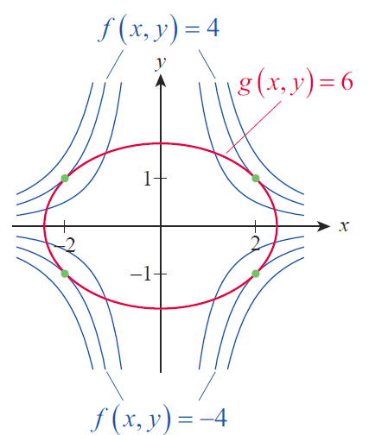
Example 1 (cont.)
Figure 2 is an illustration of
how the contour curves are
tangent to the curve g(x, y) = 6
only at (±2, ±1). A total of six
contours of f are shown, but
only for the contours f(x, y) = 4
and f(x, y) = −4 is it possible to
find points where ∇f = λ∇g.
Figure 2

Slide 11
The Method of Lagrange Multipliers
The Method of Lagrange Multipliers
If f(x, y, z) and g(x, y, z) are differentiable in an open region containing the level surface g(x, y, z) = k and
∇g ≠ 0 on g(x, y, z) = k, then any relative extrema of f can be found as follows.
Step 1: Simultaneously solve the equations

Slide 12
The Method of Lagrange Multipliers
The Method of Lagrange Multipliers (cont.)
Step 2: Evaluate f at the solution points (x, y, z) found in Step 1. To identify the relative minima and relative maxima of f on g(x, y, z) = k, it suffices to compare the value of f at the solution points.

Slide 13
The Method of Lagrange Multipliers
Proof
Suppose f has a relative extremum on the surface
g(x, y, z) = k, at the point (x₀, y₀, z₀), and that is a smooth curve on the surface containing the point (x₀, y₀, z₀). Let t₀ be the value for which Since f has a relative extremum at (x₀, y₀, z₀),

Slide 14
The Method of Lagrange Multipliers
Proof (cont.)
Geometrically, this means that is orthogonal to which is tangent to the curve r(t). But we also know that ∇g is orthogonal to any level surface of g at any point, so
as well. Since this is true for every such smooth curve through (x₀, y₀, z₀), and since
the two gradients ∇f and ∇g must be parallel at
(x₀, y₀, z₀). That is, for some constant λ.

Slide 15
Example 2
Consider again the problem of maximizing the volume function V = xyz under the constraint that
x + 2y + 2z = 84. Solve this problem using Lagrange multipliers.
Solution
If we define we need to solve the system

Slide 16
Example 2 (cont.)
This gives us the following four equations.

Slide 17
Example 2 (cont.)
Discarding a solution of 0 for any variable (since we know the maximum volume won’t be 0), the second and third equations tell us that y = z. Multiplying the first equation by 2 and substituting the result into the second equation gives us 2y = x. So we can write the fourth equation in terms of y to obtain 6y = 84, or
y = 14. Hence, z = 14 as well and x = 28. Since
(28, 14, 14) is the only solution of the system for which V ≠ 0, we know that V(28, 14, 14) = 5488 in.³ must be the maximum possible volume.

Slide 18
Example 3
Find the location on the plane −2x − 6y + 4z = 8 closest to the point (1, −2, 3).
Solution
Although vector techniques can be used to solve this problem, the method of Lagrange multipliers provides a different approach that can be generalized to other types of curves and surfaces.

Slide 19
Example 3 (cont.)
Viewing the problem from this perspective, we seek to minimize the distance between the point (1, −2, 3) and the given plane. We could proceed to work with the distance function
which represents the distance between the point
(1, −2, 3) and an arbitrary point (x, y, z) on the plane
−2x − 6y + 4z = 8 (or anywhere else in ℝ³), but we can make our work easier by instead choosing to minimize the function

Slide 20
Example 3 (cont.)
That is, the point (x, y, z) on the plane that minimizes the square of the distance will be the same point that minimizes the distance. In the language of this section, we are looking for the absolute minimum of f(x, y, z) under the constraint that g(x, y, z) = 8, where

Slide 21
Example 3 (cont.)
So we proceed to solve the following system.
Using the first three equations to express x, y, and z in terms of λ, and substituting the results into the fourth equation, we obtain 28λ + 22 = 8, so We then use this to determine that and z = 2.

Slide 22
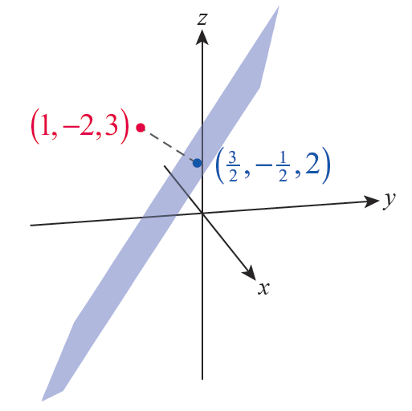
Example 3 (cont.)
Figure 3 is an illustration of the
plane, the point (1, −2, 3) in
red, and the solution point
in blue.
Figure 3

Slide 23
Example 4
In ℝ², find the points of relative minimum and maximum distance between the origin and the curve
y² = x³ + 1.
Solution
We can again make our task easier by finding the relative extrema of the function f(x, y) = x² + y², the square of the distance between (x, y) and the origin, rather than the distance function itself. And we restrict the search to those points on the curve g(x, y) = 1 where g(x, y) = y² − x³.

Slide 24
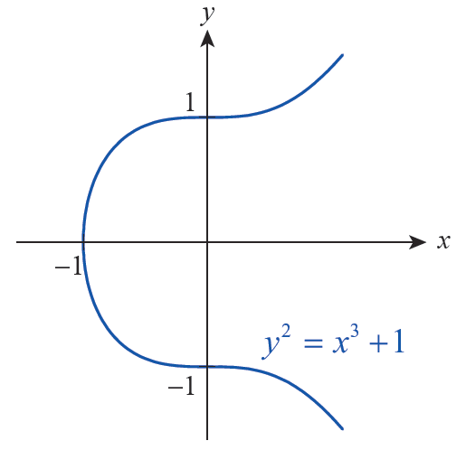
Example 4 (cont.)
Figure 4 shows a graph of the
curve g(x, y) = 1 and clearly
there is no upper bound on
the distance between the
origin and points on the
graph (as x increases, the
corresponding y‑values
increase in magnitude).
Figure 4

Slide 25
Example 4 (cont.)
But near the origin, it appears there should be points of relative extrema of f. We find them by solving the following system.

Slide 26
Example 4 (cont.)
From the second equation we know that y(λ − 1) = 0, so y = 0 or λ = 1. We consider these two cases separately as follows.
If y = 0: The third equation becomes x³ = −1 and so
x = −1.
If λ = 1: The first equation becomes x(3x + 2) = 0 so
x = 0 or
The corresponding y‑values are, respectively, y = ±1 and

Slide 27
Example 4 (cont.)
Comparing the values of f at each of these points, we find
Remember that these values are the square of the distance from the points to the origin, but the location of these relative extrema is the same whether we are optimizing the distance or the distance squared.

Slide 28
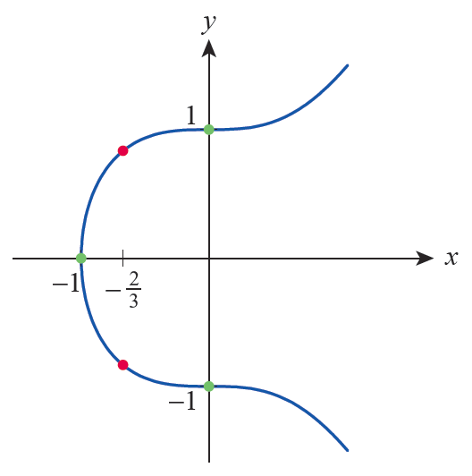
Example 4 (cont.)
Figure 5 illustrates the relative
extrema we have located,
with the relative minima in
green and the relative
maxima in red.
Figure 5

Slide 29
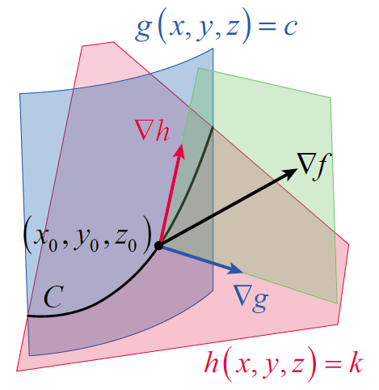
Lagrange Multipliers with Two Constraints
Lagrange’s method extends nicely to optimization problems with two constraints. Suppose we want to find the extreme values of f(x, y, z) under the side conditions that g(x, y, z) = c and
h(x, y, z) = k. Assuming that g and
h are differentiable and that ∇g
and ∇h are not parallel, the points
satisfying g(x, y, z) = c and
h(x, y, z) = k lie along the
intersection C of two surfaces,
such as those shown in Figure 6.
Figure 6

Slide 30
Lagrange Multipliers with Two Constraints
So we seek the extrema of f(x, y, z) under the constraint that (x, y, z) lies on C.
By the same reasoning as before, we know that if f has an extremum at (x₀, y₀, z₀), then ∇f is orthogonal to C at (x₀, y₀, z₀). We also know that ∇g(x₀, y₀, z₀) is orthogonal to g(x, y, z) = c and ∇h(x₀, y₀, z₀) is orthogonal to h(x, y, z) = k at the point (x₀, y₀, z₀), so
∇f(x₀, y₀, z₀) must lie in the same plane as ∇g(x₀, y₀, z₀) and ∇h(x₀, y₀, z₀).

Slide 31
Lagrange Multipliers with Two Constraints
In other words, there must exist two real numbers λ and μ (again called Lagrange multipliers) such that
We actually identify x₀ , y₀ , and z₀ by solving the following system of equations.

Slide 32
Example 5
Find the absolute extreme values of f(x, y, z) = x + y + z subject to the constraints x² + 2y² = 6 and
3x + 2y + 4z = 5.
Solution
Defining g(x, y, z) = x² + 2y² and h(x, y, z) = 3x + 2y + 4z, the constraints have the form g(x, y, z) = 6 and
h(x, y, z) = 5.

Slide 33
Example 5 (cont.)
Noting that
and introducing two Lagrange multipliers λ and μ, we are led to the following system of equations.

Slide 34
Example 5 (cont.)
The third equation gives us immediately and substituting this into the first and second equations results in and so λ x = λ y. It is easy to verify that λ = 0 is not part of a solution to the system, so we are left with x = y. Using this knowledge in the fourth equation leads to and the corresponding values for z, from the fifth equation, are then

Slide 35
Example 5 (cont.)
Evaluating f at the two critical points, we obtain the following.

Slide 36
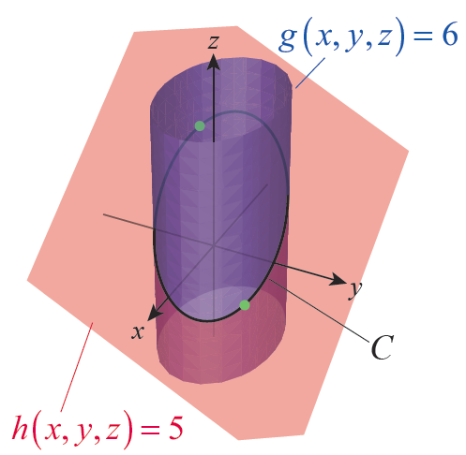
Example 5 (cont.)
Figure 7 is an illustration of the
two surfaces g(x, y, z) = 6 and
h(x, y, z) = 5 their intersection
C, and the locations of the
absolute extreme values of
f on C.
Figure 7

