Slide 1
Section 14.1
Double Integrals

Slide 2
TOPICS
Double integrals and Riemann sums
Fubini’s Theorem
3. Double integrals over general bounded regions

Slide 3
Double Integrals
In this section, we extend the definition of integration to encompass double integrals over bounded regions of ℝ². Just as the previous integrals had geometric interpretations as signed areas, the double integrals of this chapter can be interpreted as signed volumes. And just as the Fundamental Theorem of Calculus allowed us to evaluate single integrals without taking limits of Riemann sums, we will learn similar techniques that greatly simplify the evaluation of double integrals.

Slide 4
Double Integrals and Riemann Sums
Recall that the formal definition of the integral is based on the limit of Riemann sums of the form
where is a partition of the
interval [a, b] and each is a sample point from the subinterval Each term in the sum represents the area of a rectangle of height and width so the Riemann sum is an approximation of the (signed) area between the graph of f(x) and the x-axis over the interval [a, b].

Slide 5
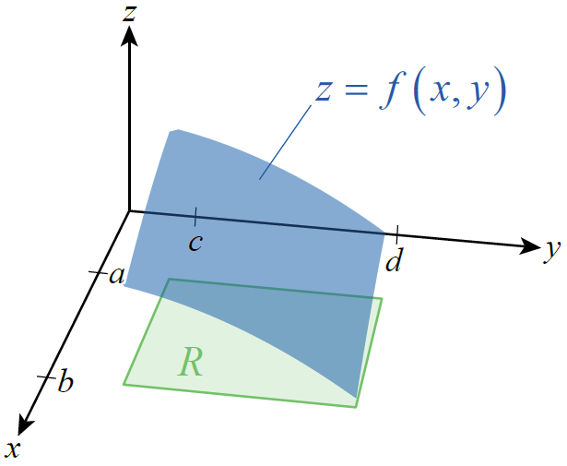
Double Integrals and Riemann Sums
To extend this idea to a function f(x, y) defined on a region R ⊆ ℝ², we assume initially that R is a rectangle in the plane defined by a ≤ x ≤ b and c ≤ y ≤ d, which we write as [a, b] × [c, d]; Figure 1 is an illustration of such a rectangle and the graph of a surface z = f(x, y).
Figure 1

Slide 6
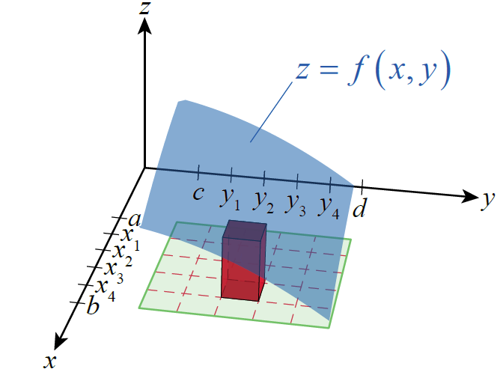
Double Integrals and Riemann Sums
We can approximate the volume of the space between z = f(x, y) and the xy-plane over the region R by partitioning R into a grid of rectangles and summing the volumes of rectangular columns, such as the one shown in Figure 2.
Figure 2

Slide 7
Double Integrals and Riemann Sums
The height of each column is the value where is a sample point chosen from the subrectangle defined by and and the area of the base is ΔA_{ij} = Δx_{i} Δy_{j}, where and So the volume of each column is and the sum of the volumes is expressed as the double summation

Slide 8
Double Integrals and Riemann Sums
where is a partition of [a, b] and is a partition of [c, d]. The double sum is an example of a Riemann sum of f(x, y) over the region R.

Slide 9
Double Integrals and Riemann Sums
In order to refine our approximation of the true volume between z = f(x, y) and the plane over R, it is important that we consider Riemann sums for which goes to zero. We use the word
partition again to refer to the subdivision of R into subrectangles, and if P represents one particular partition, we define the norm of P by

Slide 10
Double Integrals and Riemann Sums
If all double Riemann sums converge to a common value as we consider partitions of smaller and smaller norm, we define the double integral of f over R to be that common value.

Slide 11
Definition: Double Integral
Double Integral
Given a function f(x, y) defined on the region we define the double integral of f over R to be the value
provided the limit exists. If the limit exists, we say f is integrable over R, and define the signed volume between the surface z = f(x, y) and the xy‑plane over the region R to be the double integral.

Slide 12
Example 1
Given the function and the region R defined by a = 1, and d = 2, the Riemann sum approximations corresponding to n = m = 5, 10, and 20 equal partitions of each interval are as shown in Figure 3.
Note: The exact value is .

Slide 13
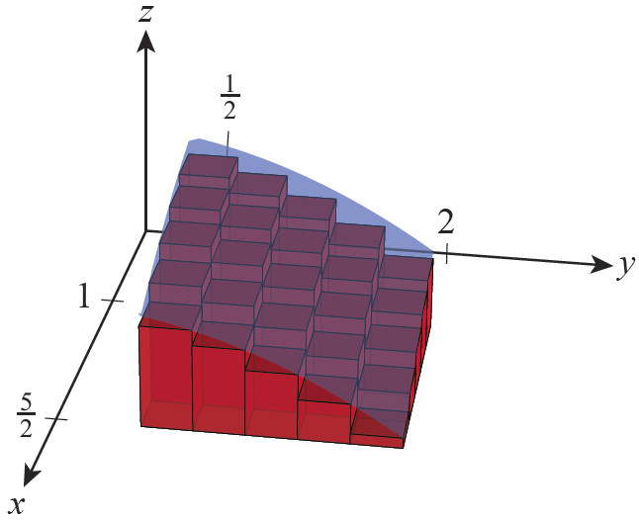
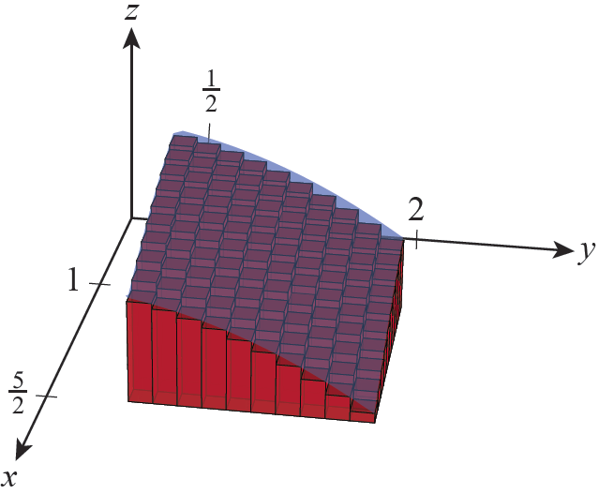
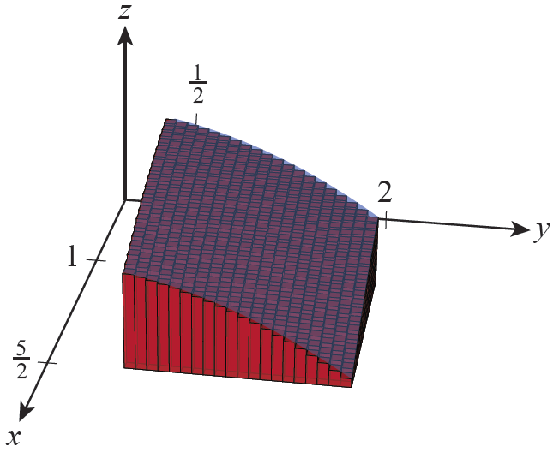
Example 1 (cont.)
Riemann sum
Difference from exact value = 2.97
Riemann sum
Difference from exact value ≈ 1.460
Riemann sum
Difference from exact value ≈ 0.724
Figure 3

Slide 14
Fubini’s Theorem
Clearly, we would prefer not to have to take limits of double Riemann sums to evaluate double integrals if there is an easier alternative. Further, while the approximations shown in Example 1 may make a fairly convincing argument that the Riemann sums converge to some value, there is nothing in the work presented to indicate that the value is

Slide 15
Fubini’s Theorem
Fubini’s Theorem allows us to both avoid limits of Riemann sums and arrive at the exact value of a double integral, at least when we are able to find antiderivatives of the integrand. It does so by reducing the task of evaluating a double integral to the task of evaluating two single integrals consecutively.

Slide 16
Fubini’s Theorem
The theorem, is based on the principle that the volume V of a solid is equal to the integral of its cross‑sectional areas over some interval. We first encountered this principle in the form and

Slide 17
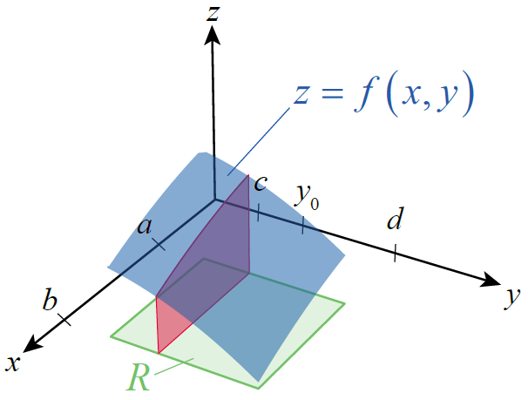
Fubini’s Theorem
Consider the solid bounded by the xy-plane and the surface z = f(x, y) over a region R, but this time with an eye toward its cross‑sectional slices perpendicular to the y-axis—one of them, through the point y = y₀ , is shown in Figure 4.
Figure 4

Slide 18
Fubini’s Theorem
Then the volume of the solid is
But each cross-sectional area A(y) corresponds to the area between a function of x and the xy-plane over the interval [a, b]; for instance,

Slide 19
Fubini’s Theorem
Hence,
Such an integral is called an iterated or repeated integral, and Fubini’s Theorem specifies conditions under which its value is equal to the double integral

Slide 20
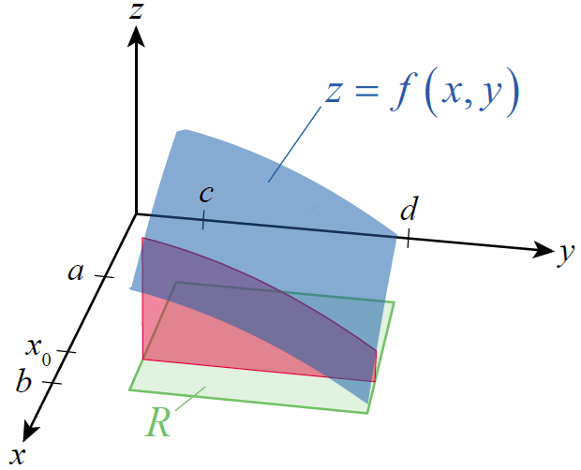
Fubini’s Theorem
Before stating the theorem formally, note that we could just as well begin with cross‑sectional slices perpendicular to the x-axis, as shown in Figure 5, in which case we arrive at the following result:
Figure 5

Slide 21
Theorem: Fubini’s Theorem
Fubini’s Theorem
If f(x, y) is continuous on the region then

Slide 22
Example 2
Evaluate the double integral where
Solution
As Figure 6 indicates, the function takes on both positive and negative values on the region R (that is, part of the surface lies above the xy-plane, and part below). This doesn’t affect the procedure for evaluating the double integral, but keep in mind that double integrals represent signed volume, and it is entirely possible for the result to be positive, negative, or zero.

Slide 23
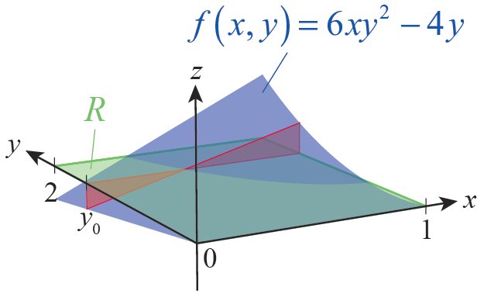
Example 2 (cont.)
By Fubini’s Theorem,
To evaluate such an iterated integral, we first evaluate the inner integral by finding an antiderivative of the integrand with y held fixed—remember, the inner integral represents a cross-sectional area A(y), such as shown in Figure 6, and y doesn’t vary until we integrate A(y) over [0, 2] in the outer integral.
Figure 6

Slide 24
Example 2 (cont.)
In this respect, the evaluation of iterated integrals is much like partial differentiation, all but one of the variables is held fixed at each stage.

Slide 25
Example 2 (cont.)
This result means that the volume between the xy-plane and the positive portion of z = 6xy² − 4y has the same magnitude (but opposite sign) as the volume between the xy-plane and the negative portion of the surface. The result is the same if we choose to work with the alternative iterated integral, though the intermediate steps differ.

Slide 26
Example 2 (cont.)

Slide 27
Example 3
Evaluate the double integral where
Solution
By Fubini’s Theorem,

Slide 28
Example 3 (cont.)

Slide 29
Double Integrals over General Bounded Regions
In the examples we have encounter thus far, we have only integrated over a rectangular region but Fubini’s Theorem extends to double integrals over more general regions. In particular, the double integrals we need to evaluate can usually be expressed in one of the two forms shown in the following figures, where g₁(x), g₂(x), h₁(y), and h₂(y) all represent continuous functions defined on a bounded interval.

Slide 30
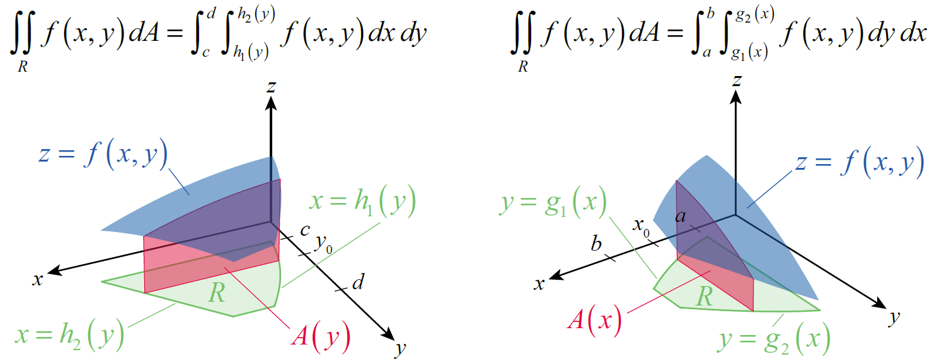
Double Integrals over General Bounded Regions
Figure 8
Figure 9

Slide 31
Double Integrals over General Bounded Regions
In Figure 8, the region R is defined by the inequalities and c ≤ y ≤ d, so each cross-sectional
area is given by and the volume
of the bounded solid by
The situation shown in Figure 9 is similar, except that each cross-sectional area is a function of x and the order of integration is reversed.

Slide 32
Example 4
Evaluate over the region R bounded between
y = 3x² and y = 2 + x².
Solution
The first step is to sketch the region R, if a sketch is not provided. We use the sketch to decide on the order of integration and to determine the limits of integration.

Slide 33
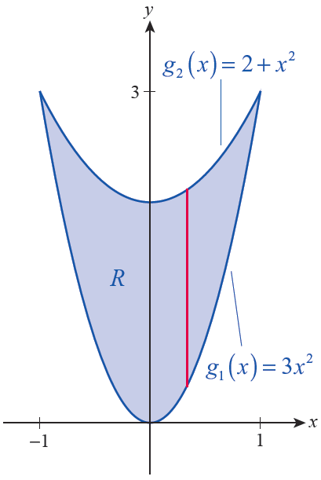
Example 4 (cont.)
Figure 10 shows the two parabolas defined by the boundary equations; note that the curves intersect at
The shape of R guides us to set up the iterated integral in the form
because we can easily define cross‑sections through R (such as the one shown in red) as line segments with lower bound g₁(x) and upper bound g₂(x).
Figure 10

Slide 34
Example 4 (cont.)
The alternative order of integration would lead to horizontal cross‑sections that are functions of y, and the left-hand and right-hand limits of the line segments would be much more cumbersome to define and use.
Note that, scanning from left to right, R is bounded by the limits x = −1 and x = 1. Putting the pieces together, we have the following.

Slide 35
Example 4 (cont.)

Slide 36
Example 5
Evaluate the iterated integral
Solution
Since the iterated integral is already set up, there is nothing to stop us from trying to evaluate it immediately. Unfortunately, as we already know, (sin x)/x has no simple antiderivative and the inner integral is nonelementary. We are stuck at the outset, unless we find a way to rewrite the problem.

Slide 37
Example 5 (cont.)
Although the region R associated with this iterated integral was not explicitly defined for us, the limits of integration define it indirectly. Beginning with the inner integral, the left and right edges of the region are given by x = y and x = 1 (we know these are the left and right edges, as opposed to bottom and top, because they define limits of x). The outer integral defines the bottom and top edges of R as y = 0 and y = 1.

Slide 38
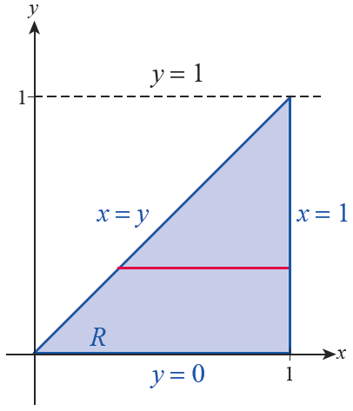
Example 5 (cont.)
Graphing these four lines gives us the region shown in Figure 11, with the red horizontal line segment representing a typical cross-sectional slice defined by the inner integral.
Figure 11

Slide 39
Example 5 (cont.)
In some cases, a double integral may be nonelementary under one order of integration but readily evaluated under the alternative. We can’t change the region R over which we are integrating, but if we use vertical cross‑sections instead of horizontal, we can use Fubini’s Theorem to rewrite the original integral.

Slide 40
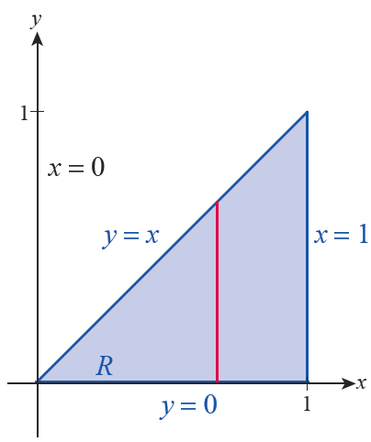
Example 5 (cont.)
Figure 12 shows a representative vertical cross‑section through R; note that it begins at the lower limit of y = 0 and ends at the upper limit of y = x.
Figure 12

Slide 41
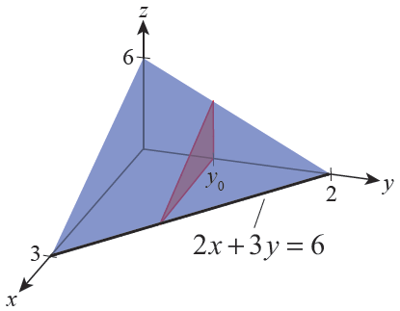
Example 6
Find the volume of the tetrahedron bounded on three sides by the coordinate planes and on the fourth side by the plane 2x + 3y + z = 6.
Solution
The four planes bound a solid in the first octant of ℝ³, as depicted in Figure 13.
Figure 13

Slide 42
Example 6 (cont.)
We can determine its volume by integrating the function over a region R in the xy-plane. We determine R by setting z = 0 in the equation 2x + 3y + z = 6, resulting in the line 2x + 3y = 6.
We could use cross‑sections in either direction to evaluate the double integral; using horizontal cross‑sections, as shown in the figure, we obtain the following volume.

Slide 43
Example 6 (cont.)

Slide 44
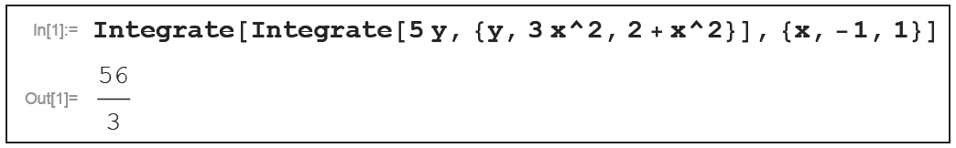
Technology Note
Technology Note
A computer algebra system can be used to evaluate double as well as single integrals. The syntax varies with the software, but the form usually reflects the fact that iterated integration is “an integral of an integral.” For instance, one way to use Mathematica to evaluate the integral of Example 4 is shown in Figure 14.
Figure 14

Slide 45
Properties of Double Integrals
Properties of Double Integrals
Assume that f(x, y) and g(x, y) are continuous, that k is a constant, and that R₁ and R₂ are two regions with at most boundary points in common. Assume also that all the integrals below exist. Then the following properties hold.
Constant Multiple Property
Sum/Difference Property

Slide 46
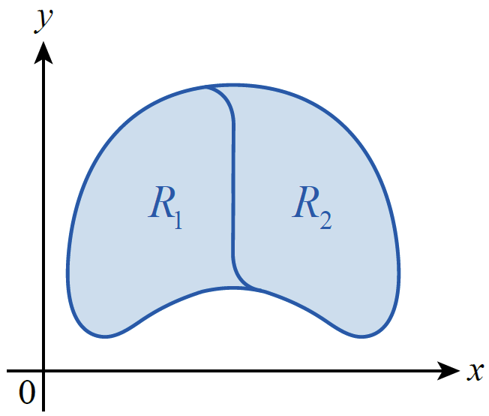
Properties of Double Integrals
Properties of Double Integrals (cont.)
Domination Property
Disjoint Region Property
(see Figure 15)
Figure 15

