Slide 1
Section 14.2
Applications of Double Integrals

Slide 2
Topics
Area by double integration
First moments
Second moments

Slide 3
Area by Double Integration
The underlying philosophy of integration is the observation that the area A of a planar region R can be found by integrating together all of the area differential elements dA over R—this informal statement was made precise with the formula

Slide 4
Area by Double Integration
We were forced to express dA in terms of a function A′(x) multiplied by a differential dx so that we could integrate over an interval, the only option available to us at the time. Using double integration, the same philosophical idea takes the form

Slide 5
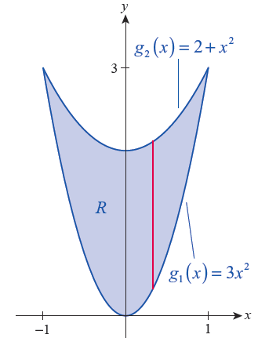
Example 1
Find the area of the region R bounded between the parabolas y = 3x² and y = 2 + x².
Solution
Referring to Figure 1, and using
vertical slices through R, its area is
as follows.
Figure 1

Slide 6
Example 1 (cont.)

Slide 7
Area by Double Integration
could also be interpreted as the volume of the
solid between the xy‑plane and the surface f(x, y) = 1 over the region R—in other words, the volume of a right cylinder of height 1 and base R. Since the volume of such a cylinder is
1 × Area (R), we have the following.

Slide 8
Area by Double Integration
Now imagine an empty tank in the shape of a right cylinder with base R and indefinite height, which we proceed to fill with a given volume V of water. Then
V = h × Area (R), where h is the ultimate height of the water in the tank. If the surface of the water is now pushed down in some areas, it must rise in other areas in order to maintain constant volume.

Slide 9
Area by Double Integration
At any given moment in time, the surface of the water represents the graph of a function f(x, y) and the volume of the solid bounded by the xy-plane and
z = f(x, y) over R is Since the volume of
water never changes, it must be the case that

Slide 10
Area by Double Integration
We use this observation to define the average value of f over R to be h, which also makes sense if h is negative (although its interpretation as the height of the water does not have any physical meaning in this case). Formally,

Slide 11
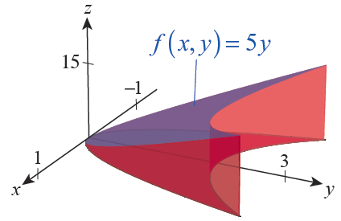
Example 2
Find the average value of f(x, y) = 5y over the region R of Example 1.
Figure 2

Slide 12
Example 2 (cont.)
Solution
In an example earlier in this chapter we determined that
and we have just calculated so the average height of the solid bounded between the xy-plane and the graph of z = 5y over R, depicted in Figure 2, is

Slide 13
Definition: First Moments about the Axes, Mass, and Center of Mass of a Planar Object
First Moments about the Axes, Mass, and Center of Mass of a Planar Object
Given a planar object modeled by the region R in the xy-plane, and whose density is represented by ρ(x, y), its first moments M_{x} and M_{y} about the coordinate axes, its mass M, and its center of mass are as follows, assuming the integrals exist.

Slide 14
Definition: First Moments about the Axes, Mass, and Center of Mass of a Planar Object
First Moments about the Axes, Mass, and Center of Mass of a Planar Object (cont.)
First moment about the x-axis
First moment about the y-axis
Mass
Center of mass

Slide 15
Example 3
Find the center of mass of the triangular plate bounded by y = 0, x = 1, and y = x if the density of the plate at the point (x, y) is given by ρ(x, y) = x² + y.
Solution
In order to develop an intuitive sense of how such a plate behaves, note that the density is very low near the origin (in fact, ρ(0, 0) = 0) and increases as x and y increase; however, the plate’s density grows faster as x increases than it does as y increases.

Slide 16
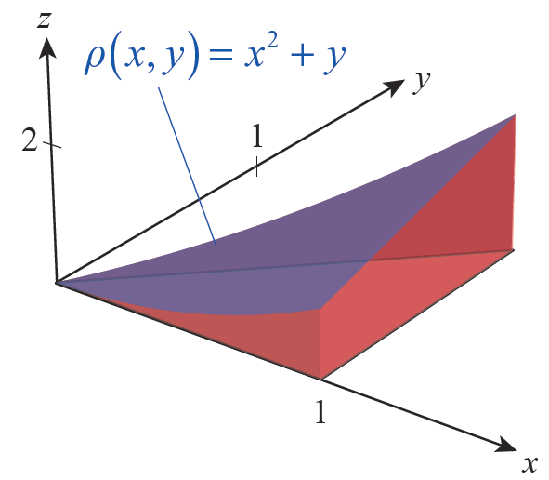
Example 3 (cont.)
One way in which a plate might have a density function ρ(x, y) = x² + y is if its thickness is defined by ρ, as shown in Figure 4. Try to
imagine where such a plate
will balance before we
actually calculate the center
of mass, as follows.
Figure 4

Slide 17
Example 3 (cont.)

Slide 18
Example 3 (cont.)
So we obtain

Slide 19
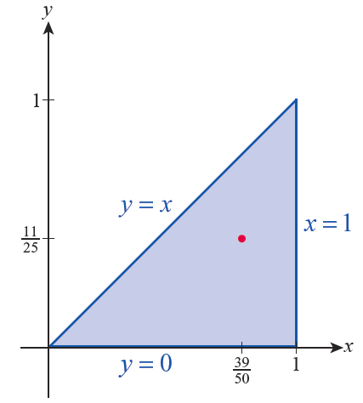
Example 3 (cont.)
The center of mass is shown in Figure 5.
Figure 5

Slide 20
Second Moments
While an object’s first moment reflects the point of balance of its static mass with respect to a given axis, its second moment, also called its moment of inertia, contains information about the kinetic energy the object possesses if it rotates about the axis.

Slide 21
Definition: Second Moments and Radii of Gyration of a Planar Object
Second Moments and Radii of Gyration of a Planar Object
Given a planar object modeled by the region R in the xy-plane, and whose density is represented by ρ(x, y), its second moments I_{x} , I_{y} , and I₀ and its corresponding radii of gyration are as follows, assuming the integrals exist.
Second moment about the x-axis

Slide 22
Definition: Second Moments and Radii of Gyration of a Planar Object
Second Moments and Radii of Gyration of a Planar Object (cont.)
Second moment about the y-axis
Second moment about the origin
Mass
Radii of gyration

Slide 23
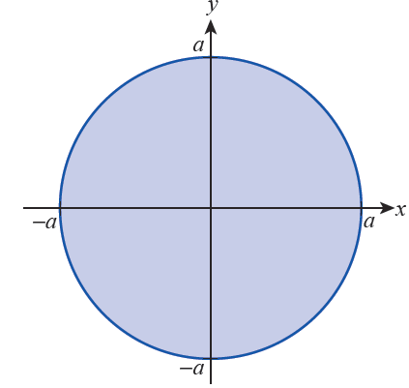
Example 4
Determine I_{x} , I_{y} , and I₀ for a disk of radius a and constant density ρ centered at the origin of the xy­plane. Then find its three radii of gyration.
Solution
The disk in question is depicted
in Figure 6, and referring to the
figure we set up the four
integrals that follow.
Figure 6

Slide 24
Example 4 (cont.)

Slide 25
Example 4 (cont.)
The techniques of integration allow us to evaluate I_{x} , as follows.

Slide 26
Example 4 (cont.)
Similar techniques can be used to evaluate I_{y} , as written, but we obtain the result faster by changing the order of integration and noting that I_{y} = I_{x}.

Slide 27
Example 4 (cont.)
The third moment of inertia comes quickly.
Without doing any integration, we know the mass of the disk is M = 𝜋a²ρ, so the three radii of gyration are

Slide 28
Example 4 (cont.)
Remember the physical interpretation of these results: a point with the same mass as the disk, but located
units from the x-axis, would have the same second moment if spun about the x-axis, with a similar meaning for r_{y}, while the same point would have to be located units from the origin for its second moment to be the same as that of the disk about the origin.

Slide 29
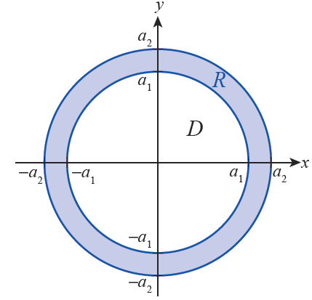
Example 5
Suppose the annulus shown in Figure 7 represents a planar object with total mass M. Determine its moment of inertia about the origin.
Figure 7

Slide 30
Example 5 (cont.)
Solution
The properties of integrals (double or single) mean that the moments of inertia of pieces of an object can be added in order to find the moment of inertia of the whole; in physics and engineering texts, this is often referred to as the Principle of Superposition. This applies whether we find it useful to decompose an object into overlapping pieces of different masses or, as in this case, to decompose a region into a union of essentially disjoint regions (regions that only intersect at their boundaries, if at all).

Slide 31
Example 5 (cont.)
Recall from Example 4 that, for a disk of radius a and constant density ρ, So if we let D represent the solid disk centered at the origin of radius a₁ and R the annulus in question, and if we imagine that the region R ∪ D is a single disk of material with constant density ρ, then

Slide 32
Example 5 (cont.)
so

Slide 33
Example 5 (cont.)
Physically, the factor represents the mass of the solid disk of radius a₂ minus the mass of the solid disk of radius a₁, so and the moment of inertia of the annular object about the origin is thus

Slide 34
Example 6
Given a fixed positive number s, determine I_{x} , I_{y} , and I₀ for the square [0, s] × [0, s] of constant density ρ. Then find its three radii of gyration.
Solution
The three second moments for this object are readily calculated.

Slide 35
Example 6 (cont.)
Since the mass of the square is M = ρs², this tells us

