Slide 1
Section 14.5
Triple Integrals in Cylindrical and Spherical Coordinates

Slide 2
Topics
The cylindrical coordinate system
The spherical coordinate system

Slide 3
The Cylindrical Coordinate System
As the name implies, the cylindrical coordinate system of ℝ³ is based on cylinders, and equations for cylinders in the cylindrical system are particularly simple in form. A point in ℝ³ with Cartesian coordinates (x,y,z) has cylindrical coordinates (r,θ,z), where r is the length of the line segment joining (0,0,0) and (x,y,0), θ is the angle between the positive x-axis and the same line segment, and z has the same meaning as in Cartesian coordinates.

Slide 4
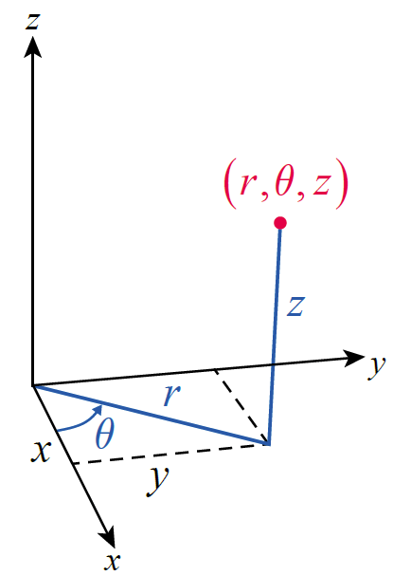
The Cylindrical Coordinate System
Figure 1 illustrates the relationship between (x,y,z) and (r,θ,z).
Figure 1

Slide 5
The Cylindrical Coordinate System
A few points deserve mention. First, note that the cylindrical coordinate system is simply the polar coordinate system of the xy-plane with the addition of a z-coordinate. Second, as with polar coordinates, points in space are associated with more than one set of cylindrical coordinates—for instance,
for every n ∈ ℤ.

Slide 6
Formula: Coordinate Conversion
Coordinate Conversion
Converting from cylindrical to Cartesian coordinates:
Converting from Cartesian to cylindrical coordinates:

Slide 7
The Cylindrical Coordinate System
The order of integration shown for illustrative purposes is one of the more frequently used, but the best order for a given problem may be different.
Setting up a Triple Integral in Cylindrical Coordinates
To express as an iterated integral using
cylindrical coordinates, perform the following steps.

Slide 8
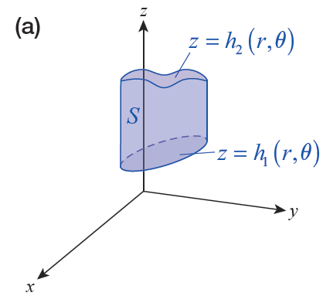
Setting up a Triple Integral in Cylindrical Coordinates
Setting up a Triple Integral in Cylindrical Coordinates (cont.)
Step 1: Draw a rough sketch
of S as an aid in determining
the z-limits. Identify the lower
surface and the
upper surface of
S—these two functions of r
and θ constitute the
z-limits (see Figure 3a).
Figure 3

Slide 9
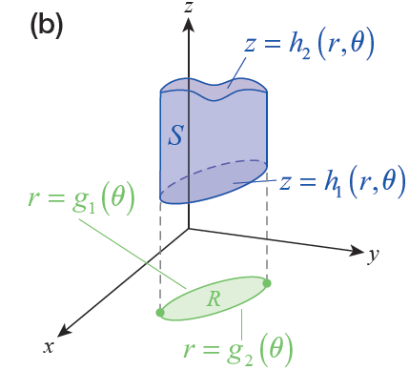
Setting up a Triple Integral in Cylindrical Coordinates
Setting up a Triple Integral in Cylindrical Coordinates (cont.)
Step 2: Define R to be the
“shadow,” or projection, of S
in the xy-plane. Sketch R, this
time as an aid in determining the
r-limits. The curve r = g₁(θ )
closer to the origin and the
farther curve r = g₂(θ ) constitute
the r-limits (see Figure 3b).
Figure 3

Slide 10
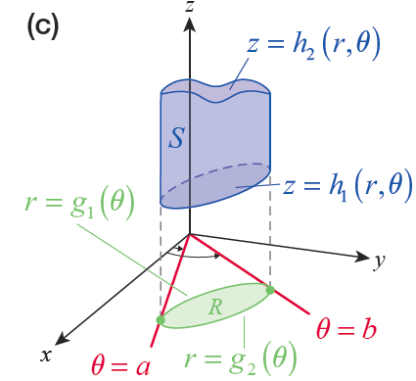
Setting up a Triple Integral in Cylindrical Coordinates
Setting up a Triple Integral in Cylindrical Coordinates (cont.)
Step 3: The lower limit of θ,
θ = a, defines one ray that
bounds R, and the upper
limit of θ, θ = b, defines the
other ray—R should be
captured between the two
rays (see Figure 3c).
Figure 3

Slide 11
Setting up a Triple Integral in Cylindrical Coordinates
Setting up a Triple Integral in Cylindrical Coordinates (cont.)
The result will be

Slide 12
Caution
Caution
Note that the limits of integration of the innermost integral may be functions of the other two variables
(r and θ in the order above). The limits of the middle integral may be functions of the outer variable
(θ above), but not the variable corresponding to the inner limits of integration (z above). The limits of the outermost integral can only be constants.

Slide 13
Example 1
Find the volume of the paraboloid solid S bounded below by the surface z = x² + y² and above by z = 1.
Solution
Since x² + y² = r², the lower and upper surfaces z-limits are z = r² and z = 1. The shadow, or projection, of the object in the xy-plane is the disk R defined by the equation x² + y² = 1, which in terms of r and θ reduces to the equation r = 1; note that in cylindrical coordinates, the equation r = 1 is a cylinder of radius 1 which entirely contains the solid S.

Slide 14
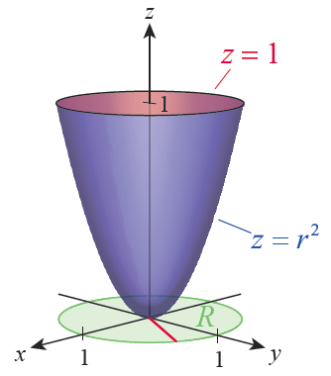
Example 1 (cont.)
Figure 4 illustrates S and R.
Figure 4

Slide 15
Example 1 (cont.)
Since we want to find the volume of S, the integrand is the function and we are led to the following integral.

Slide 16
Example 2
Find the mass and center of mass of the paraboloid solid of Example 1 if its density is described by the function
Solution
The previously defined moment formulas remain valid, but we must convert them to cylindrical coordinates if we wish to integrate with respect to r, θ, and z. In this case the conversion is easy, since z plays the same role in both Cartesian and cylindrical coordinates and symmetry tells us that without integration.

Slide 17
Example 2 (cont.)
To determine we need to evaluate the mass M and the first moment M_{xy} .

Slide 18
Example 2 (cont.)

Slide 19
Example 2 (cont.)
This gives us meaning the
z-component of the center of mass is halfway between the bottom and top of the solid.

Slide 20
Example 3
Determine the mass of the solid bounded by the cylinder the xy-plane, and the cone
given that its density function is
Solution
Although the particulars of this problem are given in Cartesian coordinates, the integral is far easier to evaluate in cylindrical coordinates. So the first order of business is to restate the geometry of the solid and its density in terms of r, θ, and z.

Slide 21
Example 3 (cont.)
Cylinder:
Cone:
Density:

Slide 22
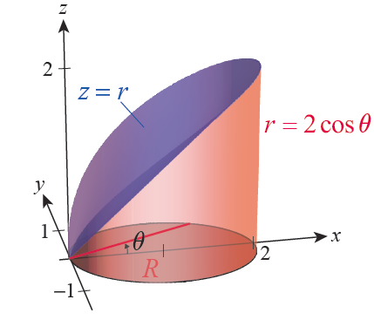
Example 3 (cont.)
Figure 5 is an illustration of the solid and its shadow R described in cylindrical coordinates. Note that the
θ -interval needed to define the
cylinder is the red
line segment shown extending
out from the origin corresponds
to one particular angle θ.
Figure 5

Slide 23
Example 3 (cont.)

Slide 24
Example 3 (cont.)

Slide 25
The Spherical Coordinate System
The spherical coordinate system is most useful when the geometry of a problem has some sort of symmetry about a point, especially if that point can be made the
origin of the system. A point with Cartesian coordinates (x,y,z) corresponds to the spherical coordinates
(ρ,θ,φ), where ρ is the distance between the origin and the point, θ has the same meaning as in cylindrical coordinates, and φ is the angle (sometimes called the polar angle) between the positive z-axis and the line segment joining the origin to the point.

Slide 26
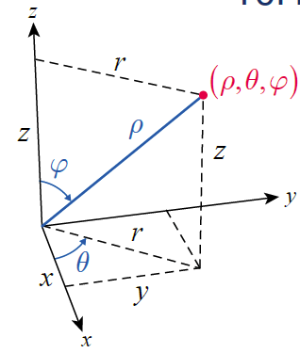
The Spherical Coordinate System
Unlike r, ρ is required to be nonnegative, and φ is restricted to the interval [0,π ]. Figure 6 illustrates the relationship between (x,y,z) and
(ρ,θ,φ), as well as the coordinate
r of the cylindrical system.
Figure 6

Slide 27
Caution
Caution
A few words of warning are in order: both the symbols used and the order of the coordinates vary somewhat with the field of study and between texts. In physics texts, θ is typically used to denote the polar angle and φ the angle in the xy‑plane (sometimes called the azimuth).

Slide 28
Caution
Caution (cont.)
And if spherical coordinates alone appear, r might be used in place of ρ (if both spherical and cylindrical coordinates are in use, it’s convenient to have different symbols for the two different coordinates). Finally, some texts swap the order of the polar and azimuth angles when listing the coordinates. Be sure to know how the symbols and their order are defined in any text you read.

Slide 29
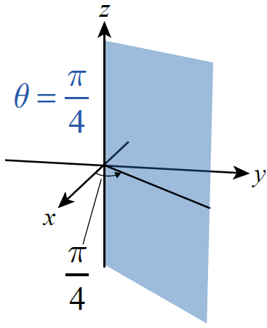
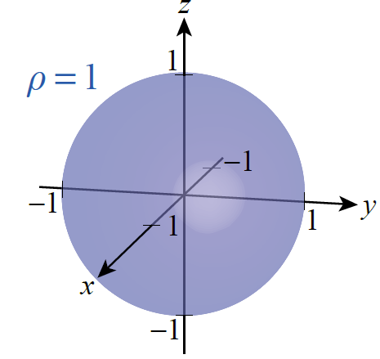
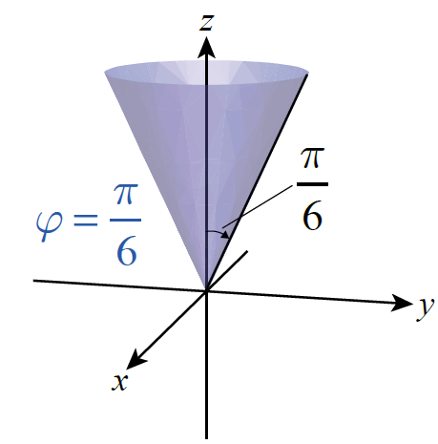
The Spherical Coordinate System
To get a sense of the kinds of objects that can easily be described with spherical coordinates, consider the graphs of ρ = 1, and shown in
Figure 7.
Half-Plane
(Remember  ≥ 0)
Sphere of
Radius 1
Cone
Figure 7

Slide 30
Coordinate Conversion Relationships
Cylindrical and Cartesian | Spherical and Cylindrical | Spherical and Cartesian
r² = x² + y² | ρ² = r² + z² | ρ² = x² + y²+ z²
x = r cosθ | r = ρ sinφ
y = r sinθ | θ = θ
z = z | z = ρ cosφ | z = ρ cosφ
Table 1
Figure 6

Slide 31
Example 4
Convert the equation to spherical coordinates.
Solution
The equation describes a sphere of radius 2 centered at (2,0,0). In order to convert to spherical coordinates, we group terms and use the conversion formulas.

Slide 32
Example 4 (cont.)
This defines the sphere as those points having spherical coordinates The surface is traced out completely over the intervals and
0 ≤ φ ≤ π ; allowing θ and φ to take on all the values
0 ≤ θ ≤ 2π and 0 ≤ φ ≤ π actually results in each point of the sphere being visited twice.

Slide 33
Setting up a Triple Integral in Spherical Coordinates
Setting up a Triple Integral in Spherical Coordinates
To express as an iterated integral using
spherical coordinates, perform the following steps.

Slide 34
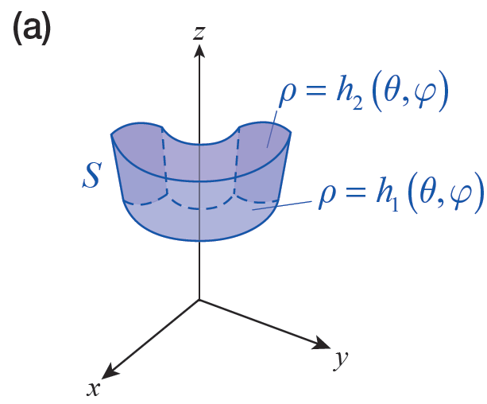
Setting up a Triple Integral in Spherical Coordinates
Setting up a Triple Integral in Spherical Coordinates (cont.)
Step 1: Draw a rough sketch
of S as an aid in determining
the ρ-limits. Identify the lower
ρ-limit as a function ρ = h₁(θ,φ)
and the upper ρ -limit as a function
ρ = h₁(θ,φ) (see Figure 9a).
Figure 9(a)

Slide 35
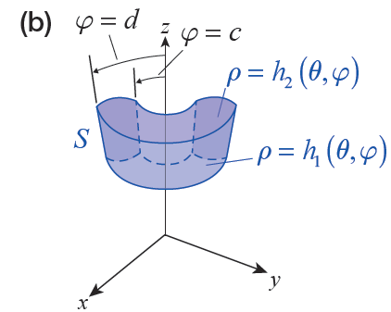
Setting up a Triple Integral in Spherical Coordinates
Setting up a Triple Integral in Spherical Coordinates (cont.)
Step 2: Determine the least
angle φ among the
φ -coordinates of all the points
of S, and use this as the lower
φ -limit φ = c. Use a similar
analysis to determine the
upper φ -limit φ = d.
Figure 9(b)

Slide 36
Setting up a Triple Integral in Spherical Coordinates
Setting up a Triple Integral in Spherical Coordinates (cont.)
While it is possible for the φ -limits to be functions of θ, this rarely happens in practice when using spherical coordinates.

Slide 37
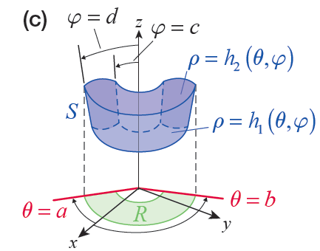
Setting up a Triple Integral in Spherical Coordinates
Setting up a Triple Integral in Spherical Coordinates (cont.)
Step 3: Define R to be the
projection of S in the xy-plane.
The lower θ -limit θ = a defines
one ray that bounds R, and
the upper θ -limit θ = b defines
the other ray—R should be
captured between the two
rays.
Figure 9(c)

Slide 38
Setting up a Triple Integral in Spherical Coordinates
Setting up a Triple Integral in Spherical Coordinates (cont.)
The result will be

Slide 39
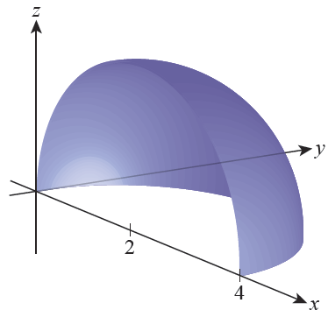
Example 5
Set up the general form for the integral of a function
f(x, y, z), over the solid S defined as the first-octant portion of the sphere
Solution
Figure 10 shows the outer surface
of the portion of the sphere we are
to integrate over.
Figure 10

Slide 40
Example 5 (cont.)
From Example 4, we know that ρ = 4 sin φ cosθ describes the surface in spherical coordinates, so to limit the integral to the part in the first octant we restrict θ and φ to and The lower ρ -limit is ρ = 0, while the upper ρ -limit is the equation for the sphere. All that remains is to convert the arguments of f appropriately and to remember to include the factor of ρ² sinφ in the integral.

Slide 41
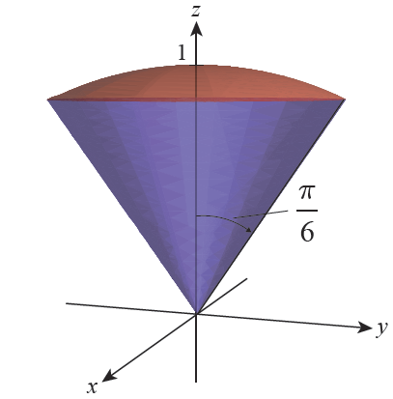
Example 6
Find the volume of the solid, shown in Figure 11, bounded below by the cone and above by the sphere ρ = 1.
Figure 11

Slide 42
Example 6 (cont.)
Solution
The lower and upper limits on ρ are 0 and 1, respectively, while the φ -interval is and the
θ-interval is Since we seek only the volume, we integrate the constant function 1 over S. However, don’t forget to include the factor of ρ²sinφ, which is part of the volume differential dV.

Slide 43
Example 6 (cont.)

