Slide 1
Section 14.6
Substitutions and Multiple Integrals

Slide 2
TOPICS
Substitutions in double integrals
Substitutions in triple integrals

Slide 3
Substitutions in Double Integrals
To set the stage for the general theory, recall the Substitution Rule (u-substitution).
While to this point we have used the Substitution Rule to replace the integral on the right with the one on the left, we focus attention now on the factor of we can think of it as a transformation factor necessary to convert the integral from one variable to the other.

Slide 4
Substitutions in Double Integrals
Similarly, the factor of r allows us to convert a double integral from Cartesian coordinates to polar coordinates.

Slide 5
Substitutions in Double Integrals
More generally, consider a transformation function T of the form T(u, v) = (x, y) from the uv-coordinate system to the xy-coordinate system. T takes a point with coordinates (u, v) and converts it to coordinates (x, y), where both x and y are functions of u and v.

Slide 6
Substitutions in Double Integrals
For our purposes, we will assume that g and h have continuous first-order partial derivatives. We also assume that T is a one-to-one function on a domain region S in the uv-plane onto a region R in the xy-plane, so that for each point there is a unique point such that

Slide 7
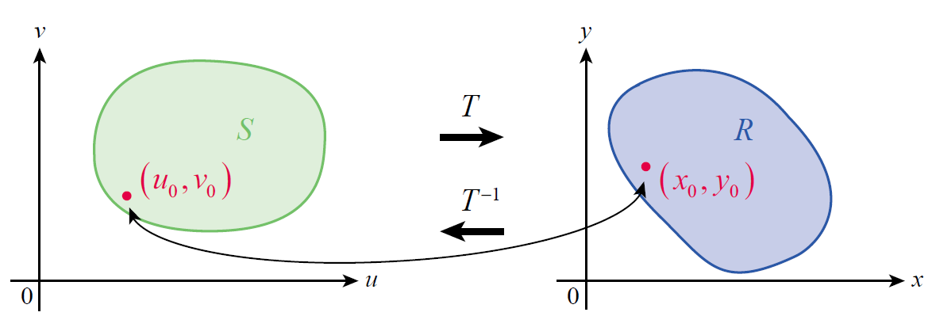
Substitutions in Double Integrals
We call (u₀, v₀) the preimage of (x₀, y₀), and (x₀, y₀) the image of (u₀, v₀); similarly, we say the region S is the preimage of R, or that R is the image of S. Figure 1 illustrates these relationships; note that since T is one­-to-one, the inverse transformation T ⁻¹ is a function from R to S.
Figure 1

Slide 8
Substitutions in Double Integrals
Our goal is to convert a double integral of a function f(x, y) over R into a double integral of f(g(u, v), h(u, v)) over S, ideally in such a manner that the converted integral is easier to evaluate. But to do so, we need to know how each differential area element dx dy relates to its corresponding differential area element du dv.

Slide 9
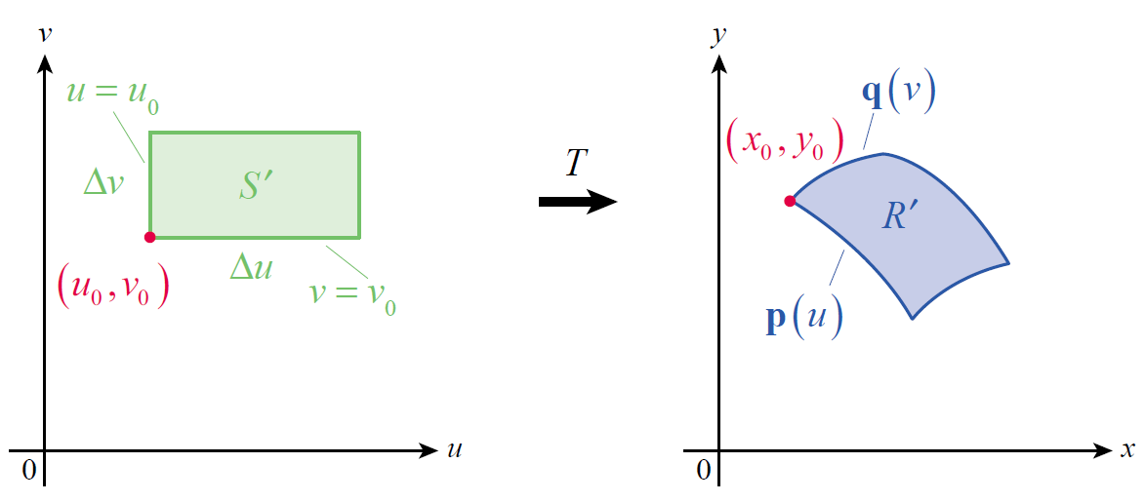
Substitutions in Double Integrals
Beginning with a fixed point (u₀, v₀) in the interior of S, let Δu and Δv be small positive increments and consider the rectangle S′ shown on the left in Figure 2 (we assume the increments are small enough so that S′ ⊆ S). The function T then transforms S′ into a region R′ ⊆ R, shown on the right in Figure 2.
Figure 2

Slide 10
Substitutions in Double Integrals
Let
and define
Then both p(u₀) and q(v₀) are position vectors for the point (x₀, y₀), and p(u) and q(v) are vector functions that trace out edges of R′ as shown in Figure 2.

Slide 11
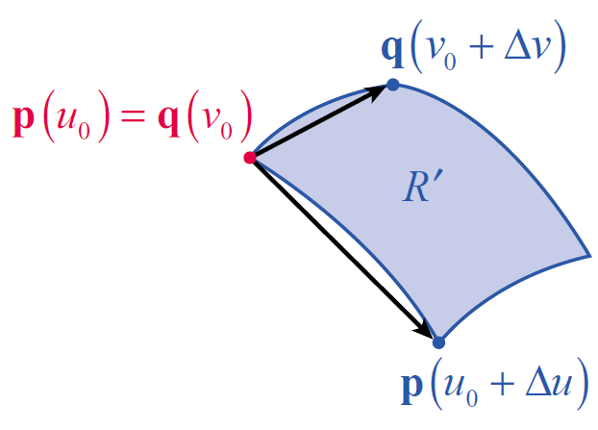
Substitutions in Double Integrals
We can approximate the area of R′ with the area of the parallelogram defined by the vectors and (see Figure 3), and we know that the area of the parallelogram is the magnitude of the cross product of the vectors.
Figure 3

Slide 12
Substitutions in Double Integrals
Since
the area of the parallelogram is

Slide 13
Substitutions in Double Integrals
Note that
and

Slide 14
Substitutions in Double Integrals
so
and hence

Slide 15
Definition: The Jacobian of a Transformation
The Jacobian of a Transformation
The Jacobian (or Jacobian determinant) of the coordinate transformation T defined by x = g(u, v) and y = h(u, v) is

Slide 16
Substitutions in Double Integrals
Given this definition, the area of the region R′ is approximately
where the Jacobian is evaluated at (u₀, v₀).

Slide 17
Substitutions in Double Integrals
So if we let ΔA denote the area of any such region R′ in R (see Figure 4), we can approximate the double integral of a function f(x, y) over R by a Riemann sum of the form
where each Jacobian is evaluated at (u*, v* ).

Slide 18
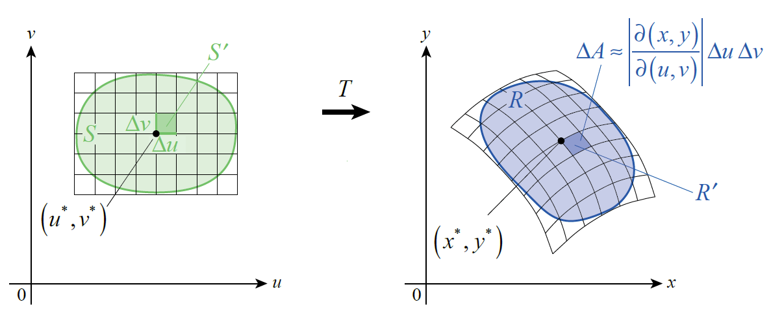
Substitutions in Double Integrals
This gives rise to the following theorem.
Figure 4

Slide 19
Theorem: Change of Variables in a Double Integral
Change of Variables in a Double Integral
Assume T is a coordinate transformation from S to R defined by x = g(u, v), and y = h(u, v), where g and h both have continuous first-order partial derivatives, and that T is one-to-one on S (except possibly on the boundary of S). Assume also that the Jacobian of T is nonzero on S and that f is continuous on R. Then

Slide 20
Example 1
Use a Jacobian to derive the formulation of double integrals in polar coordinates.
Solution
The coordinate transformation T from polar coordinates to Cartesian coordinates is defined by x = r cosθ and y = r sinθ.

Slide 21
Example 1 (cont.)
Hence,
(under the assumption that r > 0).

Slide 22
Example 2
Use a change of variables to evaluate
where R is the region bounded by x = 0, y = 0, and 3x + 2y = 2.
Solution
This double integral is awkward to evaluate using Cartesian coordinates, but the right choice of change of variables makes it much easier. One possibility is to let u equal the numerator and v the denominator of the integrand.
u = 3x + 2y and v = x + 4y

Slide 23
Example 2 (cont.)
In order to determine the Jacobian of the transformation from the uv-plane to the xy-plane, we need to solve these two equations for x and y.

Slide 24
Example 2 (cont.)
We can now calculate

Slide 25
Example 2 (cont.)
A diagram of the region S in the uv‑plane that corresponds to R in the xy‑plane is helpful in determining limits, and Figure 5 illustrates both. Each boundary of R corresponds to a boundary of S as follows.

Slide 26
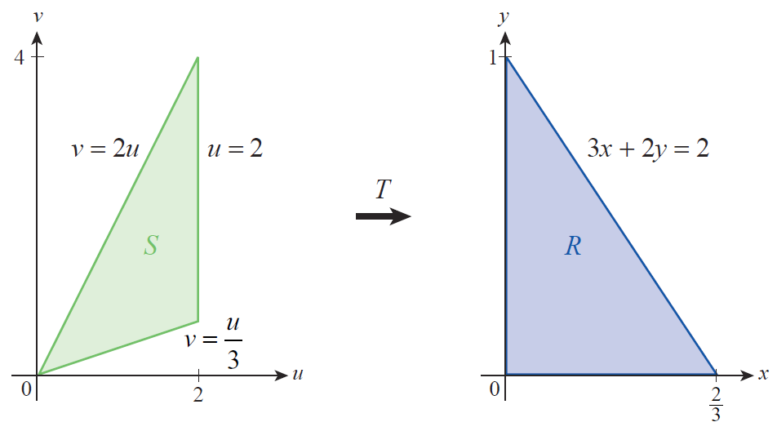
Example 2 (cont.)
Figure 5

Slide 27
Example 2 (cont.)
(By calculating the area of each triangle, note that the area of R is the area of S.) We are now ready to change variables in the integral and evaluate it.

Slide 28
Definition: The Jacobian of a Transformation (Three-Dimensional Version)
The Jacobian of a Transformation (Three-Dimensional Version)
The Jacobian of the coordinate transformation T defined by x = g(u, v, w), y = h(u, v, w), and z = k(u, v, w) is

Slide 29
Theorem: Change of Variables in a Triple Integral
Change of Variables in a Triple Integral
Assume T is a coordinate transformation from S to R defined by x = g(u, v, w), y = h(u, v, w), and z = k(u, v, w), where g, h, and k all have continuous first-order partial derivatives, and that T is one-to-one on S (except possibly on the boundary of S). Assume also that the Jacobian of T is nonzero on S and that f is continuous on R.

Slide 30
Theorem: Change of Variables in a Triple Integral
Change of Variables in a Triple Integral (cont.)
Then

Slide 31
Example 3
Use a Jacobian to derive the formulation of triple integrals in spherical coordinates.
Solution
The coordinate transformation T from spherical coordinates to Cartesian coordinates is defined by

Slide 32
Example 3 (cont.)

Slide 33
Example 3 (cont.)

Slide 34
Example 3 (cont.)
Once we take the absolute value of the Jacobian (and use the fact that 0 ≤ φ ≤ π, so sin φ ≥ 0), we obtain the following.

Slide 35
Example 4
Use a change of variables to evaluate
where R is the solid bounded by the planes y = 0, y = 3, z = 0, z = 4, 3x = z, and 3x = z + 3.
Solution
As in Example 2, the first step is to decide on a change of variables to try. On the basis of the integrand, and also guided by the form of two of the six planes, the assignment u = 3x − z appears promising.

Slide 36
Example 4 (cont.)
This will allow two of the faces of the parallelepiped to be expressed as u = 0 and u = 3. If we let and then
and

Slide 37
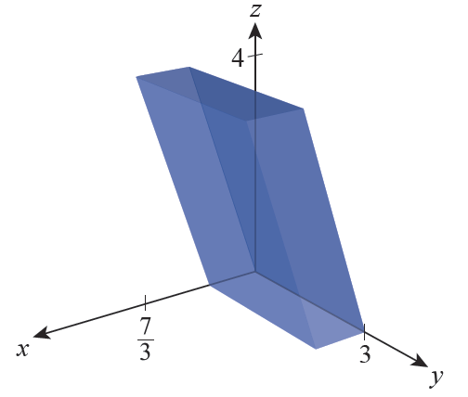
Example 4 (cont.)
The solid S corresponding to the limits, in xyz-space, appears in Figure 6.
Figure 6

