Slide 1
Section 15.1
Vector Fields

Slide 2
TOPICS
Terms and definitions
Examples of vector fields

Slide 3
Terms and Definitions
A vector field is a function that assigns a vector to each element of its domain. For our purposes, a vector field will almost always be a function whose domain is a region of ℝ² or ℝ³, and we often visualize a vector field as a collection of arrows. Typically, only a representative subset of the vectors is depicted, and we graph each vector so that its initial point (or tail) coincides with its associated domain element (in contrast to position vectors, where the head is located at the point corresponding to the components and the tail is at the origin).

Slide 4
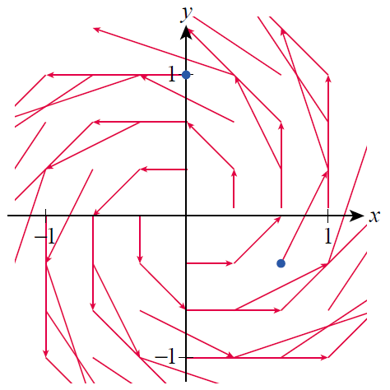
Terms and Definitions
Figure 1 is an illustration of the
function F that assigns the
vector to the point
(x, y), which we express with
the formula
The portion of ℝ² shown is
the square [−1, 1] × [−1, 1],
but F is actually defined on
all of ℝ².
Figure 1

Slide 5
Terms and Definitions
And while only a few vectors
are actually depicted, we can
infer how the vector field
behaves in general on the
basis of those shown; for
illustrative purposes, the
initial points of the two
specific vectors
and are shown
in blue in Figure 1.
Figure 1

Slide 6
Terms and Definitions
A word of caution is in order, however, regarding how CAS software displays vector fields. To avoid overly long vectors and/or confusing images, graphing packages usually scale the vectors downward in length.

Slide 7
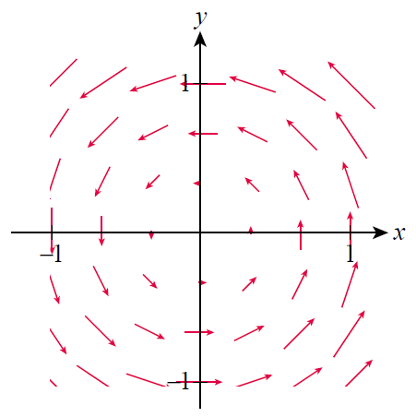
Terms and Definitions
For instance, Mathematica
depicts the same vector field
using the
built-in VectorPlot
command, as shown in
Figure 2.
Figure 2

Slide 8
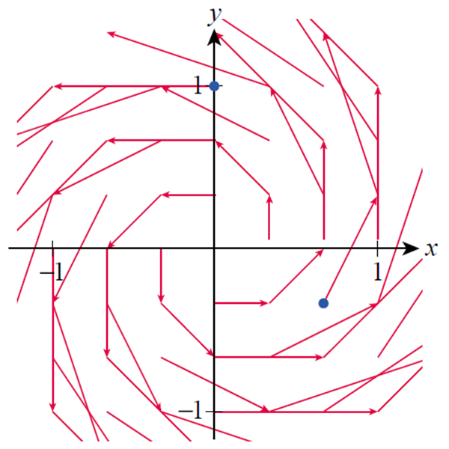
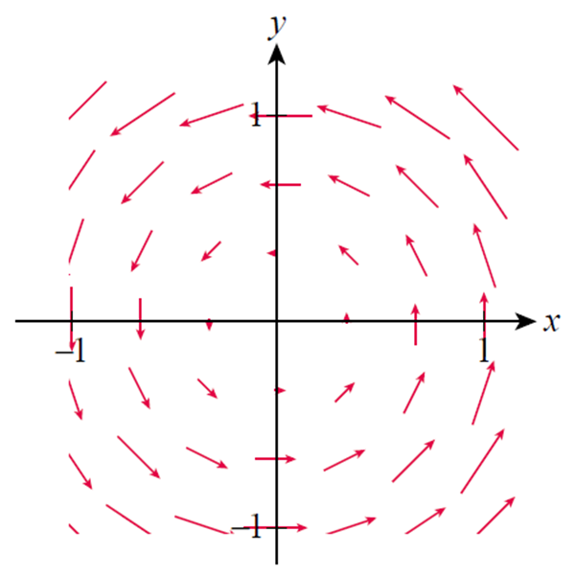
Terms and Definitions
Note the differences in the graphical representations.
Figure 1
Figure 2

Slide 9
Terms and Definitions
The relative sizes of the vectors are correct, but the actual lengths are not. Note that Mathematica also centers each vector at the point it is associated with, instead of placing the tail of the vector at the point.

Slide 10
Terms and Definitions
In the case of a vector field F defined on a region of ℝ², each component of F is itself a function of two variables, so F has the following generic form:
The typeface used is a reminder of the nature of the functions: P and Q are the component functions of F, and in this context are sometimes referred to as scalar functions or scalar fields since they return a single number (a scalar) at each point (x, y).

Slide 11
Terms and Definitions
Together, when placed in order as they are here, they constitute the components of the vector function F, which is written in bold as an indication that it is indeed a vector (when written by hand, the notation
would be used).
A vector field is said to be continuous if its component functions are continuous, and differentiable if its components are themselves differentiable.

Slide 12
Example 1
Describe the vector field and sketch F with representative vectors.
Solution
Since
each element of F is a vector of length and based on the formula, F is not defined at the origin.

Slide 13
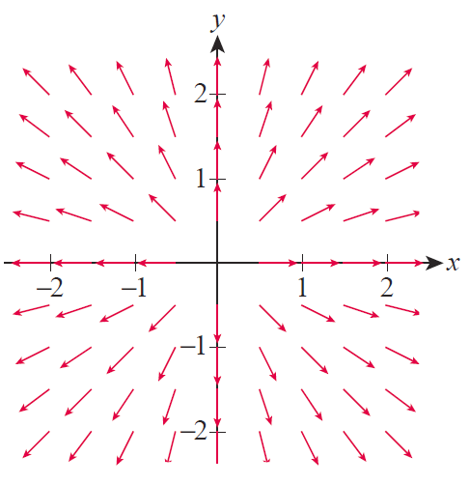
Example 1 (cont.)
At every other point, F(x, y) is
a vector pointing radially
outward from the point (x, y)
so representative elements
of F are as shown in Figure 3.
Figure 3

Slide 14
Example 1 (cont.)
Since
the component functions of F are as follows:
These two multivariable functions are differentiable everywhere they are defined, so F is differentiable everywhere in the domain.

Slide 15
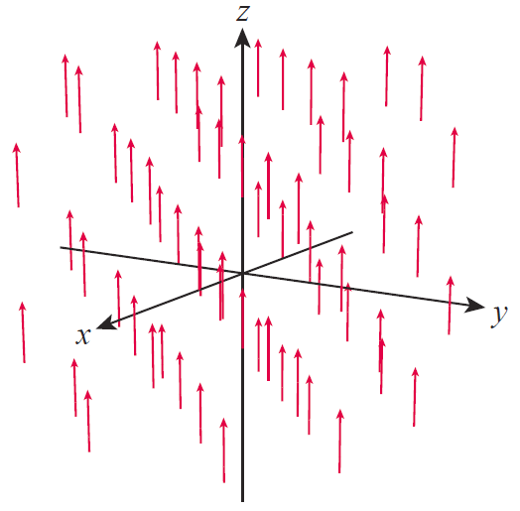
Example 2
Describe the vector field and sketch F with representative vectors.
Solution
Each point of ℝ³ is associated with
the vector
The component scalar functions
are clearly differentiable, so F is as
well, and Figure 4 shows some
representative vectors of F.
Figure 4

Slide 16
Examples of Vector Fields
Vector fields arise naturally in describing and working with many natural phenomena, and you are familiar with many examples under different nomenclature
already. For instance, any depiction of wind speed and
direction qualifies as a vector field.

Slide 17
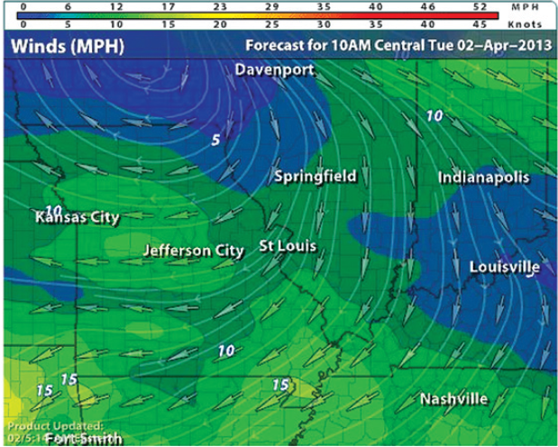
Examples of Vector Fields
If the depiction is overlaid on a two-dimensional weather map such as in Figure 5, the vector field assigns a vector to each element of a planar region.
Figure 5 Wind Pattern
Source: WSI Corporation

Slide 18
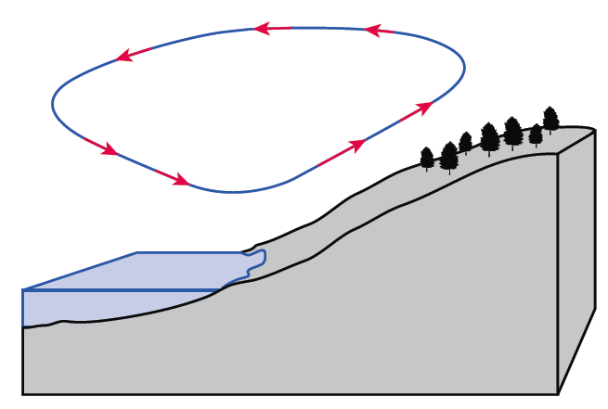
Examples of Vector Fields
A different sort of description, such as might be used to explain prevailing winds at different altitudes, assigns wind speed and direction to each point of a three‑dimensional region of space (Figure 6).
Figure 6
Wind at Different Altitudes

Slide 19
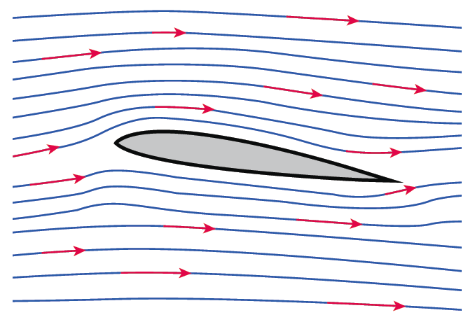
Examples of Vector Fields
And diagrams of wind velocity over and under an airfoil (Figure 7), as determined in a wind tunnel, are a standard part of many design processes.
Figure 7
Wind around an Airfoil

Slide 20
Examples of Vector Fields
Force fields, which often appear in physics and engineering problems, also qualify as vector fields. The next few examples introduce two of the more frequently encountered force fields.

Slide 21
Example 3
Newton’s Law of Universal Gravitation states that the force of attraction between an object of mass m and an another object of mass M is GMm/r², where G is a constant (called the gravitational constant) and r is the distance between the two objects. If we fix the object with mass M at the origin of a three-dimensional coordinate system and let then the force F felt by the object of mass m located at the point (x, y, z) is

Slide 22
Example 3 (cont.)
The negative sign reflects the fact that the object of mass m is attracted radially inward toward the origin.
The vector field F, in this context, is called a gravitational field.

Slide 23
Example 3 (cont.)
Since we can write F in component form as

Slide 24
Example 4
Coulomb’s Law is similar to the Law of Universal Gravitation, but encompasses both attractive and repulsive forces between electrically charged objects. If an object of charge Q is fixed at the origin, the electrostatic force F(x, y, z) felt by an object with charge q at position (x, y, z) is the electric field
where again and the constant ε is called Coulomb’s constant.

Slide 25
Example 4 (cont.)
If the two charges Q and q have the same sign (either both positive or both negative), then Qq > 0 and the force on the object of charge q is radially outward from the origin (repulsive). But if the charges have opposite sign, the objects are electrically attracted to one another and the force is directed radially inward.

Slide 26
Example 4 (cont.)
Figure 8 illustrates both repulsive and attractive force fields, using vectors of scaled length. The Law of Universal Gravitation and Coulomb’s Law are examples of inverse-square laws, meaning the magnitude of the force is inversely proportional to the square of the distance between the objects.

Slide 27
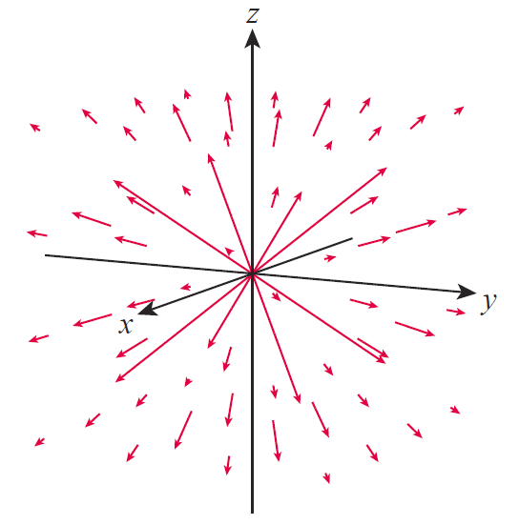
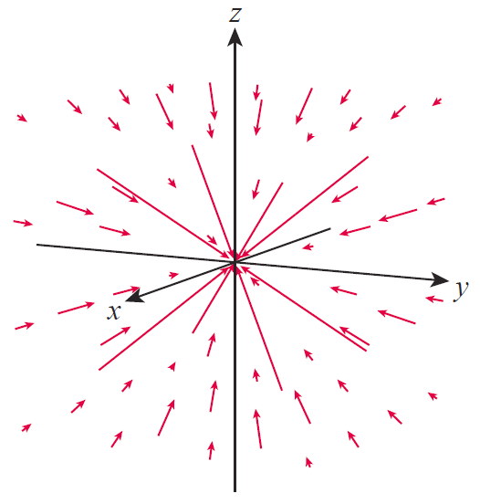
Example 4 (cont.)
Repulsive Force Field
Attractive Force Field
Figure 8

Slide 28
Examples of Vector Fields
The gradient of a scalar function is another important example of a vector field. Recall that the gradient of a function f(x, y) is
with a similar definition for the gradient of a function of three variables. In other words, the partial derivatives of a scalar field constitute the component functions of a vector field. We call such vector fields gradient vector fields.

Slide 29
Example 5
Determine the gradient vector field of the scalar field
Solution
The calculation is straightforward.
It is instructive to compare the gradient vector field to a contour map of f.

Slide 30
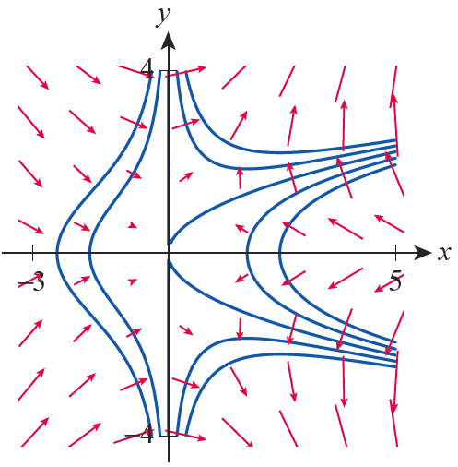
Example 5 (cont.)
Figure 9 shows contours of f
corresponding to contour values
of –6, –3, 0, 3, and 6, along with
a scaled illustration of the vector
field ∇f . Note that the gradient
vectors are perpendicular to the
contour lines, as we expect, and
also that the (relative) lengths of
the gradient vectors correspond
to how near the contour lines are
to one another.
Figure 9

Slide 31
Example 5 (cont.)
Remember that the magnitude of the gradient vector of f at any given point reflects the maximum rate of change of f, so regions of the plane where contour lines are close together correspond to relatively large gradients.

Slide 32
Examples of Vector Fields
If a vector field F can be written as the gradient of a scalar field f, so that F = ∇f , F is called a conservative vector field and we call f a potential function for F. Conservative vector fields have a special meaning in physics which will be explored later.

Slide 33
Example 6
Show that the gravitational field is conservative.
Solution
While at first this may seem like a challenging task, writing F in component form is suggestive.

Slide 34
Example 6 (cont.)
Since
it can be seen that the function
serves as a potential function for F.

Slide 35
Technology Note
Technology Note
The basic usage of the Mathematica command VectorPlot requires only a vector field F(x, y) and the region of the xy-plane to be displayed. For example, the vector field considered at the beginning of this section can be graphed over the region [−1, 1]×[−1, 1] as shown in Figure 10.

Slide 36
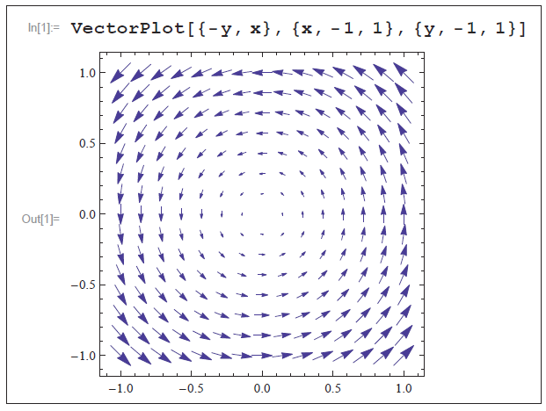
Technology Note
Technology Note (cont.)
Figure 10

Slide 37
Technology Note
Technology Note (cont.)
Additional options must be included to instruct Mathematica on the placement of tick marks on the axes, the number of vectors to draw, the style of the vectors, and so on, with the result shown in Figure 11.

Slide 38
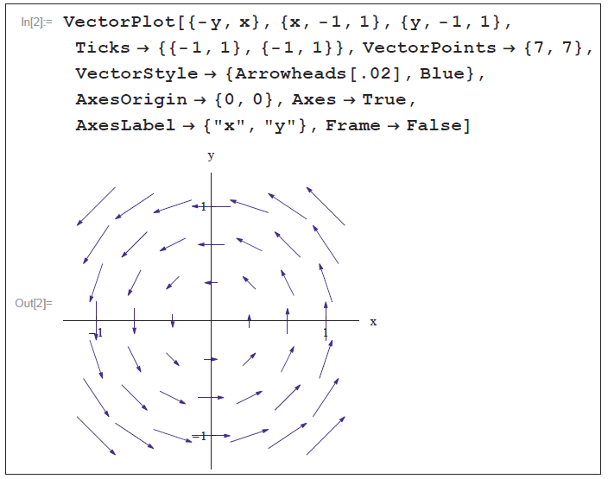
Technology Note
Technology Note (cont.)
Figure 11

