Slide 1
Section 15.2
Line Integrals

Slide 2
TOPICS
Integrals along curves in space
Masses, moments, and line integrals
3. Work, flow, and line integrals

Slide 3
Integrals along Curves in Space
Suppose C is a curve in space (either ℝ² or ℝ³) defined by a vector function r(t) over the interval a ≤ t ≤ b; that is, C is described by a function of the form
or
Assume also that C is smooth meaning that r′ is continuous and never zero on [a, b].

Slide 4
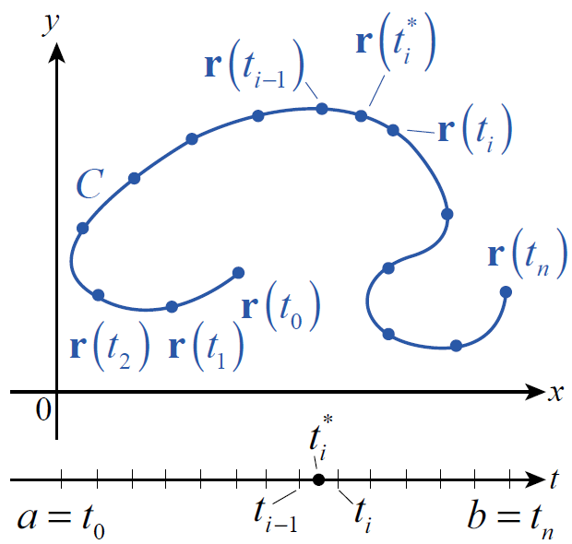
Integrals along Curves in Space
To define an integral over the curve, consider a partition P of C such as shown in Figure 1, defined by a corresponding partition
of the interval [a, b]. For each
subinterval let Δs_{i} be the
arc length of the portion of C
between and
Figure 1

Slide 5
Integrals along Curves in Space
Then for any function f whose domain contains C, we can form the Riemann sum
Where is a sample point chosen from the subinterval If, for a given function f , each such Riemann sum approaches the same value as the partitions get finer and finer, we define that value to be the line integral of f along C.

Slide 6
Definition: Line Integral
Line Integral
Given a function f defined on a curve C described by the smooth vector function r(t), a ≤ t ≤ b, the line integral of f along C is the value
provided the limit exists.

Slide 7
Integrals along Curves in Space
While the formal definition can be used as the basis for numerical approximations of line integrals, we also desire techniques to evaluate exactly, if possible. The most common formula uses the relationship between the arc length differential ds and parameter differential dt.

Slide 8
Integrals along Curves in Space
This allows us to express as an integral in the
variable t over the interval [a, b].

Slide 9
Example 1
Determine where and C is defined as the upper half of the circle x² + y² = 1 traversed counterclockwise.
Solution
The curve C is certainly smooth, and we know that the circle of radius 1 can be parametrized as

Slide 10
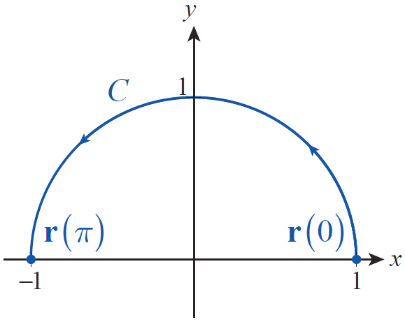
Example 1 (cont.)
To describe the upper half of the circle traversed counterclockwise, we use the t-interval
(see Figure 2). And since
Figure 2

Slide 11
Example 1 (cont.)
On C,
So,

Slide 12
Example 2
Determine where and C is
defined as the line segment starting at (−1,2,5), and ending at (2,0,1).
Solution
The vector points in the direction from the initial point to the terminal point, so we can describe C with the following parametrization:

Slide 13
Example 2 (cont.)
Alternatively, the line segment between (−1,2,5) and (2,0,1) can be described as a linear combination of the position vectors and
Either derivation results in and
so

Slide 14
Integrals along Curves in Space
If C₁ and C₂ are smooth curves such that the terminal point of C₁ coincides with the initial point of C₂ , and if f is integrable over each of C₁ and C₂ , then f is also integrable over the piecewise smooth path C₁ ∪ C₂ and
This is analogous to the property and extends to any finite number of smooth curves joined together.

Slide 15
Definition: Mass, First and Second Moments, Center of Mass, and Radii of Gyration
Mass, First and Second Moments, Center of Mass, and Radii of Gyration
Given an object in space modeled by the curve C and whose density is represented by ρ, its mass M, its first moments M_{yz}, M_{xz}, and M_{xy} about the coordinate planes, its second moments I_{x}, I_{y}, and I_{z} about the coordinate axes, its center of mass and its radii of gyration r_{x}, r_{y}, and r_{z} are as follows, assuming the integrals exist.

Slide 16
Definition: Mass, First and Second Moments, Center of Mass, and Radii of Gyration
Mass, First and Second Moments, Center of Mass, and Radii of Gyration (cont.)
Mass
First moment about the yz-plane
First moment about the xz-plane
First moment about the xy-plane
Center of mass

Slide 17
Definition: Mass, First and Second Moments, Center of Mass, and Radii of Gyration
Mass, First and Second Moments, Center of Mass, and Radii of Gyration (cont.)
Second moment about the x-axis
Second moment about the y-axis
Second moment about the z-axis
Radii of gyration

Slide 18
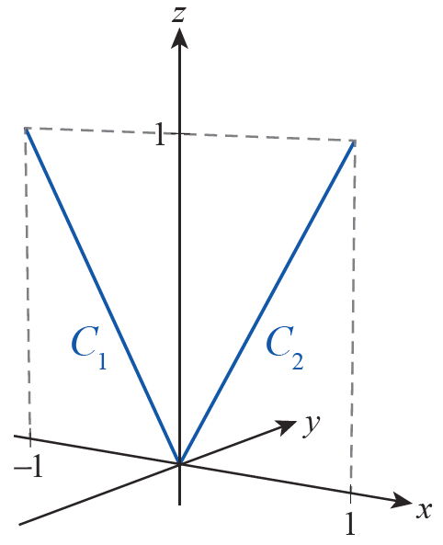
Example 3
Determine the mass, first moments, and center of mass of the V-shaped object in the xz-plane
shown in Figure 4, constructed from
two rods of constant linear density
ρ = 1.
Figure 4

Slide 19
Example 3 (cont.)
Solution
We will let C denote the given object, which consists of the line segment C₁ from (−1,0,1) to (0,0,0) joined to the line segment C₂ from (0,0,0) to (1,0,1). C₁ can be parametrized as and C₂ by both over 0 ≤ t ≤ 1.

Slide 20
Example 3 (cont.)
These lead to
By symmetry, and

Slide 21
Definition: Line Integral of a Vector Field
Line Integral of a Vector Field
Assume F is a continuous vector field whose domain contains the curve C defined by the smooth vector function r(t), with t taking on values between a and b. Then the line integral of F along C is as follows:

Slide 22
Definition: Line Integral of a Vector Field
Line Integral of a Vector Field (cont.)
Further, if F is a vector field in ℝ² or ℝ³ and has component form or and if or respectively, the line integral can be evaluated as
or

Slide 23
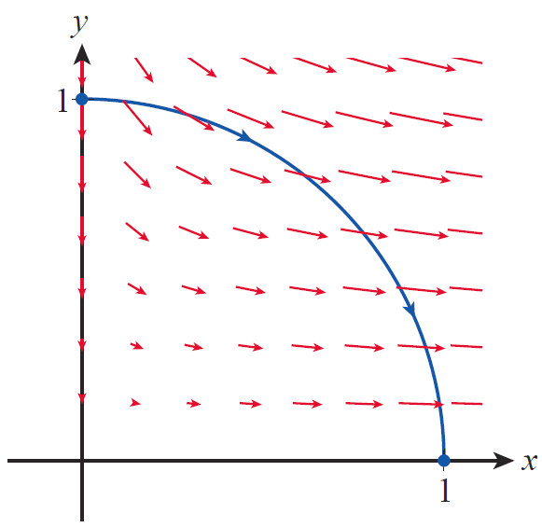
Example 4
Determine the work done by the force field
in moving a particle clockwise along the quarter circle shown in Figure 6.
Solution
The force field F is depicted in
Figure 6 by the red vectors
(shown scaled, not to actual length).
Figure 6

Slide 24
Example 4 (cont.)
We know that the circle of radius 1 can be parametrized by the vector function but to describe the path C taken by the particle we let and b = 0. We now proceed to express the work as an integral in t.

Slide 25
Example 4 (cont.)

Slide 26
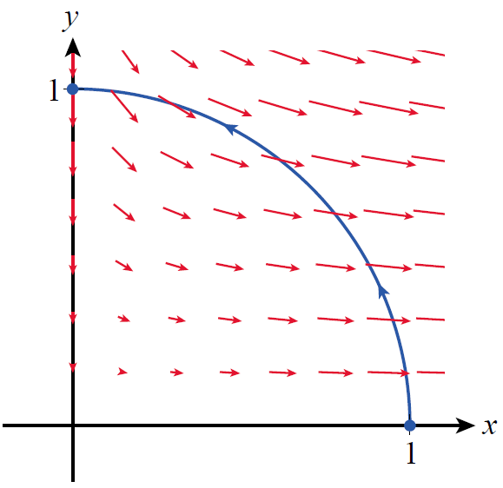
Work, Flow, and Line Integrals
In Example 4, if we had instead evaluated the integral
we would have arrived at a work
value of −2. A negative result in this
context means that the particle was
moved against the force of the vector
field, as illustrated in Figure 7.
Symbolically, if we let −C denote the
reverse orientation of a curve C, then
Figure 7

Slide 27
Work, Flow, and Line Integrals
If a given vector field F represents the velocity of a fluid in a region, F is a velocity field. The line integral of F along C may then be called a flow integral and its value represents the flow of the fluid along the curve. If C happens to be a closed loop, the flow is called the circulation of the fluid around the curve.

Slide 28
Example 5
Given a fluid velocity field defined by the gradient of the potential function determine the fluid’s flow along the curve from the point (0,0,0) to the point (1,1,1).
Solution
We start by finding the velocity field explicitly.

Slide 29
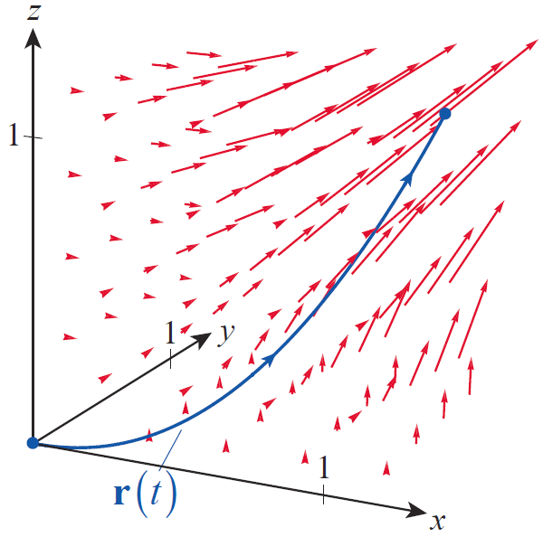
Example 5 (cont.)
This vector field is depicted in
Figure 8, with the vectors again
shown scaled. To determine the
flow, we compute the line
integral of F along the curve,
as in Example 4.
Figure 8

Slide 30
Example 5 (cont.)

