Slide 1
Section 15.3
The Fundamental Theorem for Line Integrals

Slide 2
Topics
The Fundamental Theorem for Line Integrals
Path independence and conservative fields
Finding potentials

Slide 3
Theorem: The Fundamental Theorem for Line Integrals (Gradient Theorem)
The Fundamental Theorem for Line Integrals (Gradient Theorem)
Assume that f is a differentiable function whose gradient ∇f is continuous along a curve C and that C is defined by the smooth vector function r(t), a ≤ t ≤ b. Then,

Slide 4
Proof: The Fundamental Theorem for Line Integrals (Gradient Theorem)
Proof
The theorem is true for f : ℝ^{n} → ℝ, but to illustrate the key idea, assume for the moment that we have
f : ℝ³ → ℝ. Then by the Chain Rule, we have the following:

Slide 5
Proof: The Fundamental Theorem for Line Integrals (Gradient Theorem)
Proof (cont.)
The statement is true in
general, so

Slide 6
The Fundamental Theorem for Line Integrals
Before illustrating its use in evaluating integrals, it’s worth noting an alternative expression of the formula. Recall that the total differential of a function f(x, y) is the expression df = f_{x} dx + f_{y} dy, with similar forms for
functions of three or more variables. So
and hence if C is a curve from a point A to a point B,

Slide 7
Example 1
Use the Fundamental Theorem for Line Integrals to evaluate
where C is the part of the origin‑centered circle of radius 5 starting at (5, 0) and ending at (3, 4).
Solution
In order to use the Fundamental Theorem for Line Integrals, we need to express the vector field
as the gradient of a function f.

Slide 8
Example 1 (cont.)
Alternatively, making use of the note above, we need to express the integrand y dx + x dy as the total differential df of a function f . So we want
y dx + x dy = df = f_{x} dx + f_{y} dy,
or f_{x} = y and f_{y} = x. The function f(x,y) = xy satisfies these two conditions, so

Slide 9
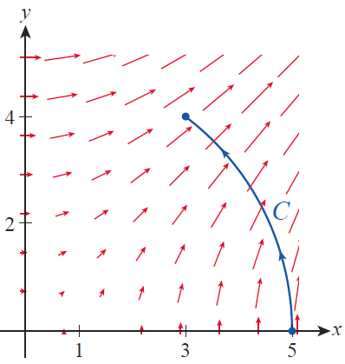
Example 1 (cont.)
Contrast this simple calculation with the method necessary when we use a parametrization of C, such as
over
the curve C is
shown in Figure 1, along with
a scaled representation of F.
Given this parameterization,
we have the following.
Figure 1

Slide 10
Example 1 (cont.)

Slide 11
Example 1 (cont.)

Slide 12
Example 2
Given a fluid velocity field defined by the gradient of the potential function f(x, y, z) = xyz, determine the fluid’s flow along the curve from the point (0, 0, 0) to the point (1, 1, 1).
Solution
This is exactly the problem seen in Example 5 of Section 15.2, but the Gradient Theorem allows us to solve it without integration. Since the vector field is defined as the gradient of

Slide 13
Definition: Path Independence of Line Integrals
Path Independence of Line Integrals
Assume that F is a continuous vector field defined on an open region D, and that A and B are two fixed points in D. If has the same value for every piecewise
smooth path joining A and B, we say that the integral is path independent in D (recall that a piecewise smooth path consists of a finite number of smooth curves joined end to end). In this case, any such line integral between A and B may be written as as the exact
path between the two points is immaterial.

Slide 14
Path Independence and Conservative Fields
Since we are primarily interested in vector fields over which line integrals make sense, we define a region D to be connected if any two points in D can be joined by a piecewise smooth path. From this point forward, unless otherwise indicated, all domains of vector fields will be assumed to be open and connected, and all line integral paths will be assumed to be piecewise smooth.

Slide 15
Theorem: Conservation Implies Path Independence
Conservation Implies Path Independence
If F is a conservative field on an open connected region D, then every line integral is path independent
in D.

Slide 16
Path Independence and Conservative Fields
Since line integrals over conservative fields are particularly easy to evaluate (assuming we can find a potential of the field), we are interested in their characteristics. One such characteristic concerns paths that are closed, meaning paths whose initial and terminal points coincide.

Slide 17
Theorem: Path Independence and Closed Path Integrals
Path Independence and Closed Path Integrals
Let D be an open connected region and F a continuous vector field defined on D. Then line integrals are path independent in D if and only if for every closed path C in D.

Slide 18
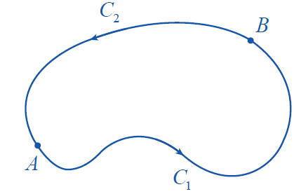
Proof: Path Independence and Closed Path Integrals
Proof
Suppose every such line integral of the form is path independent, and let C be a closed path in D. Pick any two distinct points A and B on C, and let C₁ be the part of C from A to B (following C’s
orientation) and C₂ the remaining
portion of C from B to A
(see Figure 2).
Figure 2

Slide 19
Proof: Path Independence and Closed Path Integrals
Proof (cont.)
Then −C₂ is also a path from A to B, so
by path independence. But as we have seen,
therefore

Slide 20
Proof: Path Independence and Closed Path Integrals
Proof (cont.)
On the other hand, if for every closed path C, and if C₁ and C₂ are any two paths with the same initial and terminal points, the same argument in reverse shows that
so and hence the line integrals are
path independent.

Slide 21
Theorem: Path Independence Implies Conservation
Path Independence Implies Conservation
Assume F is a continuous vector field on an open connected region D. If every line integral is path independent, then F is conservative.

Slide 22
Proof: Path Independence Implies Conservation
Proof
To show that F is conservative, we need to find a potential function f for F. We will demonstrate how this can be done for a vector field of two variables, but the proof technique extends to vector fields of any number of variables.

Slide 23
Proof: Path Independence Implies Conservation
Proof (cont.)
To construct f , let (x₀, y₀) be a fixed point in D and define
for all (x, y) ∈ D. This defines f unambiguously because of path independence—all paths between (x₀, y₀) and (x, y) lead to the same value for the line integral.

Slide 24
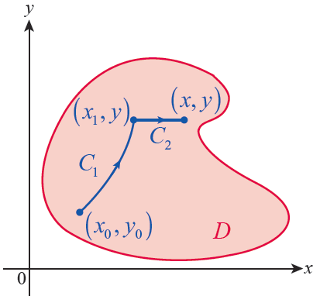
Proof: Path Independence Implies Conservation
Proof (cont.)
Now for a given point (x, y), choose x₁ < x so that the line segment between (x₁, y) and (x, y) lies entirely in D; we know we can do this for
some x₁ sufficiently close to x
because D is open. Let C₁ be a
path in D from (x₀, y₀) to (x₁, y)
and let C₂ be the line segment
from (x₁, y) to (x, y) (see Figure 3).
Figure 3

Slide 25
Proof: Path Independence Implies Conservation
Proof (cont.)
Then by path independence,
The first integral does not depend on x, so
and if we let P and Q be the component functions of F, this can be written as

Slide 26
Proof: Path Independence Implies Conservation
Proof (cont.)
On C₂, y is constant so dy = 0 and we are left with
Again, since y is constant on C₂, we can simply fix its value in the integrand. And to avoid confusion, we use the “dummy” variable u in place of x inside the integral. Then by the Fundamental Theorem of Calculus,

Slide 27
Proof: Path Independence Implies Conservation
Proof (cont.)
In words, the partial derivative of f with respect to x gives us the first component function of F, as desired. A similar argument, using a short vertical line segment from a point (x, y₁) to (x, y), shows that
so together ∇f = F.

Slide 28
Example 3
Let let C₁ be the path from (0, 1) to (1, 0) defined by the function and let C₂ be the path from (0, 1) to (1, 0) defined by the function In the exercises, you will be asked to show that
meaning that F is not a conservative vector field and that the Gradient Theorem cannot be used to evaluate either line integral.

Slide 29
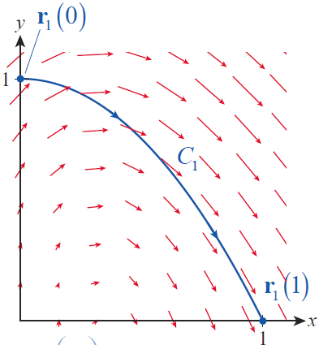
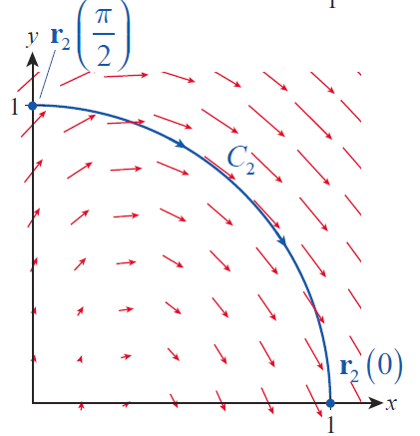
Example 3 (cont.)
Figure 4 is a scaled illustration of F and of the two paths C₁ and C₂.
Figure 4

Slide 30
Theorem: Component Test for Conservative Vector Fields
Component Test for Conservative Vector Fields
Assume D is an open and simply connected region, and that F is a vector field whose components have continuous first partial derivatives. If F is a vector field of two variables, let and if F is a vector field of three variables, let

Slide 31
Theorem: Component Test for Conservative Vector Fields
Component Test for Conservative Vector Fields (cont.)
Then in the two-variable case,
throughout D implies F is conservative;
in the three-variable case,
throughout D implies F is conservative.

Slide 32
Example 4
Show that the vector field in Example 3 is not conservative.
Solution
So F is not conservative by the Component Test.

Slide 33
Example 5
Find a potential function, if one exists, for F.
Solution
As you can verify with the Component Test, the field F is conservative, so a potential function f does exist in theory. To construct one, we begin with the goal. That is, we seek a potential f that satisfies

Slide 34
Example 5 (cont.)
We might call the method of constructing f “partial integration” since we start by integrating
f_{x} = ye^{x} + z cos x with respect to x to obtain
The as-yet-unknown function g(y, z) plays the role of the constant of integration, since any expression in the variables y and z alone is constant with respect to x. We now differentiate our result with respect to y and compare it with our goal, e^{x} − z².

Slide 35
Example 5 (cont.)
So we require and integrating with respect to y results in
giving us Differentiating this last result with respect to z and comparing it to the third component of F yields h′(z) = 0. This means h(z) can be any scalar constant so we may as well let
h(z) = 0. Hence,
is a potential function for F.

Slide 36
Example 6
Determine
where C is a piecewise smooth path from
Solution
The integral can be expressed as where f is
the potential in Example 5, f = ye^{x} + z sin x − yz². Therefore, we have the following.

Slide 37
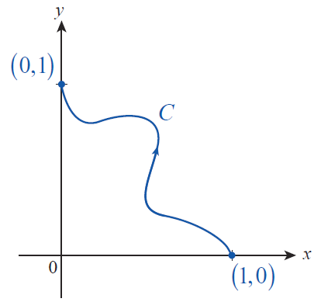
Example 7
Evaluate where C is the path
shown in Figure 6.
Solution
Since
the vector field implicit in this
line integral is conservative
and a potential function f exists.
Figure 6

Slide 38
Example 7 (cont.)
We want
From this, we obtain So we require
or where K is any constant; we will use K = 0. Hence,
and

