Slide 1
Section 15.4
Green’s Theorem

Slide 2
TOPICS
Divergence and curl operators
Green’s Theorem

Slide 3
Divergence and Curl Operators
Notational Note: The del operator ∇ can be interpreted as a vector consisting of partial differentiation operators, with the vector components determined by the context. For instance, if f is a function of two variables, and
when applied to a function g of three variables,

Slide 4
Definition: Divergence (Flux Density) of a Vector Field
Divergence (Flux Density) of a Vector Field
The divergence, or flux density, of a vector field
is the scalar function
For a vector field of three variables,

Slide 5
Definition: Divergence (Flux Density) of a Vector Field
Divergence (Flux Density) of a Vector Field (cont.)
In general, we can denote the divergence of a vector field F as the dot product of the del operator and F.
div F = ∇ ⋅ F

Slide 6
Divergence and Curl Operators
The divergence of a vector field has a physical interpretation that is important in physics and related disciplines. We develop the interpretation for a vector field of two variables, but the idea is valid for any number of variables.
Suppose that represents the velocity field of a fluid flowing in the plane, and (x, y) is the lower-left corner of a rectangle lying entirely in the domain of F. Assume the rectangle has width Δx and height Δy.

Slide 7
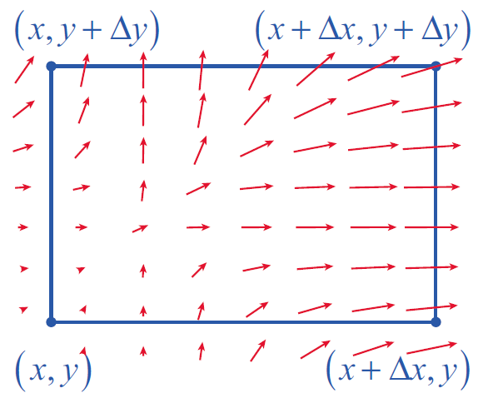
Divergence and Curl Operators
Then the rate at which the fluid leaves the rectangle by flowing across a given boundary of the rectangle is approximated by the dot product of F (evaluated at some point along the
boundary) and the outward
normal vector to the
boundary, times the length
of the boundary (see Figure 1).
Figure 1

Slide 8
Divergence and Curl Operators
For instance, since −j is the outward normal vector for the bottom of the rectangle, the flow rate of the fluid across the bottom is approximately
(if more fluid is entering than leaving the rectangle across a given boundary, the dot product is negative). In all, the rates at which the fluid flows outward across the four edges of the rectangle are as follows.

Slide 9
Divergence and Curl Operators

Slide 10
Divergence and Curl Operators
Combining opposite edges of the rectangle, note that
so the total net flow rate of the fluid out of the rectangle is approximately

Slide 11
Divergence and Curl Operators
When we divide the flow (or flux) rate by the area ΔxΔy of the rectangle we obtain the total flow per unit area, which we have defined as the divergence or flux density of the fluid.

Slide 12
Example 1
Suppose that
represents the velocity field of a gas. Calculate the divergence of F at the points (1, 2, −1), (0, 4, 1), and
(1, 6, 1) and interpret the results.
Solution

Slide 13
Example 1 (cont.)
The fact that means the gas is expanding at (1, 2, −1) the fact that
means the gas is condensing (or is being compressed) at (0, 4, 1) and the fact that div F(1, 6, 1) = 0 means the volume of gas flowing toward the point (1, 6, 1) is the same as the volume of gas flowing away.

Slide 14
Definition: Curl of a Vector Field
Curl of a Vector Field
The curl of a vector field
is the vector function
The curl of a vector field F can be remembered as the cross product of the del operator and F.
curl F = ∇ × F

Slide 15
Divergence and Curl Operators
In order to compare curl with divergence, we develop the physical interpretation of ∇ × F for a field F(x, y).
Accordingly, suppose again represents the velocity field of a fluid in the plane, and that (x, y) is the lower-left corner of a rectangle lying entirely in the domain of F. We first extend F as

Slide 16
Divergence and Curl Operators
This time, we are interested in quantifying the counterclockwise circulation of F around the rectangle, instead of the flow of F out of the rectangle (the counterclockwise, or positive, orientation around a closed curve is used to maintain consistency with the right-hand rule).

Slide 17
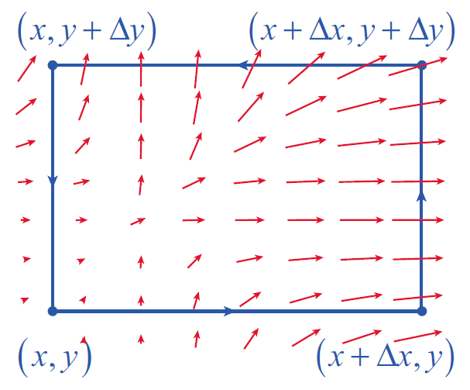
Divergence and Curl Operators
To do so, we calculate the dot product of F with the vector associated with each edge of the rectangle (see Figure 2); a positive result indicates F is flowing in the direction of the edge, while a
negative result means the
flow of F is opposite the
orientation of the edge.
Figure 2

Slide 18
Divergence and Curl Operators
This gives us the following rates of flow.

Slide 19
Divergence and Curl Operators
This time, when we combine the results for opposite sides, we obtain
and adding them together we have a total circulation (in the counterclockwise direction) around the rectangle of approximately

Slide 20
Divergence and Curl Operators
As with divergence, we divide by the area ΔxΔy of the rectangle to obtain what is sometimes called the circulation density of F. It constitutes the component of curl F in the k direction. This means for a vector field in the plane,

Slide 21
Example 2
Find the curl of the vector field in the plane.
Solution
The calculation itself is easily accomplished.

Slide 22
Example 2 (cont.)

Slide 23
Example 2 (cont.)
The physical interpretation of this result is worth our attention. If F models the velocity field for a fluid in the plane, such as water flowing toward a drain over the flat bottom of a sink, then the curl of F at any given point tells us something about the forces felt by a very small paddle wheel with axis in the k direction (see Figure 3).

Slide 24
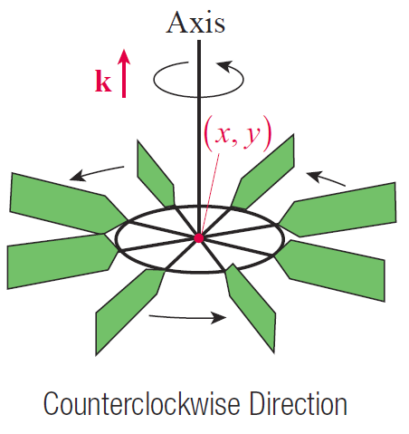
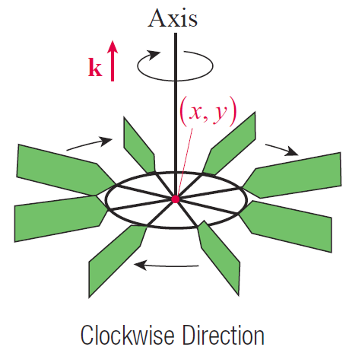
Example 2 (cont.)
Figure 3

Slide 25
Example 2 (cont.)
If curl F(x, y) = ck, with c > 0, the paddle wheel at (x, y) spins in the positive (counterclockwise) direction; if
curl F(x, y) = ck, with c < 0, the wheel spins in the opposite direction. And if curl F(x, y) = 0, the wheel doesn’t spin at all, though that doesn’t mean that there are no forces at the point (x, y)—a paddle wheel at such a point may feel a force pushing it, but not spinning it.

Slide 26
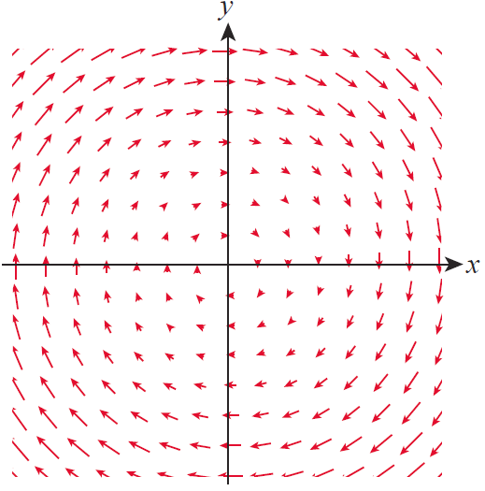
Example 2 (cont.)
Figure 4 is a scaled illustration
of the velocity field
Since we
know the curl of F is −2k at
every point, a small paddle
wheel at any point in the
plane spins in the clockwise
direction (at the same rate)
as a result of the field.
Figure 4

Slide 27
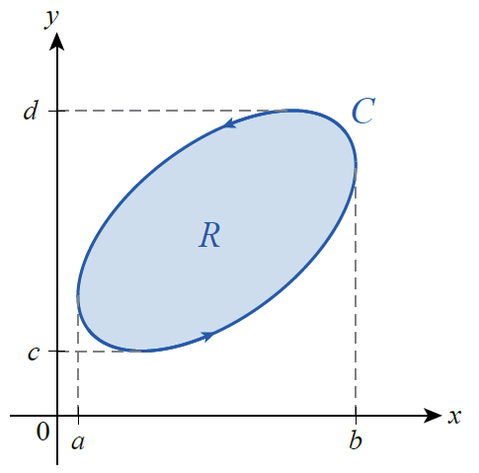
Green’s Theorem
Green’s Theorem relates line integrals around a closed path to double integrals over the region enclosed by the path.
The principle at the heart of
Green’s Theorem is most
evident if we first apply it to a
simple closed path C such as in
Figure 5, where every line
parallel to a coordinate axis
intersects C in at most two
points.
Figure 5

Slide 28
Green’s Theorem
We develop the theorem under the assumption that the orientation of C is positive, which we denote with a counterclockwise circle on the integral sign, such as ∳,
and we let R denote the region enclosed by C. To use Green’s Theorem in evaluating the line integral of a vector field around C, we assume that F has continuous first partial derivatives on an open region containing R.

Slide 29
Green’s Theorem
We already know that the total circulation of F around C can be written as
and we now examine the two integrals
∳_{C} Pdx and ∳_{C} Qdy individually.
∳_{C}
∳_{C}
∳_{C}

Slide 30
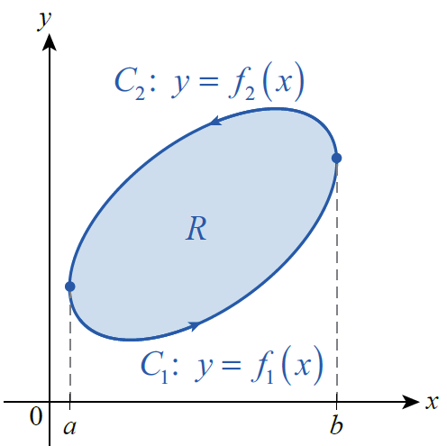
Green’s Theorem
∳_{C}
Claim 1: To prove this, split C into
the two functions of x
illustrated in Figure 6, and note
that by the Fundamental
Theorem of Calculus
Figure 6

Slide 31
Green’s Theorem
so
∳_{C}

Slide 32
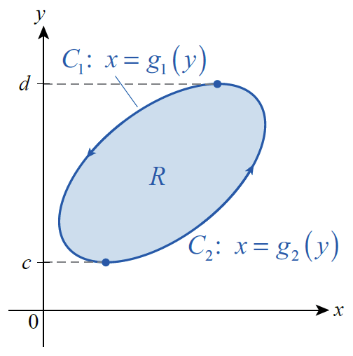
Green’s Theorem
∳_{C}
Claim 2: We prove this in a similar
fashion, but this time by
splitting C into the two
functions of y illustrated in
Figure 7. Then again by the
Fundamental Theorem of
Calculus,
Figure 7

Slide 33
Green’s Theorem
so
∳_{C}

Slide 34
Green’s Theorem
Combining the two pieces gives us one form of Green’s Theorem:
∳_{C}

Slide 35
Example 3
∳_{C}
Evaluate where C is
the circle x² + y² = 25.
Solution
Since
the vector field implicit in the integral is not conservative and the Fundamental Theorem for Line Integrals can’t be used.

Slide 36
Example 3 (cont.)
However, using Green’s Theorem,
∳_{C}

Slide 37
Example 3 (cont.)
This example demonstrates how Green’s Theorem can be used to easily evaluate integrals which would be extremely difficult to evaluate directly using a parametrization of C.

Slide 38
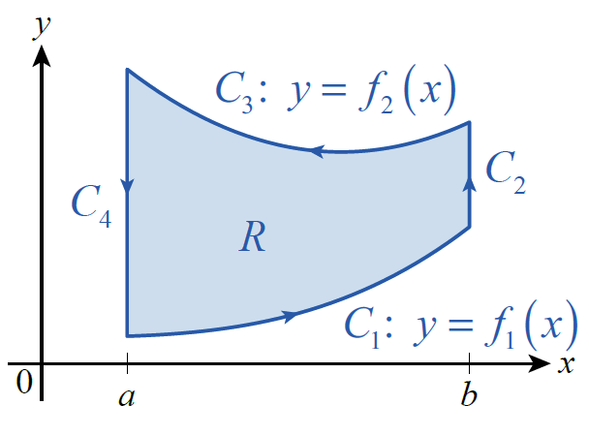
Green’s Theorem
To see how the theorem applies to more general simple closed paths, consider the region R and closed path
C = C₁ ∪ C₂ ∪ C₃ ∪ C₄ of Figure 8. Suppose C₁ and C₃ represent the graphs of
functions f₁(x) and f₂(x),
respectively. Note that x is
constant on C₂ and C₄, so dx = 0
along both sides.
Figure 8

Slide 39
Green’s Theorem
∳_{C}

Slide 40
Green’s Theorem
To see that
for the path C of Figure 8, we have to modify the argument slightly, as shown next.
∳_{C}

Slide 41
Green’s Theorem
Although we proved Green’s Theorem for a simply connected region bounded by a particularly nice simple closed path, the properties of line integrals and double integrals allow us to extend the theorem to regions and paths that are finite unions of simpler regions and paths.

Slide 42
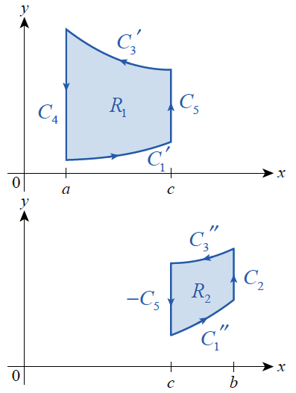
Green’s Theorem
For example, we can divide the
region R of Figure 8 into
R₁ ∪ R₂ , with boundaries as
labeled in Figure 9.
Figure 8
Figure 9

Slide 43
Green’s Theorem
We use the facts that
and
to obtain

Slide 44
Green’s Theorem
∳_{C}

Slide 45
Theorem: Green’s Theorem (Tangential-Curl Form)
Green’s Theorem (Tangential-Curl Form)
Let C be a positively oriented, piecewise smooth, simple closed curve in the plane, and let R be the region enclosed by C. If and P and Q have continuous partial derivatives on an open region containing R, then
∳_{C}
∳_{C}
∳_{C}

Slide 46
Theorem: Green’s Theorem (Tangential-Curl Form)
Green’s Theorem (Tangential-Curl Form) (cont.)
Extending F to and using the fact that
we can write this version of the formula as
∳_{C}

Slide 47
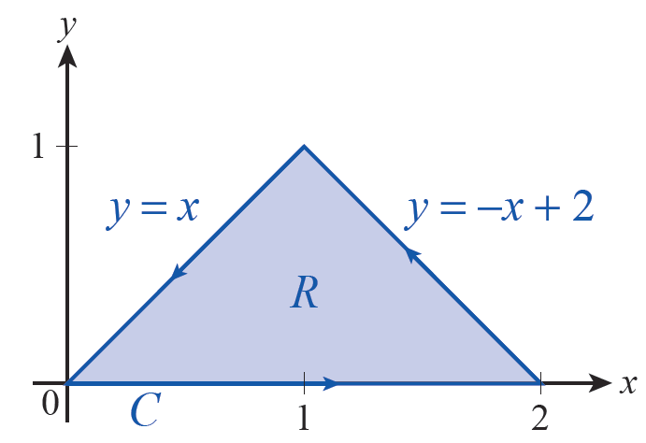
Example 4
∳_{C}
Evaluate where C is the path shown
in Figure 10.
Solution
Since P = y² and Q = 3xy,
(Alternatively, and
Figure 10

Slide 48
Example 4 (cont.)
So
∳_{C}

Slide 49
Example 4 (cont.)
Remember what the result in Example 4 means physically: if F represents the velocity field of a fluid in the plane, the total circulation of F around C is

Slide 50
Green’s Theorem
In other settings, we need to calculate the flux of F outward across the boundary of a simple closed path, and Green’s Theorem can be used for that purpose as well.
If we let n denote the unit vector normal to C at any given point of the path, then we have the following:
This is the counterpart to the integral for the circulation of F around C.
∳_{C}
∳_{C}

Slide 51
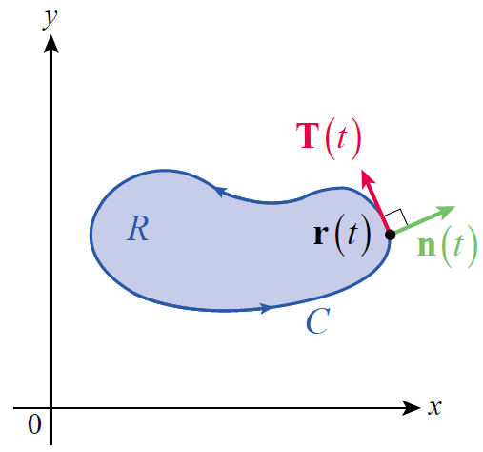
Green’s Theorem
We can now develop the second version of Green’s Theorem from the first. Since
the outward normal unit vector
n is the vector function
(see Figure 11).
Figure 11

Slide 52
Green’s Theorem
So we have
∳_{C}

Slide 53
Theorem: Green’s Theorem (Normal-Divergence Form)
Green’s Theorem (Normal-Divergence Form)
Let C be a positively oriented, piecewise smooth, simple closed curve in the plane, and let R be the region enclosed by C. If and P and Q have continuous partial derivatives on an open region containing R, then
∳_{C}
∳_{C}

Slide 54
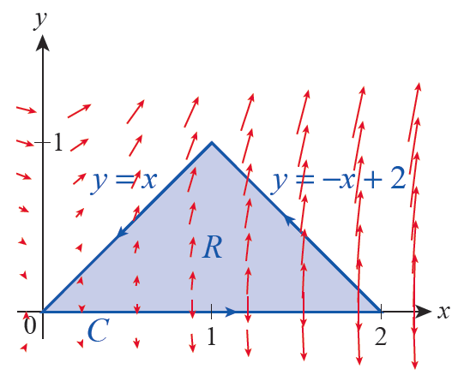
Example 5
Evaluate the outward flux of the vector field
across the path C of Figure 12.
Figure 12

Slide 55
Example 5 (cont.)
Solution
Since P = y² and Q = 3xy,
∳_{C}

Slide 56
Example 5 (cont.)
The vector field F is also shown
in Figure 12. The flux into and
out of the enclosed region
along the lower edge of C is 0
(since y = 0), and the flux is
positive (outward) along the
other two edges, consistent
with the result we have
calculated for total flux.
Figure 12

Slide 57
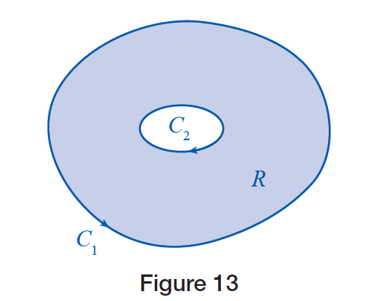
Green’s Theorem
The fact that two line integrals cancel if they are evaluated along the same path with opposite
orientation means that we can decompose even nonsimply connected regions and apply
Green’s Theorem, as long as the
boundary paths are oriented
appropriately. Consider, for
example, the region R of
Figure 13.

Slide 58
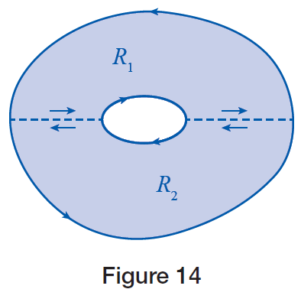
Green’s Theorem
Its boundary C consists of two simple closed curves C₁ and C₂, which we orient so that R is always on the left as we traverse either curve.
If we divide R into two subregions
R₁ and R₂ , as shown in Figure 14, the
additive properties of area and line
integrals (along with Green’s Theorem)
again allow us to state

Slide 59
Green’s Theorem

Slide 60
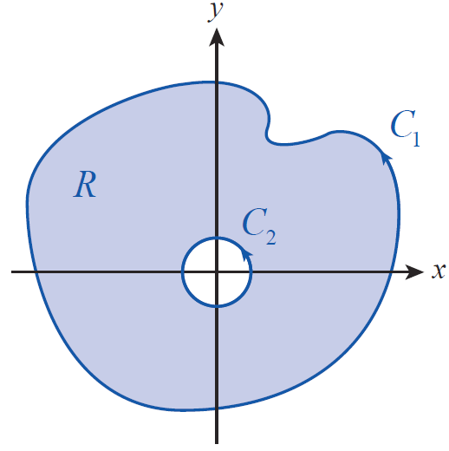
Example 6
∳_{C1}
∳_{C2}
Let Show that for
C₁ and C₂ as shown in Figure 15.
Figure 15

Slide 61
Example 6 (cont.)
Solution
Both C₁ and C₂ are oriented counterclockwise, but if we define the region R as being bounded by
then R is to the left as we traverse any part of its boundary, so

Slide 62
Example 6 (cont.)
Hence,
which is equivalent to
It can be shown that this implies
for every such simple closed path C enclosing the origin.
∳_{C1}
∳_{C2}
∳_{C}

