Slide 1
Section 15.5
Parametric Surfaces and Surface Area

Slide 2
TOPICS
Parametric surfaces
Surface area

Slide 3
Parametric Surfaces
Just as curves are objects describable with a single parameter, surfaces are, in general, objects describable with two parameters. We can do so in a very literal fashion with a vector function of the form where the parameters s and t are allowed to take on values in a prescribed parameter region. For the purposes of comparison, the elliptic paraboloid shown in Figure 1 can be defined in the following ways:

Slide 4
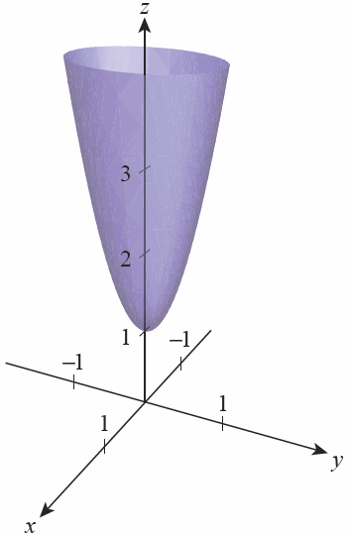
Parametric Surfaces
Explicit form
Implicit form
Parametric form
s ∈ℝ , t ∈ℝ
Figure 1

Slide 5
Parametric Surfaces
Other approaches to defining surfaces also imply two degrees of freedom (that is, two independent parameters). For instance, using cylindrical coordinates, the surface of Figure 1 can be described parametrically as

Slide 6
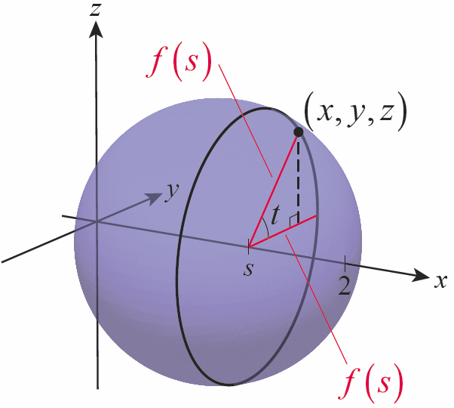
Example 1
Let S denote the surface formed by revolving the graph of 0 ≤ x ≤ 2, about the x-axis. Describe the surface with a vector function of two parameters.
Solution
If we let x = s, then the y- and z-components of the surface for any fixed s are and as shown in Figure 2.
Figure 2

Slide 7
Example 1 (cont.)
We allow s to take on any value from 0 to 2, while the parameter t represents any possible angle between 0 and 2π, so S is described by
Since this implies
another way of describing S is with the equation

Slide 8
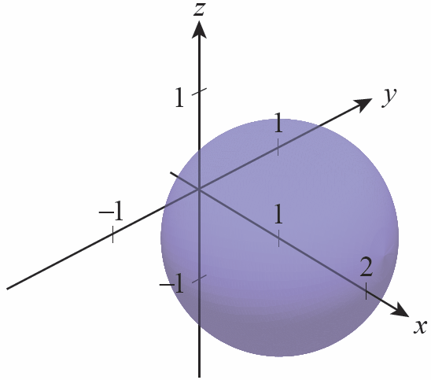
Example 1 (cont.)
Any of these approaches generates the surface shown in Figure 3.
Figure 3

Slide 9
Example 2
In spherical coordinates, the equation ρ = 3 corresponds to the sphere of radius 3 centered at the origin. Describe this surface with a vector function of two parameters.
Solution
The simplest way to do this is to convert spherical coordinates to Cartesian and use θ and φ as the parameters, as shown.

Slide 10
Parametric Surfaces
Given a surface S described parametrically by r(s, t), grid curves on S are curves along which either s or t is held constant. Grid curves are useful in visualizing a surface and, as we will see, in defining tangent planes for a surface.

Slide 11
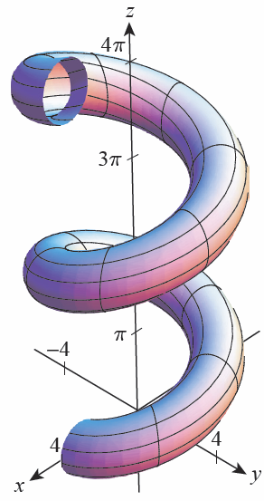
Example 3
The surface
where 0 ≤ s ≤ 4π and 0 ≤ t ≤ 2π, is shown in Figure 4. Holding s constant, say s = k, results in the family of curves
each of which is a circular cross- section of the surface.
Figure 4

Slide 12
Example 3 (cont.)
For instance,
is the circle of radius 1 in the xz-plane centered at (3, 0, 0) and
is the circle of radius 1 in the yz-plane centered at
Figure 4

Slide 13
Example 3 (cont.)
Holding t constant results in the other family of grid curves of the form
each of which is a helix on the surface.
Figure 4

Slide 14
Example 4
Let S be the plane containing the point (0, 0, 1) and grid lines whose direction vectors are and Describe S with a vector function of two parameters.
Solution
Every point on S is the terminal point of a position vector of the form
for some s and some t, so r describes S.

Slide 15
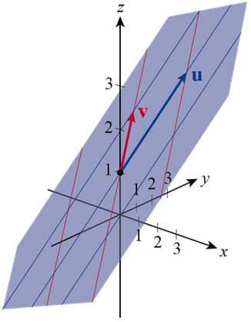
Example 4 (cont.)
Sample grid lines of S in the direction of u and v are shown in Figure 5. The vector u is shown in blue and the vector v in red, both with initial point (0, 0, 1).
Figure 5

Slide 16
Surface Area
We can use the grid curves of a surface S to describe the plane tangent to S at a given point a key step in our more general definition of surface area. Keeping the parameter t constant with t = t₀, the line in space tangent to one grid curve at has direction vector similarly, keeping s fixed at s = s₀, the line tangent to the other grid curve at the point has direction vector

Slide 17
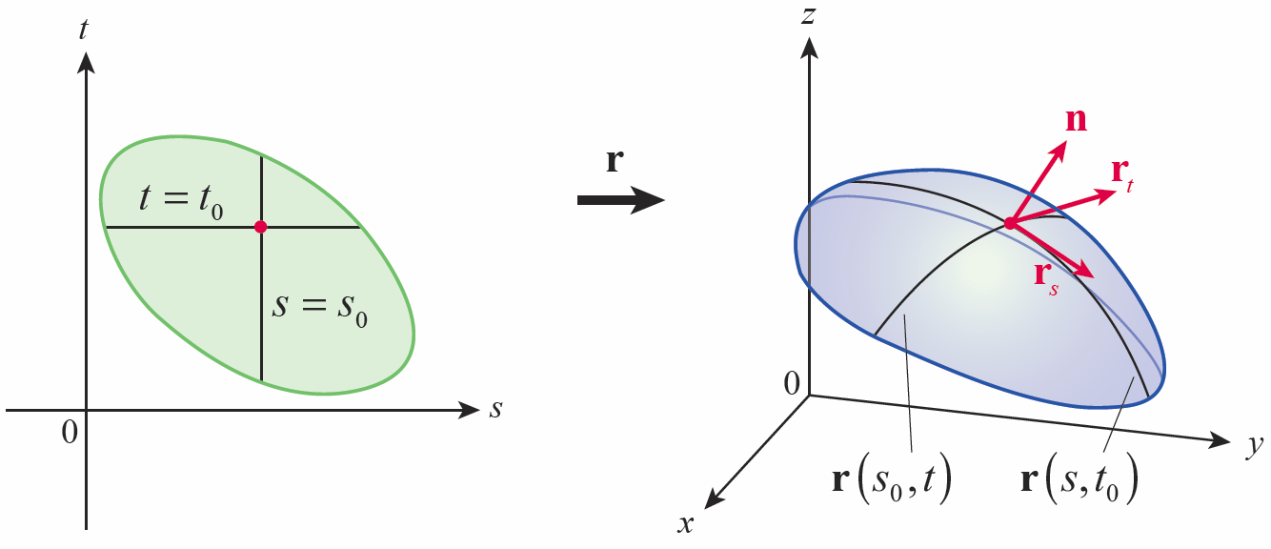
Surface Area
Since n = r_{s} × r_{t} is normal to both grid curves, we can use n to define the tangent plane to S at as long as r_{s} × r_{t} ≠ 0.
Figure 6

Slide 18
Surface Area
We say that S is smooth at if r_{s} and r_{t} are continuous at and so we now know how to construct the tangent plane to a surface r(s, t) at every point of smoothness.

Slide 19
Example 5
Construct an equation for the plane tangent to the parametric surface at the point r(1, 1).
Solution
We have and so

Slide 20
Example 5 (cont.)
Thus, is normal to the tangent plane when s = 1 and t = 1, and since we have the following equation for the plane.
Alternatively, since and the tangent plane can be described parametrically with the vector function

Slide 21
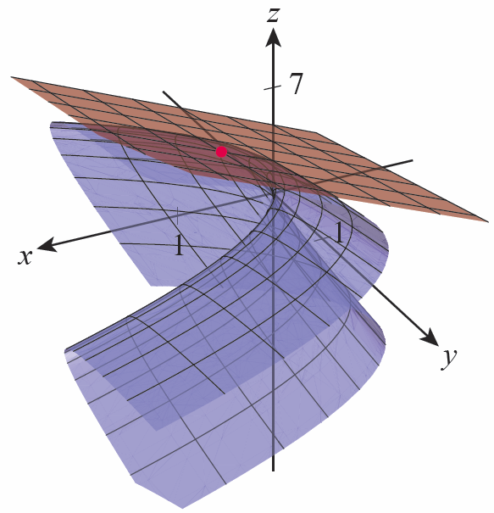
Example 5 (cont.)
An illustration of the surface (in blue) and the plane tangent at the point r(1, 1) (in red) is shown in Figure 7.
Figure 7

Slide 22
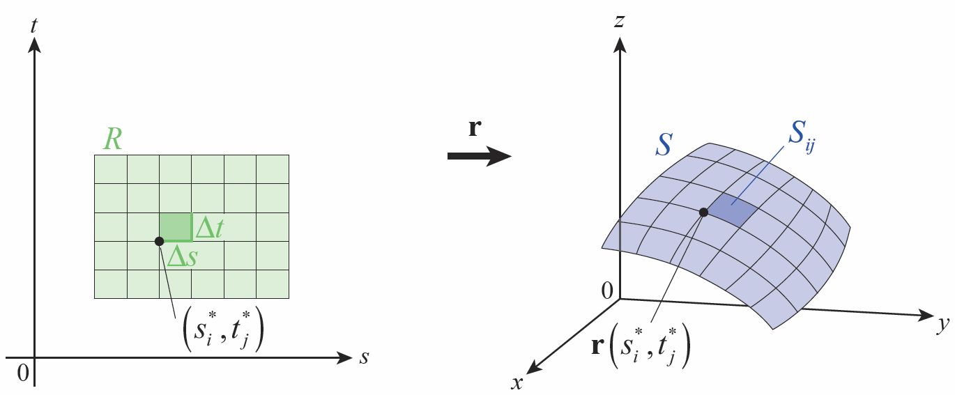
Surface Area
To determine the area of a surface S defined by the vector function over a region R of the st-plane, we divide R into an array of rectangles as shown in Figure 8 and add up the areas of the corresponding subdivisions of S.
Figure 8

Slide 23
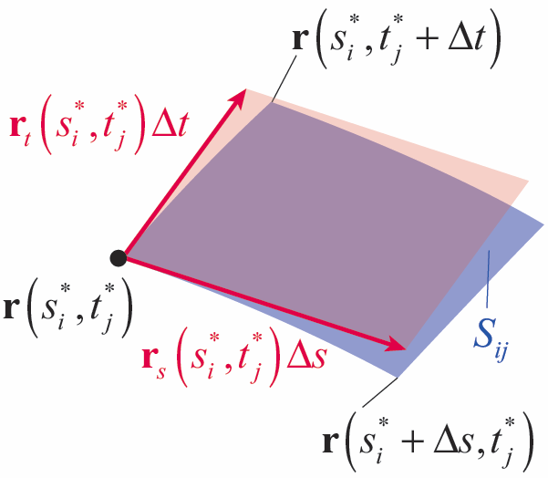
Surface Area
Let be the lower-left corner of the highlighted rectangle in the st-plane, and consider the highlighted subdivision is approximated by a parallelogram in the plane tangent to S at the point as shown in Figure 9.
Figure 9

Slide 24
Surface Area
The vectors defining the parallelogram are approximately
and
so the area of is approximately and hence the total area of S is approximately

Slide 25
Surface Area
We use the limit of this Riemann sum as the definition of the area of a parametrically defined surface.

Slide 26
Definition: Area of a Parametric Surface
Area of a Parametric Surface
Given the surface S defined by a smooth vector function the surface area A(S) of S is

Slide 27
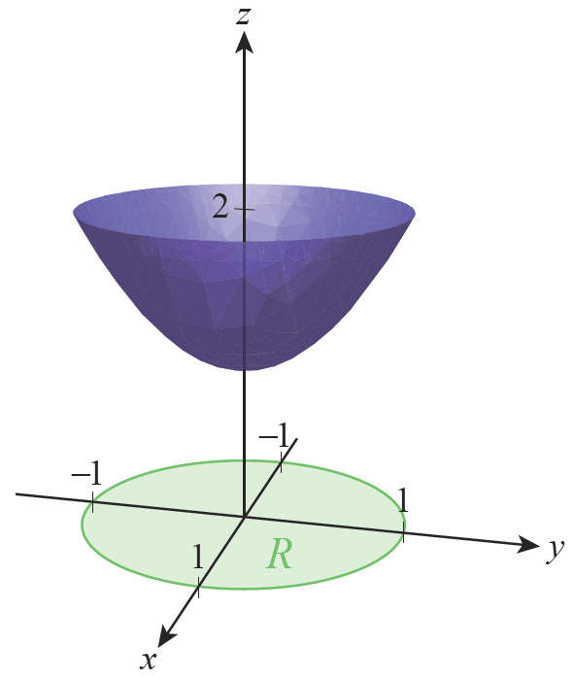
Example 6
Find the area of the surface defined by the function over the region s²+ t² ≤ 1.
Solution
The vector function r traces out the paraboloid shown in Figure 10 over the circular region R defined by s² + t² ≤ 1 (note that this is also the region x² + y² ≤ 1 in the xy-plane, since x = s and y = t in the definition of r).
Figure 10

Slide 28
Example 6 (cont.)
Since and
so and

Slide 29
Example 6 (cont.)
This double integral is easier to evaluate if we convert to polar coordinates by letting s = r cos 𝜃 and t = r sin 𝜃.

Slide 30
Example 7
Derive the formula for the surface area of a sphere of radius r using the parametric surface area definition.
Solution
We begin with a vector function describing the surface, based on our work from Example 2.
Given r,

Slide 31
Example 7 (cont.)
so
and hence, after simplifying, This gives us a surface area of

Slide 32
Formula: Surface Area of the Graph of the Function z = f(x, y)
Surface Area of the Graph of the Function z = f(x, y)
Given a surface S defined by z = f(x, y), where (x, y) ∈ R, the surface area of S is

Slide 33
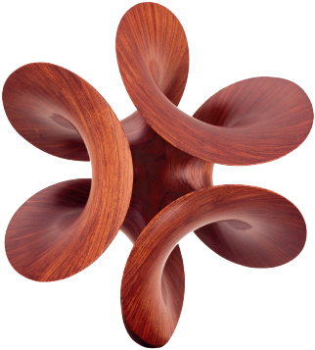
Technology Note
Technology Note
The sculpture shown is a piece entitled Arabesque XXIX by the American artist Robert Longhurst (b. 1949). The sculpture depicts an Enneper surface; it has the property of being a minimal surface, and each point on the surface is a saddle point. The boundary of the surface is the curve defined parametrically by

Slide 34
Technology Note
Technology Note (cont.)

Slide 35
Technology Note
Technology Note (cont.)
with r having the constant value of 1.38. The surface itself is defined by the same parametric formulas, allowing r to take on values over the interval [0, 1.38] and θ to take on values over the interval [0, 2π ]. The Mathematica command ParametricPlot3D can be used to graph both the boundary and the surface as shown in Figure 11.

Slide 36
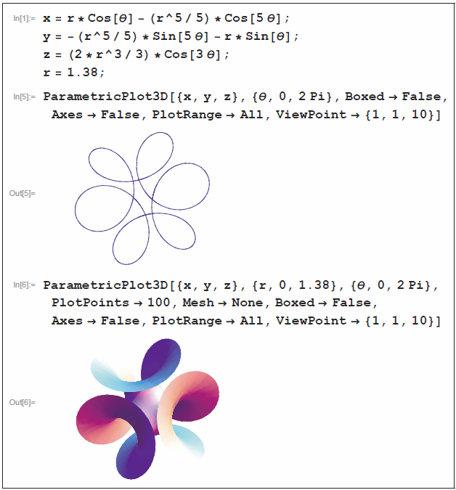
Technology Note
Technology Note (cont.)
Figure 11

