Slide 1
Section 15.6
Surface Integrals

Slide 2
TOPICS
Surface integrals of scalar functions
Orientable surfaces
3. Surface integrals of vector fields

Slide 3
Definition: Surface Integral of a Scalar Function
Surface Integral of a Scalar Function
Given the surface S defined over a region R by a smooth vector function and a continuous function f defined on S, the surface integral of f over S is

Slide 4
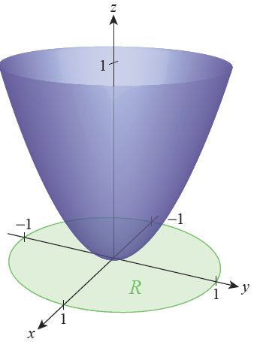
Example 1
Let represent the mass density of the surface S defined by over the region s² + t² ≤ 1. Determine the mass M of S.
Solution
The surface S is the paraboloid of Figure 2, defined over the region R consisting of the disk x² + y² ≤ 1 in the xy-plane (we can equate the xy-plane with the st-plane since x = s and y = t).
Figure 2

Slide 5
Example 1 (cont.)
The calculation of proceeds as usual yielding
Note that Putting the pieces together, the mass of S is

Slide 6
Example 1 (cont.)
The substitution u = 1 + 4r² can be used to evaluate the last integral (note that as you may verify in Exercise 1, leading to

Slide 7
Example 2
Find the center of mass of the surface in Example 1.
Solution
By symmetry, we know that the x- and y-coordinates of the center of mass must be and To determine the z-coordinate, we use the formula where, M_{xy} represents the first moment of the object about the xy-plane.

Slide 8
Example 2 (cont.)
Expressing this integral in terms of s and t we have
which, upon changing to polar coordinates, gives us

Slide 9
Example 2 (cont.)
You may verify in Exercise 2 that the substitution u = 1 + 4r² again allows us to evaluate the integral, and that

Slide 10
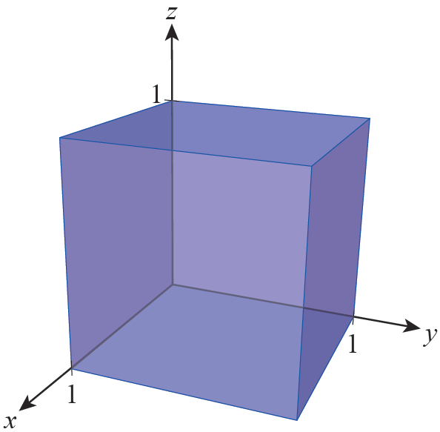
Example 3
Evaluate the integral of the function over the surface of the cube of side length 1 shown in Figure 3.
Solution
Since f = 0 on the three faces of the cube lying on the coordinate planes (where x = 0, y = 0, or z = 0), we know that the integral of f along those three faces is 0 with no need for further calculation.
Figure 3

Slide 11
Example 3 (cont.)
Along the remaining three faces of the cube, we must actually do some work. We demonstrate the procedure for the face that appears in front in Figure 3.
The front face of the cube can be described by the vector function
It follows that

Slide 12
Example 3 (cont.)
and hence We have on the face, so
Similarly, the integral of f along the remaining two faces is also so

Slide 13
Orientable Surfaces
Just as we need to know the orientation of a curve when evaluating the line integral of a vector field, we need to know the orientation of a surface in order to define and evaluate the surface integral of a vector field. The first step is to realize that some surfaces are not orientable, meaning they are not two-sided.

Slide 14
Orientable Surfaces
Surfaces that are orientable are those for which it is possible to define a unit normal vector n at every point in such a way that n varies continuously along the surface. If a surface is orientable, there are two choices for the vector field of normal vectors: those pointing in one direction away from the surface, and those pointing in the opposite direction. We call our choice for any given surface the positive orientation; for surfaces that are closed, meaning those that enclose a solid region of space, the convention is to let the positive direction for n be the outward-pointing direction.

Slide 15
Orientable Surfaces
If a surface S is described by a vector function r(s, t), then r_{s} × r_{t} is a field of vectors normal to S at any given point. We can use this fact to define a field of unit normal vectors by simply multiplying each vector by the reciprocal of its length
If we don’t want to use this result as our choice for the positive orientation of S, we simply use - n instead.

Slide 16
Example 4
Recall that the vector function
describes the sphere of radius r centered at the origin We have already computed to be
and noted that

Slide 17
Example 4 (cont.)
So
This vector field of unit normal vectors points radially inward toward the origin at every point of the sphere, which by convention we call the negative orientation. So the positively oriented field of unit normal vectors is

Slide 18
Surface Integrals of Vector Fields
We can now define the surface integral of a vector field. If S is an oriented surface, say with normal vector field n, then
gives us the flux of the continuous vector field F across S—that is, the total flow of F perpendicularly through S in the direction of positive orientation. If S is described by a vector function r(s, t) over a region R, and if we choose to let then

Slide 19
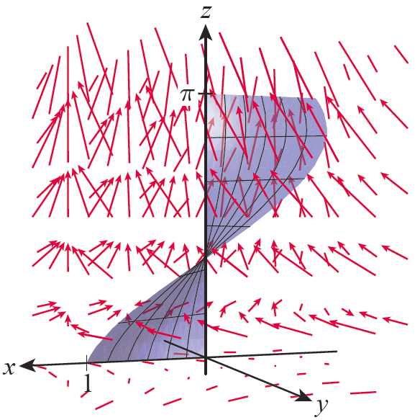
Example 5
Evaluate the flux of the vector field across the helicoid surface S defined by
with
Solution
Figure 5 is an illustration of S and the vector field F.
Figure 5

Slide 20
Example 5 (cont.)
As we will soon see, the vector field n consists of unit normal vectors pointing in a generally upward direction and, for all points above the xy-plane, the vectors of F also point generally upward, so we expect the flux of F across S to be positive.
The first step is to calculate r_{s} × r_{t} .

Slide 21
Example 5 (cont.)
We don’t need to actually compute n in order to evaluate the flux, but since 0 ≤ s ≤ 1, each element of r_{s} × r_{t} has a positive z-component, so the same must be true for each corresponding element of n (that is, the vectors normal to S point generally upward).
We next determine that

Slide 22
Example 5 (cont.)
and hence

Slide 23
Surface Integrals of Vector Fields
Fourier’s Law of Heat Conduction states that the heat flow through a substance is proportional to the negative gradient of the temperature of the substance. So if f(x, y, z) indicates the temperature of a substance at the point (x, y, z), the heat flow F is the vector field

Slide 24
Surface Integrals of Vector Fields
where κ is a constant called the thermal conductivity of the substance. The amount of heat transferred per unit time across a surface S in the substance is then the integral

Slide 25
Example 6
Suppose that represents the temperature, in degrees Celsius, of a ball of radius 1 centered at the origin (so the temperature at the center of the ball is 25 °C, and the temperature at its very outer surface is 24 °C). If S is defined as the collection of points a distance r from the center, find the flow of heat per unit time across the surface S.
Solution
Note that

Slide 26
Example 6 (cont.)
where κ is the thermal conductivity constant for the substance of the ball. From Example 4, we know that the outward unit normal vector n at the point (x, y, z) on the surface x² + y² + z² = r² is
so on S,

Slide 27
Example 6 (cont.)
Hence, the flow of heat per unit time across S is

