Slide 1
Section 15.7
Stokes’ Theorem

Slide 2
TOPICS
Circulation, curl, and Stokes’ Theorem
Consequences of Stokes’ Theorem

Slide 3
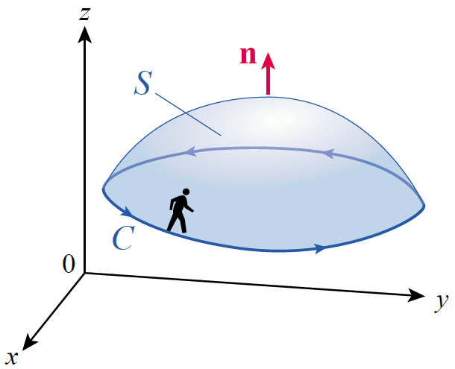
Circulation, Curl, and Stokes’ Theorem
To begin, assume that C is a simple, closed, piecewise smooth curve and that S is a piecewise smooth surface whose boundary is C, as in Figure 1. Assume also that S and C are oriented in such a way that if you were to walk around C in its direction of
orientation, with your head pointing
in the direction n normal to S, then
the surface S would lie to your left—
we call this the positive orientation
of C relative to S.
Figure 1

Slide 4
Circulation, Curl, and Stokes’ Theorem
Let F be a vector field with continuous partial derivatives on an open region containing S. Then the circulation of F around C is the line integral
where T is the unit vector tangent to C.
∳_{C}

Slide 5
Circulation, Curl, and Stokes’ Theorem
Recall that the curl of F is the vector field ∇ × F. We evaluated double integrals of the z-component of the curl, ∇ × F ⋅ k, over regions enclosed by curves;
Stokes’ Theorem extends the Tangential-Curl Form of Green’s Theorem to the more general surfaces we will consider now.

Slide 6
Theorem: Stokes’ Theorem
Stokes’ Theorem
Assume F is a vector field with continuous partial derivatives in an open region of space containing a piecewise smooth surface S. Assume that the boundary of S is a simple, closed, piecewise smooth curve C, and that C is positively oriented with respect to S. Then
∳_{C}

Slide 7
Theorem: Stokes’ Theorem
Stokes’ Theorem (cont.)
Note: If S is a region in the xy-plane, then n = k and Stokes’ Theorem reduces to one of the two forms of Green’s Theorem:
∳_{C}

Slide 8
Example 1
Verify Stokes’ Theorem for the vector field and the surface S defined as the portion of the sphere x² + y² + z² = 9 for which z ≥ 0.
Solution
Note that the boundary C of S is the circle x² + y² = 9 in the xy-plane. Since S is half of a sphere, and the convention is to define the normal vectors for closed surfaces to be outward-pointing, we will assume the vector field n of unit vectors normal to S also points outward.

Slide 9
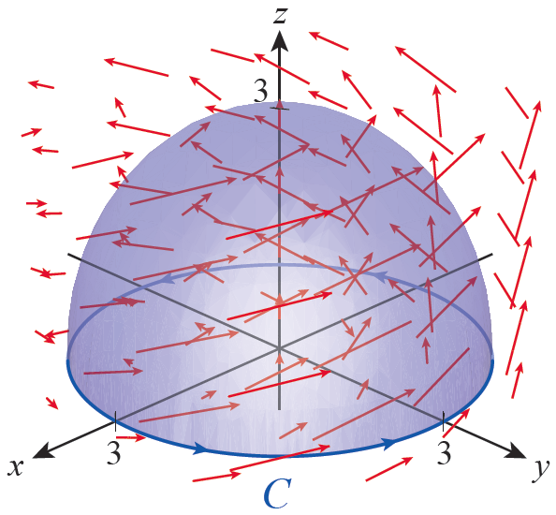
Example 1 (cont.)
This automatically assigns a counterclockwise (when viewed from above) direction as the orientation of C, as shown in Figure 2. (Stokes’ Theorem would also be verified if we chose inward-pointing
normal vectors and a clockwise
orientation for C, but each
integral would be the negative
of what we find below.)
Figure 2

Slide 10
Example 1 (cont.)
Figure 2 also shows a scaled illustration of the vector field F. Given that the elements of F point generally in the same direction as C, we expect the circulation of F around C to be positive. To
evaluate the line integral, we
can use the parametrization
with
0 ≤ θ ≤ 2π.
Figure 2

Slide 11
Example 1 (cont.)
Then
and
so
∳_{C}
∳_{C}

Slide 12
Example 1 (cont.)
To evaluate the surface integral, we first find
To now determine ∇× F ⋅ n, recall that if we parametrize S by
then so

Slide 13
Example 1 (cont.)
And to calculate the surface integral, we also need the fact that
so

Slide 14
Circulation, Curl, and Stokes’ Theorem
As Example 1 illustrates, one of the integrals in Stokes’ Theorem (in this case, the line integral) may be easier to evaluate than the other; that fact can often be used to simplify a calculation. Another fact emerges if we study the example a bit more closely: if S₁ and S₂ are any two piecewise smooth oriented surfaces with the same oriented boundary C, then
∳_{C}

Slide 15
Circulation, Curl, and Stokes’ Theorem
In such a case, S₁ and S₂ are called capping surfaces of the curve C, and Stokes’ Theorem says that the circulation of a vector field around a simple closed curve is equal to the integral of its curl over any appropriate capping surface.

Slide 16
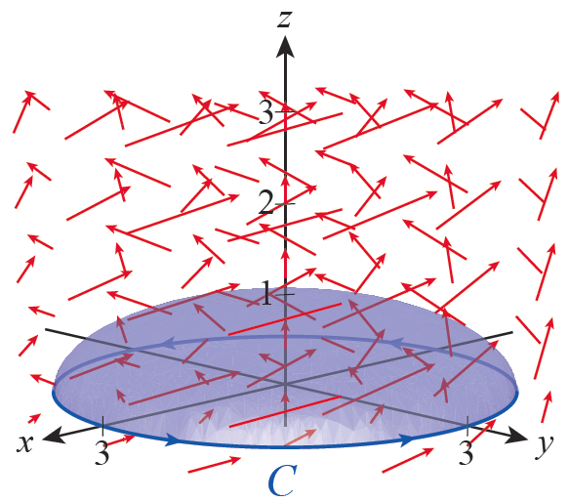
Example 2
Let be the upper half of the ellipsoid
oriented with an outward-pointing unit normal vector field n. Note that the boundary of
is also the curve x² + y² = 9 in
the xy-plane (see Figure 3). Show
that the integral of the curl of is again 18π.
Figure 3

Slide 17
Example 2 (cont.)
Solution
For comparative and illustrative purposes, we use a different parametrization for
It can be shown that

Slide 18
Example 2 (cont.)
r_{x} × r_{y} is an outward-pointing vector field, so dividing each element by its length defines the vector field n of unit normal vectors. But we don’t actually need to perform that calculation, since

Slide 19
Consequences of Stokes’ Theorem
Stokes’ Theorem is used extensively in physics and engineering, and some of the fundamental laws of physics are direct applications of Stokes’ Theorem (and many others arise from the Divergence Theorem). For example, the Maxwell-Faraday Law of Induction regarding electric field lines of force E over a surface S can be expressed as
∳_{C}

Slide 20
Consequences of Stokes’ Theorem
Stokes’ Theorem also leads to a quick physical interpretation of curl. Given a vector field F and its curl ∇× F, imagine evaluating the integral
over various (small) disks S all centered at a fixed point P in space. The orientation of S that maximizes the integral will clearly be that for which n points in the same direction as ∇× F.

Slide 21
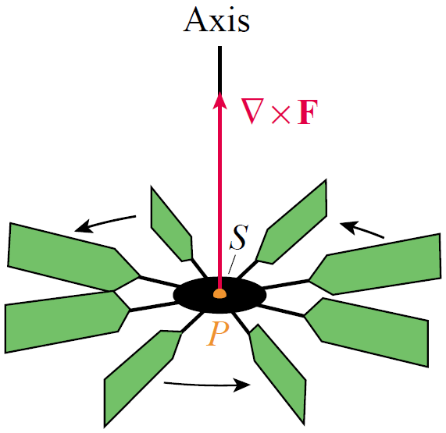
Consequences of Stokes’ Theorem
In other words, if we think of a paddle wheel spinning about an axis running through P, the wheel will spin fastest when the axis points in the direction of ∇× F (see Figure 5).
Figure 5

Slide 22
Consequences of Stokes’ Theorem
Stokes’ Theorem can be used to prove the Component Test for conservative vector fields, which we restate here in terms of the curl operator.

Slide 23
Theorem: ∇× F = 0 Implies F Is
Conservative
Implies F Is Conservative
If ∇× F = 0 at every point of an open simply connected region D of space, then for any piecewise smooth closed path C in D,
and hence F is conservative in D.
∳_{C}

