Slide 1
Section 15.8
The Divergence Theorem

Slide 2
TOPICS
The Divergence Theorem
The Fundamental Theorem of Calculus in review

Slide 3
The Divergence Theorem
Recall the Normal-Divergence Form of Green’s Theorem: given a vector field F defined on an open region containing R ⊆ ℝ², whose boundary is a positively oriented piecewise smooth simple closed curve C,
∳_{C}

Slide 4
The Divergence Theorem
In words, the total outward flux of F across C is equal to the integral of the divergence of F over the region bounded by C. This is often informally stated with a phrase like the net flow of a vector field out of a region is equal to the sum of the sources and sinks of the field in the region. In this context, a source of F is a point where its divergence ∇ ⋅ F is positive, and a sink is a point where ∇ ⋅ F is negative.

Slide 5
The Divergence Theorem
This principle holds true in any number of dimensions, and its statement in three dimensions is known as the Divergence Theorem. While the theorem applies to a variety of regions, a complete classification of them would lead us too far astray from the task of introducing the topic. For our purposes, we are interested in regions that are simple or that can be decomposed into a union of a finite number of simple regions. A simple region D in space, as illustrated in Figure 1, is one that can be described in each of the following ways:

Slide 6
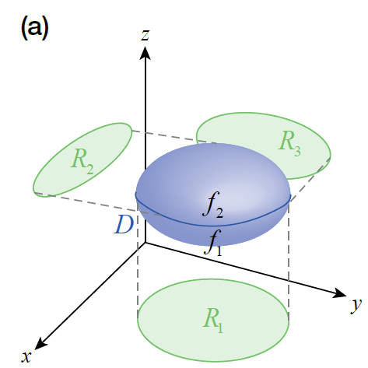
The Divergence Theorem
Figure 1a

Slide 7
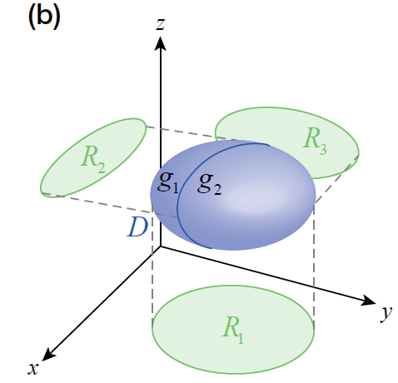
The Divergence Theorem
Figure 1b

Slide 8
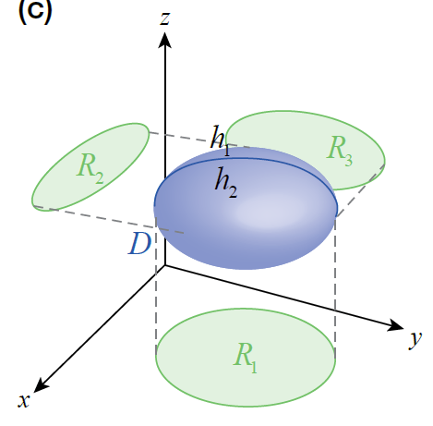
The Divergence Theorem
where the bounding surfaces are all smooth.
Figure 1c

Slide 9
Theorem: The Divergence Theorem
The Divergence Theorem
Assume F is a vector field with continuous partial derivatives in an open region of space containing D ⊆ ℝ³, and assume D is either a simple region or a finite union of simple regions. Let S denote the surface of D, and let n be the outward-pointing field of unit vectors normal to S. Then

Slide 10
Theorem: The Divergence Theorem
Proof
We prove the theorem under the assumption that D is a single simple region.
If we denote the component functions of F as then the dot product of F with the unit vector field n normal to the surface S is
and so

Slide 11
Theorem: The Divergence Theorem
Proof (cont.)
Similarly,
and the theorem will be proved if we can show that the corresponding terms in the two expressions above are equal. We will demonstrate the process by showing that

Slide 12
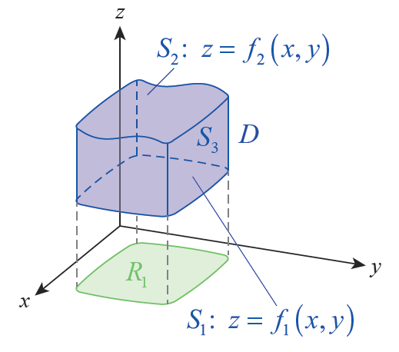
Theorem: The Divergence Theorem
Proof (cont.)
With this goal in mind, let R₁ be the projection of D in the xy-plane and assume the lower surface S₁ and upper surface S₂ of S are the graphs of z = f₁(x, y), and z = f₂(x, y), respectively, as shown in Figure 2.
Figure 2

Slide 13
Theorem: The Divergence Theorem
Proof (cont.)
The lower and upper surfaces may or may not coincide at any given point (x, y) ∈ R₁; in Figure 2, they are shown separated by some distance, so the third surface S₃ of S is part of a right cylinder perpendicular to the xy-plane. Note that k ⋅ n is therefore 0 on S₃ (since n is perpendicular to k throughout S₃), so

Slide 14
Theorem: The Divergence Theorem
Proof (cont.)
On S₁ and S₂, we need to know something about n so we can evaluate k ⋅ n dσ. Toward this, note that we can parametrize S₂ with the vector function and then that

Slide 15
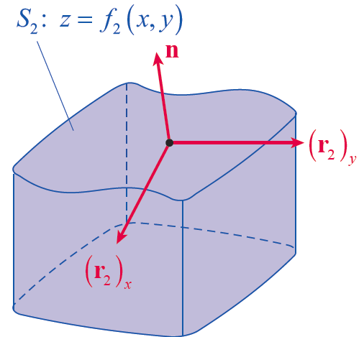
Theorem: The Divergence Theorem
Proof (cont.)
is outwardly normal to S₂—remember to use the right-hand rule in visualizing the direction of the cross product, as shown in Figure 3.
Figure 3

Slide 16
Theorem: The Divergence Theorem
Proof (cont.)
So
and hence

Slide 17
Theorem: The Divergence Theorem
Proof (cont.)
Similarly, we can parametrize S₁ with but this time, in order to construct an outwardly pointing vector, we have to form the cross product

Slide 18
Theorem: The Divergence Theorem
Proof (cont.)
The effect of this is that k ⋅ n dσ = −dA on S₁, so we are led to
and hence

Slide 19
Theorem: The Divergence Theorem
Proof (cont.)
We are nearing the end of the argument. By the Fundamental Theorem of Calculus,
so the two integrals are equal:

Slide 20
Theorem: The Divergence Theorem
Proof (cont.)
By the same sort of reasoning,
and the Divergence Theorem is thus proved for a single simple region. The fact that the theorem is also true for a finite union of simple regions follows from properties of integrals, including the fact that two surface integrals with opposite orientations over the same surface cancel one another.

Slide 21
Example 1
Find the flux of the vector field over the surface of
a. the sphere x² + y² + z² = r²;
b. the cube [0, a]³.

Slide 22
Example 1 (cont.)
Solution
a. Instead of calculating directly, we use the Divergence Theorem.

Slide 23
Example 1 (cont.)
b. The reduction in effort is even more pronounced with this region, since evaluating the surface integral directly would involve calculating a surface integral over each of the six sides. But using the Divergence Theorem,

Slide 24
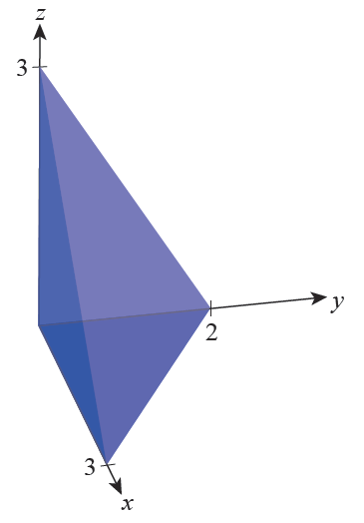
Example 2
Find the flux of the vector field
over the surface of the solid bounded by the coordinate planes and the plane 2x + 3y + 2z = 6 (see Figure 4).
Figure 4

Slide 25
Example 2 (cont.)
Solution
To calculate the flux directly would require evaluating four rather complicated surface integrals, but the volume integral of the divergence of F is a routine calculation. First,

Slide 26
Example 2 (cont.)
Omitting some of the intermediate simplifications, this gives us

Slide 27
The Fundamental Theorem of Calculus in Review
Table 1: The Fundamental Theorem of Calculus in Review
Fundamental Theorem of Calculus
Fundamental Theorem for Line Integrals
Tangential-Curl Form of Green’s Theorem
Normal-Divergence Form of Green’s Theorem
∳_{C}
∳_{C}

Slide 28
The Fundamental Theorem of Calculus in Review
Table 1: The Fundamental Theorem of Calculus in Review (cont.)
Stokes’ Theorem
Divergence Theorem
∳_{C}

