Slide 1
Section 2.1
Rates of Change and Tangents

Slide 2
TOPICS
The Velocity Problem
The Tangent Problem

Slide 3
The Velocity Problem
The simple relationship distance = rate x time, or d = rt can be used to find the average rate, r, for an object moving distance d over time t. However, this formula is limited in scope because we are often discussing rates that are not constant like velocity or speed. To make the distinction between average rate and velocity we sometimes use the term instantaneous velocity to represent the velocity at that instant.

Slide 4
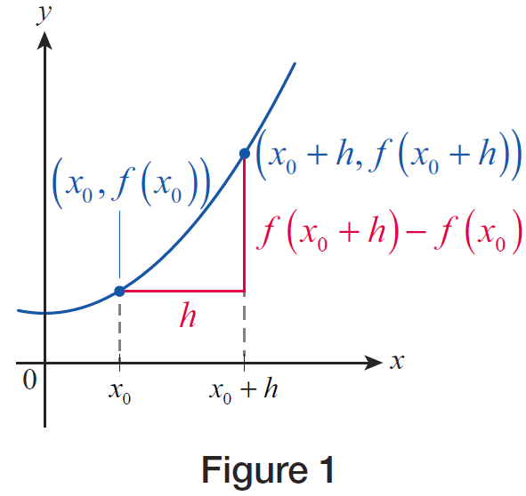
Formula: Difference Quotient
Formula
At this time, it will be convenient to introduce some more terms and notation. Given a real-valued function f defined at a point x₀,
the difference quotient of
f at x₀ with increment h
is the following ratio.
Figure 1

Slide 5
The Velocity Problem
Note that if f represents a distance function as previously described, this ratio corresponds to the average rate of travel over an interval containing x₀, with x₀ serving as either the left endpoint (if h is positive) or the right endpoint (if h is negative).

Slide 6
The Velocity Problem
More generally, if x₀ is contained in the interval [a, b], the ratio
corresponds to the average rate of travel over the interval and also serves as an approximation to the instantaneous velocity at x₀. You have probably seen the symbol Δ before: it is the Greek letter delta and is used to designate a change in the quantity that follows it.

Slide 7
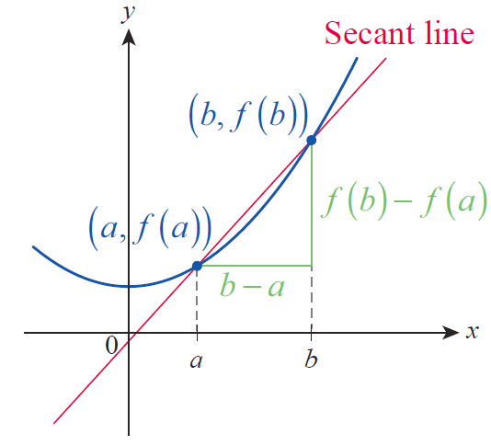
The Velocity Problem
The previous ratio is read “change in f over change in x” and can be interpreted as the slope of the line (known as the secant line) shown in Figure 2.
Figure 2

Slide 8
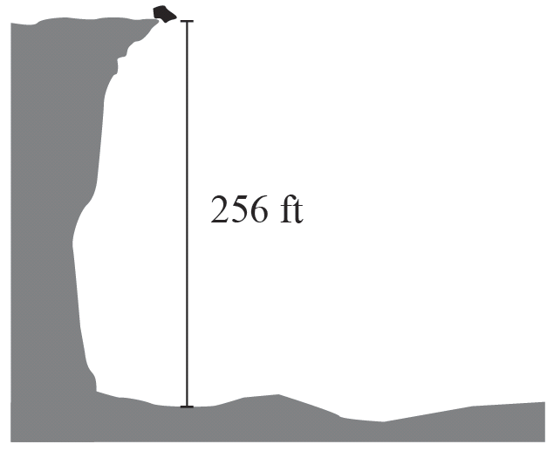
Example 1
A piece of rock falls into a 256-foot-deep canyon from its rim. If we ignore air resistance, its distance below the rim at time t is
where d is measured in feet and t is measured in seconds. Estimate a. the instantaneous velocity of the rock after 2 seconds and b. the velocity of impact.
Figure 3

Slide 9
Example 1 (cont.)
Solution
a. We will start by calculating the average velocity of the rock from t = 2 to t = 3. Note that the elapsed time is Δt = 3 − 2 = 1, while the distance traveled is Δd = d(3) – d(2), so we can set up the following difference quotient to calculate the desired average velocity over the interval [2, 3].

Slide 10
Example 1a (cont.)
However, this is not expected to be an accurate reflection of the instantaneous velocity at t = 2, since the rock is accelerating significantly between t = 2 and t = 3. We obtain a more accurate guess if we work over a much shorter time interval, say the one from t = 2 to t = 2.1.

Slide 11
Example 1a (cont.)
This is a much better guess, but there is no need to stop here. The following table summarizes the average velocities over time intervals of decreasing lengths, all the way down to a length of 0.01 seconds.

Slide 12
Example 1a (cont.)
Time interval | Average velocity Δd/Δt
[2, 2.09] | 65.44
[2, 2.08] | 65.28
[2, 2.07] | 65.12
[2, 2.06] | 64.96
[2, 2.05] | 64.80
[2, 2.04] | 64.64
[2, 2.03] | 64.48
[2, 2.02] | 64.32
[2, 2.01] | 64.16

Slide 13
Example 1a (cont.)
Since the velocity numbers in the table seem to be approaching 64 ft/s as the intervals are becoming shorter, we might guess that number to be the instantaneous velocity of the rock at t = 2. Notice also that in the above table, 2 serves as the left endpoint of all of the intervals. Intuitively, we expect the same instantaneous velocity to be obtained if t = 2 were the right endpoint, or if it were in the interior of each interval, as long as the interval’s length is decreasing and approaching 0. In our next table, we chose t = 2 to be the right endpoint of each time interval.

Slide 14
Example 1a (cont.)
Time interval | Average velocity Δd/Δt
[1.91, 2] | 62.56
[1.92, 2] | 62.72
[1.93, 2] | 62.88
[1.94, 2] | 63.04
[1.95, 2] | 63.20
[1.96, 2] | 63.36
[1.97, 2] | 63.52
[1.98, 2] | 63.68
[1.99, 2] | 63.84

Slide 15
Example 1a (cont.)
Notice that the average velocities here are all less than in the first table, but are increasing as the time interval is getting shorter, “shrinking” onto the point t = 2. This is precisely what should be expected because of the steady acceleration of the rock. In conclusion, both tables support our guess that the rock’s instantaneous velocity at t = 2 is 64 ft/s downward. As a final confirmation, let us calculate the difference quotient over the very short interval [1.999, 2].

Slide 16
Example 1 (cont.)
b. To estimate the velocity of impact, we first need to find when exactly impact occurs. Being in possession of the position function and knowing that at impact the position of the rock is exactly the depth of 256 feet, we can find the time of impact by solving
which gives us t = 4, since we can safely discard the negative root of t = −4.

Slide 17
Example 1b (cont.)
To find the velocity of impact, we use the same strategy as in part a. but this time using t = 4 as the right endpoint of our intervals for our difference quotients. The table below summarizes our calculations.

Slide 18
Example 1b (cont.)
Time interval | Average velocity Δd/Δt
[3.91, 4] | 126.56
[3.92, 4] | 126.72
[3.93, 4] | 126.88
[3.94, 4] | 127.04
[3.95, 4] | 127.20
[3.96, 4] | 127.36
[3.97, 4] | 127.52
[3.98, 4] | 127.68
[3.99, 4] | 127.84

Slide 19
Example 1b (cont.)
As before, we examine the table and conclude that the velocity of impact is approximately 128 ft/s (you may want to further confirm our finding by calculating difference quotients over even shorter time intervals).

Slide 20
Example 2
Daniela lives just a few miles down a straight stretch of highway from her college campus. One morning she left for class, and her position relative to her house was given by the function
where d is measured in miles, t in hours, with t = 0 corresponding to the time when she left her house. Use difference quotients to estimate her instantaneous velocity a. 3 minutes after she left, b. 6 minutes after she left, and c. 7.5 minutes after she left.

Slide 21
Example 2 (cont.)
From your calculations, can you guess what might have happened?
Solution
a. Just like in Example 1, we will evaluate difference quotients over shorter and shorter time intervals, each using t = 3 minutes as the left endpoint. In this example, however, we will denote the length of a time interval by h, and call it an increment.

Slide 22
Example 2a (cont.)
With this notation, and by noting that 3 minutes = 0.05 hours, a typical difference quotient becomes the following.
For example, consider the average velocity on the time interval starting at 3 minutes into the drive and lasting for h = 0.6 minutes = 0.01 hours.

Slide 23
Example 2a (cont.)
We will get a better approximation of the instantaneous velocity at t = 3 minutes if we shorten the time intervals over which we calculate the average velocities. The following table summarizes our calculations over several intervals of decreasing length.
So we conclude that at exactly three minutes into the trip, Daniela was driving at approximately 60 mph.
h | 0.01 | 0.005 | 0.001 | 0.0005 | 0.0001
v_{ave} | 57.24 | 58.81 | 59.79 | 59.90 | 59.98

Slide 24
Example 2 (cont.)
b. Next, we will estimate the instantaneous velocity at t = 6 minutes = 0.1 hours. This time, however, we will use negative increments when setting up the difference quotients. For example, with h = −0.03, we obtain

Slide 25
Example 2b (cont.)
Interestingly, it appears from the above calculation that Daniela is slowing down considerably. In search of the instantaneous velocity, we shorten the time intervals and summarize our calculations in the following table.
From the table we must conclude that Daniela slowed down and stopped, for the instantaneous velocity at t = 6 minutes appears to be 0. Did she stop due to a traffic jam, or did she turn back? Our next calculation has the answer.
h | −0.03 | −0.01 | −0.001 | −0.0005 | −0.0001
v_{ave} | 22.92 | 7.96 | 0.80 | 0.40 | 0.08

Slide 26
Example 2 (cont.)
c. If we evaluate several difference quotients with decreasing increments, using t = 7.5 minutes = 0.125 hours as the left endpoint, using the now‑familiar formula
we obtain the following table.
h | 0.01 | 0.005 | 0.001 | 0.0005 | 0.0001
v_{ave} | −43.56 | −40.65 | −38.15 | −37.82 | −37.56

Slide 27
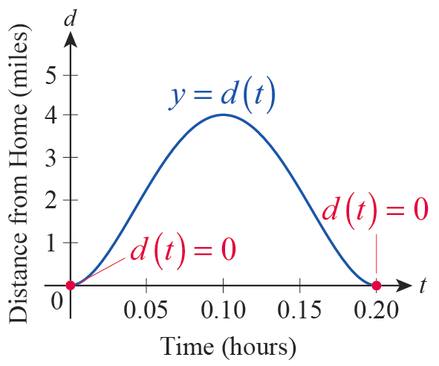
Example 2c (cont.)
We estimate the instantaneous velocity at t = 7.5 minutes to be −37.5 mph. The negative sign indicates
that the direction changed, so Daniela is actually driving back toward her house. (She might have left something at home.) In fact, the graph of the position function is quite revealing, so we show it in Figure 4.
Figure 4

Slide 28
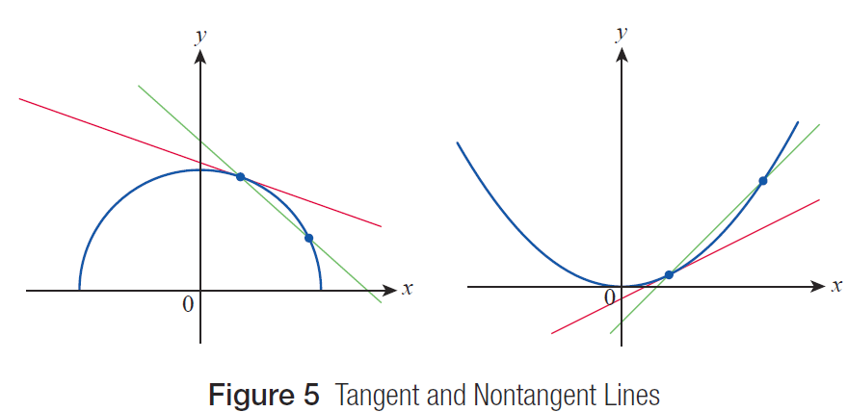
The Tangent Problem
Figure 5 Tangent and Nontangent Lines

Slide 29
The Tangent Problem
In mathematics, a line is tangent to a curve if it “just touches” the curve. It is not always clear how to construct the line tangent to a curve at a given point. We might be led to the idea that a tangent line should represent the relative rise or fall of the curve at a particular point—in other words, the tangent line should have the same “slope” or trend as the curve at that point. With this interpretation, it’s clear that sometimes a tangent line will intersect the curve at more than one point, and that sometimes it is not possible for a unique line to capture the trend at all.

Slide 30
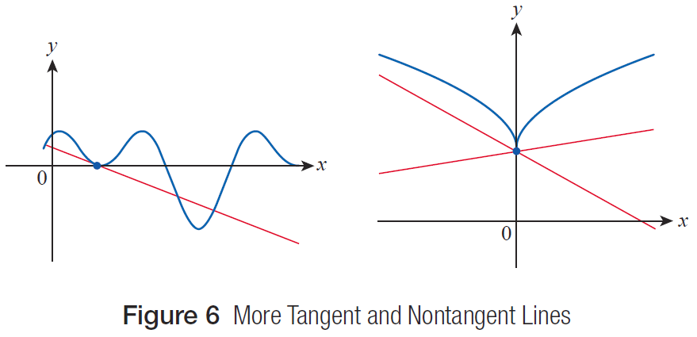
The Tangent Problem
Figure 6 illustrates these possibilities.
Figure 6 More Tangent and Nontangent Lines

Slide 31
The Tangent Problem
To set the stage, let’s assume that we have a function f for which we want to construct the tangent line at
x = x₀, that is, at the point on the graph of f .

Slide 32
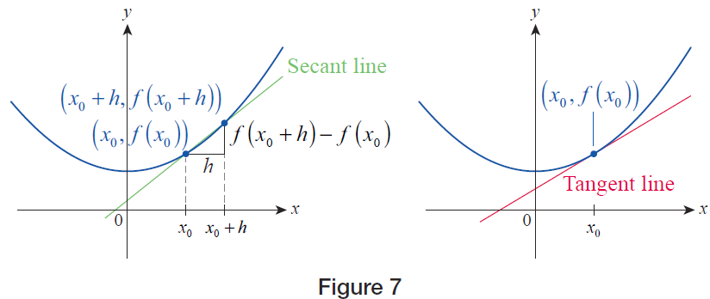
The Tangent Problem
Figure 7

Slide 33
The Tangent Problem
The connection between the tangent problem and the velocity problem is now clear, as we have just constructed a difference quotient again. In the first, we seek the instantaneous rate of change of the position of an object, and we label the result “velocity.” In the second, we seek the rate of change of the graph of a function at a particular point, and we interpret the result as the slope of the line tangent to the graph at that point.

Slide 34
Example 3
Construct difference quotients to approximate the slope of the line tangent to the graph of
f(x) = 0.2x³ −1.8x² + 3.6x at the point (1, 2).
Solution
Note that in this problem, x₀ = 1. Just as in Examples 1 and 2, we will construct difference quotients using several h-values that are decreasing in magnitude.

Slide 35
Example 3 (cont.)
To start off, letting h = 1 we obtain the following.

Slide 36
Example 3 (cont.)
This means that −0.4 is the slope of the secant line corresponding to h = 1. However, given that x₀ = 1, our choice of h = 1 means that the x‑coordinate of the “slightly removed” point in this case is x = 2, which is a rather big step away from x₀, so we don’t yet expect the above slope to reflect the trend of the graph in any meaningful way.

Slide 37
Example 3 (cont.)
Let us check what happens if h = 0.5.

Slide 38
Example 3 (cont.)
This shows us that the associated secant line is now nearly horizontal, and its slope went from negative to positive. Decreasing h even further, we evaluate several more difference quotients, and the following table displays our results.
h | 0.3 | 0.1 | 0.05 | 0.01 | 0.001
m_{sec} | 0.258 | 0.482 | 0.5405 | 0.58802 | 0.59880

Slide 39
Example 3 (cont.)
In the second row of the above table, the slope of the secant associated with each corresponding h‑value is denoted by m_{sec} , and we conclude that the slope of the actual tangent line approaches m = 0.6. (Later we will learn how to confirm that it actually is equal to 0.6.)

Slide 40
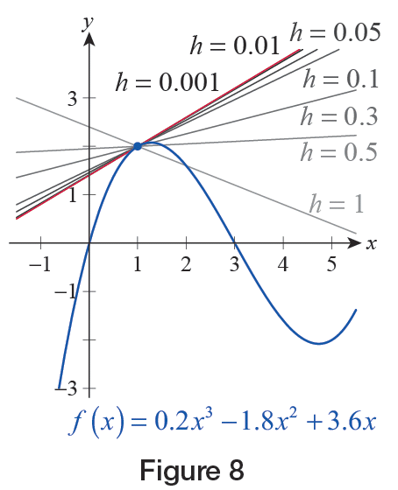
Example 3 (cont.)
Figure 8 shows the graph of f(x) and the calculated secant lines, as well as the predicted tangent. Note how the secant lines move closer and closer to the tangent as h decreases. Also, the secant line corresponding to h = 0.001 is virtually indistinguishable from the tangent line shown in red.
Figure 8

Slide 41
Example 4
Show that the slope of a tangent line of the absolute value function A(x) = |x| at (0, 0) can’t be inferred from a table of difference quotients.
Solution
In this example, x₀ = 0, so using the formula for the difference quotient with, say, h = 0.5 we obtain the following.

Slide 42
Example 4 (cont.)
On the other hand, if h is negative, say h = −0.5, the difference quotient is as follows.

Slide 43
Example 4 (cont.)
In fact, if we construct a table like before, but this time alternating between positive and negative h‑values, something curious happens.
First of all, it seems that ±1 are the only possible values for the slope of the secant, and second, it seems to be +1 when h > 0 and −1 when h < 0. Notice that this is an observation we can prove fairly easily.
h | 0.1 | −0.1 | 0.05 | −0.05 | 0.01 | −0.01
m_{sec} | 1 | −1 | 1 | −1 | 1 | −1

Slide 44
Example 4 (cont.)
If h > 0, since in this case |h| = h, the difference quotient becomes
regardless of the value of h. On the other hand, if h < 0, then |h| = −h, so
and again, h can be any negative real number.

Slide 45
Example 4 (cont.)
Notice that our results indicate that any secant line corresponding to a positive h‑value will coincide with the right branch of the graph, while all secant lines obtained from h < 0 coincide with the left branch.
What does all this mean? There is no single real number being approached by the difference quotients or slopes as h is getting smaller. Graphically, this means that there is no tangent, no single line that would “best capture” the trend of the graph, none that would best align itself to the graph of A(x) at (0, 0).

Slide 46
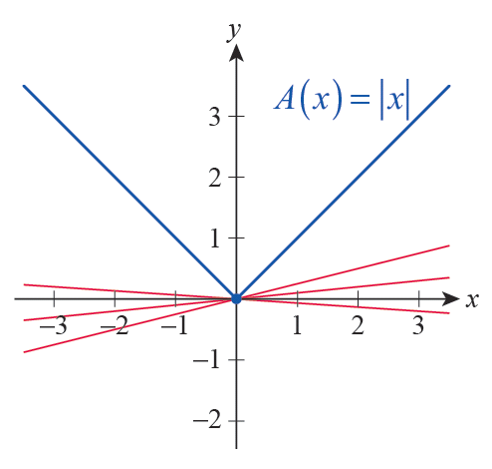
Example 4 (cont.)
The graph has a “sharp turn” there, making it impossible for a tangent line to exist, as shown in Figure 9. We also express this fact by saying that the graph is not “smooth” at x = 0.
Figure 9

Slide 47
The Tangent Problem
We might summarize the underlying idea in both the velocity and tangent line problems as follows: The true value of the quantity we seek can be approximated to any desired degree of accuracy through the use of smaller and smaller increments. Perhaps it won’t come as a surprise that the same technique can be used in a wide variety of settings, not just for velocity and the slope of a tangent.

Slide 48
Example 5
Consider the graph of the function on the interval [0, 1]. By successively dividing [0, 1] into smaller and smaller subintervals, estimate
a. the area of the region R between the curve and the x‑axis from x = 0 to x =1, and
b. the arc length s of the segment of the graph connecting the points (0, 0) and (1, 1).
Solution
a. First, we divide [0, 1] into four subintervals of equal width, by considering [0, 0.25], [0.25, 0.5], [0.5, 0.75], and [0.75, 1], respectively.

Slide 49
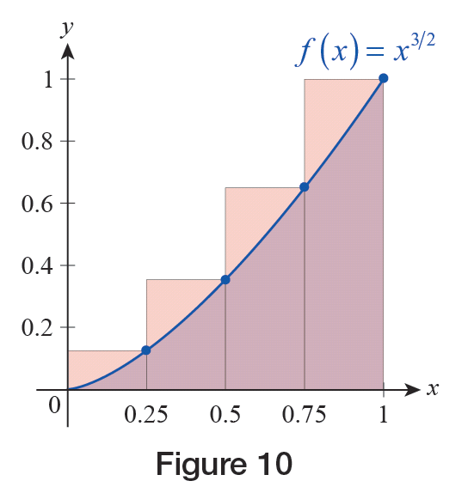
Example 5a (cont.)
Then we create rectangles of width 0.25 on top of each interval, using the function value at the right endpoint to serve as the height, as shown in Figure 10. Then we simply add up the four areas to serve as our first approximation for the area under the curve.
Figure 10

Slide 50
Example 5a (cont.)

Slide 51
Example 5a (cont.)
As is evident from our illustration in Figure 10, this calculation is overestimating the actual area of the region, since the union of the four rectangles completely covers R with lots to spare, but we can produce better estimates if we use more and more rectangles by dividing [0, 1] into more and more subintervals.
Figure 10

Slide 52
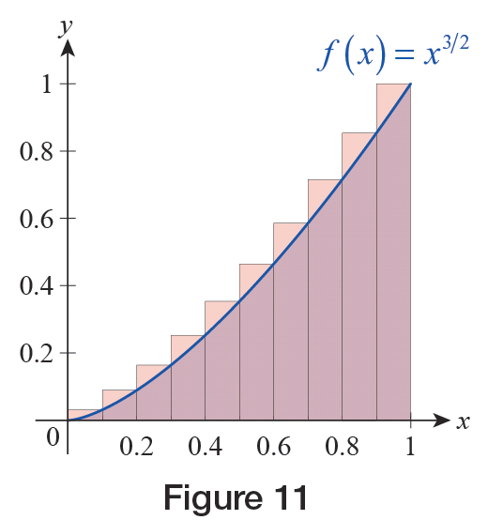
Example 5a (cont.)
For example, performing a similar calculation with 10 rectangles, each of width 0.1, and again using the function values at the right endpoints for the height of each (see Figure 11), yields the approximation S₁₀ ≈ 0.4512.
Figure 11

Slide 53
Example 5a (cont.)
We shouldn’t be surprised that this number is smaller than our result for S₄, if we compare Figures 10 and 11. S₁₀ is still overestimating the true area of R, but as we can see, the error is much less, and we expect it to go down even further if we increase the number of rectangles.

Slide 54
Example 5a (cont.)
Hand calculations quickly become tedious as the number of subintervals n increases, but a computer algebra system or a programmable calculator helps us create a table of values like the one below.
From the previous table, we conjecture that the true value of the area of R might be A = 0.4. Later we will learn how to exactly calculate this type of area.
n | 50 | 100 | 1000 | 10,000
S_{n} | 0.41005 | 0.40501 | 0.40050 | 0.40005

Slide 55
Example 5 (cont.)
b. As far as the arc length of the curve connecting (0, 0) with (1, 1), we will illustrate the calculations by first dividing [0, 1] into four subintervals, as we did in part a.

Slide 56
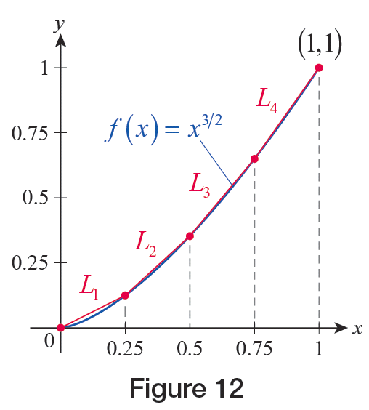
Example 5b (cont.)
If we label the endpoints as x₁ = 0, x₂ = 0.25, …, x₅ = 1, and connect the points (x_{i}, f(x_{i})) on the graph with (x_{i + 1}, f(x_{i + 1})) for i = 1, …, 4, a “crude” first approximation for the arc length will simply be the sum of the lengths of the four resulting line segments (see Figure 12).

Slide 57
Example 5b (cont.)
This can be calculated using the Pythagorean Theorem as follows.

Slide 58
Example 5b (cont.)
Upon dividing [0, 1] into 10 equal parts, a similar, but a bit longer, calculation yields the much better approximation of
As before, with the help of a computer or programmable calculator we can generate a table of values such as the following.
From the table above, we conclude that the true value of s is approximately s ≈ 1.43971.
n | 50 | 100 | 1000 | 10,000
S_{n} | 1.43966 | 1.43970 | 1.43971 | 1.43971

