Slide 1
Section 2.2
Limits All Around the Plane

Slide 2
TOPICS
Limits in Verbal, Numerical, and Visual forms
Vertical Asymptotes and One‑Sided limits
Horizontal Asymptotes and Limits at Infinity
Limits and Technology

Slide 3
Limits in Verbal, Numerical, and Visual Forms
Every limit scenario, when described verbally, contains phrases of a dynamic nature. Examples of such phrases are “as h approaches 0,” “as x goes to 3,” and “as N grows without bound.” In a less mathematical setting, the phrases might be something like “mortgage rates are expected to approach 5 percent” or “assuming the national debt keeps getting bigger and bigger.”

Slide 4
Limits in Verbal, Numerical, and Visual Forms
For the purpose of discussion, let us suppose we have a function f(x) defined on an open interval containing c, except possibly at c itself (the reason for this exception will be explained shortly). We say that the limit of f(x) is L as x approaches c, and write
if the value of f(x) is closer and closer to L as x takes on values closer and closer (but not equal) to c.

Slide 5
Limits in Verbal, Numerical, and Visual Forms
Note the small but important caveat: the limit of a function f(x) as x approaches c does not depend at all on the value of f at c; in fact, the limit may exist when f is not even defined at c. The distinction is important mathematically because, as we will see repeatedly, the behavior of a function near the point c, but not at c, is the key.

Slide 6
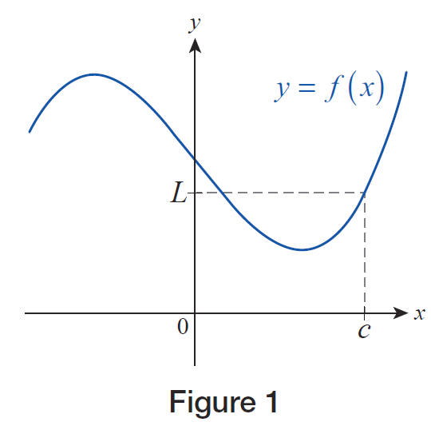
Example 1
Suppose the graph shown in Figure 1 is that of the function y = f(x). It is reasonable to conclude that the function value at x = c is L, that is, f(c) = L.
Figure 1

Slide 7
Example 1 (cont.)
Also, since the graph is a nice, smooth, unbroken curve, we expect f(x) to be close to L if x is close to c. In other words, as x approaches c from either side along the x‑axis, f(x) will be approaching L, a fact we can confirm visually. As before, we can express this by writing

Slide 8
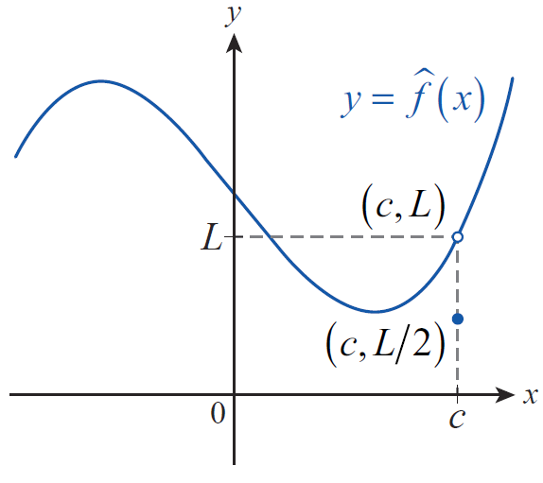
Example 1 (cont.)
Next, suppose we redefine f(c) to be (or some other number), but do not change anything else about f (let’s call the resulting function f ). Graphically, this means that the point “jumps out” of the graph, and moves down to the level, as shown in Figure 2.
ˆ
ˆ
Figure 2

Slide 9
Example 1 (cont.)
In other words, by redefining a single function value, we have relocated one point from the graph of f , but we haven’t changed a bit the behavior of the function near If x takes on values closer and closer to c, but not equal to c, the function value will still move closer and closer to L, which is the second coordinate of the empty circle (i.e., its altitude over the x‑axis). In other words, we can still write
ˆ
ˆ

Slide 10
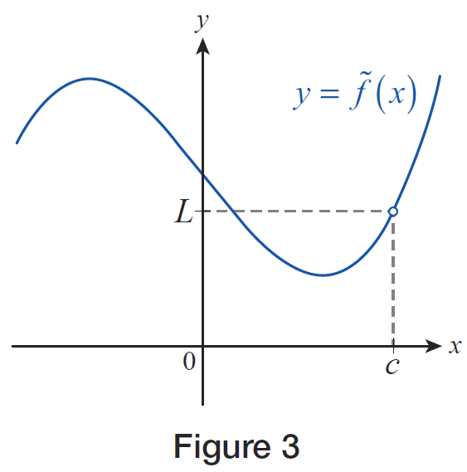
Example 1 (cont.)
Finally, we will consider one last scenario. Suppose that we delete the function value corresponding to x = c
altogether, thus making the function undefined at x = c. We will call the resulting function f. The empty circle in Figure 3 indicates that one point is “missing” from the graph; that is, the vertical line x = c doesn’t meet the graph at all.
∼
Figure 3

Slide 11
Example 1 (cont.)
However, notice that this still doesn’t have any influence on the function values near x = c. As before, when x approaches c, but is not equal to c, the function values f(x) approach L, that is,
The conclusion to be drawn is that may exist
without the actual function value f(c) being equal to it or, indeed, even defined.
∼
∼

Slide 12
Example 2
According to a classic paradox, you can never eat an apple for the following reason. A certain amount of time is needed to consume the first half of the apple, and at that point half the apple remains. Additional time is needed to eat half of the remaining half, which constitutes one-quarter of the original apple. After that, more time is needed to consume half of the remaining quarter, or one-eighth of the apple, and so on. By this reasoning, the process of eating the apple never ends.

Slide 13
Example 2 (cont.)
Of course, this runs counter to our experience, so where does the problem lie? If you were challenged by an argument such as the one above, could you provide a mathematically correct resolution of the paradox?
Solution
As we shall see, the concept of limits can help resolve the apparent flaw in the argument. Let us assume that a calculus student performs the experiment, and holding a stopwatch in her left hand, eats an apple in exactly 4 minutes.

Slide 14
Example 2 (cont.)
We will make the realistic assumption that the time necessary to eat a certain portion of the apple is directly proportional to its size, and we will monitor the portion of the fruit having been consumed. Proceeding as in the above argument, we first note that half of the apple is gone in the first 2 minutes. At the end of the third minute, another quarter is gone, so we stand at
of the apple consumed, with 1 minute left on the clock. At 3 and a half minutes, is gone, and at 3 minutes and 45 seconds, is gone.

Slide 15
Example 2 (cont.)
With half of the remaining time left, that is, at 3 minutes and 52.5 seconds, of the apple is gone, and so on. If we examine the fractions we obtain, it is easy to see that they get closer and closer to 1 as time progresses toward 4 minutes. In fact, a little later, we will have the rigorous mathematical tools to prove that the portion of the apple consumed, as time approaches 4 minutes, is as close to 1 as we desire.

Slide 16
Example 2 (cont.)
Mathematically, we say that the limit of these values is 1, that is, the student indeed ate the entire apple in 4 minutes, in accordance with what we would expect from our own experience.

Slide 17
Limits in Verbal, Numerical, and Visual Forms
As important as it is to understand what it means when we say that a certain limit exists, it is just as important to understand what it means when a limit fails to exist.
Assume again that we have a function f defined on an open interval containing the point c, except possibly at c itself. The limit of f(x) as x approaches c then fails to exist if the values of f(x) do not approach any particular real number L.

Slide 18
Limits in Verbal, Numerical, and Visual Forms
This could occur for various reasons: f(x) might be getting larger and larger (in absolute value), the values of f(x) may “jump” as x passes from one side of c to the other, or the values of f(x) may simply not “settle down” to any particular value no matter how narrowly we focus on the region around c.

Slide 19
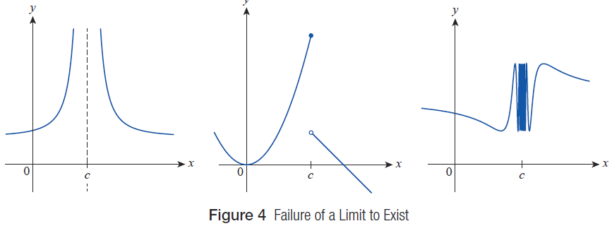
Limits in Verbal, Numerical, and Visual Forms
Figure 4 illustrates these three possibilities.
Figure 4 Failure of a Limit to Exist

Slide 20
Limits in Verbal, Numerical, and Visual Forms
While potentially confusing, we use the notation
to indicate the nonexistence of a limit when it fails to exist because the function f either increases without bound (approaches positive infinity) or decreases without bound (approaches negative infinity) as x → c.

Slide 21
Vertical Asymptotes and One‑Sided Limits
A distinguishing feature of a vertical asymptote is that, at least from one side, the function under discussion grows in magnitude without bound. Our first task is to introduce notation that succinctly and accurately describes such behavior. Assume the function f is defined on an open interval with right endpoint c. We write
if the values of f(x) increase without bound as x approaches the point c from the left.

Slide 22
Vertical Asymptotes and One‑Sided Limits
Similarly, we write
if the values of f(x) decrease without bound (approach negative infinity) as x approaches the point c from the left.

Slide 23
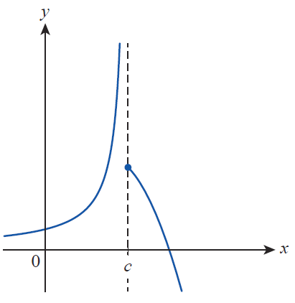
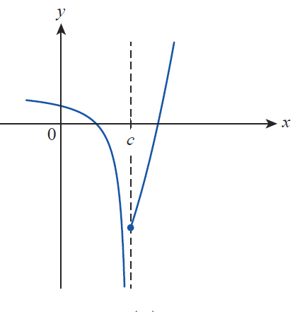
Vertical Asymptotes and One‑Sided Limits
Figure 5 illustrates these two scenarios.
Figure 5 Asymptotic Behavior from the Left

Slide 24
Vertical Asymptotes and One‑Sided Limits
Similarly, we use the notation in discussing the
limit of the function f as x approaches the point c from the right, with the implicit assumption that f is defined on an open interval whose left endpoint is c. And as noted before, we need to be careful in interpreting the four statements
all four indicate that
these one‑sided limits of f at c do not exist, since f is either increasing or decreasing without bound.

Slide 25
Example 3
Use one‑sided limit notation to describe the behavior of the following functions near their vertical asymptote(s).

Slide 26
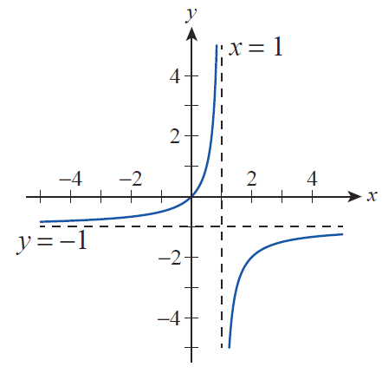
Example 3 (cont.)
Solution
a. As we can see from the graph in Figure 6, the sole vertical asymptote occurs at x = 1, a fact we can deduce from the formula as well.
Figure 6

Slide 27
Example 3a (cont.)
A further examination of the graph reveals that as x approaches 1 from the left, the function values increase without bound, a fact we can express as follows:
On the other hand, as x approaches 1 from the right, the function values decrease:

Slide 28
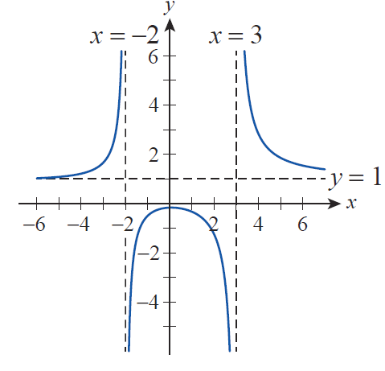
Example 3 (cont.)
b. As seen from the graph in Figure 7, g(x) has two vertical asymptotes, at
x = −2 and x = 3, a fact we can confirm algebraically by factoring the denominator of g(x).
Figure 7

Slide 29
Example 3b (cont.)
The function values increase without bound as x approaches −2 from the left and decrease in a similar manner as x approaches −2 from the right. Therefore, we can write and
Examining the graph on both sides of the vertical asymptote x = 3 in a similar manner, we conclude that
and

Slide 30
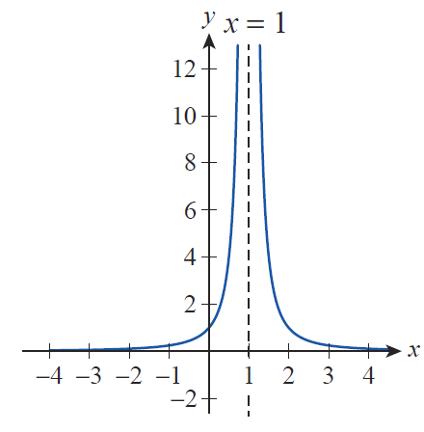
Example 3 (cont.)
c. Examining the graph of h(x) in Figure 8, we see that the behavior is the same on both sides of the vertical asymptote x = 1; namely, that of the function values increasing without bound as x approaches 1.
Figure 8

Slide 31
Example 3c (cont.)
This makes it unnecessary to distinguish between the two one‑sided limits in this case; instead, we can simply write

Slide 32
Example 4
Deduce the one‑sided infinite limits of
at its vertical asymptote without graphing the function.
Solution
We see from the formula that the sole vertical asymptote of f(x) occurs at x = 3 (which is where the denominator is 0). We will examine the two one‑sided limits separately. Let us assume first that x is approaching 3 from the left.

Slide 33
Example 4 (cont.)
This means that the x‑values are moving closer and closer to x = 3 through values less than 3 (though approaching it in magnitude). For example, when
x = 2.99,

Slide 34
Example 4 (cont.)
Throughout this process of x approaching 3, f(x) stays positive, but its denominator decreases; thus the function values themselves increase in magnitude.
A couple of easy calculations underscore this observation:
and so on.

Slide 35
Example 4 (cont.)
The closer x is to 3, the greater the function value f(x) is in magnitude (remember, x never actually reaches the value of 3).
We can now summarize our observations by writing

Slide 36
Example 4 (cont.)
If, on the other hand, x approaches 3 from the right, the denominator and thus the function value becomes negative. As an example,

Slide 37
Example 4 (cont.)
It is still true that the closer x is to 3, the greater the function values are in magnitude, but this time, they are all negative. For example, as you can easily check,
and so on. As before, we can express this by writing

Slide 38
Example 4 (cont.)
We can briefly summarize the above as follows: the presence of a vertical asymptote x = 3 indicates that the values of f(x) increase or decrease without bound near x = 3.
In general, these tendencies may or may not be different on the two sides of the asymptote, that is, for x < 3 and x > 3, respectively. We were, however, able to find out whether the respective one‑sided limits were +∞ or −∞ from the sign of the expression as x approached 3 from a fixed side, even though a graph was not readily available.

Slide 39
Definition: Vertical Asymptote
Vertical Asymptote
We say that a function f has a vertical asymptote at the point c if at least one of the following statements holds:

Slide 40
Vertical Asymptotes and One‑Sided Limits
And now that one‑sided limit notation has been introduced, it is easy to extend its meaning. We write
if the values of f(x) get closer and closer to L as x approaches c from, respectively, the left or right. The next example illustrates the use of this notation.

Slide 41
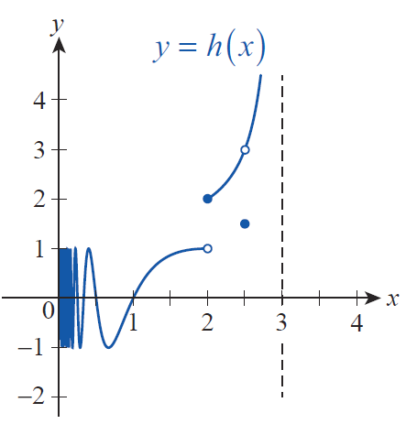
Example 5
Use the graph of the function h in Figure 9 to decide whether the given one‑sided limits exist. For those that do, find their values.
Figure 9

Slide 42
Example 5 (cont.)
a. We see from the graph that h(x) oscillates “wildly” between +1 and −1 on the right‑hand side of x = 0. Moreover, the closer x moves to 0, the more oscillations we have; in fact, there are infinitely many oscillations near 0. (Our technology is incapable of graphing infinitely many “waves,” which is the reason why we see a “shaded rectangle” immediately to the right of the y‑axis.) Therefore, there is no single value being approached by the values of h(x), so we conclude that
does not exist.

Slide 43
Example 5 (cont.)
b. As x approaches 2 from the left, the function values are approaching 1, so we conclude
Notice, however, that the actual function value is h(2) = 2. In general, we cannot expect the limit of a function at c to always equal the function value at c. In other words, as we previously observed in Example 1, what a function does near c may not be the same as what it does at c.

Slide 44
Example 5 (cont.)
c. Examining the tendency of the function values as x approaches 2 from the right, we see that
In other words, the one‑sided limit and the function value agree in this case.

Slide 45
Example 5 (cont.)
d–e. The graph shows that the function values h(x) approach 3 as x approaches 2.5 from either direction, so we can write
Notice that just like in Example 1, since both one‑sided limits exist and are equal, we conclude that the two‑sided limit exists at 2.5, and

Slide 46
Example 5 (cont.)
The last important observation we wish to make here is that the function value at x = 2.5 differs from the limit, so once again

Slide 47
Example 5 (cont.)
f. Because x = 3 is a vertical asymptote,
does not exist, but we can write

Slide 48
Horizontal Asymptotes and Limits at Infinity
We have just seen examples of when it is appropriate to say that a given limit (two‑sided or one‑sided) is ±∞; we will now study limits at ±∞.
Just as an unbounded limit at a point c corresponds to a vertical asymptote at that point, there is a connection between horizontal asymptotes and limits at infinity. Recall that a horizontal line passing through L on the y‑axis is a horizontal asymptote for the function f if the graph of f approaches the line as x is allowed to either increase or decrease without bound.

Slide 49
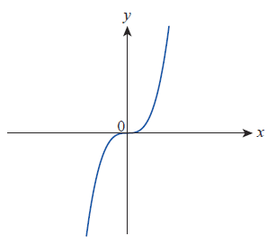
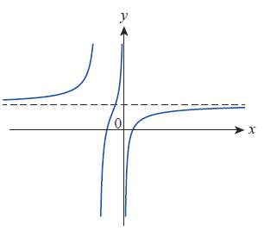
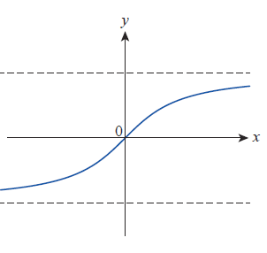
Horizontal Asymptotes and Limits at Infinity
A given function can have either 0, 1, or 2 horizontal asymptotes, as illustrated in Figure 10; unlike vertical asymptotes, a function can cross a horizontal asymptote any number of times (or not at all).
Figure 10 Limits at Infinity

Slide 50
Definition: Horizontal Asymptote
Horizontal Asymptote
We say that the line y = L is a horizontal asymptote for the function f if either of the following statements is true.

Slide 51
Example 6
Identify the horizontal asymptotes of the following functions using their graphs shown in Figures 11 and 12, respectively.

Slide 52
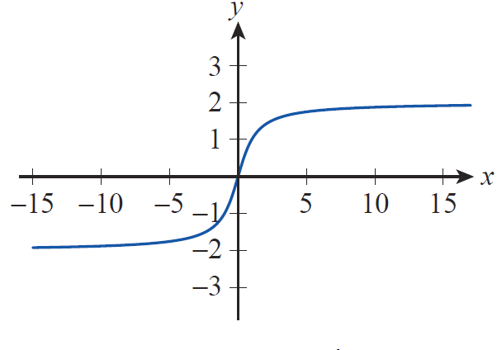
Example 6 (cont.)
a. As shown by the graph in Figure 11, the values of f(x) approach the value of 2 as x increases without bound, and they will be as close to 2 as we wish if we make sure x is large enough.
Figure 11

Slide 53
Example 6a (cont.)
In other words, we can write
and conclude that the line y = 2 is a horizontal asymptote for f . Similarly, we conclude that
and thus the line y = −2 is another horizontal asymptote for f .

Slide 54
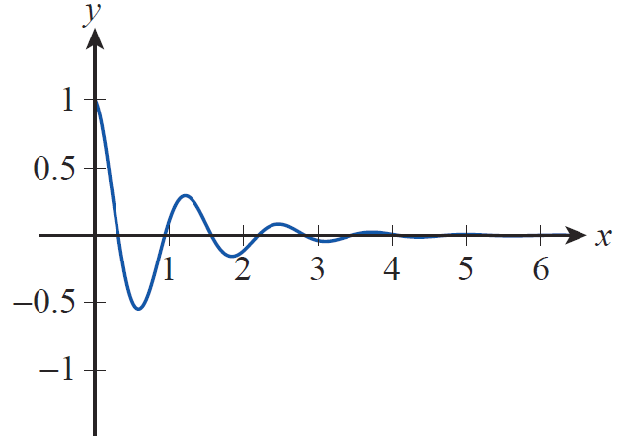
Example 6 (cont.)
b. The graph of g, though oscillating, is approaching the x‑axis more and more as x increases (see Figure 12). In other words, as we will soon be able to prove, the function values of g(x) will be as small in absolute value as we wish, if we merely choose x large enough.
Figure 12

Slide 55
Example 6b (cont.)
This is precisely what we need to conclude that the x‑axis or y = 0 is a horizontal asymptote for g. Using limit notation, this means
As a final remark, since the cosine factor causes g(x) to oscillate, the graph actually crosses its horizontal asymptote infinitely often.

Slide 56
Horizontal Asymptotes and Limits at Infinity
Many functions tend to increase in magnitude without bound as x goes to ∞ or −∞; the first graph in Figure 10 is an example. In such cases, it is natural to use limit notation to provide more information on the behavior of the function.
Figure 10 Limits at Infinity

Slide 57
Horizontal Asymptotes and Limits at Infinity
We write
if the values of f increase without bound as x → ∞, with similar meanings attached to the remaining three possibilities,

Slide 58
Example 7
Decide whether the given functions increase or decrease without bound as x goes to ∞ and −∞. Use limit notation to express your conclusion.

Slide 59
Example 7 (cont.)
Solution
a. First, we will examine the function values f(x) as x goes to ∞. Our first observation is that for any positive real number x, if x > 1 then x² > x, so if x tends to ∞, then x² will certainly grow in magnitude, without bound. Therefore, will decrease without bound as x tends to ∞. Using limit notation,

Slide 60
Example 7a (cont.)
Next, let us assume x goes to −∞. Like before, x² will grow without bound, and since x² is positive for any nonzero x, we conclude that again decreases without bound. Thus,

Slide 61
Example 7 (cont.)
b. We again let x go to ∞ first. Then by an argument similar to the one given in part a., x³ grows without bound. This tendency is not influenced by subtracting 7 from x³, so
If on the other hand, x goes to −∞, x³ − 7 will decrease without bound, since the cube of a negative number is negative. Thus we conclude that

Slide 62
Example 7 (cont.)
c. As for the function h, we will first argue that its values grow without bound as x tends toward ∞. The reasoning is as follows. It is clear that the first term, x⁵ increases without bound as x goes to ∞. And as x grows, the fifth‑degree term increases so much faster than the quadratic term, that their difference x⁵ − 6x² still increases. As an illustration, when x = 3, x⁵ − 6x² = 3⁵ − 6 ⋅ 9 = 243 − 54 = 189, but when, say, x = 10, x⁵ − 6x² = 10⁵ − 6 ⋅ 10²
= 100,000 − 600 = 99,400.

Slide 63
Example 7c (cont.)
Adding 3 to the previous expression (or adding or subtracting any constant, for that matter) will not change the increasing tendency of the function values, so we conclude that

Slide 64
Example 7c (cont.)
We can argue in a similar fashion in the case of x going to −∞, but since the fifth power of a negative number is negative, x⁵ decreases without bound in this case. This time, however, subtracting 6x² only helps (but like before, the quadratic term would not be able to change the process, even if we added it to x⁵). Again, the constant term is immaterial from the perspective of the tendency of the function values, so we conclude that

Slide 65
Limits and Technology
Consider the function
If we needed to determine the behavior of this function as x goes to 0, without the benefit of the tools we will soon encounter, we might take several different approaches. One approach would be to note that the denominator of the fraction goes to 0 as x goes to 0, so we might guess that the function “blows up”, that is, increases in magnitude without bound. That guess would be wrong—our analysis so far misses an important fact.

Slide 66
Limits and Technology
A closer examination of the fraction reveals that the numerator also approaches 0 as x goes to 0, and this common situation can lead to a variety of possible outcomes.
A second approach would be to evaluate this function for a number of values of x that are increasingly small; this may or may not lead to a correct guess for the limit, depending on the specific values chosen for x and the technology used to calculate the values of the function (see Table 1).

Slide 67
Limits and Technology
And a third approach would be to use a graphing calculator (see Figure 13) or computer algebra system (see Figure 14) to graph the function near 0. Again, this may or may not lead to a correct guess, depending on the viewing window specified for the graph.

Slide 68
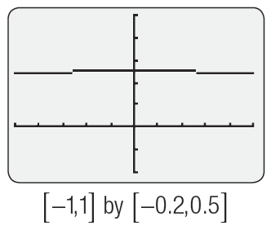
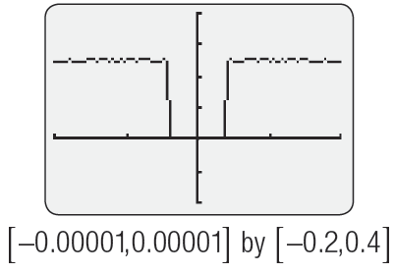
Limits and Technology
x | f(x)
0.00001 | 0.25
0.000001 | 0.2
0.0000001 | 0
0.00000001 | 0
Table 1
Figure 13
Exploring
Using a Graphing Calculator

Slide 69
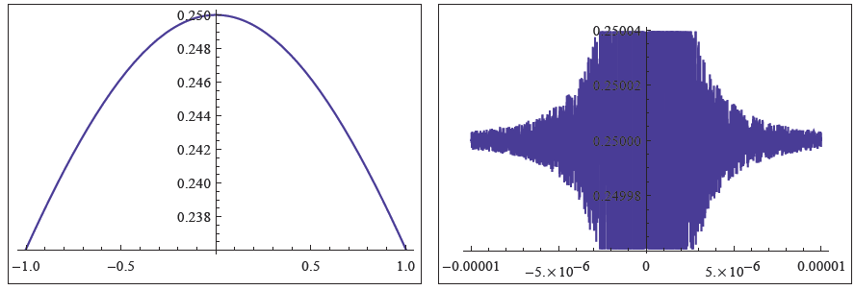
Limits and Technology
Figure 14 Exploring Using a Computer Algebra System

Slide 70
Example 8
Use graphing technology to predict the value of
where
Solution
Since cos x approaches 1 as x goes to 0, we once again face the ambiguity of both the numerator and denominator approaching 0 as x goes to 0. Again we don’t have enough information to guess at any particular number since, as we said before, a “0/0‑type” limit can lead to a variety of different answers.

Slide 71
Example 8 (cont.)
Using a graphing calculator, we can sketch and examine the graph, which appears to be approaching the origin as x goes to 0 (see Figure 15). This is confirmed by a table of values that we can create with the help of a calculator, using decreasing x‑values.

Slide 72
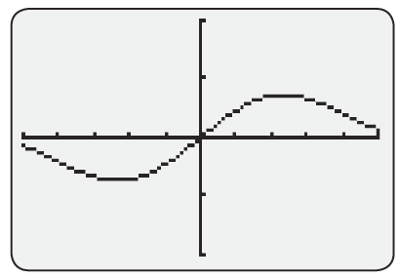
Example 8 (cont.)
x | g(x)
0.1 | 0.05
0.01 | 0.005
0.001 | 0.0005
0.0001 | 0.00005
Figure 15
Table 2

Slide 73
Example 8 (cont.)
From the above observations it is natural to expect that the function values will steadily move toward 0 when x approaches 0, as illustrated by the first graph in Figure 16. However, if we zoom in, again something strange may happen. We used a computer algebra system to illustrate.

Slide 74
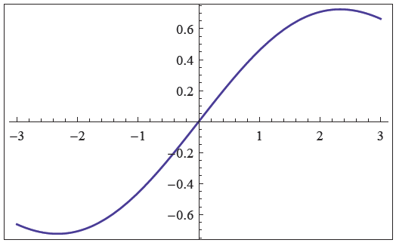
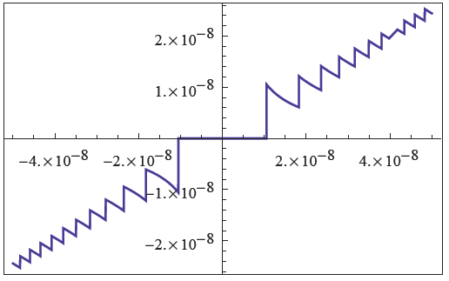
Example 8 (cont.)
Figure 16 Exploring Using a Computer Algebra System

Slide 75
Example 8 (cont.)
Again we see that, because of rounding errors and other reasons, our technology can sometimes mislead us by giving seemingly conflicting or inaccurate feedback, and we must be aware of this when using it.
We will stick with our guess that
but realize that we haven’t actually proved this at all. We will learn how to do that after discussing limit theorems in upcoming sections.

Slide 76
Technology Note
Technology Note
Computer algebra systems such as Mathematica provide additional tools for determining limits, but it should always be remembered that software has limitations and can be fooled. Mathematica contains the built‑in command Limit that uses the same mathematical facts we will learn in the next two sections to correctly evaluate many types of limits.

Slide 77
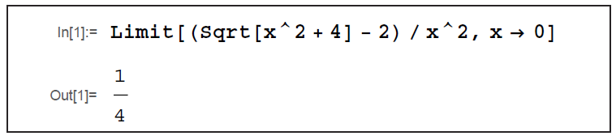
Technology Note
Technology Note (cont.)
Its use is illustrated below. (For additional information on Mathematica and the use of the Limit command, see Appendix A.)
Figure 17

