Slide 1
Section 2.5
Continuity

Slide 2
TOPICS
Continuity and Discontinuity at a Point
Continuous Functions
Properties of Continuity

Slide 3
Definition: Continuity at a Point
Continuity at a Point
Given a function f defined on an open interval containing c, we say f is continuous at c if
If the domain of f is an interval containing c either as a left or right endpoint, we also define f to be right‑continuous or left‑continuous at c if, respectively,
In usage, continuity refers to either the first or the second definition depending on the context.

Slide 4
Continuity and Discontinuity at a Point
This definition actually requires f to possess three properties, and it’s instructive to break the definition down into these three components. Specifically, in order for f to be continuous at the point c,
1. f must be defined at c;
2. the limit of f at c must exist (one‑sided limit when c is an endpoint);
3. the value of the limit must equal f(c).

Slide 5
Continuity and Discontinuity at a Point
If any one of the three properties fails to hold, then the function f is discontinuous at the point c and we call c a point of discontinuity of f. Our first two examples illustrate the identification of points of continuity and discontinuity.

Slide 6
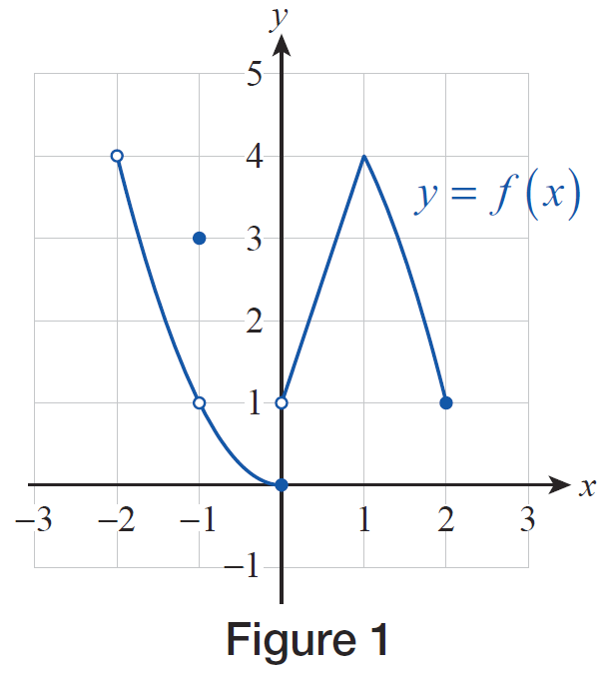
Example 1
Find all points of continuity as well as all points of discontinuity for the function f(x) given by its graph in Figure 1. For any discontinuities, identify those from the three properties that fail to hold.
Figure 1

Slide 7
Example 1 (cont.)
Solution
A careful examination of the graph, paying attention to the empty and full circles, reveals that the domain for this function is (−2, 2]. Recalling our studies of limits from the previous two sections, we see that the only point where fails to exist is c = 0; though there is a discrepancy between the limit and the function value at c = −1: but

Slide 8
Example 1 (cont.)
Thus, using the three criteria for continuity, f is continuous at every point of the following intervals: and Note that f is defined, its limit exists, and the limit equals the function value at every single point in the above intervals; so they are all points of continuity, including c = 2, where we apply the appropriate definition for right endpoints. Thus we can summarize by specifying the set of all points of continuity as follows:

Slide 9
Example 1 (cont.)
To find the points of discontinuity, we first note that c = −2 is certainly one; for f is not even defined at c = −2 (criterion 1 fails). Therefore, while f is continuous at the right endpoint of its domain, at c = 2, it is discontinuous at the left endpoint, namely at c = −2. Next, for c = −1, as we mentioned above, so it is a point of discontinuity
(criterion 3 fails).

Slide 10
Example 1 (cont.)
Note, however, that the definition f(−1) = 1 will make f continuous; that is, appropriately redefining the function will remove this discontinuity. In contrast, at c = 0 the one‑sided limits are unequal, so does
not even exist. This is not only a point of discontinuity (by virtue of criterion 2 failing), but one that cannot be removed by redefining the function. Such are called jump discontinuities; the reason for the name should be clear from the graph.

Slide 11
Example 1 (cont.)
Lastly, we note that f is certainly discontinuous everywhere outside of [−2, 2], for it is undefined at those points (again, criterion 1 fails). Thus we can summarize the points of discontinuity of f as follows:
Be sure you understand the use of different types of grouping symbols here.

Slide 12
Example 2
Identify and examine the discontinuities of the following functions.
Solution
a. The function f is a rational function, and as such it possesses the Direct Substitution Property and thus is continuous at any point where the denominator is nonzero; that is, f(x) is continuous at every x ≠ 0.

Slide 13
Example 2a (cont.)
Clearly, x = 0 is a point of discontinuity since f is not defined there; however, using a bit of algebra we can actually say more. Since
our conclusion is that actually exists, and that
the graph of f agrees with that of y = x + 1 except for the point corresponding to x = 0, where f is undefined.

Slide 14
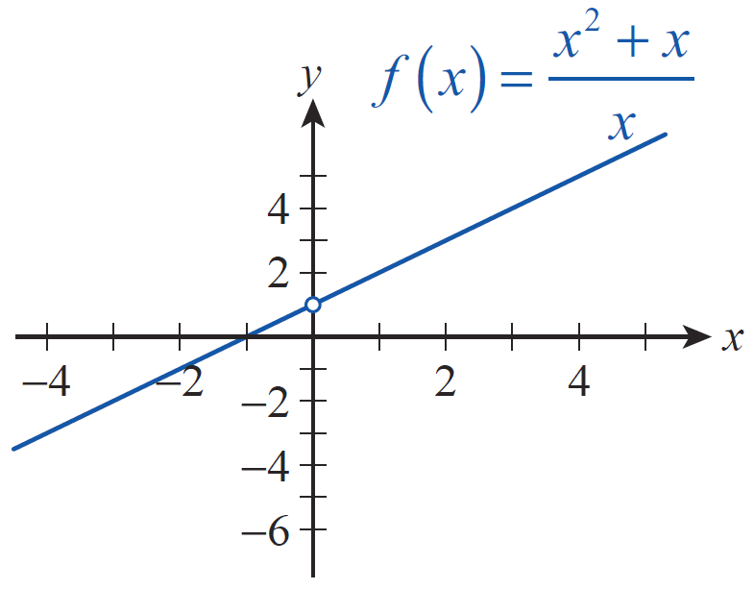
Example 2a (cont.)
In other words, you can think of the discontinuity of f arising at x = 0 as one caused by a single point
“missing” from the graph, that is, the graph being the line y = x + 1 “punctured” at (0, 1), as shown in Figure 2. This is another example of a discontinuity that can be removed; the definition f(0) = 1 will make f continuous at x = 0.
Figure 2

Slide 15
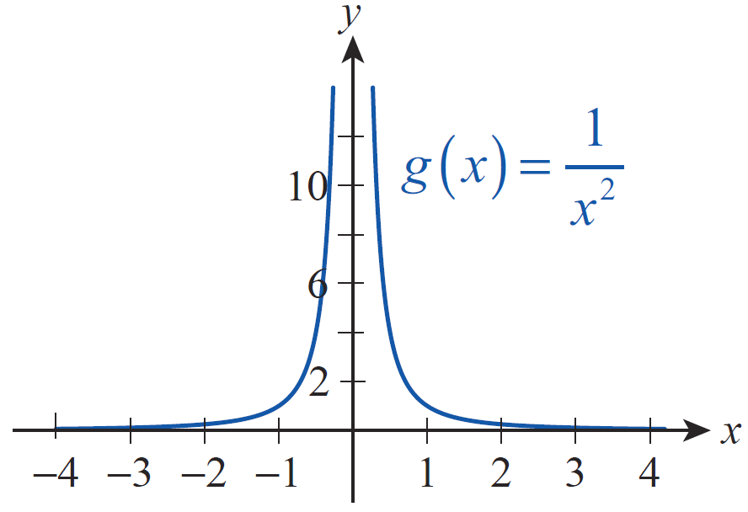
Example 2 (cont.)
b. Note that g is undefined and has a vertical asymptote at x = 0; moreover,
(see Figure 3). We can argue, as we did in part a., that g is continuous at every x ≠ 0, everywhere on its domain.
Figure 3

Slide 16
Example 2b (cont.)
The discontinuity at x = 0, however, is very different from that of f(x) in part a., since doesn’t exist
by virtue of the function values approaching infinity. In other words, no definition will make g continuous at 0. This type of discontinuity is called an infinite discontinuity.

Slide 17
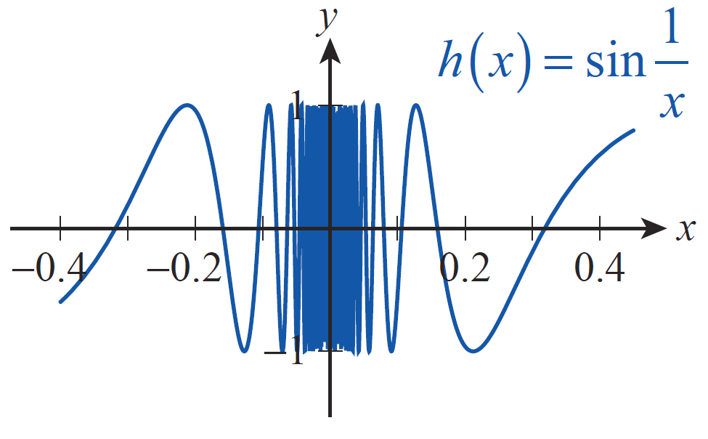
Example 2 (cont.)
c. Similar to previous arguments, one can show not only that h is undefined for x = 0, but that does not exist either. It follows from that argument that the reason for the nonexistence of the limit is
“wild” oscillation: actually, infinitely many oscillations are “squeezed” into arbitrarily small neighborhoods of 0 (see Figure 4).
Figure 4

Slide 18
Example 2c (cont.)
Even good technology cannot do full justice to what is actually going on. It is quite clear, however, that we cannot define the value of h(0) so as to make h continuous. We call this an oscillating discontinuity.

Slide 19
Definition: Removable Discontinuity
Removable Discontinuity
If a function f has a point of discontinuity at c but exists, c is called a removable discontinuity of
f . The function can be made continuous at c by redefining f at c so that
If c is an endpoint of an interval on which f is defined, replace with the appropriate one-sided limit.
If a given point of discontinuity is not removable, it is called nonremovable.

Slide 20
Example 3
Identify the discontinuities in Examples 1 and 2 as removable or nonremovable.
Solution
As we discussed in Example 1, f has a removable discontinuity at c = −1, since exists. This not
being the case at c = 0, the latter is a nonremovable discontinuity. Also, since the right‑hand limit of f exists at −2, it has a removable discontinuity there, which can be removed by defining f(−2) = 4.

Slide 21
Example 3 (cont.)
As for the functions in Example 2, we have seen that f is the only one with a removable discontinuity, which occurs at c = 0.
The discontinuities of g and h (both at c = 0) are nonremovable. The reason in the case of g is that the function values approach infinity near 0, while h has infinitely many oscillations near its point of discontinuity.

Slide 22
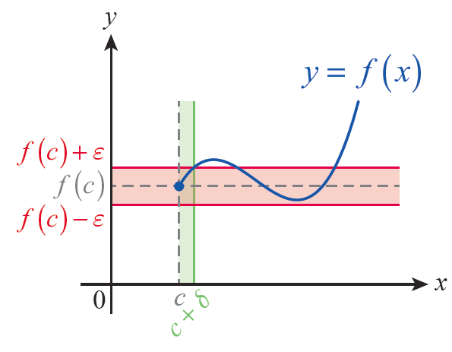
Definition: Epsilon-Delta Continuity at a Point
Epsilon-Delta Continuity at a Point
Given a function f and a point c in the domain of f , we say f is continuous at c if for every number ε > 0 there is a number δ > 0 such that for all x in the domain of f satisfying

Slide 23
Continuous Functions
Once continuity at a point has been defined, it is natural to extend the meaning of continuity to larger sets. For example, we say that a function is continuous on an interval if it is continuous at every point of that interval. For easily graphed functions defined on an interval, this extension agrees well with the intuitive sense that continuity corresponds to the ability to construct a graph without lifting pen from paper.

Slide 24
Definition: Continuity of a Function
Continuity of a Function
A function f is said to be continuous (or continuous on its domain) if it is continuous at every point of its domain.

Slide 25
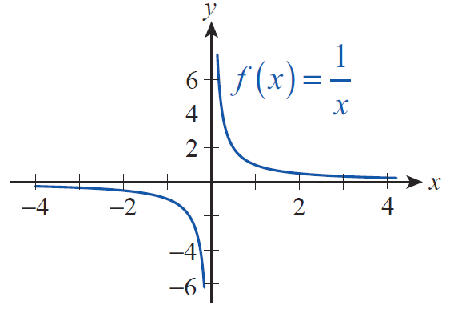
Continuous Functions
The first subtlety to be aware of is that a continuous function can have points of discontinuity. This seemingly paradoxical statement is entirely consistent
with our definitions of continuity at a point and of continuity of a function. Consider, for example, the function f(x) = 1/x (see Figure 6).
Figure 6

Slide 26
Continuous Functions
The domain of this function is (−∞, 0)∪(0, ∞), and f is indeed continuous at each point of its domain. So f is a continuous function, but it is clear that 0 is a point of discontinuity for f since does not exist. Further,
it should be noted that f is a continuous function that is not necessarily continuous on every interval of real numbers—for instance, f is not continuous on [−3,3].

Slide 27
Example 4
Discuss the continuity of If applicable, identify all points of discontinuity.
Solution
Since f is a rational function, we know that it satisfies the Direct Substitution Property and is thus continuous everywhere except at c = 1, where the denominator is 0. Note that f(1) is undefined, making c = 1 the only point of discontinuity for f.

Slide 28
Example 4 (cont.)
So once again, our seemingly paradoxical, but correct, conclusion is that f is a continuous function, and its only point of discontinuity is at c = 1.
As a final remark, since
we identify the above discontinuity as removable, since the definition f(1) = 2 makes f continuous on the entire real line.

Slide 29
Example 5
Recall from Example 2. As we have mentioned, its only point of discontinuity is at c = 0, where it is undefined, but g is continuous everywhere on its domain. In this example, we will give a rigorous proof of this latter claim, using the epsilon‑delta continuity definition.

Slide 30
Example 5 (cont.)
Indeed, choose and fix an arbitrary, nonzero c ∈ℝ. We will proceed to prove that is continuous at c. Note that we may assume c > 0 (in the negative case, the argument is similar, or one may take advantage of the fact that g is an even function).

Slide 31
Example 5 (cont.)
Our epsilon‑delta argument will be similar to those given in earlier examples to prove limit claims (this shouldn’t come as a surprise, since our epsilon‑delta continuity definition is itself closely related to the formal definition of limit). To start us off, suppose that ε > 0 is given. We need to find a δ > 0 such that

Slide 32
Example 5 (cont.)
We will first try to bound the quantity in
order to get an idea of just how small δ needs to be to satisfy the above inequality. Observe that

Slide 33
Example 5 (cont.)
Here we are safe to have omitted the absolute value symbols from the last factor, since we can assume that x is close enough to c so that x + c is positive. In fact, we will insist that throughout this argument. Note that this is equivalent to requiring that which is not a loss of generality since once a successful δ > 0 is chosen any smaller number works just fine.
Next, let’s examine the quantity Since x is in the interval specified above, and

Slide 34
Example 5 (cont.)
Thus we have
Note that since c is fixed throughout this argument, so is Putting the above two chains of equalities and inequalities together, we can summarize what we have obtained so far. If x is sufficiently close to c,

Slide 35
Example 5 (cont.)
Now it is time to pick a δ > 0 for the given ε. Let us choose it to be less than the smaller of the numbers and Then if
and our proof is complete.

Slide 36
Theorem: Properties of Continuous Functions
Properties of Continuous Functions
Let f and g be two functions both continuous at the point c, and let k be a fixed real number. Then the following combinations of f and g are also continuous at c.
Sums | “A sum of continuous functions is continuous.”
Differences | “A difference of continuous functions is continuous.”

Slide 37
Theorem: Properties of Continuous Functions
Properties of Continuous Functions (cont.)
Constant Multiples | “A multiple of a continuous function is continuous.”
Products | “A product of continuous functions is continuous.”
Quotients | “A quotient of continuous functions is continuous.”

Slide 38
Theorem: Properties of Continuous Functions
Proof
We assume that f and g are both continuous at c.

Slide 39
Properties of Continuity
As a consequence of these properties, polynomial and rational functions can be immediately classified as continuous functions. That is, every polynomial function and every rational function is continuous at every point of its domain.

Slide 40
Example 6
To illustrate the fact that a rational function is continuous everywhere on its domain, everywhere except for the zeros of the denominator, let us consider

Slide 41
Example 6 (cont.)
Since the denominator factors as we see that the domain of r is the set If c ∈ D, that is, c is an arbitrary real number other than 1 or 2, the Direct Substitution Property applies, and showing that r is continuous at every point of its domain. Using our limit determination techniques, we can even find out what happens at the two points of discontinuity.
ℝ

Slide 42
Example 6 (cont.)
Since
it follows that x = 2 is a removable discontinuity, and the graph of r agrees with that of for all x ≠ 2. The discontinuity at x = 1, however, is nonremovable. Since the numerator is bounded near 1, while the denominator nears 0, r has a vertical asymptote at x = 1.

Slide 43
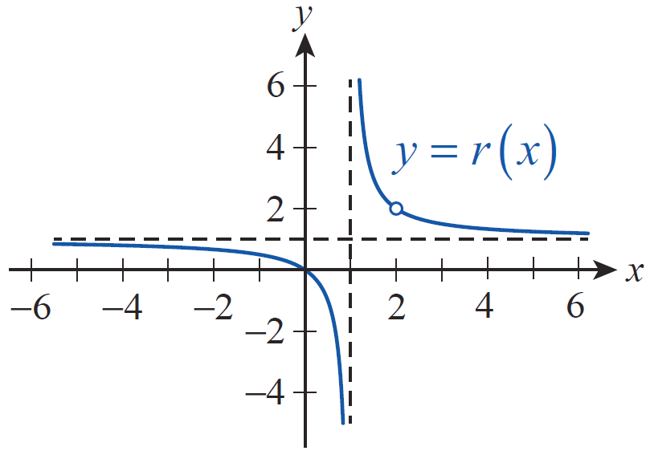
Example 6 (cont.)
Notice how the graph in Figure 7 supports all of our findings.
Figure 7

Slide 44
Theorem: “Limits Pass Through a Continuous Function”
“Limits Pass Through a Continuous Function”
Suppose and f is continuous at the point a. Then
In words, we say the limit operation passes inside the continuous function f .

Slide 45
Theorem: “A Composition of Continuous Functions Is Continuous”
“A Composition of Continuous Functions Is Continuous”
If g is continuous at the point c, and if f is continuous at g(c), then the composite function f ∘ g is continuous at c.

Slide 46
Theorem: “A Composition of Continuous Functions Is Continuous”
Proof
Because g is continuous at c, we know that and so by replacing a with g(c) in the previous theorem it follows that
Using composition notation, we have
∘
∘

Slide 47
Theorem: “The Inverse of a Continuous Function Is Continuous”
“The Inverse of a Continuous Function Is Continuous”
If f is one-to-one and continuous on the interval (a, b), then f⁻¹ is also a continuous function.

Slide 48
Example 7
Use the above theorems to discuss the continuity of the following functions.

Slide 49
Example 7 (cont.)
Solution
a. Notice that F is a composite function; you can think of it as where and Furthermore, g is continuous on all of ℝ, since its denominator is never 0. The same can be said about f, namely that it is continuous on the entire real line. Note that you can see this in at least two ways.

Slide 50
Example 7a (cont.)
Either apply the previous theorem, since f is the inverse of k(x) = x³, which is a continuous function mapping ℝ onto ℝ; or by referring to the Positive Integer Root Law, you can provide a one‑line proof of the continuity of f as follows. If c ∈ ℝ is arbitrary,
Now a simple application of the earlier theorem about continuity of compositions establishes the fact that is continuous on ℝ.

Slide 51
Example 7 (cont.)
b. As in part a., we will use the “continuity of compositions” theorem, but while the conditions of the theorem were readily satisfied by both the inner and outer functions on all of ℝ in the previous problem, we will need to pay a little extra attention here.

Slide 52
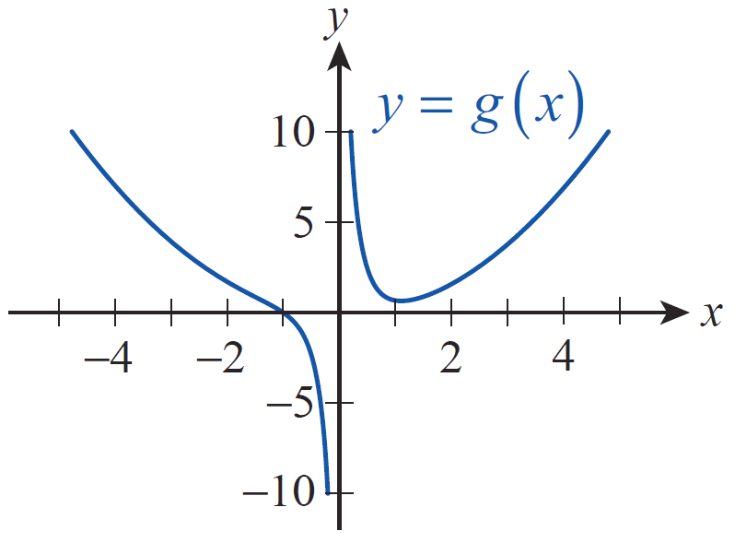
Example 7b (cont.)
To start off, we once again use the notation
however, this time
(see Figure 8), while
Figure 8

Slide 53
Example 7b (cont.)
According to our theorem, G = f ∘ g will be continuous at all points of continuity c of g(x) provided that f is also continuous at g(c). A factoring argument like the one given in part a. shows that g is undefined and has a vertical asymptote at x = 0; it is, however, continuous everywhere else. The outer function f , on the other hand, is only defined for x ≥ 0, but it is continuous on its domain.

Slide 54
Example 7b (cont.)
This latter claim can be established by an argument similar to the one given for the cube root function in part a. In fact, notice that it is easy to generalize that argument and conclude that all root functions are continuous as a result of the previous theorem and the continuity of the functions x^{n}.
Summarizing our observations up to this point, and using the fact that the composition of continuous functions is continuous, we see that will be continuous at all nonzero real numbers c such that

Slide 55
Example 7b (cont.)
Our next observation is that on the interval (−1,0), but is nonnegative everywhere else on its domain, that is, on (You can algebraically convince yourself of this fact, or simply examine the graph in Figure 8.)
Figure 8

Slide 56
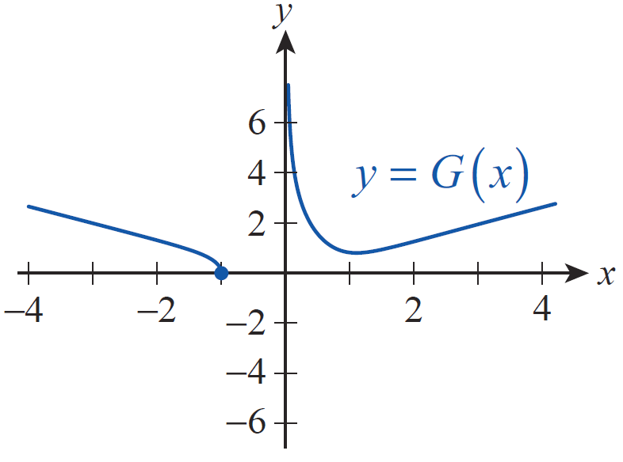
Example 7b (cont.)
Therefore, we conclude that is continuous on the set The graph of G supports our conclusion (see Figure 9).
Figure 9

Slide 57
Example 7 (cont.)
c. Factoring the denominator easily shows that the inner function of this problem has two vertical asymptotes, at x = −2 and x = 4, respectively. However, being a rational function, g is continuous everywhere else on ℝ. As we will show in Example 8, is continuous at every real number, so our conclusion is that H(x) is continuous everywhere except at x = −2 and x = 4.

Slide 58
Example 7 (cont.)
d. First of all, we observe that is continuous everywhere on its domain of [−1,1]. Furthermore, the range of g is the interval [0,1] (note that the graph of g is the upper semicircle of radius 1, centered at the origin). Using the theorem about the continuity of inverse functions, we conclude that is continuous at every point of the range of g and hence is continuous on its domain of [−1,1].

Slide 59
Properties of Continuity
In fact, most familiar functions are continuous (though many have points of discontinuity—don’t forget the subtle distinction). Trigonometric functions are continuous, a fact that is most easily proven through the use of an alternate formulation of continuity:
f is continuous at the point c if and only if

Slide 60
Example 8
Use the alternate formulation of continuity to prove that is continuous on ℝ.
Solution
Our goal is to show that for any fixed real number c,

Slide 61
Example 8 (cont.)
Using the appropriate sum identity known from trigonometry along with the relevant limit laws,
where we also used the fact that during the limit process sin c and cos c are constants, so the Constant Multiple Law applies.

Slide 62
Example 8 (cont.)
Our next step is to recall that as h approaches 0, and (You may recall these
facts from the unit‑circle definition of sine and cosine for small angles, or simply from the graphs of the sine and cosine functions.) Using these latter two limits we obtain
which is what we needed to prove.

Slide 63
Example 8 (cont.)
Finally, we note that the continuity of cos x can be established by a similar argument, or by using the continuity of the sine function along with the identity Then using the properties of continuous functions, the continuity of the remaining four trigonometric functions tan x, cot x, sec x, and csc x will follow.

Slide 64
Properties of Continuity
Exponential functions are continuous, a fact largely due to design. For a given base a, the expression a^{m/n} is easily understood for every rational number m/n, and a common way to extend the meaning of a^{x} to irrational numbers is to define a^{x} to be the limit of terms of the form where {r_{n}} is a sequence of rational numbers approaching x. And because inverse functions of continuous functions are continuous, the continuity of logarithms and inverse trigonometric functions is assured.

Slide 65
Example 9
Use the above theorems to identify where the following functions are continuous.

Slide 66
Example 9 (cont.)
Solution
a. Being the inverses of continuous functions, ln x is continuous on and arctan x is continuous on the entire real line. Thus the composition is continuous on Since the denominator of f , x² + 1 is never 0 on ℝ (check this), it follows that the quotient f(x) is continuous on

Slide 67
Example 9 (cont.)
b. Since all three functions cos x, e^{x}, and x are continuous on the entire real line, it follows from our theorems that both the composition and the product will be continuous on all of ℝ. Next, just as we did in part a., we would like to use the theorem stating the continuity of the quotient of continuous functions, but we need to carefully check the continuity of the denominator of g.

Slide 68
Example 9b (cont.)
First, the square root function requires that the inequality x² − 1 ≥ 0 be true for x. This means, we need x² ≥ 1 to hold, that is, x ≥ 1 or x ≤ −1. Since the composition of continuous functions is continuous, we conclude that is continuous on Last, but not least, in order for g to be continuous, its denominator cannot be 0, so we have to exclude the solutions of the equation By squaring both sides and adding 1 we obtain x² = 10, that is, the points have to be excluded from the domain.

Slide 69
Example 9b (cont.)
Summarizing our findings, we conclude that g(x) is continuous on the following set:

Slide 70
Example 9 (cont.)
c. Arguing as we did in part a., ln x and sin⁻¹ x are continuous, since they are inverses of continuous functions. The domain of ln x is while sin⁻¹ x is only defined on [−1,1]. However, notice that x = 1 is a zero of the denominator, so by the properties of continuous functions, we conclude that h(x) is continuous on the open interval (0, 1).

Slide 71
Properties of Continuity
Collectively, the theorems in this section allow us to identify a large number of continuous functions very quickly. It might even be possible to do something about the occasional point of discontinuity. Recall that a discontinuity is termed removable if the limit at the point exists; in such cases, we can define the continuous extension of a function as in the next example.

Slide 72
Example 10
Identify the removable discontinuities and define the continuous extension of
Solution
Factoring and canceling yields
where the previous equality holds for all x, except for x = 0 and x = 5.

Slide 73
Example 10 (cont.)
However, as we learned in Section 2.4, both
and still exist.
Therefore r has two removable discontinuities, at x = 0 and x = 5.

Slide 74
Example 10 (cont.)
∼
Now we can define the continuous extension of r, as follows.

Slide 75
Example 10 (cont.)
Let us note, however, that although correct and instructive, it is not necessary in this case to use a piecewise defined function to define the continuous extension of r. Alternatively, it is much shorter to define it simply as Note that this is equivalent to our piecewise definition above. Note also that both r and its continuous extension have nonremovable discontinuities at x = −2.

Slide 76
Theorem: The Intermediate Value Theorem
The Intermediate Value Theorem
If f is a continuous function defined on the closed interval [a, b], then f takes on every value between f(a) and f(b). That is, if L is a real number between f(a) and f(b), then there is a c in the interval [a, b] such that f(c) = L.

Slide 77
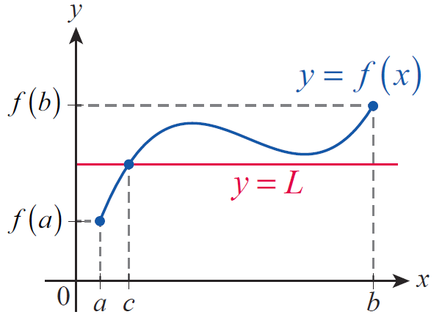
Properties of Continuity
Informally, the IVT says that the graph of a continuous function f defined on an interval [a, b] cannot avoid intersecting any horizontal line y = L if L is a value between f(a) and f(b) (see Figure 10).
Figure 10

Slide 78
Properties of Continuity
In other words, such a function f has no “breaks” or “jumps” that would allow it to skip over the value L. This property, also referred to as the Intermediate Value Property, is often used to prove that an equation of the form f(x) = L must have at least one solution in the interval [a, b]. Note that the content of the IVT is precisely the fact that a continuous function f on a closed interval [a, b] possesses the Intermediate Value Property.

Slide 79
Example 11
Use the Intermediate Value Theorem to show that the equation x⁵ + 9x − 4 = 0 has a solution between 0 and 1.
Solution
Introducing the notation notice that we are attempting to prove the existence of a solution, or root, of the equation on the interval [0,1] The existence of such root c would mean that f takes on the value L = 0 for some c in [0, 1].

Slide 80
Example 11 (cont.)
Does the Intermediate Value Theorem guarantee that? Notice first of all that f is certainly continuous on the closed interval [0, 1] (actually, it is continuous on the entire real line, but for the purposes of this problem we can safely ignore what happens outside of [0, 1]). Next, since 0 and 1 play the roles of a and b in the theorem, respectively, we proceed to examine the values f(0) and f(1).

Slide 81
Example 11 (cont.)
In other words, a change of sign occurs on [0, 1]; that is, f goes from negative to positive on [0, 1]. The statement of the Intermediate Value Theorem is precisely the fact that a continuous function cannot do this and avoid intersecting the horizontal line y = 0 (the x‑axis). More precisely, since L = 0 we have −4 < L < 6; that is, since 0 is a real number between f(0) = −4 and f(1) = 6, by the Intermediate Value Theorem there is a c in [0, 1] such that f(c) = L = 0. In other words, we have

Slide 82
Example 11 (cont.)
Thus we proved the existence of a root between 0 and 1 for the given equation.
As an important final remark, we note that the Intermediate Value Theorem is an existence theorem, in other words, we proved the existence of a solution between 0 and 1, without actually specifying what it is. However, in lieu of a formula to solve fifth‑degree equations, this is still extremely useful, and there is no need to stop here.

Slide 83
Example 11 (cont.)
Namely, if we know a solution exists, we can “narrow down” the interval around it, by refining our guesses, or by “zeroing in” on the solution. Eventually, we can come up with an approximation of the root with an acceptable level of accuracy, which is the basic idea of so‑called numerical methods of solving equations. The following Technology Note illustrates this important idea.

Slide 84
Technology Note
Technology Note
Continuing Example 11 by using Mathematica, we will illustrate the process of zooming in successively on the root of x² + 9x – 4 = 0, thereby obtaining an approximation of the solution accurate to two digits after the decimal point. Then we will use the built‑in NSolve command to obtain Mathematica’s numerical approximation of the root.

Slide 85
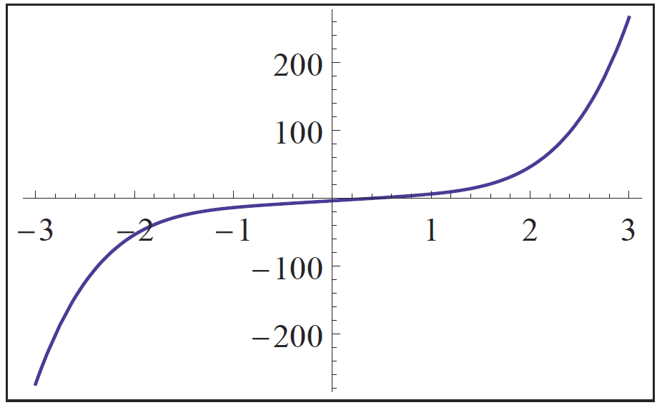
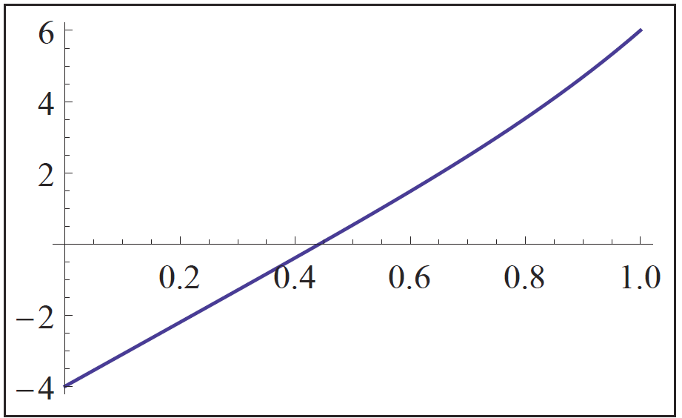
Technology Note
Technology Note (cont.)
To start us off, we have graphed f(x) = x⁵ + 9x − 4 (see Figure 11), and then we zoomed in to obtain that portion of the graph defined on [0, 1] (see Figure 12).
Figure 11
Figure 12

Slide 86
Technology Note
Technology Note (cont.)
It is clear from both graphs that f(x) = 0 has a root between 0 and 1, as we proved in Example 11. Figure 12 suggests that the root is between 0.4 and 0.5, so let’s zoom in further to gain more accuracy.

Slide 87
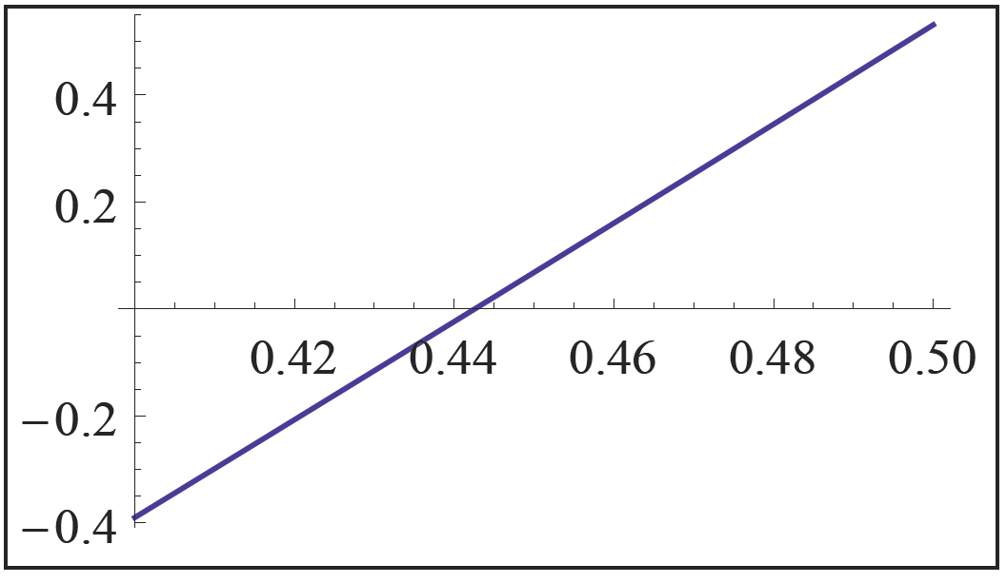
Technology Note
Technology Note (cont.)
Figure 13 suggests that we should zoom in on that portion of the graph defined on [0.44, 0.445], which we have done (see Figure 14).
Figure 13

Slide 88
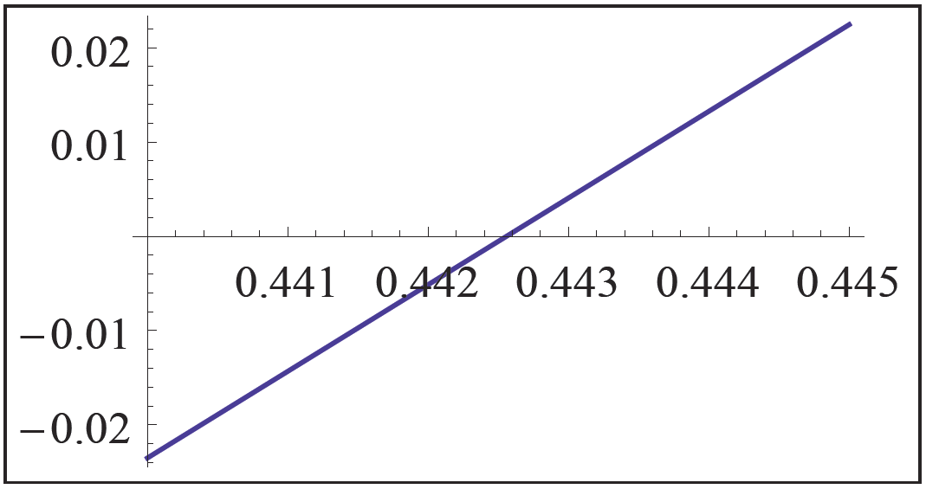
Technology Note
Technology Note (cont.)
Figure 14

Slide 89
Technology Note
Technology Note (cont.)
It is clear from Figure 14 that the root is located between 0.442 and 0.443, so we have achieved the desired accuracy; the first two digits after the decimal point are correct. We conclude that the root is c ≈ 0.44. (Note that the above accuracy could actually have been achieved from carefully eyeballing the graph in Figure 13, while the graph in Figure 14 says even more: we might guess that the root is in fact very close to 0.4426.)

Slide 90
Technology Note
Technology Note (cont.)
Note that it is also possible to estimate the root by appropriately zooming in on the graph using a graphing calculator (see Figure 15).

Slide 91
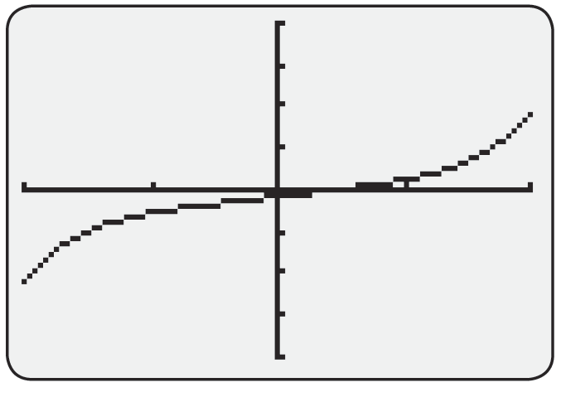
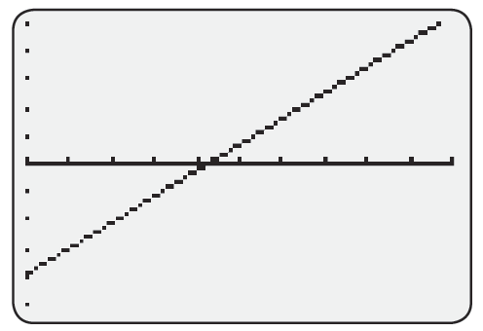
Technology Note
Technology Note (cont.)
Figure 15 Zooming In on a Root with a Graphing Calculator

Slide 92
Technology Note
Technology Note (cont.)
Finally, we use the NSolve command of Mathematica to approximate the solution of f(x) = 0. The screenshot in Figure 16 shows the feedback we receive from the software. The appearance of complex roots shows the power of the software, but we can ignore them for now and focus on the sole real root. Mathematica approximates it as c ≈ 0.442558.

Slide 93
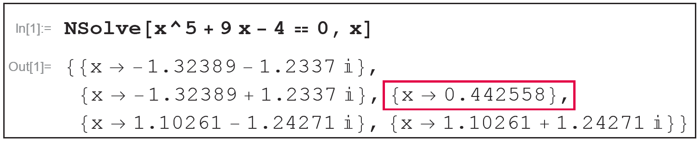
Technology Note
Technology Note (cont.)
Figure 16

