Slide 1
Section 2.6
Rate of Change Revisited:
The Derivative

Slide 2
TOPICS
Velocity and Tangent Recap
The Derivative as a Function

Slide 3
Velocity and Tangent Recap
Previously, we developed a method for determining instantaneous velocity at a particular point c in time by considering the behavior of the fraction
for smaller and smaller values of h. The function f(t) in this setting describes the position of an object at time t moving along a straight line, and the fraction was defined to be the difference quotient of f at c with increment h.

Slide 4
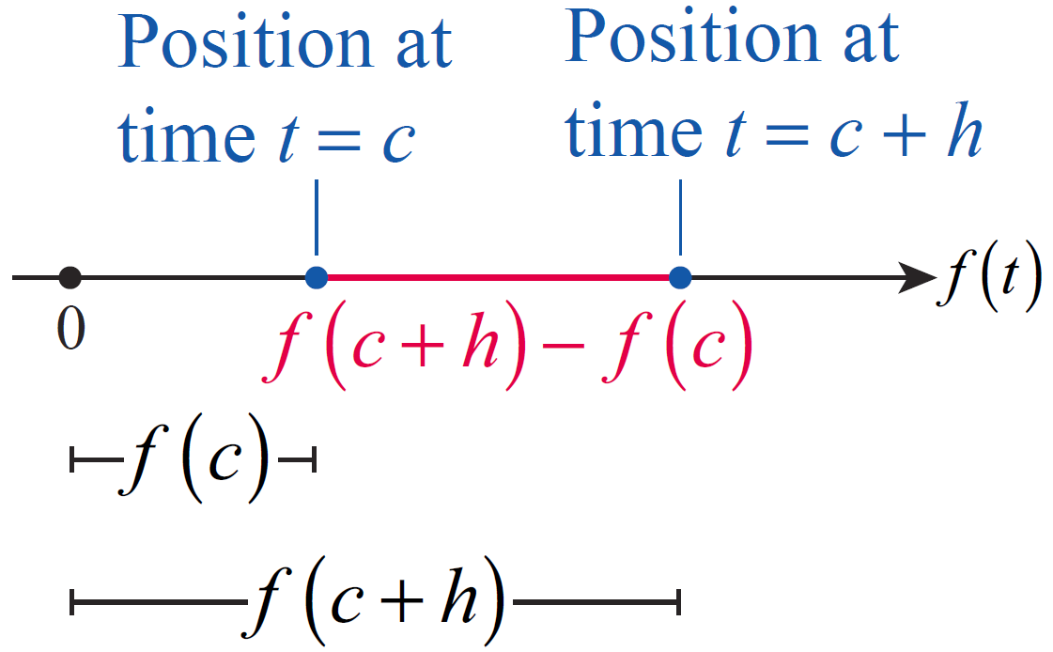
Velocity and Tangent Recap
Although we lacked the terminology and notation at the time, we can now succinctly define the (instantaneous) velocity of the object at time c to be
Figure 1

Slide 5
Velocity and Tangent Recap
Similarly, we developed a way to arrive at the slope of the line tangent to the function f(x) at the point c by considering the slopes of secant lines that approached the tangent line. Ultimately, we saw that the tangent line slope (if the tangent line exists) is also the limiting behavior of the difference quotient at c, so we can define the slope of the line tangent to f at c to also be

Slide 6
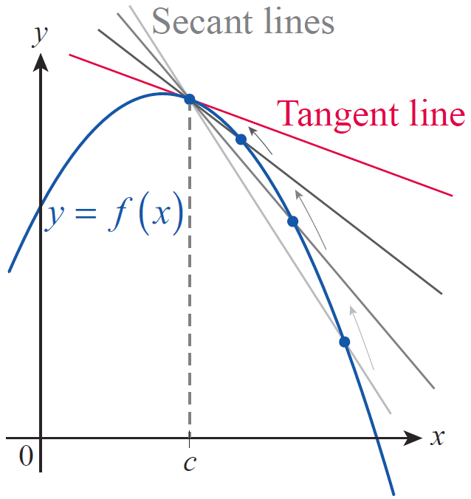
Velocity and Tangent Recap
Given this concurrence, it likely comes as no surprise that limits of difference quotients will occupy our attention for some time, and it is appropriate to now introduce some additional notation.
Figure 2

Slide 7
Definition: The Derivative at a Point
The Derivative at a Point
The derivative of the function f at the point c, denoted is
provided the limit exists. (Note that is read “ f prime of c.”)

Slide 8
Velocity and Tangent Recap
In some contexts, it may be more natural to refer to the point c + h as x, and to express the difference quotient as follows:
In this case, the derivative of f at c is obtained by letting x approach c, so an alternate definition of the derivative is

Slide 9
Velocity and Tangent Recap
One last variation of this idea comes from referring to f(x) − f(c) as the “change in f ” or “change in y” (denoted Δf or Δy) and to x − c as the “change in x” (denoted Δx). This is commonly seen when the context makes it natural to refer to the equation y = f(x) and to emphasize the fact that the numerator of the difference quotient represents a vertical difference while the denominator represents a horizontal difference. Using this notation, and with the implicit understanding that c is fixed, the derivative would be denoted as

Slide 10
Velocity and Tangent Recap
It is important to realize, however, that all these variations represent the same fundamental concept. Regardless of the difference quotient notation used, and regardless of whether we are seeking the instantaneous velocity of an object or the slope of a tangent line, f '(c) indicates the rate of change of the function f at the point c.

Slide 11
Example 1
Find the slope of the line tangent to the graph of f(x) = x² − 1 at the point (2, 3). Then use this information to derive the equation of the tangent line.
Solution
As we have discussed above, the slope of the tangent line at the point (2, 3) will be the limit of the difference quotient at c = 2, or using our new terminology, the derivative of f at the point c = 2. Recall that we denote this number by f '(c), and it is calculated as

Slide 12
Example 1 (cont.)
We now proceed to evaluate the derivative for the given at c = 2:

Slide 13
Example 1 (cont.)
So we conclude that the slope of the requested tangent is m = f '(2) = 4.
Notice that we now have all the information necessary to obtain the equation of the tangent line. It is a line with a slope of 4 that passes through the point (2, 3). Recall the point‑slope form of the equation of a line with slope m that passes through the point (x₀, y₀) is given by

Slide 14
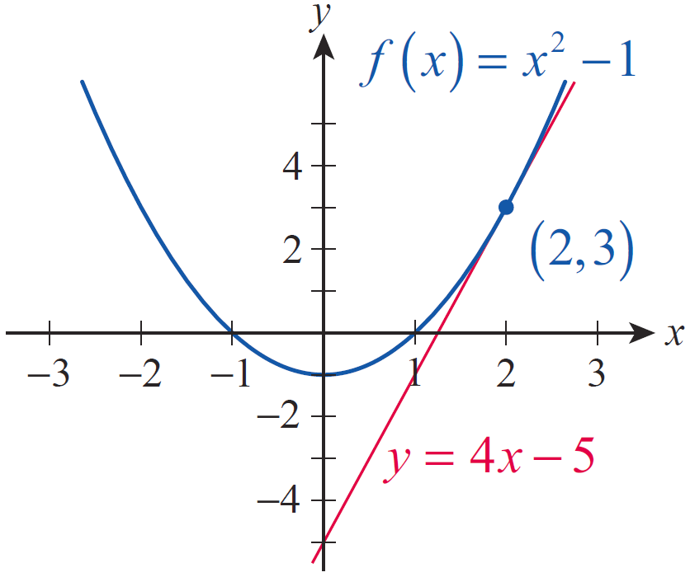
Example 1 (cont.)
Applying this formula to our situation at hand, we obtain the equation
The graph of f(x) along with the tangent line are shown in Figure 3.
Figure 3

Slide 15
Example 2
A particle is moving along a straight line so that its distance from the start is given by where d is measured in feet and t in seconds. What is the particle’s instantaneous velocity at t = 2 seconds?
Solution
As we have seen, the instantaneous velocity at time t = c of an object moving along a straight line is the derivative of its position function at t = c.

Slide 16
Example 2 (cont.)
Using this observation with our given function d and t = c = 2 seconds, we obtain the following:

Slide 17
Example 2 (cont.)
Thus we conclude that the instantaneous velocity of the particle at time 2 seconds is 3 ft/s.

Slide 18
Example 3
A piece of rock is dropped from a height of 196 feet, and its height above ground level is given by the function h(t) = 196 – 16t² feet, where t is measured in seconds. Find the instantaneous velocity of the rock at a. t = 1 second, b. t = 2 seconds, and c. t = 2.5 seconds.
What is the velocity of impact?
Solution
a. As before, the instantaneous velocity at time t = c can be found by finding the derivative of the position function at c.

Slide 19
Example 3a (cont.)

Slide 20
Example 3a (cont.)
We now obtain the instantaneous velocity at t = c = 1 by a simple substitution.
Notice that unlike in our solution of the previous example, rather than substituting c = 1 at the outset, we carried c through the computation to obtain a formula for the instantaneous velocity, which we subsequently evaluated at c = 1. The advantage of this method lies in the fact that now we can use the formula to easily answer both questions b. and c.

Slide 21
Example 3 (cont.)
Finally, we proceed to find the velocity of impact. The fundamental observation is that impact happens precisely when the position of the rock becomes 0. This helps us determine exactly how many seconds after being dropped the rock hits the ground. Thus we solve the equation h(t) = 0.

Slide 22
Example 3c (cont.)
Since time is always positive, we will only consider the solution t = 3.5 s.

Slide 23
Example 3c (cont.)
Now we can determine the velocity of impact, which is precisely the instantaneous velocity at the time of impact, by evaluating h′ at c = 3.5. Notice that we can once again use the formula we derived before:
and we conclude that the rock hits the ground with a velocity of −112 ft/s.

Slide 24
Example 3c (cont.)
In conclusion, we note that the negative signs in the above answers mean that the direction of velocity is pointing downward throughout the motion. Also, while our answer is close to what we would measure in an actual experiment, it is important to remember that we ignored air resistance in this problem.

Slide 25
Definition: The Derivative of a Function
The Derivative of a Function
The derivative of f, denoted f ′, is the function whose value at the point x is
provided the limit exists.

Slide 26
The Derivative as a Function
In usage, names other than f and f ' may be more appropriate for the functions under consideration. For instance, in a problem describing the position of an object, labels such as x(t) (if the object is moving along a horizontal line) or h(t) (if the height of a thrown object is being discussed) may be used for the position function. In such cases, it is common to name the derivative of the position function v(t) for velocity. In other words, v(t) represents the instantaneous velocity of the object at time t.

Slide 27
The Derivative as a Function
It is now appropriate to make a distinction between the ideas of velocity and speed: if v(t) represents the velocity of an object at time t, s(t) = |v(t)| represents its speed at time t.

Slide 28
Example 4
A soccer player kicks a ball vertically upward so that its position relative to ground level is h(t) = −4.9t²+19.6t+1 meters, where t is measured in seconds. Find the velocity and speed of the soccer ball at a. t = 1 second, b. t = 2.5 seconds, and c. t = 3.5 seconds.
What is this ball’s speed of impact upon its return? (Ignore air resistance.)

Slide 29
Example 4 (cont.)
Solution
a. Note first of all that the position function realistically reflects the fact that the ball does not start from ground level. Its initial height can be found by substituting t = 0 into the position function.

Slide 30
Example 4a (cont.)
In order to answer the questions, next we proceed to find v(t), the velocity function of the ball, which is the derivative of h(t). Notice that we are using the alternate notation of Δt instead of h for the increment, so as not to cause confusion with the name of the position function.

Slide 31
Example 4a (cont.)

Slide 32
Example 4a (cont.)
Already in possession of the velocity function, it is now easy to find the ball’s instantaneous velocity at t = 1.
Note that the speed equals the velocity this time, since the latter is positive.

Slide 33
Example 4a (cont.)
Notice also that, as one would expect, our function indicates that the ball is slowing down significantly from its initial velocity, which can be found by evaluating

Slide 34
Example 4 (cont.)
b. Substituting again in the velocity function, we find
The negative sign shows that the ball turned back and is now traveling downward. Its speed, however, being independent of direction, is still positive.

Slide 35
Example 4 (cont.)
c. We expect the ball to accelerate as it falls, and that is exactly what we find upon substituting t = 3.5 into the velocity function.
The negative sign shows that the direction of velocity is still downward, but its absolute value, the ball’s speed, has increased.

Slide 36
Example 4c (cont.)
In fact, as it is with any free‑falling body when air resistance is negligible, gravity increases the ball’s speed by approximately 9.8 m/s every second. (Can you see this from our results?)
To answer the final question regarding the speed of impact, we first need to know when it happens, and then we substitute the appropriate t‑value into the velocity function. Since height is 0 upon impact, we can find t by solving h(t) = 0, that is,

Slide 37
Example 4c (cont.)
An application of the quadratic formula yields the positive solution t ≈ 4.05 seconds. Therefore, the speed of impact is approximately

Slide 38
Example 5
Find the derivative of and use it to determine equations of the tangent lines to the graph
of f at the points (1, 1) and
Solution
We will start with the definition of the derivative, and make use of some of the limit‑determination techniques previously learned.

Slide 39
Example 5 (cont.)

Slide 40
Example 5 (cont.)
To find the equation of the tangent line at (1, 1) we first determine its slope by evaluating the derivative
at x = 1.
Now the point-slope equation comes to bear, and we obtain

Slide 41
Example 5 (cont.)
We deal with the equation of the tangent line at
in a similar manner. Since
the requested equation is
Notice that we can use f ′ to find the slope of the tangent at any given point x = c, if it exists, by simply evaluating f ′(c).

Slide 42
The Derivative as a Function
In business, C(x) is often used to represent the total cost of producing x items of a certain product, and is referred to as the cost function. Similarly, R(x) stands for the total revenue when x items are sold, this latter being called the revenue function. Consequently, the profit function P(x) satisfies P(x) = R(x) – C(x); or in words, profit equals total revenue minus total cost. The corresponding derivatives, or rates of change, the functions C '(x), R '(x), and P '(x), are called marginal cost, marginal revenue, and marginal profit, respectively.

Slide 43
Example 6
If a table manufacturer has a cost function of C(x) = 225 + 2x² along with its revenue function of find a. all break‑even points and b. the marginal profit when x = 10, x = 20, and x = 30.
Solution
a. Break‑even points occur when C(x) = R(x), in other words, when revenue levels equal the total cost invested. This leads to the equation

Slide 44
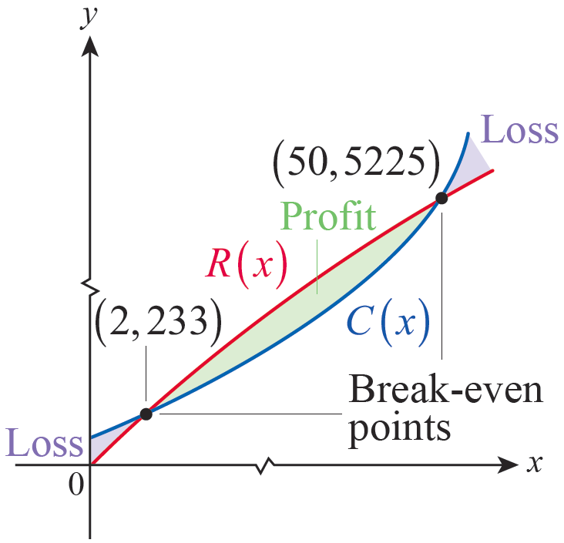
Example 6a (cont.)
After rearranging terms and factoring, this leads to
thus we conclude that break‑even points occur when x = 2 and x = 50 (see Figure 4).
Figure 4

Slide 45
Example 6 (cont.)
b. Since marginal profit is the rate of change of profit, we must first find the profit function and then calculate its derivative.

Slide 46
Example 6b (cont.)
Next, we will use the definition of the derivative to obtain the marginal profit function.

Slide 47
Example 6b (cont.)
After expanding, rearranging terms, and canceling, this reduces to

Slide 48
Example 6b (cont.)
Now we can calculate the various marginal profits.

Slide 49
Example 6b (cont.)
In conclusion, an important remark is in order. Since the number of tables produced is always an integer, the increment h in any difference quotient should be thought of as an integer, so the smallest nonzero h possible is h = 1. This explains the following interpretation of marginal profit: P‘(x) is an estimate for the increase in P(x) if x is increased by 1. Note also that in this example, P‘(x) is actually getting smaller as x gets larger.

Slide 50
Example 6b (cont.)
This shows that the rate of growth of profit per table is actually decreasing at a rate of $18 per table when 30 tables are manufactured and sold. This does not necessarily mean there is a loss, but as production increases, the profit per table is growing less because costs are increasing faster than revenue.

