Slide 1
Section 3.2
Derivatives of Polynomials, Exponentials, Products, and Quotients

Slide 2
TOPICS
Elementary Differentiation Rules
Differentiation of Exponential Functions
The Product and Quotient Rules

Slide 3
Theorem: The Constant Rule
The Constant Rule
If f is a constant function, say then In other notation, we write

Slide 4
Theorem: The Positive Integer Power Rule
The Positive Integer Power Rule
If where n is a positive integer, then
In other notation, we write

Slide 5
Theorem: The Positive Integer Power Rule
Proof
There are actually several ways to prove this first Power Rule, and because they introduce useful techniques we will provide two common proofs here.
Proof 1
The identity
can be verified by multiplying out the right‑hand side and canceling the common terms.

Slide 6
Theorem: The Positive Integer Power Rule
Proof (cont.)
With this identity in hand, we can use one of the alternative forms of the difference quotient to obtain the following.

Slide 7
Theorem: The Positive Integer Power Rule
Proof (cont.)

Slide 8
Theorem: The Positive Integer Power Rule
Proof (cont.)
Proof 2
Alternatively, we can use the Binomial Theorem to expand the term as follows.

Slide 9
Theorem: The Positive Integer Power Rule
Proof (cont.)

Slide 10
Example 1
Use the Constant Rule and Positive Integer Power Rule to determine the derivative of the given function.
a. b.
c. d.
e. f.

Slide 11
Example 1 (cont.)
Solution
a. Since f is a constant function, the Constant Rule applies. Using the various notations, we obtain
Recall that there are even more ways to express our answer. For example, or if f appears in the form of y = 5, we might write dy/dx = 0, etc.

Slide 12
Example 1 (cont.)
b. Again, since g is constant, its derivative will be identically 0, just like that of any other constant function.

Slide 13
Example 1 (cont.)
c. At first, it might be tempting to try to use the Positive Integer Power Rule on h, but we must be careful to avoid that mistake. Notice that π ³ is a constant, so h(x) is a constant function and when differentiated it behaves like any other constant function.

Slide 14
Example 1 (cont.)
d. Since k(x) is a positive integer power of the independent variable x, the Positive Integer Power Rule applies with n = 4.

Slide 15
Example 1 (cont.)
e. Notice that the independent variable of s is denoted by t, but the Positive Integer Power Rule applies, just like it would with the variable x.

Slide 16
Example 1 (cont.)
f. Since is not a positive integer power of z, we cannot apply the Positive Integer Power Rule for w, but will proceed using the definition of the derivative instead. Our conclusion will be pleasantly consistent.

Slide 17
Example 1f (cont.)
Notice that if we had applied the Positive Integer Power Rule, we would have obtained
which is precisely the correct answer. In other words, the pattern of the rule still applies to the exponent of −1. As mentioned immediately preceding this example, the Power Rule actually holds true for any real exponent, a fact we will prove later.

Slide 18
Theorem: The Constant Multiple Rule
The Constant Multiple Rule
Given a constant k and a differentiable function f, the derivative of is In other notation,

Slide 19
Theorem: The Sum and Difference Rules
The Sum and Difference Rules
If f and g are both differentiable at x, the sum f + g is
also differentiable at x and In other notation,
Similarly, f − g is differentiable and

Slide 20
Theorem: The Sum and Difference Rules
Proof

Slide 21
Theorem: The Sum and Difference Rules
Proof (cont.)
To prove the corresponding Difference Rule, we can make use of the Sum Rule and the Constant Multiple Rule.

Slide 22
Example 2
Use the above rules to find the derivative of the given function.
a.
b.
c.

Slide 23
Example 2 (cont.)
Solution
a. Since p is a polynomial of two terms, the Sum Rule immediately ensures that we can differentiate it termwise; that is, we can differentiate the terms separately and add up the results.

Slide 24
Example 2a (cont.)
Next, the Constant Multiple Rule and the Power Rule come to bear, and we obtain
Thus we conclude that Notice what we found here is that the derivative of a quadratic polynomial is a linear polynomial. This is indeed the case in general; in fact it is not hard to see that if the degree of p is n, then its derivative has degree n − 1.

Slide 25
Example 2 (cont.)
b. Even though q(x) has more than two terms, a repeated use of the Sum Rule still enables us to differentiate termwise, as shown.

Slide 26
Example 2b (cont.)

Slide 27
Example 2b (cont.)

Slide 28
Example 2 (cont.)
c. With regards to f(x), recall that from Example 1 we know the derivative of 1/x to be −1/x²; and also
We previously calculated this latter
derivative, or you might arrive at it by using the yet‑unproven Power Rule for a fractional exponent.

Slide 29
Example 2c (cont.)

Slide 30
Example 3
Find the equation of the line tangent to the graph of
at the point (1,3).
Solution
Recall that the slope of the tangent is the derivative of p at x = 1.

Slide 31
Example 3 (cont.)
Termwise differentiation yields

Slide 32
Example 3 (cont.)
and thus the slope we are seeking is
Now the point‑slope form of the equation of a line yields
or equivalently, the requested equation of the tangent is

Slide 33
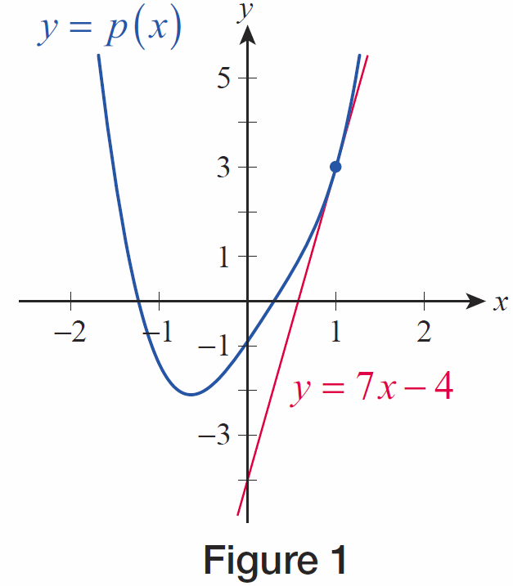
Example 3 (cont.)
The curve and its tangent line are graphed in Figure 1.
Figure 1

Slide 34
Example 4
The distance from the origin of a particle moving along the x‑axis is described by the function
inches, where t is measured in seconds. Find the instantaneous velocity and acceleration of the particle at t = 2 seconds.
Solution
As we have seen before, velocity is the derivative of the position function. Note, however, that in this example x is actually the dependent variable, and differentiation takes place with respect to the independent variable t.

Slide 35
Example 4 (cont.)
Thus the instantaneous velocity of the particle at t = 2 seconds is

Slide 36
Example 4 (cont.)
To find the acceleration, we differentiate the velocity function.

Slide 37
Example 4 (cont.)
Substituting t = 2 into the acceleration function gives the instantaneous acceleration of the particle at t = 2 seconds.

Slide 38
Theorem: Derivative of e^{x}
Derivative of e^{x}

Slide 39
Example 5
Find the first three derivatives of the following functions.
a.
b.
c. a ∈ ℝ

Slide 40
Example 5 (cont.)
Solution
a. Using the Constant Multiple Rule along with the fact that e^{x} is its own derivative we have:
In other words, we find that f(x) is also the derivative of itself. Repeating the above calculation two more times, we conclude that the second and third derivatives of f are also equal to f , that is,

Slide 41
Example 5 (cont.)
b. In addition to the rules used in part a., to find the derivative of g(s) we will also need the Sum Rule:

Slide 42
Example 5b (cont.)
A similar calculation yields the second derivative.
You might already have figured out the third derivative by observing that differentiation only affects the first term. Here are the details.

Slide 43
Example 5 (cont.)
c. Let us now investigate the derivatives of ae^{x}, where a is a real constant. We now use the prime notation along with the Constant Multiple Rule:
In other words, the derivative of any constant multiple of e^{x} is itself.

Slide 44
Example 5c (cont.)
Repeating the above procedure any number of times allows us to conclude that derivatives of all orders of the function h(x) = ae^{x} are equal to h itself for all a∈ℝ. This is a generalization of the observation we made in part a. of this example.

Slide 45
Caution
Caution
The derivative of a product is not the product of the derivatives.
Similarly, the derivative of a quotient is not the quotient of the derivatives.

Slide 46
Theorem: The Product Rule
The Product Rule
If f and g are both differentiable at x, the product fg is also differentiable at x and
In other notation,

Slide 47
Theorem: The Product Rule
Proof

Slide 48
Theorem: The Product Rule
Proof (cont.)
We begin above, unsurprisingly, with the limit of a difference quotient. In order to make the limit tractable, however, we need to rewrite the difference quotient in such a way that difference quotients for f and g make an appearance, and the easiest way to do this is to add and subtract the expression in the numerator, as shown in the second step.

Slide 49
Theorem: The Product Rule
Proof (cont.)
The third step then splits the difference quotient into two fractions, and we proceed by applying additional limit properties.

Slide 50
Theorem: The Product Rule
Proof (cont.)
Note that we have used the fact that differentiability implies continuity in order to replace with g(x) in the last step.

Slide 51
Example 6
Use the Product Rule to find the derivative of each function.
a. b.
c. d.
Solution
a. In order to differentiate F, we could certainly use the approach of Example 2 and, with the help of the Constant Multiple Rule, arrive at the answer of

Slide 52
Example 6a (cont.)
However, our aim here is to demonstrate the truth of the Product Rule, so let’s think of F as the product of the constant function f(x) = 5 and the function g(x) = x and apply the Product Rule:

Slide 53
Example 6 (cont.)
b. Again, the Positive Integer Power Rule is perhaps the easiest way to determine G’, but let us see how the Product Rule gives us the same answer. Since x² = x ⋅ x, we have
which is exactly what the Positive Integer Power Rule would tell us.

Slide 54
Example 6 (cont.)
c. With the assignments and we see that so we will apply the Product Rule.

Slide 55
Example 6c (cont.)

Slide 56
Example 6c (cont.)
Notice that we can check our answer by multiplying the two factors of H together and differentiating the resulting polynomial the usual way:
so applying our rules,
as we expected.

Slide 57
Example 6 (cont.)
d. While all the previous derivatives could be handled in alternative ways, in the case of the function K there is no apparent way to avoid the Product Rule. Using the prime notation this time, we can write
where we again used the fact that e^{x} is the derivative of itself.

Slide 58
Example 7
Find F(1) if and and
Solution
First of all, since we know finding F(1) or g(1) are equivalent problems. Keeping this in mind, it is not hard to see that the Product Rule provides us with an equation to determine g(1), as follows.

Slide 59
Example 7 (cont.)

Slide 60
Example 7 (cont.)
Substituting x = 1, we have
(Note that in general, if x = c, it follows from the Product Rule that
We used this fact with c = 1 in our equation above.)

Slide 61
Example 7 (cont.)
Next, substituting the known quantities of and our equation becomes
Solving the above for g(1), we obtain
Finally, recalling that F(1) = g(1), we conclude that F(1) = −2.

Slide 62
Theorem: The Reciprocal Rule
The Reciprocal Rule
If g is differentiable at x and is also differentiable at x and

Slide 63
Theorem: The Reciprocal Rule
Proof

Slide 64
Theorem: The Reciprocal Rule
Proof (cont.)
We are hoping to relate the derivative of 1/g to the derivative of g if possible, so we are again seeking a way to rewrite the difference quotient so that g′ will make an appearance. Using the fact that 1/g(x) is independent of h and can be pulled out of the above limit, and using the continuity of g at x, we can rearrange the quotient to obtain the following.

Slide 65
Theorem: The Reciprocal Rule
Proof (cont.)

Slide 66
The Product and Quotient Rules
One immediate application of the Reciprocal Rule is the extension of the Power Rule to negative integers. Given a positive integer n, note the following.

Slide 67
Example 8
Use the Reciprocal Rule to find the derivative of
Solution
Recall that Using this fact along with
the Reciprocal Rule, we can write

Slide 68
Theorem: The Quotient Rule
The Quotient Rule
If f and g are both differentiable at x and is also differentiable at x and

Slide 69
Theorem: The Quotient Rule
Proof
The Product and Reciprocal Rules together allow us to quickly arrive at the Quotient Rule, as follows.

Slide 70
Example 9
Use the Quotient Rule to find the following derivatives.
a. b.
c.

Slide 71
Example 9 (cont.)
Solution
a. Using the Quotient Rule with and we obtain the following.

Slide 72
Example 9a (cont.)

Slide 73
Example 9 (cont.)
b. While we could certainly proceed with the Quotient Rule for this function, this is a situation when it pays to rewrite our quotient before differentiating. Notice that by multiplying both the numerator and denominator by x, we obtain an expression that is free of reciprocals and therefore is more convenient to handle.

Slide 74
Example 9b (cont.)

Slide 75
Example 9 (cont.)
c. Again, we can make the expression look simpler if we rewrite before differentiating. We will start by multiplying both the numerator and denominator
by

Slide 76
Example 9c (cont.)

Slide 77
Example 9c (cont.)
What you should remember from the last two differentiations is that it might not always be the best idea to proceed right away with the Quotient Rule whenever you see a quotient. While you can certainly obtain the correct answer that way, often you can save a lot of time just by rewriting the expression before differentiating.

