Slide 1
Section 3.3
Derivatives of Trigonometric Functions

Slide 2
TOPICS
Two Useful Limits
Derivatives of Sine and Cosine
Derivatives of Other Trigonometric Functions

Slide 3
Lemma
Lemma
Measuring θ in radians (as is customary),

Slide 4
Lemma
Proof
Neither limit is trivial, as the numerator and denominator approach 0 in both cases—the key to the evaluation is determining the relative rate at which this happens.

Slide 5
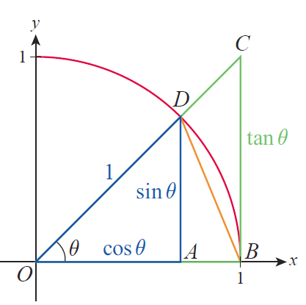
Lemma
Proof (cont.)
We can construct some bounds on the relative rate for the first limit by referring to Figure 1. For any angle θ between 0 and π/2, the area of triangle OBD is less than the area of the circle sector OBD, which in turn is less than the area of triangle OBC.

Slide 6
Lemma
Proof (cont.)
Note also that since the radius of the circle is 1, the lengths of the two legs of triangle OAD are cosθ and
sinθ, while the length of the leg opposite θ in triangle OBC is tanθ. Using the area formulas for triangles and circular sectors, we have the following.

Slide 7
Lemma
Proof (cont.)

Slide 8
Lemma
Proof (cont.)
So the above statements imply
Since sinθ is positive for all θ in this range, dividing by sinθ and multiplying by 2 leaves each inequality unchanged.

Slide 9
Lemma
Proof (cont.)
Taking the reciprocal of each fraction does reverse each inequality, so the above is equivalent to
This is the sort of upper and lower bound on
that we need. Since cosθ has a limit of 1 as θ → 0, the Squeeze Theorem tells us that

Slide 10
Lemma
Proof (cont.)
Since is an even function,
and we also have
so the first limit is proved.

Slide 11
Lemma
Proof (cont.)
We can now use this result to prove the second limit, making use of the trigonometric identity
Replacing 2x with θ and subtracting 1 from both sides of this identity, we have

Slide 12
Lemma
Proof (cont.)
and dividing through by θ results in
So we calculate the limit as follows.

Slide 13
Lemma
Proof (cont.)

Slide 14
Caution
Caution
The assumption that the angles in the preceding lemma are measured in radians is critical, as our formula for the area of a circular sector is based on radian measure. We will later learn how to find derivatives of trigonometric functions when using other angle measurements.

Slide 15
Example 1
Use the lemma to find the following limits.

Slide 16
Example 1 (cont.)
Solution
a. In order for us to be able to use the lemma, we first multiply and divide by 3:
where in the last step we used the fact that when x approaches 0, so does 3x and vice versa.

Slide 17
Example 1a (cont.)
Next, if we rename 3x by calling it θ, we can rewrite our limit as
Now by a direct application of the lemma,

Slide 18
Example 1 (cont.)
b. This limit does not directly resemble either of those in the lemma, but we can rewrite it as follows.

Slide 19
Example 1b (cont.)
Applying the limit laws and both parts of the lemma, along with the fact that we now obtain

Slide 20
Theorem: Derivative of Sine
Derivative of Sine

Slide 21
Theorem: Derivative of Sine
Proof

Slide 22
Theorem: Derivative of Sine
Proof (cont.)

Slide 23
Example 2
If we follow the slopes of tangent lines to the graph of
y = sin x starting, say, at x = 0, it is not difficult to discover an oscillating “sinusoidal” pattern.

Slide 24
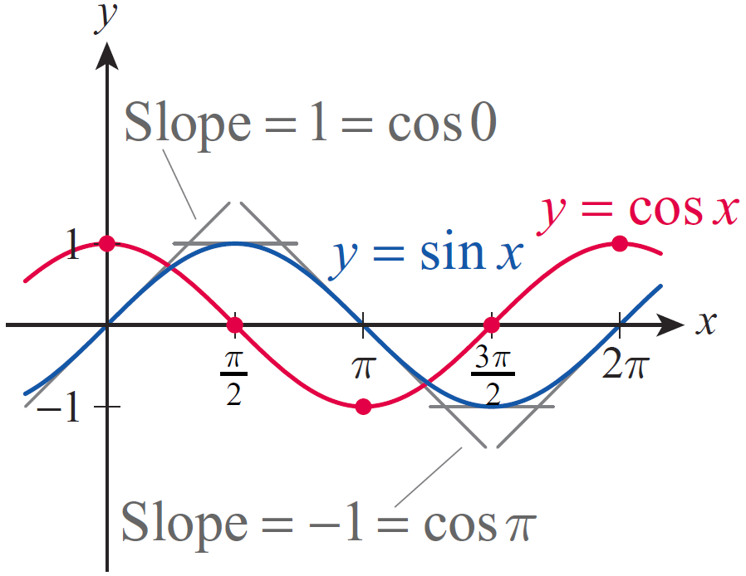
Example 2 (cont.)
As shown in Figure 2, when x = 0 the corresponding tangent is a line through the origin, which appears to have a slope of 1. As x increases, the slopes of the tangent lines decrease, reaching 0 when The slopes then become negative as x continues to increase from
Figure 2

Slide 25
Example 2 (cont.)
When x reaches the value of π, the slope of the corresponding tangent of the sine function is −1. The slopes then start to increase, reaching the value of 0 again at as a close examination of the sine graph reveals. Notice that this is exactly the behavior of the function values of y = cos x, that is, the slope of the tangent to the sine graph at any given x‑value appears to equal the corresponding function value of the cosine function, which is exactly what we proved in the previous theorem.

Slide 26
Example 3
Use differentiation rules to find the derivative of
Solution
The Product Rule along with the previous theorem yields

Slide 27
Theorem: Derivative of Cosine
Derivative of Cosine
Proof
This can be proven using the methods used to show that the derivative of the sine function is cosine.

Slide 28
Example 4
Use differentiation rules to find the following derivatives.

Slide 29
Example 4 (cont.)
Solution
We will need the differentiation rules of the previous section along with the derivatives of sine and cosine, as follows.

Slide 30
Example 4 (cont.)
b. Note that we need to start with the Quotient Rule:

Slide 31
Example 5
If an object is oscillating so that the so-called restoring force acting on the object is directly proportional to the negative of its displacement at any time, the resulting motion is called simple harmonic motion. This happens, for example, when an object is attached to a spring, pulled or pushed, and then let go. (We are ignoring air resistance, friction, and all other forces here.)

Slide 32
Example 5 (cont.)
Recall that the equation of this motion, or the position function of the object, can be either or
depending on initial conditions (ω is a constant related to the spring, A is the amplitude).
Suppose an object of mass m is hanging on a spring and is at equilibrium.

Slide 33
Example 5 (cont.)
If we pull it downward by 50 cm and release it, the equation of motion is given by
where y is the vertical distance from equilibrium, measured in meters with upward displacement considered positive, and t is measured in seconds.

Slide 34
Example 5 (cont.)
a. Find the position at t = 10 seconds.
b. What is the maximum displacement of the object and when does it occur?
c. Find the maximum velocity and the position where it occurs.
d. Find the maximum acceleration value. When does it occur?

Slide 35
Example 5 (cont.)
Solution
a. The position at t = 10 seconds is quickly found by evaluating the position function.
The positive sign means that the object is found approximately 41.95 cm above equilibrium at t = 10 seconds.

Slide 36
Example 5 (cont.)
b. Since displacement is “signed distance” from equilibrium, maximum displacement will occur precisely when the position function assumes its maximum value (positive or negative). Stated more precisely, this happens when the absolute value of the position is maximum. Since the cosine function oscillates between +1 and −1 reaching these maximum absolute values at kπ, k ∈ ℤ, we conclude that the absolute value of the position function given in this example is greatest when t = kπ seconds, for k ∈ ℤ, k ≥ 0.

Slide 37
Example 5b (cont.)
The greatest displacement value is
Note that this is consistent with our everyday experience. Since there was no initial velocity (no initial “push” or “shove” at the start of motion), we expect the initial displacement of 50 cm to remain maximal throughout the motion. (As we have stated already, we are ignoring all other forces and therefore the fact that the motion actually “dies down” over the long term.)

Slide 38
Example 5b (cont.)
Also, recalling that if k is even and
for an odd k, in light of the position function we conclude that the object reaches its maximum displacement of 50 cm below equilibrium when t = kπ and k is a nonnegative even integer. If k is odd, on the other hand, the object is 50 cm above equilibrium at t = kπ seconds.

Slide 39
Example 5 (cont.)
c. The velocity function is the derivative of the position function.
By an argument similar to the one given in part b., and keeping the graph of the sine function in mind, we see that velocity is greatest when the absolute value of the sine function is 1, that is, when
k ∈ ℤ.

Slide 40
Example 5c (cont.)
Moreover, since
we conclude that velocity is maximal and pointing upward when for a nonnegative even k.

Slide 41
Example 5c (cont.)
On the other hand, if k is odd and positive,
that is, velocity is maximal and is pointing downward in this case. Note that for the above t‑values the cosine function is 0, so maximum velocity (or speed) occurs each time the object is passing through the equilibrium position.

Slide 42
Example 5 (cont.)
d. Since acceleration is the derivative of velocity, we will obtain the acceleration function by differentiating.

Slide 43
Example 5d (cont.)
Since this is precisely the negative of the position function, we can use our observations made in part b. and conclude that the acceleration values are greatest when the object is in its extreme positions, but acceleration is positive when the object’s position is negative, that is, the object is accelerating downward when above the equilibrium position and vice versa.

Slide 44
Example 5d (cont.)
The maximum acceleration values are
when k is an even nonnegative integer and
when k is odd.

Slide 45
Theorem: Derivatives of Tangent, Cotangent, Secant, and Cosecant
Derivatives of Tangent, Cotangent, Secant, and Cosecant

Slide 46
Theorem: Derivatives of Tangent, Cotangent, Secant, and Cosecant
Proof
We will prove two of the above statements, and leave the remaining two as exercises.

Slide 47
Theorem: Derivatives of Tangent, Cotangent, Secant, and Cosecant
Proof (cont.)
For the derivative of cosecant, we could either use the Quotient Rule or, more quickly, its specialized form as shown.

Slide 48
Theorem: Derivatives of Tangent, Cotangent, Secant, and Cosecant
Proof (cont.)

Slide 49
Example 6
Use the above theorem to find the derivatives of the following functions.
Solution
a. Using the Product Rule, we calculate the derivative as follows.

Slide 50
Example 6a (cont.)

Slide 51
Example 6a (cont.)
Notice, however, that differentiation will be much easier if we rewrite f before differentiating. Since
our theorem tell us that

Slide 52
Example 6a (cont.)
However, is this answer equivalent to the one we obtained above? The answer, reassuringly, is yes, which we can show by using the identity

Slide 53
Example 6 (cont.)
b. Using the Quotient Rule this time, we obtain the following.

Slide 54
Example 6b (cont.)

Slide 55
Example 7
Determine the second derivative of
Solution
Since we will obtain the second
derivative of f by differentiating
We can differentiate by using the Generalized Positive Integer Power Rule or simply by an application of the Product Rule.

Slide 56
Example 7 (cont.)

Slide 57
Example 8
Find all points on the graph of where the slope of its tangent line is −3.
Solution
Our plan is to find first, and then by solving the equation identify all values such that
In order to differentiate g, we will use the identity
sin 2t = 2 sint cost followed by the Product Rule.

Slide 58
Example 8 (cont.)

Slide 59
Example 8 (cont.)
Next, we solve the trigonometric equation 6 cos 2t = −3.
Equivalently, the solutions are
k ∈ ℤ
k ∈ ℤ.

Slide 60
Example 8 (cont.)
The corresponding points on the graph of g where the tangents have a slope of −3 are as follows.
k ∈ ℤ

