Slide 1
Section 3.6
Derivatives of Inverse Functions

Slide 2
TOPICS
The Derivative Rule for Inverse Functions
Derivatives of Logarithms
Logarithmic Differentiation
Derivatives of Inverse Trigonometric Functions

Slide 3
Theorem: The Derivative Rule for Inverse Functions
The Derivative Rule for Inverse Functions
If a function f is differentiable on an interval (a, b) and if f ’(x) ≠ 0 for all x ∈ (a, b), then f ⁻¹ both exists and is differentiable on the image of the interval (a, b) under f , denoted as f((a, b)) in the formula below. Further,
and

Slide 4
Example 1
a. Given use the Derivative Rule for Inverse Functions to determine
b. Given use the Derivative Rule
for Inverse Functions to determine at the point

Slide 5
Example 1 (cont.)
Solution
a. Keeping in mind that and using the second form of the rule, we obtain the following.

Slide 6
Example 1 (cont.)
b. Notice that although we cannot find a formula for the good news is that we don’t have to if we use the first form of the Derivative Rule for Inverse Functions.

Slide 7
Theorem: Derivatives of Logarithms
Derivative of ln x

Slide 8
Theorem: Derivatives of Logarithms
Proof
We begin by defining since we already know that and we seek a formula for the derivative of

Slide 9
Theorem: Derivatives of Logarithms
Proof (cont.)

Slide 10
Example 2
Determine for the following functions.

Slide 11
Example 2 (cont.)
Solution
a. Defining and applying the formula we obtained,
Notice that what we have found is the fact that ln x and ln(kx) have the same derivative. This shouldn’t come as a surprise if we recall that by the properties of logarithms,

Slide 12
Example 2a (cont.)
therefore,
Recall that what this means geometrically is the fact that the graph of ln (kx) can be obtained from that of ln x by a vertical shift of ln k units. However, vertical shifting doesn’t change the slope of a tangent at any point, which visually explains why the derivatives are equal.

Slide 13
Example 2 (cont.)
b. By the same formula that we put to good use in part a.,

Slide 14
Example 2 (cont.)
c. We could define and proceed like above; however, finding seems a bit tedious at best. Instead, it is to our advantage to use the properties of logarithms before differentiating. Since
differentiating becomes much more straightforward.

Slide 15
Example 2c (cont.)

Slide 16
Example 3
Find the equation of the line tangent to the graph of f at the point (0, 1).
Solution
After defining we can proceed by differentiating f to obtain the slope.

Slide 17
Example 3 (cont.)
Therefore, the slope of the desired tangent is
Finally, using the point‑slope form, the equation of the tangent line is obtained:

Slide 18
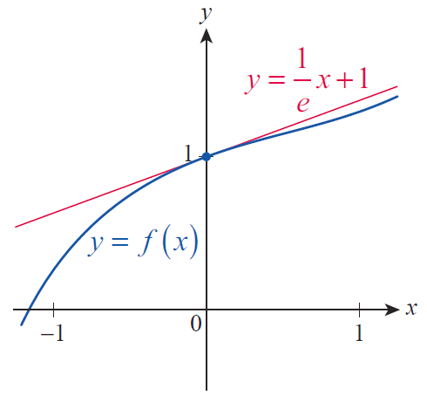
Example 3 (cont.)
or equivalently,
The function and its tangent are graphed in Figure 2.
Figure 2

Slide 19
Theorem: Derivative of log_{a} x
Derivative of log_{a} x
Given a positive base a, a ≠ 1, and for all x > 0,

Slide 20
Theorem: Derivative of log_{a} x
Proof
Since we now know the derivative of ln x, all we need is the logarithmic change of base formula.

Slide 21
Example 4
Determine the following derivatives.
Solution
a. Note that if so by the above formula we obtain the following.

Slide 22
Example 4 (cont.)
b. First of all, recall that “log” stands for the common logarithm, whose base is 10. Second, we will be better off if we rewrite the logarithmic expression before differentiating.

Slide 23
Example 4b (cont.)

Slide 24
Logarithmic Differentiation
Logarithmic Differentiation
Step 1: Apply the natural logarithm to both sides of the equation y = f(x), and use the properties of logarithms as appropriate.
Step 2: Under the assumption that y is differentiable, differentiate both sides of the resulting equation implicitly with respect to x.
Step 3: Solve the resulting equation for y ′.

Slide 25
Example 5
Use logarithmic differentiation to differentiate the following functions.

Slide 26
Example 5 (cont.)
Solution
a. We start by writing
then take the natural logarithm of both sides and use properties of logarithms.

Slide 27
Example 5a (cont.)
Next, we differentiate both sides implicitly with respect to x, and solve for y ′.

Slide 28
Example 5 (cont.)
b. Proceed in a manner similar to part a.

Slide 29
Example 5b (cont.)
Implicit differentiation now yields the following.

Slide 30
Example 5 (cont.)
c. Notice first of all that since both the base and exponent are variable expressions, h is neither an exponential function nor a power function, so none of the differentiation formulas we learned up to this point are going to help. The fact that we can still differentiate h is perhaps an illustration of logarithmic differentiation at its best. Simply we follow the three-step process.

Slide 31
Example 5c (cont.)

Slide 32
Theorem: The Power Rule
The Power Rule
Under the assumption that x^{r} is a real number, where r is a fixed real number constant, the derivative of x^{r} is rx^{r−1}.

Slide 33
Theorem: The Power Rule
Proof
We begin with the equation y = x^{r}, but in order to apply the natural logarithm to both sides, we insert an intermediate step to obtain |y| =|x^{r}|. Logarithmic differentiation then gives us the following.

Slide 34
Theorem: The Power Rule
Proof (cont.)

Slide 35
Theorem: The Power Rule
Proof (cont.)
Note that we are safe in assuming x ≠ 0 above, as we can easily determine the (possibly one‑sided) derivative of x^{r} at x = 0 from a limit of difference quotients for r ≥ 1, and for r < 1 the derivative is undefined at x = 0.

Slide 36
Example 6
Find all points of differentiability for the following functions and determine the derivatives.
Solution
a. For x ≠ 0, the Power Rule applies, and we have

Slide 37
Example 6a (cont.)
If x = 0, we use the definition of the derivative:
Thus we conclude that so f is in fact differentiable everywhere on ℝ, and the formula
does hold for all x ∈ ℝ.

Slide 38
Example 6 (cont.)
b. Again, if x ≠ 0,
For x = 0,
indicating that is undefined (in fact, g has a vertical tangent) at x = 0. Thus we conclude that g is differentiable only on

Slide 39
Example 6 (cont.)
c. The first important observation about h is that since
h is only defined for nonnegative x‑values. If x > 0, by the Power Rule
For x = 0, the derivative cannot exist, since h is undefined on the left‑hand side of 0; however, we may attempt to evaluate the right‑hand derivative, using the definition:

Slide 40
Example 6c (cont.)
Thus we see that h is undefined and hence cannot be differentiable for x < 0, but is differentiable on with its one‑sided derivative also existing at x = 0.

Slide 41
Example 7
Use the Power Rule to determine the derivative of
Solution
First of all, notice that we can rewrite f as
The Power Rule assures us that the derivative of the power function is but in the problem at hand, we need to combine this fact with the Chain Rule.

Slide 42
Example 7 (cont.)

Slide 43
Theorem: The Generalized Power Rule
The Generalized Power Rule
If u = u(x) is differentiable and x^{r} is differentiable at u(x), then

Slide 44
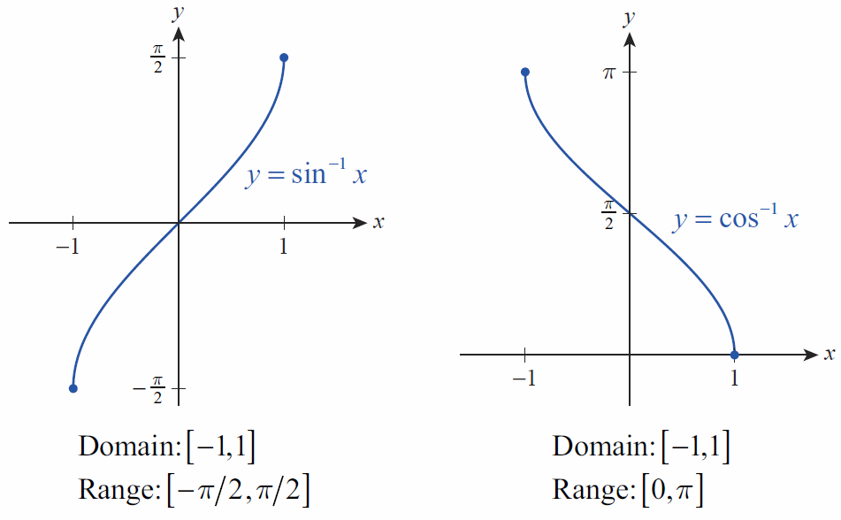
Derivatives of Inverse Trigonometric Functions

Slide 45
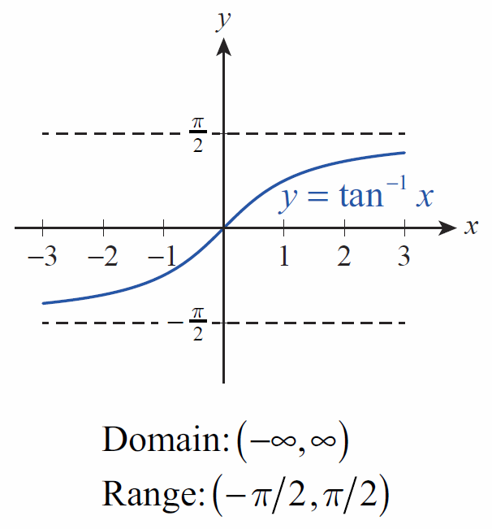
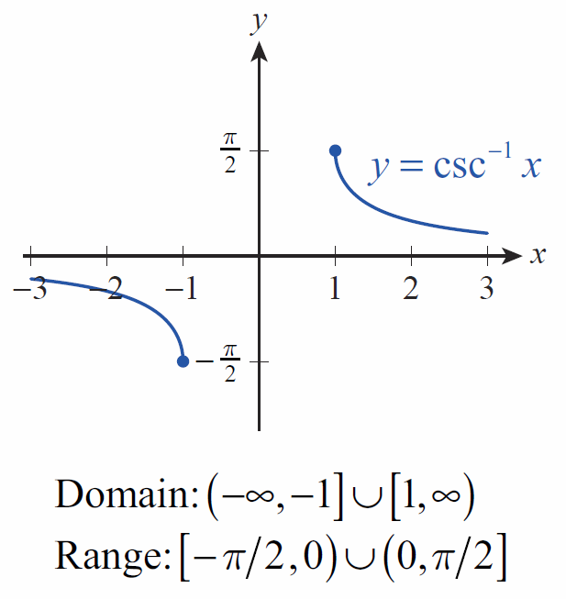
Derivatives of Inverse Trigonometric Functions

Slide 46
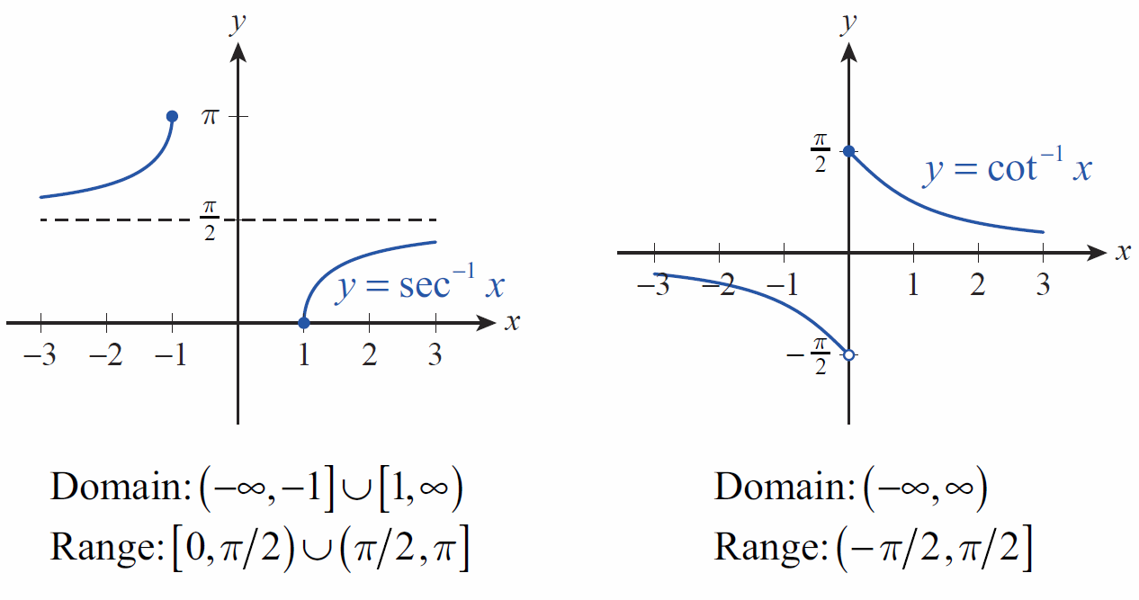
Derivatives of Inverse Trigonometric Functions

Slide 47
Derivatives of Inverse Trigonometric Functions
One advantage of this particular choice of definitions is that the following identities hold:

Slide 48
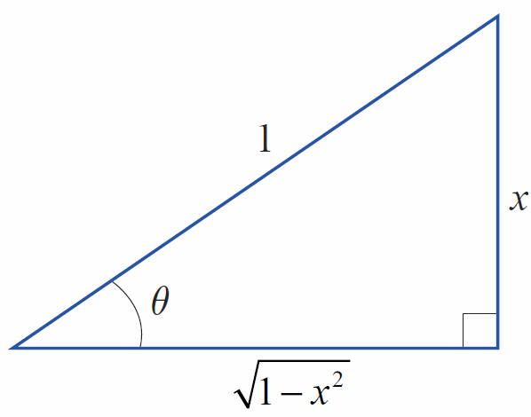
Derivatives of Inverse Trigonometric Functions
We evaluate expressions
such as by
constructing a diagram like the one in Figure 4. Start by letting θ = sin⁻¹ x, rewriting this in the equivalent form sinθ = x, and then labeling the angle, hypotenuse, and opposite side of a right triangle as shown.
Figure 4

Slide 49
Derivatives of Inverse Trigonometric Functions
Such a diagram is the pictorial representation of the statement sinθ = x, and the Pythagorean Theorem tells us that the adjacent side must consequently have a
length of The final steps are then as follows.

Slide 50
Example 8
Use this same technique to determine the derivative of tan⁻¹ x.
Solution
Again, using the second form of the Derivative Rule for Inverse Functions, we obtain

Slide 51
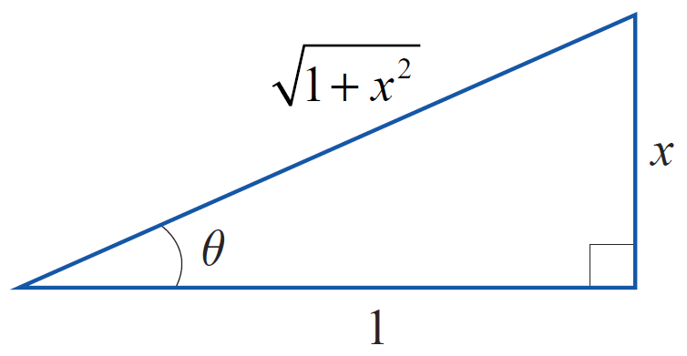
Example 8 (cont.)
Notice how the labeling in Figure 5 helps determine Since
Figure 5

Slide 52
Example 8 (cont.)
we have
Therefore,

Slide 53
Theorem: Derivatives of Inverse Trigonometric Functions
Derivatives of Inverse Trigonometric Functions

Slide 54
Example 9
Use the appropriate rules to find the following derivatives.
Solution

Slide 55
Example 9 (cont.)

