Slide 1
Section 3.7
Rates of Change in Use

Slide 2
TOPICS
Biology Applications
Physics Applications
Chemistry Applications
Business and Economics Applications

Slide 3
Biology Applications
Recall that the number e is the unique exponential base
for which that is, the exponential function with base e and its derivative are equal. A quick application of the Chain Rule then tells us that for any
constant k, an equation very much like More generally, note that if we let where c and k are both constants, then If we specify that the population at time t = 0 is P₀, then giving us the following basic population model.

Slide 4
Definition: Exponential Growth Model
Exponential Growth Model

Slide 5
Example 1
As an example of the use of the exponential growth model, suppose a strain of bacteria being cultured in a petri dish is observed to double in count every hour. That information alone is sufficient to determine the growth constant k, under the assumption that t is measured in hours, as follows.

Slide 6
Example 1 (cont.)
If the culture began with, say, P₀ = 15 bacteria, the population of bacteria (rounded to the nearest integer) and the rate of population growth (rounded to one decimal place) at the 0, 1, and 2 hour marks are as follows.

Slide 7
Example 1 (cont.)
Population | Rate of population growth

Slide 8
Theorem: Newton’s Second Law of Motion
Newton’s Second Law of Motion

Slide 9
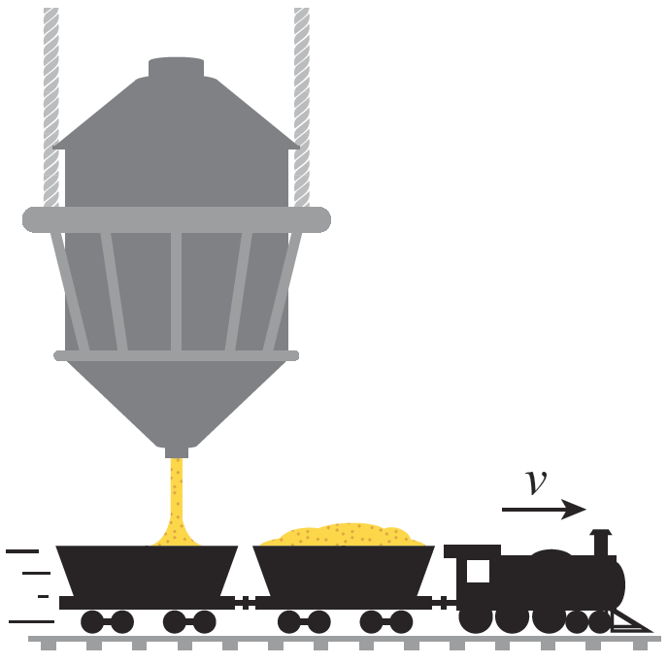
Example 2
A freight train is slowly moving forward at a constant velocity v under a hopper that is dropping grain at a constant rate into the train’s open‑topped freight cars. In order to maintain its constant velocity, the train’s engine must exert a force (beyond that necessary to counter friction) equal to the rate of change of its momentum mv. What is that force?
Figure 1

Slide 10
Example 2 (cont.)
Solution
In this setting, v is constant and hence the (or acceleration) factor is 0. But the mass is changing, and so Newton’s Second Law tells us that the force necessary to overcome the increasing load is

Slide 11
Example 2 (cont.)
Using units of kilograms (kg) for mass, meters (m) for distance, seconds (s) for time, and newtons (N) for force, if the train has a constant forward velocity of and is being loaded at a rate of the force the engine must exert is

Slide 12
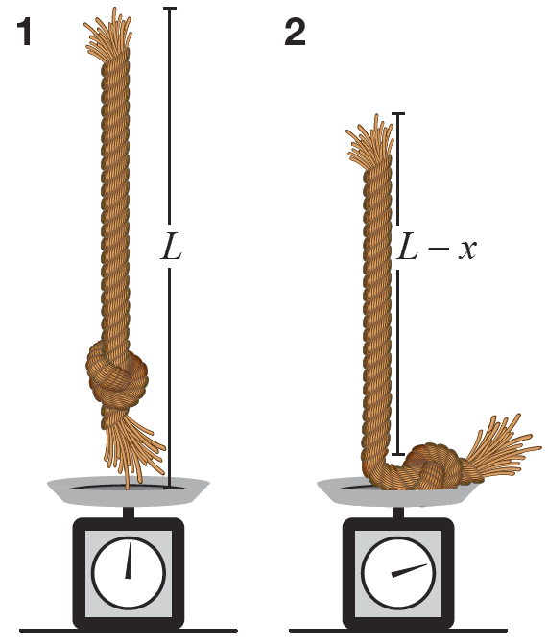
Example 3
A rope of length L and mass M is held vertically over a scale so that its lower end just touches the scale, and is then allowed to drop onto the scale. What force does the scale register as the rope drops onto it?
Figure 2

Slide 13
Example 3 (cont.)
Solution
The answer to this question after the rope has fully dropped onto the scale and is at rest is easily found with an elementary application of Newton’s Second Law: the force registering at that point is the mass of the rope M times the acceleration due to gravity g.

Slide 14
Example 3 (cont.)
The product Mg is what we normally call weight, and Mg is indeed what would show on the scale’s dial. But the more interesting question is what registers on the scale during intermediate stages when, say, a segment of length x has landed on the scale and the segment of length L − x has yet to hit.
For convenience, let m denote the mass of the segment of length x that has dropped and is lying at rest on the scale.

Slide 15
Example 3 (cont.)
At any moment in time we know that (the total mass times the fraction of the rope on the scale), but it is important to keep in mind that m is continuously changing over time from the moment the rope is dropped to the time when x = L. The number registering on the scale at any given moment reflects both the force necessary to counter the weight of the mass m and the force necessary to stop the segment of the rope just hitting the scale with velocity v. We will find the net force by determining the rate of change of momentum P (recall that P = mv).

Slide 16
Example 3 (cont.)
Newton’s Second Law tells us that
and the determination of affords a good opportunity to apply the Chain Rule. We already know how m depends on x, but it’s also true that m is a function of time.

Slide 17
Example 3 (cont.)
Thus,
and so
where we have also replaced the rate of change of velocity with the acceleration due to gravity g.

Slide 18
Example 3 (cont.)
At the moment in time when a segment of length x is lying on the scale, the portion of the rope just hitting the scale has fallen from a height of x. If v is the velocity of an object with initial velocity 0 that has fallen a distance x, it can be shown that v² = 2xg.

Slide 19
Example 3 (cont.)
This gives us

Slide 20
Example 3 (cont.)
Note that this tells us that the force registered by the scale just as the top of the rope hits (x = L) is 3Mg, and then the scale equilibrates and registers Mg soon after.

Slide 21
Chemistry Applications
A process in which a molecule of each of two reactants A and B produces a molecule of substance C is represented by
A + B → C,
and chemists often need to understand the rates of change of the concentrations of the individual substances in such a reaction.

Slide 22
Chemistry Applications
The notation [ X ] is used to denote the concentration of a substance X (typically measured in moles per liter, where 1 mole = 6.022 × 10²³ molecules), so the rates of change of the concentrations of the three substances in the reaction A + B → C correspond to the derivatives

Slide 23
Chemistry Applications
The reaction rate of a chemical process is defined as the rate of change of concentration of one of the products or, equivalently, the negative of the rate of change of concentration of one of the reactants. The negative sign is attached to the derivatives of the concentrations of the reactants because those substances are decreasing with respect to time, while the rate of change of concentration of a product is positive. In the reaction A + B → C, the reaction rate r is thus defined to be

Slide 24
Chemistry Applications
If a molecules of substance A and b molecules of substance B react to produce c molecules of the product C, denoted symbolically as
aA + bB → cC,
then the reaction rate r is

Slide 25
Example 4
Nitrogen gas N₂ and hydrogen gas H₂ react to produce ammonia NH₃ according to the process
so the reaction rate r for the process and the rates of change of concentrations of the substances are related by

Slide 26
Example 4 (cont.)
If we measure the production of ammonia as
(i.e., 1.2 moles of ammonia per liter per hour), then the rate of change of concentration of hydrogen gas is
and the rate of change of concentration of nitrogen gas is

Slide 27
Business and Economics Applications
Business models often begin with basic assumptions about the cost C(x) of producing x units of a particular product, the revenue R(x) that can be generated by selling x units, and the resultant profit function P(x) = R(x) − C(x). Once these functions are determined, economists and business strategists are then interested in the marginal cost, the marginal revenue, and the marginal profit. These three functions approximate, respectively, the cost, revenue, and profit associated with increasing production from x units to x + 1 units.

Slide 28
Definition: Marginal Cost, Marginal Revenue, and Marginal Profit
Marginal Cost, Marginal Revenue, and Marginal Profit

Slide 29
Example 5
Let w(t) represent the number of workers in a given industry at time t, and let p(t) represent each worker’s average productivity. Then the gross productivity at time t is given by g(t) = w(t) p(t). Suppose that it is known that at a specific time t the labor force is decreasing at a rate, relative to the size of the labor force, of 1 percent. This translates into the statement
(such “relative” data is often more commonly cited than “absolute” data).

Slide 30
Example 5 (cont.)
Suppose that at the same time it is also known that the average relative productivity per worker is increasing at a rate of 3 percent (note again the “relative” modifier). This second fact tells us that and we can use these two pieces of information to determine the relative rate of change of gross productivity as follows.

Slide 31
Example 5 (cont.)
So the relative rate of change of gross productivity at time t is 2 percent.

