Slide 1
Section 3.8
Related Rates

Slide 2
TOPICS
Constructing and Solving Related Rates Equations
Interlude: A Cautionary Tale

Slide 3
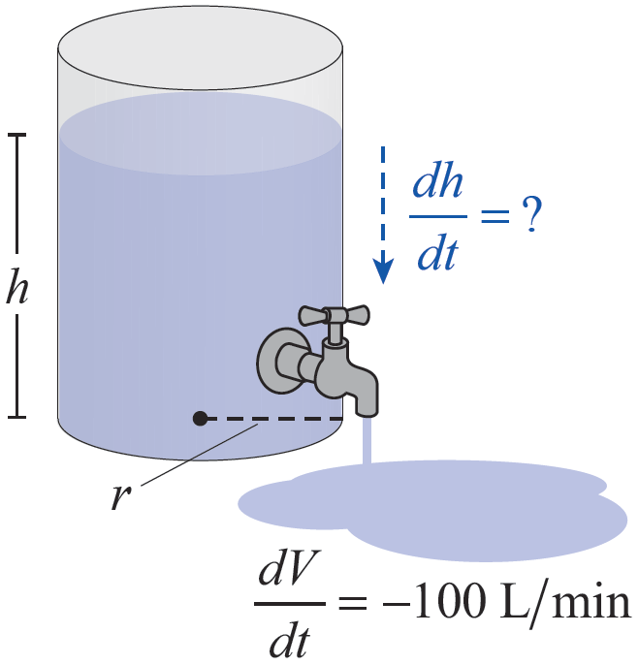
Example 1
A cylindrical water tank is being emptied at a rate of
100 liters/minute (L/min).
How quickly does the height h of the water level fall if the radius of the tank is 1 meter? How does the answer change if the radius is 10 meters? (Note that 1 liter = 0.001 cubic meters.)
Figure 1

Slide 4
Example 1 (cont.)
Solution
It is important to identify what it is exactly that we are seeking to determine and what it is that we know.
As is typical, the problem as it is given does not contain such mathematical language as “derivative” or even “rate of change,” but a careful reading of the problem reveals that we are seeking and that we are given information about the rate of change of the volume V of water in the tank.

Slide 5
Example 1 (cont.)
The next step is to relate the relevant quantities in the problem. In addition to height h and volume V, the radius r of the tank plays a role. These three physical quantities are related by the volume formula V = π r²h.
Note that we are not trying to relate rates of change at this point—that will come in the following step.
In this problem, two of the three quantities, V and h, change with respect to time t. But we also know how V depends on h. Using the Chain Rule, we now relate to as follows:

Slide 6
Example 1 (cont.)
so
We are given that and (note the negative sign, signifying a loss of volume with respect to time). So if the radius r of the tank is 1 m, then

Slide 7
Example 1 (cont.)
whereas if the radius is 10 m, then
The first rate of drop in water level is 3 centimeters per minute, which would be perceptible, while the second rate of change would be a very slow 0.3 millimeters per minute.

Slide 8
Constructing and Solving Related Rates Equations
Strategy for Solving Related Rates Problems
Step 1: Read the given information carefully and identify what is known and what needs to be found. Typically, the overall goal is to determine the rate of change of one particular variable with respect to time.

Slide 9
Constructing and Solving Related Rates Equations
Strategy for Solving Related Rates Problems (cont.)
Step 2: Identify and appropriately label the relevant quantities and draw a diagram, if possible, as an aid in determining the relationship between them. Express the known and desired quantities in terms of your chosen labels.
Step 3: Write an equation expressing the relationship between the relevant quantities. Be sure you know which of them are functions of time t.

Slide 10
Constructing and Solving Related Rates Equations
Strategy for Solving Related Rates Problems (cont.)
Step 4: Using the Chain Rule, differentiate both sides of the equation with respect to t.
Step 5: Using the given information, solve for the desired rate of change. Check your answer to see if it makes sense as a solution to the problem. Such characteristics as sign, relative magnitude, and the units of your answer are helpful cues.

Slide 11
Example 2
A hot air balloon rising straight up is being tracked by a film crew stationed 200 meters away on level ground from its takeoff point. At the moment when the balloon is 150 meters up it is rising at a rate of 50 meters per minute. How fast is the camera angle (measured with respect to the ground) increasing at that moment?
Solution
We know how fast the balloon is rising at a particular moment in time, and we are being asked to determine the rate of change of the camera angle at that moment.

Slide 12
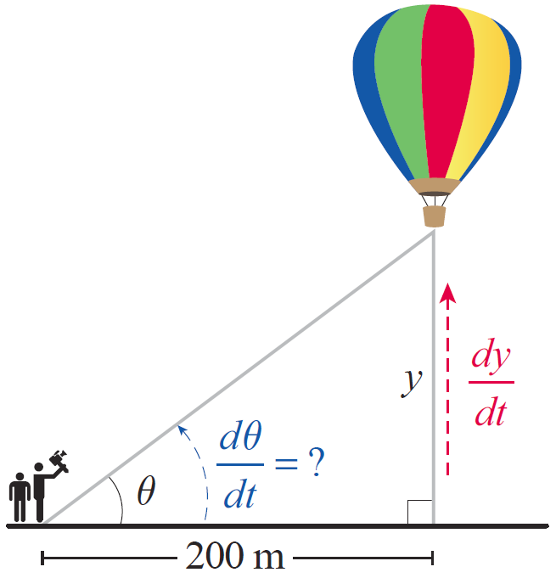
Example 2 (cont.)
Since the balloon is rising straight up from level ground, a right triangle such as the one in Figure 2 captures the essential elements of the problem. The camera crew is stationed at a fixed distance of 200 meters from the takeoff point, but the balloon’s height above the ground is changing.
Figure 2

Slide 13
Example 2 (cont.)
In the diagram, y represents the balloon’s height, and θ is the camera angle measured from the ground as it tracks the balloon’s ascent. We need to determine at the moment when y = 150 m and

Slide 14
Example 2 (cont.)
The equation defines the relationship between y and θ. Now we differentiate both sides with respect to t and solve for

Slide 15
Example 2 (cont.)
We know that but we need to perform one more computation in order to determine at the moment when y = 150 m. From the Pythagorean Theorem, the hypotenuse at that moment
is and so
Hence, we calculate the answer as follows:

Slide 16
Example 2 (cont.)
Note that this rate of change of the camera angle is in radians per minute because we implicitly assumed radian measure in applying our differentiation rules; it can also be expressed as approximately 9.2 degrees per minute.

Slide 17
Example 3
Susan is in her car, leading a group of other drivers to a restaurant. She has just completed a right turn at an intersection and is accelerating away. At the moment that she is 40 ft from the intersection and heading north at 25 ft/s, the second car in the convoy is still 40 ft away from the intersection and is approaching it at 15 ft/s. How fast is the “as the crow flies” distance between Susan and the second car increasing at that particular moment?

Slide 18
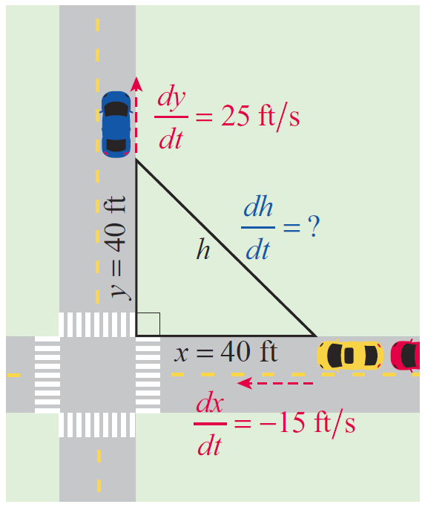
Example 3 (cont.)
Solution
We know how quickly Susan is pulling away from the intersection, how quickly the second car is approaching it, and their respective distances from the intersection at a given moment in time. We want to determine the rate of change of the actual distance between the two cars at that moment.
Figure 3

Slide 19
Example 3 (cont.)
A right triangle is again the appropriate diagram, though this time both legs (as well as the hypotenuse) of the triangle are changing with respect to time. With the labels as shown, we know that when y = 40 ft and that when x = 40 ft (note that is negative since x is decreasing). We want to determine at that particular moment.
Differentiating both sides of the relationship x² + y² = h² with respect to t yields the following:

Slide 20
Example 3 (cont.)
At the moment when y = x = 40, Substituting these numbers and the two rates that we are given, we calculate the answer.

Slide 21
Example 3 (cont.)

Slide 22
Example 3 (cont.)
The sign and magnitude of this answer are reasonable. The magnitude is comparable to the other two rates of change, and since Susan is pulling away from the intersection (thus increasing the relative distance) at a faster rate than the second car is approaching the intersection (and shortening the distance), we would expect the rate of change to be positive.

Slide 23
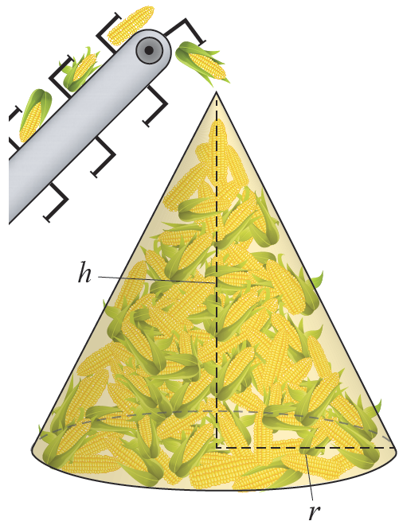
Example 4
Corn is falling from the end of a conveyor belt at a rate of 10 m³/min and is forming a conical pile below. As the corn falls, the height of the pile is remaining equal to the diameter of the base. How fast are the height and radius of the pile changing at the moment when the pile is 4 m high?
Figure 4

Slide 24
Example 4 (cont.)
Solution
If we let V denote the volume of corn in the conical pile, h the height of the pile, and r the radius of the base, then we have been given information about and want to determine and We know that h and r are related by the equation h = 2r since the height and diameter of the base remain equal to one another as the pile grows.

Slide 25
Example 4 (cont.)
Beginning with the formula for the volume of a cone and making the substitution r = h/2, we obtain the following relationship between the three variables.
Differentiating with respect to t, we have

Slide 26
Example 4 (cont.)
and substituting our given values for the rate of change of volume and the height h = 4 m, we find that
so
Note that the equation r = h/2 tells us that the rate of change of the radius is half the rate of change of the height, so

Slide 27
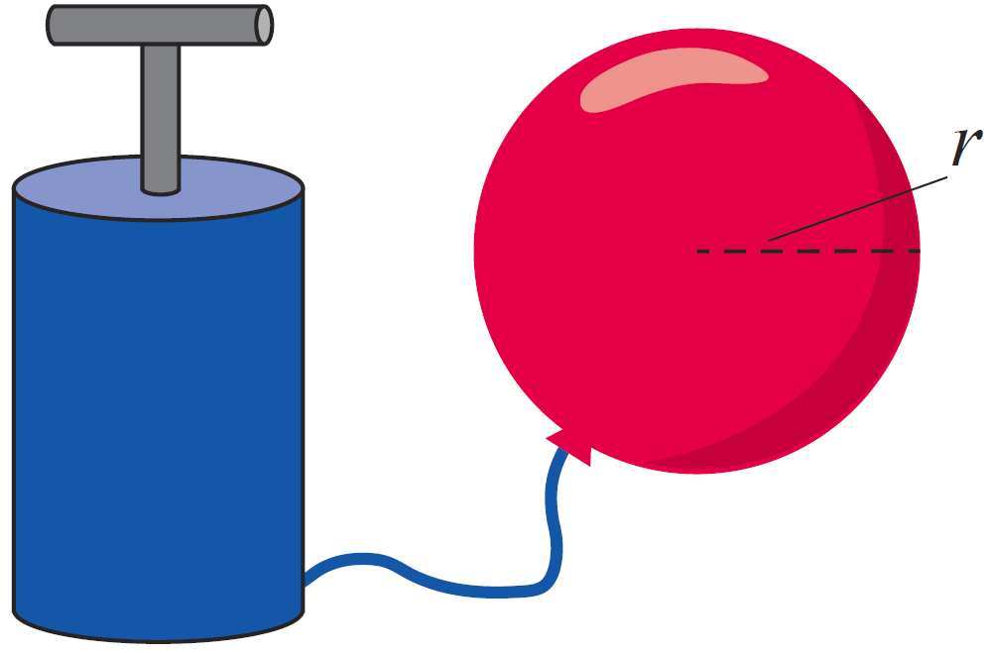
Example 5
A spherical balloon is being filled with helium at a rate of 200 cm³/s. At the moment when the radius is 20 cm, how fast is the surface area of the balloon increasing?
Figure 5

Slide 28
Example 5 (cont.)
Solution
We know the rate of change of the volume, and want to determine the rate of change of the surface area at the moment when the radius is 20 cm. If we let S denote surface area and V volume, it appears that we want to relate to This is indeed the case, but we will do so indirectly.
We can begin with the relationships that we know:

Slide 29
Example 5 (cont.)
V, S, and r are all functions of time and we can relate the following rates easily enough:
Since we know in terms of and can express in terms of our path forward is beginning to appear. Note that and that r = 20 cm at the moment in time we are interested in. So at that moment,

Slide 30
Example 5 (cont.)
Now we can calculate the rate of change of the surface area.
Note that our units of measurement are consistent with a change of area over time—such dimensional verification is a useful way to catch errors.

