Slide 1
Section 4.1
Extreme Values of Functions

Slide 2
TOPICS
Absolute and Relative Extrema
Finding Extrema

Slide 3
Definition: Absolute (Global) Extrema
Absolute (Global) Extrema
We say the function f has an absolute maximum (or global maximum) on the domain D at the point c if f(c) ≥ f(x) for all x ∈ D. Consequently f(c) is called the maximum value of f on D.
Similarly, if f(c) ≤ f(x) for all x ∈ D, we would say f has an absolute minimum (or global minimum) at c. We call f(c) the minimum value of f on D.

Slide 4
Definition: Absolute (Global) Extrema
Absolute (Global) Extrema (cont.)
These extreme values of f are termed absolute or global because they are, respectively, the largest and smallest values of the function over D.

Slide 5
Example 1
Identify the absolute extrema, if they exist.

Slide 6
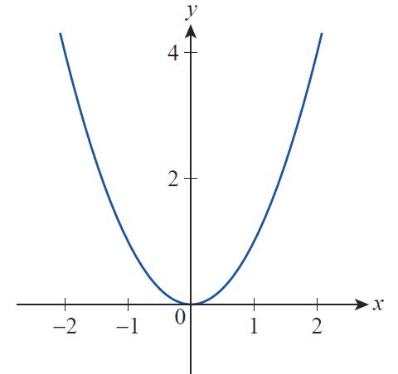
Example 1 (cont.)
Solution
a. The function f(x) = x² increases without bound as x → ±∞, so it has no absolute maximum over (−∞, ∞), But clearly f(0) = 0 is the absolute minimum over the domain.
Figure 1

Slide 7
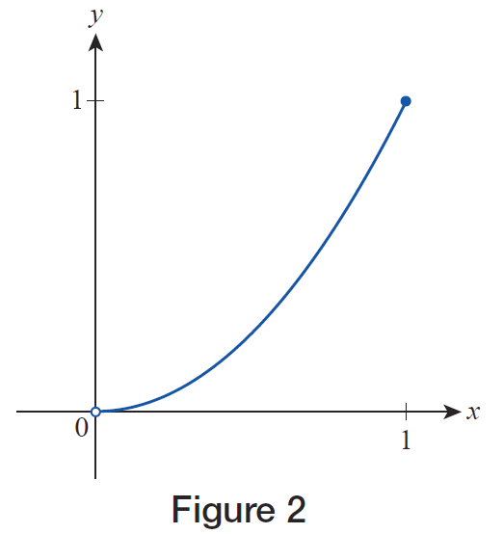
Example 1 (cont.)
b. On the interval (0, 1] f(x) = x² has an absolute maximum of f(1) = 1, but no absolute minimum value.
Figure 2

Slide 8
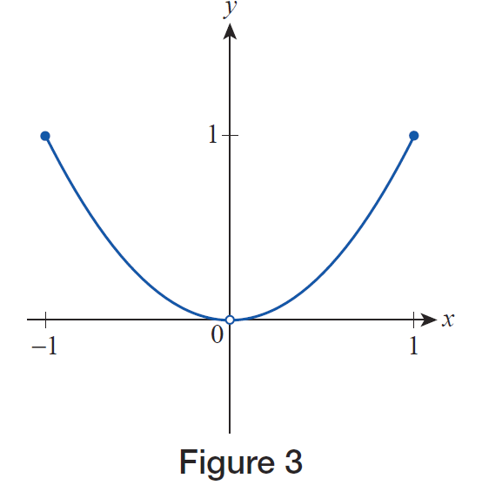
Example 1 (cont.)
c. On the domain
[−1, 0)∪(0, 1], f(x) = x² has an absolute maximum of f(−1) = f(1) = 1, but no absolute minimum.
Figure 3

Slide 9
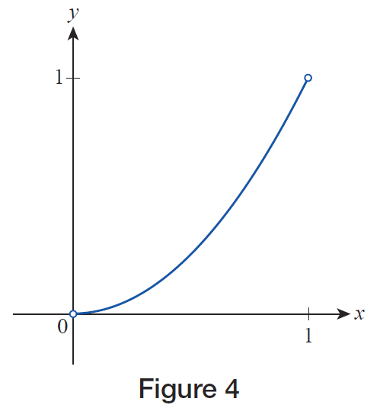
Example 1 (cont.)
d. On the interval (0, 1), f(x) = x² has neither an absolute maximum nor an absolute minimum.
Figure 4

Slide 10
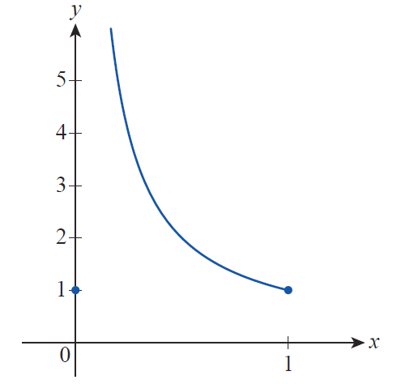
Example 1 (cont.)
e. On the domain [0, 1],
has an absolute minimum of f(0) = f(1) = 1, but no absolute maximum (note the different scales on the axes).
Figure 5

Slide 11
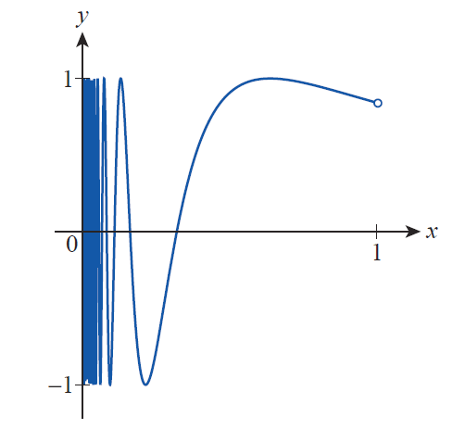
Example 1 (cont.)
f. On the interval (0, 1), f(x) = sin (1/x) attains both its absolute maximum of 1 and its absolute minimum of −1 infinitely often.
Figure 6

Slide 12
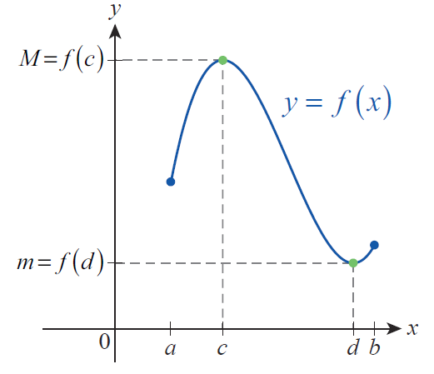
Theorem: The Extreme Value Theorem
The Extreme Value Theorem
If f is a continuous function defined on the closed interval [a,b], then there exist points c and d in [a,b] where f attains both its absolute maximum value M = f(c) and absolute minimum value
m = f(d).
Figure 7 Extreme Values

Slide 13
The Extreme Value Theorem
The Extreme Value Theorem tells us two important pieces of information:
The absolute extrema exist for a continuous function defined on a closed and bounded interval.
There are points in the interval where those extreme values are actually attained.

Slide 14
Definition: Relative (Local) Extrema
Relative (Local) Extrema
We say the function f has a relative maximum (or local maximum) at the point c if f(c) ≥ f(x) for all x in some open interval containing c.
Similarly, if f(c) ≤ f(x) for all x in some open interval containing c, we say f has a relative minimum (or local minimum) at c.

Slide 15
Definition: Relative (Local) Extrema
Relative (Local) Extrema (cont.)
We can extend the definition to the endpoints of an interval by saying f has a relative extremum at an endpoint of [a,b] if f attains its maximum or minimum value at that endpoint in a half‑open interval containing it.

Slide 16
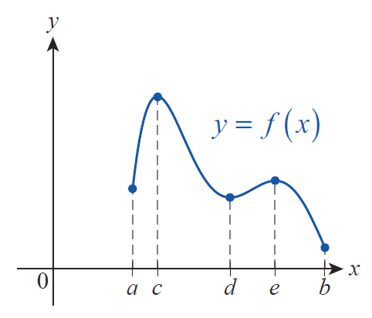
Example 2
Identify the relative and absolute extrema for the function f over the interval [a,b] graphed in Figure 8.
Figure 8

Slide 17
Example 2 (cont.)
Solution
The function has relative maxima at the points c and e, since f(c) and f(e) are the largest values f attains over small open intervals containing c and e. To illustrate this fact, a small portion of the graph focusing on (c, f(c)) is reproduced in Figure 9; note that f(c) ≥ f(x) for all x near c.
Similarly, a, d, and b are points where f has relative minima (note that a and b are also the endpoints of the interval).

Slide 18
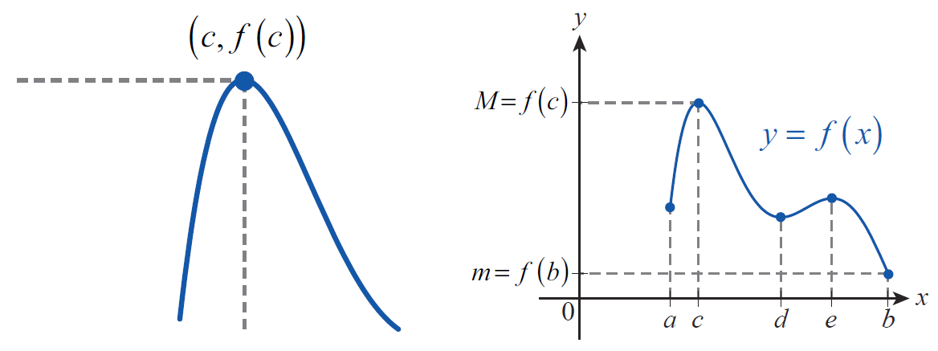
Example 2 (cont.)
By comparing the values of f at each of the five points a through e, we see that f(c) is the absolute maximum and f(b) is the absolute minimum.
Figure 9
Figure 10

Slide 19
Theorem: Fermat’s Theorem
The following theorem, the essence of which was conceived by the French mathematician Pierre de Fermat (1601–1665) even before the formalization of calculus, shows how differentiation greatly simplifies the task of finding extrema.
Fermat’s Theorem
If f has a relative extremum at a point c ∈ (a,b), and if f ’(c) exists, then f ’(c) = 0.

Slide 20
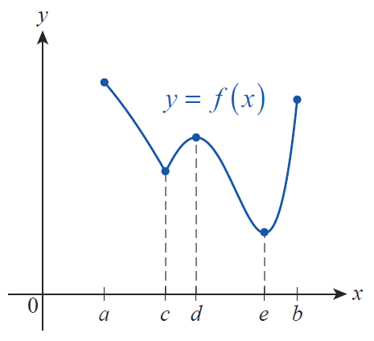
Finding Extrema
Before proving Fermat’s Theorem, it’s useful to consider a graph such as the one sketched in Figure 11. For this function, there are three points in (a,b) referred to as the interior of the interval [a,b], where relative extrema occur.
Figure 11
Applying Fermat’s Theorem

Slide 21
Theorem: Fermat’s Theorem
Proof
We will first assume that f has a relative maximum at c ∈ (a,b), and that f ’(c) exists; from these two facts, we will prove that f ’(c) = 0. A similar argument can be used to show that if f has a relative minimum at c and if f ’(c) exists, then again f ’(c) = 0.

Slide 22
Theorem: Fermat’s Theorem
Proof (cont.)
Since f ’(c) exists, we know that the limit
exists (recall that this is one
formulation of the difference quotient), and since f has a relative maximum at c, f(x) − f(c) ≤ 0 for all x close to c; this is just a different way of expressing the fact that f(c) ≥ f(x) for all x in some open interval containing c.

Slide 23
Theorem: Fermat’s Theorem
Proof (cont.)
The existence of the two‑sided limit above means both one‑sided limits exist and are equal to f ’(c), so

Slide 24
Theorem: Fermat’s Theorem
Proof (cont.)
The only number that is both nonnegative and nonpositive is 0, so f ’(c) = 0.
The only change necessary if we begin with the assumption that f has a relative minimum at c is to note that f(x) − f(c) ≥ 0 for all x sufficiently close to c and to reverse the two inequalities above.

Slide 25
Definition: Critical Point
Critical Point
Assume that f is defined on an open interval containing c. We say c is a critical point of the function f if f ’(c) = 0 or f ’(c) does not exist.
Thus if f is defined on a closed interval [a,b], the only candidates for extrema (relative or absolute) are critical points in (a,b) and the two endpoints a and b.

Slide 26
Caution
Caution
Don’t read too much into the definition of critical point and Fermat’s Theorem. Points where the derivative fails to exist are not guaranteed to be relative extrema, as the first graph in Figure 12 illustrates. Similarly, the converse of the theorem is false: points at which the derivative is 0 are not necessarily relative extrema, as seen in the second graph of Figure 12.

Slide 27
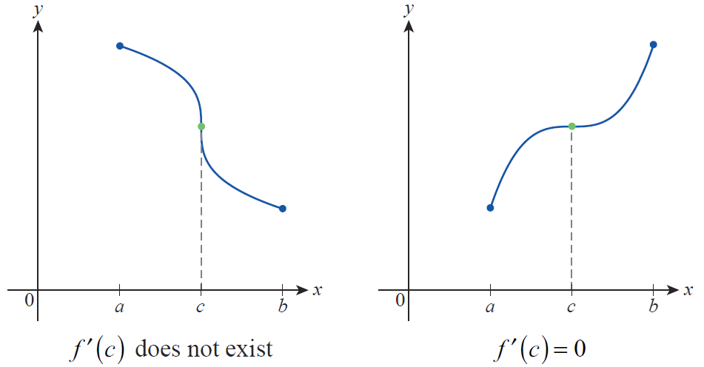
Caution
Caution (cont.)
Figure 12 Critical Points That Are Not Extreme Points

Slide 28
Finding Extrema
Together the Extreme Value Theorem and Fermat’s Theorem provide a very useful method for locating the absolute extrema of a function defined on a closed and bounded interval:
Finding Absolute Extrema
Assume that f is continuous on the interval [a,b]. To find the absolute extrema of f on [a,b], perform the following steps.
Step 1: Find the critical points of f in (a,b).

Slide 29
Finding Extrema
Finding Absolute Extrema (cont.)
Step 2: Evaluate f at each of the critical points in (a,b) and at the two endpoints a and b.
Step 3: Compare the values of the function found in Step 2. The largest is the absolute maximum of f on [a,b] and the smallest is the absolute minimum of f on [a,b].

Slide 30
Example 3
Find the absolute extrema of on the interval [−2,3].
Solution

Slide 31
Example 3 (cont.)
The derivative of f is defined for all real numbers. So the only critical points are those where f ’(x) = 0; the solutions of this equation are 0, 2, and −1, all of which are in the interval [−2,3]. We now compute f at the endpoints and the three critical points in the given interval.

Slide 32
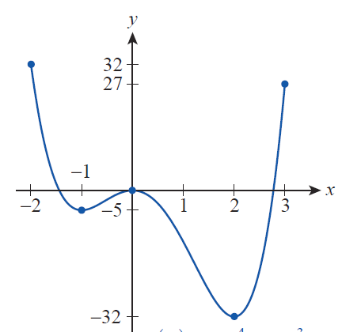
Example 3 (cont.)
 | Point in [−2, 3]
 | Left endpoint
 | Critical point
 | Critical point
 | Critical point
 | Right endpoint
Figure 13

Slide 33
Example 3 (cont.)
Comparing these values, we see that the absolute maximum of f on [−2,3] is f(−2) = 32 and that the absolute minimum is f(2) = −32.

Slide 34
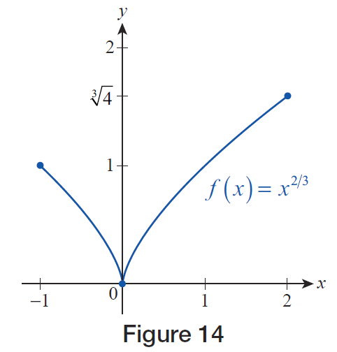
Example 4
Find the absolute extrema of on the interval [−1,2].
Solution
Figure 14

Slide 35
Example 4 (cont.)
The derivative of f is never 0. Since f ’ is, however, undefined at x = 0, 0 is the one critical point of f. Comparing the values of f at the two endpoints and 0 we have:
So the absolute minimum value of f on [−1,2] is 0 and the absolute maximum value is

Slide 36
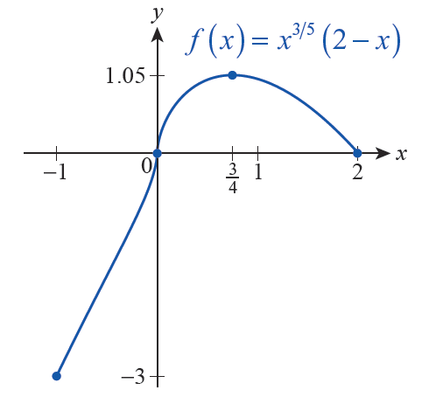
Example 5
Find the absolute extrema of on the interval [−1,2].
Solution
We can use the Product Rule to find f ’, as follows.
Figure 15

Slide 37
Example 5 (cont.)
From this, we see that f ’ does not exist at x = 0, and that We now note that f(−1) = −3, f(0) = 0,
and f(2) = 0. So f has its absolute
minimum value of −3 at the left endpoint of [−1,2], and its absolute maximum value of approximately 1.05 at

Slide 38
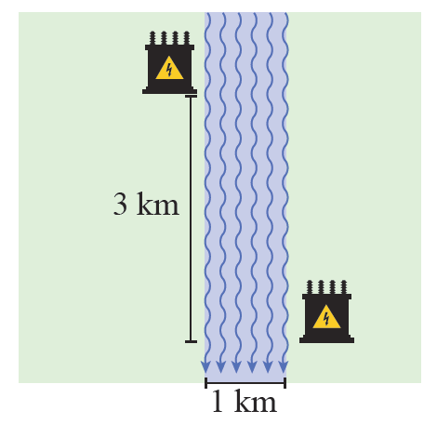
Example 6
A new electrical power substation is being built on the right bank of a river. Cables to the substation need to be laid underground and underwater from another substation 3 kilometers upstream and on the opposite bank.
Figure 16

Slide 39
Example 6 (cont.)
The river follows a straight route through this stretch and has a fairly constant width of 1 kilometer. Given that the cost of laying cable underground is $30,000/km and the cost of laying cable underwater is $50,000/km, how should the cable be laid in order to minimize cost?
Solution
Even bearing in mind that the shortest distance between two points is a straight line, there are an infinite number of reasonable solutions to this problem.

Slide 40
Example 6 (cont.)
One very elementary approach would be to simply lay all the cable diagonally underwater in one straight shot, but given the fact that underwater installation is more expensive than underground installation, this is unlikely to be the most economical solution. Another approach would be to cross the river in the shortest possible path (so as to minimize underwater installation) and then run cable 3 kilometers along the bank of the river. But any combination of the two approaches is also a possibility, and some combination may lead to the absolute minimum cost. Calculus allows us to find that optimal solution.

Slide 41
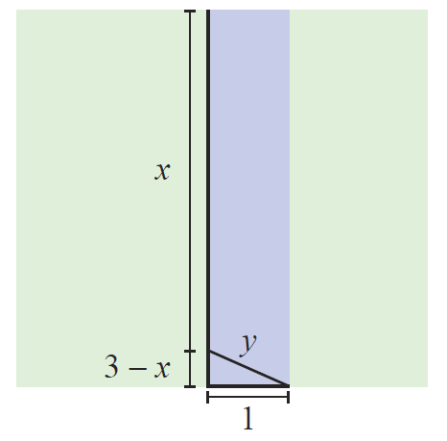
Example 6 (cont.)
We will begin with a schematic that defines and relates the variables in the problem. We can assume that the underground installation follows the left bank of the river, as shown in Figure 17. Let x represent the length of the underground cable in kilometers.
Figure 17

Slide 42
Example 6 (cont.)
Let y then represent the length of the underwater installation. (We could have proceeded by first crossing the river and then laying cable down the right bank, but for given lengths x and y the cost would be the same.)
Note that x = 0 corresponds to the solution in which all the cable is underwater, and x = 3 corresponds to the solution in which the shortest length of underwater installation (y = 1) is called for. Any value for x in the interval [0,3] corresponds to an intermediate solution.

Slide 43
Example 6 (cont.)
From the diagram, so and the total cost of laying the cable for a given value of x is as follows.

Slide 44
Example 6 (cont.)
We are looking for the absolute minimum of the function C on the interval [0,3], so we proceed to find the critical points of C.

Slide 45
Example 6 (cont.)
The derivative C’ exists for all x, but there are two values of x for which C’(x) = 0.

Slide 46
Example 6 (cont.)
The point does not actually solve the original equation, so we only have to evaluate C at the two endpoints 0 and 3 and at the critical point

Slide 47
Example 6 (cont.)
From this comparison, we see that the minimal cost of installation can be achieved by laying the cable with an underground run of and a diagonal
run underwater of

