Slide 1
Section 4.2
The Mean Value Theorem

Slide 2
TOPICS
Rolle’s Theorem and the Mean Value Theorem
Consequences of the Mean Value Theorem

Slide 3
Rolle’s Theorem and the Mean Value Theorem
Our development begins with a preliminary observation first proved by the French mathematician Michel Rolle (1652–1719) in 1691. Suppose f is a function that is continuous on the interval [a,b] and suppose further that f has the same value at the two endpoints a and b, as illustrated in Figure 1. Your intuition may suggest that if the graph of f begins and ends with the same value and varies in a sufficiently “smooth” manner over the interval, then there must be at least one point c where it has a horizontal tangent line.

Slide 4
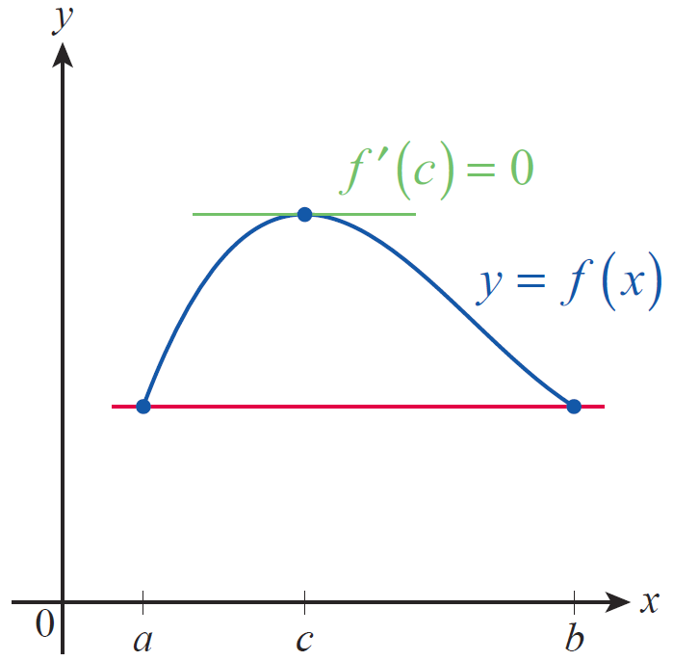
Rolle’s Theorem and the Mean Value Theorem
This is exactly what Rolle’s Theorem guarantees, and the precise property corresponding to a “smoothly” varying graph is differentiability on the open interval (a,b).
Figure 1

Slide 5
Theorem: Rolle’s Theorem
Rolle’s Theorem
If f is continuous on the closed interval [a,b] and differentiable on (a,b), and if f(a) = f(b), then there is at least one point for which

Slide 6
Theorem: Rolle’s Theorem
Proof
Because f is continuous on the closed interval [a,b], the Extreme Value Theorem tells us that f attains its absolute maximum and minimum values on [a,b]. If f attains both its absolute maximum and absolute minimum at an endpoint of the interval, then f is a constant function on [a,b] (note that in this case f(x) = f(a) = f(b) for all x in the interval) and so we know that for all proving the claim.

Slide 7
Theorem: Rolle’s Theorem
Proof (cont.)
If, on the other hand, f assumes either its absolute maximum or absolute minimum at an interior point then f(c) is a relative extremum of the function and by Fermat’s Theorem since by assumption exists for all x in (a,b).

Slide 8
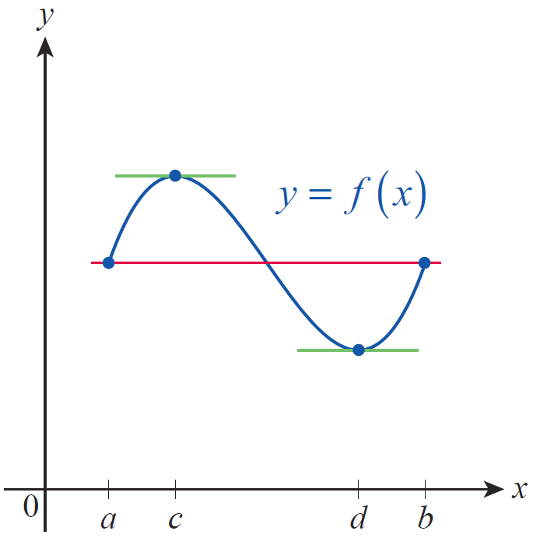
Rolle’s Theorem and the Mean Value Theorem
There may be more than one point in (a,b) where f has a horizontal tangent line when the hypotheses of Rolle’s Theorem are satisfied, but in practice it suffices to know for certain that there is at least one such point. Theorems of this sort are known as existence theorems, and they often provide great insight into the nature of objects under study. Note that in Figure 2, f ’(c) = f ’(d) = 0.
Figure 2

Slide 9
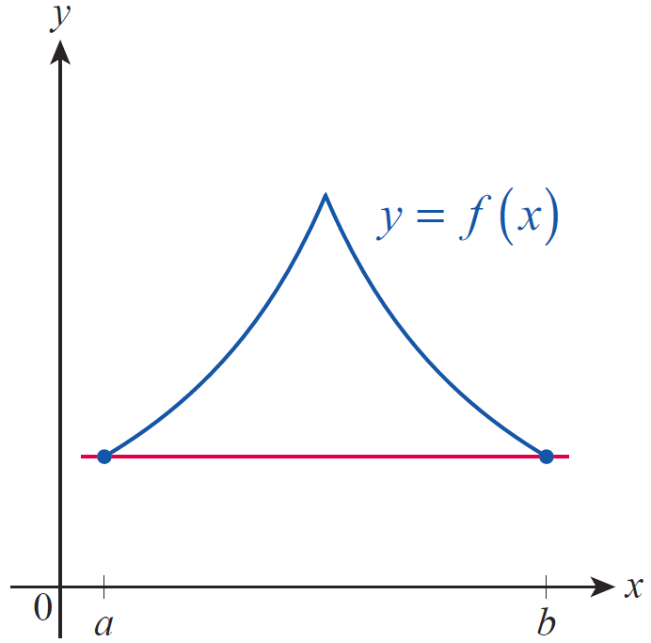
Rolle’s Theorem and the Mean Value Theorem
In Figure 3, there is no point c in [a,b] for which f ’(c) = 0, but this does not violate Rolle’s Theorem as the function is not differentiable everywhere on (a,b).
Figure 3

Slide 10
Example 1
Show that the equation x⁵ + 3x = 2 has exactly one real solution.
Solution
Let f(x) = x⁵ + 3x − 2. Then which is defined and positive (in fact, greater than or equal to 3) for all real x. If there were two solutions x = a and x = b of the equation x⁵ + 3x = 2, then we would have f(a) = 0 = f(b), and by Rolle’s Theorem there would then be a point c between a and b for which contradicting for all x. So x⁵ + 3x = 2 has no more than one solution.

Slide 11
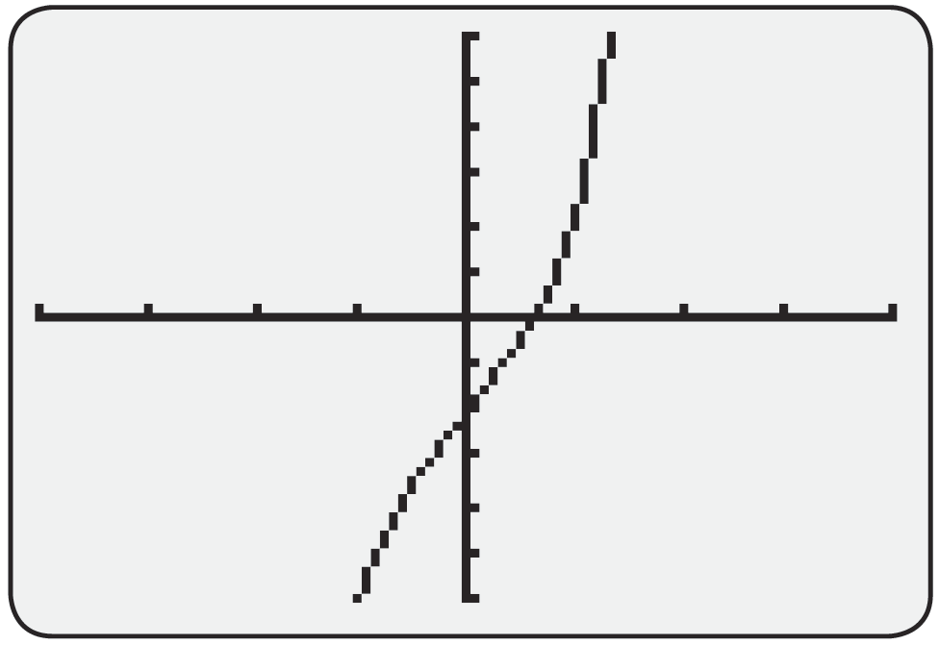
Example 1 (cont.)
The fact that it does have a solution follows from the observation that and so by the Intermediate Value Theorem there is a point c between 0 and 1 for which f(c) = 0.

Slide 12
Example 2
Suppose that f(t) is a differentiable function describing the location at time t of an object moving along a straight line. If f(t₁) = f(t₂) for two points in time t₁ and t₂, then there must be a time t₃ between t₁ and t₂ for which That is, the velocity of the object at t₃ is 0.
As a particular example, if h(t) represents the vertical height of a thrown object with, say, h(t₁) = h(t₂) = 0, then h’(t₃) = 0 and h(t₃) represents the maximum height achieved by the object.

Slide 13
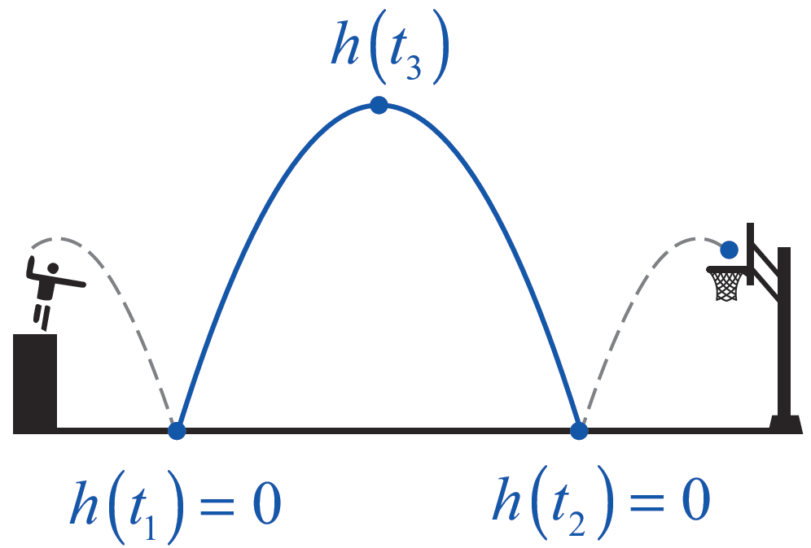
Example 2 (cont.)
(Note that in this example, h(t) represents the motion up and down relative to ground level. The object may also travel horizontally, as shown in Figure 5, but such motion happens independently of h(t) and would be measured by another function.)
Figure 5

Slide 14
Theorem: The Mean Value Theorem
The Mean Value Theorem (MVT) is a generalization of Rolle’s Theorem. It provides the same sort of insight into the behavior of a function defined on an interval [a,b] while relaxing one of the hypotheses.
The Mean Value Theorem
If f is continuous on the closed interval [a,b] and differentiable on (a,b), then there is at least one point
for which

Slide 15
Rolle’s Theorem and the Mean Value Theorem
In preparation for proving the MVT, it’s important to understand geometrically what it says. Figure 6 on the next slide shows how the MVT can be viewed as a “slanted” version of Rolle’s Theorem, in that it guarantees the existence of at least one point at which the line tangent to the graph of f is parallel to the secant line through and

Slide 16
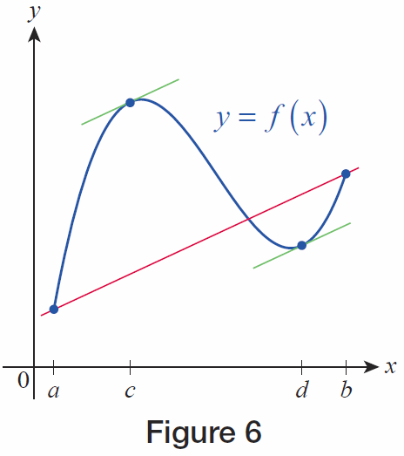
Rolle’s Theorem and the Mean Value Theorem
In Figure 6, this conclusion is actually true for two points c and d in the interval.
Figure 6

Slide 17
Theorem: The Mean Value Theorem
Proof
The sort of depiction shown in Figure 6 points the way toward a proof of the MVT: if we can modify the function under consideration by “unslanting” it, we can then apply Rolle’s Theorem.

Slide 18
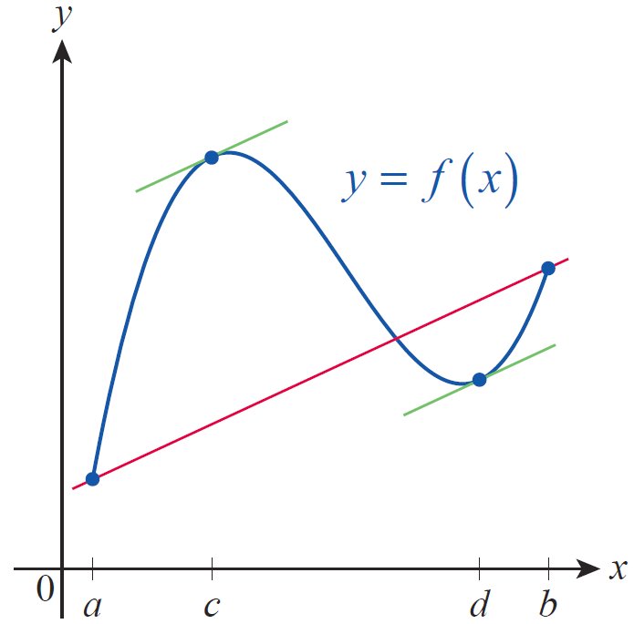
Theorem: The Mean Value Theorem
Proof (cont.)
To do this, we want to
consider a new function
defined as the difference
between f and the function
whose graph is the secant line
passing through (a, f(a)) and
(b, f(b)), shown in red in the
figure.
Figure 6

Slide 19
Theorem: The Mean Value Theorem
Proof (cont.)
The slope of the secant line is
So is an equation for the secant line in point‑slope form; solving for y, the secant line is the graph of the function If we now define a new function g by

Slide 20
Theorem: The Mean Value Theorem
Proof (cont.)
then we have, by design, constructed a function for which
and
That is, satisfying one of the hypotheses of Rolle’s Theorem.

Slide 21
Theorem: The Mean Value Theorem
Proof (cont.)
The other two hypotheses of Rolle’s Theorem are also satisfied by g. Since L is continuous on [a,b] and differentiable on (a,b) as is f , then g = f − L possesses these two properties as well. Rolle’s Theorem thus tells us there is at least one point c in (a,b) for which

Slide 22
Theorem: The Mean Value Theorem
Proof (cont.)
Since we have
or

Slide 23
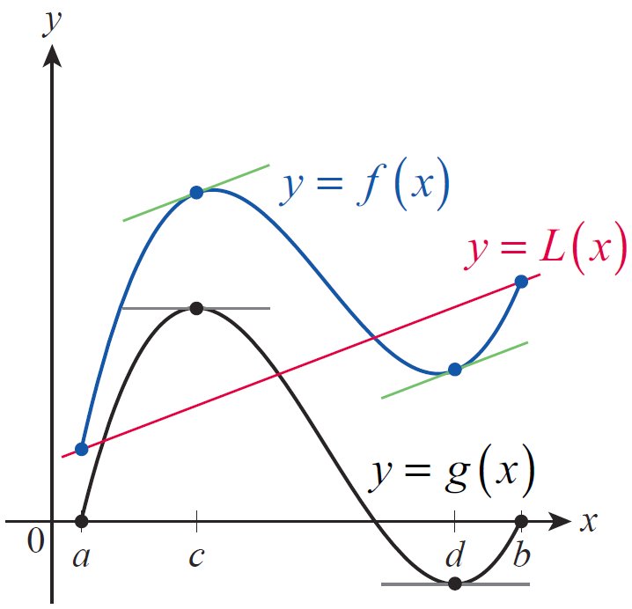
Rolle’s Theorem and the Mean Value Theorem
Figure 7 illustrates the process of subtracting the secant line L from the function f of Figure 6 in preparation for applying Rolle’s Theorem. Note that c and d are points where g has horizontal tangent lines and f has tangent lines with slope m_{sec}.
Figure 7

Slide 24
Example 3
The function is differentiable everywhere, so it satisfies the hypotheses of the Mean Value Theorem over any closed, bounded interval. Find the point(s) satisfying the conclusion of the MVT over the interval [0,4].
Solution
We begin by calculating the slope of the secant line over the interval.

Slide 25
Example 3 (cont.)
The Mean Value Theorem guarantees the existence of at least one point where but we want to go one step further and actually find the point (or points). Since we proceed to solve the equation

Slide 26
Example 3 (cont.)

Slide 27
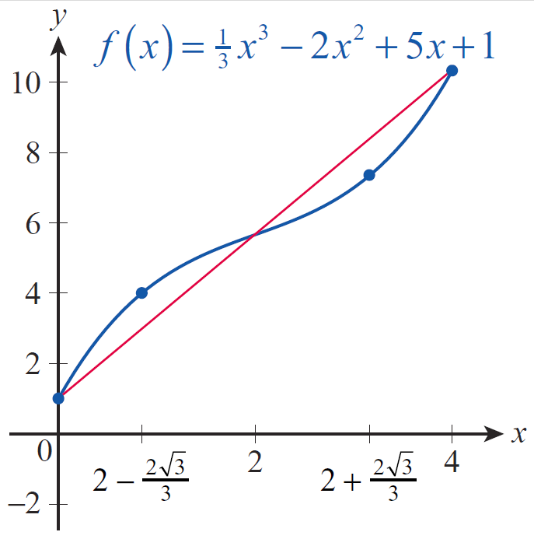
Example 3 (cont.)
These two solutions, approximately equal to 0.85 and 3.15, both satisfy the conclusion of the MVT.
Figure 8

Slide 28
Consequences of the MVT
Recall that a discussion of average and instantaneous velocities was one of the motivating examples we used to develop the concept of differentiation. The MVT provides a more quantitative connection between these ideas.

Slide 29
Example 4
An aerial surveillance crew is monitoring traffic on the roads below and timing the passage of cars between painted road marks that are 1 mile apart. The crew spots a distinctive yellow Lotus Elise and records its passage between two marks at 47 seconds. What speed can the crew assert the Elise must have reached during the 47 seconds?

Slide 30
Example 4 (cont.)
Solution
If we let f(t) denote the position of the Elise along the stretch of road over the time interval [0,47], then f ’(t) denotes the car’s velocity and the Mean Value Theorem guarantees that there is at least one for which
That is, at least once over the mile‑long stretch of road, the Elise was moving at a rate of approximately 77 miles per hour.

Slide 31
Theorem: Corollary 1
We already know that a constant function has a derivative of zero at all points of its domain, but we don’t yet know that the converse is true. That is, does the fact that f’(x)=0 for all x in a given interval mean that f is a constant function? The MVT provides an elegant answer to this question.
Corollary 1
If f ‘(x) = 0 for each x in an open interval (a,b), then f is constant on (a,b).

Slide 32
Theorem: Corollary 1
Proof
We will show that given any two distinct points x₁ and x₂ in (a,b), f (x₁) = f (x₂). Since x₁ ≠ x₂, one is less than the other; we can assume x₁ < x₂. The fact that f is differentiable on all of (a,b) means that f is continuous on [x₁, x₂], and differentiable on (x₁, x₂), so by the MVT there is a point such that

Slide 33
Theorem: Corollary 1
Proof (cont.)
But since f ‘ is 0 throughout (a,b), this means that
so

Slide 34
Theorem: Corollary 2
While much of the focus of this text has been on differentiation, Corollary 1 is a good illustration of what knowledge of a function’s derivative tell us about the function itself. The next corollary is similar in nature.
Corollary 2
If f ‘(x) = g‘(x) for all x in an open interval (a,b), then there is a constant C such that f(x) = g(x) + C for all

Slide 35
Theorem: Corollary 2
Proof
Since f ’(x) = g‘ (x) we know that for all x in (a,b). So by Corollary 1, it must be the case that f − g is a constant function on (a,b). That is, there is a constant C such that (f – g)(x) = C for all or

Slide 36
Example 5
Suppose that f(0) = −2 and that for all x. What is the largest possible value of f(4)?
Solution
The implication is that f ‘ exists everywhere, so f is certainly continuous on [0,4] and differentiable on (0,4). So by the MVT,
for some

Slide 37
Example 5 (cont.)
Since for all x, rearranging the above equation gives us the following.
Hence the largest possible value of f(4) is 10.

Slide 38
Example 6
Find the unique function f whose derivative is 3x² and whose graph passes through (1,5).
Solution
By now, we have differentiated enough polynomials to recognize 3x² as the derivative of x³. If we let g(x) = x³, then g and f have the same derivative and by Corollary 2 it must be the case that f(x) = g(x) + C for some constant C. We can determine C as follows.

Slide 39
Example 6 (cont.)
Now it can be easily verified that f(x) = x³ + 4 satisfies the given criteria, and by Corollary 2 it is the unique function to do so.

