Slide 1
Section 4.3
The First and Second Derivative Tests

Slide 2
Topics
First Derivative Tools
Second Derivative Tools

Slide 3
First Derivative Tools
In our first example of an application of Rolle’s Theorem in Section 4.2, we used the fact that f ’(x) was positive for all x to show that the equation f(x) = 0 couldn’t have more than one solution. The reasoning in that example can be extended to make the following more general observations.

Slide 4
Theorem: Monotonicity Test
Monotonicity Test
Assume f is differentiable at all points of an interval I.
1. If for all x ∈ I, then f is strictly increasing on I.
2. If for all x ∈ I, then f is strictly decreasing on I.
In other words, if is either entirely positive or entirely negative on I, then f is strictly monotonic on I. (Note that I may be an unbounded interval.)

Slide 5
Theorem: Monotonicity Test
Proof
Following the definition of strict monotonicity (Section 1.1), we start by assuming x₁, x₂ ∈ I with x₁ < x₂. Since exists on all of I, we know that f is continuous on [x₁,x₂] and differentiable on (x₁,x₂); by our definition of one‑sided differentiation, this conclusion is true even if x₁ or x₂ is an endpoint of I.

Slide 6
Theorem: Monotonicity Test
Proof (cont.)
Now, by the Mean Value Theorem, there is a point c ∈ (x₁,x₂), such that

Slide 7
Theorem: Monotonicity Test
Proof (cont.)
Since x₂ − x₁ > 0, the right‑hand side of the above equation is either positive if is positive or negative if is negative, leading to the respective results of or Since this can be done for each such pair of points x₁ and x₂, we are done.

Slide 8
The Monotonicity Test
In practice the Monotonicity Test is used to find intervals where a function is monotonic by first locating the function’s critical points. If a and b are successive critical points of f and if f ’ exists on all of (a,b), then f ’ must be either positive or negative on (a,b). The easiest way to determine which is to evaluate f ’ at a test point in (a,b) as shown in the next example.

Slide 9
Example 1
Determine the intervals of monotonicity of the function
Solution
The critical points of f are −2, 0, and 1. These divide the real line (the domain of f) into the open intervals and The following table indicates the sign of and the corresponding monotonicity of f in each of these intervals as determined by evaluating at a convenient test point.

Slide 10
Example 1 (cont.)
Interval
f ’ at test point
Sign of f ’ | − | + | − | +
Monotonicity of f | Decreasing | Increasing | Decreasing | Increasing

Slide 11
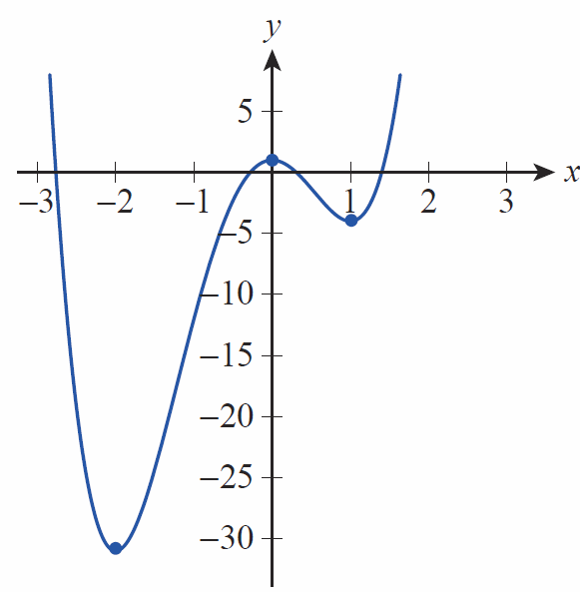
Example 1 (cont.)
So, f is decreasing on (−∞, −2) and (0,1) and increasing on (−2,0) and (1,∞) as shown in Figure 1.

Slide 12
Example 1 (cont.)
Note that we are actually only interested in the sign of at each test point, and this can typically be determined very quickly, especially if has been factored as in this example—there is no need to determine the actual numerical value of

Slide 13
First Derivative Tools
Given a differentiable function defined on an open interval, Fermat’s Theorem tells us that relative extrema occur only at critical points, but we’ve seen that not every critical point is a relative extremum—we need a test that we can apply to critical points.

Slide 14
Theorem: First Derivative Test
First Derivative Test
Suppose c is a critical point of a function f that is continuous on an open interval containing c and differentiable on the same interval, except possibly at c itself. Moving through c from left to right,
1. if changes from positive to negative at c, then f has a relative maximum at c;

Slide 15
Theorem: First Derivative Test (cont.)
First Derivative Test (cont.)
2. if changes from negative to positive at c, then f has a relative minimum at c;
3. if does not change sign at c (that is, if it is either positive on both sides of c or negative on both sides of c), then f does not have a relative extremum at c.

Slide 16
Theorem: First Derivative Test (cont.)
Proof
The conclusions of the First Derivative Test follow from applying the Monotonicity Test and determining whether f is increasing or decreasing to the left and to the right of a given critical point c. If, for instance, f is an increasing function to the left of c and a decreasing function to the right of c, then f has a relative maximum value at c. Figure 2 illustrates some of the possible combinations of intervals of monotonicity and critical points.

Slide 17
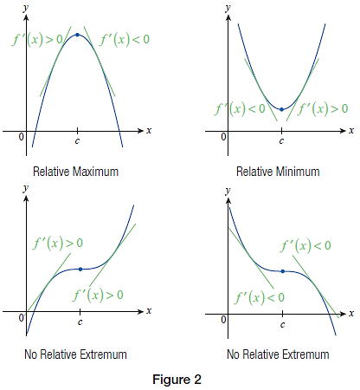
Theorem: First Derivative Test (cont.)

Slide 18
Example 2
Find the critical points of and then use the First Derivative Test to locate the relative extrema of f.
Solution
We note first that f is continuous everywhere, and then proceed to find

Slide 19
Example 2 (cont.)

Slide 20
Example 2 (cont.)
Factoring makes it clear that the three critical points of f are 0 (where is undefined) and ±1 (where is 0).
We can now quickly determine the sign of on each of the intervals between critical points, making use of the factored form. The following table shows this information.

Slide 21
Example 2 (cont.)
Interval
f ’ at test point
Sign of f ’ | + | − | − | +
Monotonicity of f | Increasing | Decreasing | Decreasing | Increasing

Slide 22
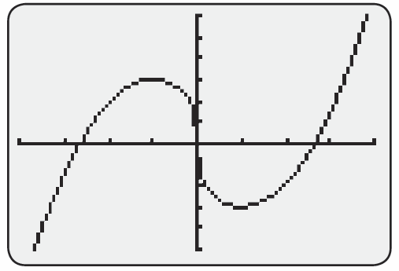
Example 2 (cont.)
The First Derivative Test now tells us that f has a local maximum at −1, a local minimum at 1, and 0 is neither a local maximum nor minimum. The values of these local extrema are, respectively, and
Figure 3 confirms our findings.

Slide 23
Second Derivative Tools
In reading a detailed analysis of, say, national economic trends, you might run across a complicated‑sounding phrase like “the rate of growth is expected to decrease” or “the pace of increase picked up in the third quarter.” What do these statements actually mean?

Slide 24
Second Derivative Tools
These phrases are saying something about the rate of change of a rate of change—in other words, they refer to the second derivative of a quantity. Geometrically, they tell us whether the slopes of the tangent lines of a function are decreasing or increasing as we scan the graph from left to right. Figure 4a on the next slide illustrates the first sort of situation and Figure 4b the second.

Slide 25
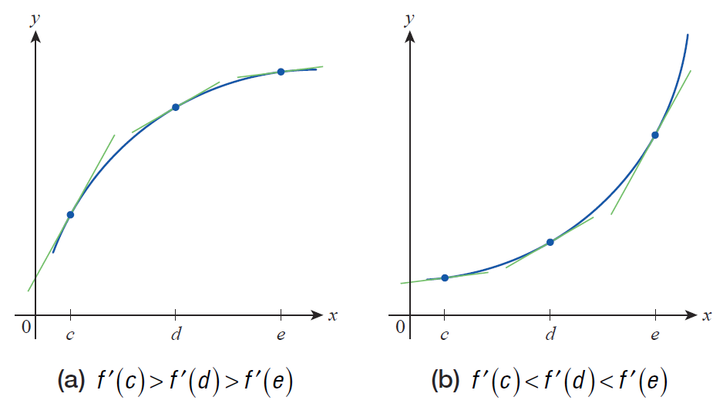
Second Derivative Tools
Figure 4 Decreasing and Increasing Slopes of Tangent Lines

Slide 26
Definition: Concavity
Concavity
Given a differentiable function f on an interval I, we say f is concave up on I if is an increasing function on the interval and concave down on I if is a decreasing function on the interval.

Slide 27
Second Derivative Tools
Equivalently, we could define a concave up function as one that lies above all of its tangent lines on an interval and a concave down function as one that lies below all of its tangent lines (note how the graphs in Figure 4 illustrate downward and upward concavity by either definition).

Slide 28
Theorem: Concavity Test
Concavity Test
Assume f is twice differentiable at all points of an interval I.
1. If for all x ∈ I, then f is concave up on I.
2. If for all x ∈ I, then f is concave down on I.

Slide 29
Example 3
Determine the intervals of concavity of the function
Solution
We identified the intervals of monotonicity for this function in Example 1, and we will resume our study of f by determining its second derivative.

Slide 30
Example 3 (cont.)
Using the quadratic formula to solve the equation
yields the two solutions of or
approximately −1.22 and 0.55. Since these are the only two points where is 0, we would expect (and Figure 5 would lead us to believe) that will be either consistently positive or consistently negative on each of the three intervals defined by the two points. We proceed then to make a table to determine the sign of on each interval.

Slide 31
Example 3 (cont.)
Interval
at test point
Sign of | + | − | +
Concavity of f | Concave up | Concave down | Concave up

Slide 32
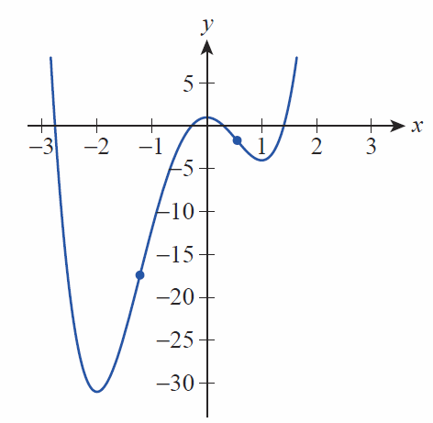
Example 3 (cont.)
The three test points of −2, 0, and 1 were chosen merely for convenience—they lie in the interior of each interval, and it is relatively easy to compute
at each. Note the behavior of f at each of the two points where as shown in the graph in Figure 5.

Slide 33
Second Derivative Tools
In Example 3, we determined the intervals of concavity of f by locating those points where f ” changed sign, a process very similar to determining intervals of monotonicity. Informally, Darboux’s Theorem (Section 3.1) says that derivatives always possess the Intermediate Value Property, so f ” (being the derivative of f ’) can only change sign at a point where it is zero or where it is undefined.

Slide 34
Second Derivative Tools
Keep in mind, however, that points where f ” is either undefined or zero are only candidates for points where the concavity of f may change, and the concavity on either side of such a point must be checked in order to determine whether it actually does change. For example, if f (x) = x⁴, f ”(x) = 12x² and hence f ”(0) = 0, but f is concave up everywhere (f ” is always nonnegative).

Slide 35
Definition: Inflection Point
Inflection Point
A point on the graph of a function f is called an inflection point if f is continuous there and changes concavity from upward to downward or from downward to upward. If the graph has a tangent line at the inflection point, the graph will cross the tangent line at that point.

Slide 36
Definition: Inflection Point
Inflection Point (cont.)
An alternate definition found in some settings requires the graph of f to actually possess a tangent line at the point of inflection, a stronger condition than just being continuous and one that guarantees the crossing behavior.

Slide 37
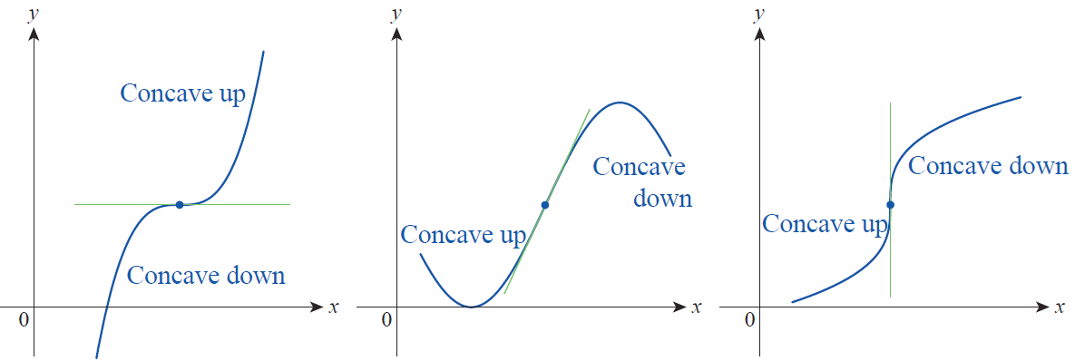
Second Derivative Tools
Note that, as shown in Figure 6, f ’ can have any value or be undefined at a point of inflection. f ”, however, will either be zero or undefined at such points.
Figure 6

Slide 38
Second Derivative Tools
Inflection points occur in many different settings and go by many different names. The commonly heard phrase “point of diminishing returns” actually refers to a point of inflection. What does this phrase mean in economics?

Slide 39
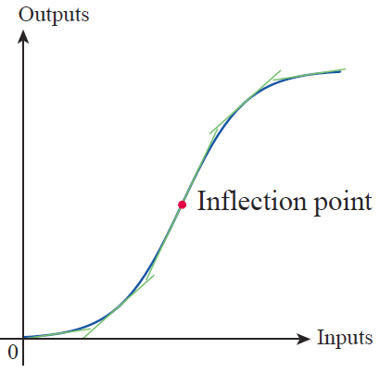
Second Derivative Tools
It doesn’t mean that production actually starts to decline at that point, but it does mean that the rate of growth of productivity becomes negative; that is, the graph of the outputs versus the inputs changes concavity.
Figure 7

Slide 40
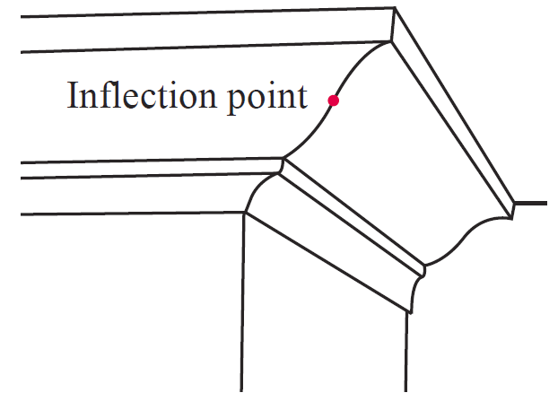
Second Derivative Tools
The ogee curve in architecture contains an inflection point. Ogee curves are often found in crown molding and in the designs of building columns.
Figure 8

Slide 41
Second Derivative Tools
Suppose that f ”(c) < 0 on an open interval containing c and f ’(c) = 0. Then f is concave down on the interval and the graph of f has a horizontal tangent line at c. A sketch of how f must roughly appear close to c will likely convince you that f must have a relative maximum at c. This is, in fact, true, and the formal statement of the observation and a parallel one for f ”(c) > 0 comprise the following theorem.

Slide 42
Theorem: Second Derivative Test
Second Derivative Test
Suppose that and that exists at c.
1. If then f has a relative maximum at c.
2. If then f has a relative minimum at c.
If the test does not apply and the graph of f may have a relative maximum, a relative minimum, or neither at c.

Slide 43
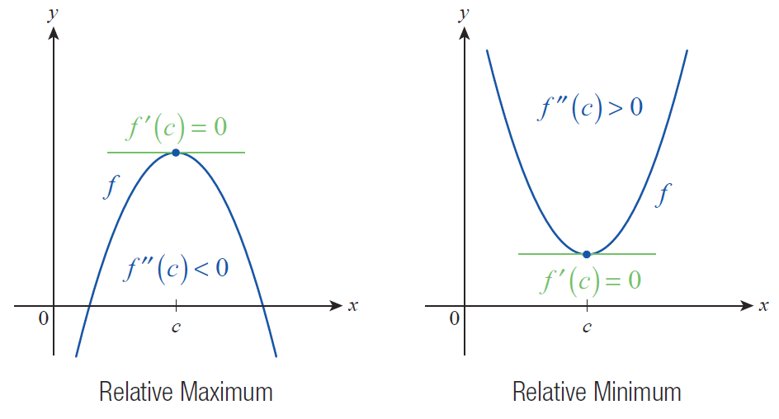
Second Derivative Tools
Figure 9

Slide 44
Theorem: Second Derivative Test
Proof
Recall that “Differentiability Implies Continuity”; this is one of our theorems from Section 3.1. So the fact that exists at c means that is differentiable at c and hence continuous at c. This, in turn, means that there exists an open interval containing c for which is defined. If we know further that and that then for all h sufficiently close to 0,

Slide 45
Theorem: Second Derivative Test
Proof (cont.)
and so must be positive for h < 0 and negative for h > 0. Restated, this means that is positive to the left of c and negative to the right of c, so by the First Derivative Test we can conclude that f has a relative maximum at c. The proof of the second statement is similar in nature.
To see that the test does not apply if consider the graphs of and at x = 0.

Slide 46
Example 4
Use the first and second derivatives of to identify the intervals of monotonicity, extrema, intervals of concavity, and inflection points on its graph.
Solution
and
Solving the equation gives us the critical points 0 and

Slide 47
Example 4 (cont.)
Solving gives us the possible inflection points 0 and 1 (note that 0 is both a critical point and a potential inflection point).
We proceed to evaluate the signs of on the intervals of interest.
Interval
Sign of
Monotonicity of f | Decreasing | Decreasing | Increasing

Slide 48
Example 4 (cont.)
We now have a wealth of information about f at our disposal, and can easily answer all of the questions about its graph.
Interval
Sign of
Concavity of f | Concave up | Concave down | Concave up

Slide 49
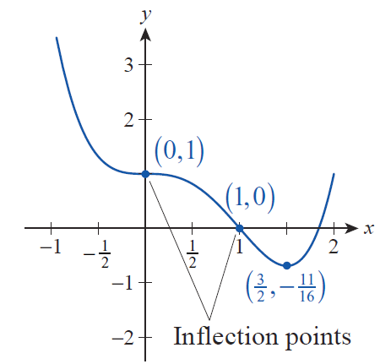
Example 4 (cont.)
First, the two tables above identify the intervals of constant monotonicity and concavity and whether f is increasing, decreasing, concave up, or concave down on each. Note how those intervals correspond to the graph of f shown in Figure 10.

Slide 50
Example 4 (cont.)
Second, we can use the First Derivative Test to realize that f does not have a relative extremum at the critical point 0, but does have a relative minimum at And since the concavity changes from up to down at 0 and from down to up at 1, both 0 and 1 are inflection points.

Slide 51
Example 4 (cont.)
We could also have used the Second Derivative Test to determine that f has a relative minimum at the critical point even though we never actually evaluated at the point. The reason is that we know exists on the open interval containing (indeed, exists everywhere), and that it is positive on the interval. In particular, it is positive at

Slide 52
Example 4 (cont.)
The last step is to evaluate f at the two inflection points and the one relative extremum—those values are shown in Figure 10. Note that f has no absolute maximum value, but the relative minimum at is also its absolute minimum.

