Slide 1
Section 4.4
L’Hôpital’s Rule

Slide 2
TOPICS
L’Hôpital’s Rule
Limits of Indeterminate Form

Slide 3
L’Hôpital’s Rule
Consider a limit of the form
where f(c) = g(c) = 0, and both exist, and Such a limit is said to be of indeterminate form 0/0, and the limit cannot be determined by simply evaluating f(c)/ g(c). However, we can rewrite the limit in a form that can be evaluated, as follows.

Slide 4
L’Hôpital’s Rule

Slide 5
L’Hôpital’s Rule
So if the values of these derivatives are known (and the evaluation of the limit can be accomplished with a different substitution. This observation is a simple form of l’Hôpital’s Rule, named after the French nobleman Guillaume François Antoine de l’Hôpital (1661–1704) in whose introductory calculus textbook it first appeared—the result is actually due to the Swiss mathematician Johann Bernoulli (1667–1748).

Slide 6
Example 1
Determine
Solution
Although we have learned ways to algebraically manipulate fractions of this sort in order to find the limit, l’Hôpital’s Rule makes it strikingly easy.

Slide 7
Theorem: Cauchy’s Mean Value Theorem
Cauchy’s Mean Value Theorem
Suppose that f and g are continuous on [a,b] and differentiable on (a,b), on (a,b), and
Then there is a point such that

Slide 8
L’Hôpital’s Rule
Note that Cauchy’s Mean Value Theorem reduces to the simpler Mean Value Theorem if g(x) = x.
The simpler version of the MVT guarantees the existence of a point where the tangent to a function is parallel to a secant line, and Cauchy’s MVT does something similar.

Slide 9
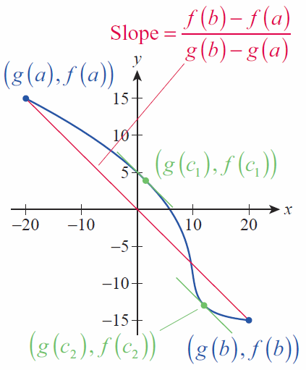
L’Hôpital’s Rule
Given two functions f and g with the properties above, the collection of ordered pairs
defines a curve in ℝ² such as the one depicted in Figure 1, and the red line segment connecting and is also called a secant line.
Figure 1
Cauchy’s Mean Value Theorem

Slide 10
L’Hôpital’s Rule
Specifically, the blue curve in Figure 1 is defined by the two functions and and the interval [a,b] is [−3,2]; the slope of the secant line is Cauchy’s MVT tells us that for at least one number the line tangent to the curve at
is parallel to the secant line.
We are now ready for a stronger form of l’Hôpital’s Rule.

Slide 11
Theorem: L’Hôpital’s Rule
L’Hôpital’s Rule
Suppose f and g are differentiable at all points of an open interval I containing c, and that for all
x ∈ I except possibly at x = c. Suppose further that either
or

Slide 12
Theorem: L’Hôpital’s Rule
L’Hôpital’s Rule (cont.)
Then
assuming the limit on the right is a real number or ∞ or −∞.
Further, the rule is true for one‑sided limits at c and for limits at infinity; that is, x → c can be replaced with
x → c⁺, x → c⁻, x → −∞, or x → ∞, assuming always that the limit on the right is a real number or ∞ or −∞.

Slide 13
L’Hôpital’s Rule
We have already mentioned limits of indeterminate form 0/0 in passing; the other type of limit described in l’Hôpital’s Rule is of indeterminate form and we will discuss other variations soon.

Slide 14
Theorem: L’Hôpital’s Rule
Proof
We will prove only the case in which
and we will prove that the claim is true as x → c⁻; the corresponding result for x → c⁺ is nearly identical, and the two one‑sided limits together prove the theorem.
Suppose that x ∈ I is a number lying to the left of c. Then and we can apply Cauchy’s MVT to the interval [x,c].

Slide 15
Theorem: L’Hôpital’s Rule
Proof (cont.)
Thus, there is a point such that
∼
∼
∼

Slide 16
Theorem: L’Hôpital’s Rule
Proof (cont.)
As we let x → c⁻, as well since c always lies between x and c. Hence,
∼
∼
∼
∼

Slide 17
L’Hôpital’s Rule
The value of l’Hôpital’s Rule comes from the fact that differentiating the numerator and denominator of a fraction of indeterminate form often results in a fraction that is not, making the limit easier to determine.

Slide 18
Example 2
Determine
Solution
First, note that l’Hôpital’s Rule is indeed applicable: this limit at infinity is of indeterminate form So we evaluate the limit as follows.

Slide 19
Example 3
Determine where a > 0 is a constant.
Solution
The limit is of indeterminate form so we proceed using l’Hôpital’s Rule.

Slide 20
Caution
Caution
L’Hôpital’s Rule says the limit of a quotient of two functions is equal to the limit of the quotient of their derivatives—don’t mistakenly apply the Quotient Rule of differentiation! After verifying that the conditions of l’Hôpital’s Rule are satisfied, proceed by differentiating the numerator and denominator individually.

Slide 21
L’Hôpital’s Rule
L’Hôpital’s Rule is obviously useful, but there is even more power in it than might appear at first glance. Suppose the rule is applied to a limit of indeterminate form, and the resulting limit is again of indeterminate form. Does that mean the rule fails to tell us anything? Often, no—if the new limit is also indeterminate, then we can again apply l’Hôpital’s Rule. This process can be repeated as often as necessary, as long as we stop as soon as we reach a limit that is not indeterminate.

Slide 22
Example 4
Evaluate the following limits.

Slide 23
Example 4 (cont.)
Solution
a. The limit is of indeterminate form so we can apply l’Hôpital’s Rule.

Slide 24
Example 4 (cont.)
b. The limit is of indeterminate form 0/0 and we apply l’Hôpital’s Rule.
If we mistakenly continued to apply the rule, we would have obtained
which is incorrect.

Slide 25
Limits of Indeterminate Form
In addition to the two indeterminate forms we have already seen, l’Hôpital’s Rule can be used to evaluate other potentially challenging limits. The remaining examples illustrate how indeterminate products, differences, and powers can be rewritten in such a way that l’Hôpital’s Rule applies.

Slide 26
Example 5
Determine
Solution
We say that a limit of a product fg is of indeterminate form 0 ⋅ ∞ if one of the functions approaches 0 and the other approaches ∞ or −∞. The limit, if it exists, depends on which function dominates—the product could tend toward 0, could grow unbounded, or could approach some nonzero real number if the two functions balance one another just right.

Slide 27
Example 5 (cont.)
We can apply l’Hôpital’s Rule if we can rewrite the product as a quotient in either the indeterminate form
or That is, we rewrite fg as either
whichever is easier to work with.

Slide 28
Example 5 (cont.)
In this example,

Slide 29
Example 6
Determine
Solution
A limit of a difference f − g is of indeterminate form
∞ − ∞ if f → ∞ and g → ∞. Again, such limits are usually not trivial: if f dominates, the difference will tend to ∞; and if g dominates, the difference will tend to −∞; but it is also possible for the two to balance out and result in a finite limit.

Slide 30
Example 6 (cont.)
To use l’Hôpital’s Rule, we need to rewrite the difference as a quotient. In this case, we can do so by combining the two fractions using a common denominator; in other such problems, rationalization or factoring out a common factor may be helpful.

Slide 31
Example 6 (cont.)
Apply l’Hôpital’s Rule once.
Simplify the fraction.
Apply l’Hôpital’s Rule again.

Slide 32
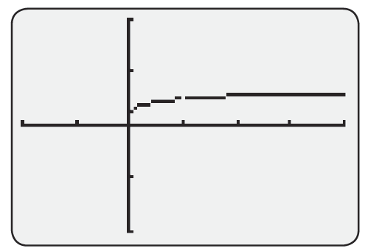
Example 6 (cont.)
Figure 2 visually confirms the limit we found.
Figure 2

Slide 33
Limits of Indeterminate Form
The next three limits are all of the form and constitute limits of indeterminate forms 1∞, 0 ⁰, and ∞⁰. As with the other indeterminate forms, there is competition between the effects of the two functions in the limit. In order to use l’Hôpital’s Rule, we set y = f ^{g} and take the natural logarithm of both sides to obtain ln y = g ln f . If we can determine the limit of g ln f , we can determine the limit of

Slide 34
Example 7
Determine
Solution
Note that the base of the expression goes to 1 and the exponent goes to ∞ as x → 0⁺. We let

Slide 35
Example 7 (cont.)
The limit of this last expression is of the form and we can apply l’Hôpital’s Rule.
Since
Hence,

Slide 36
Example 8
Determine
Solution
Both the base and the exponent approach 0. Letting
y = x^{x}, we arrive at
a limit of indeterminate form

Slide 37
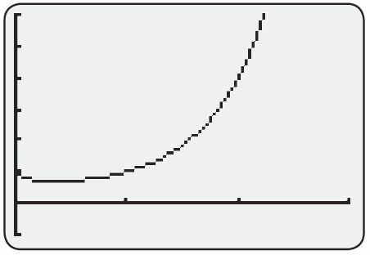
Example 8 (cont.)
So,
and hence x^{x} → e⁰ = 1 as x → 0⁺
(don’t forget this last step!).
Figure 3
Y = x^{x} on [0, 3] by [−1, 6]

Slide 38
Example 9
Determine
Solution
The base has a limit of ∞ and the exponent has a limit of 0. We proceed as in the last two examples.

Slide 39
Example 9 (cont.)
Applying l’Hôpital’s Rule,
and therefore

