Slide 1
Section 4.6
Optimization Problems

Slide 2
TOPICS
Mathematical/Geometrical Problems
Optimization Problems from Other Disciplines

Slide 3
Mathematical/Geometrical Problems
Optimization Strategy
Step 1: Read the given information carefully and identify what is known and what needs to be found. What quantity must be optimized in order to solve the problem?
Step 2: Identify and appropriately label the relevant quantities and draw a diagram, if possible, as an aid in determining the relationships between them.

Slide 4
Mathematical/Geometrical Problems
Optimization Strategy (cont.)
Step 3: Assign a label to the quantity that needs to be maximized or minimized, and work toward expressing that quantity (we’ll give it the generic name f for now) as a function of one variable. This may require some intermediate steps in which you write equations relating the quantities you have identified and use algebra to write f as a function of one of them. Note the appropriate domain of f for the problem.

Slide 5
Mathematical/Geometrical Problems
Optimization Strategy (cont.)
Step 4: Using the techniques of this chapter, find the absolute minimum or maximum of f (whichever is desired) on the domain.
Step 5: Check your answer to see if it makes sense as a solution to the problem.

Slide 6
Example 1
A 15 in. by 24 in. piece of sheet metal is to be formed into an open‑top box by cutting out a square from each of the four corners and folding up the sides. How large should each square be in order to achieve a box of maximum volume?

Slide 7
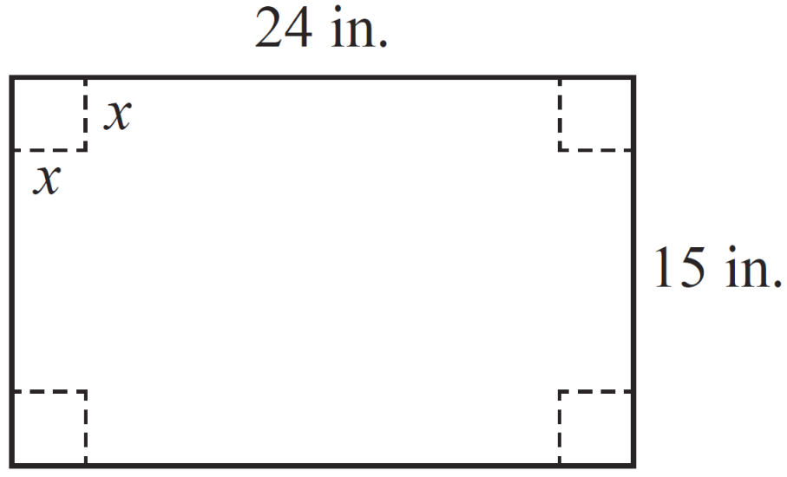
Example 1 (cont.)
Solution
We begin with a picture, illustrating a rectangular piece of metal with four squares of side length x to be cut out. Once the squares have been removed
Figure 1
and the edges folded upward, the volume of the resulting open box will be

Slide 8
Example 1 (cont.)
Note that in this problem, we have quickly arrived at a function of one variable to be maximized—no intermediate steps were necessary. And in order for V to make sense as a volume, its domain is limited to
V is a cubic polynomial, and although a graph of V is not necessary in order to solve this problem, it’s never a bad idea to graph your function to be maximized if it can be easily done—such a graph can serve as another self check of your work.

Slide 9
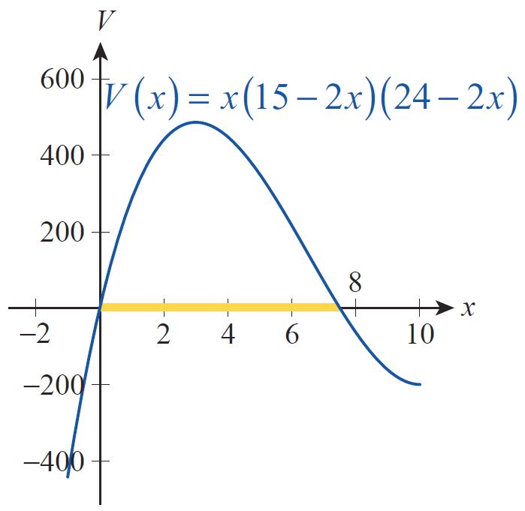
Example 1 (cont.)
In Figure 2, V is graphed over an interval larger than its domain for this problem, with the actual domain highlighted in yellow.
Figure 2

Slide 10
Example 1 (cont.)
The remaining steps are to find the critical point(s) and test them to identify the absolute maximum—from the graph, we expect to find just one critical point in the domain, and that is indeed the case.

Slide 11
Example 1 (cont.)
The only critical point in is 3. Evaluating V at this critical point and at the endpoints of the domain we see that the maximum possible volume is obtained when x = 3:

Slide 12
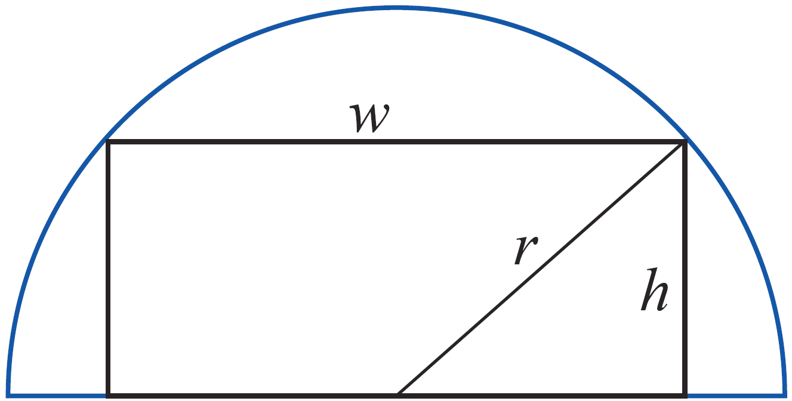
Example 2
Find the rectangle of largest possible area that can be inscribed in a semicircle of radius r.
Solution
We begin again with a sketch in order to better understand the problem and to begin labeling relevant quantities and dimensions with names.
Figure 3

Slide 13
Example 2 (cont.)
Given the labels we have assigned, the quantity we want to maximize is A = wh. At this point, A is a function of the two variables w and h, so we need to use another relationship in order to reduce A to a function of one variable.
From the figure and the Pythagorean Theorem, we see that
or w² + 4h² = 4r².

Slide 14
Example 2 (cont.)
We can solve this equation easily for w to obtain (note that only the positive root makes sense), and then write
From the geometry of the problem, as well as the nature of the formula, we know that that is, the domain of A is the closed bounded interval [0,r], so absolute extrema are guaranteed to exist.

Slide 15
Example 2 (cont.)
We now proceed to find the critical point(s):

Slide 16
Example 2 (cont.)
A’ is also undefined when h = r, but that’s one of the endpoints of the domain. Because is not in the domain of A, we evaluate A at the two endpoints and the one critical point in (0,r):

Slide 17
Example 2 (cont.)
So the maximum possible area for an inscribed rectangle is r², and it occurs when and One way to quickly check the reasonableness of this answer is to note that r² is smaller than the area of the semicircle.

Slide 18
Optimization Problems from Other Disciplines
The need to either minimize or maximize some quantity is extremely common, and the next few examples illustrate how optimization problems arise in a variety of contexts.

Slide 19
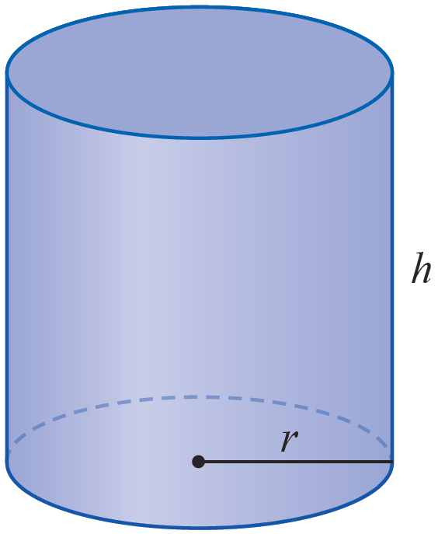
Example 3
As it prepares to expand into a new market, an American oil company decides to design a half‑liter can
for its brand of engine oil. The can will have the typical shape of a right circular cylinder. What dimensions for the can will minimize the amount of metal used to form it?
Figure 4

Slide 20
Example 3 (cont.)
Solution
We will label the radius and height of the cylinder r and h, respectively. And since the can consists of two circles of radius r and a (rolled‑up) rectangle of width 2π r and height h, the area of the metal used to form it is A = 2π r² + 2π rh.
One liter corresponds to a volume of 1000 cm³, so a half liter of oil occupies 500 cm³. That is,
V = π r²h = 500. We want to minimize A, which currently is a function of two variables.

Slide 21
Example 3 (cont.)
But we can use the volume relationship between r and h to eliminate one of them; it’s easier to eliminate h (you should check that this is so).

Slide 22
Example 3 (cont.)
Note that in this problem, the domain of A is In practice, we know we won’t use a radius r close to 0, nor will we use a very large r, but we have no way to narrow down the domain at the moment. However, the calculus techniques we have learned will still resolve the question definitively. We proceed to find A’ and then the critical points.

Slide 23
Example 3 (cont.)
The only critical point is

Slide 24
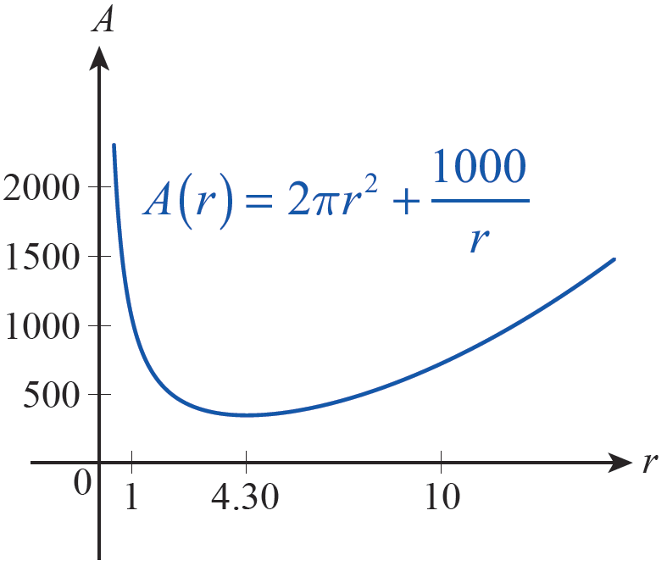
Example 3 (cont.)
The First Derivative Test verifies that A does indeed have a relative and absolute minimum at this critical point, as and (1 and 10 are merely convenient test points). Figure 5 is a graph of A and confirms our findings. The corresponding value of h is as follows.
Figure 5

Slide 25
Example 3 (cont.)
Thus, to minimize the amount of metal used for the half‑liter can, the radius should be approximately 4.30 cm and the height approximately 8.60 cm.

Slide 26
Optimization Problems from Other Disciplines
Recall from that the profit P(x) realized by selling x units of a given product is related to the cost C(x) to produce x units and the revenue R(x) by the formula P(x) = R(x) − C(x). If we seek to maximize profit, the techniques of this chapter lead us to look at the critical points of P; in particular, if C and R are differentiable functions, we are interested in the solutions of the equation P’(x) = 0, which are also the solutions of the equation R’(x) = C’(x).

Slide 27
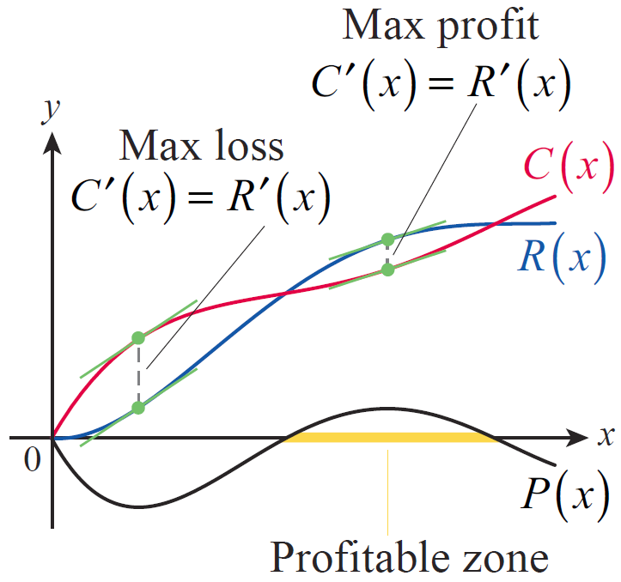
Optimization Problems from Other Disciplines
Figure 6 is a graph of typical cost and revenue functions—costs often initially exceed revenue, then fall below revenue as bulk manufacturing and transportation savings are realized, then eventually exceed revenue again as production capacity and market saturation points are reached.
Figure 6

Slide 28
Optimization Problems from Other Disciplines
Note that the profitable zone is bounded by the two positive break‑even points, where C(x) = R(x), and that the points of maximum profit and loss are indeed where C’(x) = R’(x).

Slide 29
Example 4
Suppose that Jan’s Custom Calendar Company models the coming year’s revenue and cost functions, in thousands of dollars, to be and where x represents units of 1000 calendars and where the model is thought to be accurate up to approximately x = 6. What is Jan’s profitable zone, and what level of production will maximize her profit?

Slide 30
Example 4 (cont.)
Solution
The profit function in this problem is which factors as
Solving the equation P(x) = 0 is equivalent to solving R(x) = C(x), so we know that the positive break‑even points are x = 2 and x = 5. Therefore, Jan’s profitable zone is between 2000 and 5000 calendars.

Slide 31
Example 4 (cont.)
Similarly, we can solve either the equation P’(x) = 0 or the equation to find the relative extrema of P.

Slide 32
Example 4 (cont.)
We can use either derivative test to determine that P has a relative minimum at 0.880 and a relative maximum at 3.786, corresponding to production of, respectively, 880 and 3786 calendars.

Slide 33
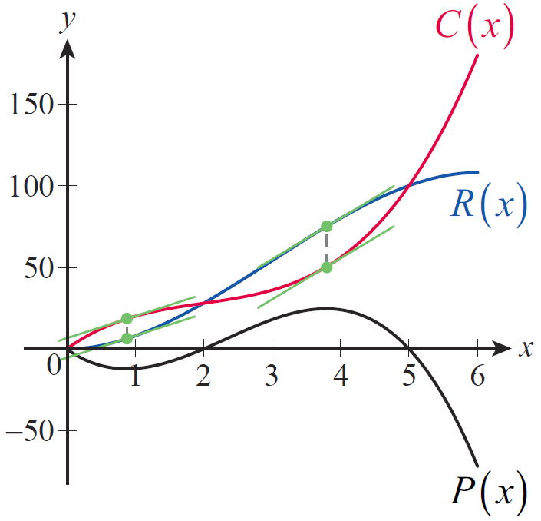
Example 4 (cont.)
The maximum possible profit is thus P(3.786) = 24.626 or $24,626. Figure 7 shows the graphs of R, C, and P. Note how the relative extrema of P correspond to the points where R’ = C ’.
Figure 7

Slide 34
Example 5
Another useful model in business is the average cost function. If C(x) represents the cost of producing x units of a product, then the average cost of producing those x units is C(x)/x. Show that if the average cost function is differentiable, then the marginal cost C ’(x) is equal to the average cost at the critical points of the average cost function.

Slide 35
Example 5 (cont.)
Solution
We begin by looking at the critical points of C(x)/x.

Slide 36
Example 5 (cont.)
We are assuming that C(x)/x is differentiable, so its critical points are where the expression above is 0.

Slide 37
Example 6
An object underwater can appear to be at a position slightly offset from its actual position; this is due to refraction. In optics, Fermat’s Principle says that the light rays observed in such a situation are those that travel from the object to your eyes in the shortest period of time, and light travels at different speeds through different media (such as water and air).

Slide 38
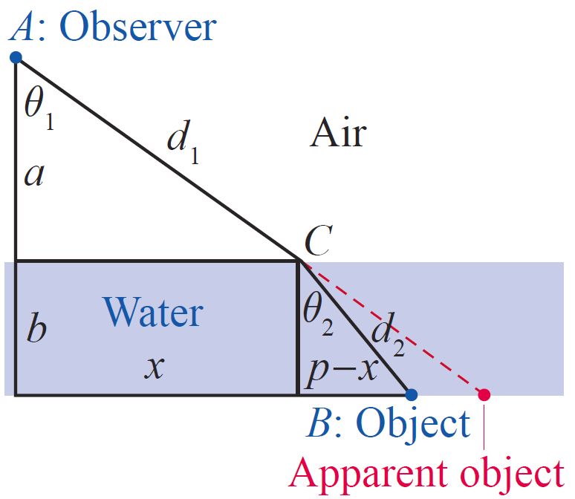
Example 6 (cont.)
If v₁ and v₂ represent the speeds of light in, respectively, air and water, and are the angles shown in Figure 8, use Fermat’s Principle to derive Snell’s Law:
Figure 8

Slide 39
Example 6 (cont.)
Solution
The given information consists only of the two angles and the two speeds, but in the figure we have already labeled other quantities that might help us relate the angles and speeds and arrive at Snell’s Law. Specifically, we have let p denote the horizontal distance between the object B and the point directly beneath the observer at A.

Slide 40
Example 6 (cont.)
And since the point C of refraction (where the rays of light bend) is unknown, we have given its horizontal displacement from A the label x, meaning the horizontal distance between C and B is p − x. The vertical distances a and b are fixed, but the lengths of the hypotenuses, d₁ and d₂, will vary as x varies.

Slide 41
Example 6 (cont.)
At this point, it may be unclear how to arrive at Snell’s Law from what we have. But we haven’t yet applied Fermat’s Principle, and we can deduce many relationships between the labeled quantities. Since distance = rate ⋅ time, the time it takes light to travel from B to C is and the time it takes to travel from C to A is So the total time is expressed as follows.

Slide 42
Example 6 (cont.)
We can express the two hypotenuses as functions of x by noting that and so
and the domain of T is [0,p].

Slide 43
Example 6 (cont.)
The actual distance x must be the value of x that minimizes T, so our next step is to find T’.

Slide 44
Example 6 (cont.)
Note that and so by Darboux’s Theorem (Section 3.1), there is a point for which And by the First Derivative Test, that point must minimize T. Rewriting we have developed the formula for Snell’s Law.

