Slide 1
Section 5.1
Area, Distance, and Riemann Sums

Slide 2
TOPICS
The Area Problem
The Distance Problem
Riemann Sums and Summation Formulas

Slide 3
Example 1
Find the area under the graph of f(x) = x² and above the x‑axis on the interval [0, 1].
Solution
We have nothing to work with other than our existing knowledge of area.

Slide 4
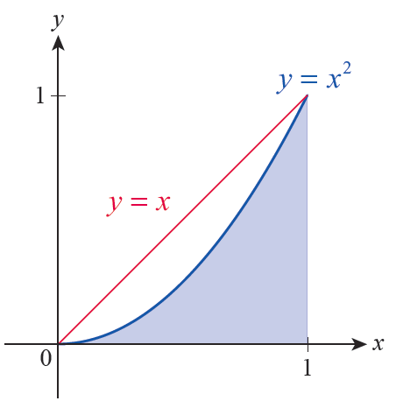
Example 1 (cont.)
A line such as y = x can be used to obtain an estimate of the area under the parabola or we can estimate the area by breaking it into smaller regions.
Figure 2

Slide 5
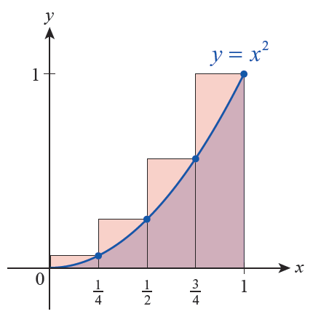
Example 1 (cont.)
Four rectangles with equal widths and heights of
can be used to overestimate
the desired area as shown in Figure 3.
Figure 3

Slide 6
Example 1 (cont.)
The combined area of these four rectangles, denoted O₄ for “Over,” is as follows.

Slide 7
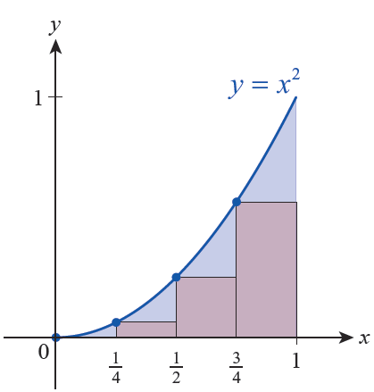
Example 1 (cont.)
We could also underestimate the area by adding up the areas of the four rectangles whose heights are
(see Figure 4).
Figure 4

Slide 8
Example 1 (cont.)
This would give us the approximation U₄ (U for “Under”).

Slide 9
Example 1 (cont.)
Knowing that the area under the parabola is actually something between these two approximations, we might estimate the area with their average:

Slide 10
Example 1 (cont.)
To obtain a better approximation of the desired area, we can increase the number of rectangles. Graphs of the results, such as those from Figure 5 for n = 10, certainly seem to indicate that the errors in the approximations get smaller as n increases.

Slide 11
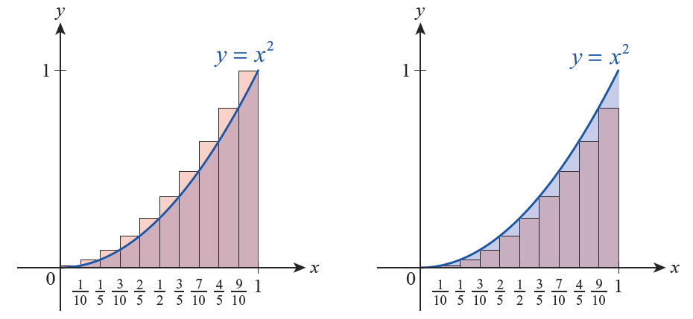
Example 1 (cont.)
Figure 5 Approximating the Area with 10 Rectangles

Slide 12
Example 1 (cont.)
n | O_{n} | U_{n} | O_{n} − U_{n} | (O_{n} + U_{n})/2
10 | 0.385 | 0.282 | 0.1 | 0.335
100 | 0.33835 | 0.32835 | 0.01 | 0.33335
1000 | 0.33383 | 0.33283 | 0.001 | 0.33333
Given the results in the table, we would be justified in guessing that the area under f(x) = x² over the interval [0, 1] is

Slide 13
The Distance Problem
The symbol Σ is the capital Greek letter sigma (standing for “sum”), and the letter i is the index of summation.
In general, an expression such as stands for the
sum of all the terms a₁ through a_{n}; that is,

Slide 14
Example 2
A stone is released from a high cliff and falls for many seconds before hitting the canyon floor. Assuming air resistance is negligible, how far does the stone fall in the interval t = 1 second to t = 3 seconds?
Solution
The acceleration due to gravity is −32 ft/s^{2.}

Slide 15
Example 2 (cont.)
So if we let t denote the time in seconds after release, the stone falls with velocity v(t) = −32t. Since we are interested only in determining the difference between the stone’s position at time t = 1 and time t = 3, we will work with the speed of the stone s(t) = |v(t)| = 32t.

Slide 16
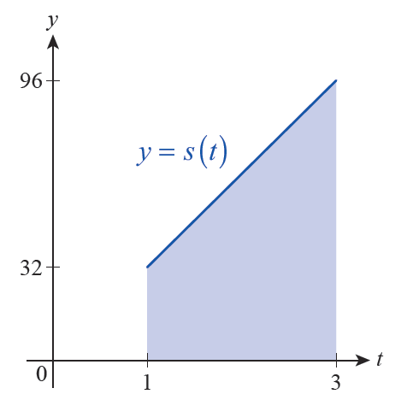
Example 2 (cont.)
The graph of s is linear, and the distance traveled by the stone between t = 1 and t = 3 corresponds to the shaded area between the graph and the t‑axis (see Figure 9). This area is 128 square units, so the distance traveled between these two points in time is 128 feet.
Figure 9

Slide 17
Example 2 (cont.)
Although we now know the answer to our question, it is worthwhile to obtain it again through the approximation process we have developed—this will give us a chance to practice the techniques and notation that we will use for the next several sections.

Slide 18
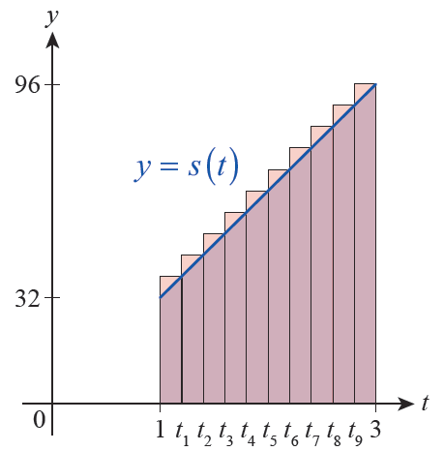
Example 2 (cont.)
Let O_{n} denote the overestimate that results by dividing the interval [1, 3] into n subintervals and defining to be the right endpoint of the subinterval
Figure 10 Depiction of 0₁₀

Slide 19
Example 2 (cont.)
Using sigma notation, the “over” approximation of the area divided into n subintervals is

Slide 20
Example 2 (cont.)
Note that

Slide 21
Example 2 (cont.)
Hence,
This notation signifies a sum, so all of the usual properties of arithmetic hold.

Slide 22
Example 2 (cont.)

Slide 23
Example 2 (cont.)
Sums such as arise frequently, and it can be shown
that
Therefore,

Slide 24
Example 2 (cont.)
We can study this expression to see what happens as n → ∞. Since as n → ∞, we see that O_{n} → 128, confirming that the distance the stone falls between the first and third seconds is 128 feet.

Slide 25
Riemann Sums and Summation Formulas
We have now seen sums of the form arise
several times, and we will study them further as we develop the notion of the integral. Such an expression is an example of a Riemann sum of the function f over an interval [a, b].
represents a sample point in the i^{th} subinterval
is the width of each subinterval
is the value of f at the i^{th} sample point

Slide 26
Theorem: Summation Facts and Formulas
Summation Facts and Formulas
Constant Rule for Finite Sums
Constant Multiple Rule for Finite Sums
Sum/Difference Rule for Finite Sums

Slide 27
Theorem: Summation Facts and Formulas
Summation Facts and Formulas (cont.)
Sum of the First n Positive Integers
Sum of the First n Squares
Sum of the First n Cubes

Slide 28
Example 3
Simplify the following sums.
Solution

Slide 29
Example 3 (cont.)

Slide 30
Example 4
Find the area under the graph of f(x) = x² and above the x‑axis on the interval [0, 1].
Solution
We will construct an expression for U_{n} (the underestimate based on n subintervals) and evaluate

Slide 31
Example 4 (cont.)
If we divide [0, 1] into n subintervals of equal width, each one has width The minimum value of f on occurs at
So in general
Therefore:

Slide 32
Example 4 (cont.)
We have already simplified the sum in part c. of Example 3.

