Slide 1
Section 5.2
The Definite Integral

Slide 2
TOPICS
Riemann Sums and the Definite Integral
Properties of the Definite Integral

Slide 3
Definition: Definite Integral
Definite Integral
Given a function f defined on an interval [a, b] let
let [a, b] be divided into n subintervals of equal width, where
and let the i^{th} sample point satisfy
Then the (Riemann) definite integral of f
from a to b is denoted and is defined to be

Slide 4
Definition: Definite Integral
Definite Integral (cont.)
provided the limit exists and is the same for every choice of the sample points. If so, we say f is integrable on [a, b], and call f the integrand of the integral. In this context, a and b are called, respectively, the lower and upper limits of integration.

Slide 5
Riemann Sums and the Definite Integral
The symbol ∫ was introduced by Leibniz and represents a stylized “S” as a reminder that the basis of the definite integral is summation. Similarly, the process of calculating the value of a definite integral is termed integration—this reflects the fact that we arrive at a definite integral by adding up (integrating) a finite number of summands, and taking the limit as the number of summands approaches infinity.

Slide 6
Riemann Sums and the Definite Integral
∫ represents “S” for summation, the basis of the definite integral.
Introduced by Leibniz.
The process of calculating the value of a definite integral is termed integration.

Slide 7
Riemann Sums and the Definite Integral
Given an interval [a, b], a partition P of [a, b] is any finite set where (note that the x_{i}’s don’t have to be evenly spaced).
The norm of the partition P is defined to be where that is,
is the maximum of the subinterval widths.

Slide 8
Riemann Sums and the Definite Integral
Using the epsilon‑delta formulation of limit, f is integrable on [a, b] and its definite integral is
if for every ε > 0 there is a δ > 0 so that

Slide 9
Example 1
George uses a slingshot to shoot a small stone straight up into the sky with a vertical velocity of
What is the height of the stone, relative to its initial height, when t = 4 s?
Solution
Find the limit of Riemann sums of the form
to deduce the position of the stone after 4 seconds—the distance traveled over the interval is approximately

Slide 10
Example 1 (cont.)
There is one important difference between this example and Example 2 of the previous section.
To set the stage, note that and, if we decide to let be the right endpoint of each subinterval, then
and, in general,

Slide 11
Example 1 (cont.)
Using the integral notation:

Slide 12
Example 1 (cont.)
Using the summation formulas:

Slide 13
Example 1 (cont.)
represents the stone’s distance from its
starting point after 4 seconds.

Slide 14
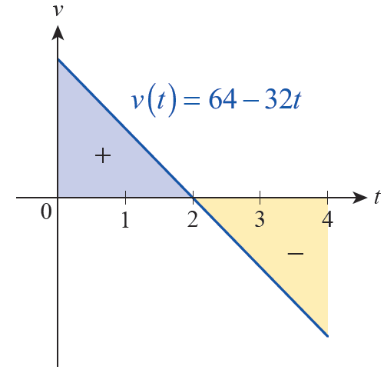
Example 1 (cont.)
But, we want to know how far the stone travels over the interval [0, 4], so we need to determine a task that is left as an exercise.
Figure 4

Slide 15
Theorem: Piecewise Continuous Functions Are Integrable
Piecewise Continuous Functions Are Integrable
If f is a continuous function defined on [a, b], or if f is a piecewise continuous function on [a, b] (meaning it is continuous except for a finite number of jump discontinuities), then f is integrable on [a, b].

Slide 16
Definition: Left and Right Riemann Sums
Left and Right Riemann Sums
Given a function f defined on the interval [a, b], let L_{n} and R_{n} denote the Riemann sums obtained by dividing [a, b] into n subintervals of equal width,
and defining the i^{th} sample point to be, respectively, the left and right endpoint of the i^{th} subinterval. That is,
where and

Slide 17
Example 2
Evaluate by taking the limit of the associated right Riemann sum.
Solution
If then a = −1, and b = 3.
So
and

Slide 18
Example 2 (cont.)
Hence,

Slide 19
Example 2 (cont.)
Applying summation formulas:

Slide 20
Example 3
Evaluate
Solution
The Riemann sum based on the function
is quite difficult to evaluate.

Slide 21
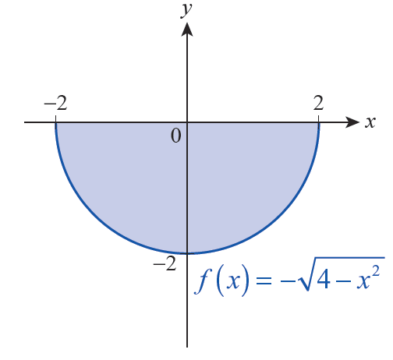
Example 3 (cont.)
represents the lower half of the circle; the graph of f is shown in Figure 5.
Figure 5

Slide 22
Example 3 (cont.)
Hence, represents the negative of half
of the area of a circle of radius 2. That is,

Slide 23
Properties of the Definite Integral
Properties of the Definite Integral
Given the integrable functions f and g on the interval [a, b] and any constant k, the following properties hold.

Slide 24
Properties of the Definite Integral
Properties of the Definite Integral (cont.)

Slide 25
Selected Proofs and Comments
Property 1: represents the signed
area of a rectangle of height f(a) and width zero. Any Riemann sum approximating the integral would consist of exactly one term, namely f(a)Δx, with Δx = a − a = 0.
Therefore, we should define to be 0.

Slide 26
Selected Proofs and Comments
Property 2:

Slide 27
Selected Proofs and Comments
Property 3: If f(x) = k, then
for every n and for any choice of sample points.

Slide 28
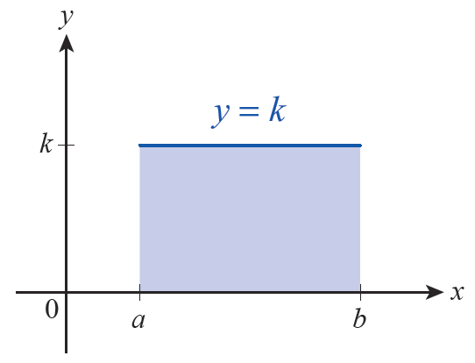
Selected Proofs and Comments
Property 3 (cont.):
corresponds to the signed area of the shaded rectangle in Figure 6, which is k(b − a).

Slide 29
Selected Proofs and Comments
Property 5:

Slide 30
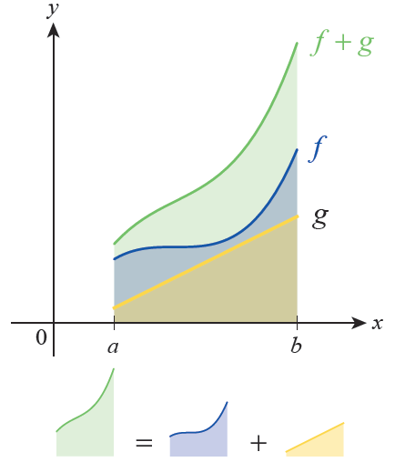
Selected Proofs and Comments
Property 5 (cont.):
Figure 7 shows the graphs of three functions f, g, and f + g.

Slide 31
Example 4
Given that and
determine
Solution
By Property 6,
and so
Hence,

Slide 32
Example 5
Use Property 8 to find lower and upper bounds on the
integral
Solution
The function is an increasing function, so
Hence,

Slide 33
Example 6
Determine the average value of on the interval
Solution
The Average Value, h, of f(x) over [a, b]:
We have already determined in Example 3 that

Slide 34
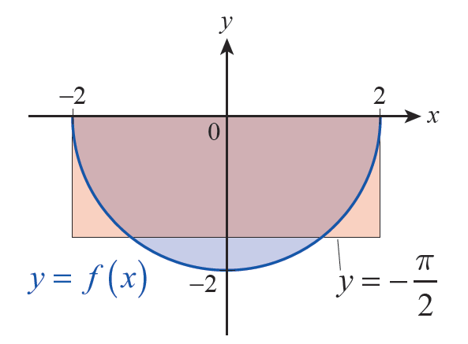
Example 6 (cont.)
Note that, geometrically, this corresponds to transforming a half circle into a rectangle, as shown in Figure 10.
Figure 10

