Slide 1
Section 5.3
The Fundamental Theorem of Calculus

Slide 2
TOPICS
The Fundamental Theorem, Part I
The Fundamental Theorem, Part II

Slide 3
Theorem: The Mean Value Theorem for Definite Integrals
The Mean Value Theorem for Definite Integrals
If f is a continuous function on the interval [a, b], then there exists a point c in [a, b] for which

Slide 4
Theorem: The Mean Value Theorem for Definite Integrals
Proof
The proof of this statement follows from the application of the Intermediate Value Theorem to a slight rephrasing of one of the definite‑integral properties seen in the previous section. Recall that for a continuous function f on [a,b],

Slide 5
Theorem: The Mean Value Theorem for Definite Integrals
Proof (cont.)
Dividing each side of the inequality by b − a, we see that
Since f is continuous, the Intermediate Value Theorem tells us that f takes on every value between m and M at least once on the interval [a,b].

Slide 6
Theorem: The Mean Value Theorem for Definite Integrals
Proof (cont.)
In particular, there must exist a point c ∈ [a,b], such that f (c) is the value

Slide 7
Example 1
Find every point c in the interval at which the
function takes on its average value.
Solution
To find each point c at which f assumes its average
value, simply solve the equation

Slide 8
Example 1 (cont.)

Slide 9
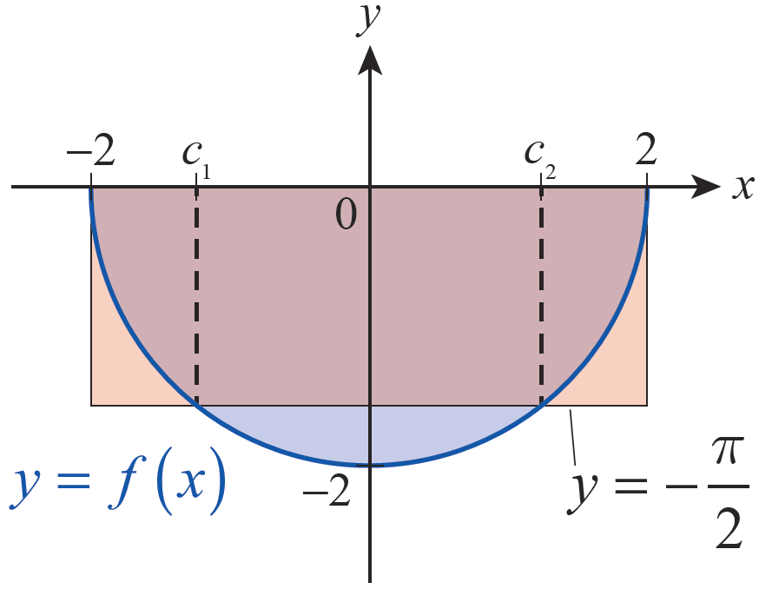
Example 1 (cont.)
These two solutions are labeled c₁ and c₂ in Figure 1.
Figure 1

Slide 10
Theorem: The Fundamental Theorem of Calculus, Part I
The Fundamental Theorem of Calculus, Part I
Given a continuous function f on an interval I and
a fixed point a ∈ I, define the function F on I by
Then for all x ∈ I.

Slide 11
Theorem: The Fundamental Theorem of Calculus, Part I
Proof
We will prove that by showing that
for all x ∈ I. In what follows, we will assume that each h is sufficiently small so that both x − h ∈ I and x + h ∈ I. Further, if x happens to be an endpoint of I, then should be interpreted as a one‑sided derivative and the limit above restricted to h > 0 (if x is the left endpoint of I) or h < 0 (if x is the right endpoint).

Slide 12
Theorem: The Fundamental Theorem of Calculus, Part I
Proof (cont.)
Note that one of the properties of the definite integral tells us that
and so, for each h sufficiently small,

Slide 13
Theorem: The Fundamental Theorem of Calculus, Part I
Proof (cont.)
By the Mean Value Theorem for Definite Integrals, there is a point c between x and x + h for which
note that if h is
positive and if h is negative. As Figures 3a and 3b illustrate (for a positive h), F(x + h) − F(x) represents the signed area bounded by the graph of f between x and x + h, and this signed area is equal to the area of the rectangle with width (x + h) − x = h and height f(c).

Slide 14
Theorem: The Fundamental Theorem of Calculus, Part I
Proof (cont.)
As h → 0, it must be the case that c → x, as c is squeezed between x and x + h. Hence,

Slide 15
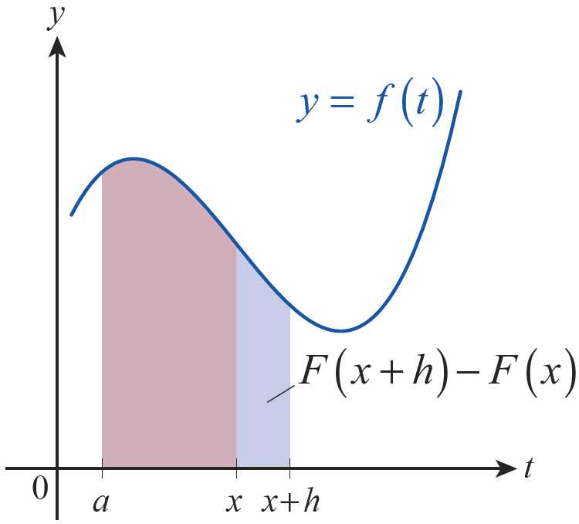
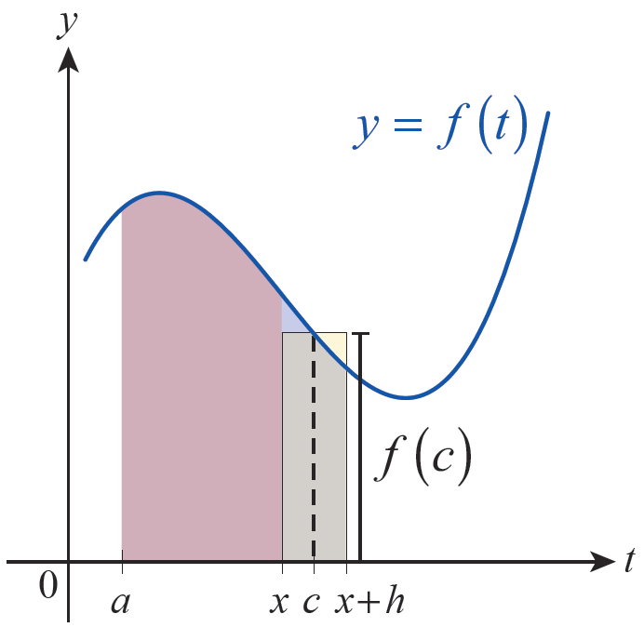
Theorem: The Fundamental Theorem of Calculus, Part I
Proof (cont.)
Figure 3a
Figure 3b

Slide 16
Example 2
Given a function F defined by
determine the interval on which the Fundamental Theorem of Calculus can be applied and find on that interval.
Solution
is continuous on and 4 is an element of I. So the FTC applies for each nonnegative x,
and For x = 0,

Slide 17
Example 3
Use the FTC to evaluate the following:
a.
b.
c.

Slide 18
Example 3 (cont.)
Solution
a. represents a function in x, but because the upper limit of integration is x² and not x, dy/dx is not simply 1/(2+x).

Slide 19
Example 3a (cont.)
Using the Chain Rule, let u = x², then

Slide 20
Example 3 (cont.)
b.

Slide 21
Example 3 (cont.)
c.

Slide 22
Example 4
Given the function define
functions F, G, and H by
Determine the intervals on which the FTC applies for each integral, and find on those intervals. How are F, G, and H similar and how are they different?

Slide 23
Example 4 (cont.)
Solution
The function f has a single point of discontinuity at x = −1, and so the FTC is applicable for F and G on the interval (−1, −∞), and for the function H on the interval (−∞, −1) Next, the FTC tells us that for all and that for all

Slide 24
Example 4 (cont.)
By Corollary 2 of the Mean Value Theorem from Section 4.2, two functions with the same derivative on an open interval differ only by a constant. So on (−1, ∞) for some constant C. And while it’s also true that the domain of H does not overlap with the domain of F or G at all.

Slide 25
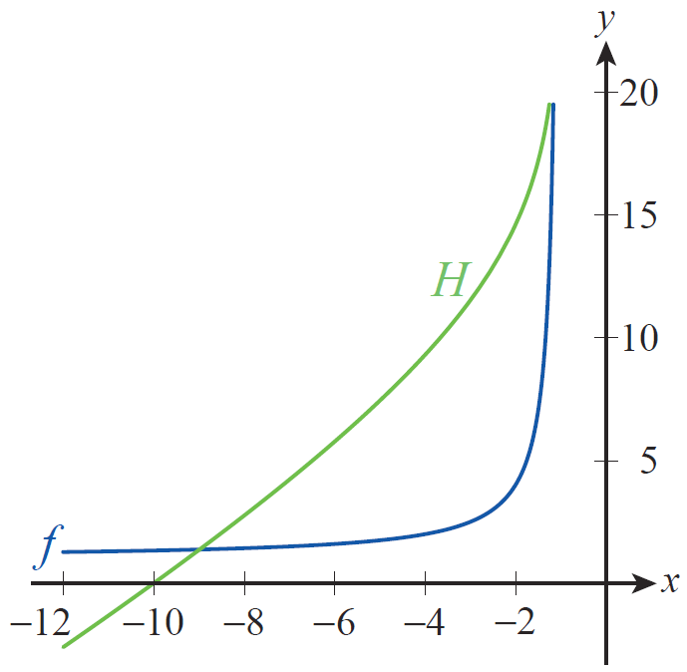
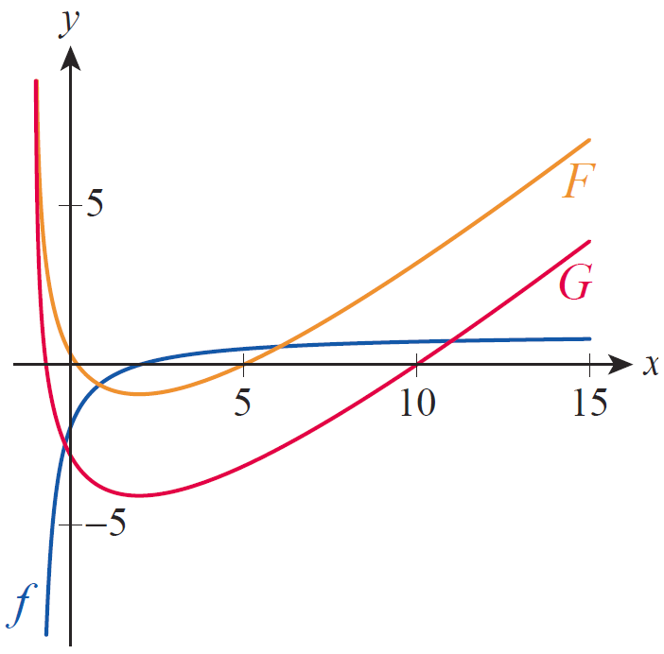
Example 4 (cont.)
In Figures 4 and 5, the graphs of f, F, G, and H are shown.
Figure 4 Graphs of f and H
Figure 5 Graphs of f , F, and G

Slide 26
Example 4 (cont.)
since
H(x) should be positive for since f is positive on the interval and we are integrating from left to right for such x’s.
H(x) should be negative for since f is again positive on the interval but for these values of x we are integrating from right to left.

Slide 27
Example 4 (cont.)
F and G should have a horizontal tangent line at x = 2, since f(2) = 0 and the FTC tells us that and
and
All of these facts are reflected in the graphs of F and G.

Slide 28
Example 4 (cont.)
If F(x) = G(x) + C for some constant C on (−1, ∞), what is the actual value of C? For any x ∈ (−1, ∞), then

Slide 29
Theorem: The Fundamental Theorem of Calculus, Part II
The Fundamental Theorem of Calculus, Part II
If f is a continuous function on the interval [a, b] and if F is any antiderivative of f on [a, b] then

Slide 30
Theorem: The Fundamental Theorem of Calculus, Part II
Proof
First, we know the definite integral
exists, since f is continuous on the interval. Further, by Part I of the FTC, we know that the function
exists and is an antiderivative of f on
[a, b]. This means for all and we
know for all (since F is an
antiderivative of f ), so for all

Slide 31
Theorem: The Fundamental Theorem of Calculus, Part II
Proof (cont.)
Hence, by Corollary 2 of the Mean Value Theorem for derivatives (Section 4.2) it must be the case that F(x) = G(x) + C for all and for some constant C—we have already seen this consequence in Example 4. Since differentiability implies continuity,
and

Slide 32
Theorem: The Fundamental Theorem of Calculus, Part II
Proof (cont.)
So we have

Slide 33
The Fundamental Theorem, Part II
Since expressions of the form F(b) − F(a) arise so frequently in this context, the following notation is useful:
This may also appear as

Slide 34
Example 5
Evaluate the following integrals.
a. b. c.
Solution
In each case, our knowledge of derivatives will be sufficient to “reverse differentiate” and find a suitable antiderivative—you may want to refer to Section 4.7 for a refresher. Remember, any antiderivative of the integrand will do.

Slide 35
Example 5 (cont.)
a. Since we will use F(x) = e^{x}.
Hence,
b. Recall that so

Slide 36
Example 5 (cont.)
c. Note that so

Slide 37
Example 6
Construct a function f(x) whose derivative is sin x and which has the value −3 at 0.
Solution
The function has the desired derivative, by Part I of the FTC. Modify this function to have the correct value at 0 by defining now,

Slide 38
Example 6 (cont.)

Slide 39
Example 7
Recall that the difference between the functions F and
G in Example 4 was determined to be Evaluate this integral.
Solution
Rewrite the integrand as follows.

Slide 40
Example 7 (cont.)
The same result can be obtained by dividing x − 2 by x + 1.

Slide 41
Example 7 (cont.)
Also, since (you should verify this),

