Slide 1
Section 5.5
The Substitution Rule and Definite Integration

Slide 2
TOPICS
Substitution and Definite Integration
Area between Curves

Slide 3
Theorem: The Substitution Rule for Definite Integrals
The Substitution Rule for Definite Integrals
If g′ is a continuous function on the interval [a, b] and if f is continuous on the range of u = g(x), then

Slide 4
Theorem: The Substitution Rule for Definite Integrals
Proof
First, we know that both integrals exist since both integrands are continuous on their respective intervals: is a product of two continuous functions on [a, b] and f is continuous on the interval Our task is simply to prove that the integrals are equal.
∘

Slide 5
Theorem: The Substitution Rule for Definite Integrals
Proof (cont.)
As in the first version of the Substitution Rule, let F be an antiderivative of f.

Slide 6
Example 1
Evaluate
Solution
Using the substitution of u = x² + 1:

Slide 7
Example 1 (cont.)
so

Slide 8
Example 1 (cont.)
Alternatively, we can change the limits of integration: when x = 0, u = 0² + 1 = 1, and when x = 2, u = 2² + 1 = 5.

Slide 9
Caution
Caution
The two methods illustrated in Example 1 result in the same answer; the choice usually depends only on which seems easier to apply. Just be careful not to mix and match—don’t evaluate an antiderivative expressed in the variable u with limits that belong to the original variable! To keep track of which variable the limits correspond to, it can be useful to explicitly note the variable in the integral symbol as we did above.

Slide 10
Theorem: Definite Integrals of Even and Odd Functions
Definite Integrals of Even and Odd Functions
Assume f is continuous on the interval [−a, a]. Then
1. if f is even,
2. if f is odd,

Slide 11
Theorem: Definite Integrals of Even and Odd Functions
Proof
We will prove the first statement here. Note the use of the Substitution Rule for Definite Integrals in the second-to-last step and, as an aid in making the change of variable, the explicit mention of the variable corresponding to the limits in two of the integrals.

Slide 12
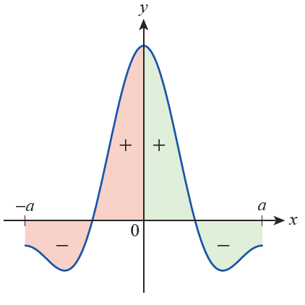
Theorem: Definite Integrals of Even and Odd Functions
Proof (cont.)
The symmetry with respect to the y‑axis in Figure 1 illustrates why the signed area of an even function over the interval [−a, a] is twice its signed area over the interval [0, a].
Figure 1 Signed Area
of an Even Function

Slide 13
Theorem: Definite Integrals of Even and Odd Functions
Proof (cont.)

Slide 14
Theorem: Definite Integrals of Even and Odd Functions
Proof (cont.)
The proof of the second statement is similar, with the difference that in the third step above we will use −f(x) = f(−x) since f is odd.

Slide 15
Example 2
Evaluate
Solution
The integrand is continuous and
odd since it is a product of an odd continuous function
sin x and an even continuous function
Since the interval is centered at 0,

Slide 16
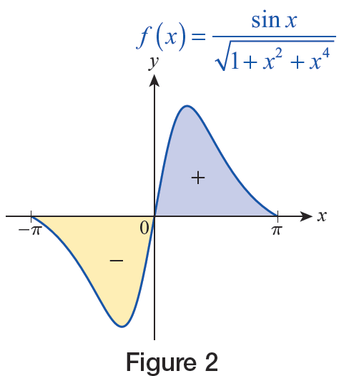
Example 2 (cont.)
Geometrically, this reflects the fact that the signed areas in Figure 2 cancel each other out.
Figure 2

Slide 17
Area between Curves
In general, if the rate of change of an area A with respect to some variable, say x, over an interval [a,b] then
In hindsight, this is simply one way of expressing the Fundamental Theorem of Calculus.

Slide 18
Area between Curves
This reflects the key idea at the heart of integration—namely, that “adding up” all of the small elements dA over some interval [a, b] results in the total quantity A.

Slide 19
Definition: Area between Curves
Area of a Region between Two Curves
Given two continuous functions f and g defined on an interval [a, b] with for all the area of the region bounded between the graphs of f and g
over [a, b] is

Slide 20
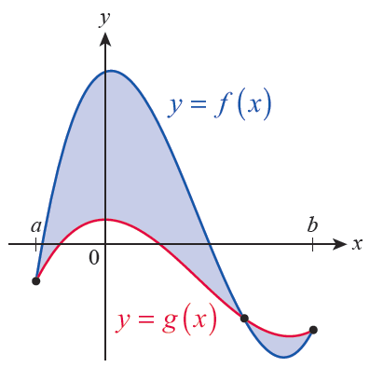
Example 3
The graphs of the functions
are shown in Figure 5.
Determine the total area
of the shaded regions.
Figure 5

Slide 21
Example 3
Solution
Using the graphs depicted in Figure 5, it appears that f is the upper function on the first part of the interval [a, b] and that g is the upper function on the remainder of the interval.

Slide 22
Example 3 (cont.)
So in order to find the area of the shaded regions, we have to determine not only a and b but also the point inside the interval [a, b] where f and g intersect.
All three are points where so we begin by solving this equation.

Slide 23
Example 3 (cont.)
Since the leading coefficient is 1 in this case, a rational root of the polynomial x³ − 4x² + x + 6 must be one of the numbers ± {1, 2, 3, 6}. As you can verify by synthetic or long division, −1, 2, and 3 are roots, so we know that a = −1, b = 3, and x = 2 must be the third point where

Slide 24
Example 3 (cont.)
So the area of the shaded regions can be found as follows:

Slide 25
Example 4
Find the area of the region bounded by the graphs of
the equations y = 0, 3x − 5y = 12, and
Solution
Two edges of the described region are lines, and the remaining edge is the graph of the function the upper half of the parabola x = y².

Slide 26
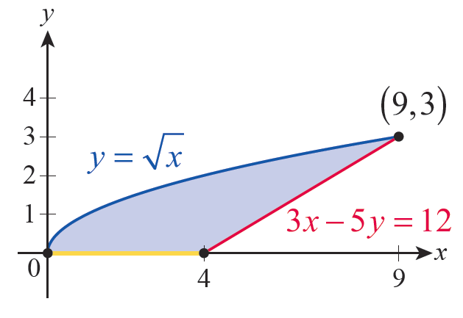
Example 4 (cont.)
Figure 7 illustrates the described region.
Figure 7

Slide 27
Example 4 (cont.)
On the interval [0, 4], the lower function is g(x) = 0, and on the interval [4, 9] the lower function is The upper function is for the entire interval [0, 9]. So the total area of the described region is

Slide 28
Example 4 (cont.)
The left edge of the region is the function g(y) = 2 (corresponding to the equation x = y²) and the right edge is the function (obtained by solving 3x − 5y = 12 for x).

Slide 29
Example 4 (cont.)
So each horizontal differential element of area can be written as
thus the area is calculated as follows:

