Slide 1
Section 6.1
Finding Volumes Using Slices

Slide 2
TOPICS
Integral Definition of Volume
Integrating Slices
Disks and Washers
Interlude: The Big Picture

Slide 3
Integral Definition of Volume
Our philosophy of integration can be put to good use immediately. Recall that the most general statement regarding area and integration can be expressed as that is, the area of a region can be found by “integrating together” its area differentials.

Slide 4
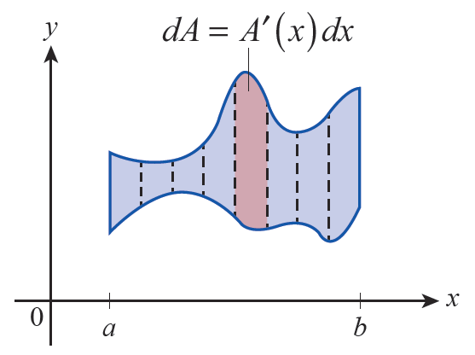
Integral Definition of Volume
In practice, we typically know how to express the area differential dA in terms of another differential dx, for instance dA = A′(x)dx, and we might also know that the region is bounded between certain limits, say x = a and x = b (see Figure 1).
Figure 1
Area as an Integral

Slide 5
Integral Definition of Volume
If so, we write
and use the Fundamental Theorem of Calculus to evaluate A.

Slide 6
Integral Definition of Volume
In similar fashion, we define the volume V of a
three‑dimensional body by where dV
represents a volume differential. Suppose, as in the above paragraph, we are able to express dV in terms of another differential, say and we again know that the body is bounded between the limits x = a and x = b. What does the corresponding illustration look like?

Slide 7
Integral Definition of Volume
First, note that the two equations x = a and x = b represent planes in the three‑dimensional space, as they describe the set of ordered triples
respectively.
ℝ
ℝ
ℝ
ℝ

Slide 8
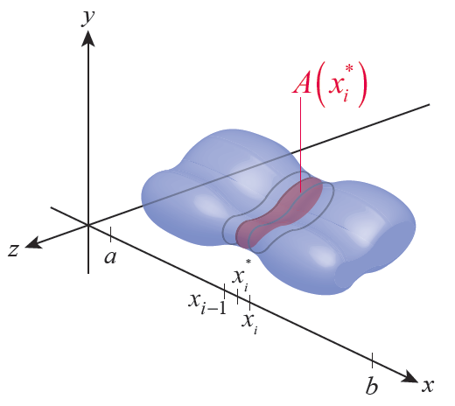
Integral Definition of Volume
Next, as illustrated in Figure 2, each element dV is approximated by a thin slab (perpendicular to the
x‑axis) with volume where is the area of the cross‑section of the body through on the x‑axis and Δx_{i} is the width of a subinterval containing The formula comes from the fact that each thin slab is a generalized cylinder.
Figure 2

Slide 9
Definition: Cylinders and Their Volumes
Cylinders and Their Volumes
Given a plane region B and a distance h, a cylinder formed by base B and height h is the solid body bounded by B and a translated copy of B in a second plane parallel to the first and separated by the distance h.

Slide 10
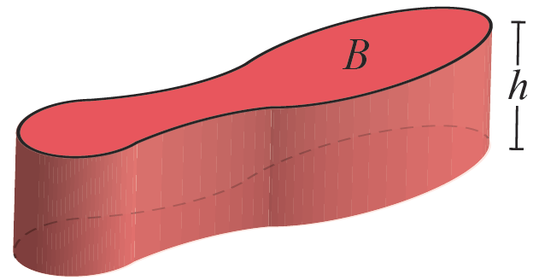
Definition: Cylinders and Their Volumes
Cylinders and Their Volumes (cont.)
The volume of a cylinder is the product of its height and the area of its base:
Figure 3
Volume of a Cylinder V = Area(B) ⋅ h

Slide 11
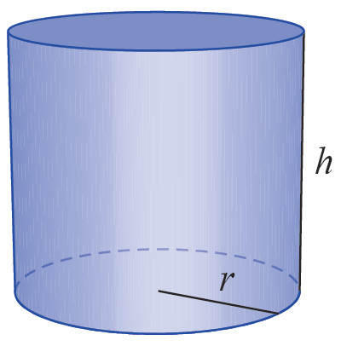
Integral Definition of Volume
The simple formula of base area times height is the basis of some well‑known volume formulas. For instance, if the base B is a circle of radius r, the cylinder formed is a circular cylinder with volume V = πr²h (see Figure 4a).
Figure 4a
Circular Cylinder with V = πr²h
Volumes of Familiar Cylinders

Slide 12
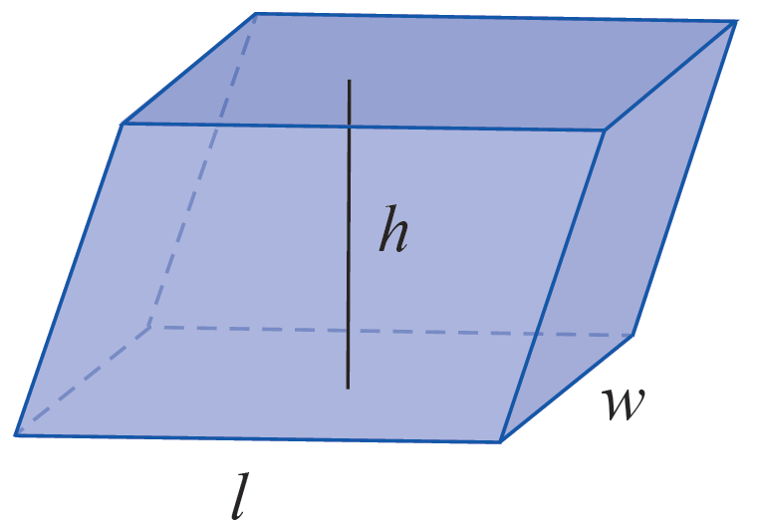
Integral Definition of Volume
And if B is a rectangle, the solid body formed is an example of a parallelepiped with volume V = lwh, where l and w are the dimensions of the rectangle (see Figure 4b).
Figure 4b
Parallelepiped with V = lwh
Volumes of Familiar Cylinders

Slide 13
Integral Definition of Volume
For our purposes, the formula for cylinder volume is all we need to extend our definition of volume to more general bodies. Referring to Figure 2 again, we partition the x‑axis interval [a, b] at the n + 1 points
and slice the body into n “slabs”, with the i^{th} slab having width Δx_{i}.
Figure 2

Slide 14
Integral Definition of Volume
We then choose a sample point in each subinterval and form the products each of which represents an approximation of the volume of the i^{th} slab. So an approximation to the total volume V of the body is given by

Slide 15
Integral Definition of Volume
The summation above is an example of a Riemann sum,
and in the limit as n → ∞ we write
In summary, the formula defines the volume of a given body in three‑dimensional space, and if the body is bounded between the two planes x = a and x = b, we can express this volume as
where A(x) represents the area of a cross-sectional slice of the body through x. Note that this incorporates the fact that the rate of change of V with respect to x is A(x).

Slide 16
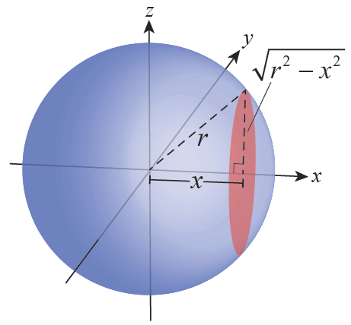
Example 1
Find the volume V of a sphere of radius r.
Solution
To find the volume of a sphere by integrating slices, it is most convenient to define three coordinate axes with the origin at the center of the sphere, as shown in Figure 5.
Figure 5

Slide 17
Example 1 (cont.)
We can choose to slice up the sphere into parallel cross‑sections any way we like; we’ll use slices that are perpendicular to the x‑axis, as in the previous discussion. Finally, we’ll take advantage of the symmetry of a sphere and integrate cross‑sectional areas from x = 0 to x = r and then simply double the result.

Slide 18
Example 1 (cont.)
Let A(x) denote the area of a cross‑section of the sphere passing through x that is parallel to the yz‑plane. Then by the Pythagorean Theorem, the
Radius of the cross‑section is and so

Slide 19
Example 1 (cont.)
So half of the total volume V is calculated as follows:
The total volume is the familiar formula

Slide 20
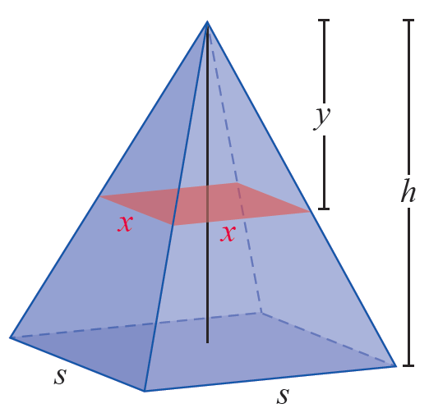
Example 2
Find the volume of a pyramid of height h whose base is a square of side length s.
Solution
If we slice the pyramid into cross‑sections parallel to the base, as shown in Figure 6, each cross‑section has area
Figure 6

Slide 21
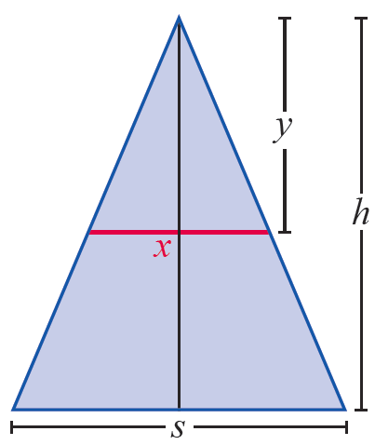
Example 2 (cont.)
The easiest way to see this is to use similar triangles (see Figure 7) to express x in terms of y.
Thus the area of the cross-section is
Figure 7

Slide 22
Example 2 (cont.)
We can now integrate the area differentials A(y)dy from y = 0 to y = h to obtain the volume.

Slide 23
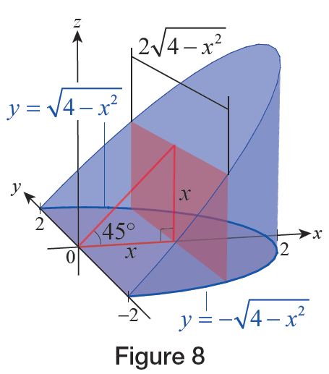
Example 3
The curved wedge in Figure 8 is bounded by a right circular cylinder, the xy‑plane, and a second plane passing through the y‑axis at an angle of 45° to the xy-plane, as shown. The cylinder’s axis is the z‑axis and it has a radius of 2. What is the volume of the wedge?
Figure 8

Slide 24
Example 3 (cont.)
Solution
If we decompose the wedge into slices perpendicular to the x‑axis, each cross‑section is a rectangle; since the areas of rectangles are especially easy to calculate, this seems like a promising way to slice up the solid. The area of each rectangle, A(x), will depend on the point where it crosses the x‑axis—we need to find a formula for A(x).

Slide 25
Example 3 (cont.)
In the xy‑plane, the curves and
define the base of the wedge, so the width of each
cross-sectional rectangle is
As a check of our work, note that as we would expect, since the cross‑sectional rectangles at x = 0 and x = 2 are actually just line segments.

Slide 26
Example 3 (cont.)
We are now ready to determine the volume.

Slide 27
Theorem: Cavalieri’s Principle
Cavalieri’s Principle
If two solids of the same height have cross-sectional areas that are equal at each possible distance from their respective bases, then their volumes are also equal.

Slide 28
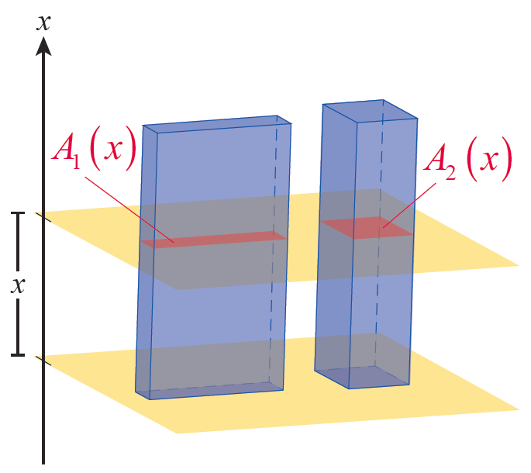
Theorem: Cavalieri’s Principle
Proof
Let V₁ and V₂ represent the volumes of the two solids, and define the x‑axis along the solids’ respective
heights as shown in Figure 9. Let A₁(x) and A₂(x) denote the cross‑sectional areas of the two solids a distance x from their bases. Then since A₁(x) = A₂(x) for each x,
Figure 9

Slide 29
Disks and Washers
Many solids are radially symmetric with respect to a central axis and are formed by revolving a plane region about that axis. Such objects are called solids of revolution, and it is often convenient to define their volumes in terms of cross‑sections perpendicular to the axis of rotation. Those cross‑sections typically take the form of either disks or washers, depending on whether the cross‑sections are solid regions or not.

Slide 30
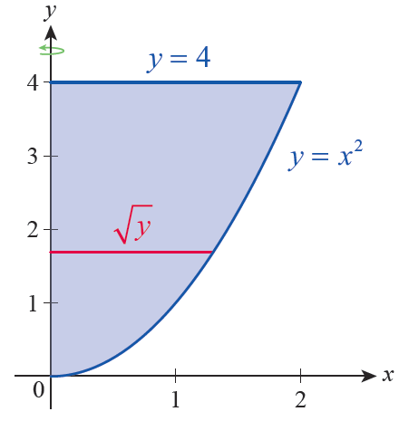
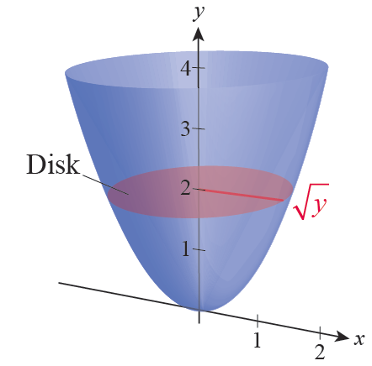
Example 4
The region bounded by y = x², y = 4, and x = 0 (see Figure 10) is rotated about the y‑axis and generates the solid paraboloid in Figure 11. Find the volume of the solid.
Figure 10 Plane Region
Figure 11 Solid of Revolution

Slide 31
Example 4 (cont.)
Solution
Each cross‑section perpendicular to the y‑axis is solid and has the form of a disk. The radius of the cross‑section passing through the point is
so the cross‑sectional area function A(y) is as follows:
This leads to the volume of the solid.

Slide 32
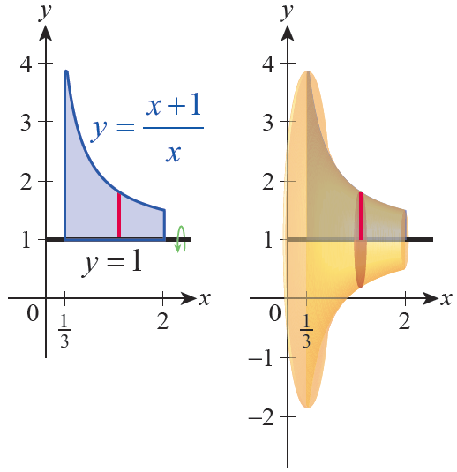
Example 5
Find the volume of the solid formed by revolving the region bounded by , y = 1, and
x = 2 about the line y = 1.
Solution
The described region and the solid it generates are shown in Figure 12.
Figure 12
Plane Region and
Solid of Revolution

Slide 33
Example 5 (cont.)
Slicing the solid into disks perpendicular to the axis of revolution y = 1, we see that the disk passing through the point (x, 1) has radius

Slide 34
Example 5 (cont.)
So and the volume can be found as follows:

Slide 35
Example 6
Find the volume of the solid formed by revolving the region bounded by y = 1, and
x = 2 about the x-axis.
Solution
The region is the same as the one from Example 5, but with a different axis of revolution. When we rotate the region about the x‑axis, the generated solid has a hollow core.

Slide 36
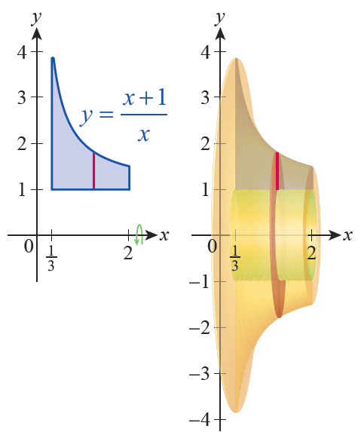
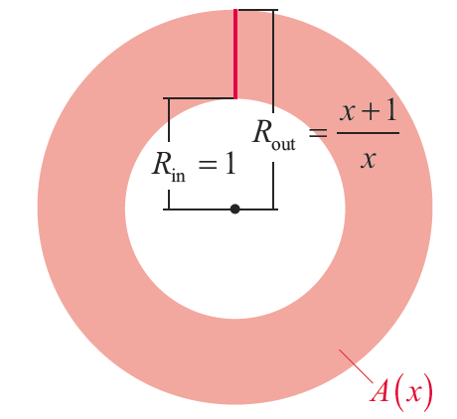
Example 6 (cont.)
And when we slice the solid perpendicularly to the axis of revolution, we obtain cross‑sections that are washers instead of disks (see Figures 13 and 14).
Figure 13
Plane Region and
Solid of Revolution
Figure 14
Washer Cross-Section

Slide 37
Example 6 (cont.)
The areas of these cross‑sections are just as easily found, though—the area of a washer is where R_{out} is the outer radius of the washer and R_{in} is the inner radius.

Slide 38
Example 6 (cont.)
Therefore the volume of the solid is as follows:

Slide 39
Example 7
Find the volume of the solid generated by revolving the region bounded by y = x and y = x² about the following lines.
a. about the y‑axis b. about the line y = 2
Solution
a. The region to be revolved about the y‑axis is shown in Figure 15 and the solid generated is shown in Figure 16.

Slide 40
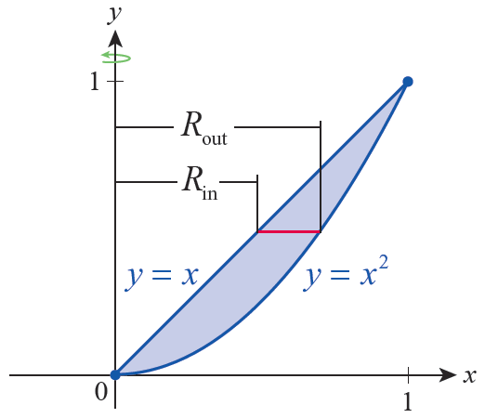
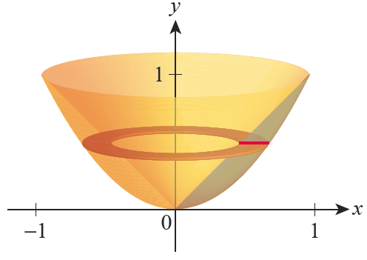
Example 7a (cont.)
Figure 15 Plane Region
Figure 16 Solid of Revolution

Slide 41
Example 7a (cont.)
The red horizontal line is a representative segment that will rotate around the y‑axis, so the outer radius is given by the curve y = x² and the inner radius by y = x. But we will be integrating cross‑sectional washers with respect to y, thus we need expressions for the outer and inner radii in terms of y. They are, respectively,
and R_{in} = y.

Slide 42
Example 7a (cont.)
Now the volume of the solid can be calculated.

Slide 43
Example 7 (cont.)
b. The region is the same, but this time we are revolving about the horizontal line y = 2 so the cross‑sectional washers will be functions of x and we will integrate their areas from x = 0 to x = 1.

Slide 44
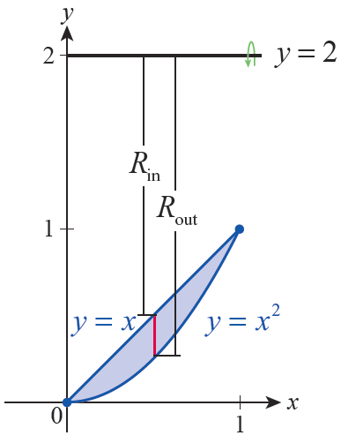
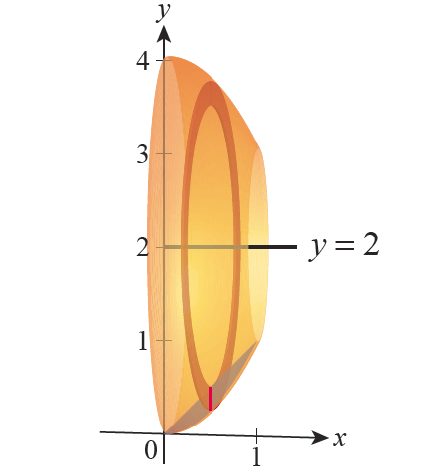
Example 7b (cont.)
Figure 17 Plane Region
Figure 18 Solid of Revolution

Slide 45
Example 7b (cont.)
Note that, as shown in Figure 17, the outer and inner radii are, respectively, the distances from the line y = 2 to the curve y = x² and y = x. So R_{out} = 2 − x² and R_{in} = 2 − x.

Slide 46
Example 7b (cont.)
The volume is

Slide 47
Definition: The Disk and Washer Methods
The Disk and Washer Methods
For the purpose of this discussion, assume the given solid of revolution has an axis of revolution parallel to the x‑axis, that the cross‑sections with respect to x are either disks or washers, and that the solid is bounded by the planes x = a and x = b.

Slide 48
Definition: The Disk and Washer Methods
The Disk and Washer Methods (cont.)
Then the volume V can be expressed in one of the following forms.

Slide 49
Interlude: The Big Picture
It is easy to lose sight of the basic principles of integration, especially when first learning the techniques of setting up and evaluating integrals. Remember that the first principle of both area and volume, at least as far as integration is concerned, is that
That is, if you can find a convenient (meaning integrable) expression for the differential in either case, then you have accomplished the most important task.

Slide 50
Interlude: The Big Picture
We have extensively studied some of the more common ways of setting up area and volume integrals, but have by no means exhausted the possibilities. For any given problem, there may be many ways of setting up the integral, and the common approaches may not lead to the “best” integral.

Slide 51
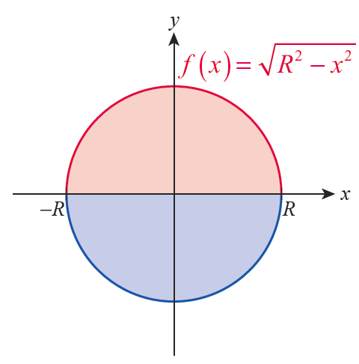
Example 8
You know that the area of a circle of radius R is A = πR²,
and one straightforward way to arrive at this formula is to integrate the function over the interval [−R, R] and then double the result (see Figure 19). However, we will learn an easier way in later chapters. Here are two other approaches.
Figure 19

Slide 52
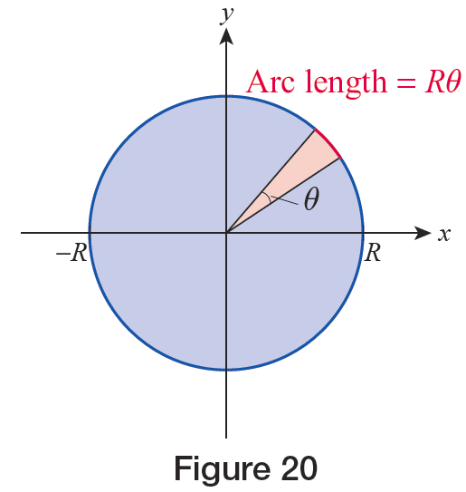
Example 8 (cont.)
1. The area of a triangle is half the product of its base and height. A thin sector of our circle is approximately a triangle (and the approximation gets better and better as the angle approaches 0), with the base of the triangle equal to Rdθ and the height equal to R.
Figure 20

Slide 53
Example 8 (cont.)

Slide 54
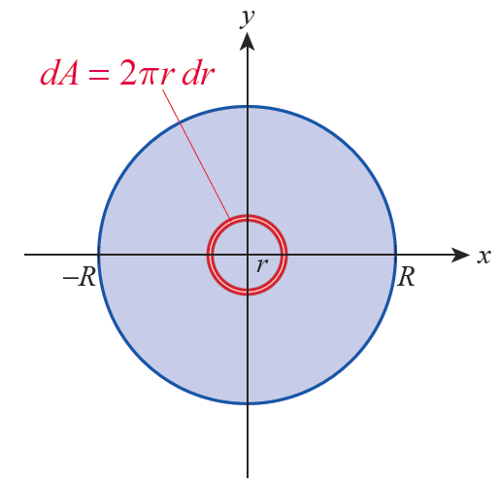
Example 8 (cont.)
2. If we assume the formula for a circle’s circumference is known, then we can decompose our given circle into a sequence of thin concentric rings with each one having area approximately equal to its circumference times dr.
Figure 21

Slide 55
Example 8 (cont.)

Slide 56
Example 9
Assume the formula for the surface area of a sphere of radius r is known: A = 4πr² (we will soon find this formula on our own). Then an alternative way of finding the volume of a sphere of radius R is to decompose it into a sequence of thin concentric shells, each with volume approximately equal to its surface area times dr.

