Slide 1
Section 6.5
Force, Work, and Pressure

Slide 2
TOPICS
Integral definition of work
Fluid pressure and fluid force

Slide 3
Integral Definition of Work
Work W is defined as the application of a force F over a distance d. The equation W = Fd assumes that the force is constant over the distance d, and if the force in a given situation truly is constant, as in Example 1, then no calculus is required to determine the work done.

Slide 4
Example 1
Calculate the work done
a. in lifting a 10-pound bucket of water out of a 50­foot-deep well and
b. in picking a 2‑kilogram book 0.9 meters up off the floor.
Solution
a. In the US Customary System of units, the pound is the unit of force and the foot is the unit of distance; it is a measure of the gravitational attraction between the Earth and, in this case, a bucket of water. So the work done is as follows.

Slide 5
Example 1 (cont.)
b. In the International System (SI) framework, the unit of force is the newton (N), the force required to accelerate a mass of 1 kg at 1 m/s². (For comparison, the 10-pound bucket in this example would weigh about 45 newtons.) The distance is measured in meters, and a unit of work is the Newton‑meter (N ⋅ m), also called the joule (J) after the English physicist James Joule (1818–1889). The book in this example has a mass of 2 kilograms and the gravitational force between it and Earth is the force

Slide 6
Example 1b (cont.)
Now the work performed in lifting it 0.9 meters can be determined.
Note the distinction between the pound, a measure of force, and the kilogram, a measure of mass. In the US Customary System, a unit of mass is the slug, which is an object’s weight in pounds divided by g ≈ 32 ft/s². Although its use is rare (the SI is more typically used to measure mass), the 10‑pound bucket of water in part a. has a mass of approximately 0.31 slugs.

Slide 7
Integral Definition of Work
As you might expect, it is frequently the case that the force in question varies over the distance. But we can still use the relationship W = Fd to construct a more general formula. To this end, assume F is a continuous function of x and that we wish to calculate the work performed by F over the distance d represented by the interval [a, b] on the x-axis. If we partition [a, b] into n subintervals with the n + 1 points then over each subinterval the force can be
approximated by the constant where is, as usual, a sample point.

Slide 8
Integral Definition of Work
As the subintervals decrease in width, the amount by which F can vary also decreases, making the approximations better as we consider finer and finer partitions. Adding up the incremental amounts of work performed over each subinterval, the total work done is approximated by a Riemann sum:
In the limit as n →∞, this leads to the following definition.

Slide 9
Definition: Work Done by a Variable Force
Work Done by a Variable Force
The work done by a continuous force F(x) over the interval [a, b] is

Slide 10
Integral Definition of Work
A simple but important application of the above definition comes from Hooke’s Law, which states that the force needed to stretch or compress a spring (within reasonable limits) is proportional to the distance x it is stretched or compressed from its natural length. That is, F(x) = kx, where k is the spring constant, a number that depends on the particular spring.

Slide 11
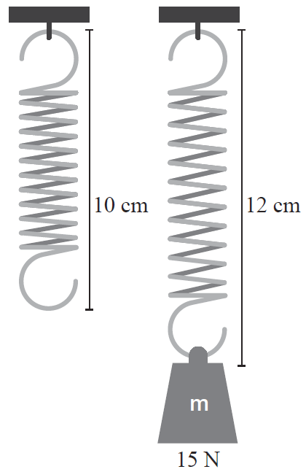
Example 2
A spring with an unstressed length of 10 cm is held stretched to 12 cm with a force of 15 N. How much work will be done in stretching the spring from 12 cm to 15 cm?
Figure 1

Slide 12
Example 2 (cont.)
Solution
The first step is to determine the spring constant k. Since a force of 15 N is required to stretch the spring 12 cm − 10 cm = 2 cm = 0.02 m (remember to convert centimeters to meters), we find k as follows:

Slide 13
Example 2 (cont.)
Thus F(x) = 750x and the work done in stretching the spring from 2 cm to 5 cm beyond its natural length is

Slide 14
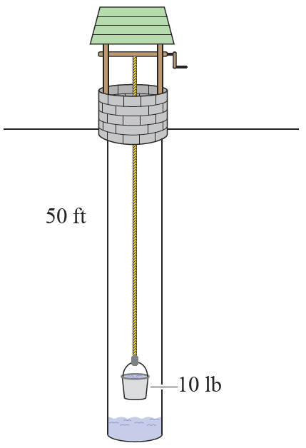
Example 3
A bucket of water weighing 10 lb is lifted out of a well by pulling it up with a 50 ft rope. The rope itself weighs 0.1 lb/ft. How much work is done in lifting the bucket and the rope?
Figure 2

Slide 15
Example 3 (cont.)
Solution
The weight of the rope is significant, since 50 ft of rope weighs (0.1 lb/ft) (50 ft) = 5 lb. But after x ft of rope has been pulled in, only 50 − x feet are left contributing to the weight of the bucket and remaining rope.
So when the bucket has been lifted x ft, the total remaining weight to be lifted is

Slide 16
Example 3 (cont.)
The work done can now be calculated as follows:

Slide 17
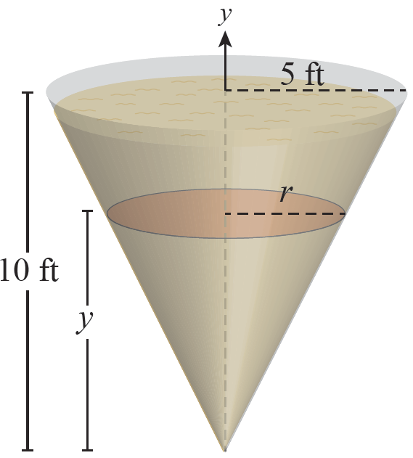
Example 4
The conical underground tank shown in Figure 3 has a radius at the top of 5 ft and a depth of 10 ft. It is filled with gasoline that weighs 44 lb/ft³. How much work is needed to pump all of the gasoline to a. the top of the tank and b. 3 ft above the top of the tank?
Figure 3

Slide 18
Example 4 (cont.)
Solution
We can approach this problem by thinking of the gasoline as made up of a sequence of thin layers, like the one shown in Figure 3, and constructing the differential elements of work dW required to lift each layer the required distance. Each layer is approximately a circular cylinder with differential thickness dy and radius r, so its differential element of volume is
dV = πr² dy.

Slide 19
Example 4 (cont.)
By similar triangles, we can compute r:
This leads to

Slide 20
Example 4 (cont.)
The weight of each differential layer is 44dV = 11πy² dy; remember, the weight is the force due to gravity that must be overcome. All that remains is to determine the distance over which each layer must be lifted—that is, the distance over which each force must be applied. In part a., the layer at a height of y above the origin must be lifted 10 − y ft, so dW = 11π y²(10 − y)dy.
In part b. the same layer must be lifted 13 − y ft, so dW = 11π y²(13 − y)dy.

Slide 21
Example 4 (cont.)
Thus our two answers are as follows.

Slide 22
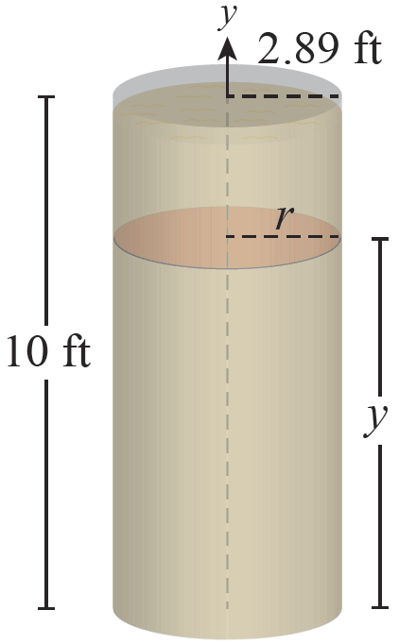
Example 5
An underground cylindrical tank of depth 10 ft and radius 2.89 ft holds about the same volume as the conical tank of Example 4. It also is filled with gasoline. Determine the work required to pump all of the gasoline to the top of the tank, and compare the answer to part a. of Example 4.
Figure 4

Slide 23
Example 5 (cont.)
Solution
Each differential element of volume in this case is dV = π (2.89)²dy, and its weight is 44π (2.89)²dy. So the work needed is as follows:

Slide 24
Example 5 (cont.)
This is about twice the work that was required to pump out the conical tank of the same volume and depth. Remember, work equates to energy, and energy costs money: between these two tanks, the conical is by far the better choice. Of course, many other configurations are possible.

Slide 25
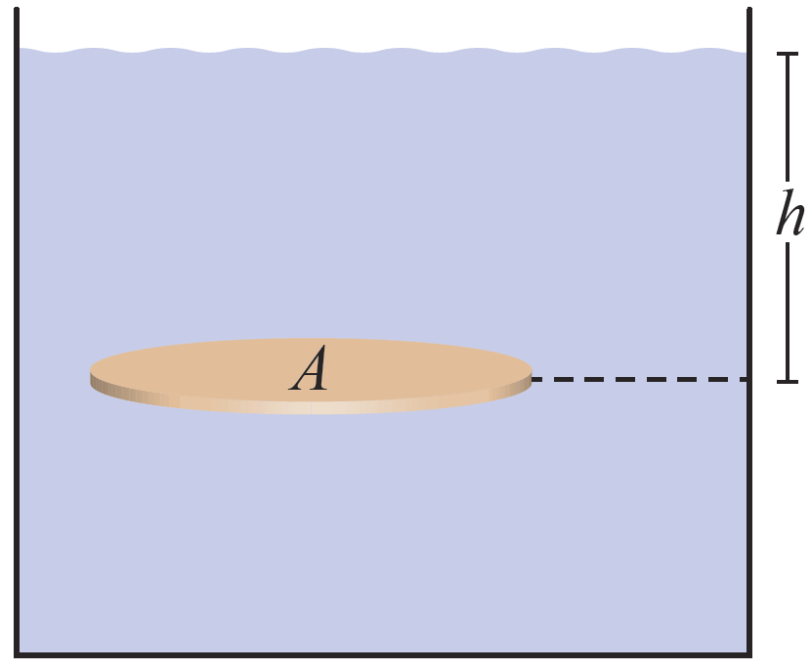
Fluid Pressure and Fluid Force
Forces due to fluids appear in another important context—that exerted by the weight of fluids on surfaces. In some instances, the calculation of fluid pressure is easy. For example, consider a plate of surface area A that is oriented horizontally at a depth h
below the surface of a liquid, as in Figure 5. The volume of the liquid above the plate is V = Ah, so if its density is ρ then its mass is m = ρV and its weight is
Figure 5

Slide 26
Fluid Pressure and Fluid Force
Pressure is defined to be force per unit area, so the pressure P of the body of liquid above the horizontal plate is P = F/A = ρhg. In SI units, pressure is usually measured in pascals (Pa) or kilopascals (kPa), where 1 Pa = 1 N/m² and 1 kPa = 1000 Pa. In the US Customary System, it is convenient to use the weight density δ of the fluid in question, where δ = ρg (and ρ is the fluid’s mass density). In this system, P = ρhg = 𝛿h,
δ is typically measured in lb/ft³ , and pressure therefore has units of pounds per square foot.

Slide 27
Fluid Pressure and Fluid Force
The unit of pressure Pa is named after the French mathematician, physicist, and inventor Blaise Pascal (1623–1662) who, in addition to much else, provided insight into a key principle of fluid pressure: The pressure at any point in a fluid is the same in all directions. This principle, which reflects the behavior of matter, underlies many familiar properties, such as the fact that divers feel the same pressure on their eardrums at a given depth no matter which way they are oriented in the water.

Slide 28
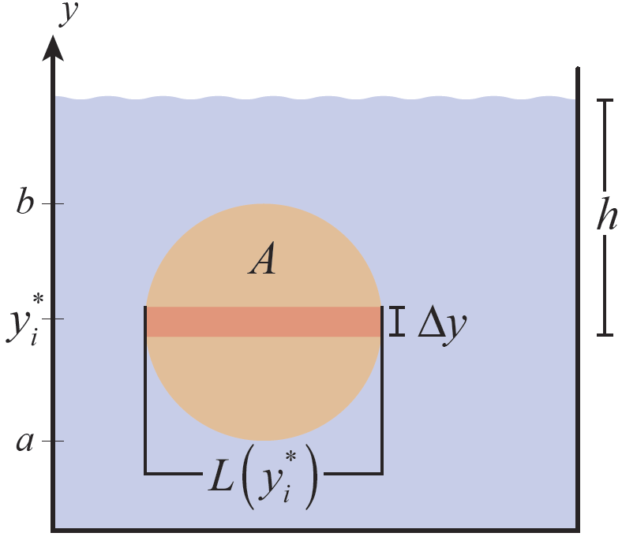
Fluid Pressure and Fluid Force
Consider a submerged vertically oriented plate such as shown in Figure 6. Knowing its area is not sufficient to determine the fluid force exerted against one side of it, because the fluid pressure varies with the depth h
below the surface. But if we partition the interval [a, b] in the usual manner, all the area of any given horizontal strip is approximately at the same depth h, with the approximation getting better and better as Δy → 0.
Figure 6

Slide 29
Fluid Pressure and Fluid Force
In particular, if the i^{th} subinterval [y_{i-1} , y_{i}], of the partition has thickness Δy_{i} and if is a sample point, then the area of the i^{th} horizontal strip is and the fluid force exerted on one side of it is
where is the length of the plate at ρ is its mass density, and δ = ρg is its weight density.

Slide 30
Fluid Pressure and Fluid Force
So the total force on one side of the plate can be approximated as follows.

Slide 31
Definition: Fluid Force against a Vertical Plate
Fluid Force against a Vertical Plate
Given a plate submerged vertically in a fluid of density ρ (or weight density δ ), the fluid force exerted against one side of it is
where L(y) is the length of a horizontal strip of the plate at y and the plate is bounded between y = a and y = b.

Slide 32
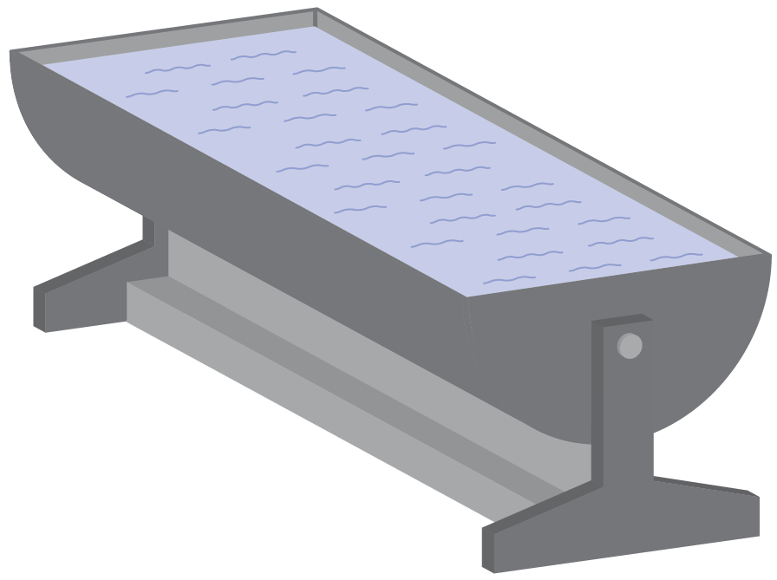
Example 6
The two ends of a water trough are semicircular plates, each with a radius of 2 ft. The trough is filled with water, and the weight density of water is 62.4 lb/ft³ . How much force is exerted on each end of the trough?
Figure 7

Slide 33
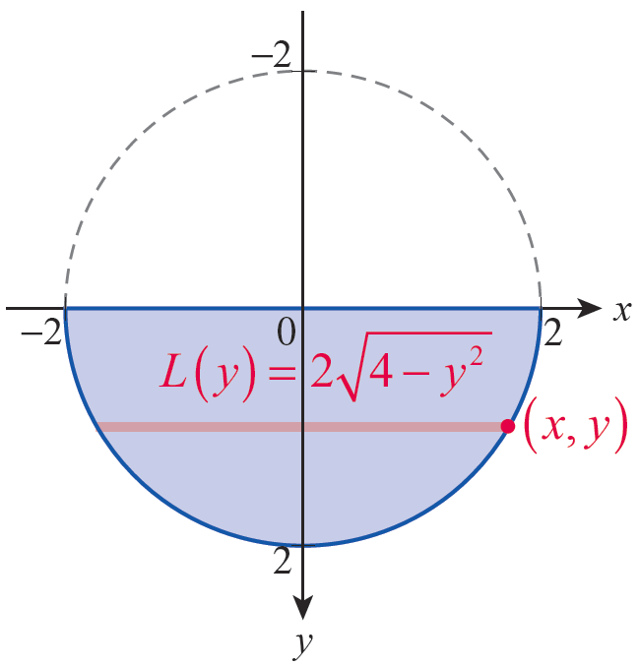
Example 6 (cont.)
Solution
In order to describe the semicircular ends easily, we can set up our coordinate system so that the positive y‑axis points downward and the origin is at the center of the circle as shown in Figure 8.
Figure 8

Slide 34
Example 6 (cont.)
The complete circle is the graph of the equation x² + y² = 4, so if (x, y) is a point on the lower semicircle,
Hence the length L(y) of a given horizontal
strip is The depth of the strip shown is y.

Slide 35
Example 6 (cont.)

Slide 36
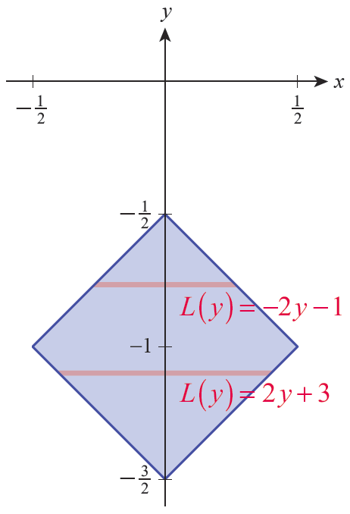
Example 7
A square pump compartment cover plate with the dimensions in meters shown in Figure 9 is installed into the wall of a pool; its centerline is 1 m below the water’s surface. What is the fluid force on the plate?
Figure 9

Slide 37
Example 7 (cont.)
Solution
The positive y‑axis in Figure 9 is pointing upward, in contrast to its orientation in Example 6, but we apply our integral formula in the same way—we just have to be careful to describe the strip depths and the limits of integration correctly.
We also need an expression for the strip lengths, L(y). Equations for the two lower edges of the plate are
(lower left edge) and
(lower right edge).

Slide 38
Example 7 (cont.)
Solving these for x and subtracting the first from the second gives us between and
y = −1; we can check our work by noting that and which corresponds with what we expect from Figure 9. In similar fashion, describes the lengths of the horizontal strips between y = −1 and
Since the water’s surface is at y = 0, the depth of the strip passing through y on the vertical axis is 0 − y = −y.

Slide 39
Example 7 (cont.)
We are now ready to apply our formula.

Slide 40
Example 7 (cont.)
We have used the first version of our fluid force formula (with ρg instead of δ) because the dimensions in the problem, as given, were SI units. The density ρ of water is 1000 kg/m³ and g = 9.8 m/s².

Slide 41
Fluid Pressure and Fluid Force
In some cases, the centroid and area of a submerged vertical plate is obvious or easily calculated. If so, they can be used to calculate the fluid force on one side of the plate without integration, by the following argument.

Slide 42
Fluid Pressure and Fluid Force
The second coordinate, of the centroid with respect to the fluid’s surface level is
where y^{c} is the distance of the center of mass of horizontal strips from the surface (that is, the depth of the horizontal strip) and A is the surface area of the plate.

Slide 43
Fluid Pressure and Fluid Force
The differential dA can be expressed as
Multiplying both ends of this last equation by either ρg or δ (depending on the context), we obtain the following:

Slide 44
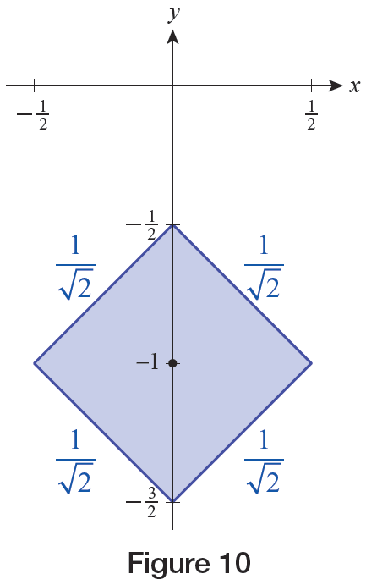
Example 8
Calculate the fluid force on the square cover plate of Example 7 using its centroid and area.
Figure 10

Slide 45
Example 8 (cont.)
Solution
The centroid of the plate is 1 m from the water’s surface, and the area of the square plate is

