Slide 1
Section 7.1
Integration by Parts

Slide 2
TOPICS
Integration by parts—indefinite version
Integration by parts—definite version

Slide 3
Formula: Integration by Parts Formula
Integration by Parts Formula
Given differentiable functions f and g,
If we let u = f(x) and v = g(x), then du = f ’(x)dx and dv = g’(x)dx and the equation takes on the more easily remembered differential form

Slide 4
Example 1
Evaluate
Solution
If we want to use integration by parts, we have several choices for u and dv. If we let u = x and dv = cos x dx, then du = dx and one possible v is sin x (we could also use sin x + C, where C is any other constant, but v = sin x is the simplest choice). It helps to write this as follows:

Slide 5
Example 1 (cont.)
Now we can apply integration by parts.
What happens if we use another choice for u and dv? For example, u = cos x and dv = x dx? In this case,
and

Slide 6
Example 1 (cont.)
The new integral on the right is more difficult to evaluate than the original integral, so if this had been our first approach we would need to consider stopping at this point and trying another choice.

Slide 7
Example 2
Evaluate
Solution
If we want to use integration by parts on this integral, we don’t actually have much choice for dv. If we let dv = ln x dx, finding v amounts to evaluating the original integral. So we are led to try dv = dx and u = ln x.

Slide 8
Example 2 (cont.)
Integrating by parts, we obtain the following:

Slide 9
Example 3
Evaluate
Solution
We could let dv = x² dx, but then v would be a third degree polynomial—increasing the degree of part of the integrand takes us further from our goal. So we are led to the following:
and thus

Slide 10
Example 3 (cont.)
The integral on the right is not one that can be evaluated on sight, but we have already used integration by parts in Example 1 to find

Slide 11
Example 4
Evaluate
Solution
Any choice of u and dv results in an integral that is no worse than the original, but unfortunately also no better. However, we can evaluate the integral by using integration by parts twice.
and

Slide 12
Example 4 (cont.)
Replacing the integral on the right of the first step with the result of the second step, we have the following:
Our original integral appears on both sides of this last equation, but we can now solve for it.

Slide 13
Example 5
Given n ∈ ℕ, prove that
Solution
If we let u = cos^{n−1} x and dv = cos x dx, then
This is a reasonable choice for u and
dv because we can certainly find v.

Slide 14
Example 5 (cont.)
Now we can apply integration by parts.

Slide 15
Example 5 (cont.)
Adding to both sides of this equation gives us
and so

Slide 16
Example 6
Evaluate
Solution

Slide 17
Formula: Integration by Parts Formula for Definite Integrals
Integration by Parts Formula for Definite Integrals

Slide 18
Example 7
Evaluate
Solution
We will have to use integration by parts twice.

Slide 19
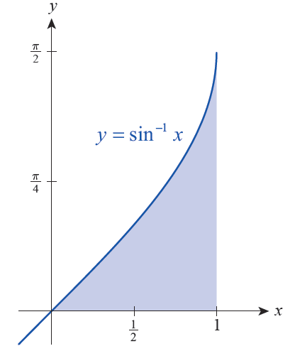
Example 8
Find the area between the graph of sin⁻¹ x and the x-axis from x = 0 to x = 1.
Solution
The region described is depicted in Figure 1, and its area is
Figure 1

Slide 20
Example 8 (cont.)
Evaluating this integral will illustrate the use of u­substitution as well as integration by parts.

