Slide 1
Section 7.4
Trigonometric Substitutions

Slide 2
TOPICS
Three common trigonometric substitutions
Additional substitutions

Slide 3
Three Common Trigonometric Substitutions
The basic idea behind trigonometric substitutions is a change of variables—the translation of an expression from one set of variables into another.
The Substitution Rule, or u-substitution, was our first example of a change of variables, and in fact the Substitution Rule is the basis of trigonometric substitutions.

Slide 4
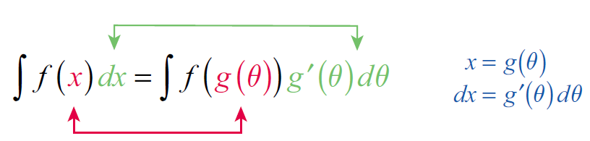
Three Common Trigonometric Substitutions
In general, given an integral we replace x with a differentiable one-to-one function and write the following:

Slide 5
Three Common Trigonometric Substitutions
Three of the most frequently used trigonometry-based substitutions, and the expressions they help to simplify, are described below.
Table 1: Three Trigonometric Substitutions
Expression | Substitution | Useful Identity
 | x = a tanθ with | 1 + tan²θ = sec²θ
 | x = a sinθ with | 1 − sin²θ = cos²θ

Slide 6
Three Common Trigonometric Substitutions
Table 1: Three Trigonometric Substitutions (cont.)
Expression | Substitution | Useful Identity
 | x = a secθ with | sec²θ − 1 = tan²θ

Slide 7
Example 1
Evaluate
Solution
This integral contains an expression of the form
with a = 5, so we make the substitution x = 5 tanθ. Note that this means dx = 5 sec²θ dθ.

Slide 8
Example 1 (cont.)
We know that secθ > 0 on the interval
so our integral can be simplified further and then evaluated.
The only remaining step is to reverse the substitution and express our answer in terms of x.

Slide 9
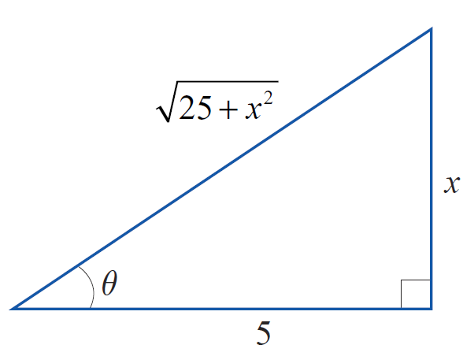
Example 1 (cont.)
Since x = 5 tanθ , we could do this by replacing each θ with and then simplify the result—no trivial task! Instead, it is far easier to sketch a diagram such as the one in Figure 2 that illustrates the relationship
From the angle θ and the known opposite and adjacent sides, we can determine the
hypotenuse to be and hence
Figure 2

Slide 10
Example 1 (cont.)
~
~

Slide 11
Example 2
Evaluate
Solution
First, we replace x with 2 sinθ, where

Slide 12
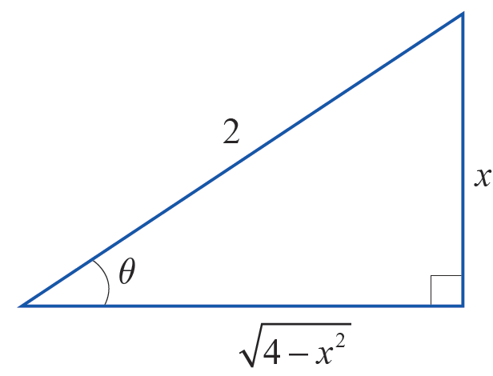
Example 2 (cont.)
Note that, as in Example 1, we have used the fact that
since cosθ ≥ 0 for θ in the specified interval. We can now proceed to integrate using another trigonometric identity.
We again need to express this answer back in x, and we can do so using Figure 3 and the identity sin 2θ = 2 sinθ cosθ.
Figure 3

Slide 13
Example 2 (cont.)

Slide 14
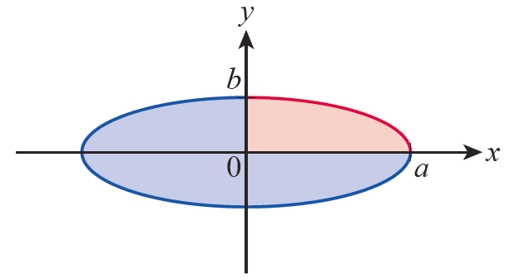
Example 3
Find the area of the ellipse defined by the equation
Solution
The graph of the equation is shown in Figure 4; we will find the area of the ellipse by finding the area of the portion in the 1st quadrant and multiplying by 4.
Figure 4 Area of an Ellipse

Slide 15
Example 3 (cont.)
In order to work with a function of x that we can integrate, we solve the equation for y.
The integral corresponding to the area shaded red in
Figure 4 is which we can evaluate with
the substitution x = a sinθ.

Slide 16
Example 3 (cont.)

Slide 17
Example 3 (cont.)
Be sure to note how the change in the limits of integration corresponds geometrically to the area being found; although we determined the limits by solving two equations for θ, the variable of integration and its limits clearly describe a region in the first quadrant. We can now evaluate the integral with a familiar identity.

Slide 18
Example 3 (cont.)
Multiplying by 4 gives us the result that the area of an ellipse with semiaxes of lengths a and b is πab. In particular, if a = b = r, we have confirmed that the area of a circle is π r².

Slide 19
Example 4
Find a general formula for under the assumption a > 0.
Solution
This uses the third of the three trigonometric substitutions: we let x = a secθ and specify that
(the reason for this will soon be apparent). So dx = a secθ tanθ dθ.

Slide 20
Example 4 (cont.)
To express the answer in terms of x, we sketch a right triangle illustrating the relationship between θ, a, and x.

Slide 21
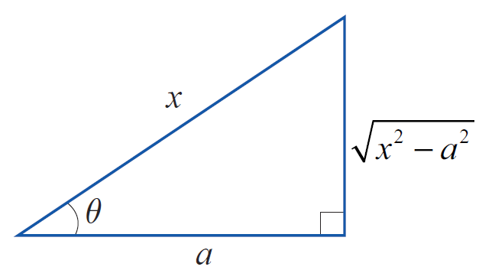
Example 4 (cont.)
Note that in order for the integrand to be real, and for the diagram in Figure 5 to make sense, we must assume that x ≥ a (so if we were evaluating a definite integral, this would restrict the interval of integration).
Also, the specification that
is consistent with the relationship between the variables, as shown in Figure 5.
Figure 5

Slide 22
Example 4 (cont.)
We can now rewrite our formula.
~
~

Slide 23
Example 5
Use the substitution x = a cosh u to find an alternative
general formula for under the assumption
a > 0.
Solution
Recall that cosh² u − sinh² u = 1.

Slide 24
Example 5 (cont.)

Slide 25
Example 6
Evaluate
Solution
The integrand contains an expression almost, but not quite, of the form We can easily eliminate the coefficient in front of x² by making the change of variable t = 3x. Note the change in the limits of integration that result.

Slide 26
Example 6 (cont.)
Now, proceed with t = 2 tanθ and dt = 2 sec2θ dθ.

Slide 27
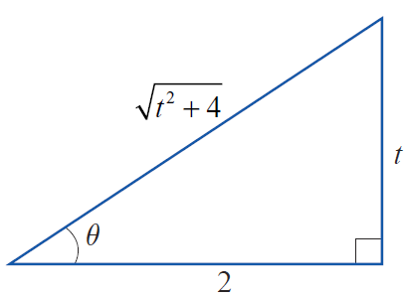
Example 6 (cont.)
Note that our antiderivative is a function of θ, but the limits of integration are still in terms of t. In order to evaluate the expression, we sketch the triangle in Figure 6 and write everything in terms of t.
Figure 6

