Slide 1
Section 7.5
Integration Summary and Integration Using Computer Algebra Systems

Slide 2
TOPICS
Integration recap and guidelines
Integration with computer algebra systems

Slide 3
Integration Recap and Guidelines
The techniques that we have learned are, in order, as follows.
The Substitution Rule (u-substitution)
Integration by parts
Partial fractions
Simplification through trigonometric identities
Trigonometric substitution
Given an integral, there is no “correct” strategy guaranteed to lead to its evaluation, but there are general guidelines to keep in mind.

Slide 4
Integration Guidelines
Integration Guidelines
1. Change the Appearance: Simplify and/or rewrite the integrand to put it into a recognizable form, perhaps matching an integral formula found in a table. This step may involve a change of variables to simplify the appearance of variables. Other options include completing the square of a quadratic expression, splitting apart fractions, rationalizing the denominator or numerator of a fractional expression, and carrying out polynomial long division.

Slide 5
Integration Guidelines
Integration Guidelines (cont.)
u-Substitution: Look for a factor of the integrand that is (up to a constant multiple) the derivative of the remainder of the integrand. Such integrals are good candidates for u-substitution.
Integration by Parts: If the integrand is the product of two expressions, one of which is easily integrated, integration by parts may be called for.

Slide 6
Integration Guidelines
Integration Guidelines (cont.)
Partial Fractions Method: If the integrand is a proper rational function and not easily integrated by inspection, try partial fractions.
5. Trigonometric Identities: If the integrand consists of a product of sine and cosine functions or tangent and secant functions (or products that can be rewritten as such), try simplifying it with a trigonometric identity.

Slide 7
Integration Guidelines
Integration Guidelines (cont.)
6. Trigonometric Substitutions: Integrands containing
factors of the form are candidates for a trigonometric substitution. Remember that a change of variables may be necessary in order to get the integrand into a good form for this technique.

Slide 8
Example 1
Evaluate
Solution
If we complete the square in the denominator, we get an integral that is close to one we’ve seen, one that appears in the table of integrals.

Slide 9
Example 1 (cont.)
If the denominator of the integrand were simply x² + 1, the integrand would be the derivative of tan⁻¹ x. But we can accomplish this with an easy change of variables.

Slide 10
Example 2
Evaluate
Solution
The radicals in the numerator and denominator of this integrand make it difficult to work with, and such expressions are good candidates for rationalizing. We can choose to rationalize either part of the fraction, but rationalizing the denominator doesn’t immediately lead to anything that looks better. So we try the numerator.

Slide 11
Example 2 (cont.)
The presence of a quadratic polynomial in the denominator and a linear polynomial in the numerator looks promising, but u-substitution with u = 25 − x² doesn’t quite help yet. However, simply splitting the fraction into two pieces results in two integrals we can handle. The first, after dividing the top and bottom by 5, takes on a form we have seen before, and the second can be integrated with the u-substitution just mentioned.

Slide 12
Example 2 (cont.)

Slide 13
Example 3
Find a general formula for the integral
Solution
We already know the answer, which we used repeatedly while learning the partial fractions method.

Slide 14
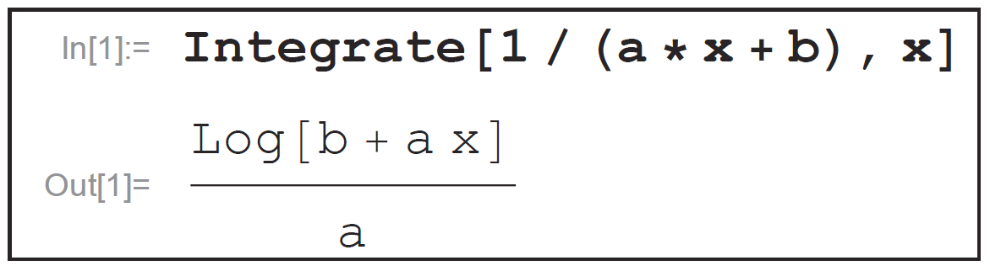
Example 3 (cont.)
Figure 1 shows the relevant Mathematica command and result. Note that the output cites the Log function (a built-in function); we must be familiar enough with Mathematica to know that Log, without any other qualifier, refers to the natural logarithm.
Figure 1 Basic Indefinite Integration

Slide 15
Example 3 (cont.)
Also, note that the Mathematica answer does not include absolute value signs—we need to know to include those. Finally, Mathematica, as is typical with CAS, does not include an arbitrary constant C in its answer.

Slide 16
Example 4
Use Mathematica to evaluate and compare the result with our solution.

Slide 17
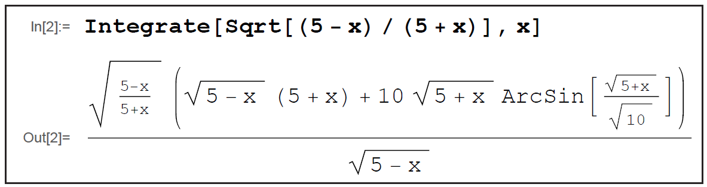
Example 4 (cont.)
Solution
Figure 2
As Figure 2 illustrates, the form of an answer provided by a CAS may not be aesthetically pleasing. Recall from Example 2 that our solution to this integral is

Slide 18
Example 4 (cont.)
The two answers are equivalent, a fact that can be verified by differentiating each one and showing that the result (after significant simplification) is the original integrand. Mathematica can also be used to confirm that our work is correct with the differentiation and simplification commands shown in Figure 3 (note that we must still simplify the output slightly to obtain the form of the original integrand).

Slide 19
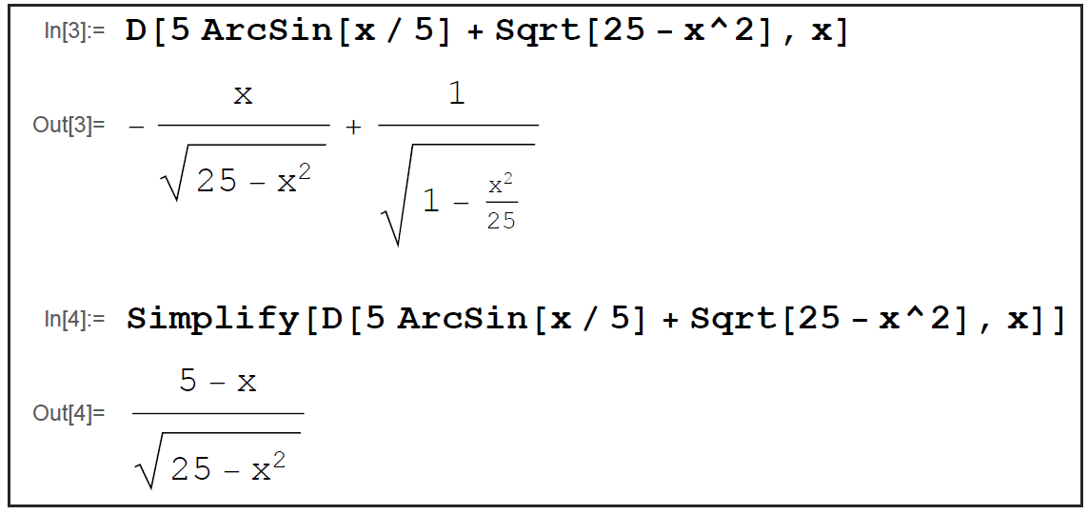
Example 4 (cont.)
Figure 3 Verifying the Solution of Example 2

Slide 20
Example 5
Evaluate the integral
Solution
We could proceed directly to the definite integral calculation, but how would we know if the numerical result we obtain is reasonable or not? It would be nice to use the power of Mathematica to give us some measure of confidence in the answer.

Slide 21
Example 5 (cont.)
One way of doing that is to ask Mathematica to graph the function over an interval that contains the interval of integration and to visually compare the integral with the area between the graph and the t-axis. We are trusting Mathematica to provide a reasonably accurate graph, but at least this gives us a way to cross-check several answers. Figure 4 illustrates how to first define a function f(t) in Mathematica, then plot it over the interval [0, 5].

Slide 22
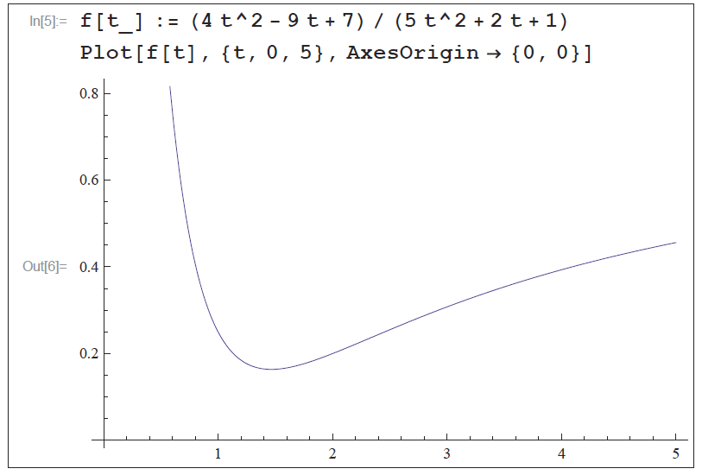
Example 5 (cont.)
Figure 4 Plotting a Function

Slide 23
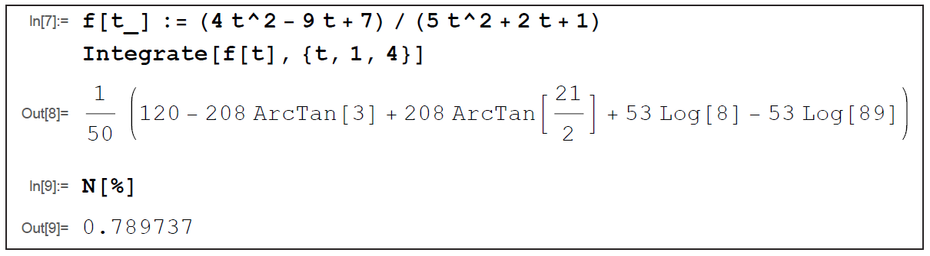
Example 5 (cont.)
Then we ask for the definite integral from 1 to 4. The exact answer that results is not especially meaningful, so the last command in Figure 5 asks for the numerical evaluation of the result immediately preceding it.
Figure 5 Evaluating a Definite Integral

Slide 24
Example 5 (cont.)
Since the interval of integration has width 3 and the function takes on values between approximately 0.2 and 0.4 over that interval, the numerical answer of 0.789737 throws up no red flags.

Slide 25
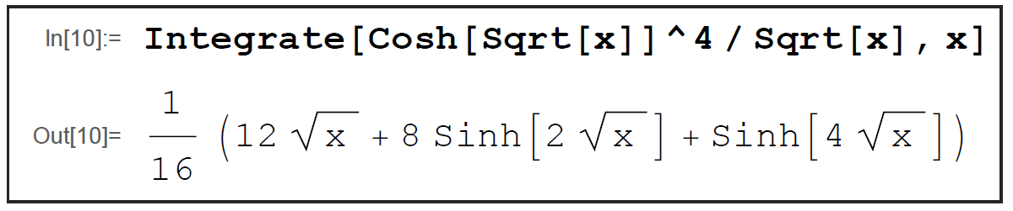
Example 6
Evaluate the integral
Solution
Figure 6 Integrating a Hyperbolic Function

Slide 26
Example 6 (cont.)
The Mathematica command and output are shown in Figure 6. Note how the numerator of the integrand is expressed in Mathematica as Cosh[Sqrt[x]]^4,
which reflects the fact that an alternative way of writing the numerator is

