Slide 1
Section 7.6
Numerical Integration

Slide 2
TOPICS
The Trapezoidal Rule
Simpson’s Rule

Slide 3
Numerical Integration
If we can find an antiderivative of a given function f , evaluating is straightforward. But there are two fairly common circumstances under which this is difficult or impossible. The first is when the integrand f has no antiderivative expressible in terms of elementary functions, which are those we work with most frequently.

Slide 4
Numerical Integration
Such integrals are termed nonelementary, and include the following:

Slide 5
Numerical Integration
The other circumstance is when the integral in question is defined by a function for which we know only a few values, such as a collection of data points from an experiment or a set of measurements of some physical object. Numerical integration is the name given to a set of techniques that can be used to provide approximations in these cases, along with estimates of the errors in the approximations. We study two such techniques in this section.

Slide 6
The Trapezoidal Rule
When we compute a Riemann sum with either left endpoints or right endpoints of subintervals as the sample points, the result is, of course, an approximation to the integral. The Trapezoidal Rule is a slight modification of such an approach that, in general, improves on the accuracy of the approximation.

Slide 7
The Trapezoidal Rule
Recall that a Riemann sum approximation of the integral assuming equal-width subintervals,
has the form
Where and [a, b] is partitioned into n subintervals by the points The i^{th} sample point x_{i}* is equal to x_{i−1} if we choose to let each one be the left subinterval endpoint and is equal to x_{i} if we choose to use right endpoints.

Slide 8
The Trapezoidal Rule
Since each Riemann sum is an approximation of the integral, we might hope that the average of the two approximations would be a better approximation.

Slide 9
The Trapezoidal Rule

Slide 10
The Trapezoidal Rule
The sum is referred to as the trapezoidal approximation to the integral, because each expression
corresponds to the area of the i^{th} trapezoid shown in Figure 1.

Slide 11
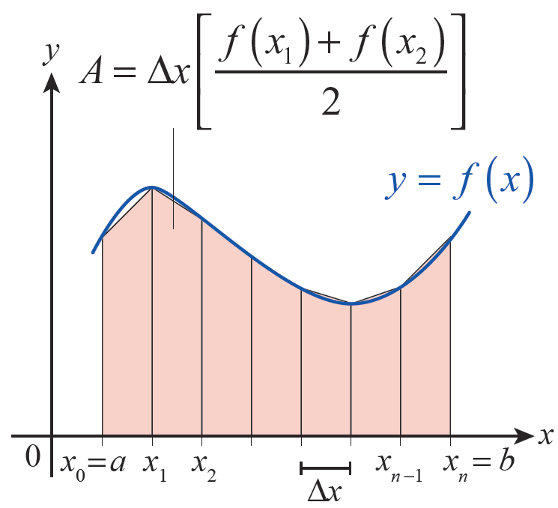
The Trapezoidal Rule
Figure 1 Areas of Trapezoids

Slide 12
Definition: Trapezoidal Rule
Trapezoidal Rule
An approximation of using the Trapezoidal Rule is the sum
where and x_{i} = a + iΔx for i = 0, 1, …, n.

Slide 13
Example 1
Use the Trapezoidal Rule to approximate with n = 10, and compare the result to the exact value of this integral.
Solution
Given that a = 1, b = 2, and n = 10, we note that and for i from 0 to 10.

Slide 14
Example 1 (cont.)
Using integration by parts, we know that so
So
approximately 0.1% of the exact value.

Slide 15
Example 2
A hygrometer at a weather station records the following percent humidity measurements at the top of the hour from midnight to noon one day.
Use the Trapezoidal Rule to find the approximate average percent humidity over this 12-hour period.
Time | Humidity (%) | Time | Humidity (%)
12 a.m. | 55 | 7 a.m. | 70
1 a.m. | 57 | 8 a.m. | 62
2 a.m. | 60 | 9 a.m. | 50
3 a.m. | 65 | 10 a.m. | 48
4 a.m. | 72 | 11 a.m. | 48
5 a.m. | 75 | 12 p.m. | 47
6 a.m. | 74

Slide 16
Example 2 (cont.)
Solution
Taking this approach to finding the average humidity, we are implicitly making the assumption that humidity h is a continuous function of time—under this
assumption, we know that exists, even if we
don’t actually know a formula for h. Assumptions like this are reasonable, because physical attributes like humidity don’t typically exhibit abrupt discontinuous changes.

Slide 17
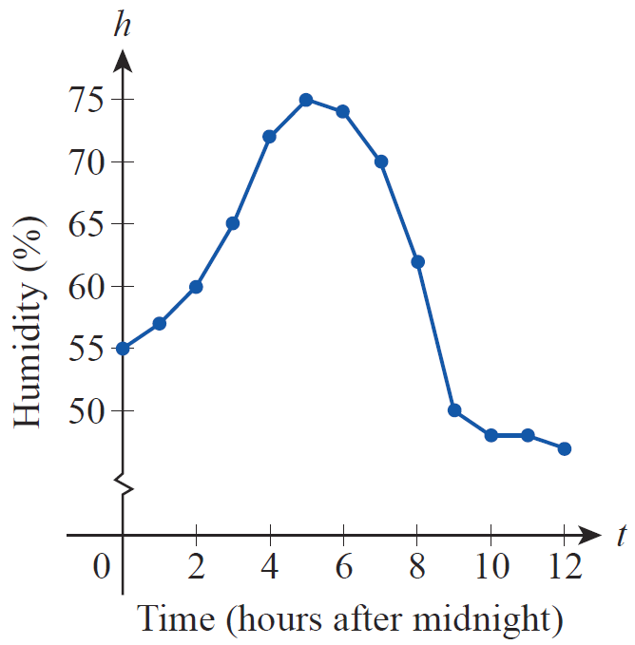
Example 2 (cont.)
If we simply plot the 13 data points we have and connect them with straight lines, the result is the graph in Figure 2.
Figure 2
Humidity Measurements

Slide 18
Example 2 (cont.)
Note that the data indicate sharper changes in humidity over some one-hour periods than others. Using our formula for the average value of a function over an interval we have
Since we don’t have a formula for h, we use the Trapezoidal Rule with Δt = 1 hour.

Slide 19
Example 2 (cont.)
Compare this to the less sophisticated approach of simply taking the average of the 13 data points, which gives us an answer of approximately 60.2% humidity. The difference comes from the fact that a simple average does not take into account differing rates of change of the humidity over the interval.

Slide 20
Theorem: Error Estimate for the Trapezoidal Rule
Error Estimate for the Trapezoidal Rule
If f″ is continuous on [a, b] and M is an upper bound for |f′ (x)|, then the error E_{T} between the exact value of
and the Trapezoidal Rule approximation T_{n}
satisfies
where n is the number of subintervals in the partition.

Slide 21
Example 3
Determine a number of subintervals that will guarantee
an approximation of to within an error of
0.01 using the Trapezoidal Rule.
Solution
Although an antiderivative of cannot be expressed in terms of elementary functions, its second derivative is easy enough to determine:

Slide 22
Example 3 (cont.)
Since sine and cosine are always bounded by 1 in magnitude, we have the following:

Slide 23
Example 3 (cont.)
Any upper bound M of |f″ (x)| on the interval will work, and M = 48 is a convenient number larger than 2 + 4π ². We can now ensure |E_{T}|< 0.01 by solving the inequality
for n.

Slide 24
Example 3 (cont.)
So n = 112 subintervals will provide an approximation of the integral safely within an error of 0.01.

Slide 25
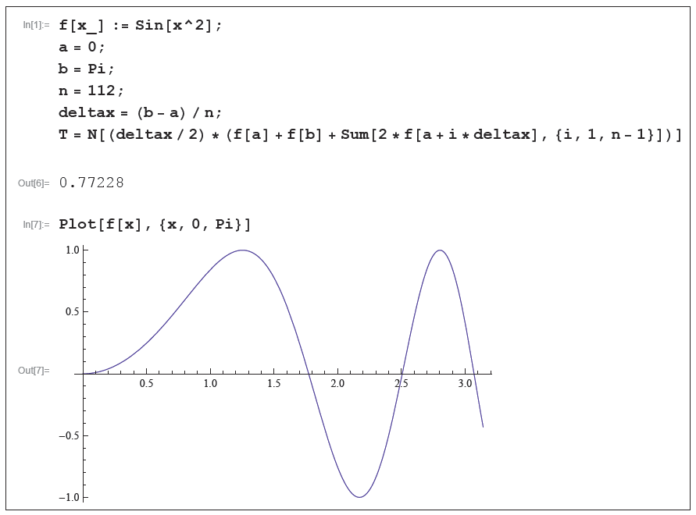
Technology Note
Referring back to Example 3, a computer algebra system like Mathematica can be used to calculate the approximation T₁₁₂ = 0.77228 with commands such as the ones shown in Figure 3.
Figure 3 Using the Trapezoidal Rule in Mathematica

Slide 26
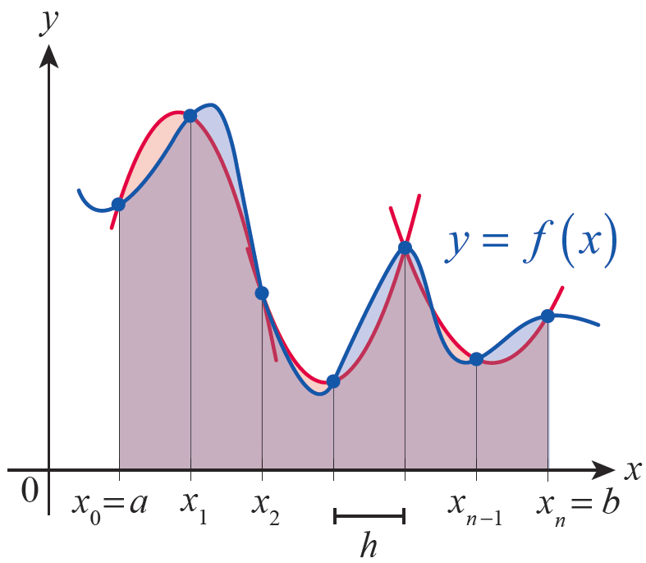
Simpson’s Rule
There are several variations of Simpson’s Rule, but the simplest assumes that the number of subintervals n is even; the resulting formula is then based on parabolas fitted through three points on the graph of the integrand f for each successive pair of subintervals. A representative illustration is shown in Figure 4.
Figure 4
Simpson’s Rule

Slide 27
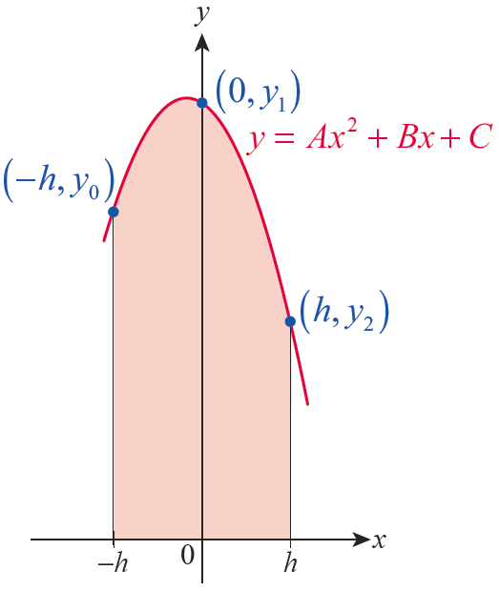
Simpson’s Rule
To construct the formula, let y_{i} = f(x_{i}) for each i = 0, …, n and let For ease of calculation, we shift the graph of f left or right so that the first two subintervals [x₀, x₁] and [x₁, x₂] are located on either side of 0 as shown in Figure 5; doing so doesn’t affect the area between the graph of f and the x-axis over the interval [x₀, x₂]
Figure 5
Fitting a Parabola

Slide 28
Simpson’s Rule
After shifting, note that x₀ = −h, x₁ = 0, and x₂ = h. So the parabola we are looking for must pass through the three points (−h, y₀), (0, y₁) and (h, y₂). If we assume the parabola is the graph of the quadratic y = Ax² + Bx + C, then we know the following:
y₀ = Ah² − Bh + C,
y₁ = C,
and y₂ = Ah² + Bh + C.

Slide 29
Simpson’s Rule
The integral of the quadratic over the interval [−h, h] is
which can be expressed in terms of y₀, y₁, and y₂ by noting that y₀ + y₂ = 2Ah² + 2C and 4y₁ = 4C. So I = (h/3)(y₀ + 4y₁ + y₂).

Slide 30
Simpson’s Rule
Similarly, shifting the graph of f so that the subintervals [x₂, x₃] and [x₃, x₄] are located on either side of 0 (so that x₃ = 0), the integral of the parabola fitted through (−h, y₂), (0, y₃), and (h, y₄) is equal to (h/3)(y₂ + 4y₃ + y₄).
Our approximation to is the sum of the
integrals of the parabolas.

Slide 31
Simpson’s Rule

Slide 32
Theorem: Simpson’s Rule
Simpson’s Rule
An approximation of using Simpson’s Rule is the sum
where n is even, and x_{i} = a + iΔx for
i = 0, …, n. (Note the pattern of the coefficients:
1, 4, 2, 4, 2, …, 2, 4, 1.)

Slide 33
Example 4
Use Simpson’s Rule to approximate with n = 10.
Solution
As in Example 1, a = 1, b = 2, and x_{i} = I + i/10 for i from 0 to 10.
This is a considerable improvement over the Trapezoidal Rule approximation, and only differs in the 6th decimal place from the exact answer.

Slide 34
Simpson’s Rule
As with the Trapezoidal Rule, a result from advanced calculus says that, under the assumption that f⁽⁴⁾ is continuous on [a, b], the exact integral and a Simpson’s Rule approximation of it are related by
where c is some point in [a, b]. So if we let
we know the following about the
accuracy of a Simpson’s Rule approximation.

Slide 35
Theorem: Error Estimate for Simpson’s Rule
Error Estimate for Simpson’s Rule
If f⁽⁴⁾ is continuous on [a, b] and M is an upper bound for |f ⁽⁴⁾ (x)|, then the error E_{S} between the exact value
of and the Simpson’s Rule approximation S_{n}
satisfies
where n is the number of subintervals in the partition.

Slide 36
Example 5
Use Simpson’s Rule with n = 4 to approximate the
nonelementary integral and estimate the error
in the approximation.
Solution
With a = 0, b = 1, and n = 4, we have and x_{i} = i/4 for i = 0, …, 4.

Slide 37
Example 5 (cont.)
The fourth derivative of is and for we know
so the error estimate E_{S} satisfies

Slide 38
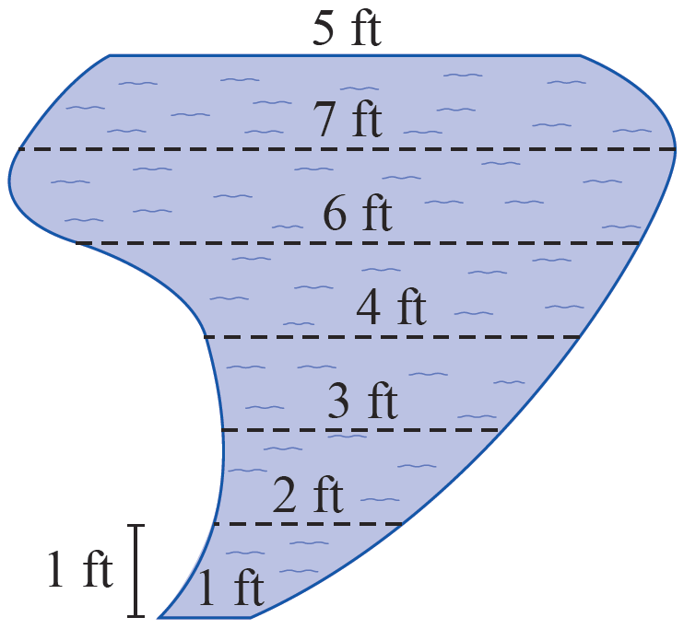
Example 6
A landscape designer has planned a free-form garden pond with the shape shown in Figure 6 and needs to estimate its volume in cubic feet. The pond will have a uniform depth of 2 feet. At 1-foot intervals, the distances across the pond are to be as indicated in the diagram. Use Simpson’s Rule to estimate the volume of the pond.
Figure 6
Garden Pond

Slide 39
Example 6 (cont.)
Solution
To use Simpson’s Rule, we let Δx = 1 and take the distances as shown to be the values of a function. Note that n = 6.
So the estimated volume of the pond is this surface area times the depth, or

