Slide 1
Section 7.7
Improper Integrals

Slide 2
TOPICS
Improper Integrals of Type I
Improper Integrals of Type II
The Direct Comparison Test

Slide 3
Improper Integrals
So far, all the definite integrals we have worked with have been defined over a finite interval [a, b] and the integrands have all been continuous (and hence bounded) over that interval. We now turn to definite integrals in which either the interval of integration is unbounded (extends to infinity in one or both directions) or in which the integrand has an unbounded range over the interval. Both types of integrals are termed improper.

Slide 4
Improper Integrals
The fact that an infinite series, which is a sum of an infinite number of numbers, can be finite is at first counterintuitive, and the fact that improper integrals can also be finite is likely also surprising.

Slide 5
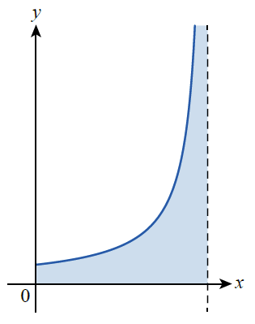
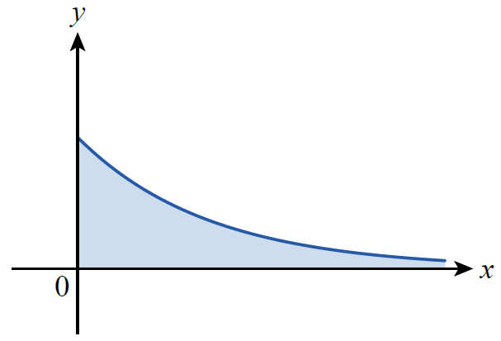
Improper Integrals
This is especially so if we are faced with an improper integral of a positive function f and are interpreting the integral as the area of an unbounded region, as depicted in Figure 1.
Figure 1 Improper Integrals and Unbounded Regions

Slide 6
Improper Integrals
In both cases, although the region is unbounded (meaning it cannot be captured inside a circle of radius R for any R), it is possible for its area to be finite. Understanding exactly how this can be, and how we evaluate such integrals, is the purpose of this section.

Slide 7
Example 1
If possible, find the area of the region bounded between the graph of and the x-axis over the interval
Solution
The area asked for corresponds to the integral
Since we don’t yet know how to evaluate
such an integral, we will first construct a reasonable interpretation of what it must mean, consistent with what we already know about integration.

Slide 8
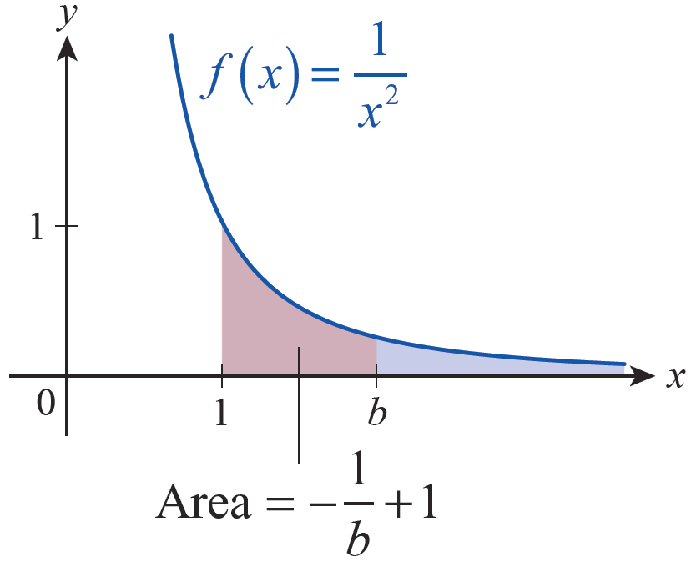
Example 1 (cont.)
If the area under f over the interval is finite,
say then a
reasonable interpretation of area would indicate that the area over the interval must approach A as b → ∞ (see Figure 2).
Figure 2 Defining Area of an Unbounded Region

Slide 9
Example 1 (cont.)
We know how to evaluate so we’ll use this interpretation to define

Slide 10
Definition: Improper Integrals of Type I
Improper Integrals of Type I
An improper integral of type I is an integral over an unbounded interval, and falls into one of the following classes if the interval is unbounded on one side only.

Slide 11
Definition: Improper Integrals of Type I
Improper Integrals of Type I (cont.)
In each case, the integral is said to converge if the limit exists, and if so we define the value of the improper integral to be the limit. If the limit does not exist, the integral is said to diverge.
If the interval of integration is and if both integrals on the right converge for some real number c, then we have the following.

Slide 12
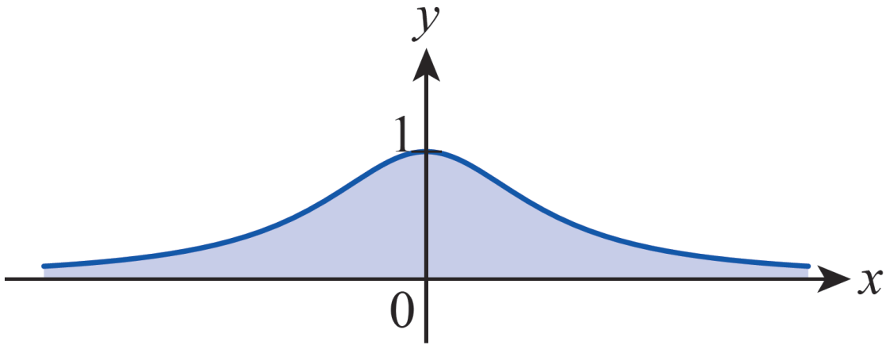
Example 2
Evaluate
Solution
We can choose any value for c, but the most convenient value is c = 0.
Figure 3 Area under

Slide 13
Example 2 (cont.)

Slide 14
Example 3
Evaluate
Solution
Since
we know that this integral diverges. The geometric interpretation of this result is that the area under over the interval is infinite.

Slide 15
Example 3 (cont.)
In Exercise 65 you’ll consider all integrals of the form
and show that such an integral converges if
p > 1 and diverges if p ≤ 1.

Slide 16
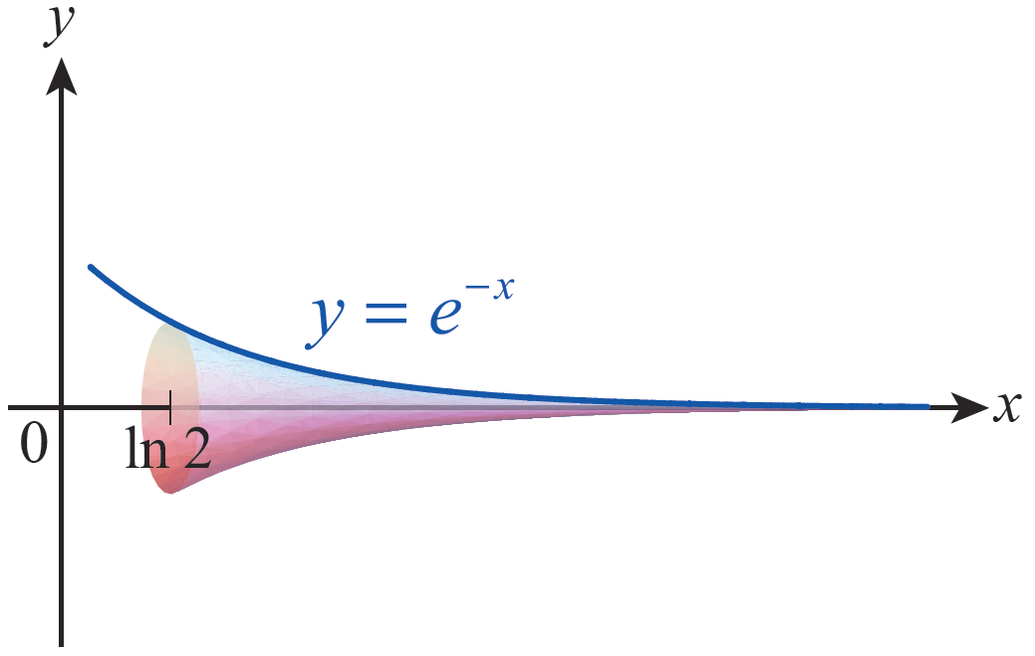
Example 4
The infinitely long horn depicted in Figure 4 extends from x = ln 2 to infinity. The area of a typical cross-section is Determine the volume of the horn.
Figure 4 Infinitely Long Horn

Slide 17
Example 4 (cont.)
Solution
Recall that so the volume of the horn is as follows.

Slide 18
Definition: Improper Integrals of Type II
Improper Integrals of Type II
An improper integral of type II is one in which the integrand has an unbounded range over the interval of integration, and falls into one of the following classes:
1. If f is continuous on (a, b] and discontinuous at a, then
2. If f is continuous on [a, b) and discontinuous at b, then

Slide 19
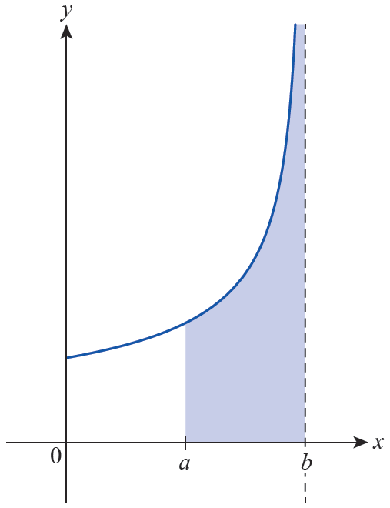
Definition: Improper Integrals of Type II
Improper Integrals of Type II (cont.)
In each case, the integral is said to converge if the limit exists, and if so we define the value of the improper integral to be the limit. If the limit does not exist, the integral is said to diverge.
Figure 5 Improper Integral of Type II

Slide 20
Definition: Improper Integrals of Type II
Improper Integrals of Type II (cont.)
3. If f is continuous on [a, b] except for a vertical asymptote at c, where a < c < b, then
assuming both
integrals on the right converge.

Slide 21
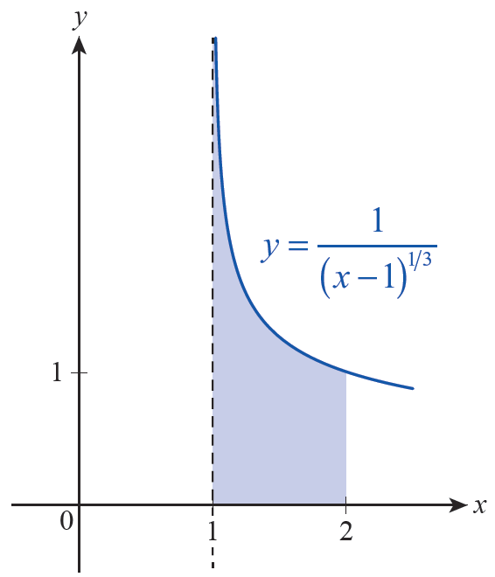
Example 5
Evaluate
Solution
The integrand is continuous except at its vertical asymptote x = 1.
Figure 6

Slide 22
Example 5 (cont.)

Slide 23
Example 6
Evaluate
Solution
In this example, the integrand has a vertical asymptote in the interior of the interval, so we must break it into two improper integrals.

Slide 24
Example 6 (cont.)
Remember that both of these integrals must converge for the original integral to converge. Examining the first one, we obtain the following.
We can stop right here, because the first improper integral diverges and hence diverges (there is no need to examine the second improper integral, but it also diverges).

Slide 25
Caution
Caution
If we had missed the fact that is discontinuous at 0 and blindly proceeded to antidifferentiate in Example 6, we would have obtained the incorrect result that

Slide 26
Example 7
Evaluate
Solution
We know ln x is continuous for all x > 0 and that it has a vertical asymptote at x = 0.

Slide 27
Example 7 (cont.)
The remaining limit in the last expression is of an indeterminate form that we can evaluate with l’Hôpital’s Rule.
Therefore,

Slide 28
The Direct Comparison Test
Sometimes we care more about whether a given improper integral converges than we do about its value if it does converge. The Direct Comparison Test helps us answer this question.
The test is based on a very straightforward argument: if f and g are integrable and for all x on an interval of integration I (whether finite or infinite), then

Slide 29
Theorem: The Direct Comparison Test
The Direct Comparison Test
If f and g are continuous functions on and for all a ≤ x < ∞, then
1. If converges, so does
2. If diverges, so does

Slide 30
Example 8
Determine if the integral converges.
Solution
As we previously learned, this integral is nonelementary—we can’t attempt to evaluate it by working with an antiderivative. But we can easily compare it to a simpler integral. Since −x² ≤ −x for all x ≥ 1, for all such x. Since
we know converges and hence so does

Slide 31
Example 9
Determine whether converges.
Solution
For x ≥ 1, we have the following.
You will show in Exercise 17 that the integral
diverges, so diverges as well.

