Slide 1
Section 9.1
Parametric Equations

Slide 2
TOPICS
Terminology of parametric equations
Applications of parametric equations

Slide 3
Terminology of Parametric Equations
One of the best reasons for describing curves parametrically is simply that there are many examples of curves in the plane that are not the graph of any equation of the form y = f(x) or x = f(y). The parametric skills we gain now can be easily extended to apply to curves (and other objects) in three-dimensional space.

Slide 4
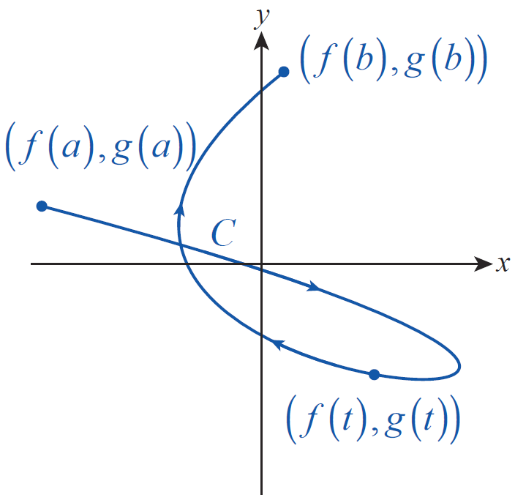
Terminology of Parametric Equations
Figure 1 illustrates a curve C defined by two parametric equations x = f(t) and y = g(t).
Each point on the parametric curve corresponds to an ordered pair (f(t), g(t)) where the parameter t is allowed to take on values over a parametric
Figure 1
Parametrically Defined Curve
interval I. If the domain I of the parameter is a closed interval [a, b] then we call (f(a), g(a)), the initial point and (f(b), g(b)) the terminal point of the curve.

Slide 5
Terminology of Parametric Equations
We say C is defined parametrically by f and g over the interval I. It is often helpful to think of the parameter t as time, and of C as the path “traced out” by the point (f(t), g(t)) as t moves from a toward b. In some applications it is helpful to indicate the direction of travel along the curve that corresponds to the increasing parameter, which we do with arrows as shown in Figure 1. The direction traveled along the curve as the parameter increases is called the curve’s orientation.

Slide 6
Terminology of Parametric Equations
One way to sketch a parametrically defined curve is to simply calculate a sequence of representative points (f(t), g(t)) and connect them with our best guess at the points in between. But it may also be possible to eliminate the parameter in the parametric equations and arrive at a meaningful equation in x and y.

Slide 7
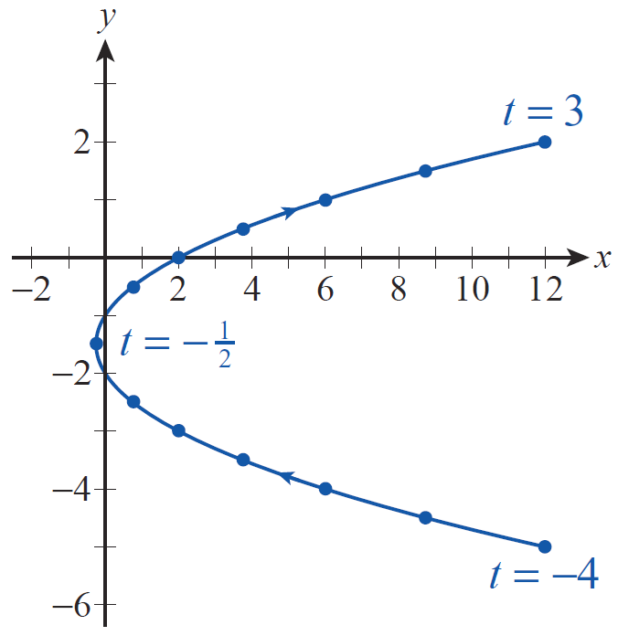
Example 1
Sketch the curve defined parametrically by x = t² + t and y = t − 1,
Solution
If we were to plot points, we would obtain a collection of points and a sketch such as that shown in Figure 2.
Figure 2 Parametric Parabola

Slide 8
Example 1 (cont.)
−4 (12, −5) |  | 1 (2, 0)
 | −1 (0, −2)
−3 (6, −4) |  | 2 (6, 1)
 | 0 (0, −1)
−2 (2, −3) |  | 3 (12, 2)

Slide 9
Example 1 (cont.)
It certainly appears that the curve is parabolic in nature, and a moment’s thought about the parametric equations justifies that impression. The equation in y is linear, meaning y changes linearly with respect to t. So the fact that x is a quadratic function of t means that x is also a quadratic function of y. We can make this explicit by solving the second equation for t, substituting the result into the first equation, and simplifying the result.

Slide 10
Example 1 (cont.)
If we complete the square of the right-hand side of the last equation, we obtain
telling us that the vertex of the parabola is at Note that when as indicated in Figure 2.

Slide 11
Example 2
Sketch the curve defined parametrically by x = 3 cost and y = 3 sint, 0 ≤ t ≤ 2π.
Solution
We could eliminate the parameter in this pair of equations by solving one of them for t and substituting the result into the other, but we can shorten the process by making use of a trigonometric identity. Since cos²t + sin²t = 1 for every t, we have the following:

Slide 12
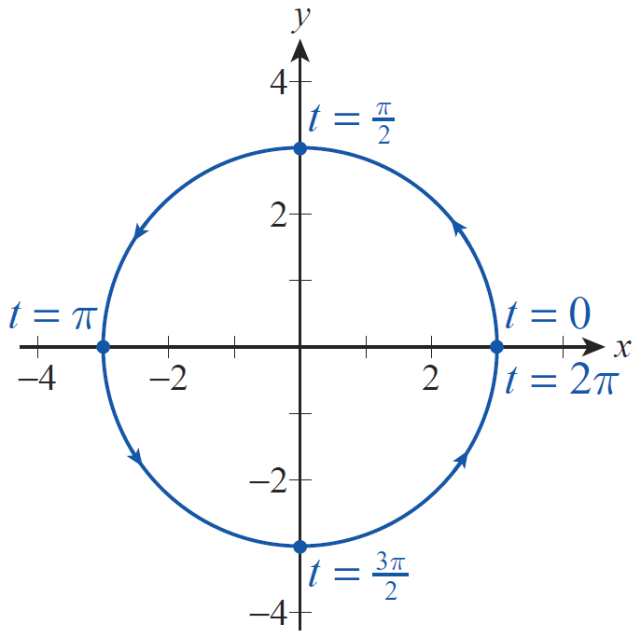
Example 2 (cont.)
Hence, the parametrically defined curve is a circle of radius 3 centered at the origin, with the parameter t corresponding to the radian measure of the central angle as shown in Figure 3.
Figure 3

Slide 13
Example 3
Describe the curve defined parametrically by x = cos2t and y = sin2t,
Solution
This curve is also a circle, as you can verify by repeating the procedure of Example 2. However, this example illustrates the important fact that parametrically defined curves can be traced out at different rates. The curve traced out by (cos2t, sin2t) as t ranges over the interval is a circle of radius 1 centered at the origin, as is the curve (cost, sint) over the interval

Slide 14
Example 3 (cont.)
But any given arc of (cos2t, sin2t) is traced out twice as quickly as the corresponding arc of (cost, sint).
Another important characteristic of some parametric curves is illustrated by the fact that the curve (cost, sint) over the interval doesn’t appear any different than the curve (cost, sint) over the interval when the parametric interval is the circle is simply traced twice.

Slide 15
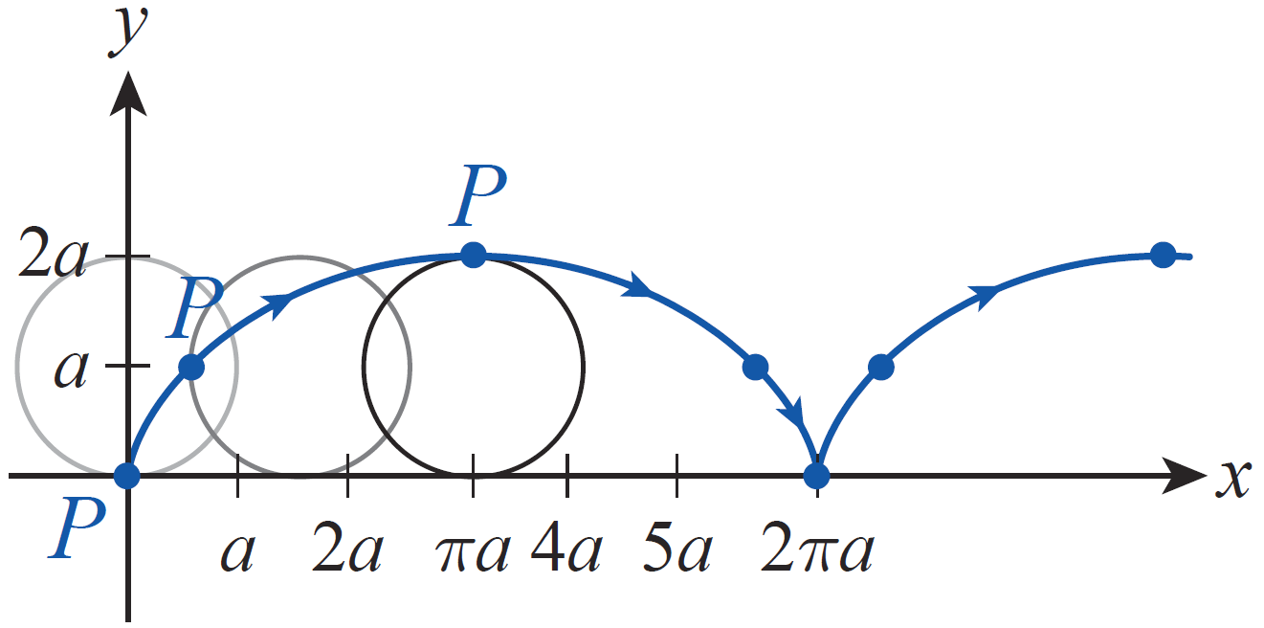
Example 4
A cycloid is the curve, shown in blue in Figure 4, traced out by a point P on a circle of radius a as it rolls (without slipping) along the x-axis. Find parametric equations defining such a curve.
Figure 4 Generating the Cycloid

Slide 16
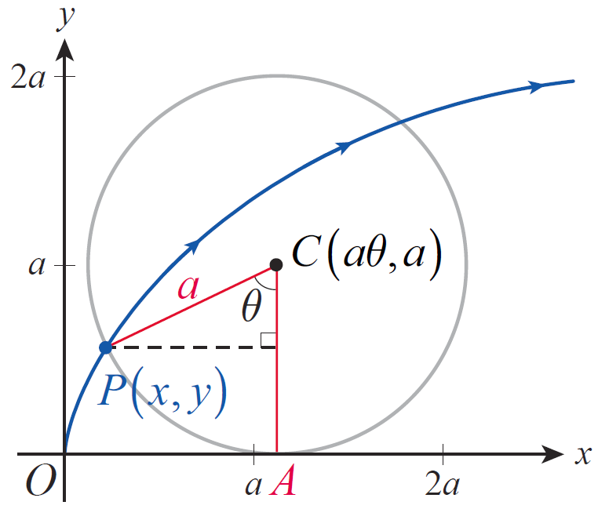
Example 4 (cont.)
Solution
The first step is to make a wise choice of parameter. To this end, let θ measure the angle between the ray extending straight down from the circle’s center and the ray extending from the circle’s center through the point P, as shown in Figure 5.
Figure 5

Slide 17
Example 4 (cont.)
Then when the circle is in the initial position, the two rays coincide and θ = 0. As the circle rolls to the right, θ increases; when the circle is in the position of the second circle shown in Figure 4, and when the circle is in the position of the rightmost circle the point P reaches its maximum height and θ = π.
Consider the enlarged diagram in Figure 5. If we let (x, y) denote the coordinates of the point P, our goal is to write x and y as functions of the parameter θ.

Slide 18
Example 4 (cont.)
Our first observation is that the line segment must have the same length as the arc since the circle rolls without slipping. The length of the arc is aθ, so that is the length of as well. This means the coordinates of the point C are The dashed line in Figure 5 has length and the other leg of the right triangle has length Putting this all together, we have

Slide 19
Example 4 (cont.)
Solving for x and y gives us the parametrization and Note that the parametric interval produces one full arch of the cycloid.

Slide 20
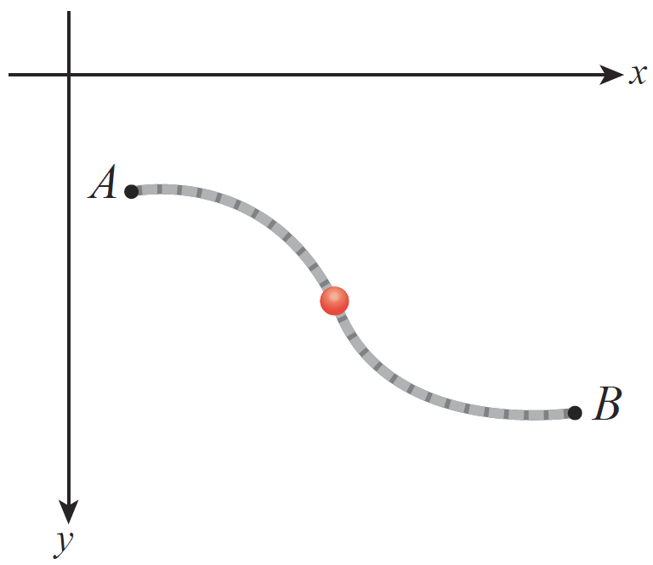
Applications of Parametric Equations
The cycloid, because of its physical properties, turns out to be the solution to two famous problems. One is known as the brachistochrone problem, or shortest-
time problem. It asks for the curve connecting a point A to a lower point B along which a particle, subject only to the force of gravity, will travel in the shortest time—imagine a frictionless bead sliding along a curved wire connecting A and B, as illustrated in Figure 6.
Figure 6

Slide 21
Applications of Parametric Equations
The answer is trivial if B is directly below A, so we seek the curve when this is not the case. The tautochrone problem, or same-time problem, asks for the curve connecting A and B with the property that a frictionless bead, when released anywhere along the curve, takes the same time to slide to the point B. Another way of asking the tautochrone question is this: along what path should a pendulum be constrained to swing so that its period (time of one full oscillation) is the same no matter where along the path the pendulum is released?

Slide 22
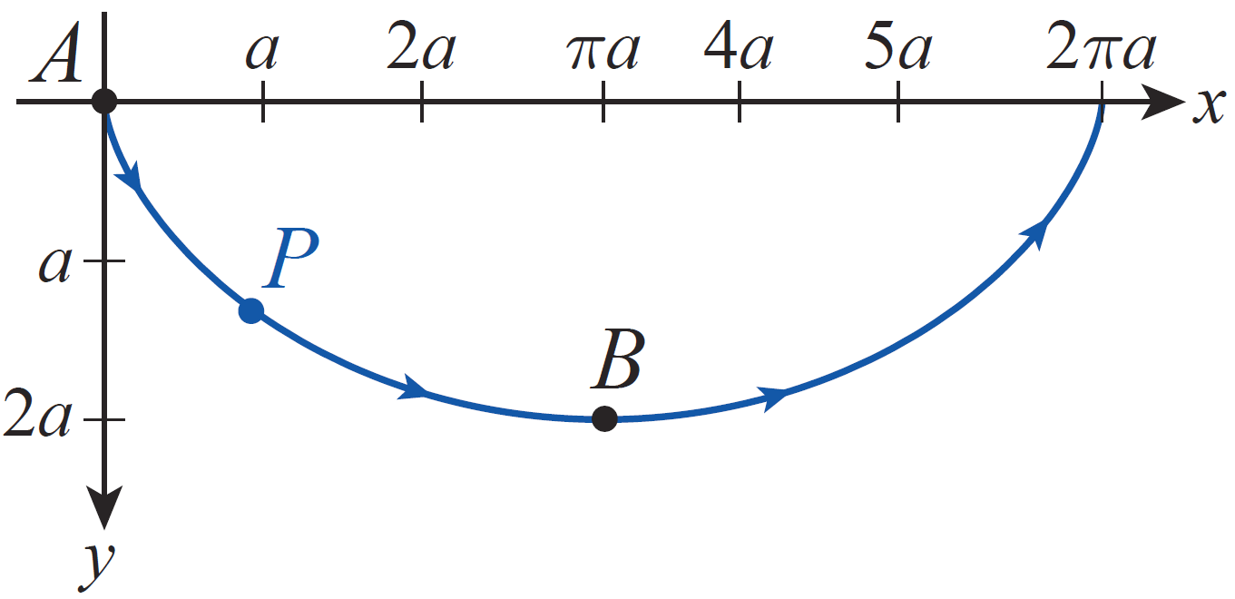
Applications of Parametric Equations
The Dutch scientist Christiaan Huygens (1629–1695) showed that a cycloid (inverted so that the positive y­axis points down, as in Figure 7) is a solution of the tautochrone problem in 1673; his motivation was to
improve the accuracy of pendulum clocks, which he had previously invented.
Figure 7 Inverted Cycloid

Slide 23
Applications of Parametric Equations
And the Swiss mathematician Johann Bernoulli (1667–1748) showed in 1697 that such a cycloid is also the solution of the brachistochrone problem, after posing the question himself in 1696. Other mathematicians, including his brother Jakob and Isaac Newton, also provided solutions, and the ideas and techniques they used in doing so developed into the area of mathematics now called the calculus of variations.

Slide 24
Applications of Parametric Equations
We can set up both problems by starting with a principle of physics. Suppose a curve C connects points A and B as in Figure 6, but let A be the origin (assume also that the positive y-axis points downward). A frictionless bead released with velocity v = 0 at A has kinetic energy 0, and the work done by gravity moving the bead from A to another point (x, y) in the plane is mgy, where m is the mass of the bead and g is the acceleration due to gravity.

Slide 25
Applications of Parametric Equations
The kinetic energy mv²/2 of the bead at the point (x, y) must equal the work done by gravity in moving it there, so

Slide 26
Applications of Parametric Equations
Note that this expresses the velocity v of the bead as it passes through (x, y) as a function of y alone. If we let s denote the arc length of C from A to the point (x, y), then ds/dt = v, so we have the following:

Slide 27
Applications of Parametric Equations
The solution of the brachistochrone problem then amounts to finding a curve y = f(x) so that the total time T taken for the bead to slide from (0, 0) to B = (B_{x} , B_{y}) is minimized, where

Slide 28
Applications of Parametric Equations
We can, at this point, verify that the cycloid solves the tautochrone problem between the points A(0, 0) and as depicted in Figure 7.
Figure 7 Inverted Cycloid

Slide 29
Applications of Parametric Equations
First, note that for a cycloid parametrized by and and So the time it takes for a bead to slide from A to B is calculated as follows:

Slide 30
Applications of Parametric Equations

Slide 31
Applications of Parametric Equations
Now, for a bead that is instead released at the point (x₀, y₀) corresponding to the point
on the cycloid, its velocity as it passes through a later point (x, y) on the cycloid is

Slide 32
Applications of Parametric Equations
So the time it requires to slide from the point (x₀, y₀) to B is calculated as follows:

Slide 33
Applications of Parametric Equations

Slide 34
Applications of Parametric Equations
Since this is the same amount of time required for the bead to slide from the origin to B, the cycloid is indeed a solution of the tautochrone problem.

Slide 35
Technology Note
Technology Note
Use technology to graph the following parametrically defined curves.
a. x = 3 sin 5t, y = 2 cos 3t, 0 ≤ t ≤ 2π
b. x = 8 cost + 2 cos 4t, y = 8 sint − 2 sin 4t, 0 ≤ t ≤ 2π
Graphing calculators and computer algebra systems can generate parametrically defined curves. On a graphing calculator the mode needs to change from the function graphing mode to the parametric mode. This can be done by selecting PAR from the MODE menu.

Slide 36
Technology Note
Technology Note (cont.)
Then the parametric equations are entered in the Y= editor. Since the equations are depending on t, when selecting the viewing window, the t‑interval will be indicated in there. In Mathematica the built-in command is ParametricPlot. The command takes two arguments—the first is an ordered pair (enclosed in braces) consisting of the parametrized formulas for x and y. The second argument is a list indicating the parametric interval to use.

Slide 37
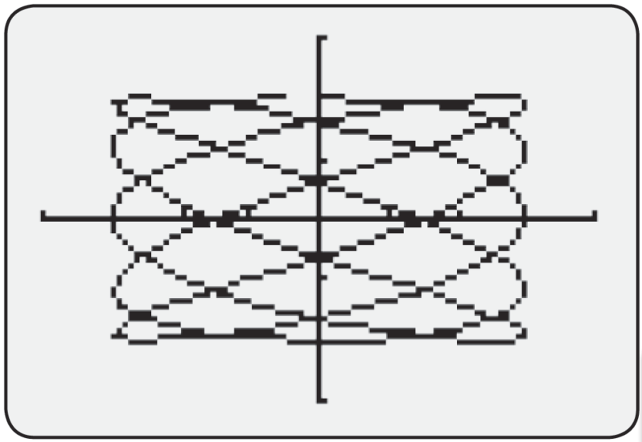
Technology Note
Technology Note (cont.)
a. Parametric equations of the form and generate curves known as Lissajous figures. A Lissajous figure with A = 3, B = 2, is illustrated in Figure 8.
Figure 8a

Slide 38
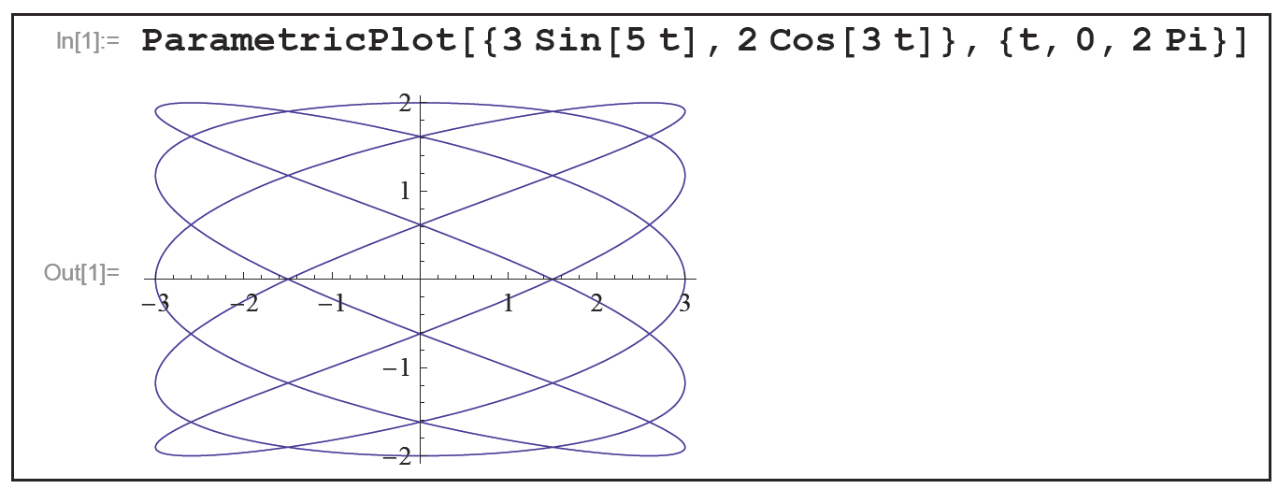
Technology Note
Technology Note (cont.)
Figure 8b

Slide 39
Technology Note
Technology Note (cont.)
b. A hypocycloid is formed by tracing a fixed point on a circle of radius r as it rolls on the inside of a larger circle with radius R. If R = kr, then the parametrization of the curve is

Slide 40
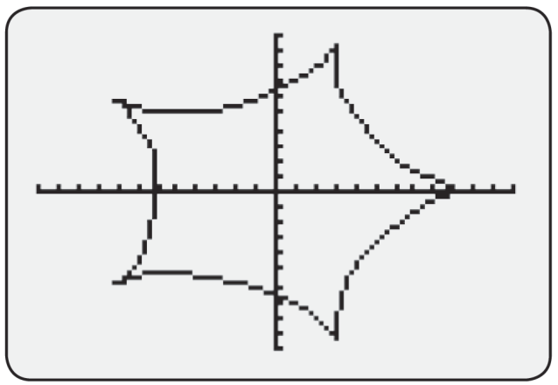
Technology Note
Technology Note (cont.)
Figure 9 illustrates the given hypocycloid (r = 2, k = 5) for 0 ≤ t ≤ 2π.
Figure 9a [−12, 12] by [−10, 10]

Slide 41
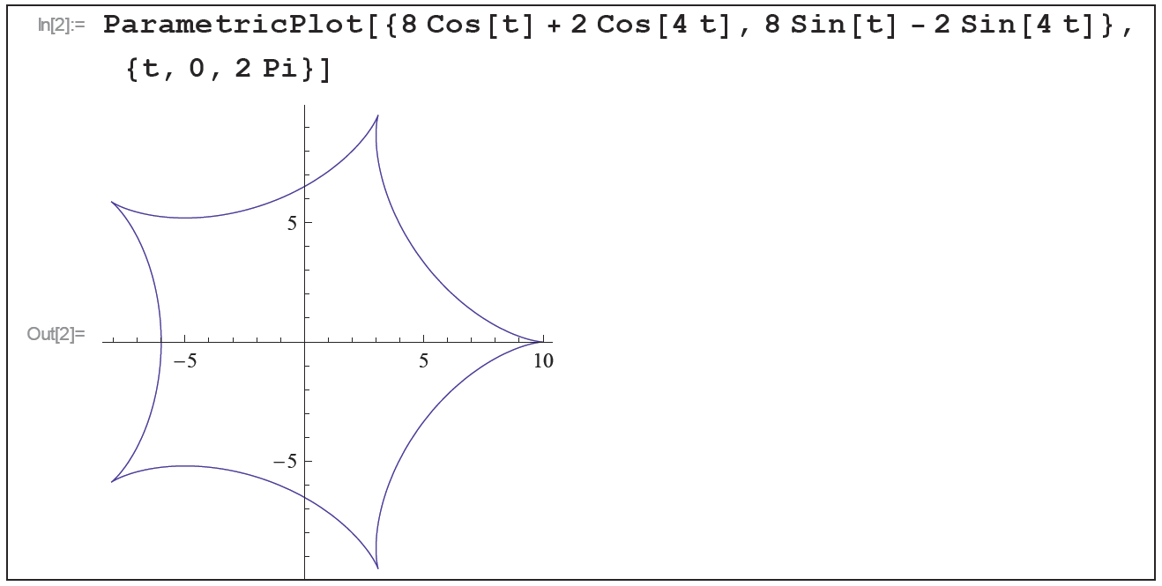
Technology Note
Technology Note (cont.)
Figure 9b

Slide 42
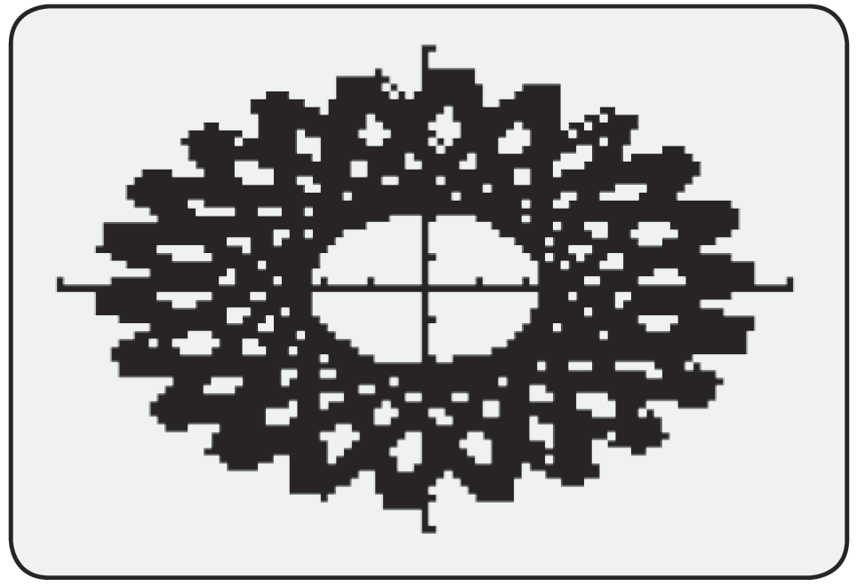
Technology Note
Technology Note (cont.)
The number of cusps (which, as we will see in the next section, qualify as points where the curve is not smooth) can be determined from k if k is either an integer or a rational number. If k is irrational, the hypocycloid never retraces itself no matter how long the parametric interval.
Figure 10a [−7,7] by [−7,7]

Slide 43
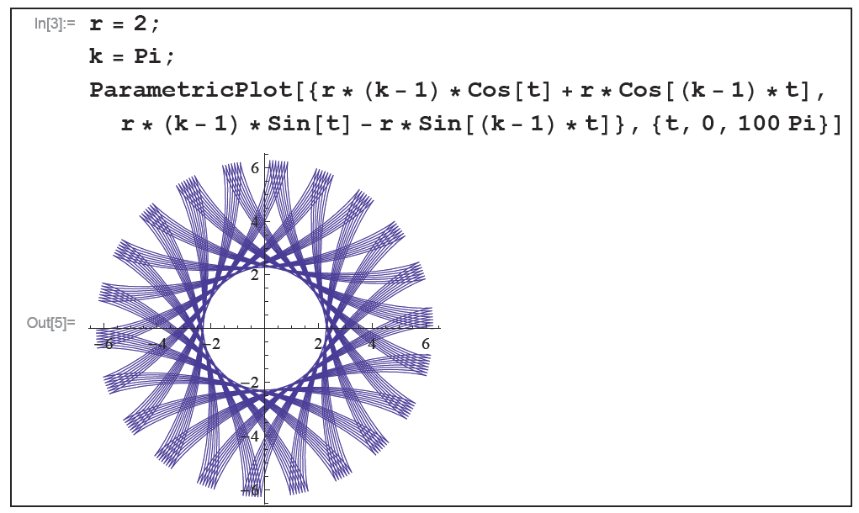
Technology Note
Technology Note (cont.)
Figure 10 shows a hypocycloid with r = 2, k = π, and a parametric interval of [0, 100π ]
Figure 10b

