Slide 1
Section 9.3
Polar Coordinates

Slide 2
TOPICS
The polar coordinate system
Coordinate conversion
The form of polar equations
Graphing polar equations

Slide 3
The Polar Coordinate System
The polar coordinate system, like the Cartesian coordinate system, serves as a means of locating points in the plane, and both systems are centered at a point O called the origin, sometimes referred to as the pole in the polar system. Starting from the origin O, a ray (or half-line) called the polar axis is drawn; in practice, the polar axis is usually drawn extending horizontally to the right, so that it corresponds with the positive x-axis in the Cartesian system.

Slide 4
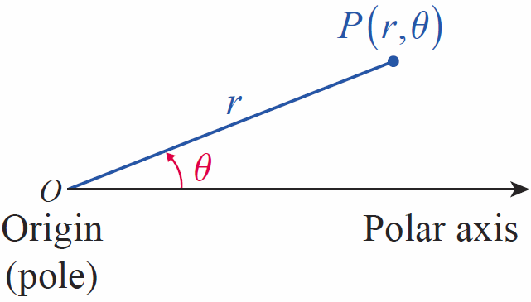
The Polar Coordinate System
Now, given any point P in the plane other than the origin, the line segment has a unique positive length; we will label this length r (as in radius). Finally, we let θ denote the angle, measured counterclockwise, between the polar axis and the segment and we say (r, θ ) are polar coordinates of the point P (see Figure 1).
Figure 1

Slide 5
The Polar Coordinate System
The origin is the unique point for which r = 0 and for which the angle θ is irrelevant; the coordinates (0, θ ) refer to O for any angle θ. Figure 2 illustrates the process of determining r and θ for several points.

Slide 6
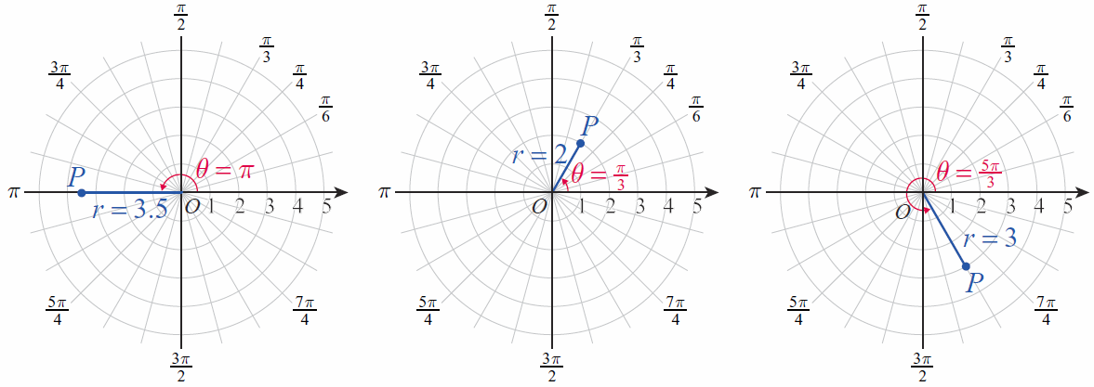
The Polar Coordinate System
Figure 2 The Polar Coordinate System

Slide 7
The Polar Coordinate System
Before proceeding further, it is important to recognize one very critical difference between Cartesian and polar coordinates. A given point P corresponds to unique Cartesian coordinates (x, y) but the polar coordinates (r, θ ) of P as described above are only one of an infinite number of ways of specifying P in the polar system.

Slide 8
The Polar Coordinate System
Our familiarity with trigonometric functions indicates one reason for this: (r, θ + 2nπ ) also represents P, since θ and θ + 2nπ have the same terminal sides for any integer n. Further, (–r, θ + (2n + 1)π ) also represents P for any integer n, given the interpretation that –r indicates travel in the opposite direction through the origin.

Slide 9
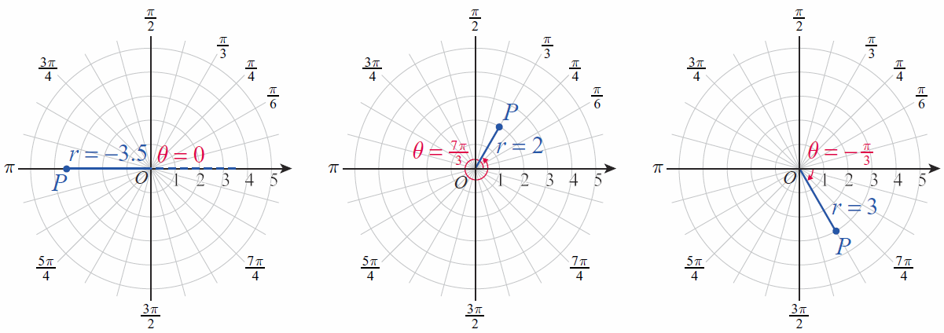
The Polar Coordinate System
These observations are illustrated in Figure 3 with alternate descriptions of the points from Figure 2.
Figure 3 Alternate Polar Coordinates

Slide 10
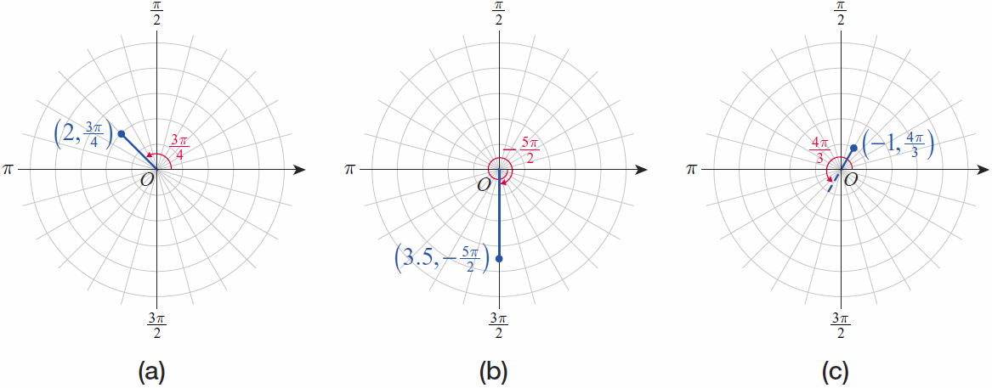
Example 1
Plot the points given by the following polar coordinates.
Solution
Figure 4

Slide 11
Coordinate Conversion
Converting from Cartesian coordinates to polar coordinates, and vice versa, is easily accomplished. To do so, we will assume that the polar axis is aligned with the positive x-axis and that a fixed point P has Cartesian coordinates (x, y) and polar coordinates (r, θ ).

Slide 12
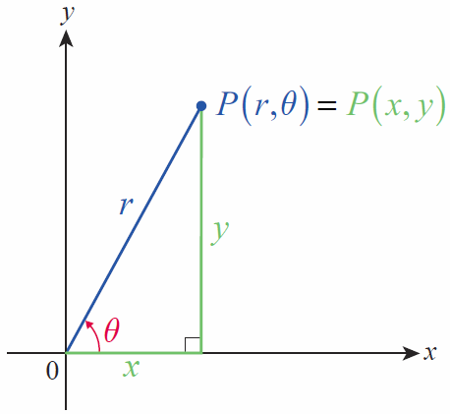
Coordinate Conversion
Then, as seen in Figure 5, r² = x² + y² and
Figure 5
Converting between Polar and Cartesian Coordinates

Slide 13
Formula: Coordinate Conversion
Coordinate Conversion
Converting from Polar to Cartesian Coordinates
Given (r, θ), x and y are defined as follows:
x = r cosθ, y = r sinθ
Converting from Cartesian to Polar Coordinates
Given (x, y), r and θ are defined as follows:

Slide 14
Formula: Coordinate Conversion
Coordinate Conversion (cont.)
Make note of the quadrant of the original Cartesian coordinate when converting, to be sure the polar coordinates fall in the same quadrant (see Example 3).

Slide 15
Example 2
Convert the following points from polar to Cartesian coordinates.

Slide 16
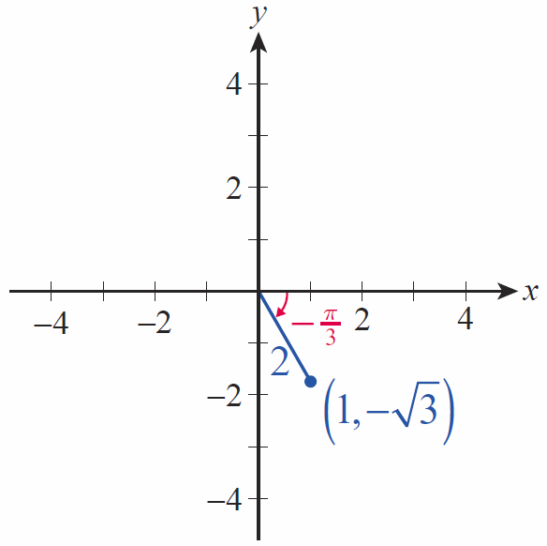
Example 2 (cont.)
Solution
a. We calculate
and so the Cartesian coordinates
are (see Figure 6).
Figure 6

Slide 17
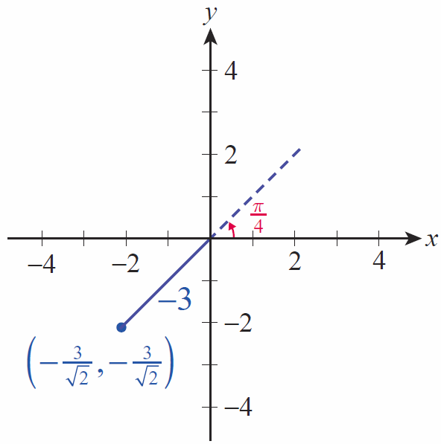
Example 2 (cont.)
b. We calculate
and so the Cartesian coordinates
are
(see Figure 6).
Figure 7

Slide 18
Example 3
Convert the following points from Cartesian to polar coordinates.
Solution
a. To avoid making an error, be sure you have some rough idea of what the answer should be before doing any calculations. Since (−3, 2) is in the second quadrant, one possible conversion will lead to
π/2 < θ < π.

Slide 19
Example 3a (cont.)
To get the exact angle, we use the fact that so (remember, this is in radians). Depending on your calculator, though, you may have found an angle in the fourth quadrant; if so, it is up to you to remember to either add π in order to get an angle in the second quadrant, or to use a negative value for r.

Slide 20
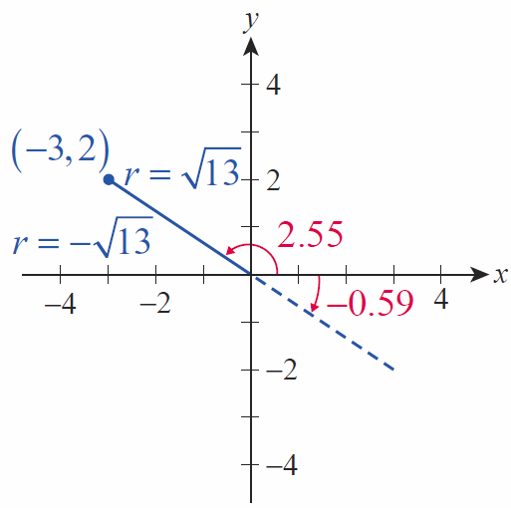
Example 3a (cont.)
The radius is more easily determined:
The two answers we have
found are thus
and
(see Figure 8).
Figure 8

Slide 21
Example 3 (cont.)
b. The polar coordinates of are more easily determined. The point lies in the fourth quadrant, so the two most obvious conversions will lead to either or The coordinates give rise to a familiar triangle with convenient angles, and it’s probably easiest to use

Slide 22
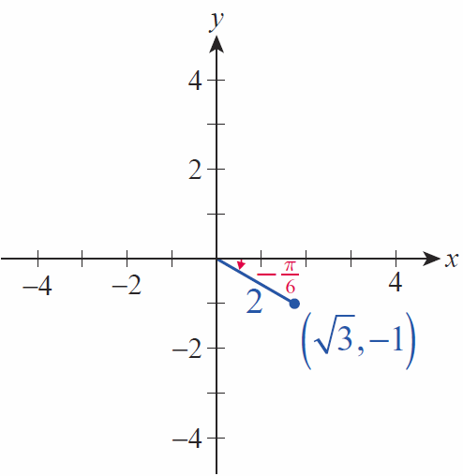
Example 3a (cont.)
The radius is r = 2, so one set of polar coordinates for the point is
(see Figure 9).
Figure 9

Slide 23
The Form of Polar Equations
In the most general terms, a polar equation is an equation in the variables r and θ that defines a relationship between these polar coordinates. A solution to a polar equation is thus an ordered pair
(r, θ ) that makes the equation true, and the graph of a polar equation consists of all such ordered pairs. Many polar equations can be written in the form r = f(θ ); in such a form, the distance from the origin is expressed as a function of the angle θ and the graph of the equation is usually fairly easy to determine.

Slide 24
Example 4
Rewrite the equation x² – 2x + y² = 0 in polar form.
Solution
Making the appropriate substitutions in the equation x² – 2x + y² = 0 and simplifying, we obtain the following:

Slide 25
Example 5
Rewrite the equation 2r = sec θ in rectangular form.
Solution
One good way to begin is to rewrite the equation as follows:
Now we recognize the term on the left-hand side as x, and we see that the equation is

Slide 26
Example 6
Sketch the graphs of the following polar equations, and then convert the equations to rectangular coordinates.

Slide 27
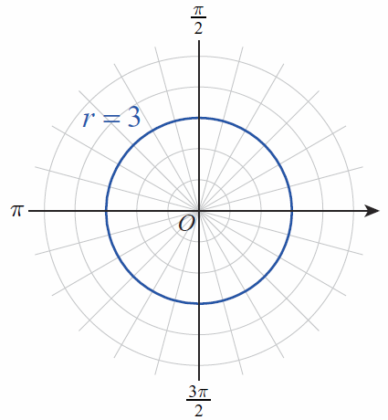
Example 6 (cont.)
Solution
a. Since θ doesn’t appear in the equation r = 3, θ is allowed to take on any value. The equation thus describes all points (r, θ ) for which r = 3; that is, a circle of radius 3 as shown in Figure 10. The equation in rectangular coordinates is x² + y² = 9.
Figure 10

Slide 28
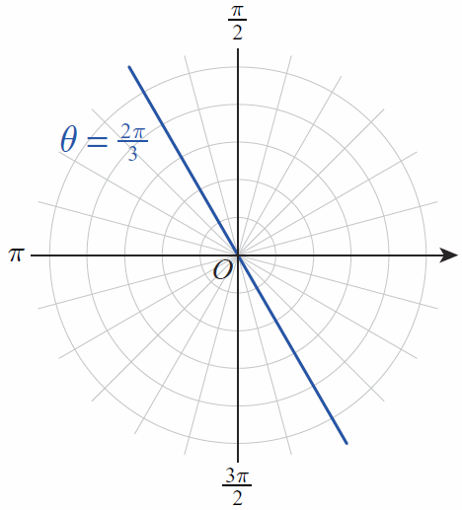
Example 6 (cont.)
b. In this equation, r is allowed to take on any value. But every point (r,θ) that satisfies the equation must have θ = 2π/3. The graph is thus a straight line passing through the origin (see Figure 11), and
so
Figure 11

Slide 29
Example 7
Sketch the graph of the equation r = 2 cos θ.
Solution
We can begin by calculating some values of r for given values of θ:
θ | 0
r | 2 |  |  | 1 | 0 | −1

Slide 30
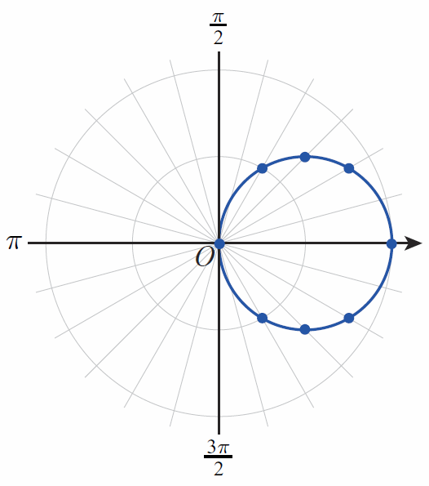
Example 7 (cont.)
Now if we plot the pairs (r, θ ) from the table, we obtain the points shown in Figure 12. These certainly appear to lie along the circumference of a circle, so the points have been connected with a curve.
Figure 12 r = 2 cosθ

Slide 31
Example 7 (cont.)
If we convert the equation into rectangular coordinates as shown below, we see that the graph indeed is a circle of radius 1 centered at x = 1, y = 0.

Slide 32
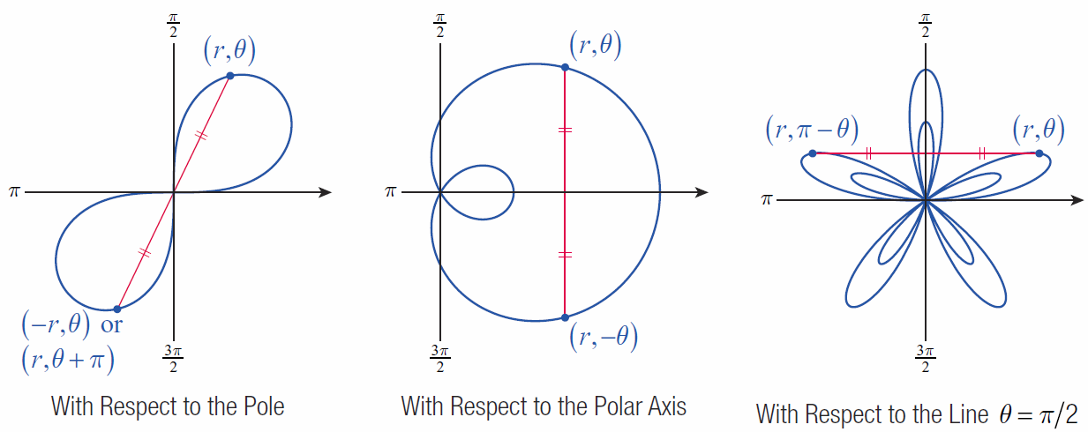
Graphing Polar Equations
Consider the three types of symmetry illustrated in Figure 13.
Figure 13 Symmetry in Polar Coordinates

Slide 33
Definition: Symmetry of Polar Equations
Symmetry of Polar Equations
An equation in r and θ is symmetric with respect to
1. the pole if replacing r with −r (or replacing θ with
θ + π) results in an equivalent equation;
2. the polar axis if replacing θ with −θ results in an equivalent equation;
3. the vertical line θ =π/2 if replacing θ with π − θ results in an equivalent equation.

Slide 34
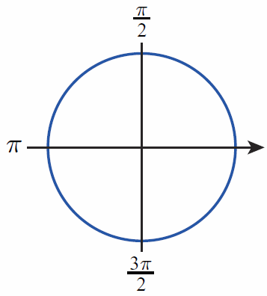
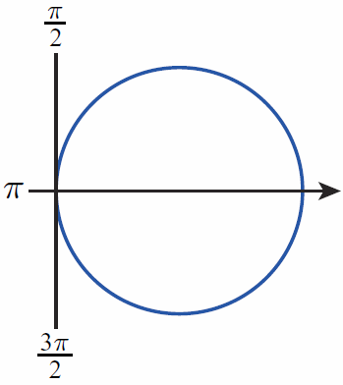
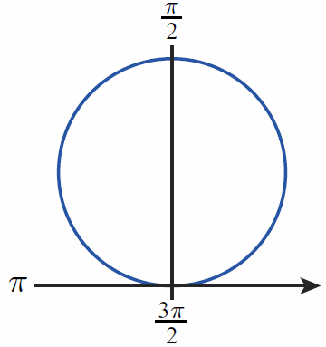
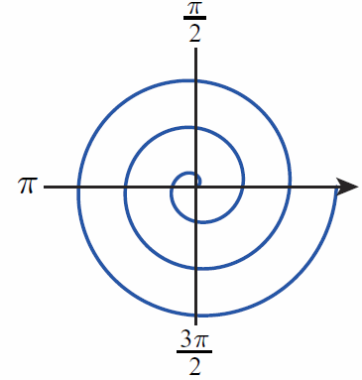
Common Polar Equations and Graphs
Circles and Archimedes’ Spirals (a > 0)
r = a
Circle
r = a cosθ
Circle
r = a sinθ
Circle
r = aθ
Archimedes’
Spiral

Slide 35
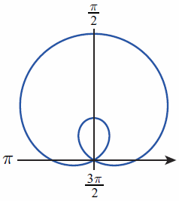
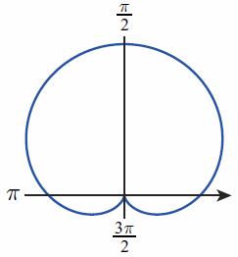
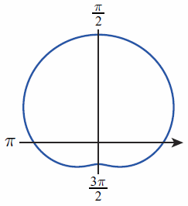
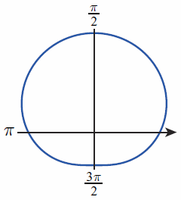
Common Polar Equations and Graphs
Limaçons r = a ± b sinθ r = a ± b cosθ (a > 0, b > 0)
Limaçon with
Inner Loop
Cardioid
(Heart Shape)
Dimpled Limaçon
Convex
Limaçon

Slide 36
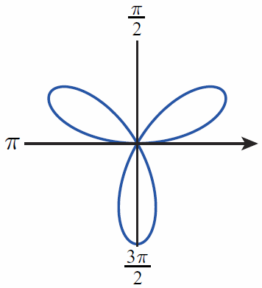
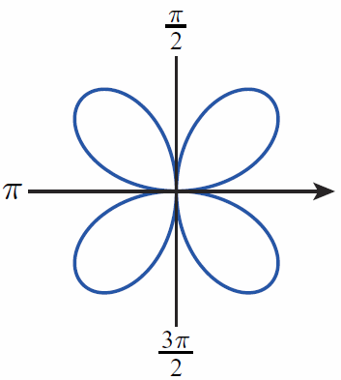
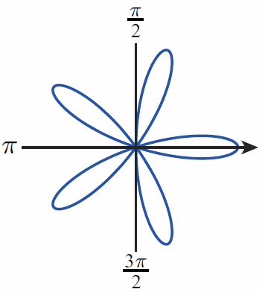
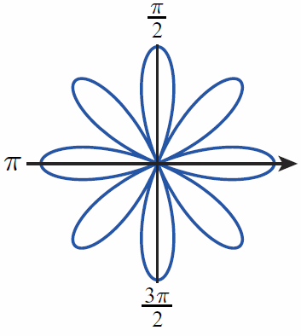
Common Polar Equations and Graphs
Roses r = a sin nθ r = a cos nθ (a > 0) n‑petaled if n is odd 2n‑petaled if n is even
r = a sin 3θ
3-Petaled Rose
or Trifolium
r = a sin 2θ
4-Petaled Rose or Quadrifolium
r = a cos 5θ
5-Petaled Rose
r = a cos 4θ
8-Petaled Rose

Slide 37
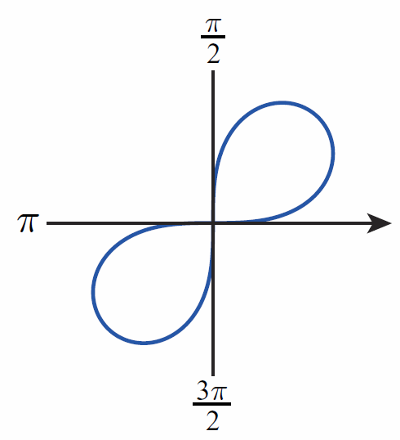
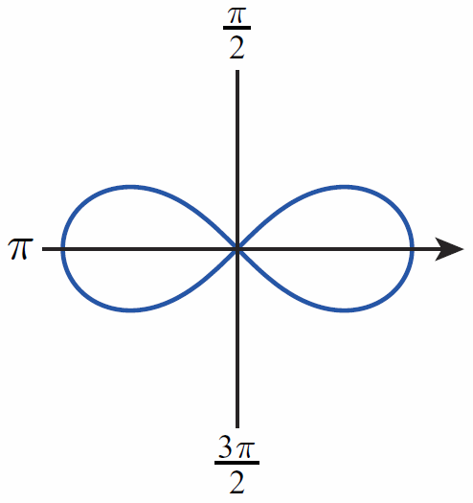
Common Polar Equations and Graphs
Lemniscates (figure-eight shapes)
r² = a² sin 2θ
Lemniscate
r² = a² cos 2θ
Lemniscate

Slide 38
Example 8
Use symmetry and the table of common polar equations and graphs to sketch the graph of r = 3 cos 4θ.
Solution
The equation r = 3 cos 4θ possesses all three kinds of symmetry, and reference to the preceding table indicates that the graph is an 8-petaled rose. Several aspects of the graph can be determined easily, such as the fact that the maximum distance between the origin and points on the graph is 3; this follows from the fact that −1 ≤ cos 4θ ≤ 1 for all θ.

Slide 39
Example 8 (cont.)
Some points can be easily calculated by hand, but a graphing calculator or software package is very useful in generating a large number of points. The polar coordinates of points on the graph for 0 ≤ θ ≤ 2π in increments of π/16, are shown in the next slide.

Slide 40
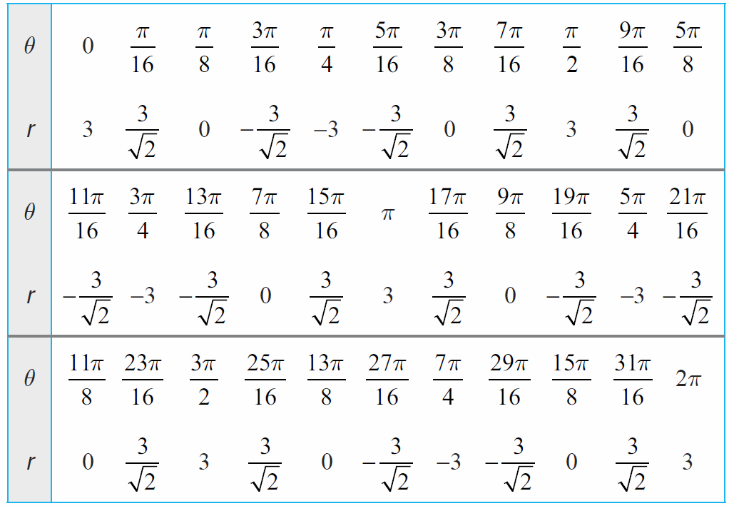
Example 8 (cont.)

Slide 41
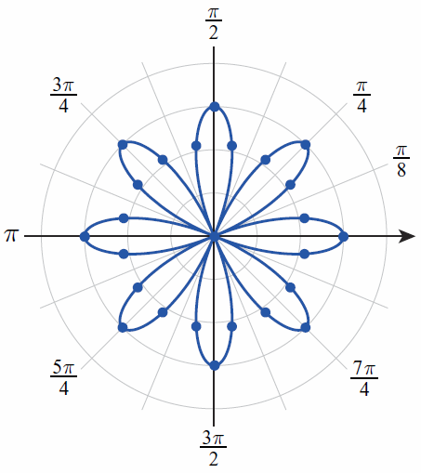
Example 8 (cont.)
These points, and the rest of the graph, are plotted in Figure 14.
Figure 14 r = 3 cos 4θ

Slide 42
Example 9
Use symmetry and the table of common polar equations and graphs to sketch the graph of r = 1 + 2 cosθ.
Solution
The graph of r = 1 + 2 cosθ is a limaçon with an inner loop. Since cosine is an even function
and the graph is symmetric with respect to the polar axis.

Slide 43
Example 9 (cont.)
Some points on the graph are as follows:
θ | 0
r | 3 | 2 | 1 | 0 | −1 | 0 | 1 | 2 | 3

Slide 44
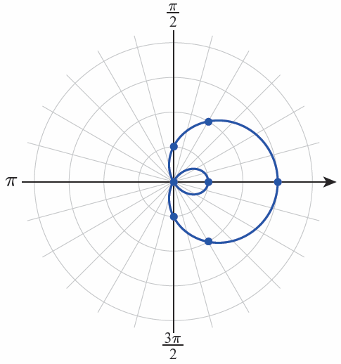
Example 9 (cont.)
The graph of r = 1 + 2 cosθ is shown in Figure 15.
Figure 15 r = 1 + 2 cosθ

Slide 45
Technology Note
Technology Note
Graphing calculators and computer algebra systems can be very useful in constructing accurate graphs of polar equations, though their capabilities are limited and vary considerably.

Slide 46
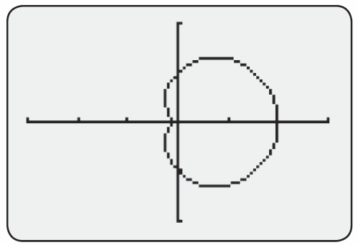
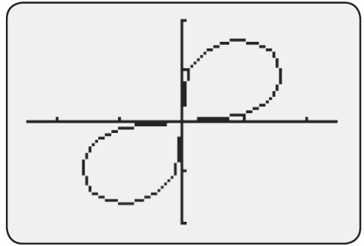
Technology Note
Technology Note (cont.)
Figure 16 shows the graphs of a cardioid and a lemniscate on a graphing calculator.
[−3, 3] by [−2, 2]
[−2.5, 2.5] by [−2, 2]
Figure 16

Slide 47
Technology Note
Technology Note (cont.)
To generate those graphs the selected graphing mode needs to be POL and the polar equations are entered in the Y= editor. Figure 17 illustrates how Mathematica is used to graph the same cardioid and lemniscate. The built-in command is PolarPlot.

Slide 48
Technology Note
Technology Note (cont.)
Often, a polar equation must be solved for r in order to use the graphing feature of a particular technology. Note that in order to graph the lemniscate shown, we solved the equation for r and then typed in both the positive and negative square roots that resulted.

Slide 49
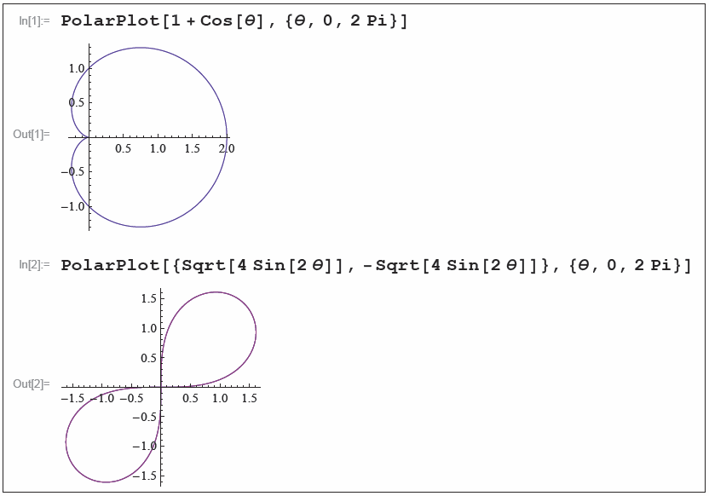
Technology Note
Technology Note (cont.)
Figure 17 Graphing Polar Equations in Mathematica

