Slide 1
Section 9.4
Calculus in Polar Coordinates

Slide 2
TOPICS
Tangents to polar curves
Area and arc length in polar coordinates

Slide 3
Tangents to Polar Curves
We will focus on the most commonly occurring polar curves, those defined by an equation of the form
r = f(θ ). If we are interested in determining the tangent to a polar curve at a particular point, it is important to realize we are still primarily interested in dy/dx. And to find dy/dx, we use the coordinate conversion equations to write

Slide 4
Tangents to Polar Curves
We now have two equations in the parameter θ describing the curve, and if f is a differentiable function of θ, then when

Slide 5
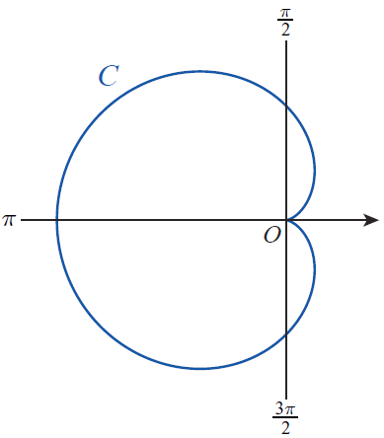
Example 1
Find all points where the cardioid C defined by r = 1 − cosθ has a horizontal or vertical tangent.
Figure 1 r = 1 − cosθ

Slide 6
Example 1 (cont.)
Solution
Using the notation above, and so

Slide 7
Example 1 (cont.)
By determining where the numerator and denominator of this fraction are equal to 0, we can locate the horizontal and vertical tangent lines of the cardioid (we restrict attention to since the cardioid is traced out exactly once over this parametric interval).

Slide 8
Example 1 (cont.)
The fraction as a whole is 0 when the numerator is 0 and the denominator is not 0, and the fraction is undefined when the exact opposite occurs. Thus,
C has horizontal tangent lines at θ = 2π/3 and
θ = 4π/3;
C has vertical tangent lines at θ = π, θ = π/3, and
θ = 5π /3.

Slide 9
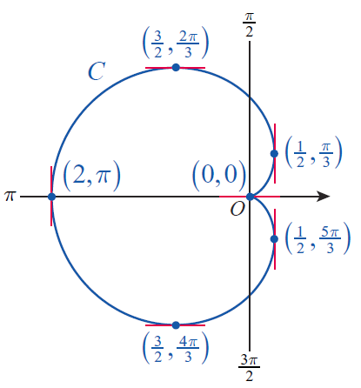
Example 1 (cont.)
The points on C corresponding to these values of the parameter θ are shown in Figure 2.
Figure 2

Slide 10
Example 1 (cont.)
The point (0, 0) which is both the initial and terminal point of C, requires a bit more analysis to prove the existence of a tangent line. Since both the numerator and denominator are 0 at θ = 0 (or 2π ), l’Hôpital’s Rule is called for:
so C has a horizontal tangent line at (0, 0).

Slide 11
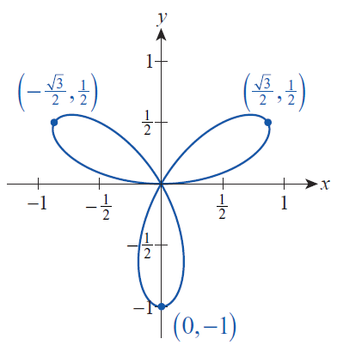
Example 2
Figure 3 depicts the 3-petaled rose r = sin 3θ. Determine the slopes of the lines tangent to the tips of each petal.
Figure 3 r = sin 3θ

Slide 12
Example 2 (cont.)
Solution
Although we want to find dy/dx at each petal tip, we first identify the value of the parameter θ at each tip by solving the equation dr/dθ = 0. This works because each tip is a point on the parametric curve where r makes the transition from being an increasing function of θ to a decreasing function of θ. Note that the rose is traced out entirely over a parametric interval of [0, π ], so we look for values of θ restricted to this interval:

Slide 13
Example 2 (cont.)
Now, since y = sin 3θ sinθ and x = sin 3θ cosθ, we know that
We leave it as an exercise (Exercise 63) to show that

Slide 14
Example 2 (cont.)
Alternatively, since dr/dθ = 0 at each point (x, y) at the tip of a petal, and the slope of the line passing through the origin and (x, y) is y/x, we can find the slope of these three specific tangent lines by calculating the negative reciprocal, or −x/y, at each of the three tips. But this only works for these particular tangents to the curve—other tangents require knowing dy/dx.

Slide 15
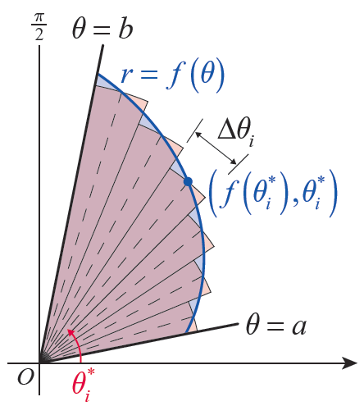
Area and Arc Length in Polar Coordinates
Suppose R is a region bounded between two rays θ = a and
θ = b, where 0 < b − a ≤ 2π, and by the polar equation r = f(θ ), where f is a continuous positive function as shown in Figure 4. We can find the area A of the region by following the same sort of Riemann sum construction that we used when first calculating areas under curves.
Figure 4
Area of a Polar Region

Slide 16
Area and Arc Length in Polar Coordinates
Recall that the area of a sector of a circle is given by the formula where r is the radius of the circle and θ is the angle defining the sector (this follows from the fact that the sector’s area is θ /2π times the area of the complete circle, π r²).

Slide 17
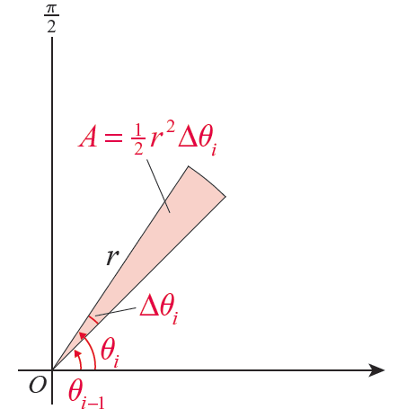
Area and Arc Length in Polar Coordinates
If we partition the θ ‑interval [a, b] into n subintervals defined by the n + 1 angles
as shown in Figure 4, then the area of the i^{th} sector is depicted in Figure 5.
Figure 5

Slide 18
Area and Arc Length in Polar Coordinates
And similar to our previous Riemann sum approximations, the radius r of this i^{th} sector can be given the value where is any sample angle chosen from the subinterval
Adding up the areas of the n sectors, we have the following Riemann sum:

Slide 19
Area and Arc Length in Polar Coordinates
In the limit of finer and finer partitions, we arrive at the following formula for the area of such a polar region.

Slide 20
Formula: Area of a Polar Region
Area of a Polar Region
The area A of a region bounded between two rays θ = a and θ = b, where 0 < b − a ≤ 2π, and by the polar equation r = f(θ), where f is a continuous positive function, is given by

Slide 21
Example 3
Find the area enclosed by the rose r = sin 3θ.
Solution
The graph of the polar equation
r = sin 3θ is shown in Figure 3. By symmetry, we only need to find the area of one petal and then triple it to find the total area. But in order to find the area of one petal, we need to determine appropriate rays θ = a and θ = b that bound the petal.
Figure 3 r = sin 3q

Slide 22
Example 3 (cont.)
If we choose to work with the petal in the 1st quadrant, then it is fairly clear that θ = 0 is the lower bound (we will verify that guess soon). And since we have already determined that the tip of the petal occurs at θ = π/6, we might feel comfortable guessing that θ = π /3 is the other bounding ray. But how would we determine this if we hadn’t already done the work of Example 2? We would do so by identifying the values of θ for which r = f(θ ) = 0; remember that the entire polar curve is traced out over the interval [0, π] so we only need to look for θ ’s in that interval.

Slide 23
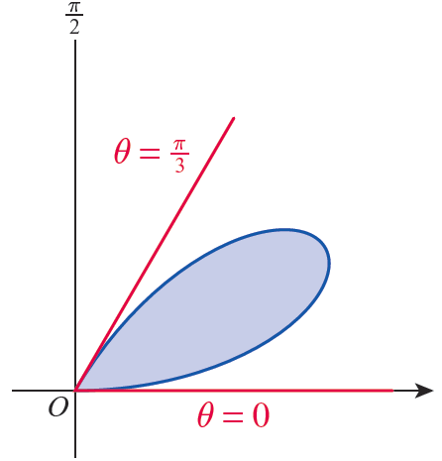
Example 3 (cont.)
Since sin 3θ = 0 when 3θ is a multiple of π, the values we seek are θ = 0, π/3, 2π /3, and π. The first‑quadrant petal is bounded by θ = 0 and θ = π /3, as shown in Figure 6. (Note that, somewhat counterintuitively, the downward-pointing petal is bounded by θ = π /3 and
θ = 2π /3, since sin 3θ is negative for θ ’s in that interval.)
Figure 6
One Petal of r = sin 3θ

Slide 24
Example 3 (cont.)
We are now ready to find the area enclosed by one petal.
And so the entire area enclosed by r = sin 3θ is as follows:

Slide 25
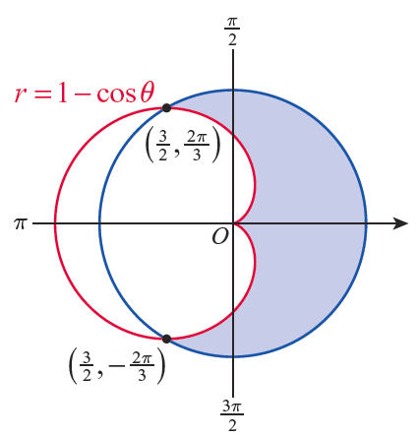
Example 4
Find the area of the region outside the cardioid r = 1 − cosθ and inside the circle that intersects the cardioid at the two points indicated in Figure 7.
Figure 7
Area between Polar Curves

Slide 26
Example 4 (cont.)
Solution
We find the area between two polar curves in the same way we find the area between two functions of x—by subtracting the area under the smaller function from the area under the larger function. The only difference is that in this context, “larger” means farther away from the origin, and we must remember to use the polar integral formula for area.

Slide 27
Example 4 (cont.)
In general, if for a ≤ θ ≤ b, the area bounded by the rays θ = a and θ = b and the two curves r = g(θ) and r = f(θ) is given by

Slide 28
Example 4 (cont.)
In this example, and the two rays are as shown in Figure 7. And from the two points of intersection of the curves, we can deduce that that is, the larger curve is the circle of radius centered at the origin. So the area between the two curves is calculated as follows:

Slide 29
Example 4 (cont.)

Slide 30
Area and Arc Length in Polar Coordinates
The arc length of a curve defined parametrically over an interval [a, b] with parameter t is
In this context, the parameter is θ and if our polar curve is given as then we know and

Slide 31
Area and Arc Length in Polar Coordinates

Slide 32
Formula: Arc Length of a Polar Curve
Arc Length of a Polar Curve
Assume the curve C is defined by r = f(θ) over the θ ‑interval [a, b] where f has a continuous first derivative over the interval and the curve is traced out exactly once (except possibly for a finite number of self‑intersections). Then the arc length of C is given by

Slide 33
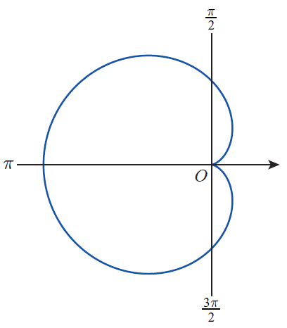
Example 5
Find the arc length of the cardioid r = 1 − cosθ.
Solution
The curve from Figure 1, which we are very familiar with now, is shown again in Figure 8.
Figure 8 r = 1 − cosθ

Slide 34
Example 5 (cont.)
Note that
Since we need to integrate the square root of this expression, the trigonometric identity is useful.

Slide 35
Example 5 (cont.)

