Slide 1
Section 9.5
Conic Sections in Cartesian Coordinates

Slide 2
TOPICS
Ellipses
Parabolas
Hyperbolas
Rotating conic sections

Slide 3
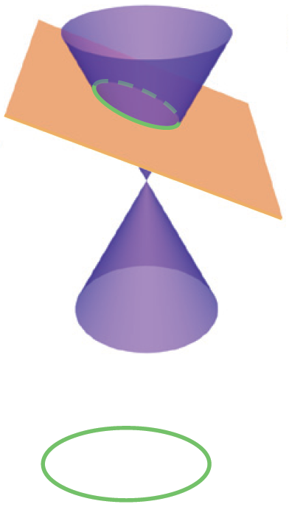
Conic Sections in Cartesian Coordinates
The three families of curves, ellipses, parabolas, and hyperbolas, are collectively known as conic sections because each type of curve arises from the intersection of a plane with a (double) circular cone.
An ellipse is a closed curve resulting from the intersection of a plane with only one nappe, half of a double cone (the two nappes of a cone each extend outward from the common vertex).
Ellipse

Slide 4
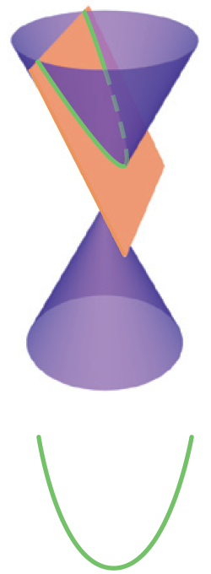
Conic Sections in Cartesian Coordinates
A parabola results from intersecting a cone with a plane that is parallel to a line on the surface of the cone passing through the vertex; note that a parabola also intersects only one nappe of the cone.
Parabola

Slide 5
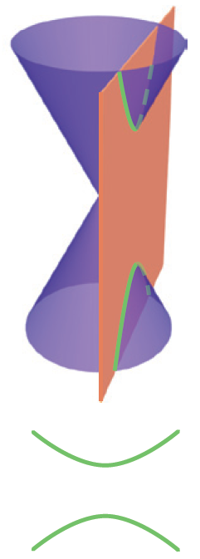
Conic Sections in Cartesian Coordinates
A hyperbola is the intersection of a cone with a plane that intersects both nappes. In each case, we specify that the intersecting plane does not contain the vertex—a figure that results when the intersecting plane does contain the vertex is called a degenerate conic section and is a point, a line, or a pair of intersecting lines.
Hyperbola

Slide 6
Definition: Algebraic Classification of Conic Sections
Algebraic Classification of Conic Sections
As a curve in the Cartesian plane, every conic section is the graph of an equation of the form
Ax² + Bxy + Cy² + Dx + Ey + F = 0, where the coefficients are real constants.

Slide 7
Definition: Algebraic Classification of Conic Sections
Algebraic Classification of Conic Sections (cont.)
Assuming the conic section described by such an equation is nondegenerate, the curve is
1. an ellipse if B² − 4AC < 0;
2. a parabola if B² − 4AC = 0;
3. a hyperbola if B² − 4AC > 0.
The quantity B² − 4AC is called the discriminant of the equation.

Slide 8
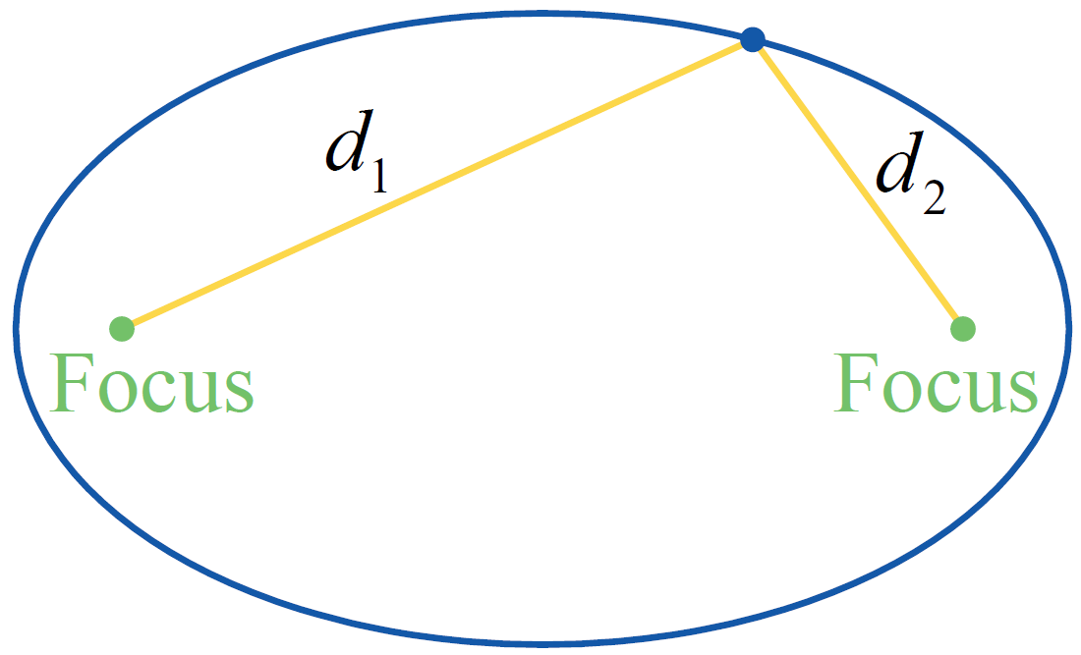
Definition: Geometric Characteristic of Ellipses
Geometric Characteristic of Ellipses
An ellipse consists of the set of points in the plane for which the sum of the distances d₁ and d₂ to two foci is a fixed constant (see Figure 2).
Figure 2 Ellipse

Slide 9
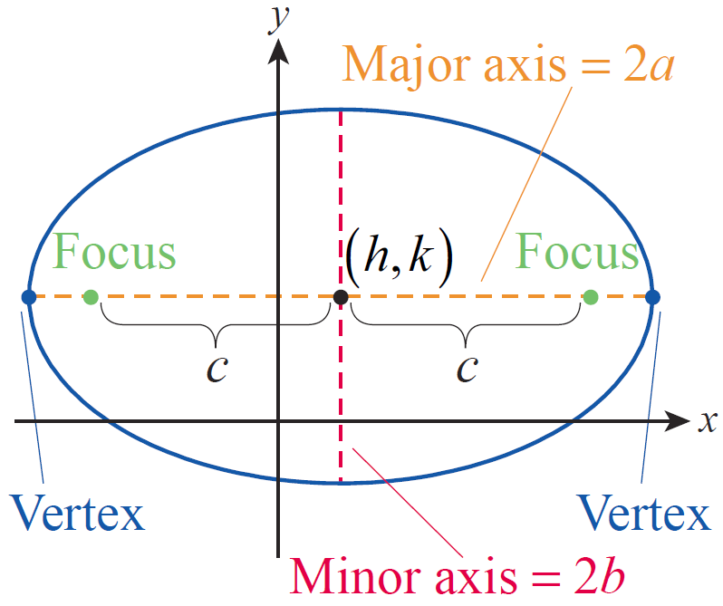
Ellipses
An ellipse with major and minor axes parallel to the x- and y-axes, respectively, can be written in the standard form
Figure 3

Slide 10
Ellipses
In this form, (h, k) is the center of the ellipse and 2a and 2b are, respectively, the lengths of the horizontal and vertical axes of the ellipse (see Figure 3). The two foci lie on the major axis (the longer axis) of the ellipse, each a distance c from the center of the ellipse, where c² = a² − b².
Figure 3

Slide 11
Ellipses
We assume a ≥ b; note that c = 0 if and only if a = b, in which case the ellipse is a circle and the two foci coincide with the center. The two vertices are located at the ends of the major axis, each a distance a from the center. If the equation above is rewritten in the form
it is clear that it falls under the algebraic classification of an ellipse, as the discriminant is

Slide 12
Ellipses
For an ellipse whose major axis is parallel to the y‑axis, the corresponding equation has the form
where we again assume a ≥ b.

Slide 13
Example 1
Graph the equation 25x² + 4y² + 100x − 24y + 36 = 0, and determine the foci of the resulting ellipse.
Solution
The fact that the coefficients of x² and y² are both positive tells us that the discriminant is negative and thus falls into the classification of an ellipse, but we know little else from the equation in this form.

Slide 14
Example 1 (cont.)
By completing the square in both variables and rearranging terms, we can learn more:

Slide 15
Example 1 (cont.)
In this form, we can infer that the center of the ellipse is the point (−2, 3), that a = 5 and b = 2, and that the major axis is vertical. Further, since c² = a² − b² = 21, and so the foci are located ±4.6 units away from the center, or at approximately (−2, −1.6) and (−2, 7.6).

Slide 16
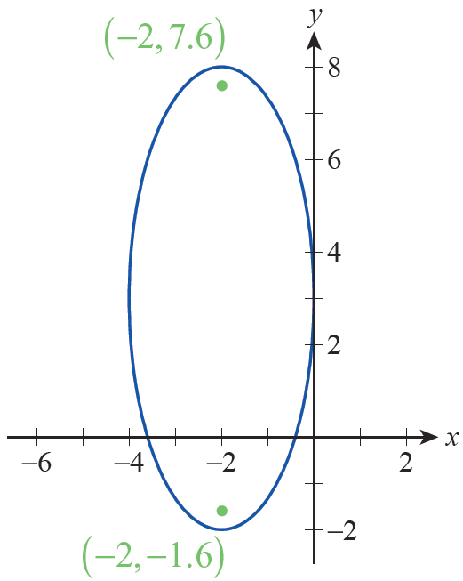
Example 1 (cont.)
A graph of the ellipse is shown in Figure 4.
Figure 4

Slide 17
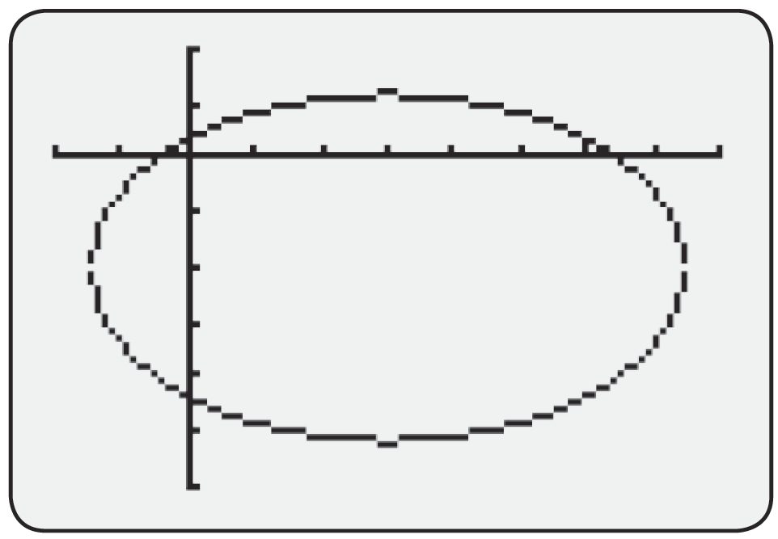
Technology Note
Technology Note
A graphing calculator or CAS can be used to sketch the graph of an ellipse, with the specific commands varying with the technology. Figure 5 shows the graph of the ellipse x² − 6x + 2y² + 8y = 3 on a graphing calculator.
Figure 5 [−2,8] by [−6,2]

Slide 18
Technology Note
Technology Note (cont.)
In order to generate this graph, the equation of the ellipse needs to be solved for y and then both the positive and negative square roots that result entered into the Y= editor.
The Mathematica command ContourPlot, used for this purpose, requires only three arguments: an equation, an interval for the variable x, and an interval for the variable y.

Slide 19
Technology Note
Technology Note (cont.)
Figure 6 illustrates the use of ContourPlot to graph the same ellipse, x² − 6x + 2y² + 8y = 3, with two additional arguments included that tell Mathematica to display the coordinate axes but not to display a frame around the graph.

Slide 20
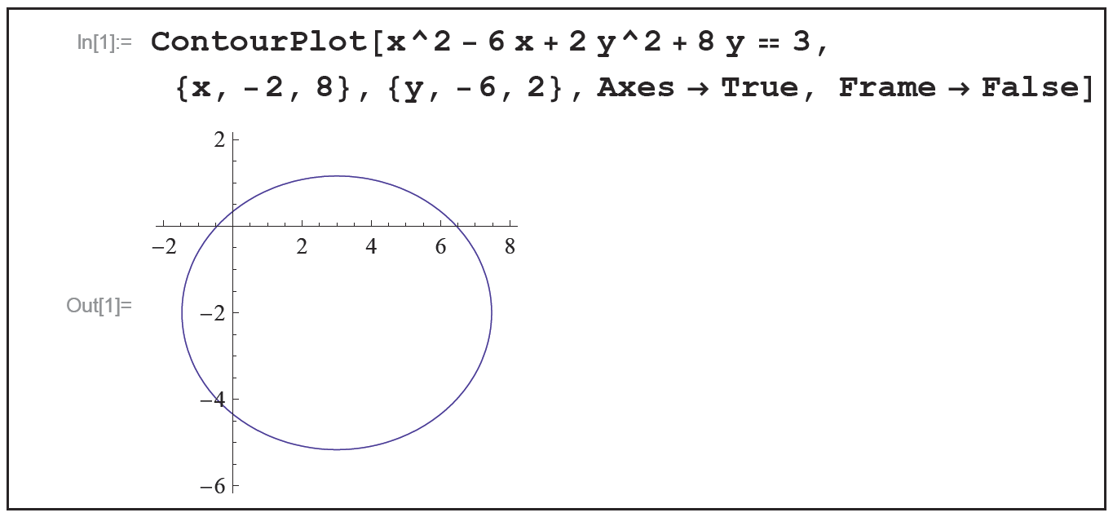
Technology Note
Technology Note (cont.)
Figure 6

Slide 21
Definition: Eccentricity of an Ellipse
Eccentricity of an Ellipse
Given an ellipse with major and minor axes of lengths 2a and 2b, respectively, the eccentricity of the ellipse, often denoted by the symbol e, is defined by
If e = 0, then c = 0 and the ellipse is actually a circle. At the other extreme, c may be close to (but cannot equal) a, in which case e is close to 1. An eccentricity close to 1 indicates a relatively narrow ellipse.

Slide 22
Theorem: Kepler’s Laws of Planetary Motion
Kepler’s Laws of Planetary Motion
1. Each planet revolves around the sun in an elliptical orbit, with the sun at one focus of the ellipse.
2. A line segment between the sun and a given planet sweeps out equal areas of the ellipse over equal periods of time.
3. The ratio of the square of the period of one revolution of a planet and the cube of the length of the semimajor axis of its orbit is a constant independent of the planet.

Slide 23
Example 2
Given that the furthest Earth gets from the sun is approximately 94.56 million miles and that the eccentricity of Earth’s orbit is approximately 0.017, estimate the closest approach of the Earth to the sun.
Solution
Kepler’s First Law states that each planet follows an elliptical orbit and that the sun is positioned at one focus of the ellipse. Thus the Earth is furthest from the sun when Earth is at the end of the ellipse’s major axis on the other side of the center from the sun.

Slide 24
Example 2 (cont.)
Using our standard terminology, and units of millions of miles, this means that
a + c = 94.56.
By the definition of eccentricity, we also know that
or c = 0.017a. Combining these pieces of information, we get 1.017a = 94.56, leading to a = 92.98 million miles. From this, we know c = (0.017)(92.98) = 1.58 million miles. The closest approach to the sun must be a − c, which is approximately 91.4 million miles.

Slide 25
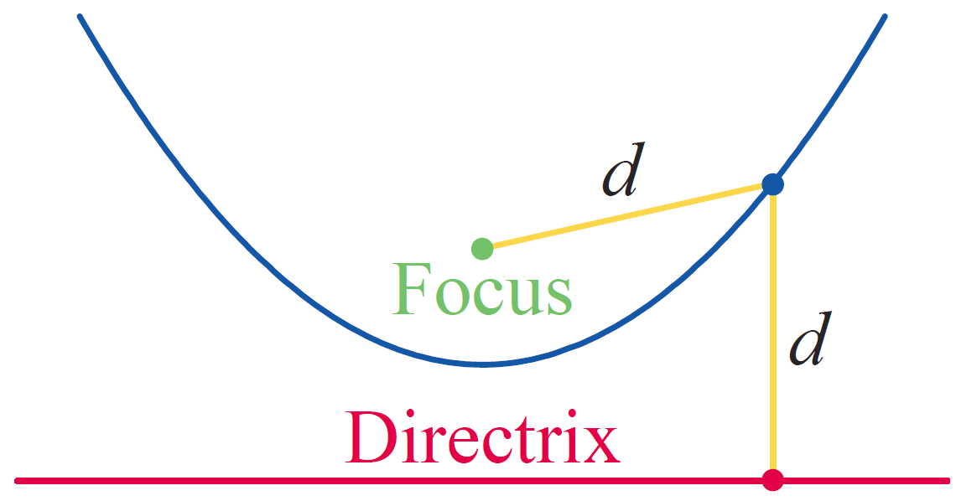
Definition: Geometric Characteristic of Parabolas
Geometric Characteristic of Parabolas
A parabola consists of the set of points in the plane that are the same distance d from a line (called the directrix) and a point not on the line (called the focus). See Figure 7 for an illustration of this property.
Figure 7 Parabola

Slide 26
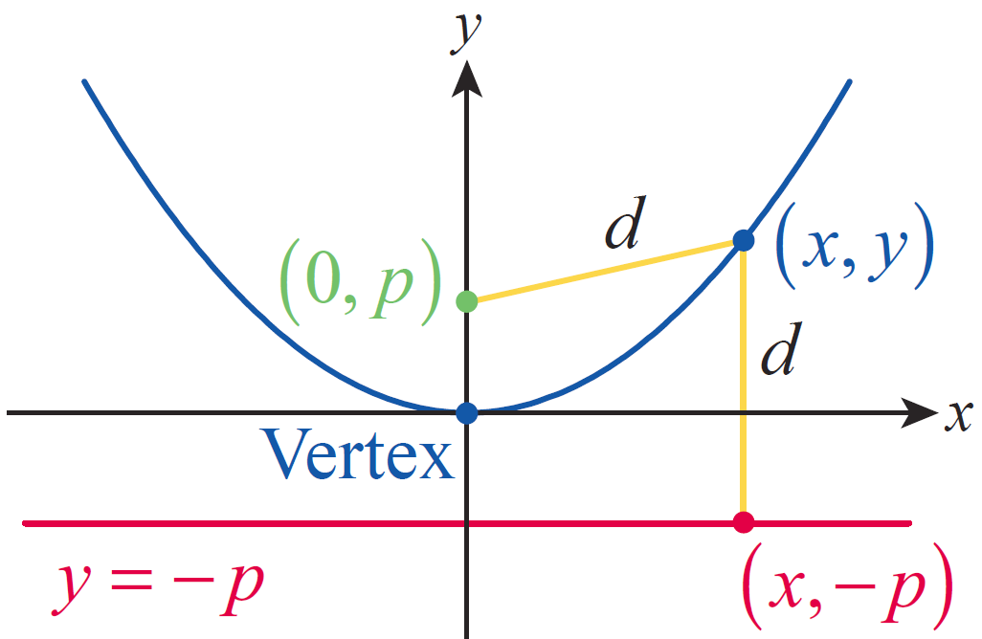
Parabolas
The general form for the equation of a parabola can be constructed by beginning with a parabola oriented as in Figure 8, where the vertex of the parabola has been
placed at the origin, the focus is the point (0, p) and the directrix is the line y = −p (the distance |p| is called the focal length of the parabola).
Figure 8

Slide 27
Parabolas
The geometric property above leads immediately to the algebraic relationship
which, after
squaring both sides and simplifying, becomes x² = 4py. This can be generalized to describe a parabola with vertex at (h, k) by replacing x with x − h and y with y − k, giving us the equation (x − h)² = 4p(y − k). And to describe parabolas opening horizontally, the roles of x and y are simply reversed.

Slide 28
Parabolas
In sum, a parabola oriented vertically or horizontally with vertex at (h, k) and focus p units from the vertex can be written in one of the two standard forms below.

Slide 29
Parabolas
Vertically oriented parabola:
Horizontally oriented parabola:
Note that if either equation is written in the form
Ax² + Bxy + Cy² + Dx + Ey + F = 0, B = 0 and either A = 0 or C = 0, so the discriminant B² − 4AC = 0 and indicates that the equation corresponds to a parabola.

Slide 30
Example 3
Find the focus and directrix of the parabola
−y² + 2x + 2y + 5 = 0.
Solution
Since y is the squared variable, we know from the outset that the parabola is oriented horizontally. To identify the focus and directrix, we rewrite the equation by completing the square and factoring out a 4 in the final form:

Slide 31
Example 3 (cont.)
In this form, we can see that the vertex of the parabola is at (−3, 1) and that

Slide 32
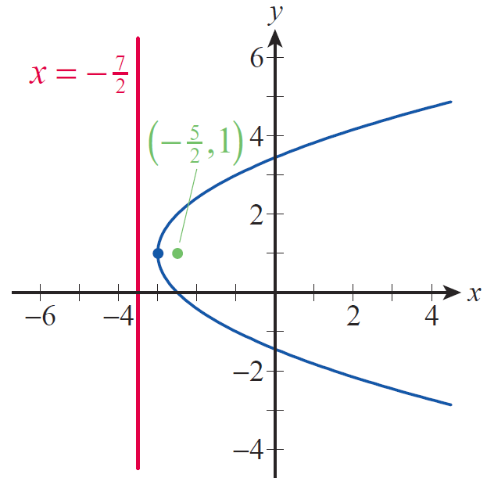
Example 3 (cont.)
Since p is positive the parabola opens to the right, the focus is at and the directrix is the line as illustrated in Figure 9.
Figure 9

Slide 33
Parabolas
An important example of a parabola is the path of a thrown object under the influence of gravity (ignoring friction and other forces). Algebraically, we know that the height h(t) of an object with initial velocity v₀ and initial height h₀ is
where g, a constant, is the acceleration due to gravity.

Slide 34
Example 4
The Hale Telescope at Palomar Observatory in California is a very large reflecting telescope. The paraboloid is the top surface of a large cylinder of Pyrex glass 200 inches in diameter. Along the outer rim, the cylinder is 26.8 inches thick, while at the center, it is 23 inches thick. Where is the focus of the parabolic mirror located?

Slide 35
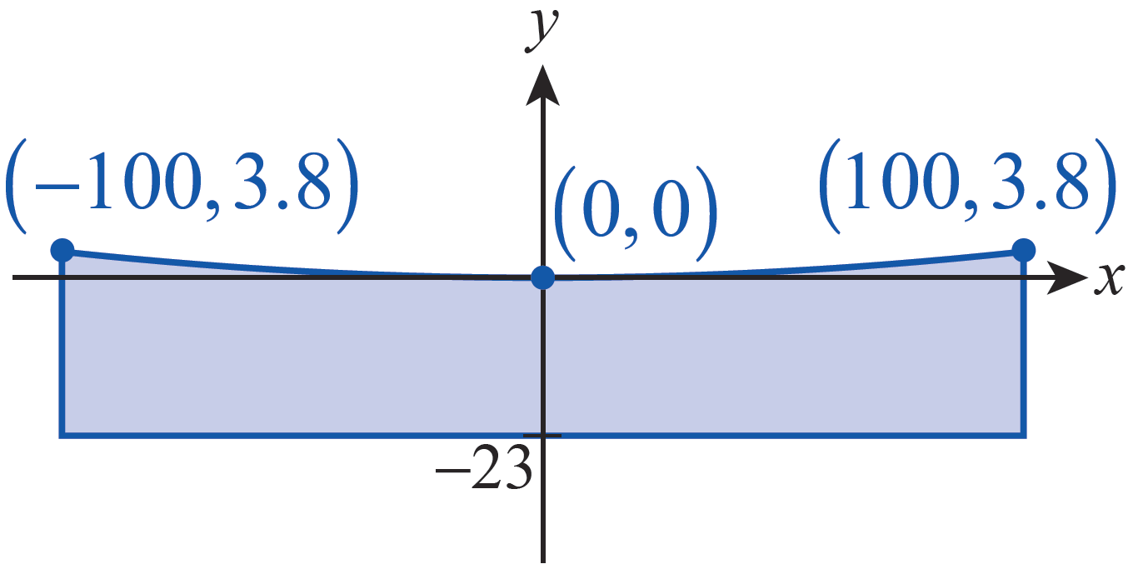
Example 4 (cont.)
Solution
First, we need to draw a picture of the situation. In order to make the math as easy as possible, we can locate the origin of our coordinate system at the vertex
of a parabolic cross-section of the mirror, and we can assume the parabola opens upward (see Figure 11).
Figure 11

Slide 36
Example 4 (cont.)
Since we placed the vertex at (0, 0) we know the equation x² = 4py describes the shape of the cross-section for some value p. If we can determine p, we can find the focus of the parabola.
To find p, we need the coordinates of another point on the parabola. The difference in thickness of the mirror between the center and the outer rim is 3.8 inches, and the mirror has a diameter of 200 inches, so the two points (−100, 3.8) and (100, 3.8) must lie on the graph.

Slide 37
Example 4 (cont.)
Substituting the coordinates of one of these points into the equation x² = 4py, we can solve for p.
We know that the focus of a parabola is p units from the vertex, so the focus of the Hale Telescope is nearly 55 feet from the mirror.

Slide 38
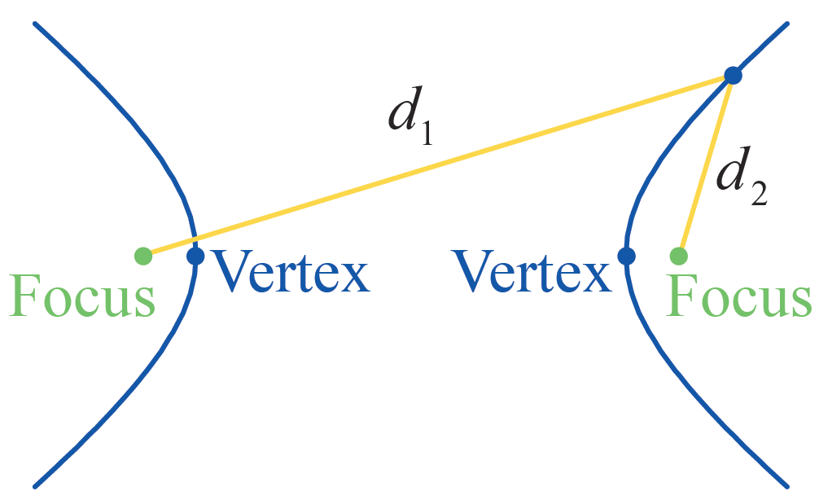
Definition: Geometric Characteristic of Hyperbolas
Geometric Characteristic of Hyperbolas
A hyperbola consists of the set of points in the plane for which the absolute value of the difference between the distances d₁ and d₂ to two foci is fixed (see Figure 12).
Figure 12 Hyperbola

Slide 39
Parabolas
The standard form of the equation for a hyperbola whose foci are aligned horizontally or vertically is shown below.
Foci aligned horizontally:
with asymptotes
Foci aligned vertically:
with asymptotes

Slide 40
Parabolas
In both cases, the center of the hyperbola is (h, k) the vertices are located a units on either side of the center, and the foci are c units away from the center, where
c² = a² + b². Note that if either equation is rewritten in the form Ax² + Bxy + Cy² + Dx + Ey + F = 0, the discriminant is equal to B² − 4AC = 4a²b² > 0.

Slide 41
Example 5
Find the foci, vertices, and asymptotes of the hyperbola.
−16x² + 9y² + 96x + 18y = 279
Solution
As in Examples 1 and 3, we complete the square and rewrite the equation to put it in a more meaningful form:

Slide 42
Example 5 (cont.)
This tells us that the foci are aligned vertically (since the positive fraction is in terms of y), that a = 4, b = 3, and the center is (3, −1) So the vertices are the two points (3, −1 −4) = (3, −5) and (3, −1 +4) = (3, 3).

Slide 43
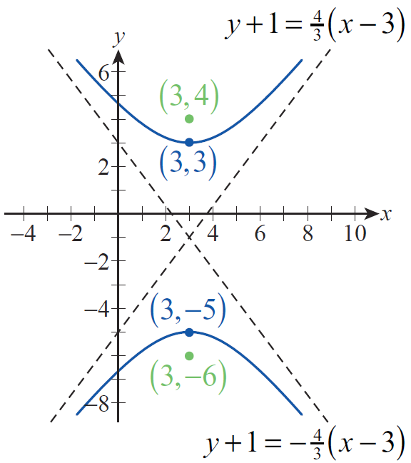
Example 5 (cont.)
To locate the foci, we first calculate c from the fact that c² = a² + b²; this gives us c = 5 in this case, so the two foci are the points (3, −1 − 5) = (3, −6) and (3, −1 +5) = (3, 4). Finally, the two asymptotes are the lines shown as dashed lines in Figure 13.
Figure 13

Slide 44
Rotating Conic Sections
Recall that the general form of the equation for a conic section is Ax² + Bxy + Cy² + Dx + Ey + F = 0. Geometrically, the condition B ≠ 0 leads to a conic that is not oriented vertically or horizontally. The ellipses, parabolas, and hyperbolas graphed so far have all been aligned so that the axis (or axes in the case of ellipses or hyperbolas) of symmetry is parallel to the x-axis or y-axis. If B ≠ 0, the graph is a conic section that has been rotated through some angle θ. We can exploit this fact to make the graphing of a rotated conic section relatively easy.

Slide 45
Rotating Conic Sections
Our method will be to introduce a new set of coordinate axes (i.e., a second Cartesian plane) rotated by an acute angle θ with respect to the original coordinate axes and then to graph the conic in the new coordinate system. Algebraically, the goal is to begin with an equation of the form
Ax² + Bxy + Cy² + Dx + Ey + F = 0
and define a new set of coordinate axes x′ and y′ in which the equation has the form

Slide 46
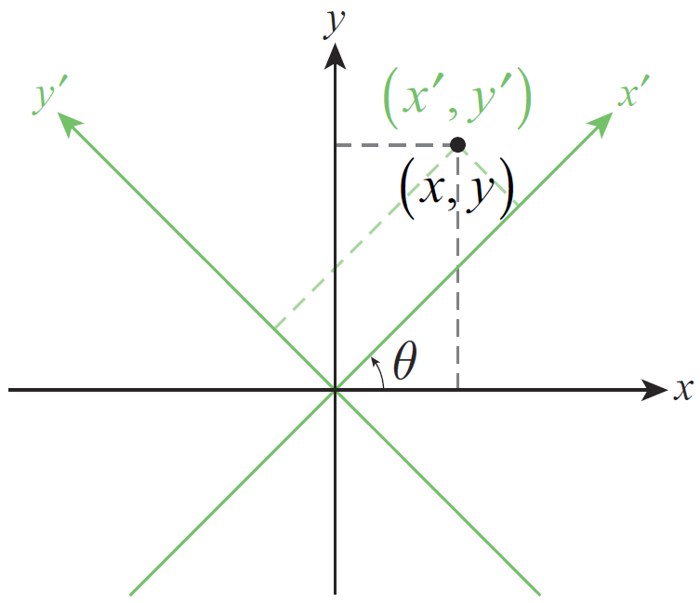
Rotating Conic Sections
We begin with a picture. Figure 14 is an illustration of two rectangular coordinate systems, with the new system rotated by an acute angle with respect to the original. The point in Figure 14 has two sets of coordinates corresponding to the two coordinate planes.
Figure 14 Two Coordinate Systems

Slide 47
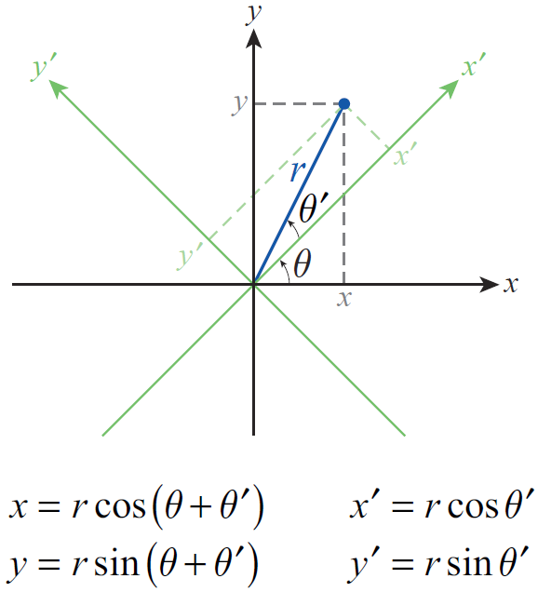
Rotating Conic Sections
However, the distance r between the origin and the point is the same in both, and this fact along with the introduction of the angle
θ ′ shown in Figure 15 allow us to relate the two sets of coordinates.
Figure 15 Relation between x′, y′, x, and y

Slide 48
Rotating Conic Sections
We can now apply one of the trigonometric identities.
Similarly,

Slide 49
Rotating Conic Sections
We will also need to be able to express x′ and y′ in terms of x and y, and we can do so through the clever application of another trigonometric identity. By multiplying the two equations we have just derived by respectively, and then adding the results, we obtain the following:

Slide 50
Formula: Rotation Relations
Rotation Relations
Given a rectangular coordinate system with axes x′ and y′ rotated by an acute angle θ with respect to axes x and y, as in Figure 14, the two sets of coordinates
(x′, y′) and (x, y) for the same point are related by the following equations:

Slide 51
Example 6
Given find the x′ y′-coordinates of the point with xy‑coordinates (−1, 5).
Solution
Using the rotation relations we calculate the x′ y′­coordinates as follows:

Slide 52
Example 6 (cont.)
The x′y′-coordinates are thus

Slide 53
Example 7
Use the rotation to show that the graph of
xy = 1 is a hyperbola.
Solution
Using the angle in the rotation relations, we convert the equation as follows:

Slide 54
Example 7 (cont.)

Slide 55
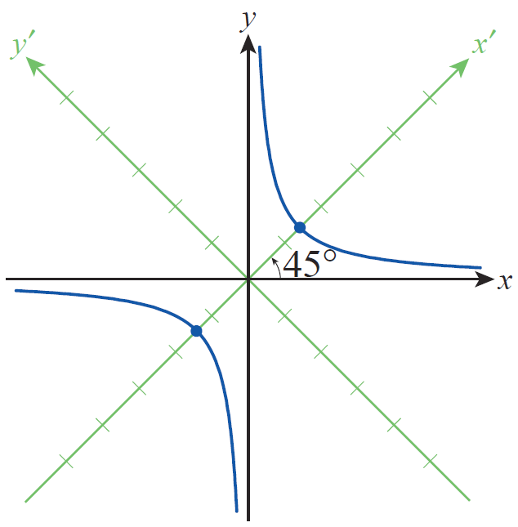
Example 7 (cont.)
We recognize this last equation as a hyperbola in the x′ y′-plane with its center at the origin and vertices away from the center on the x′‑axis. The asymptotes are which correspond to the x- and y-axes (see Figure 16).
Figure 16

Slide 56
Rotating Conic Sections
Remember that the goal in general is to determine θ so that the conversion of the equation
has no x′ y′-term.
We begin with the replacements:

Slide 57
Rotating Conic Sections
When the left-hand side of this equation is expanded and like terms collected, the result is an equation of the form

Slide 58
Rotating Conic Sections
where

Slide 59
Rotating Conic Sections
Since we want B′ = 0, this gives us an equation in 𝜃 to solve. To do so, we will use the double‑angle identities for both sine and cosine in reverse:

Slide 60
Definition: Elimination of the xy‑Term
Elimination of the xy‑Term
The graph of the equation
Ax² + Bxy + Cy² + Dx + Ey + F = 0 in the xy-plane is the same as the graph of the equation in the x′y′‑plane, where the acute angle of rotation θ between the two coordinate systems satisfies

Slide 61
Example 8
Graph the conic section by first determining the appropriate angle 𝜃 by which to rotate the axes.
Solution
Since the angle θ is to be acute, it must be the case that and hence

Slide 62
Example 8 (cont.)
By the rotation relations, then
and

Slide 63
Example 8 (cont.)
Making these substitutions into the equation, we obtain the following:

Slide 64
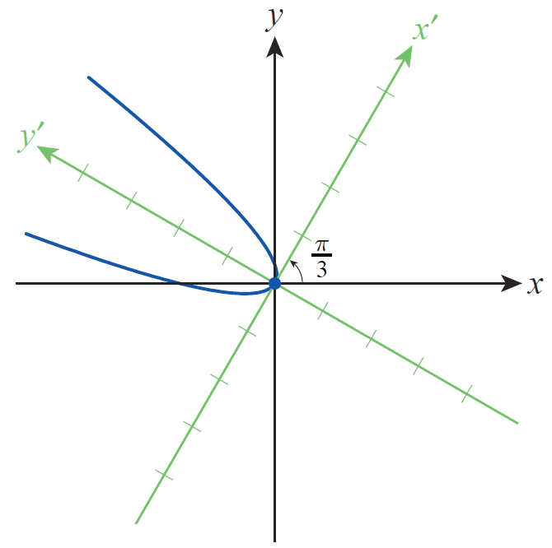
Example 8 (cont.)
Multiplying out and collecting like terms in this equation results in
which we recognize as the equation of a parabola with its vertex at the origin. The graph of this equation in the x′ y′-plane is shown in Figure 17.
Figure 17

