Slide 1
Section 9.6
Conic Sections in Polar Coordinates

Slide 2
TOPICS
The focus-directrix description of conic sections
Using the polar form of conic sections

Slide 3
The Focus-Directrix Description of Conic Sections
Probably the most striking virtue of equations of conics using polar coordinates is that the equations for the three types of conics all have the same form. The three varieties are easily identified, and the magnitude of a parameter e, called the eccentricity, determines whether the conic is an ellipse, a parabola, or a hyperbola.

Slide 4
The Focus-Directrix Description of Conic Sections
Throughout this section, we will assume that a point F, called the focus, lies at the origin of the plane and that a line L, called the directrix, lies d units away from the focus. Until we discuss rotated conics in polar form, the directrix will be oriented either vertically or horizontally, so the equation for the directrix will be x = −d, x = d, y = −d, or y = d. We will let D(P, F) denote the distance between a variable point P and the fixed focus F, and we will let D(P, L) denote the shortest distance between a variable point P and the fixed directrix L. The eccentricity e will be a fixed positive number for any given conic.

Slide 5
Theorem: Focus-Directrix Description of Conics
Focus-Directrix Description of Conics
Let D(P, F) denote the distance between a variable point P and the fixed focus F; and let D(P, L) denote the shortest distance between P and the fixed directrix L. A conic section consists of all points P in the plane that satisfy the equation
where e is a fixed positive constant.

Slide 6
Theorem: Focus-Directrix Description of Conics
Focus-Directrix Description of Conics (cont.)
1. The conic is an ellipse if 0 < e < 1.
2. The conic is a parabola if e = 1.
3. The conic is a hyperbola if e > 1.

Slide 7
The Focus-Directrix Description of Conic Sections
A conic section consists of all those points for which the ratio of the distance from the focus to the distance from the directrix is a fixed constant e. Figure 1 illustrates three conic sections that share the directrix x = −1 but with three different eccentricities. In all three graphs, the directrix appears in red and the focus in green.

Slide 8
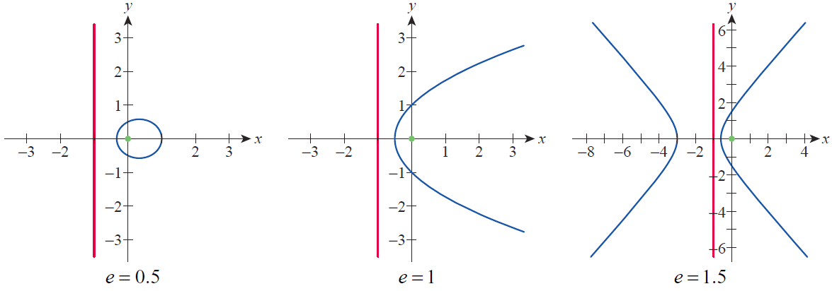
The Focus-Directrix Description of Conic Sections
Figure 1 Common Directrix and Focus, Three Eccentricities

Slide 9
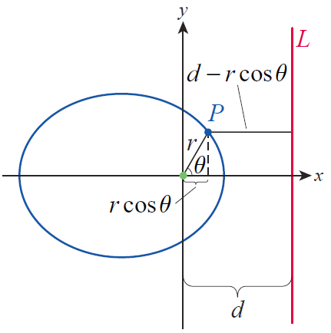
The Focus-Directrix Description of Conic Sections
The next step is to use the focus-directrix description to develop the form of the polar equations for conics. If we let (r, θ ) denote a point P on a given conic section, then D(P, F) = r. To determine D(P, L) consider the diagram in Figure 2, which depicts an ellipse and a directrix L of the form x = d.
Figure 2
Determining D(P, L)

Slide 10
The Focus-Directrix Description of Conic Sections
We see that so the equation in polar coordinates is
This equation will be more useful if we solve for r:

Slide 11
Theorem: Polar Forms of Conic Sections
Polar Forms of Conic Sections
In polar coordinates, a conic section with its focus at the origin and either a horizontal or vertical directrix has one of the following forms.

Slide 12
Theorem: Polar Forms of Conic Sections
Polar Forms of Conic Sections (cont.)
Equation of Conic Section | Directrix
 | Vertical directrix x = d
 | Vertical directrix x = −d
 | Horizontal directrix y = d
 | Horizontal directrix y = −d

Slide 13
Example 1
Identify the variety of conic and determine the equation of the directrix for each of the following conic sections.

Slide 14
Example 1 (cont.)
Solution
a. First we need to determine the two constants e and d, and we can accomplish this by algebraically manipulating the given equation. In order to have the correct form, the constant term in the denominator must be a 1.

Slide 15
Example 1a (cont.)
This tells us that so the conic is an ellipse. To determine the constant d, we need to write the numerator as a product of e and d. Since the numerator is 3 and since we now know we can do this as follows:

Slide 16
Example 1a (cont.)
Hence, d = 5. The last observation is that the trigonometric function in the denominator is cosine and the sign between the two terms in the denominator is negative. By the guidelines for conics in polar form, this tells us that x = −5 is the equation for the directrix.

Slide 17
Example 1 (cont.)
b. We use the same methods as above to determine first e and then d.
From this form, we can see that and that the directrix is Thus, the conic section is a hyperbola and the directrix is horizontal and above the x-axis.

Slide 18
Example 2
Construct a polar equation for a leftward-opening parabola with focus at the origin and directrix 2 units from the focus.
Solution
Since we are discussing a parabola, e = 1. If the parabola is to open to the left, the directrix must be oriented vertically and must lie to the right of the focus, so d = 2 and the trigonometric function in the denominator must be cosine. Thus, the equation is

Slide 19
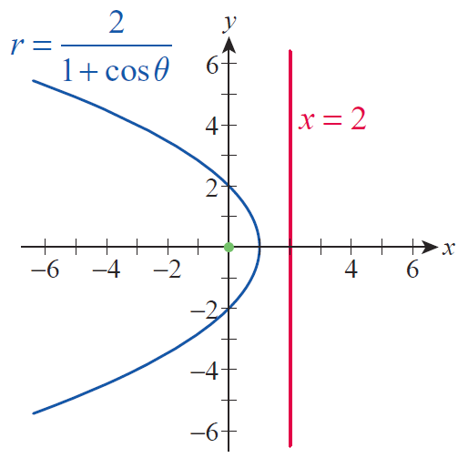
Example 2 (cont.)
The graph of the parabola appears in Figure 3, with the focus shown in green and the directrix in red.
Figure 3

Slide 20
Using the Polar Form of Conic Sections
The two constants e and d can be determined from the equation for a conic in polar form. In order to get an even better understanding of a given conic section, it may be useful to determine the constants a, b, and c as well. 2a is the distance between vertices of an ellipse or a hyperbola, 2b is the length of the minor axis of an ellipse, and 2c is the distance between foci of an ellipse or a hyperbola.

Slide 21
Using the Polar Form of Conic Sections
We begin with a. Eccentricity was earlier defined as e = c/a, and this relation still holds for the expanded definition of eccentricity that we now have. In originally discussing ellipses, we noted that c² = a² − b², which can be rewritten as b² = a² − c²; and in originally discussing hyperbolas, we noted that c² = a² + b², meaning that b² = c² − a². We can combine these two statements by noting that b is nonnegative and that b² = |a² – c²|. Note that if e = 1, a = c and, hence, b = 0; this should not be surprising, as b played no role in the original discussion of parabolas.

Slide 22
Example 3
Sketch the graph of the conic section
Solution
This is the first equation from Example 1, and we have already seen that the equation can be written in the following form:

Slide 23
Example 3 (cont.)
So d = 5, and the directrix is the line x = −5. This tells us that the graph is an ellipse and that the major axis is oriented horizontally (perpendicular to the directrix). The entire graph is traced out as θ increases from 0 to 2π, with the right vertex corresponding to
θ = 0, and the left vertex corresponding to θ = π (halfway around the ellipse). When θ = 0, and when θ = π ,
In rectangular coordinates, the coordinates of the right vertex are and the coordinates of the left vertex are (remember that θ = π, so a positive r corresponds to a point left of the origin).

Slide 24
Example 3 (cont.)
Now that we know the coordinates of the two vertices, we can determine that
and so Since and c = ea, this means
Finally, from the relation we can determine that

Slide 25
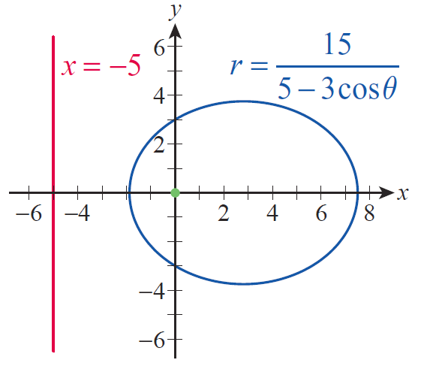
Example 3 (cont.)
With this knowledge of a and b, we can sketch the graph in Figure 4.
Figure 4

Slide 26
Example 4
Sketch the graph of the conic section
Solution
This is the second equation from Example 1, and we already know that and that is the equation for the directrix. This tells us that the graph is a hyperbola and that the vertices are aligned vertically (perpendicular again to the directrix).

Slide 27
Example 4 (cont.)
One vertex corresponds to θ = π /2 while the other vertex corresponds to θ = 3π/2 (it might also be useful to note that the lower branch of the hyperbola crosses the x-axis at θ = 0 and θ = π). When θ = π /2, and when θ = 3π /2, r = −1 (make note of the negative sign on r). This means that the rectangular coordinates of the two vertices are and (0, 1) so and From this, and the relation leads to The equations for the asymptotes of the hyperbola are

Slide 28
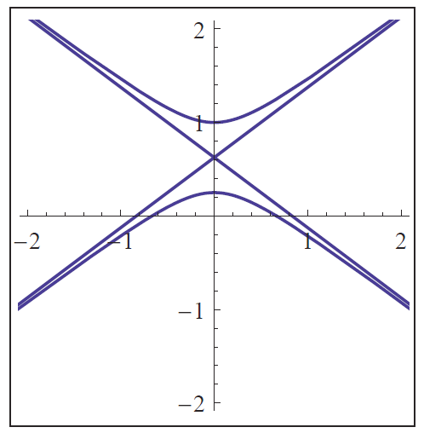
Example 4 (cont.)
A computer algebra system has been used to plot the given hyperbola (see Figure 5); the crossed straight lines running through are actually artifacts of the graphing algorithm, but they approximate the asymptotes.
Figure 5

Slide 29
Example 5
Sketch the graph of the conic section
Solution
We constructed the equation in Example 2, so we know its graph is a parabola opening to the left with directrix x = 2.

Slide 30
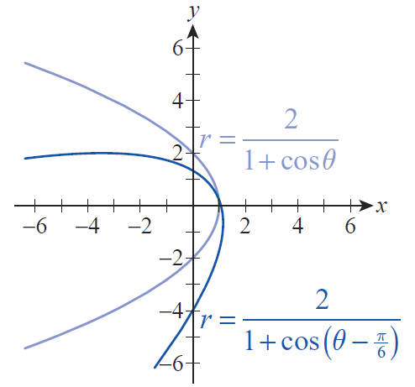
Example 5 (cont.)
The graph of
is the same shape rotated π/6 radians counterclockwise, as shown in Figure 6.
Figure 6

