Slide 1
Section 4.R.1
Introduction to Functions and Function Notation

Slide 2
Objectives
Find the domain and range of a relation.
Determine whether a relation is a function.
Use the vertical line test to determine whether a graph is the graph of a function.
Determine the domains of linear and nonlinear functions.
Evaluate functions written in function notation.
Use a graphing calculator to graph functions.

Slide 3
Relation, Domain, and Range
Definition
A relation is a set of ordered pairs of real numbers.
The domain, D, of a relation is the set of all first coordinates in the relation.
The range, R, of a relation is the set of all second coordinates in the relation.

Slide 4
Finding Domain and Range
Notes
The ordered pairs discussed in this text are ordered pairs of real numbers. However, more generally, ordered pairs might be other types of pairs such as (child, mother), (city, state), or (name, batting average).

Slide 5
Example 1: Finding the Domain and Range
Find the domain and range for each of the following relations.
g = {(5, 7), (6, 2), (6, 3), (−1, 2)}
Solution
Note that 6 is written only once in the domain and 2 is written only once in the range, even though each appears more than once in the relation.

Slide 6
Example 1: Finding the Domain and Range (cont.)
Find the domain and range for each of the following relations.
f = {(−1, 1), (1, 5), (0, 3)}
Solution

Slide 7
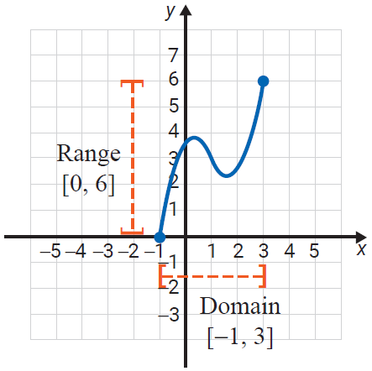
Example 2: Reading Domain and Range from the Graph of a Relation
Identify the domain and range from the graph of each relation.
The domain consists of the set of x-values for all points on the graph. In this case, the domain is the interval [−1, 3].
The range consists of the set of y-values for all points on the graph. In this case, the range is the interval [0, 6].

Slide 8
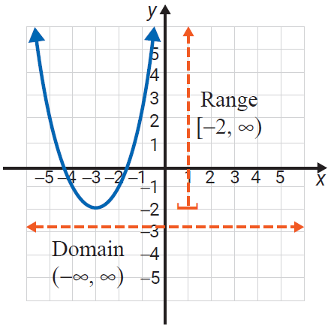
Example 2: Reading Domain and Range from the Graph of a Relation (cont.)
There is no restriction on the x-values which means that for every real number there is a point on the graph with that number as its x-value.
Thus the domain is the set of all real numbers: (−∞, ∞).
The y-values begin at −2 and then increase to infinity. The range is the interval [−2, ∞).

Slide 9
Functions
Definition
A function is a relation in which each domain element has exactly one corresponding range element.

Slide 10
Example 3: Determining if a Relation is a Function
Determine whether each of the following relations is a function.

Slide 11
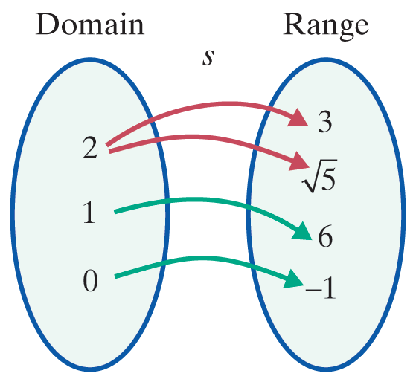
Example 3: Determining if a Relation is a Function (cont.)
Solution
s is not a function. The number 2 appears as a first coordinate more than once.

Slide 12
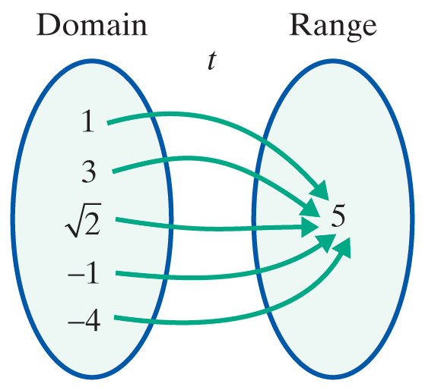
Example 3: Determining if a Relation is a Function (cont.)
t is a function. Each first coordinate appears only once. The fact that the second coordinates are all the same has no effect on the concept of a function.

Slide 13
Vertical Line Test
Procedure
If any vertical line intersects the graph of a relation at more than one point, then the relation is not a function.

Slide 14
Example 4: Using the Vertical Line Test
Use the vertical line test to determine whether each graph represents a function. Then list the domain and range of each graph.

Slide 15
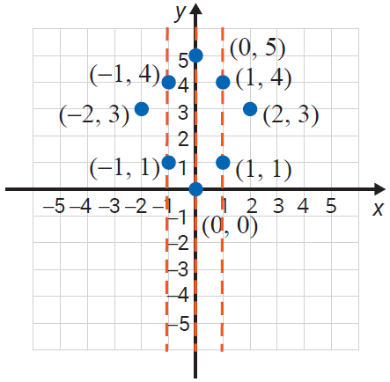
Example 4: Using the Vertical Line Test (cont.)
Solution
The relation is not a function since a vertical line can be drawn that intersects the graph at more than one point. Listing the ordered pairs shows that several x-coordinates appear more than once.
Here D = {−2 , −1, 0, 1, 2}
and R = {0, 1, 3, 4, 5}.

Slide 16
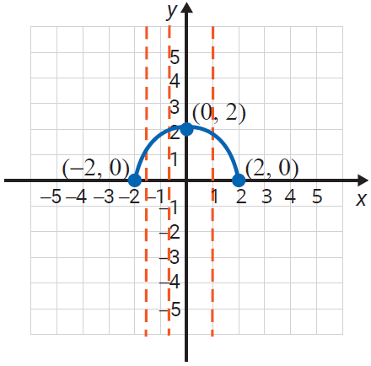
Example 4: Using the Vertical Line Test (cont.)
The relation is a function.
No vertical line will intersect
the graph at more than one
point. Several vertical lines are drawn to illustrate this.
For this function, we see
from the graph that
D = [−2, 2] and R = [0, 2].

Slide 17
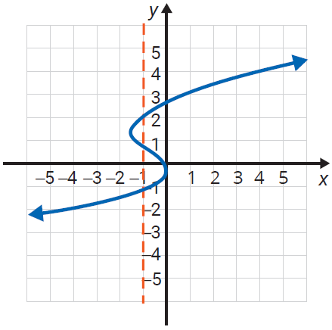
Example 4: Using the Vertical Line Test (cont.)
The relation is not a function.
At least one vertical line (drawn) intersects the graph at more than one point.
Here,
and

Slide 18
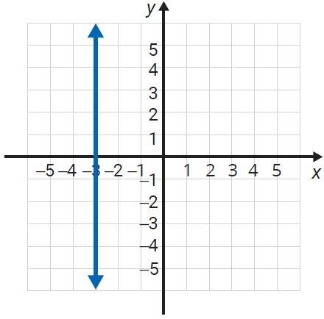
Example 4: Using the Vertical Line Test (cont.)
The relation is not a function. Every point has the same x‑value: x = −3. In fact, no vertical line is a function since every point will have the same x‑value.
Here,
and

Slide 19
Linear Functions
Definition
A linear function is a function represented by an equation of the form
y = mx + b.
The domain of a linear function is the set of all real numbers:

Slide 20
Finding Domains of Functions
Attention!
In determining the domain of a function, one fact to remember at this stage is that no denominator can equal 0. In future chapters we will discuss other nonlinear functions with limited domains.

Slide 21
Example 5: Finding the Domain of a Function
Find the domain for the function
Solution
The domain is all real numbers for which the
expression is defined. Thus, ,
or because the denominator is 0 when x = 5.
Note: Here interval notation tells us that x can be any real number except 5.

Slide 22
Example 6: Evaluating Functions
For the function g(x) = 4x + 5, find:
g(2)
g(−1)
g(0)
Solution
g(2) = 4(2) + 5 = 13
g(−1) = 4(−1) + 5 = 1
g(0) = 4(0) + 5 = 5

Slide 23
Example 7: Evaluating Nonlinear Functions
For the function h(x) = x² − 3x + 2, find:
h(4)
h(0)
h(−3)
Solution
h(4) = (4)² − 3(4) + 2 = 16 − 12 + 2 = 6
h(0) = (0)² − 3(0) + 2 = 0 − 0 + 2 = 2
h(−3) = (−3)² − 3(−3) + 2 = 9 + 9 + 2 = 20

Slide 24
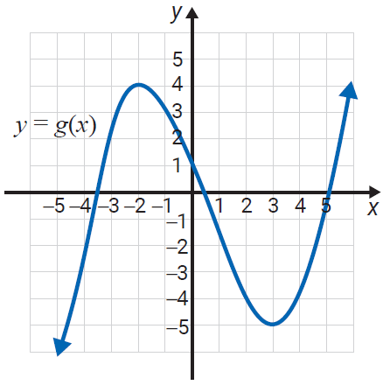
Example 8: Evaluating Functions From a Graph
Using the graph of g(x), find each of the following values.
g(−2)
g(0)
g(3)

Slide 25
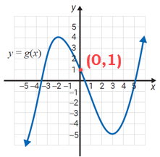
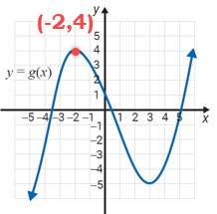
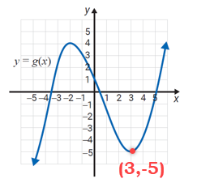
Example 8: Evaluating Functions From a Graph (cont.)
Solution
Using the graph, we need to find the y‑value that corresponds to each x‑value.
Thus, the function values are as follows.
g(−2) = 4
g(0) = 1
g(3) = −5

Slide 26
Example 9: Graphing Functions with a TI-84 Plus
Use a TI-84 Plus graphing calculator to find the graphs of each of the following functions. Use the CALC key to find the point where each graph intersects the x-axis. Changing the WINDOW may help you get a “better” or “more complete” picture of the function. This is a judgement call on your part.
3x + y = −1
y = 2x − 1; y = 2x + 1; y = 2x + 3

Slide 27

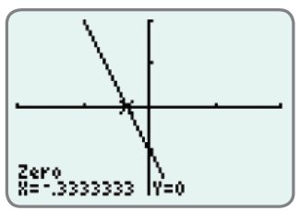
Example 9: Graphing Functions with a TI-84 Plus (cont.)
3x + y = −1
Solution
To have the calculator graph a nonvertical straight
line, you must first solve the equation for y. Solving
for y gives,
y = −3x − 1.
(It is important that the key be used to indicate the negative sign in front of 3x. This is not the same as the subtraction key.

Slide 28
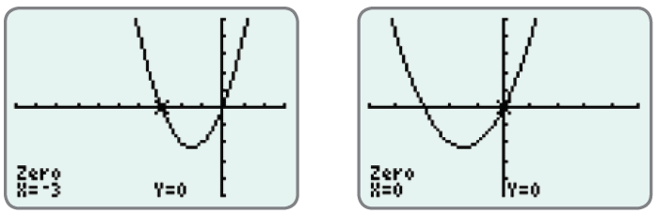
Example 9: Graphing Functions with a TI-84 Plus (cont.)
b.
Since the graph of this function has two x-intercepts,
we have shown the graph twice. Each graph shows
the coordinates of a distinct x-intercept.

Slide 29
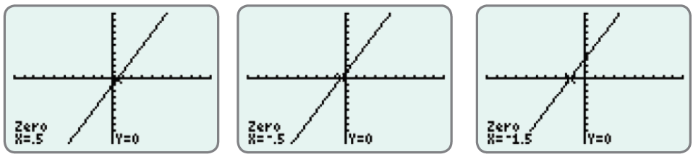
Example 9: Graphing Functions with a TI-84 Plus (cont.)
y = 2x − 1
y = 2x + 1
y = 2x + 3

Slide 30
Using a Graphing Calculator to Graph Functions
Notes
Vertical lines are not functions and cannot be graphed by the calculator in function mode.

Slide 31
Using a Graphing Calculator to Graph Functions
Notes
The standard window shows 96 pixels across the window and 64 pixels up and down the window. This gives a ratio of 3 to 2 and can give a slightly distorted view of the actual graph because the vertical pixels are squeezed into a smaller space. For Example 9c, the graphs of all three functions are in the standard window. Experiment by changing the window to a square window, say −9 to 9 for x and −6 to 6 for y.

Slide 32
Using a Graphing Calculator to Graph Functions
Notes (cont.)
Then graph the functions and notice the slight differences (and better representation) in the appearances on the display.

