Slide 1
Section 1.3
Properties of Exponents

Slide 2
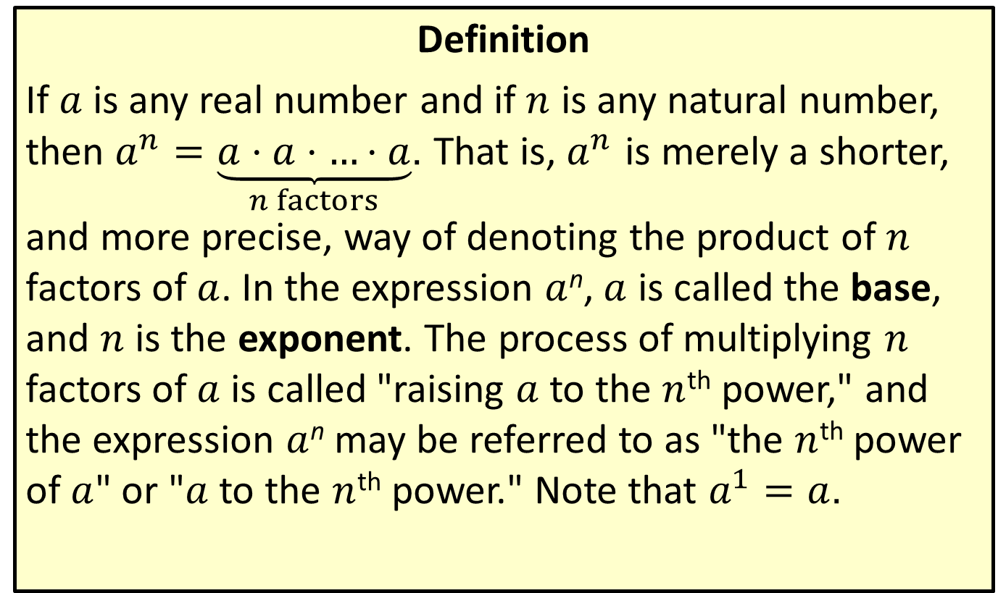
Natural Number Exponents
Definition
If $a$ is any real number and if $n$ is any natural number, then $a^{n}=\underset{n factors}{\underbrace{a⋅a⋅…⋅a}}$. That is, $a^{n}$ is merely a shorter, and more precise, way of denoting the product of $n$ factors of $a$. In the expression $a$^{n}, $a$ is called the base, and $n$ is the exponent. The process of multiplying $n$ factors of $a$ is called "raising $a$ to the $n$^{th} power," and the expression $a$^{n} may be referred to as "the $n$^{th} power of $a$" or "$a$ to the $n$^{th} power." Note that $a^{1}=a$.

Slide 3
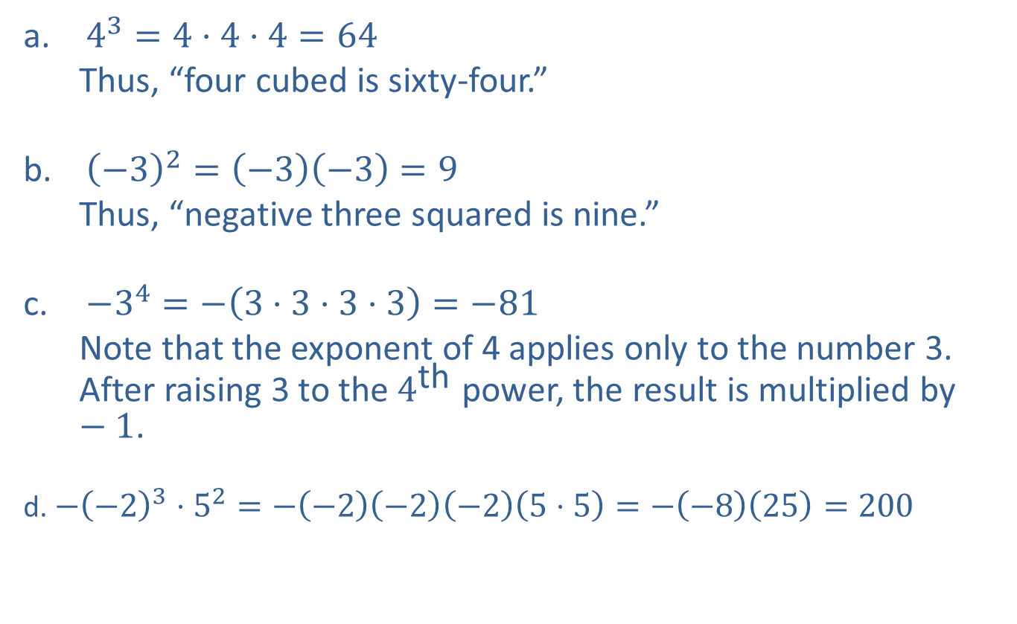
Example 1: Using Natural Number Exponents
​$4^{3}=4⋅4⋅4=64$
Thus, “four cubed is sixty-four.”
​${\left(−3\right)}^{2}=\left(−3\right)\left(−3\right)=9$
Thus, “negative three squared is nine.”
​$−3^{4}=−\left(3⋅3⋅3⋅3\right)=−81$
Note that the exponent of 4 applies only to the number 3. After raising 3 to the $4^{\text{th}}$ power, the result is multiplied by $−1$.
d. $−{\left(−2\right)}^{3}⋅5^{2}=−\left(−2\right)\left(−2\right)\left(−2\right)\left(5⋅5\right)=−\left(−8\right)\left(25\right)=200$
​

Slide 4
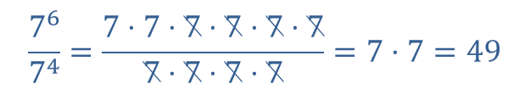
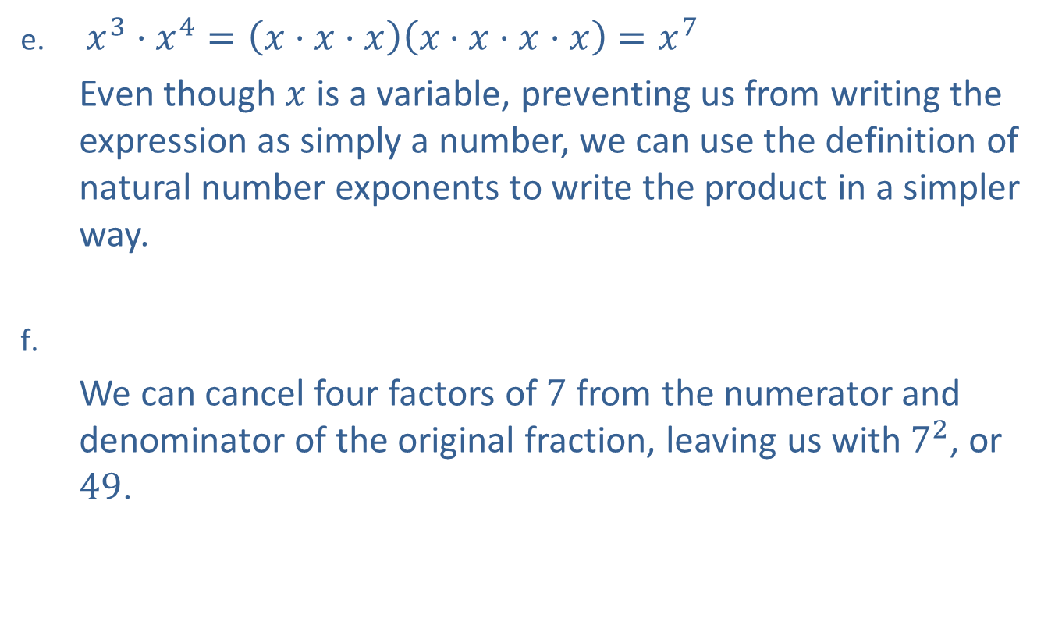
Example 1: Using Natural Number Exponents (cont.)
​$x^{3}⋅x^{4}=\left(x⋅x⋅x\right)\left(x⋅x⋅x⋅x\right)=x^{7}$
Even though $x$ is a variable, preventing us from writing the expression as simply a number, we can use the definition of natural number exponents to write the product in a simpler way.
​
We can cancel four factors of 7 from the numerator and denominator of the original fraction, leaving us with $7^{2}$, or 49.
$$\frac{7^{6}}{7^{4}}=\frac{7⋅7⋅7⋅7⋅7⋅7}{7⋅7⋅7⋅7}=7⋅7=49$$

Slide 5
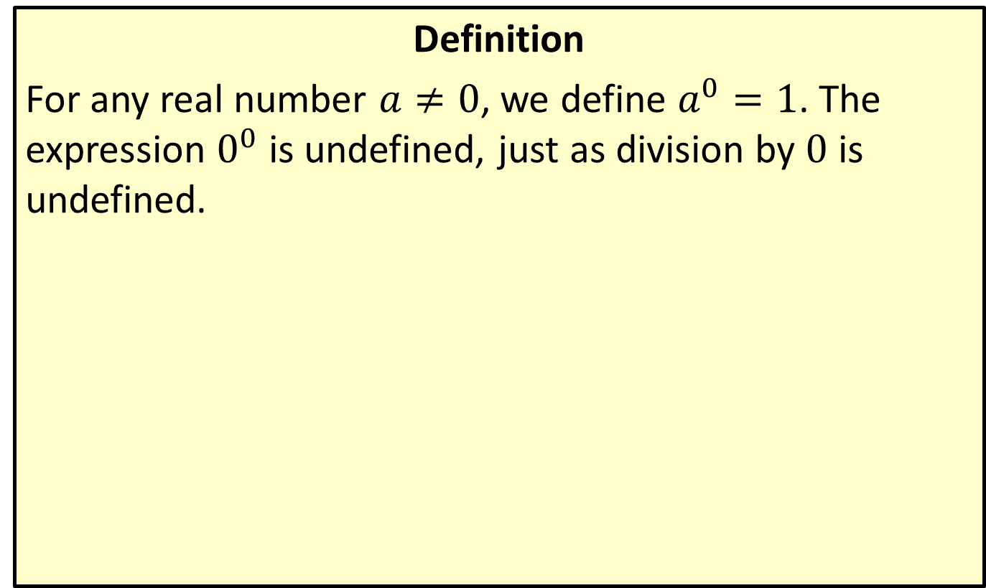
0 as an Exponent
Definition
For any real number $a≠0$, we define $a^{0}=1$. The expression $0^{0}$ is undefined, just as division by 0 is undefined.

Slide 6
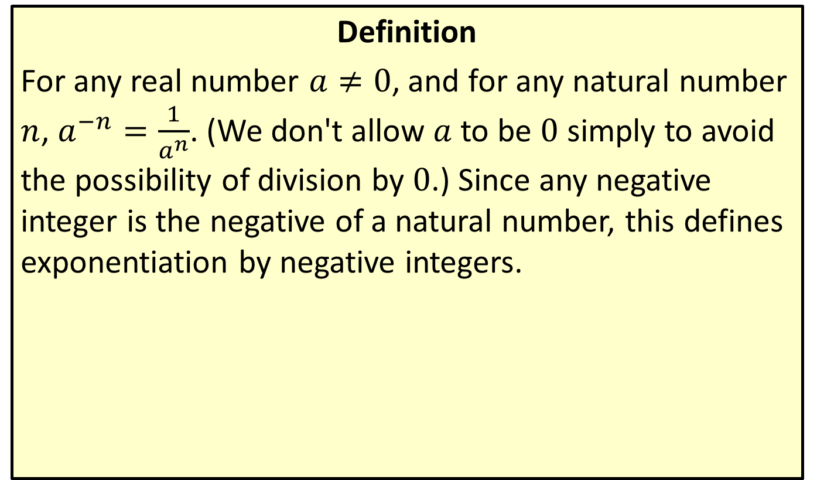
Negative Integer Exponents
Definition
For any real number $a≠0$, and for any natural number $n$, $a^{−n}=\frac{1}{a^{n}}$. (We don't allow $a$ to be 0 simply to avoid the possibility of division by 0.) Since any negative integer is the negative of a natural number, this defines exponentiation by negative integers.

Slide 7
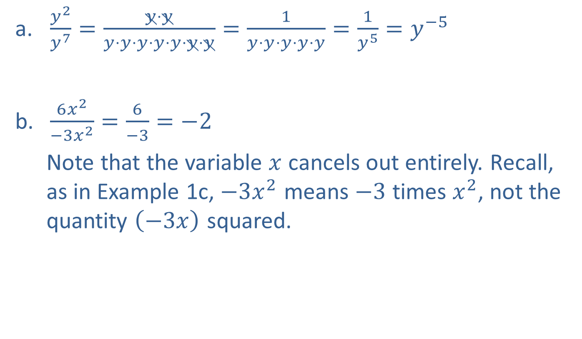
Example 2: Simplifying Exponents
​$\frac{y^{2}}{y^{7}}=\frac{y⋅y}{y⋅y⋅y⋅y⋅y⋅y⋅y}=\frac{1}{y⋅y⋅y⋅y⋅y}=\frac{1}{y^{5}}=y^{−5}$
​$\frac{6x^{2}}{−3x^{2}}=\frac{6}{−3}=−2$
Note that the variable $x$ cancels out entirely. Recall, as in Example 1c, $−3x^{2}$ means $−3$ times $x^{2}$, not the quantity $\left(−3x\right)$ squared.
​

Slide 8

Example 2: Simplifying Exponents (cont.)
c. ​ $5^{0}⋅5^{−3}=5^{0−3}=5^{−3}=\frac{1}{125}$
Note that $5^{0}=1$, as does $a^{0}$ for any $a≠0$.
​$\frac{1}{t^{−3}}=\frac{1}{\frac{1}{t^{3}}}=1⋅\frac{t^{3}}{1}=t^{3}$
​${\left(x^{2}y\right)}^{3}=\left(x^{2}y\right)\left(x^{2}y\right)\left(x^{2}y\right)=x^{2}⋅x^{2}⋅x^{2}⋅y⋅y⋅y=x^{6}y^{3}$

Slide 9
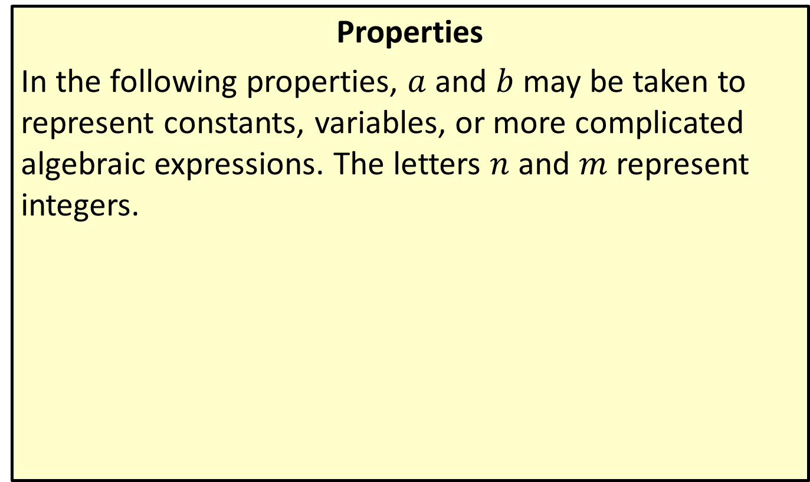
Properties of Exponents
Properties
In the following properties, $a$ and $b$ may be taken to represent constants, variables, or more complicated algebraic expressions. The letters $n$ and $m$ represent integers.

Slide 10
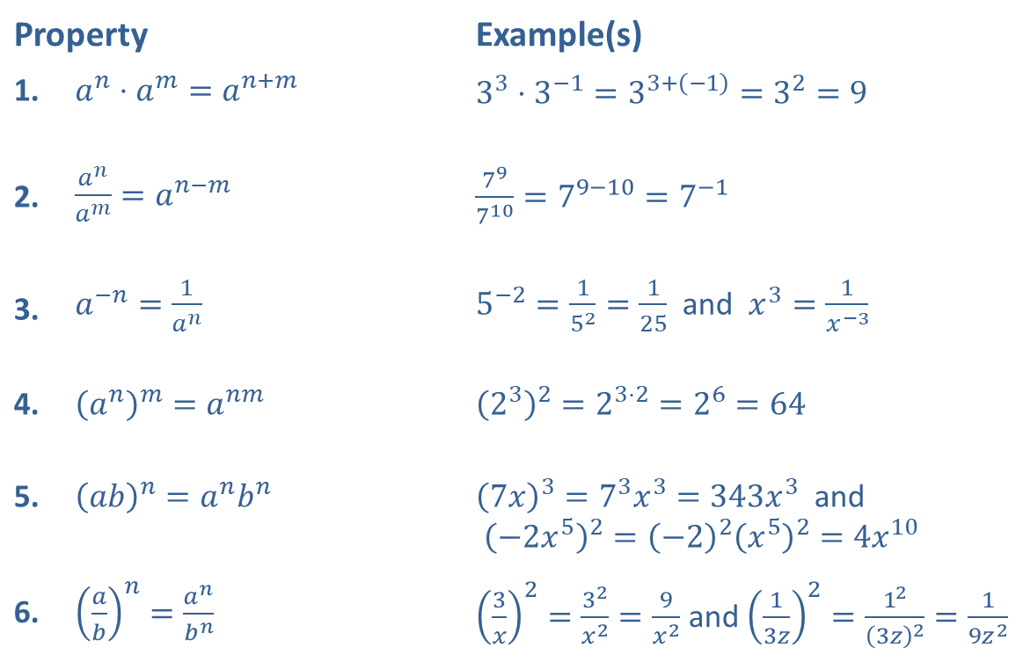
Properties of Exponents (cont.)
Property |  | Example(s)
1. | ​$a^{n}⋅a^{m}=a^{n+m}$ | ​$3^{3}⋅3^{−1}=3^{3+\left(−1\right)}=3^{2}=9$
2. | ​$\frac{a^{n}}{a^{m}}=a^{n−m}$ | ​$\frac{7^{9}}{7^{10}}=7^{9−10}=7^{−1}$
3. | ​$a^{−n}=\frac{1}{a^{n}}$ | ​$5^{−2}=\frac{1}{5^{2}}=\frac{1}{25}$ and $x^{3}=\frac{1}{x^{−3}}$
4. | ​${\left(a^{n}\right)}^{m}=a^{nm}$ | ​${\left(2^{3}\right)}^{2}=2^{3⋅2}=2^{6}=64$
5. | ​${\left(ab\right)}^{n}=a^{n}b^{n}$ | ​${\left(7x\right)}^{3}=7^{3}x^{3}=343x^{3}$ and ${\left(−2x^{5}\right)}^{2}={\left(−2\right)}^{2}{\left(x^{5}\right)}^{2}=4x^{10}$
6. | ​${\left(\frac{a}{b}\right)}^{n}=\frac{a^{n}}{b^{n}}$ | ​${\left(\frac{3}{x}\right)}^{2}=\frac{3^{2}}{x^{2}}=\frac{9}{x^{2}}$ and ${\left(\frac{1}{3z}\right)}^{2}=\frac{1^{2}}{{\left(3z\right)}^{2}}=\frac{1}{9z^{2}}$

Slide 11
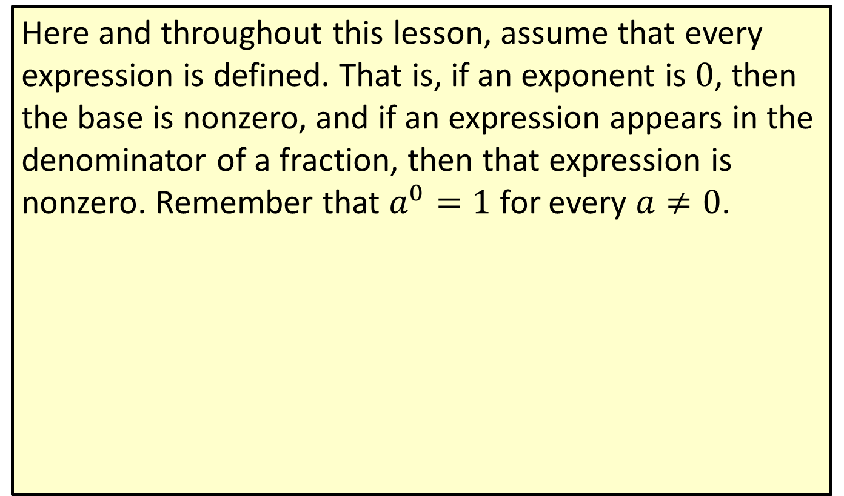
Properties of Exponents (cont.)
Here and throughout this lesson, assume that every expression is defined. That is, if an exponent is 0, then the base is nonzero, and if an expression appears in the denominator of a fraction, then that expression is nonzero. Remember that $a^{0}=1$ for every $a≠0$.

Slide 12
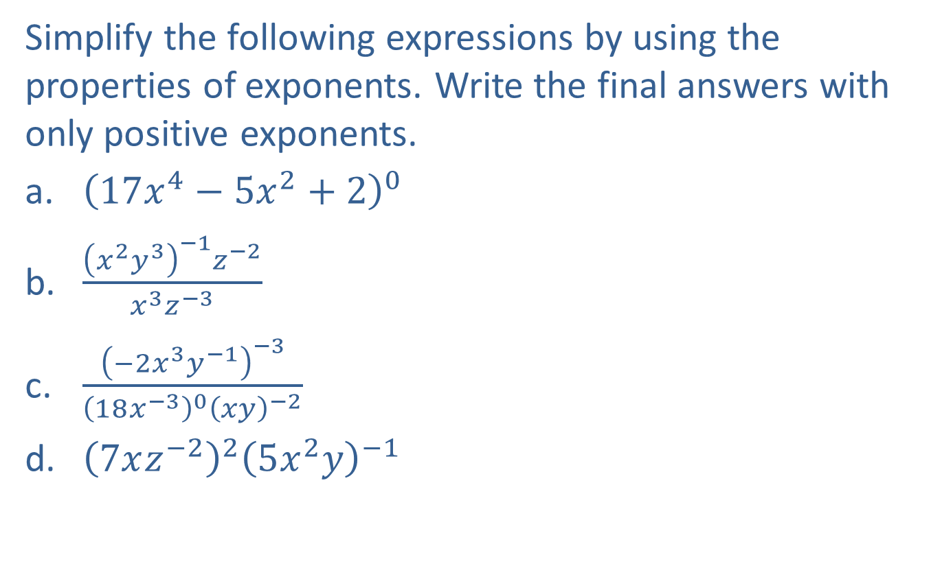
Example 3: Using Properties of Exponents
Simplify the following expressions by using the properties of exponents. Write the final answers with only positive exponents.
​${\left(17x^{4}−5x^{2}+2\right)}^{0}$
​$\frac{{\left(x^{2}y^{3}\right)}^{−1}z^{−2}}{x^{3}z^{−3}}$
​$\frac{{\left(−2x^{3}y^{−1}\right)}^{−3}}{{\left(18x^{−3}\right)}^{0}{\left(xy\right)}^{−2}}$
​${\left(7xz^{−2}\right)}^{2}{\left(5x^{2}y\right)}^{−1}$

Slide 13
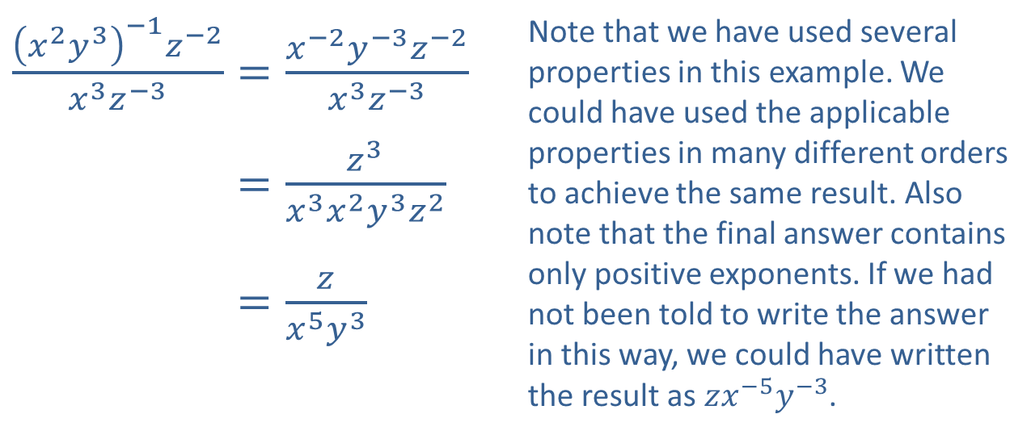

Example 3: Using Properties of Exponents (cont.)
Solution
​${\left(17x^{4}−5x^{2}+2\right)}^{0}=1$
Any nonzero expression with an exponent of 0 is 1.
​
​$\frac{{\left(x^{2}y^{3}\right)}^{−1}z^{−2}}{x^{3}z^{−3}}=\frac{x^{−2}y^{−3}z^{−2}}{x^{3}z^{−3}}$ | Note that we have used several properties in this example. We could have used the applicable properties in many different orders to achieve the same result. Also note that the final answer contains only positive exponents. If we had not been told to write the answer in this way, we could have written the result as $zx^{−5}y^{−3}$.
​𝑥2𝑦3−1𝑧−2𝑥3𝑧−3=𝑧3𝑥3𝑥2𝑦3𝑧2
​𝑥2𝑦3−1𝑧−2𝑥3𝑧−3=𝑧𝑥5𝑦3

Slide 14
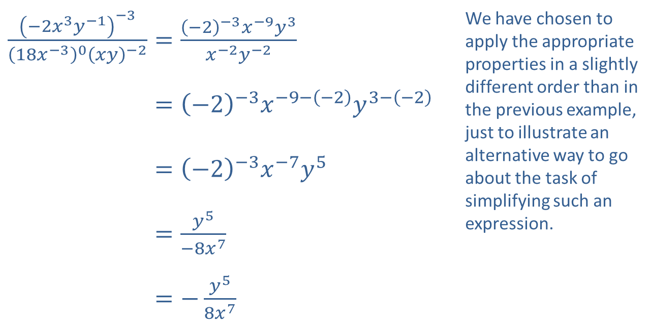
Example 3: Using Properties of Exponents (cont.)
​$\frac{{\left(−2x^{3}y^{−1}\right)}^{−3}}{{\left(18x^{−3}\right)}^{0}{\left(xy\right)}^{−2}}=\frac{{\left(−2\right)}^{−3}x^{−9}y^{3}}{x^{−2}y^{−2}}$ | We have chosen to apply the appropriate properties in a slightly different order than in the previous example, just to illustrate an alternative way to go about the task of simplifying such an expression.
​−2𝑥3𝑦−1−318𝑥−30𝑥𝑦−2=−2−3𝑥−9−−2𝑦3−−2
​−2𝑥3𝑦−1−318𝑥−30𝑥𝑦−2=−2−3𝑥−7𝑦5
​−2𝑥3𝑦−1−318𝑥−30𝑥𝑦−2=𝑦5−8𝑥7
​−2𝑥3𝑦−1−318𝑥−30𝑥𝑦−2=−𝑦58𝑥7
c. ​

Slide 15
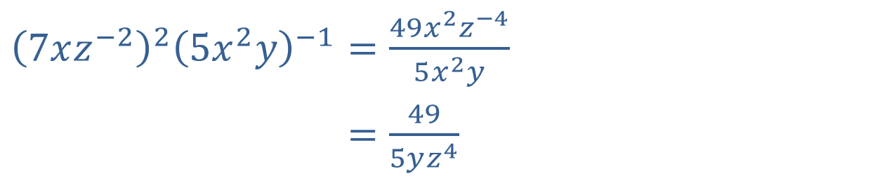
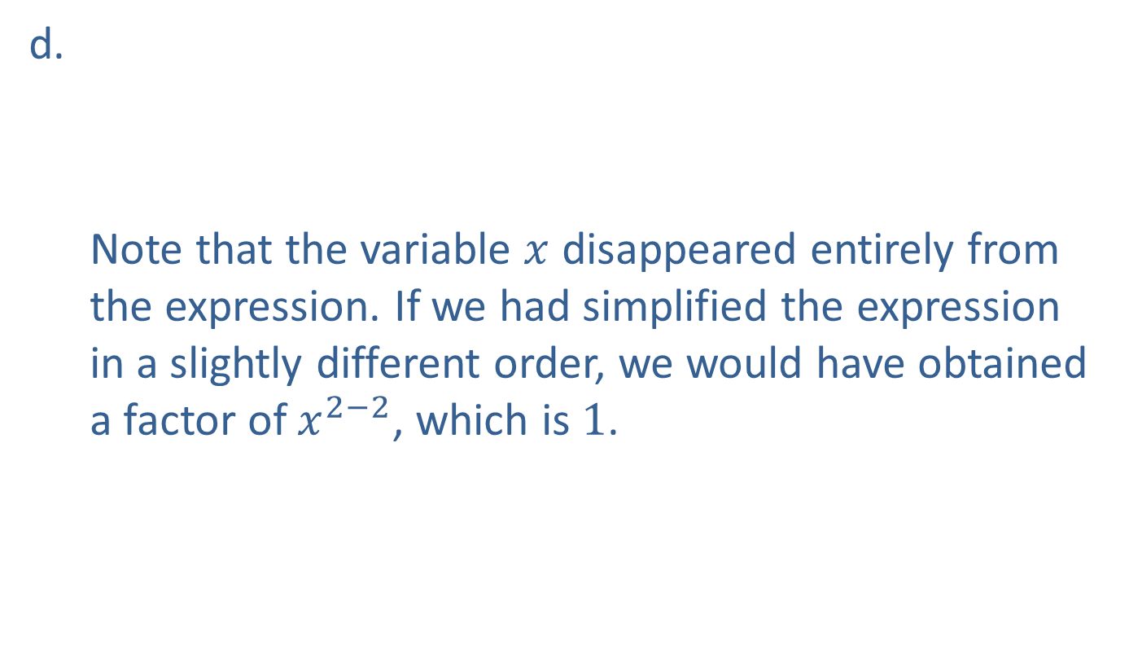
Example 3: Using Properties of Exponents (cont.)
​${\left(7xz^{−2}\right)}^{2}{\left(5x^{2}y\right)}^{−1}=\frac{49x^{2}z^{−4}}{5x^{2}y}$
​7𝑥𝑧−225𝑥2𝑦−1=495𝑦𝑧4
d.
Note that the variable $x$ disappeared entirely from the expression. If we had simplified the expression in a slightly different order, we would have obtained a factor of $x^{2−2}$, which is 1.
​

Slide 16
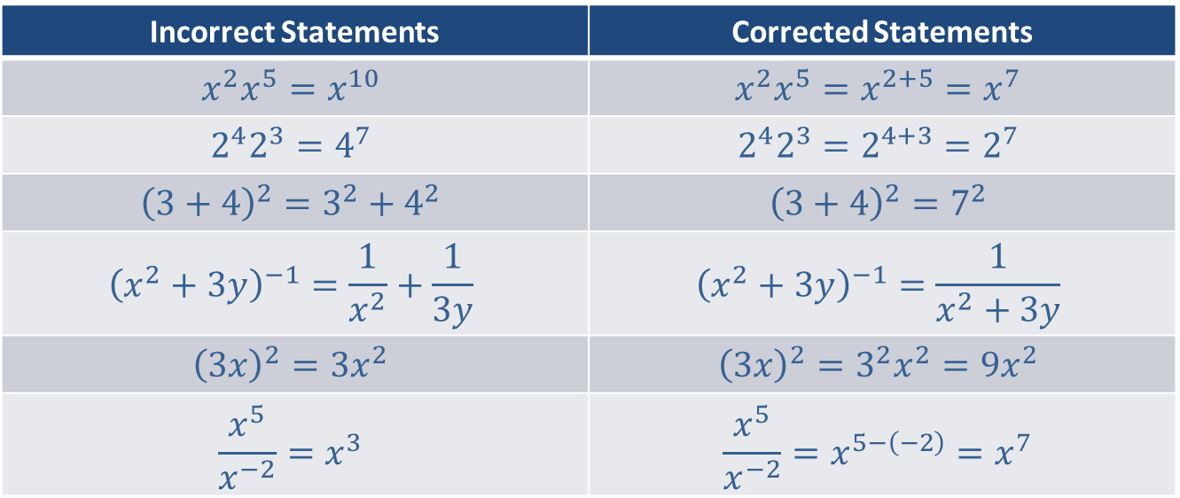
CAUTION!
Many common errors result from forgetting the exact forms of the properties of exponents, as shown below.
Incorrect Statements | Corrected Statements
$$x^{2}x^{5}=x^{10}$$ | $$x^{2}x^{5}=x^{2+5}=x^{7}$$
$$2^{4}2^{3}=4^{7}$$ | $$2^{4}2^{3}=2^{4+3}=2^{7}$$
$${\left(3+4\right)}^{2}=3^{2}+4^{2}$$ | $${\left(3+4\right)}^{2}=7^{2}$$
$${\left(x^{2}+3y\right)}^{−1}=\frac{1}{x^{2}}+\frac{1}{3y}$$ | $${\left(x^{2}+3y\right)}^{−1}=\frac{1}{x^{2}+3y}$$
$${\left(3x\right)}^{2}=3x^{2}$$ | $${\left(3x\right)}^{2}=3^{2}x^{2}=9x^{2}$$
$$\frac{x^{5}}{x^{−2}}=x^{3}$$ | $$\frac{x^{5}}{x^{−2}}=x^{5−\left(−2\right)}=x^{7}$$

Slide 17
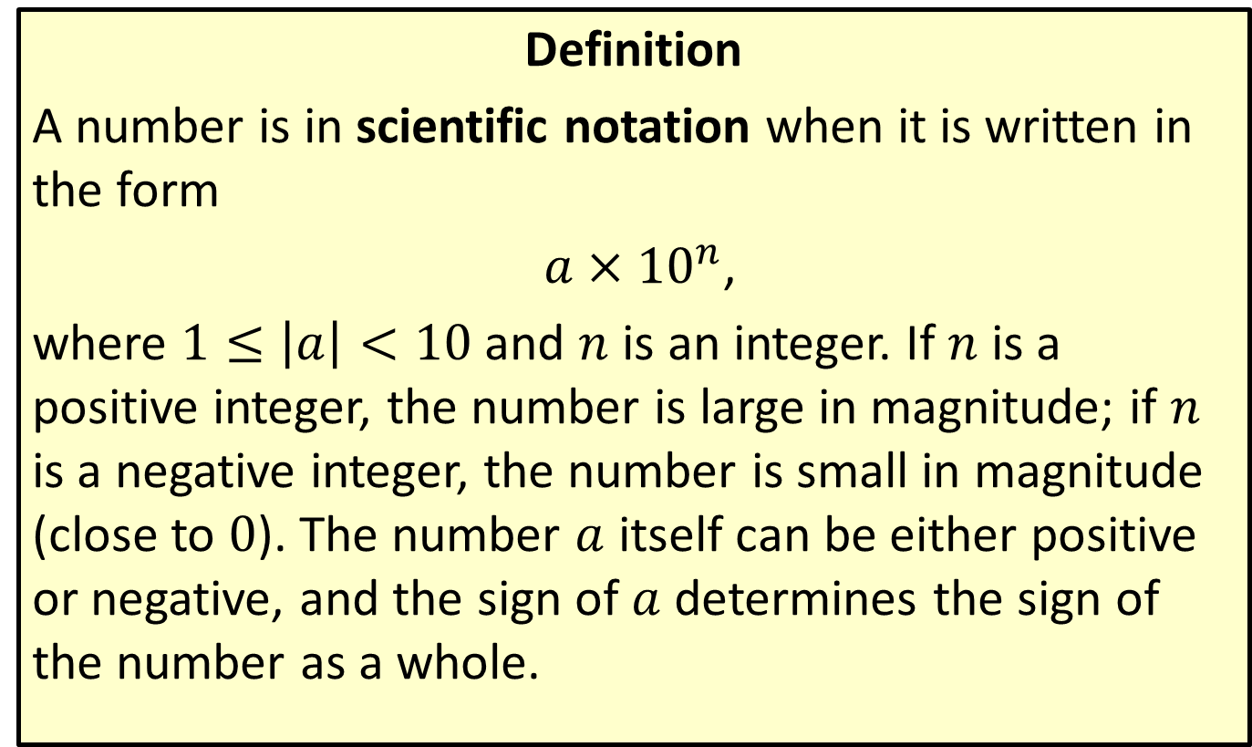
Scientific Notation
Definition
A number is in scientific notation when it is written in the form
$a×{10}^{n}$,
where $1≤\left|a\right|<10$ and $n$ is an integer. If $n$ is a positive integer, the number is large in magnitude; if $n$ is a negative integer, the number is small in magnitude (close to 0). The number $a$ itself can be either positive or negative, and the sign of $a$ determines the sign of the number as a whole.

Slide 18
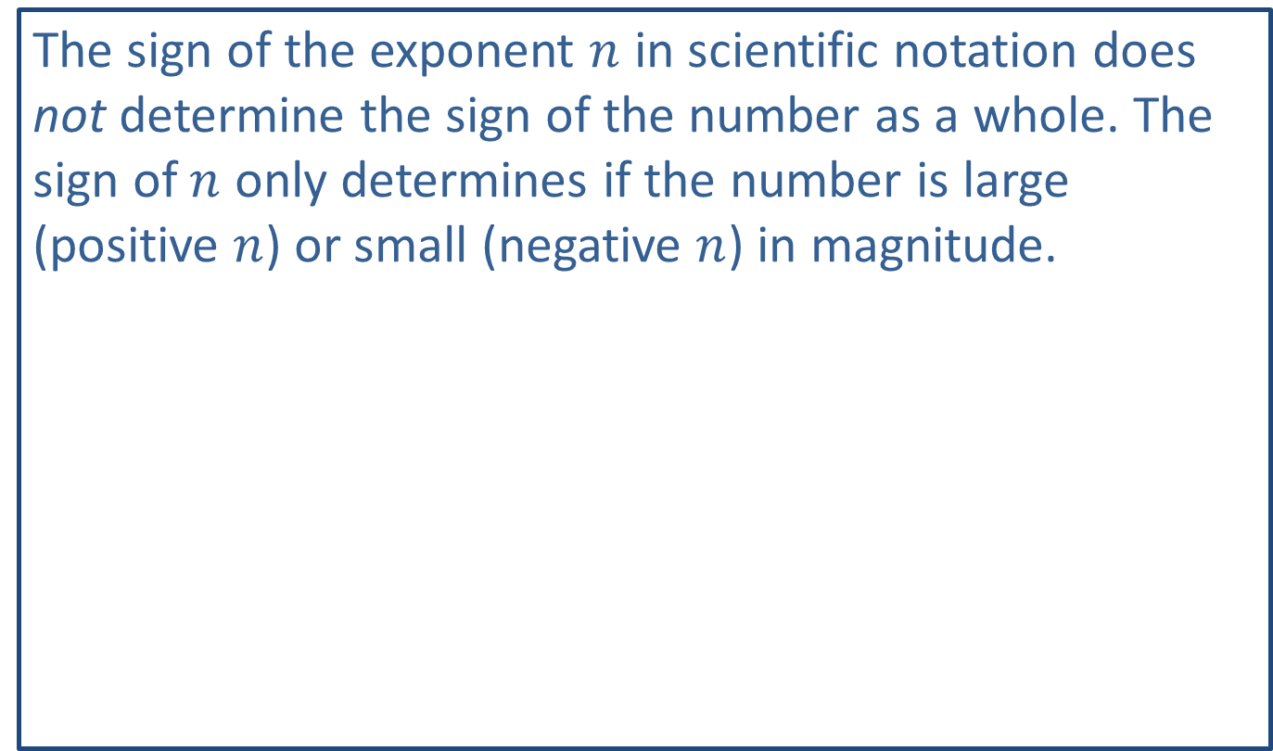
CAUTION!
The sign of the exponent $n$ in scientific notation does not determine the sign of the number as a whole. The sign of $n$ only determines if the number is large (positive $n$) or small (negative $n$) in magnitude.

Slide 19
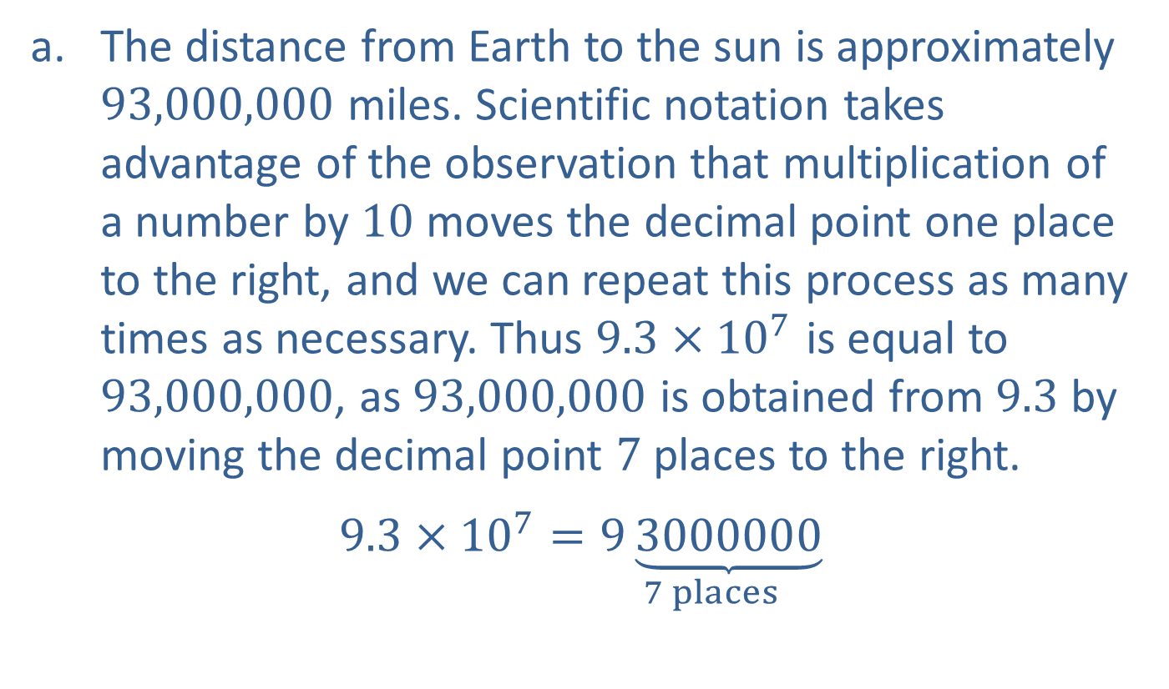
Example 4: Using Scientific Notation
​The distance from Earth to the sun is approximately 93,000,000 miles. Scientific notation takes advantage of the observation that multiplication of a number by 10 moves the decimal point one place to the right, and we can repeat this process as many times as necessary. Thus $9.3×{10}^{7}$ is equal to 93,000,000, as 93,000,000 is obtained from 9.3 by moving the decimal point 7 places to the right.
​$9.3×{10}^{7}=\underset{7 places}{9\underbrace{3000000}}$
​

Slide 20
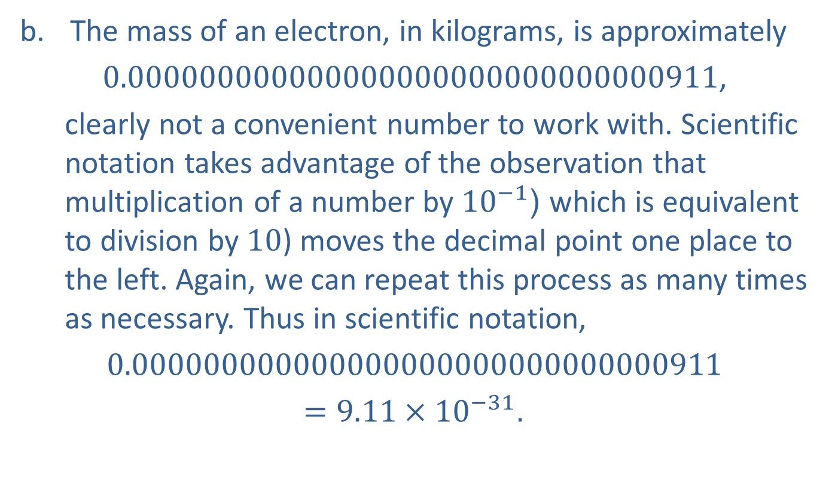
Example 4: Using Scientific Notation (cont.)
​The mass of an electron, in kilograms, is approximately
​0.000000000000000000000000000000911,
clearly not a convenient number to work with. Scientific notation takes advantage of the observation that multiplication of a number by ${10}^{−1}$ (which is equivalent to division by 10) moves the decimal point one place to the left. Again, we can repeat this process as many times as necessary. Thus in scientific notation,
​$0.000000000000000000000000000000911$
$=9.11×{10}^{−31}$.

Slide 21

Example 4: Using Scientific Notation (cont.)
​The speed of light in a vacuum is approximately $3×{10}^{8}$ meters per second. In standard (nonscientific) notation, this number is written as 300,000,000.

Slide 22
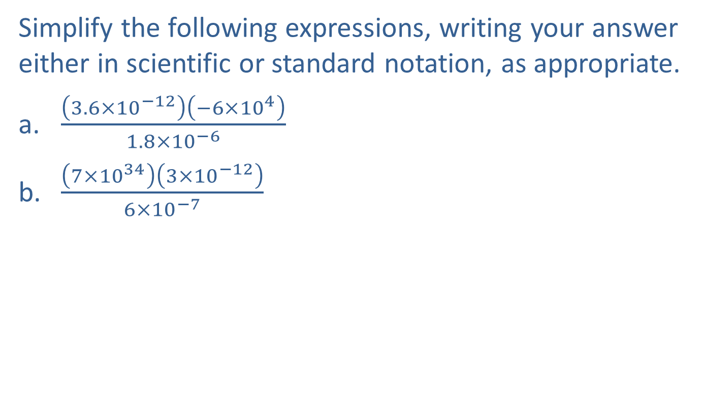
Example 5: Simplifying Expressions with Scientific Notation
Simplify the following expressions, writing your answer either in scientific or standard notation, as appropriate.
​$\frac{\left(3.6×{10}^{−12}\right)\left(−6×{10}^{4}\right)}{1.8×{10}^{−6}}$
​$\frac{\left(7×{10}^{34}\right)\left(3×{10}^{−12}\right)}{6×{10}^{−7}}$

Slide 23
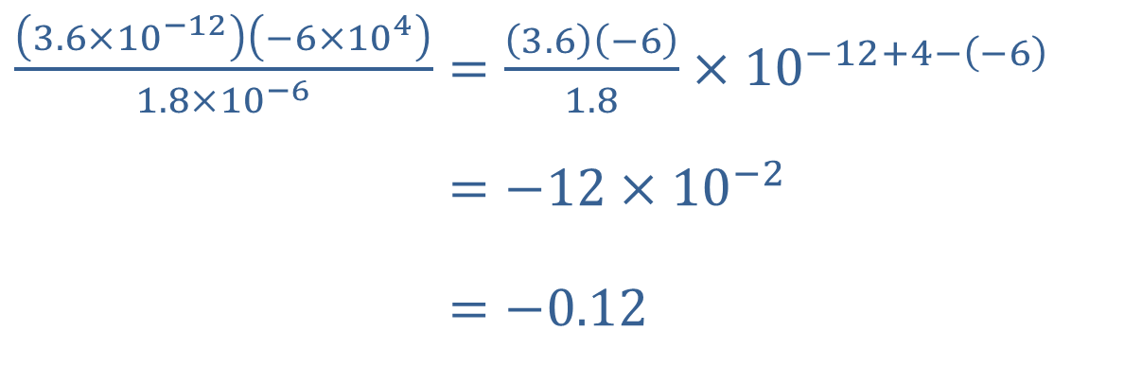

Example 5: Simplifying Expressions with Scientific Notation (cont.)
Solution
​
We have written the final answer in standard notation (as it is not inconvenient to do so). Note that in scientific notation, it would be written as $−1.2×{10}^{−1}$.
​$\frac{\left(3.6×{10}^{−12}\right)\left(−6×{10}^{4}\right)}{1.8×{10}^{−6}}=\frac{\left(3.6\right)\left(−6\right)}{1.8}×{10}^{−12+4−\left(−6\right)}$
​3.6×10−12−6×1041.8×10−6=−12×10−2
​3.6×10−12−6×1041.8×10−6=−0.12

Slide 24
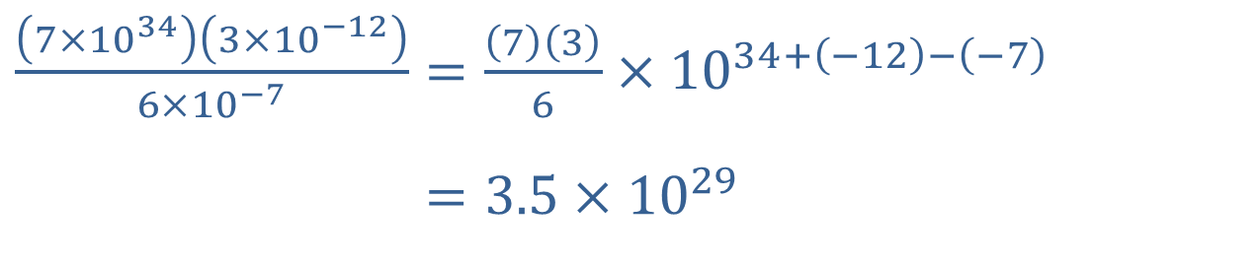
Example 5: Simplifying Expressions with Scientific Notation (cont.)
​$\frac{\left(7×{10}^{34}\right)\left(3×{10}^{−12}\right)}{6×{10}^{−7}}=\frac{\left(7\right)\left(3\right)}{6}×{10}^{34+\left(−12\right)−\left(−7\right)}$
​7×10343×10−126×10−7=3.5×1029
​
This answer is best written in scientific notation.

Slide 25
Example 6: Using Geometric Formulas
Find formulas for each of the following:
​The surface area of a box
​The surface area of a soup can
​The volume of a birdbath in the shape of half of a sphere
​The volume of a gold ingot whose shape is a right trapezoidal cylinder

Slide 26
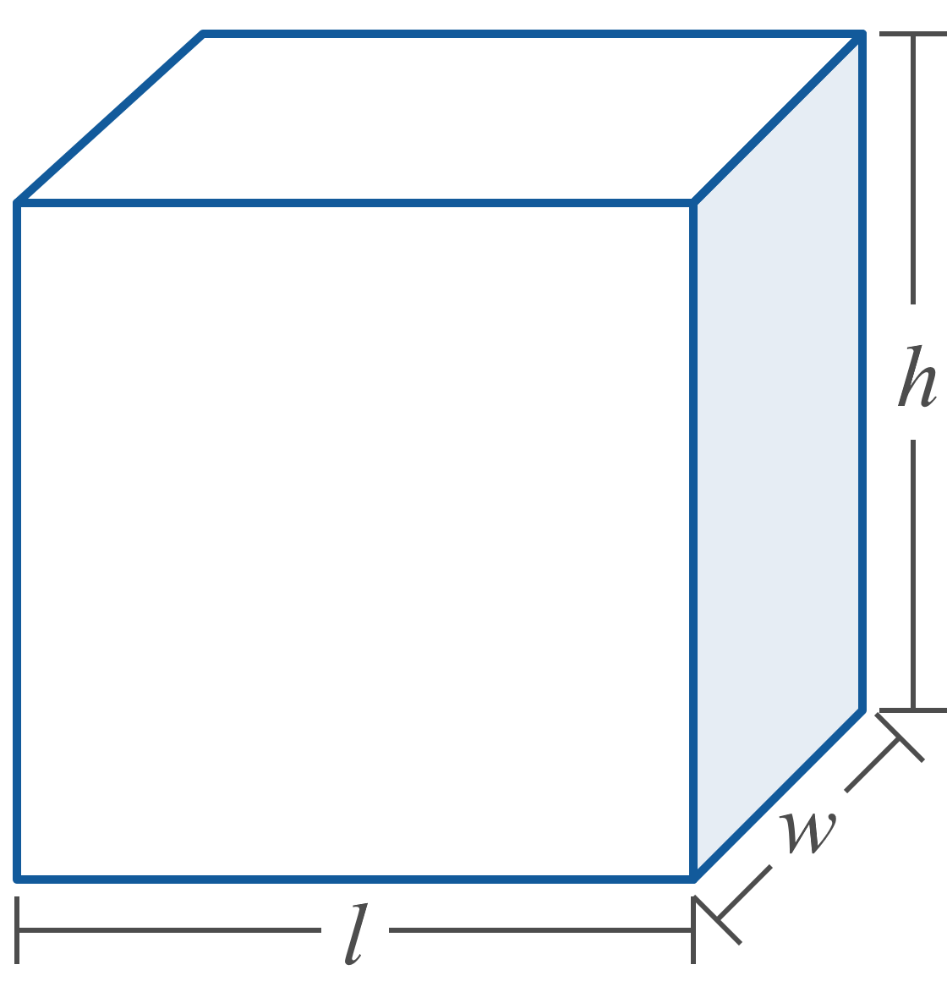
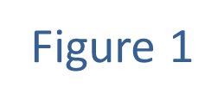
Example 6: Using Geometric Formulas (cont.)

Slide 27
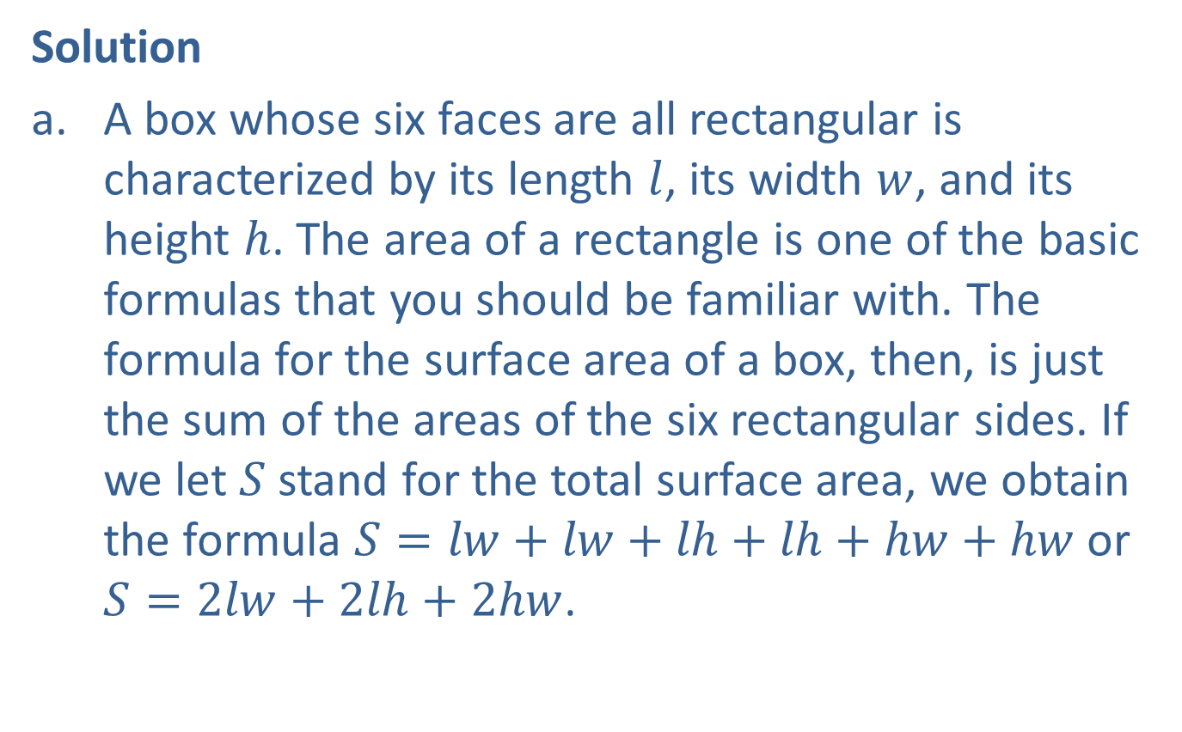
Example 6: Using Geometric Formulas (cont.)
Solution
​A box whose six faces are all rectangular is characterized by its length $l$, its width $w$, and its height $h$. The area of a rectangle is one of the basic formulas that you should be familiar with. The formula for the surface area of a box, then, is just the sum of the areas of the six rectangular sides. If we let $S$ stand for the total surface area, we obtain the formula $S=lw+lw+lh+lh+hw+hw$ or $S=2lw+2lh+2hw$.
​

Slide 28
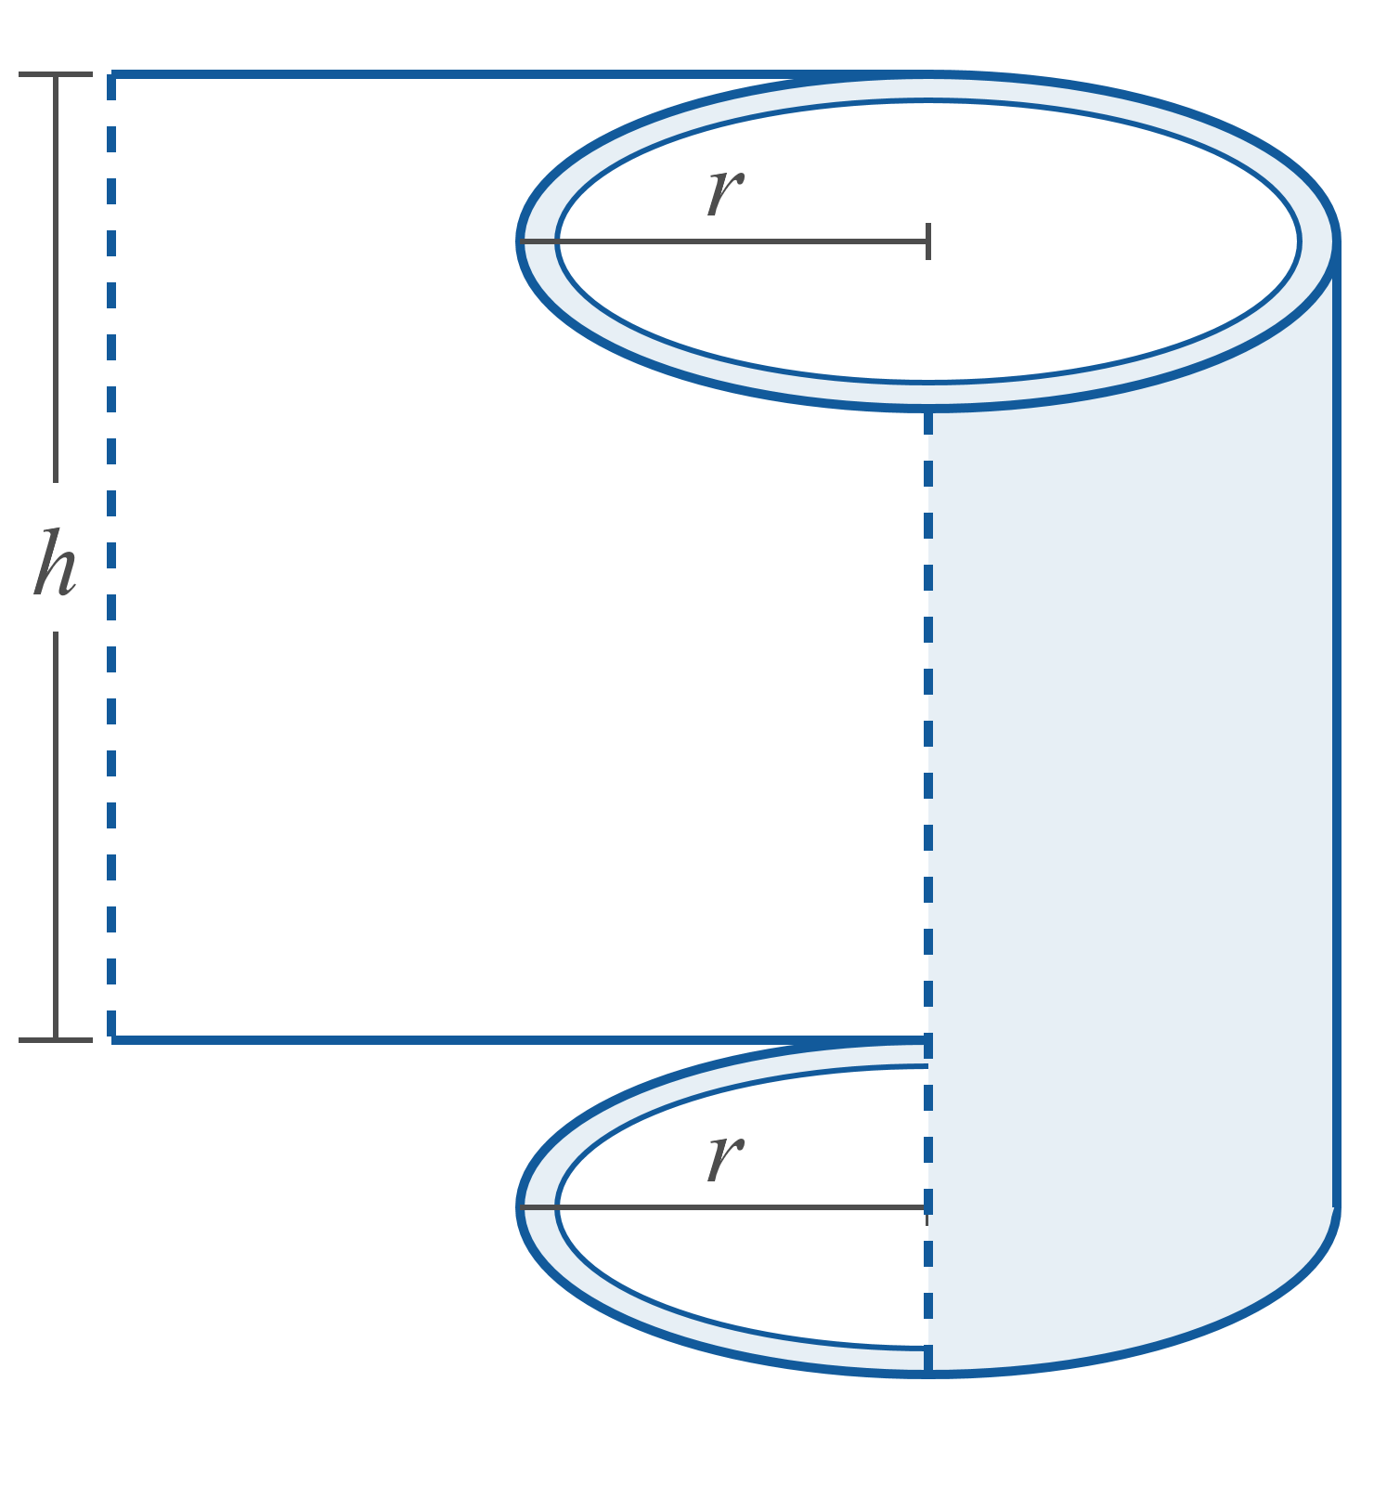
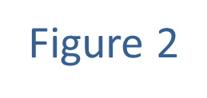
Example 6: Using Geometric Formulas (cont.)

Slide 29
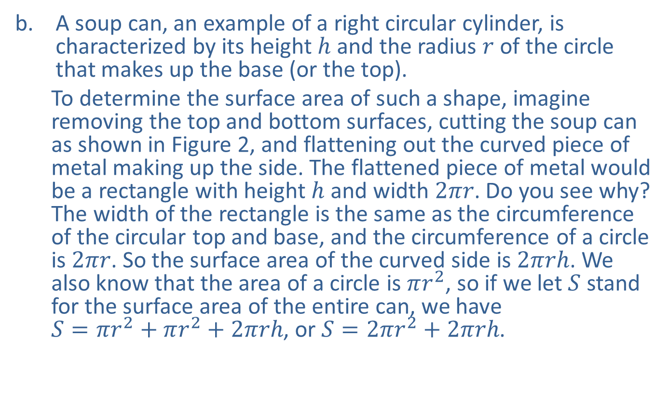
Example 6: Using Geometric Formulas (cont.)
​A soup can, an example of a right circular cylinder, is characterized by its height $h$ and the radius $r$ of the circle that makes up the base (or the top).
To determine the surface area of such a shape, imagine removing the top and bottom surfaces, cutting the soup can as shown in Figure 2, and flattening out the curved piece of metal making up the side. The flattened piece of metal would be a rectangle with height $h$ and width $2πr$. Do you see why? The width of the rectangle is the same as the circumference of the circular top and base, and the circumference of a circle is $2πr$. So the surface area of the curved side is $2πrh$. We also know that the area of a circle is $πr^{2}$, so if we let $S$ stand for the surface area of the entire can, we have $S=πr^{2}+πr^{2}+2πrh$, or $S=2πr^{2}+2πrh$.
​

Slide 30
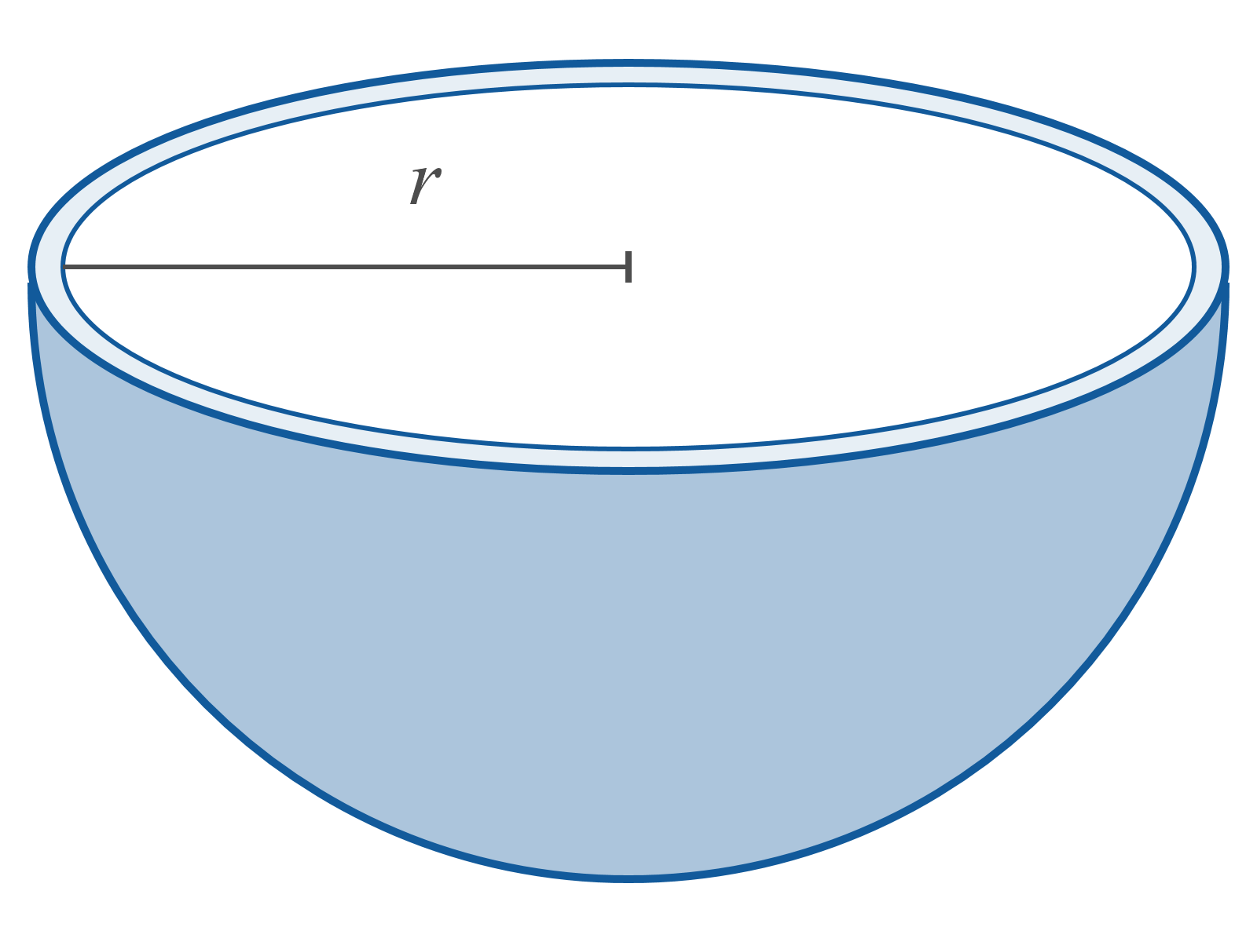
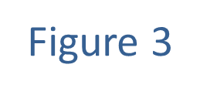
Example 6: Using Geometric Formulas (cont.)

Slide 31
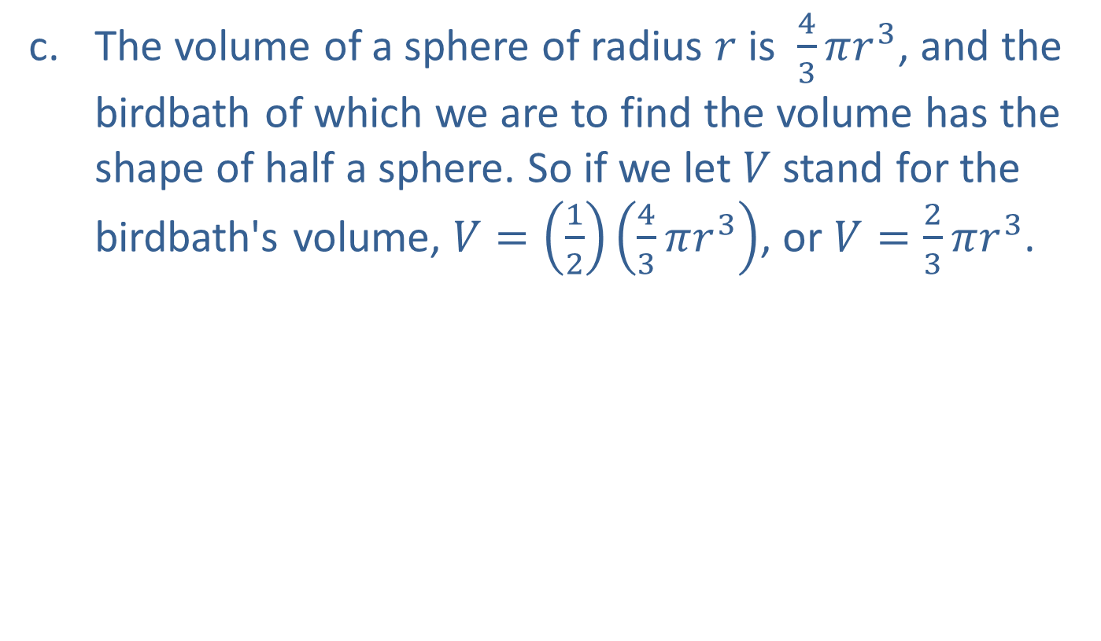
Example 6: Using Geometric Formulas (cont.)
​The volume of a sphere of radius $r$ is $\frac{4}{3}πr^{3}$, and the birdbath of which we are to find the volume has the shape of half a sphere. So if we let $V$ stand for the birdbath's volume, $V=\left(\frac{1}{2}\right)\left(\frac{4}{3}πr^{3}\right)$, or $V=\frac{2}{3}πr^{3}$.
​

Slide 32
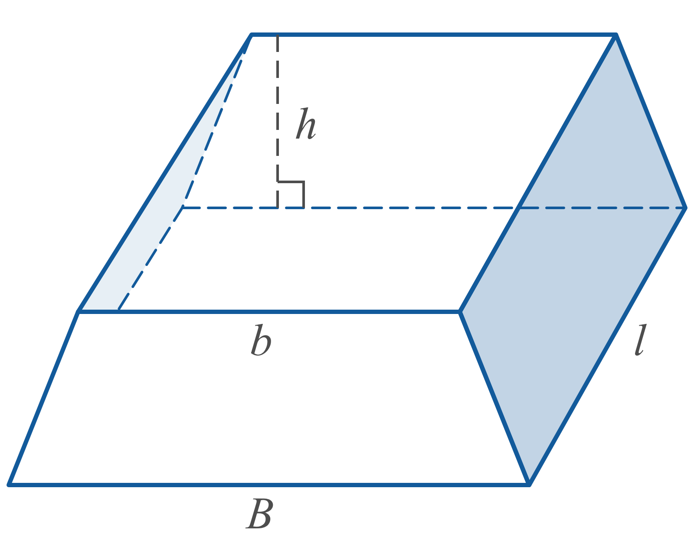
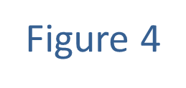
Example 6: Using Geometric Formulas (cont.)

Slide 33
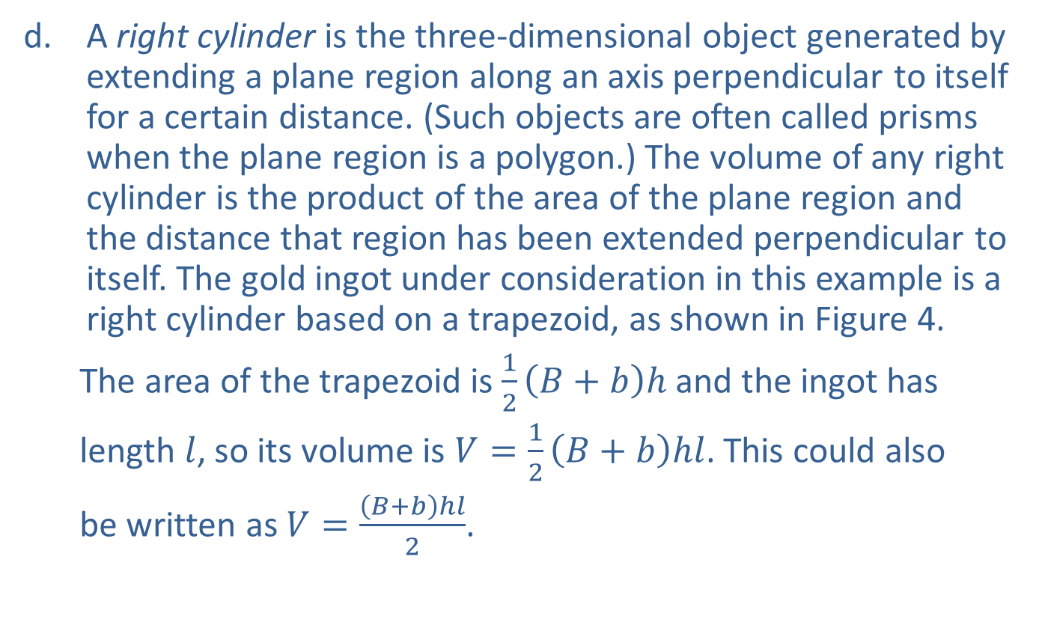
Example 6: Using Geometric Formulas (cont.)
​A right cylinder is the three-dimensional object generated by extending a plane region along an axis perpendicular to itself for a certain distance. (Such objects are often called prisms when the plane region is a polygon.) The volume of any right cylinder is the product of the area of the plane region and the distance that region has been extended perpendicular to itself. The gold ingot under consideration in this example is a right cylinder based on a trapezoid, as shown in Figure 4.
The area of the trapezoid is $\frac{1}{2}\left(B+b\right)h$ and the ingot has
length $l$, so its volume is $V=\frac{1}{2}\left(B+b\right)hl$. This could also
be written as $V=\frac{\left(B+b\right)hl}{2}$.
​

