Slide 1
Section 1.5
Polynomials

Slide 2
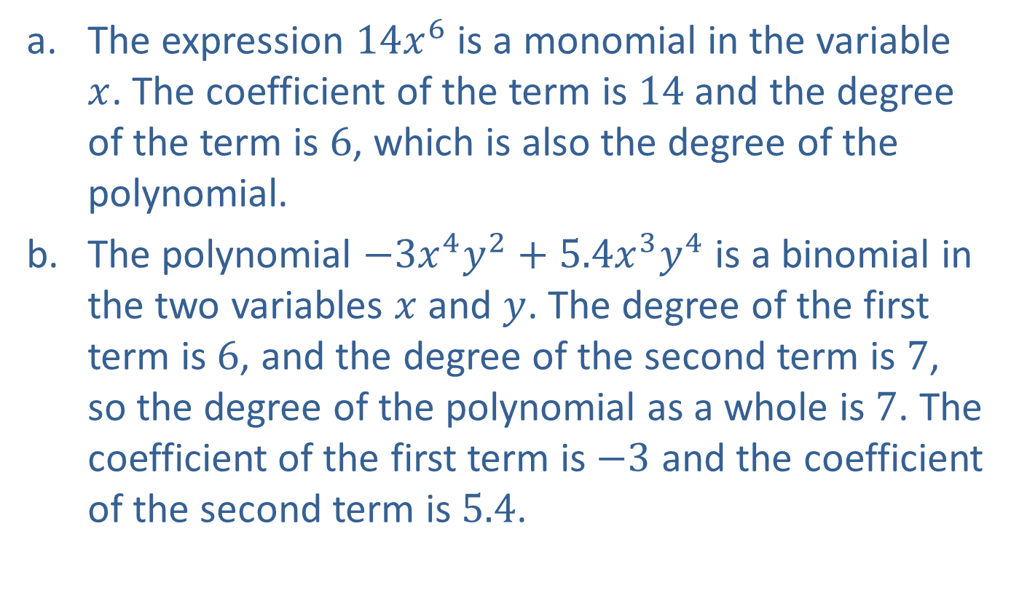
Example 1: Polynomial Expressions
​The expression $14x^{6}$ is a monomial in the variable $x$. The coefficient of the term is 14 and the degree of the term is 6, which is also the degree of the polynomial.
​The polynomial $−3x^{4}y^{2}+5.4x^{3}y^{4}$ is a binomial in the two variables $x$ and $y$. The degree of the first term is 6, and the degree of the second term is 7, so the degree of the polynomial as a whole is 7. The coefficient of the first term is $−3$ and the coefficient of the second term is 5.4.

Slide 3
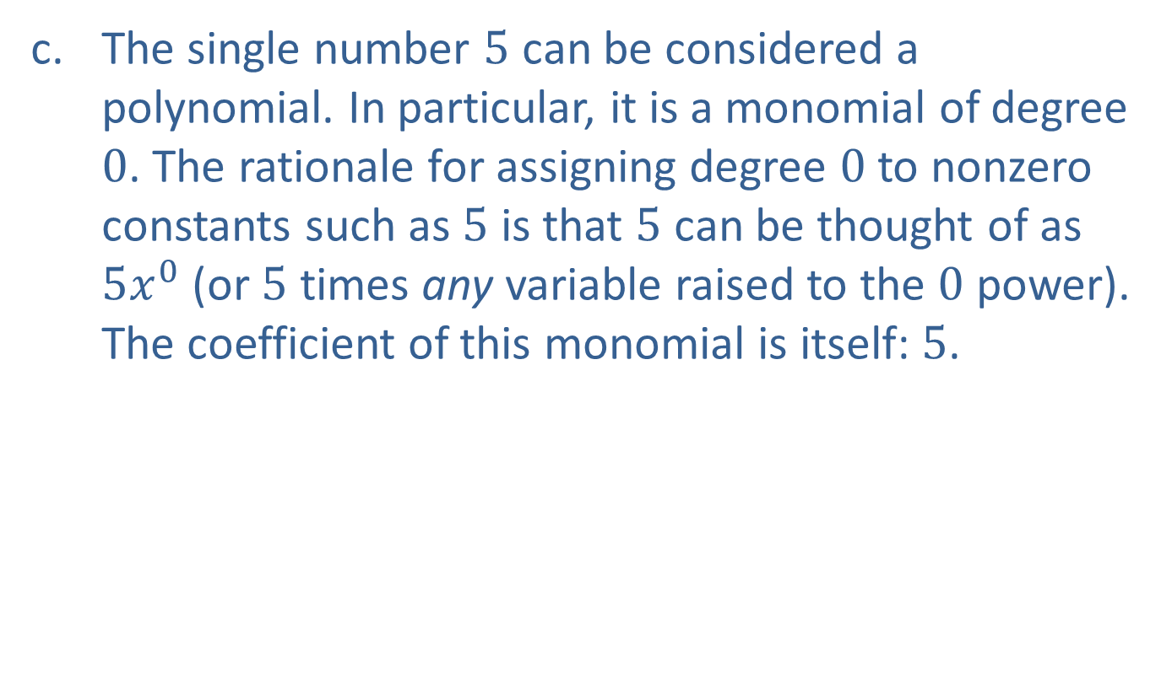
Example 1: Polynomial Expressions (cont.)
​The single number 5 can be considered a polynomial. In particular, it is a monomial of degree 0. The rationale for assigning degree 0 to nonzero constants such as 5 is that 5 can be thought of as $5x^{0}$ (or 5 times any variable raised to the 0 power). The coefficient of this monomial is itself: 5.

Slide 4
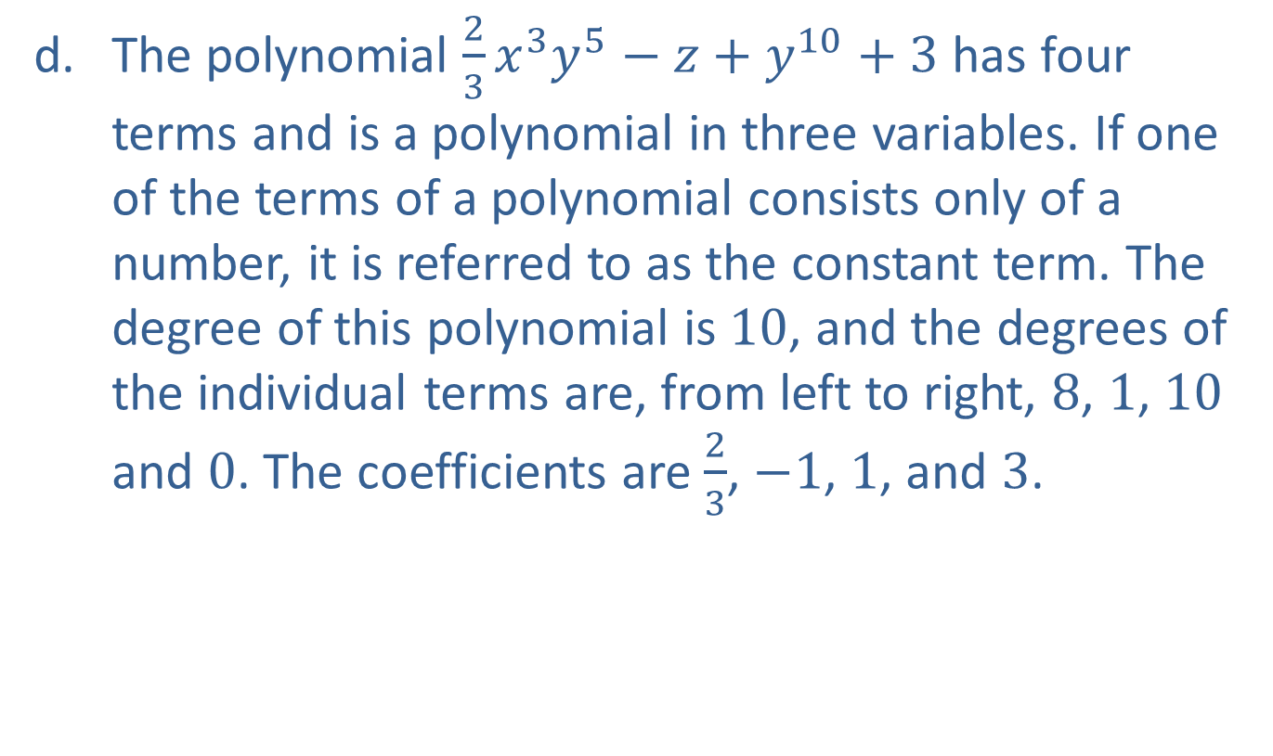
Example 1: Polynomial Expressions (cont.)
​The polynomial $\frac{2}{3}x^{3}y^{5}−z+y^{10}+3$ has four terms and is a polynomial in three variables. If one of the terms of a polynomial consists only of a number, it is referred to as the constant term. The degree of this polynomial is 10, and the degrees of the individual terms are, from left to right, 8, 1, 10 and 0. The coefficients are $\frac{2}{3}$, $−1$, 1, and 3.

Slide 5
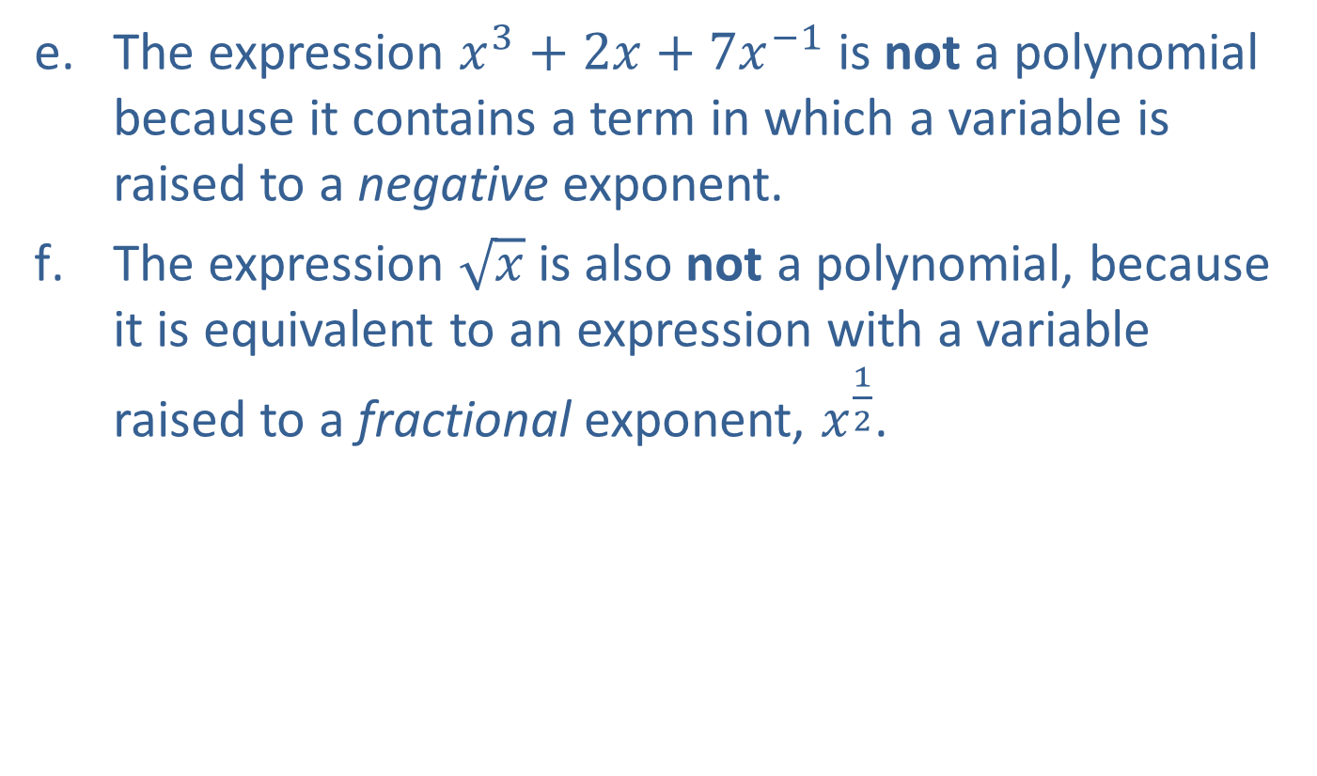
Example 1: Polynomial Expressions (cont.)
​The expression $x^{3}+2x+7x^{−1}$ is not a polynomial because it contains a term in which a variable is raised to a negative exponent.
​The expression $\sqrt{x}$ is also not a polynomial, because it is equivalent to an expression with a variable raised to a fractional exponent, $x^{\frac{1}{2}}$.

Slide 6
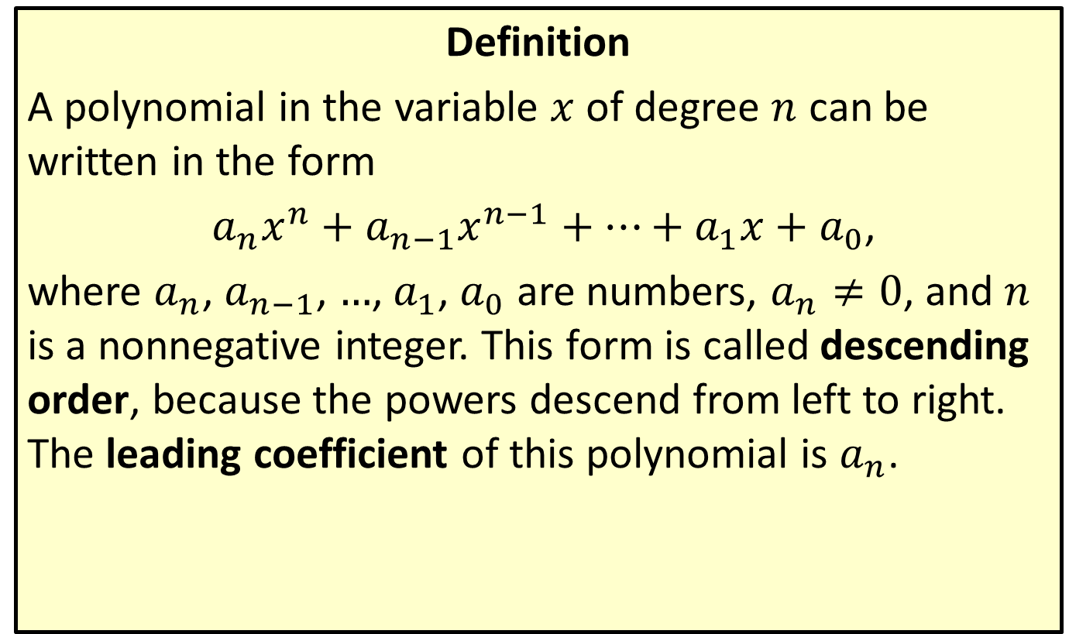
Polynomials of a Single Variable
Definition
A polynomial in the variable $x$ of degree $n$ can be written in the form
$a_{n}x^{n}+a_{n−1}x^{n−1}+…+a_{1}x+a_{0}$,
where $a_{n}$, $a_{n−1}$, …, $a_{1}$, $a_{0}$ are numbers, $a_{n}≠0$, and $n$ is a nonnegative integer. This form is called descending order, because the powers descend from left to right. The leading coefficient of this polynomial is $a_{n}$.

Slide 7

Example 2: Adding and Subtracting Polynomials
Add or subtract the polynomials, as indicated.
​$\left(2x^{3}y−3y+z^{2}x\right)+\left(3y+z^{2}−3xz^{2}+4\right)$
​$\left(4ab^{3}−b^{3}c\right)−\left(4−b^{3}c\right)$

Slide 8
Note:
The first step is always to identify and group like terms. The like terms are then combined using the distributive property.

Slide 9
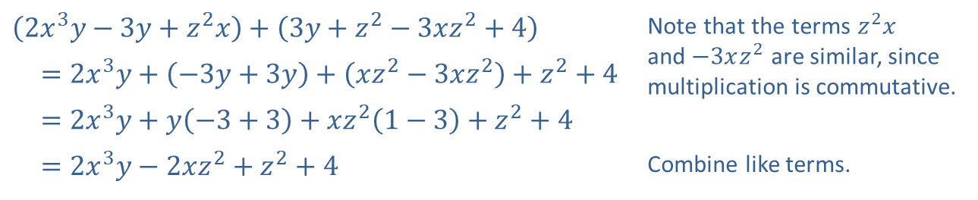
Example 2: Adding and Subtracting Polynomials (cont.)
Solution
​
​$\left(2x^{3}y−3y+z^{2}x\right)+\left(3y+z^{2}−3xz^{2}+4\right)$ | Note that the terms $z^{2}x$ and $−3xz^{2}$ are similar, since multiplication is commutative.
​ $=2x^{3}y+\left(−3y+3y\right)+\left(xz^{2}−3xz^{2}\right)+z^{2}+4$
​ $=2x^{3}y+y\left(−3+3\right)+xz^{2}\left(1−3\right)+z^{2}+4$
​ $=2x^{3}y−2xz^{2}+z^{2}+4$ | Combine like terms.

Slide 10
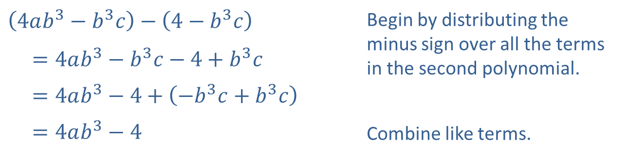
Example 2: Adding and Subtracting Polynomials (cont.)
​
​$\left(4ab^{3}−b^{3}c\right)−\left(4−b^{3}c\right)$ | Begin by distributing the minus sign over all the terms in the second polynomial.
​ $=4ab^{3}−b^{3}c−4+b^{3}c$
​ $=4ab^{3}−4+\left(−b^{3}c+b^{3}c\right)$
​ $=4ab^{3}−4$ | Combine like terms.

Slide 11

Example 3: Multiplying Polynomials
Multiply the polynomials, as indicated.
​$\left(2x^{2}y−z^{3}\right)\left(4+3z−3xy\right)$
​$\left(3ab−a^{2}\right)\left(ab+a^{2}\right)$

Slide 12
Note:
We use the distributive property first, and multiply each term of the first polynomial by each term of the second.

Slide 13
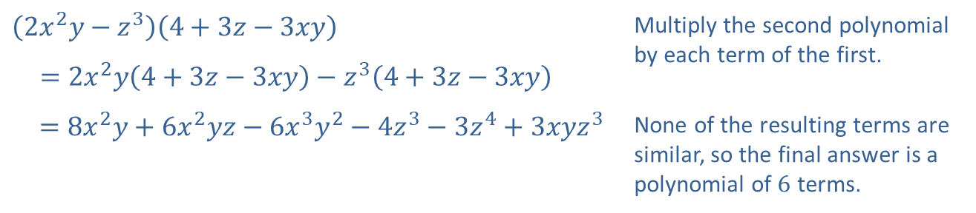
Example 3: Multiplying Polynomials (cont.)
Solution
​
​$\left(2x^{2}y−z^{3}\right)\left(4+3z−3xy\right)$ | Multiply the second polynomial by each term of the first.
​ $=2x^{2}y\left(4+3z−3xy\right)−z^{3}\left(4+3z−3xy\right)$
​$=8x^{2}y+6x^{2}yz−6x^{3}y^{2}−4z^{3}−3z^{4}+3xyz^{3}$ | None of the resulting terms are similar, so the final answer is a polynomial of 6 terms.

Slide 14
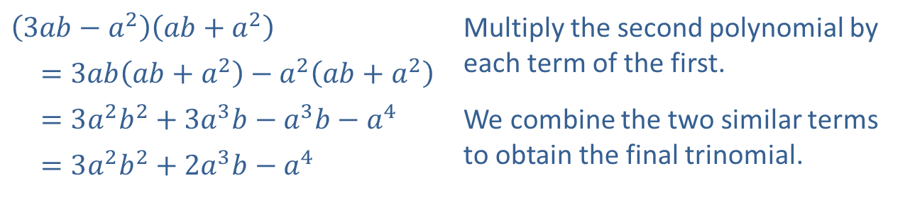
Example 3: Multiplying Polynomials (cont.)
​
​$\left(3ab−a^{2}\right)\left(ab+a^{2}\right)$ | Multiply the second polynomial by each term of the first.
​ $=3ab\left(ab+a^{2}\right)−a^{2}\left(ab+a^{2}\right)$
​ $=3a^{2}b^{2}+3a^{3}b−a^{3}b−a^{4}$ | We combine the two similar terms to obtain the final trinomial.
​ $=3a^{2}b^{2}+2a^{3}b−a^{4}$

Slide 15
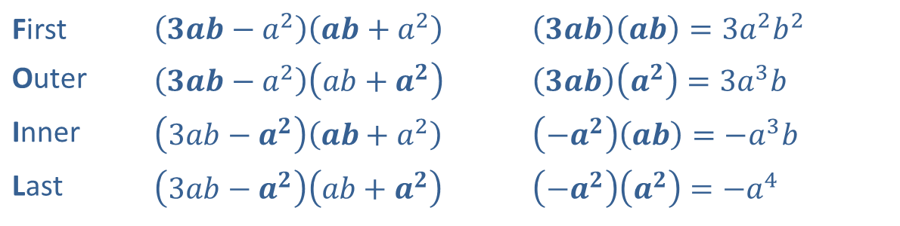

Example 4: The FOIL Method
When a binomial is multiplied by another binomial, as in Example 3b, the acronym FOIL is commonly used as a reminder of the four necessary products. Again consider the product $\left(3ab−a^{2}\right)\left(ab+a^{2}\right)$. Each letter represents a pair of terms to multiply:
First | ​$\left(3ab−a^{2}\right)\left(ab+a^{2}\right)$ | ​$\left(3ab\right)\left(ab\right)=3a^{2}b^{2}$
Outer | ​$\left(3ab−a^{2}\right)\left(ab+a^{2}\right)$ | ​$\left(3ab\right)\left(a^{2}\right)=3a^{3}b$
Inner | ​$\left(3ab−a^{2}\right)\left(ab+a^{2}\right)$ | ​$\left(−a^{2}\right)\left(ab\right)=−a^{3}b$
Last | ​$\left(3ab−a^{2}\right)\left(ab+a^{2}\right)$ | ​$\left(−a^{2}\right)\left(a^{2}\right)=−a^{4}$

Slide 16
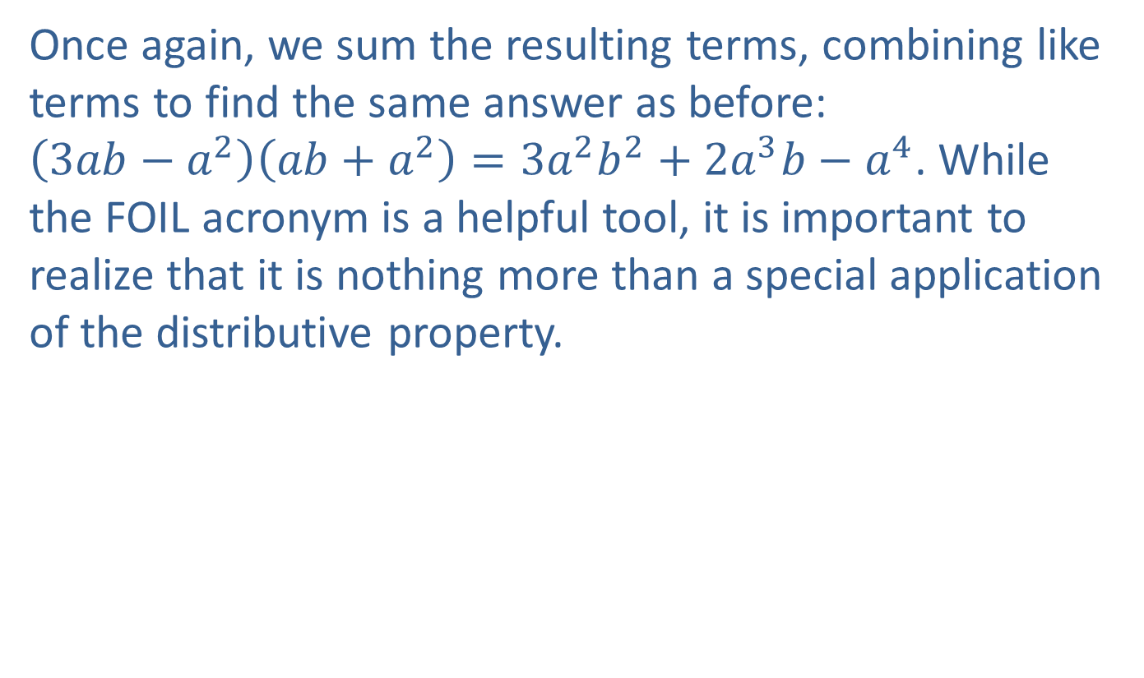
Example 4: The FOIL Method (cont.)
Once again, we sum the resulting terms, combining like terms to find the same answer as before: $\left(3ab−a^{2}\right)\left(ab+a^{2}\right)=3a^{2}b^{2}+2a^{3}b−a^{4}$. While the FOIL acronym is a helpful tool, it is important to realize that it is nothing more than a special application of the distributive property.

Slide 17
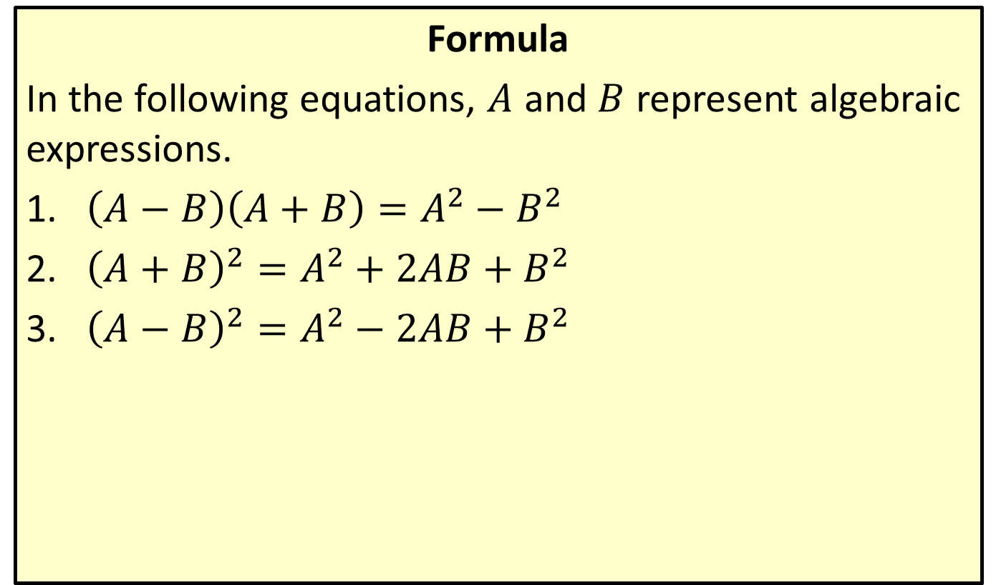
Special Product Formulas
Formula
In the following equations, $A$ and $B$ represent algebraic expressions.
​$\left(A−B\right)\left(A+B\right)=A^{2}−B^{2}$
​${\left(A+B\right)}^{2}=A^{2}+2AB+B^{2}$
​${\left(A−B\right)}^{2}=A^{2}−2AB+B^{2}$

Slide 18

Example 5: Using Special Product Formulas
Use a special product formula to perform the indicated operations.
​${\left(2x−y\right)}^{2}$
​$\left(\sqrt{x}−\sqrt{y}\right)\left(\sqrt{x}+\sqrt{y}\right)$

Slide 19
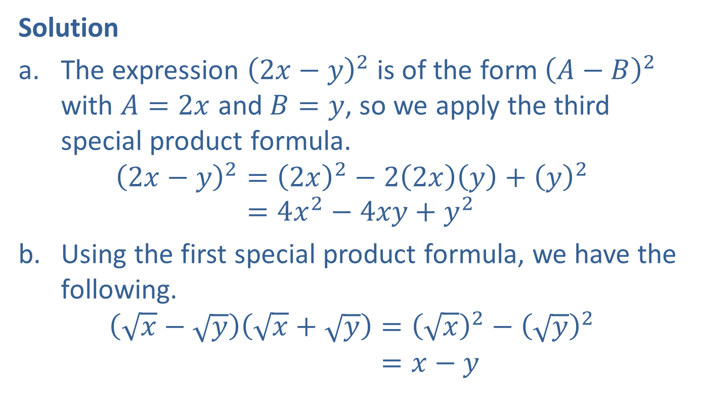
Example 5: Using Special Product Formulas (cont.)
Solution
​The expression ${\left(2x−y\right)}^{2}$ is of the form ${\left(A−B\right)}^{2}$ with $A=2x$ and $B=y$, so we apply the third special product formula.
2𝑥−𝑦2=2𝑥2−22𝑥𝑦+𝑦22𝑥−𝑦2=4𝑥2−4𝑥𝑦+𝑦2
​Using the first special product formula, we have the following.
𝑥−𝑦𝑥+𝑦=𝑥2−𝑦2𝑥−𝑦𝑥+𝑦=𝑥−𝑦

